Slide 1
Assessing the Accessible Content Provider Landscape
Meredith Hatton and Andrea Kosavic,
York University

Slide 2
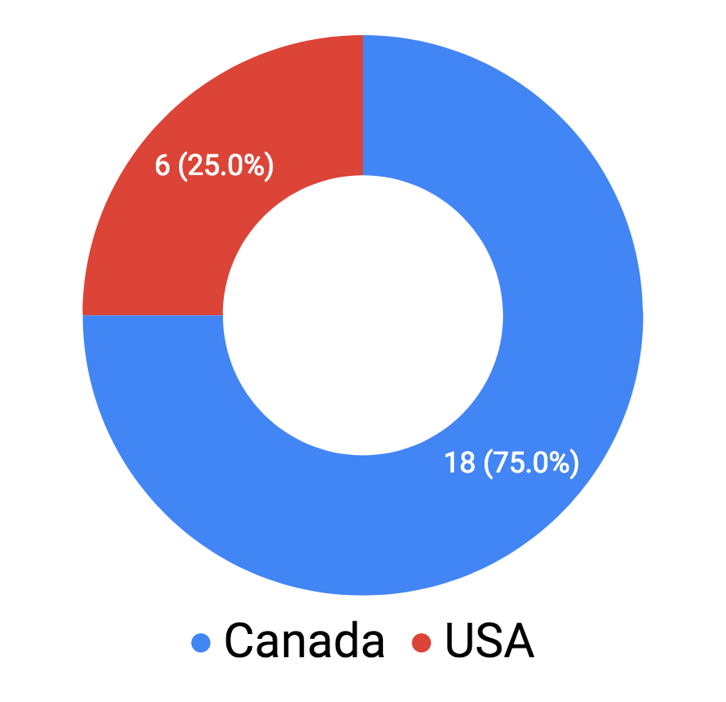
About the Survey
Circulated:
Canada, USA
September - October 2018
Total responses:
24

Slide 3
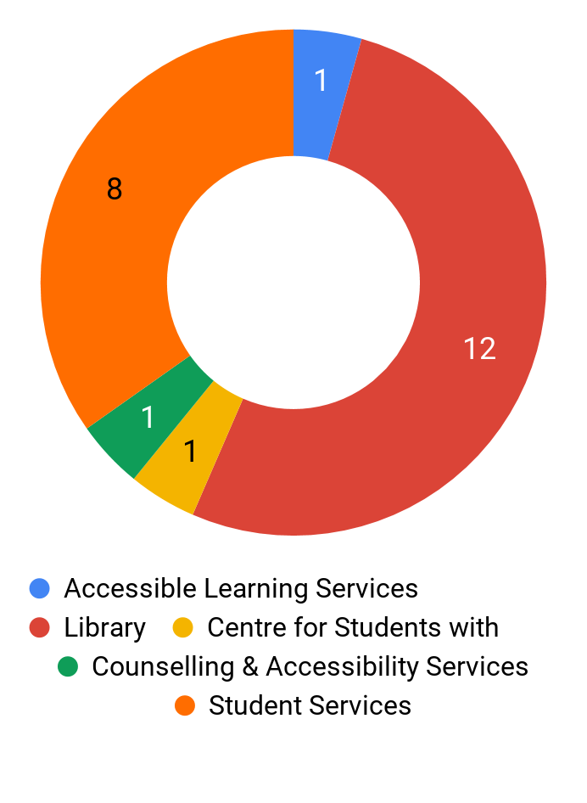
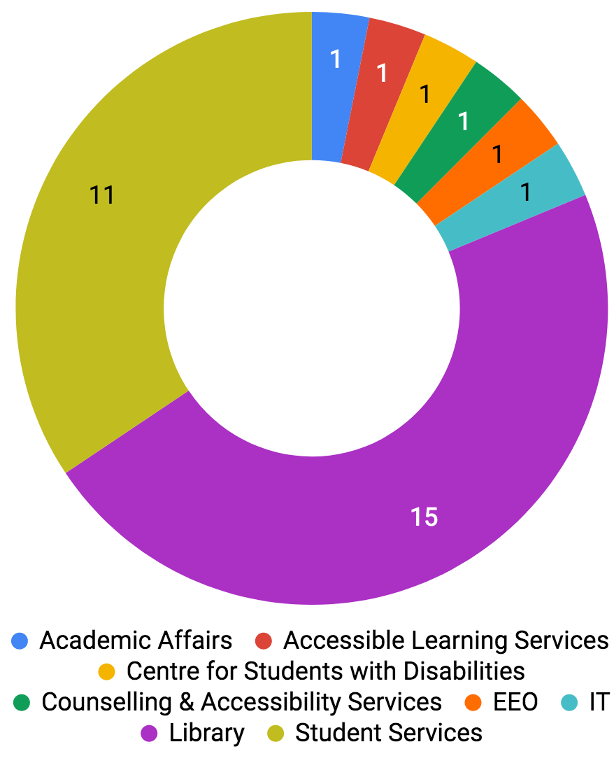
Who provides accessible formats at your institution?
Canada
(n=18)
All
(n=24)

Slide 4
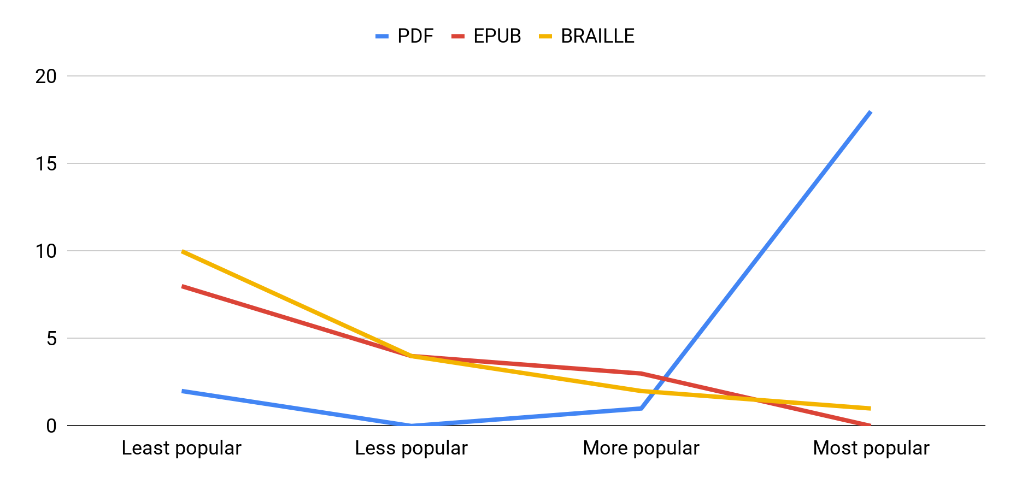
Popularity of Accessible Formats
All (n=23)

Slide 5
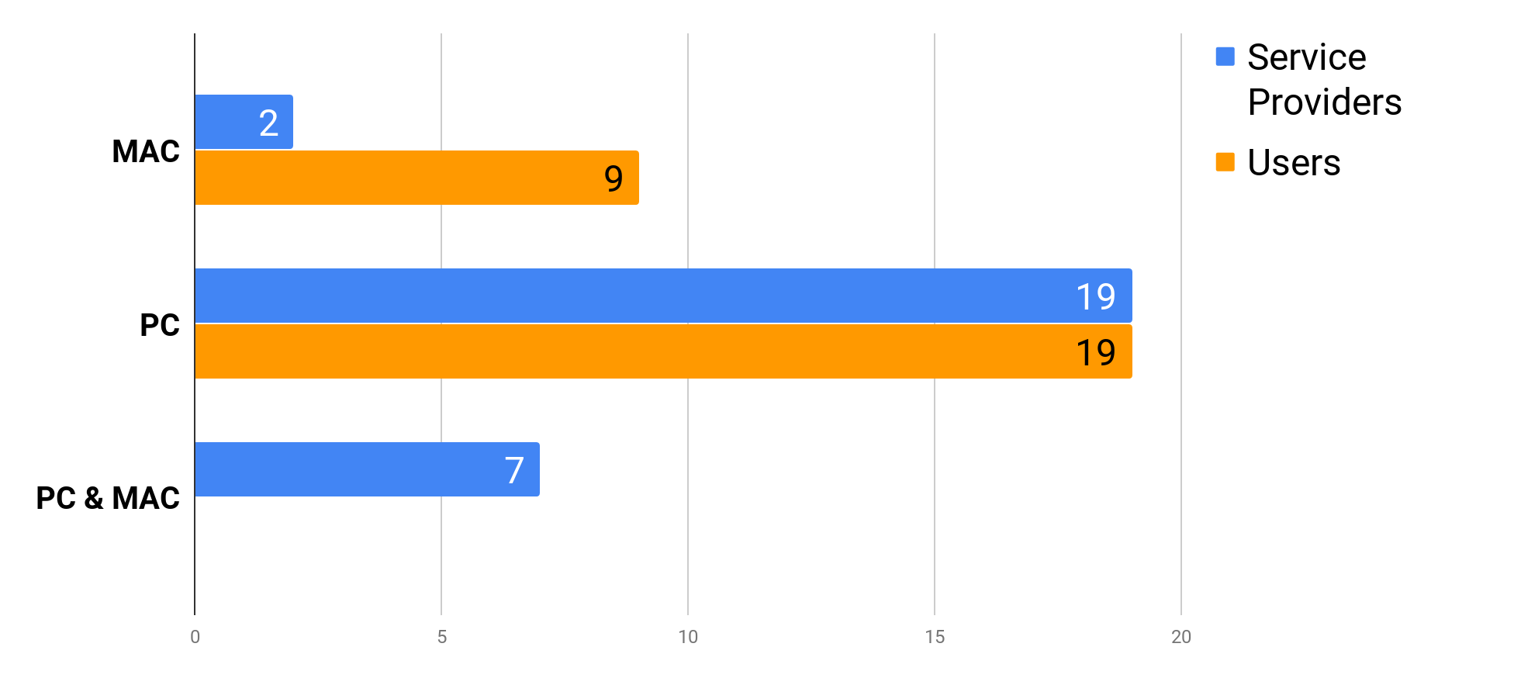
Computing platform preferences
All (n=24)

Slide 6
Accessible Books

Slide 7
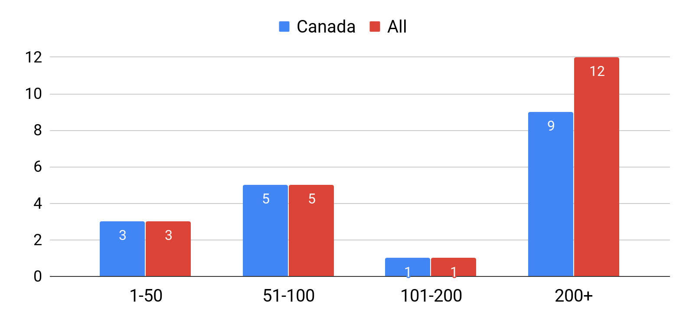
Number of book requests per year
All (n=21)

Slide 8
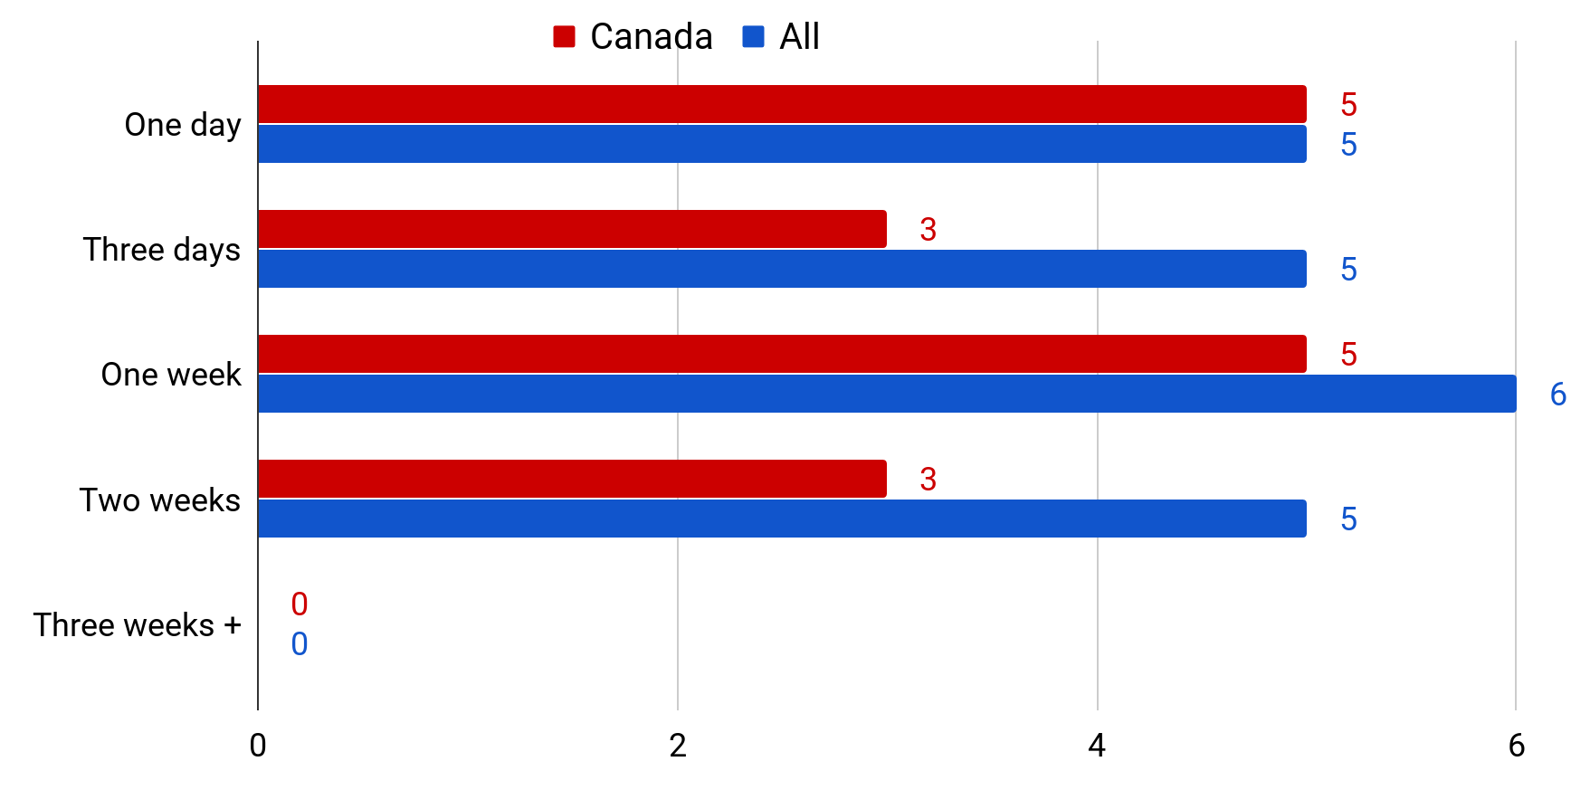
Average turnaround time for a 350 page book
All (n=21)

Slide 9
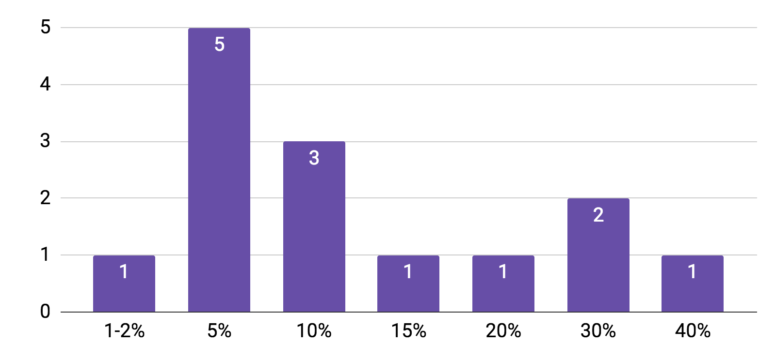
Percentage of book requests requiring original scans
All (n=14)

Slide 10
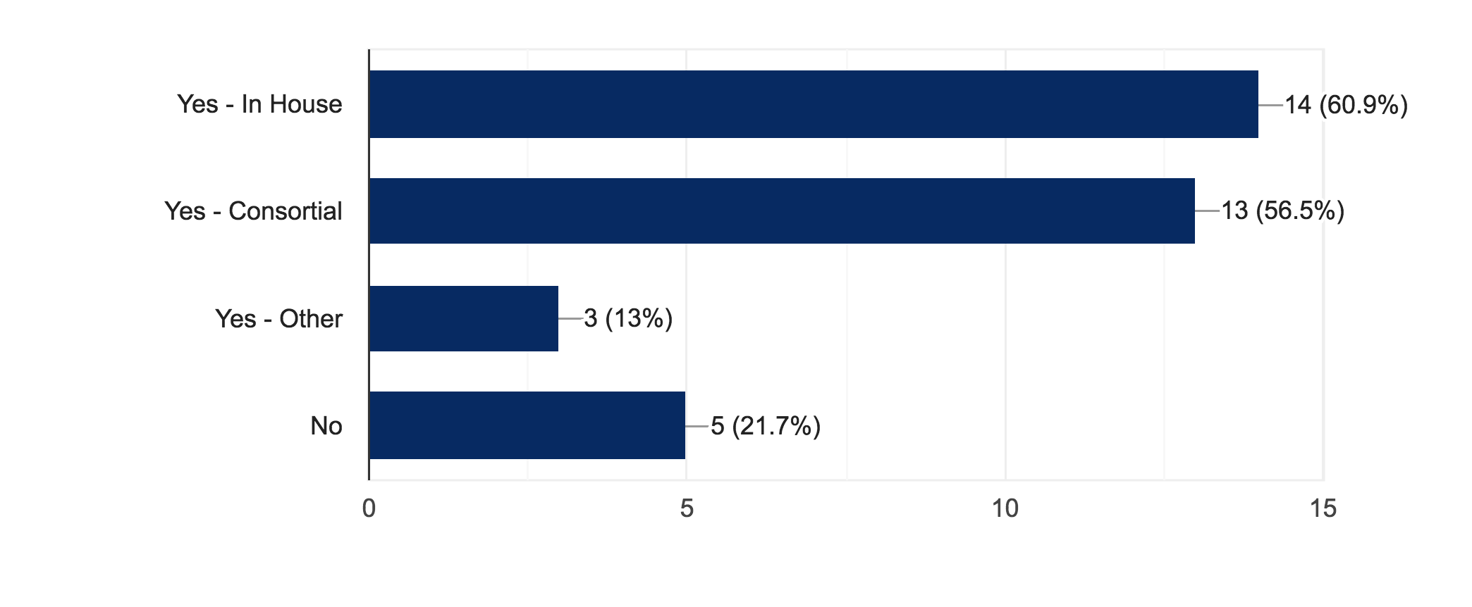
Do you make use of a central repository? Select all that apply.
All (n=23)

Slide 11
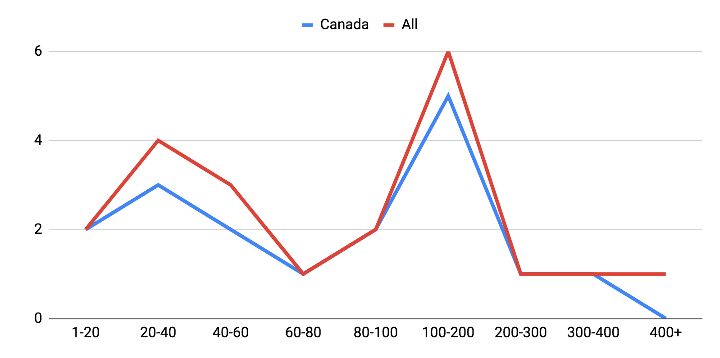
How many faculty, staff, and students does your institution provide alt-formats for each year?
All (n=21)

Slide 12
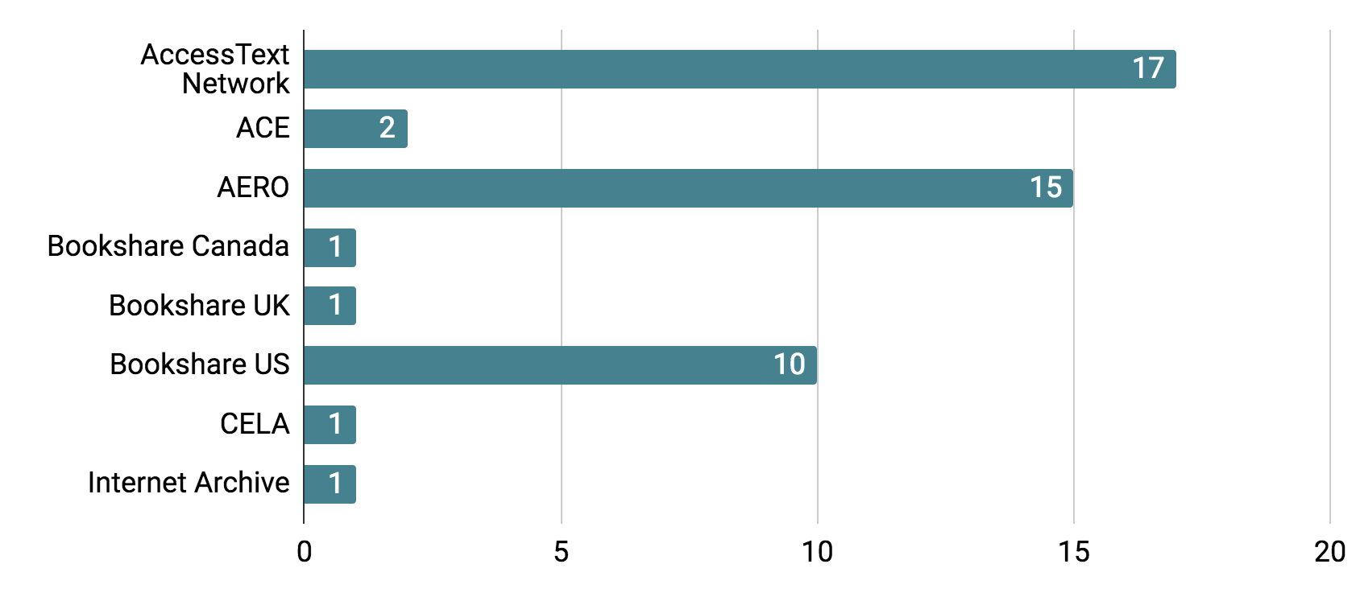
Arrangements with publisher file repositories
All (n=21)

Slide 13
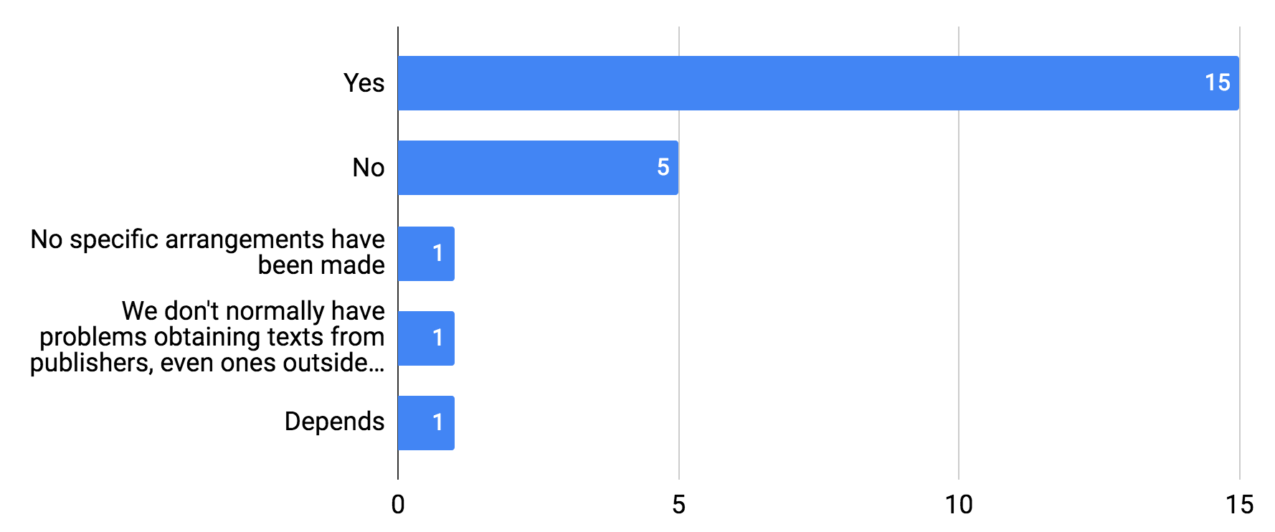
For publishers outside of the larger sharing networks, have you had any luck securing special arrangements to obtain accessible versions of etexts/ebooks for registered students?
All (n=23)

Slide 14
Respondents have had success with obtaining accessible versions of etexts/ebooks from the following:
House of Anansi Press
Irwin Law
Johns Hopkins U. Press
LexisNexis
Lippincott
Little
Lyceum Books Inc.
MacMillan
McClelland & Stewart
McGill-queen's U. Press
MIT Press
Nelson
Oxford University Press
Palgrave Macmillan
Pearson (US)
Penguin Random House Canada
Penguin (US)
Perseus Books
Pine Forge Press
Any university press
Bedford/St.Martn's
Between the Lines
Bloomsbury
Broadview Press
Brown Book Group
Canadian Scholars Press
Carswell
Cdn Assoc. of OTs
Cengage
Elsevier
Fernwood Publishing
Gaspereau Press
Greenwood/Praeger/Linworth/Libraries Unlimited
Grove Press (Grove Atlantic)
Guilford Press
Harper Collins
Houghton Mifflin
Playwrights Canada Press
Random House
Routledge (Taylor & Francis)
Rowman & Littlefield Publ. Inc.
Running Press
Sagamore Publishing
Sage
South End Press
Stanford U. Press
Taylor and Francis
The New Press
Thompson Books
Thompson-Reuters
U. of California Press
U. of Chicago Press
U. of Nebraska Press
U. of North Carolina Press
U. of Pittsburg Press
U. of Texas Press
U. of Toronto Press
UBC Press
Vintage Canada
W.H. Freeman
Waveland Press Inc.
West Academic
Westview Press
Wiley
Williams & Wilkins (also Wolters Kluwer)
Yale University Press
Problematic:
Penguin and Captus Corp due to DRM

Slide 15
Digitization Services

Slide 16
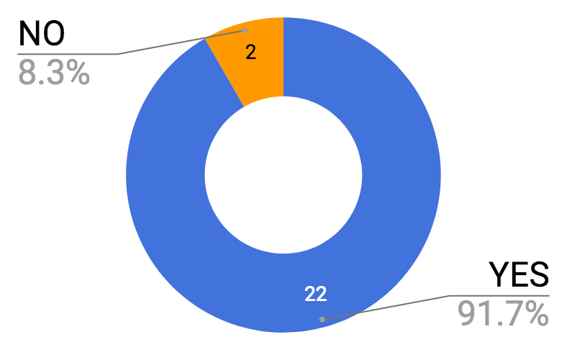
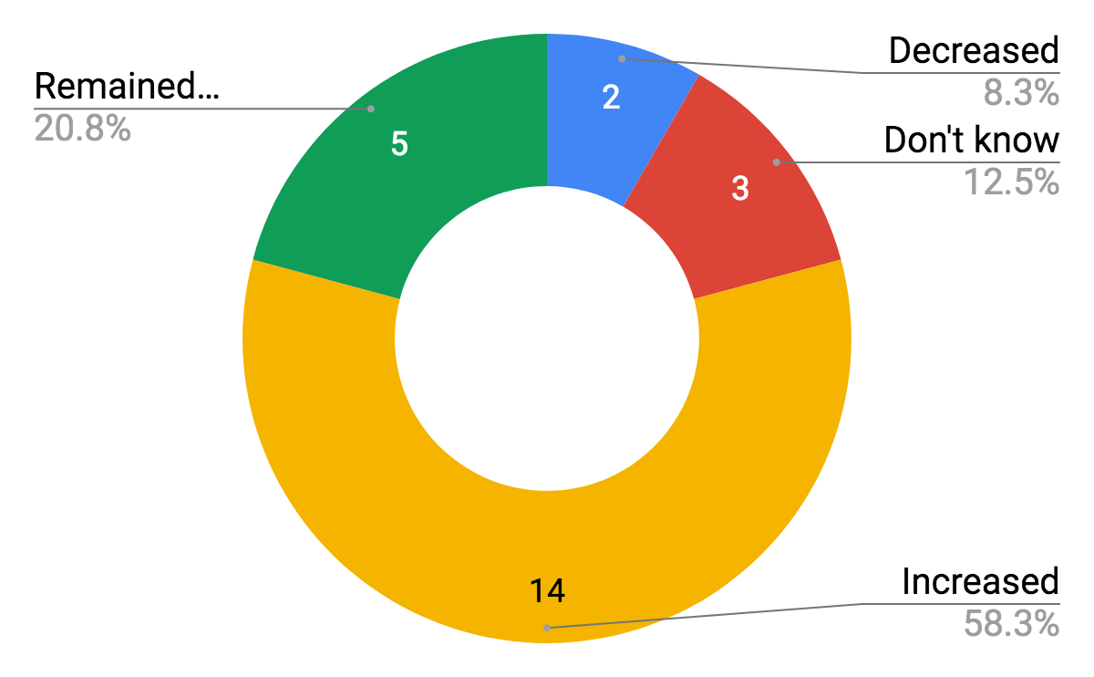
Demand for digitization services
Offering digitization services
Digitization requests over the last 3 years have...
All (n=23)
All (n=21)

Slide 17
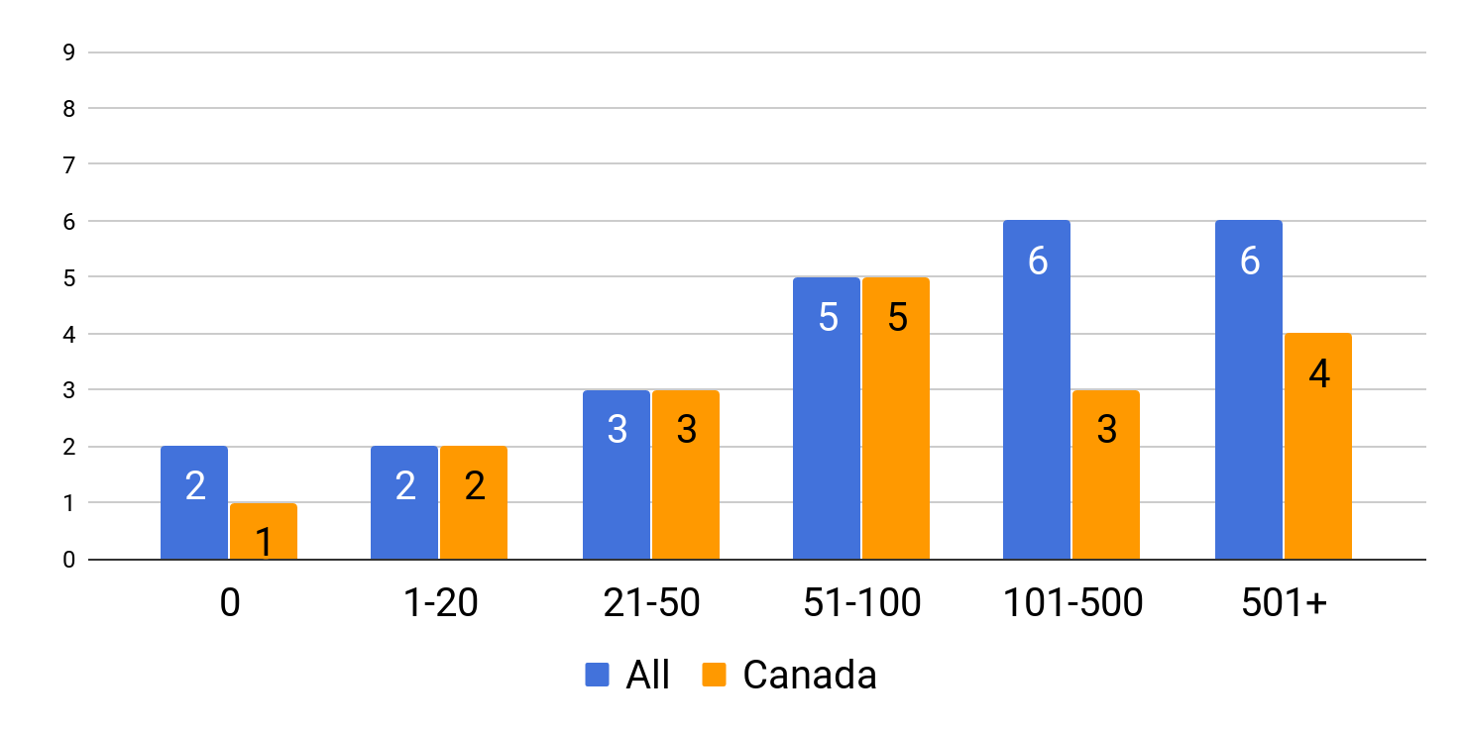
Number of digitization requests fulfilled per year
All (n=23)

Slide 18
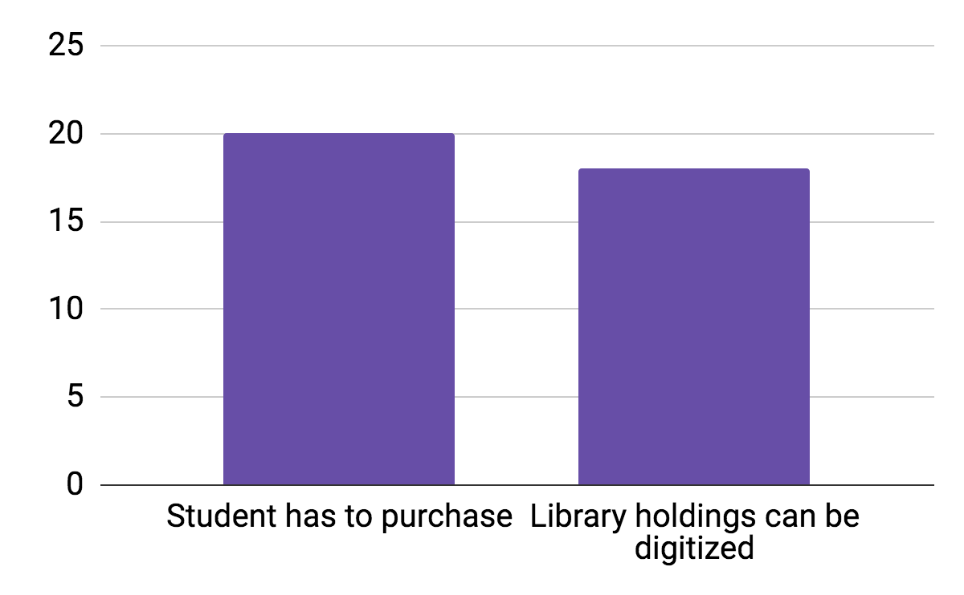
Are students required to purchase materials for which they are requesting alternate formats?
All (n=24)
Qualifiers:
Depends on the publisher (1)
Students have to purchase textbooks (2)
Students purchase only if library does not hold item (1)

Slide 19
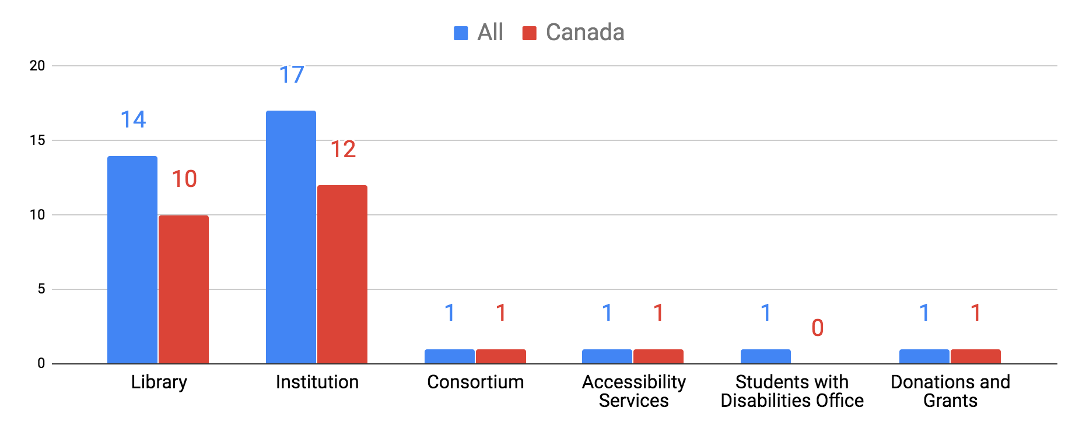
Funding sources for purchase of digitization equipment
All (n=24)

Slide 20
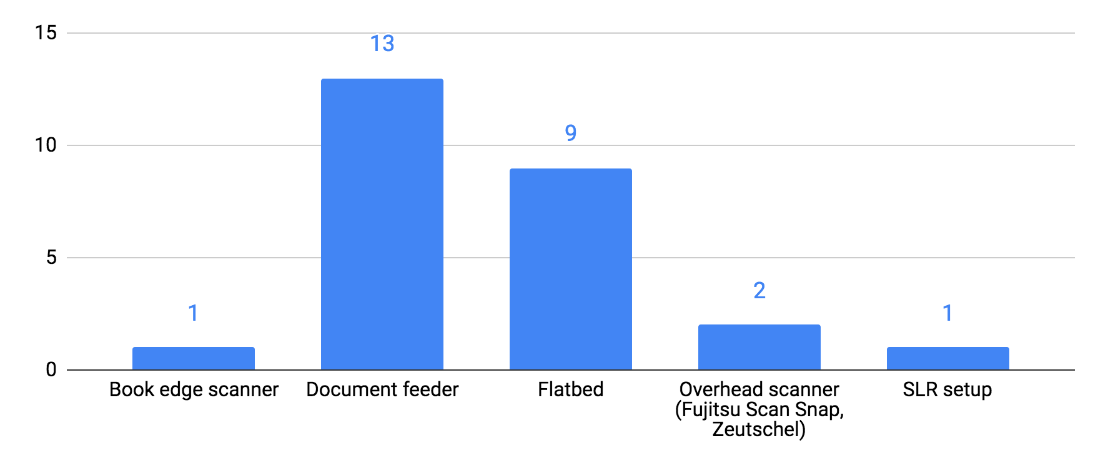
Hardware used for digitization
All (n=21)

Slide 21
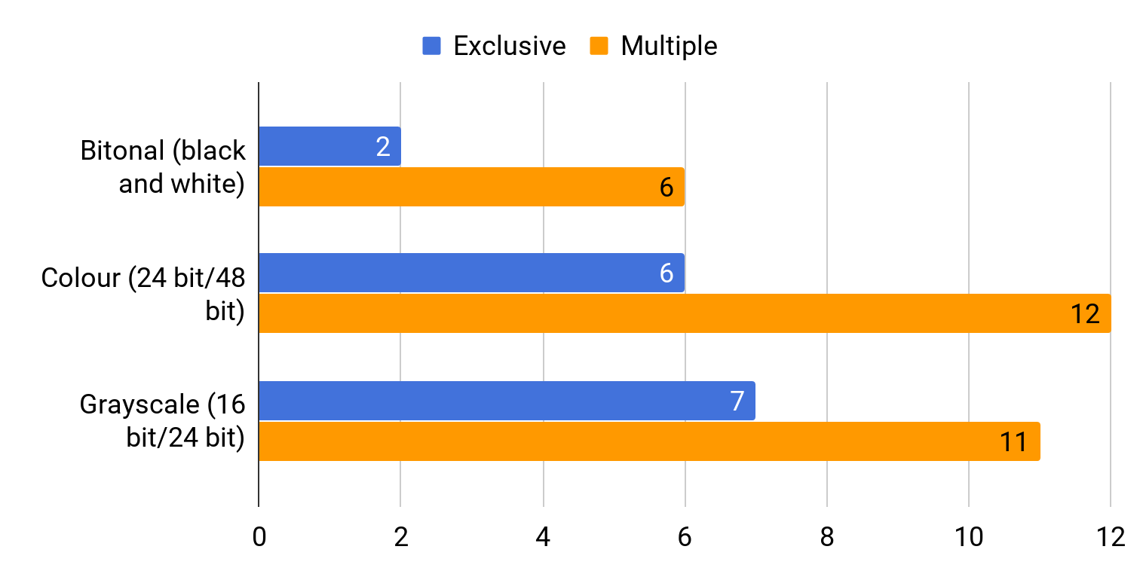
Image capture preferences
All (n=21)

Slide 22
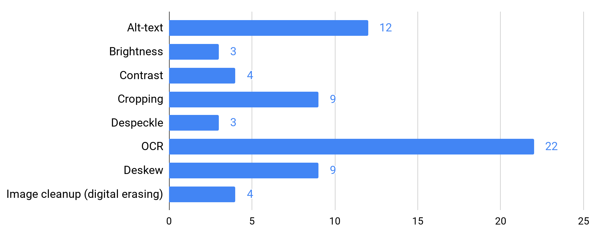
Post processing operations in use
All (n=22)
*Showing data where n=2 or greater. See dataset for n=1 responses.

Slide 23
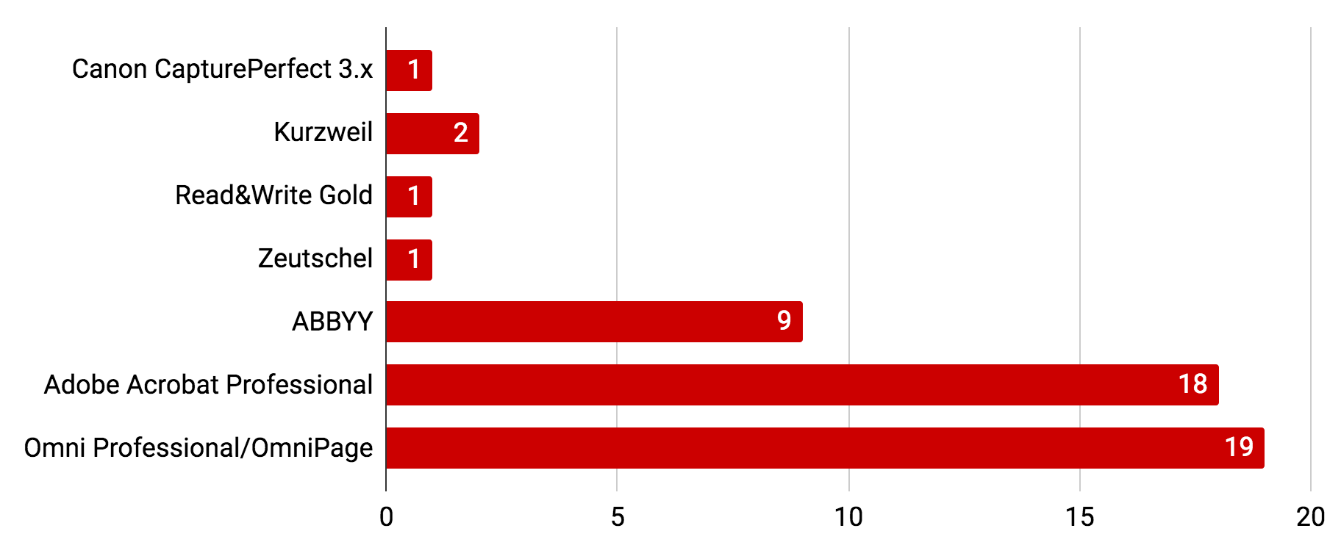
Software used for OCR creation
All (n=22)

Slide 24
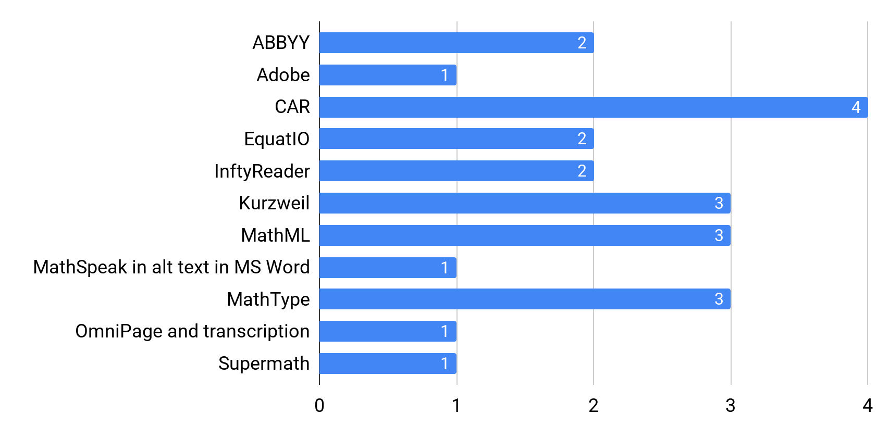
Use of specialized software for delivering mathematical materials
All (n=14)

Slide 25
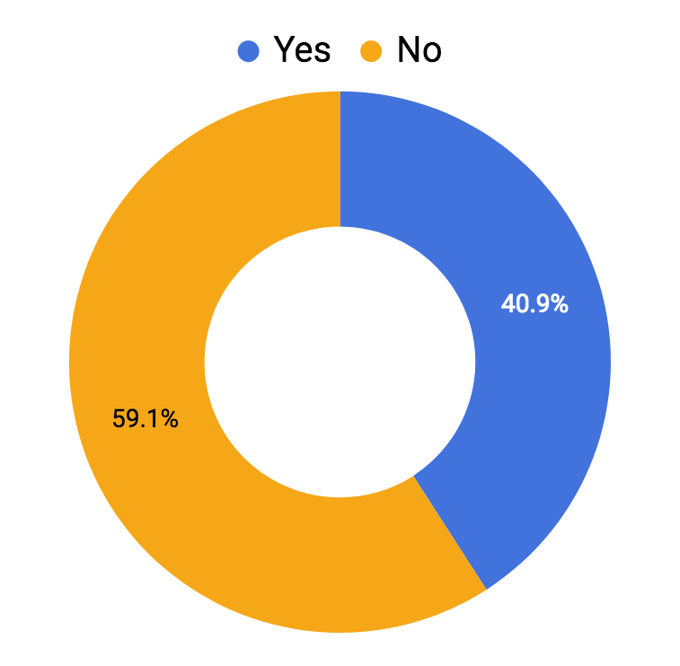
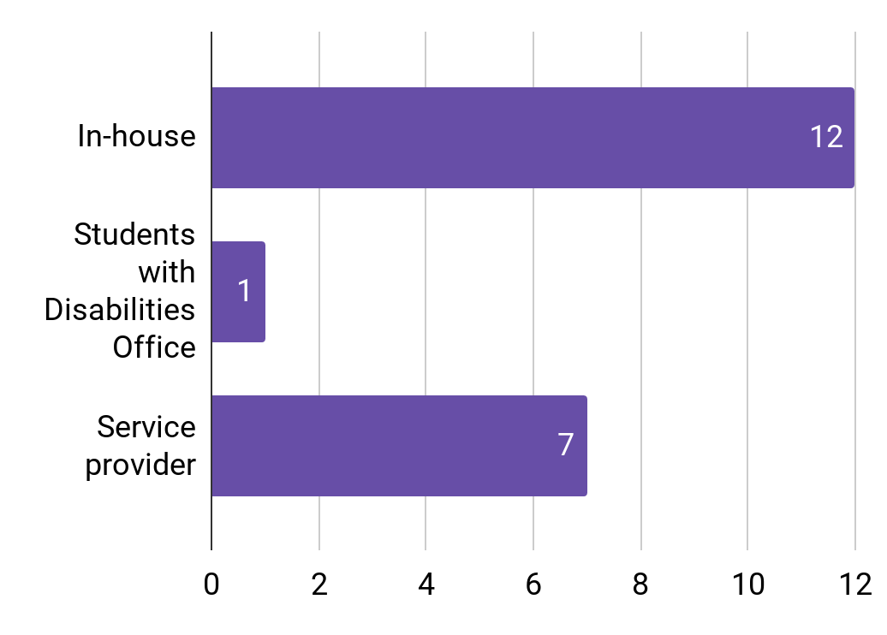
Percentage of respondents offering professionally produced MS Word materials. (OCR verification and correction)
All (n=22)
All (n=18)

Slide 26
Braille and Tactile Braille

Slide 27
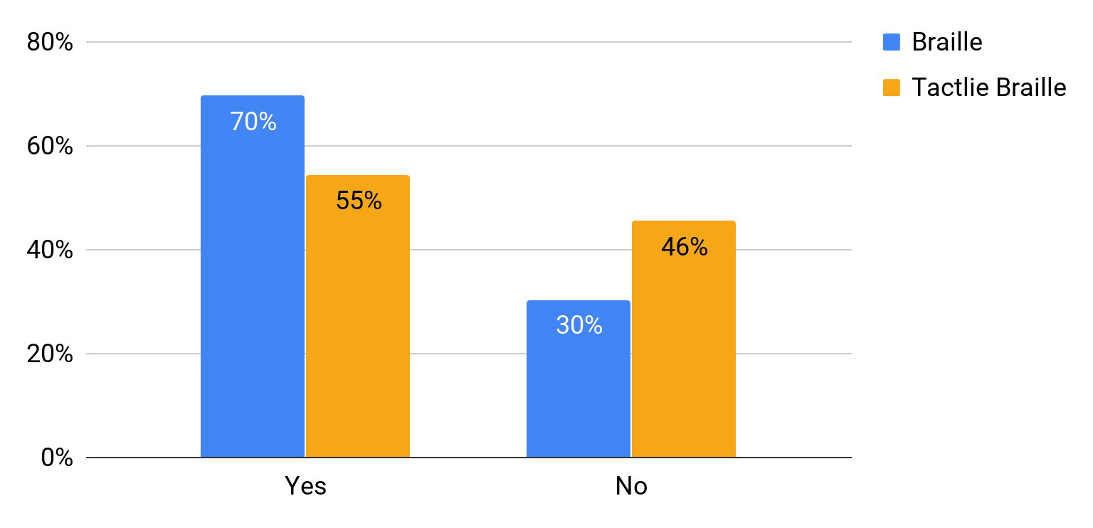
Institutions providing braille and tactile braille
All (Braille n=24, Tactile Braille n=23)

Slide 28
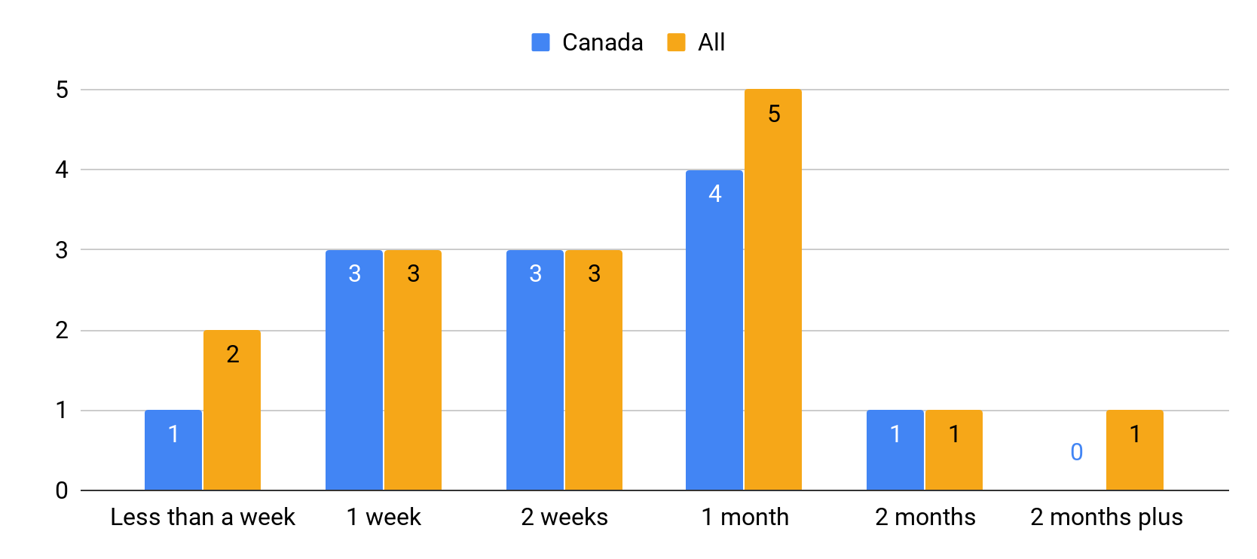
Timelines for providing braille/tactile braille
All (n=15)

Slide 29
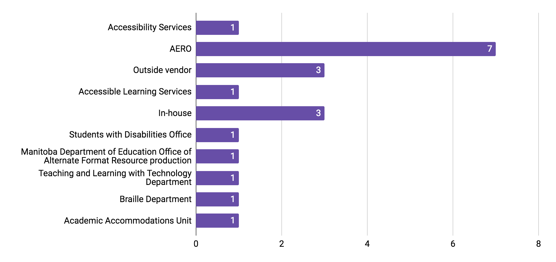
Braille and tactile braille requests are fulfilled by:
All (n=16)

Slide 30
Dataset is available here:
https://www.doi.org/10.25071/10315/35711
bit.ly/AccessibleContentLandscape

Slide 31
Thank you!
A special thank you to all those who helped with survey development.
The York University Libraries Library Accessibility Team:
Vivian Alfieri, Claudio Iacoe, Laszlo Juhos and Veronica Pinnock
Nancy Waite, TD Coordinator for Library Accessibility Services, Library Accessibility Services, McMaster University Libraries
Notes:
LAS worked with us to develop questions and tested the beta before release
Nancy Waite reviewed all questions and gave feedback

