Slide 1

Pitch 3 - UN SDG 5 Gender Equality
Doing cross tabulation with data

Slide 2

The requirements for this UN SDG data assignment is to complete 5 cross tabulations and/or content analysis from the original data sheets uploaded here. There are examples of both content analysis and cross tabulation for each pitch to show you want to do. Please make sure to do a combination, so that your assignment includes 5 but at least one is a cross tabulation and one is a content analysis. Please submit in the place created for UN SDG data assignment on Submit Assignment Here. The PowerPoints are the examples of what to do. Each has a data narrowed down from the original data sheets that follows. Then the original data sheets that you will used for the assignment will be at the end in this UN SDG data assignments Box. What you submit is 5 different spreadsheets as indicated above.
© Anne MacLennan, 2024​​

Slide 3
UN SDG 5
"Strong and sustained commitments to changing biased social norms, eliminating harmful practices and abolishing discriminatory laws are urgently needed. Enhancing women’s roles in leadership and decisionmaking and adequately scaling up investments in gender equality on national, regional and global scales are top priorities" (UN DESA, 2024).
Department of Economic and Social Affairs (2024). The sustainable development goals​ report 2024. United Nations.
© Anne MacLennan, 2024​​​

Slide 4
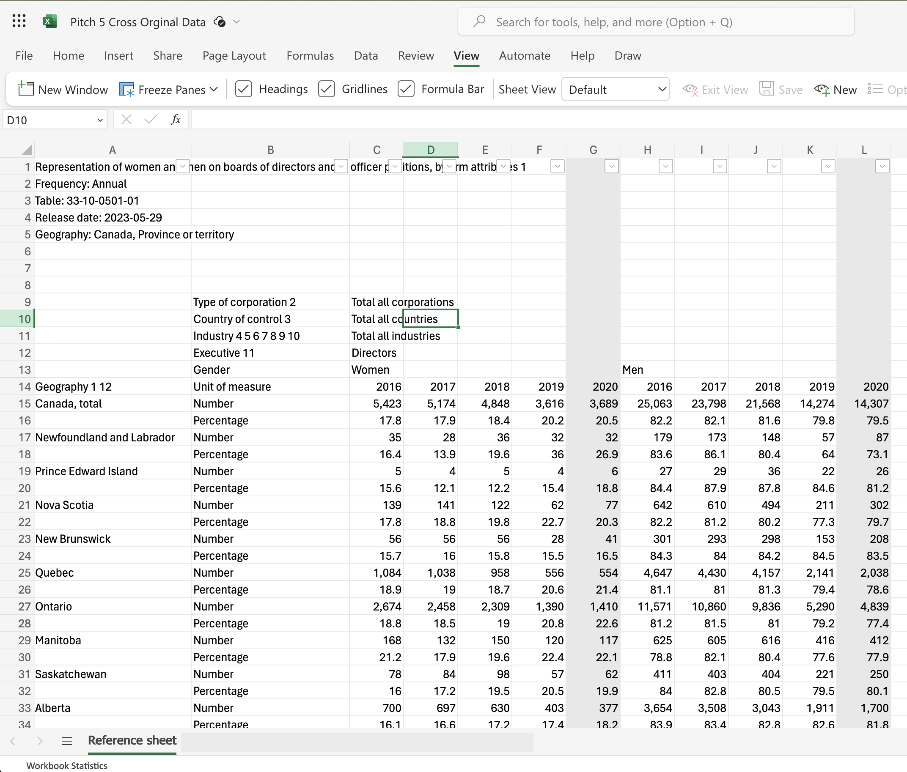
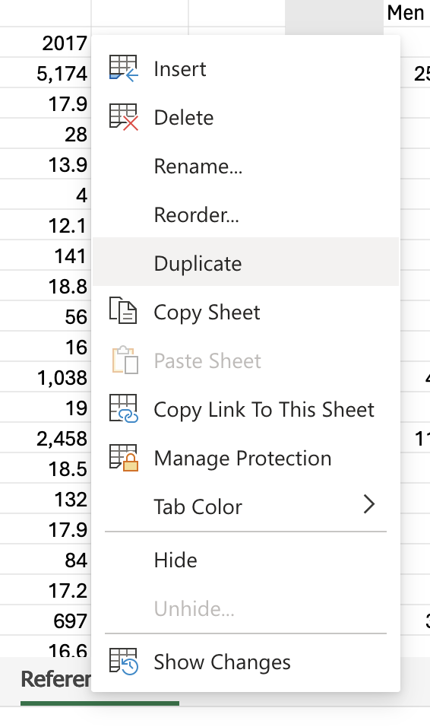
Step 1: Get raw data table and duplicate it for back up
Example is from Statistics Canada
© Anne MacLennan, 2024​
Statistics Canada. (2023, May 29). Table 33‑10‑0501‑01: Representation of women and men on boards of directors and in officer positions, by firm attributes. Statistics Canada. https://www150.statcan.gc.ca/t1/tbl1/en/tv.action?pid=3310050101

Slide 5
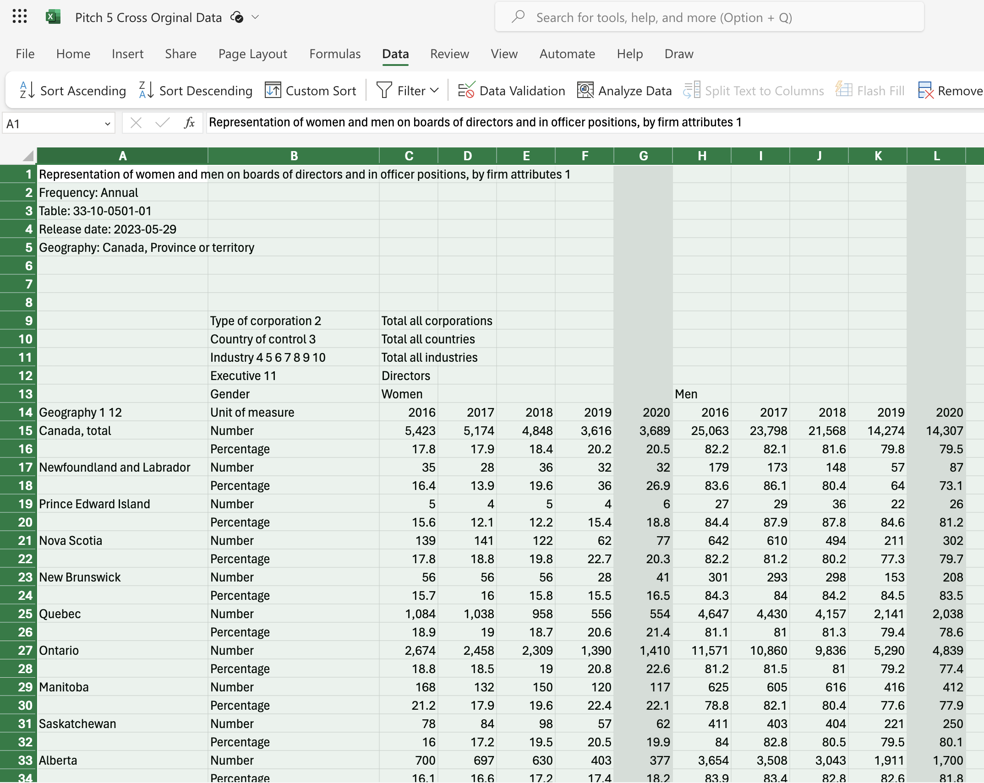
Step 2: Highlight all in the duplicate sheet
The way to highlight an Excel sheet is to go to this cell (box) and click on it. Then the wholesheet will be highlighted.​
This is an Excel tip only ​
Statistics Canada. (2023, May 29). Table 33‑10‑0501‑01: Representation of women and men on boards of directors and in officer positions, by firm attributes. Statistics Canada. https://www150.statcan.gc.ca/t1/tbl1/en/tv.action?pid=3310050101
© Anne MacLennan, 2024​

Slide 6
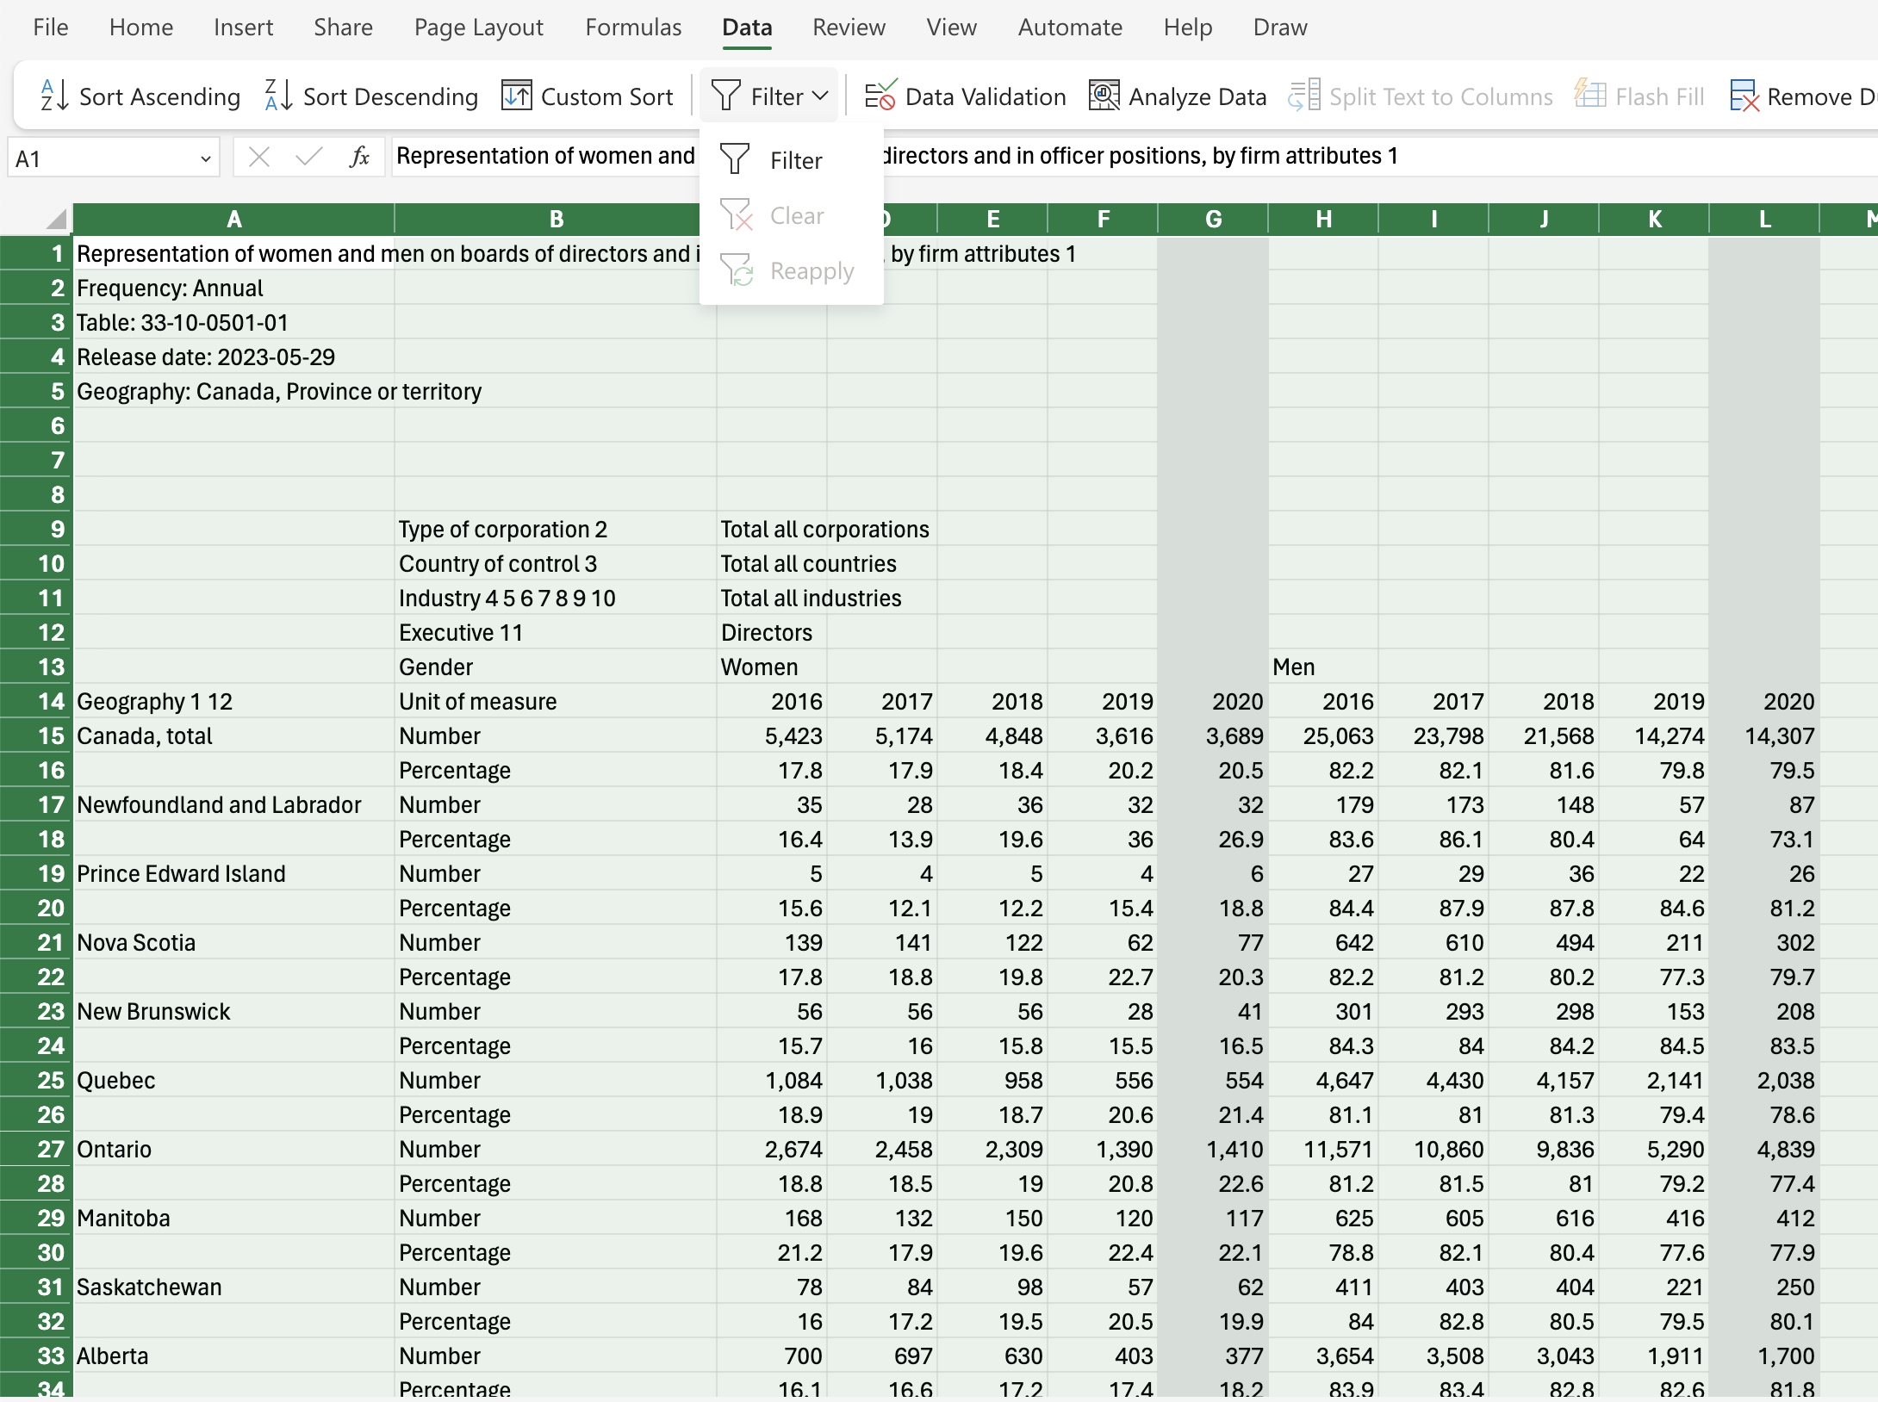
Step 3: Click data and then filter
© Anne MacLennan, 2024​
Statistics Canada. (2023, May 29). Table 33‑10‑0501‑01: Representation of women and men on boards of directors and in officer positions, by firm attributes. Statistics Canada. https://www150.statcan.gc.ca/t1/tbl1/en/tv.action?pid=3310050101

Slide 7
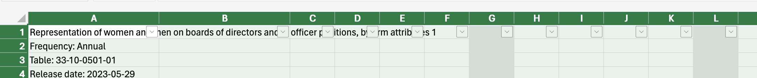
Step 4: Click data and then filter
Make sure the dropdown arrows appear
Statistics Canada. (2023, May 29). Table 33‑10‑0501‑01: Representation of women and men on boards of directors and in officer positions, by firm attributes. Statistics Canada. https://www150.statcan.gc.ca/t1/tbl1/en/tv.action?pid=3310050101
© Anne MacLennan, 2024​

Slide 8
Cross tabulating
When you cross tabulate what you are doing is comparing at least two variables. You need to pick two variables you want to cross tabulate, such as gender and wages in the workplace.
In step 3, we will select variables by using the select all feature in the filtered columns.
© Anne MacLennan, 2024​

Slide 9
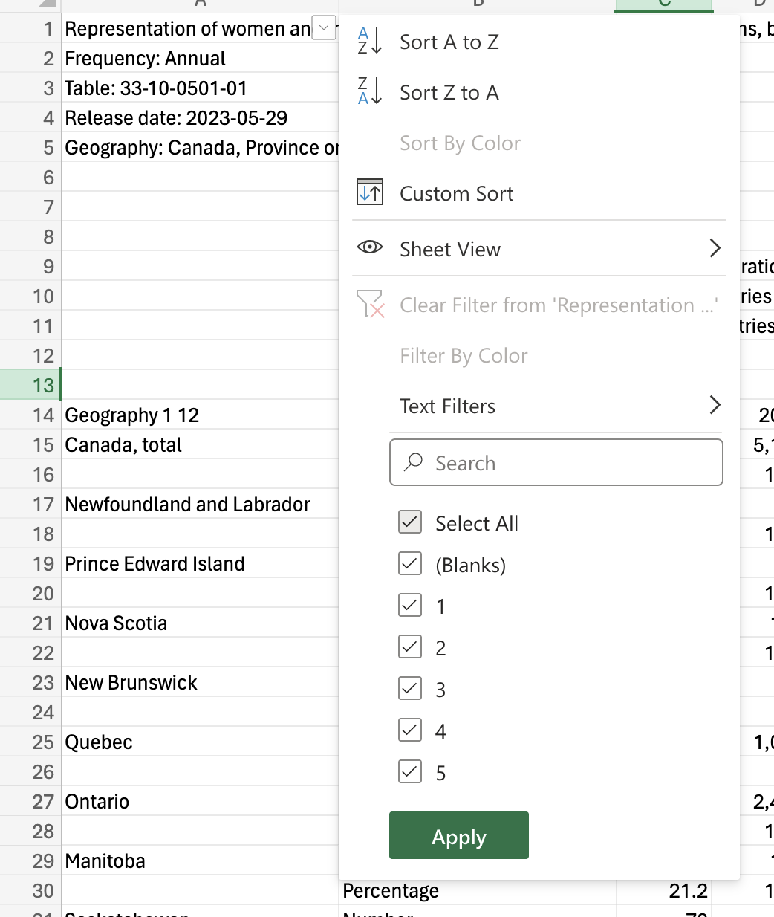
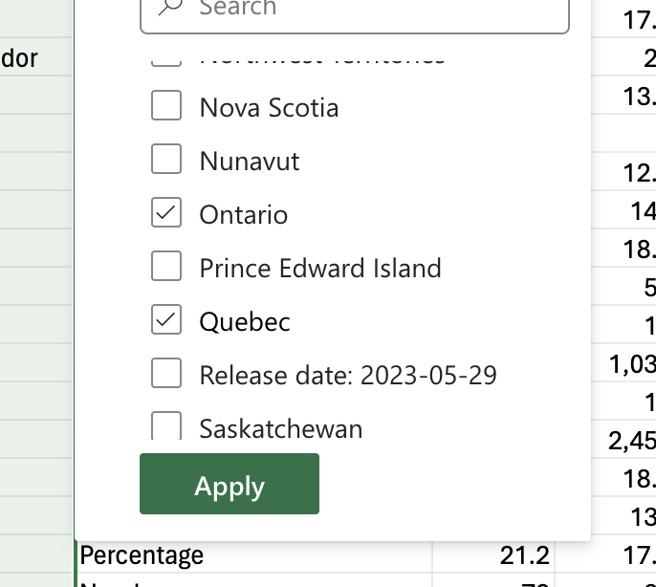
Step 5: click arrow down to sort column
Make sure to unselect all, then select all relevant input (for this example, Ontario and Quebec). Click apply after.
Statistics Canada. (2023, May 29). Table 33‑10‑0501‑01: Representation of women and men on boards of directors and in officer positions, by firm attributes. Statistics Canada. https://www150.statcan.gc.ca/t1/tbl1/en/tv.action?pid=3310050101
© Anne MacLennan, 2024

Slide 10
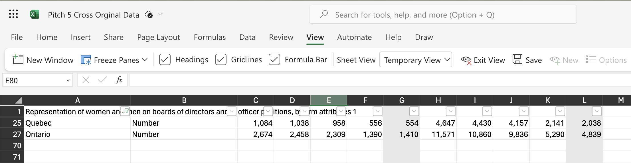
This is how it should look after completing Step 5
Statistics Canada. (2023, May 29). Table 33‑10‑0501‑01: Representation of women and men on boards of directors and in officer positions, by firm attributes. Statistics Canada. https://www150.statcan.gc.ca/t1/tbl1/en/tv.action?pid=3310050101
© Anne MacLennan, 2024​

Slide 11
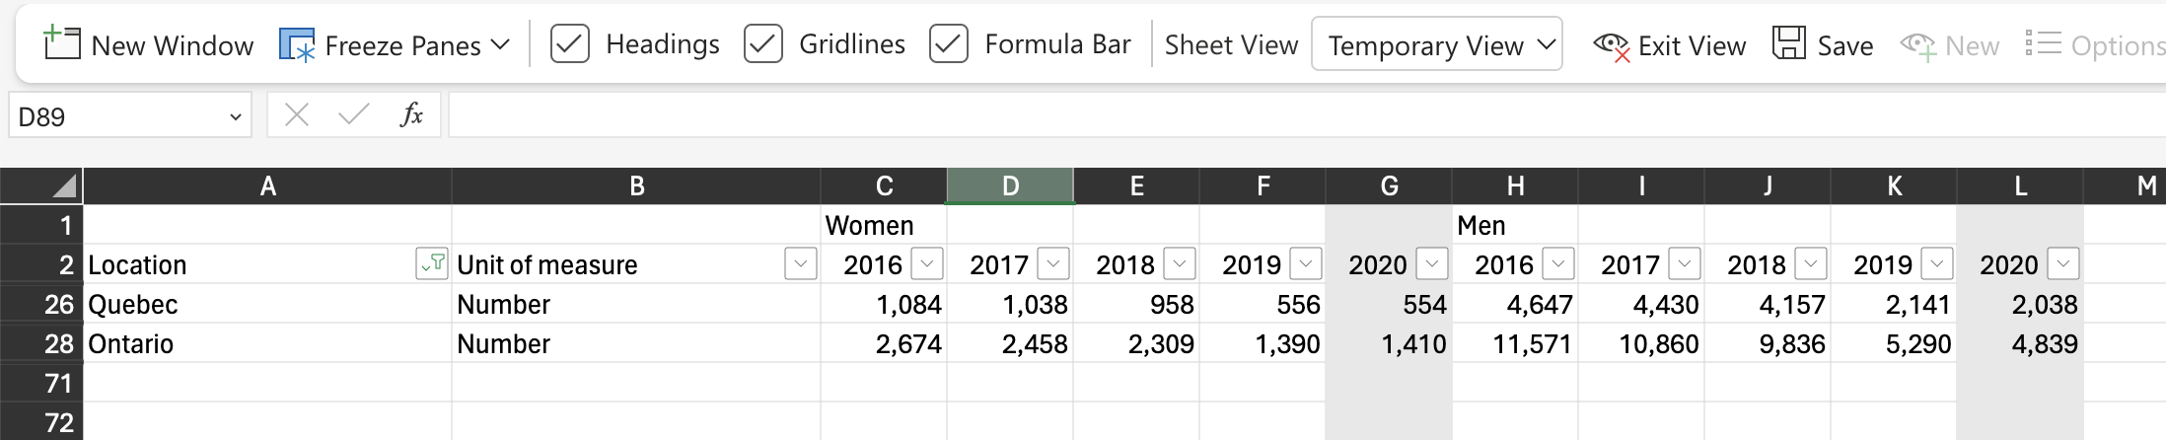
Step 6: Fix headers and formatting
Cross check duplicate sheet (the one you're working on) with the original sheet for important information
Statistics Canada. (2023, May 29). Table 33‑10‑0501‑01: Representation of women and men on boards of directors and in officer positions, by firm attributes. Statistics Canada. https://www150.statcan.gc.ca/t1/tbl1/en/tv.action?pid=3310050101
© Anne MacLennan, 2024​

Slide 12
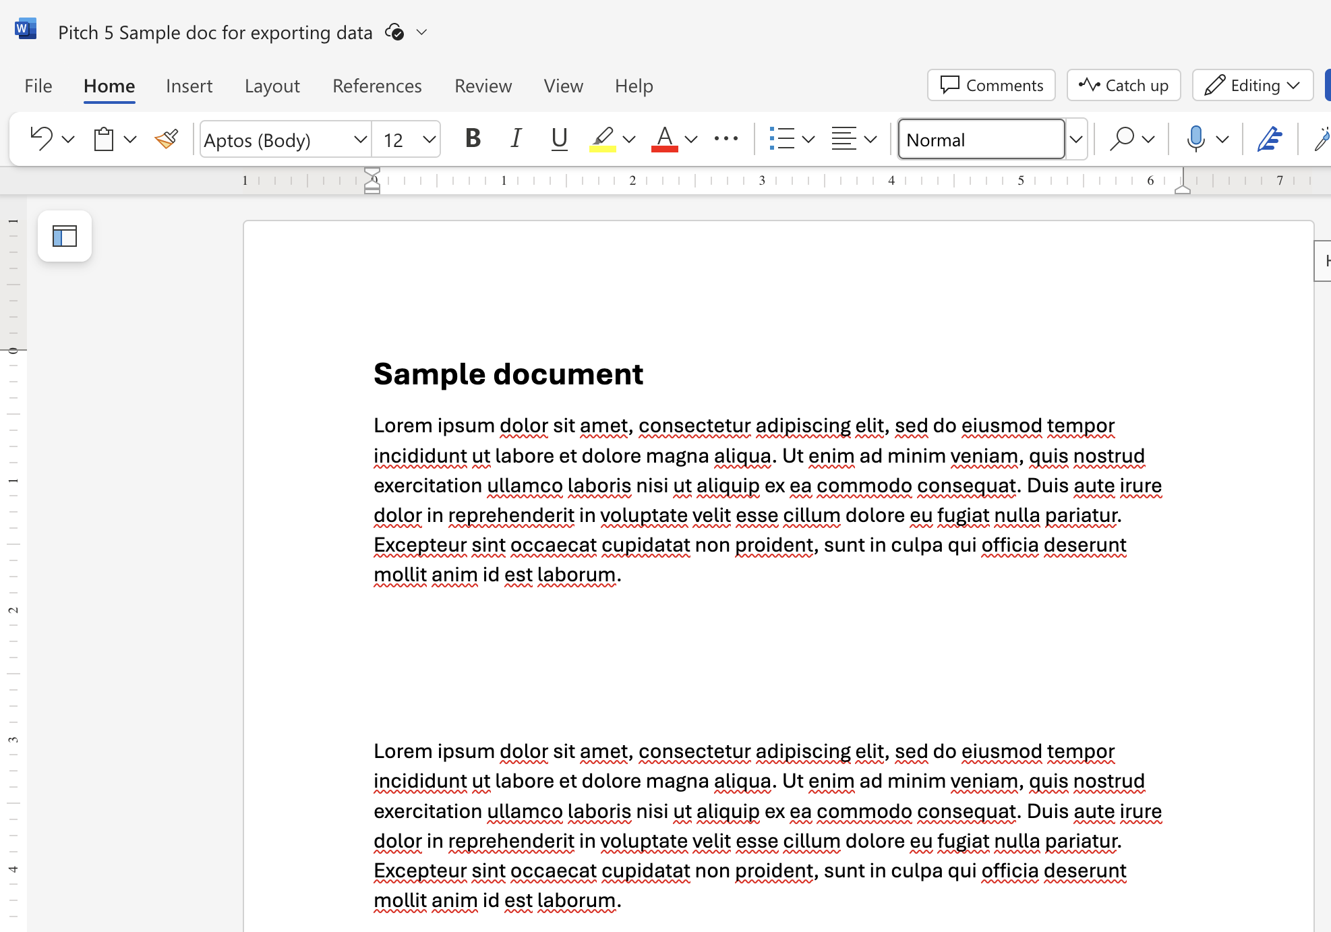
Ways to move data from Excel to Word file
This is an Excel tip only ​​​
Statistics Canada. (2023, May 29). Table 33‑10‑0501‑01: Representation of women and men on boards of directors and in officer positions, by firm attributes. Statistics Canada. https://www150.statcan.gc.ca/t1/tbl1/en/tv.action?pid=3310050101
© Anne MacLennan, 2024

Slide 13
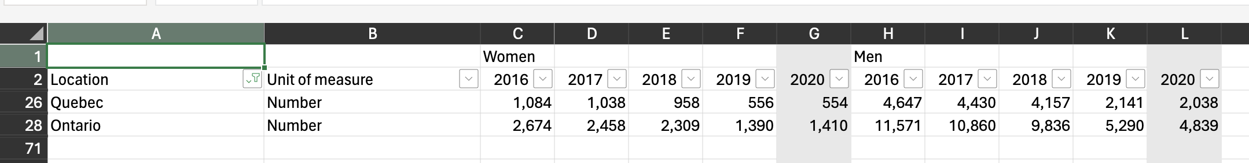
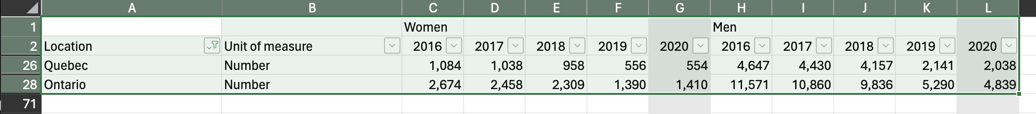
Step 1: Selecting Data
Click top left cell > hold shift > click bottom right cell to highlight all information
This is an Excel tip only
Statistics Canada. (2023, May 29). Table 33‑10‑0501‑01: Representation of women and men on boards of directors and in officer positions, by firm attributes. Statistics Canada. https://www150.statcan.gc.ca/t1/tbl1/en/tv.action?pid=3310050101
© Anne MacLennan, 2024​

Slide 14
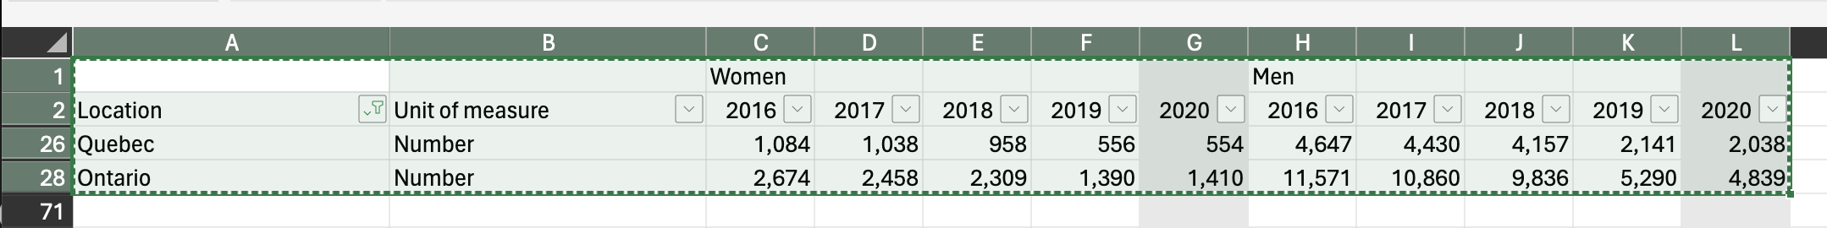
Step 2: Copying and Pasting Data
Ctrl + c (PC) or command + c (Mac) then Ctrl + v (PC) or command + v (Mac) into section in Word file
This is an Excel tip only
Note: marching ants border indicates that the data is copied and ready for pasting
Statistics Canada. (2023, May 29). Table 33‑10‑0501‑01: Representation of women and men on boards of directors and in officer positions, by firm attributes. Statistics Canada. https://www150.statcan.gc.ca/t1/tbl1/en/tv.action?pid=3310050101
© Anne MacLennan, 2024​

Slide 15
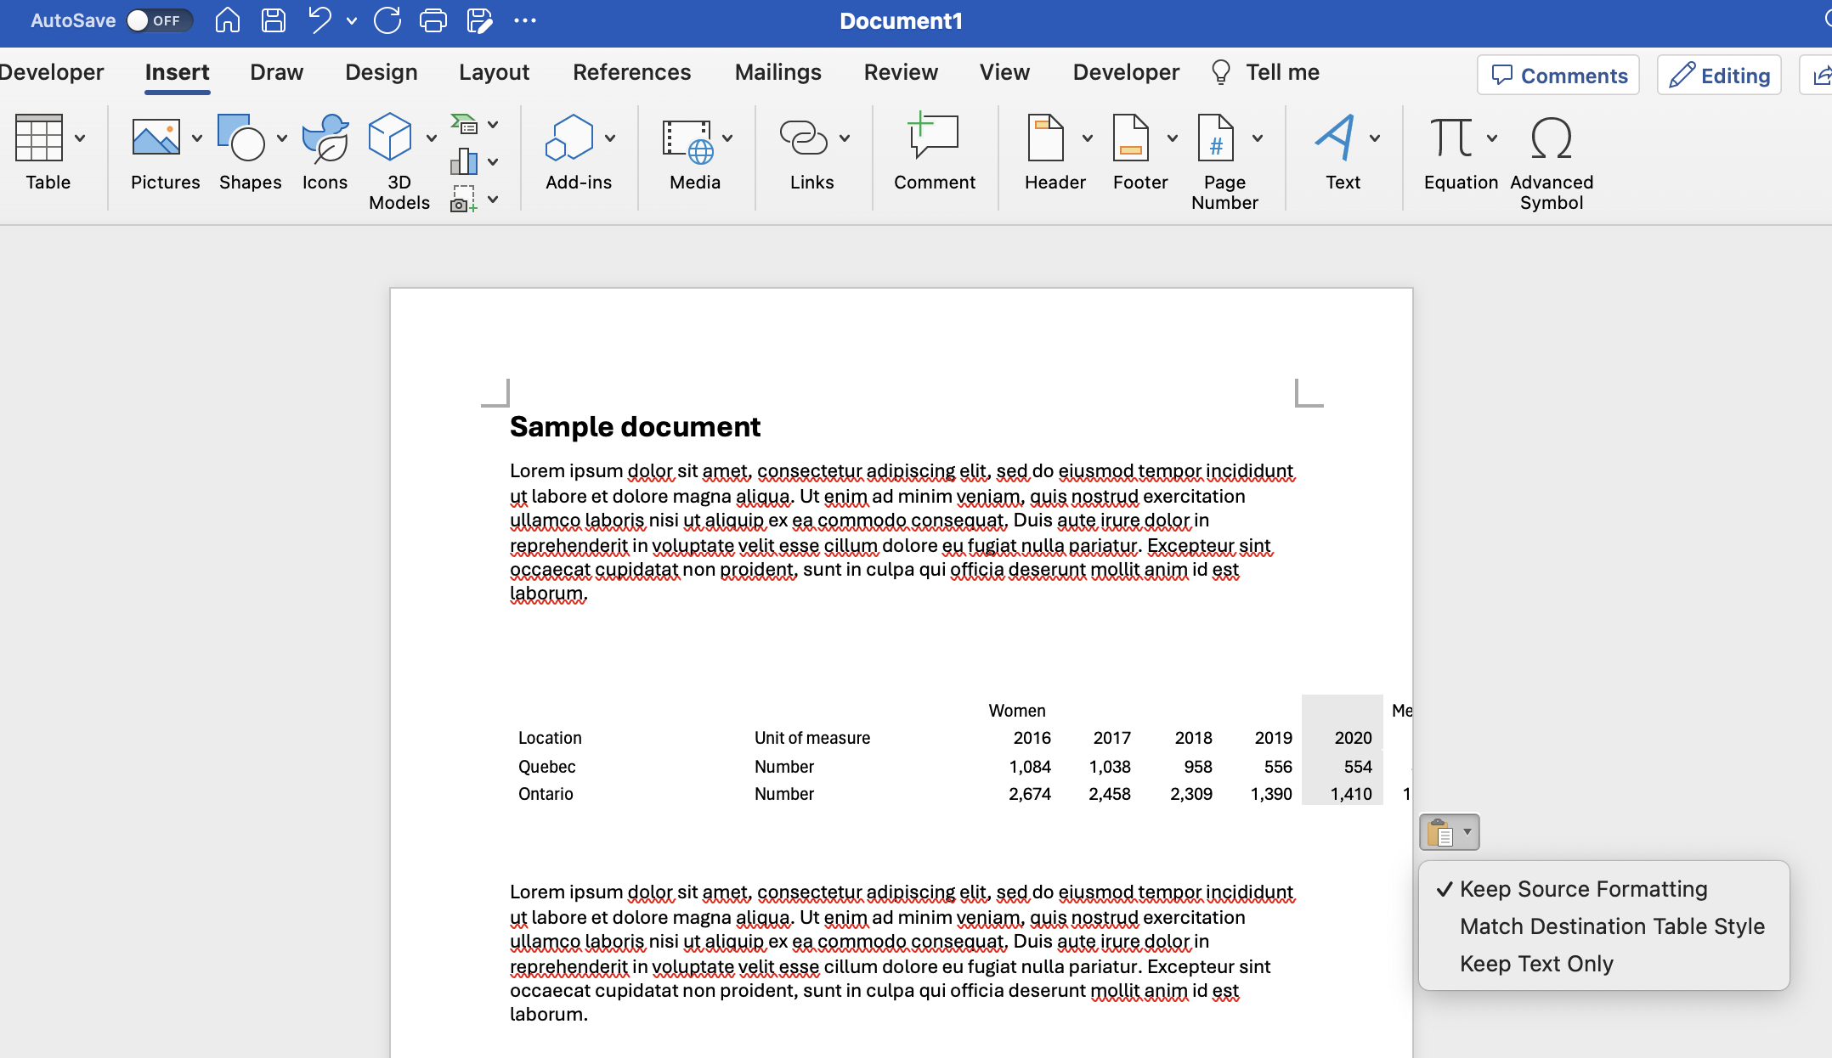
Step 2: Copying and Pasting Data
Ctrl + c (PC) or command + c (Mac) then Ctrl + v (PC) or command + v (Mac) into section in Word file
Statistics Canada. (2023, May 29). Table 33‑10‑0501‑01: Representation of women and men on boards of directors and in officer positions, by firm attributes. Statistics Canada. https://www150.statcan.gc.ca/t1/tbl1/en/tv.action?pid=3310050101
© Anne MacLennan, 2024​

Slide 16
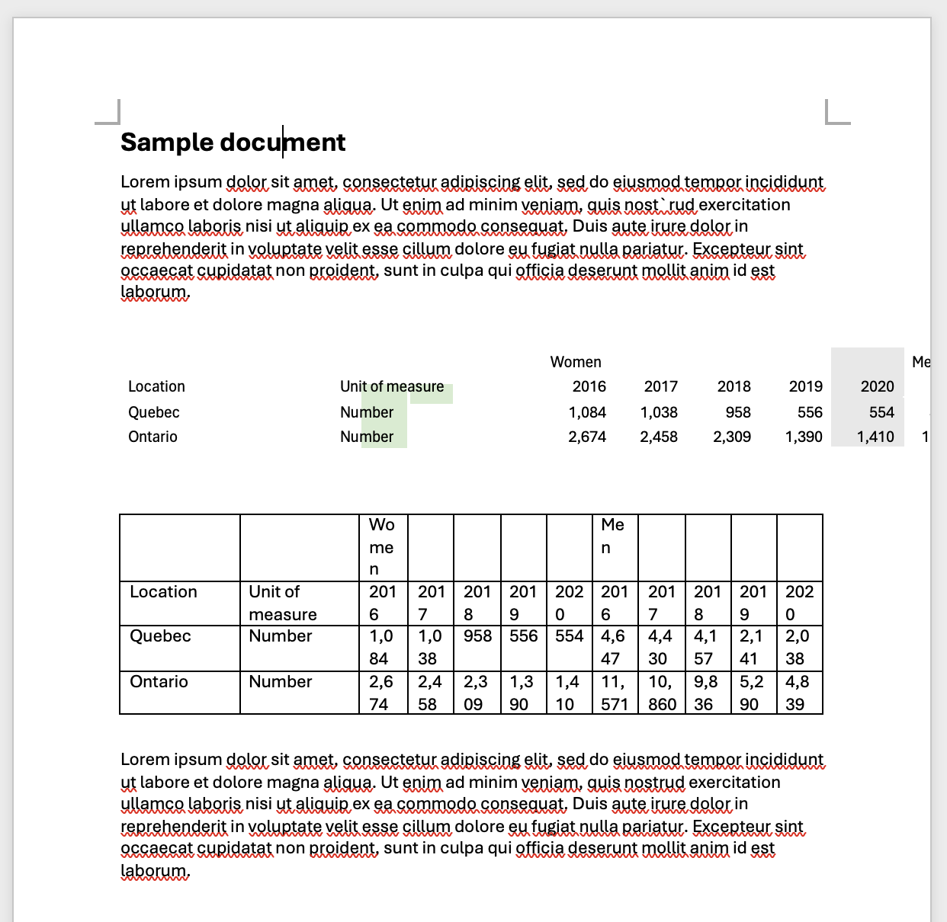
Step 3: Fixing the Formatting
Keep source formatting uses the same fonts and styles as the Excel sheet, match destination table style converts the copied data into the document's style
Make changes as needed
Statistics Canada. (2023, May 29). Table 33‑10‑0501‑01: Representation of women and men on boards of directors and in officer positions, by firm attributes. Statistics Canada. https://www150.statcan.gc.ca/t1/tbl1/en/tv.action?pid=3310050101
© Anne MacLennan, 2024​

Slide 17
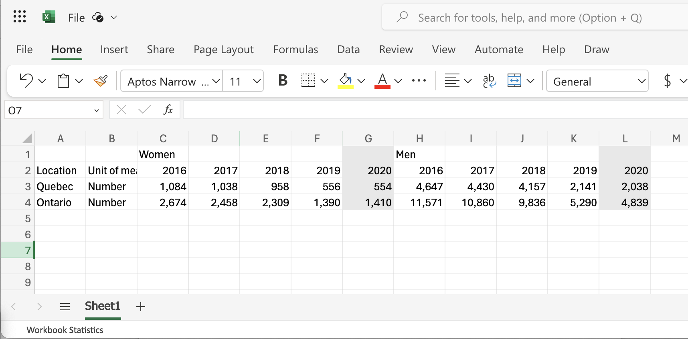
Step 4: Fixing the Formatting
You can copy paste your table into a new file to fix formatting easier
Make sure all text is seen by clicking cell and clicking text wrap button
Statistics Canada. (2023, May 29). Table 33‑10‑0501‑01: Representation of women and men on boards of directors and in officer positions, by firm attributes. Statistics Canada. https://www150.statcan.gc.ca/t1/tbl1/en/tv.action?pid=3310050101
© Anne MacLennan, 2024​

Slide 18
Screenshot Step 1: Taking a Screenshot
Windows key + print scr (PC)
Shift + control + command + 3 (Mac)
© Anne MacLennan, 2024​

Slide 19
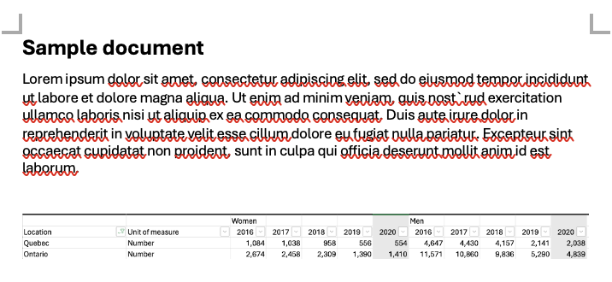
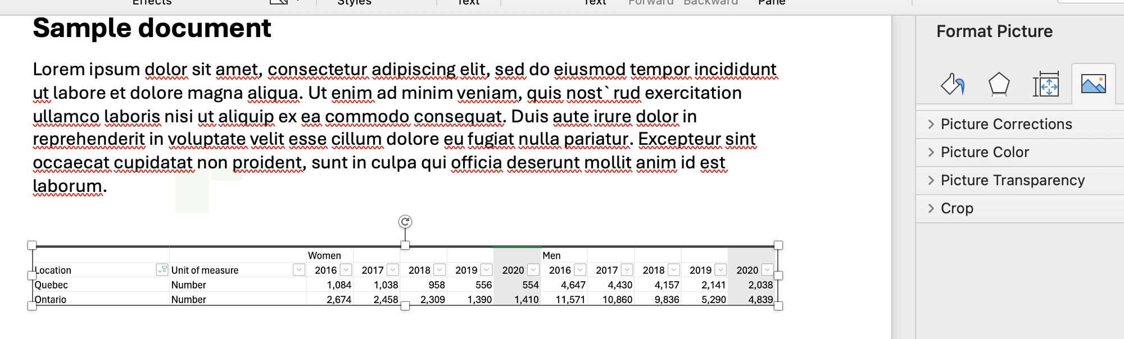
Step 2: Pasting a Screenshot
Go to Word document then press
  Ctrl + V (PC)
  Command + V (Mac)
Double click to crop and edit
Edit as needed
© Anne MacLennan, 2024​

Slide 20
References
Department of Economic and Social Affairs (2024). The sustainable development goals report 2024. United Nations. https://unstats.un.org/sdgs/report/2024/The-Sustainable-Development-Goals-Report-2024.pdf.
Statistics Canada. (2023, May 29). Table 33‑10‑0501‑01: Representation of women and men on boards of directors and in officer positions, by firm attributes. Statistics Canada. https://www150.statcan.gc.ca/t1/tbl1/en/tv.action?pid=3310050101

