Slide 1


PSYC 2030
Library Session
Winter 2021

Slide 2


Slide 3
Learning Objectives or Goals for Library Session
Choosing the most appropriate database to search
Build an effective search strategy
Critically evaluate sources
Find books in the library catalogue
Search for scholarly journal articles in PsycINFO
Academic integrity and citing using APA style

Slide 4
Where do you start and where you should end
Google
Google Scholar
duckduckgo
Bing
Library – OMNI
PsycINFO

Slide 5
Where Do you Start and Where you Should
Why the differences?
Audiences
Monetary
Relevance algorithm
Linking
Tagging
Popularity
Current events

Slide 6
Search strategies
Concepts
Keywords
AND / OR
Relevant? Current? Methodology? Age group? Cause? Treatment? ……

Slide 7

Search strategies: Boolean operators
Use AND to narrow your search
Tells the database to search ALL terms
AND

Slide 8

Search strategies: Boolean operators
Use OR to broaden your search
Connect synonyms or similar concepts
OR

Slide 9
Search strategies: Phrase searching and Truncation
Use quotation marks (“ ”) to search for an exact phrase
e.g. “behaviour therapy”
Use the asterisk (*) to replace one or more characters
e.g. therap* will ﬁnd therapy, therapists, therapeutic, etc.

Slide 10
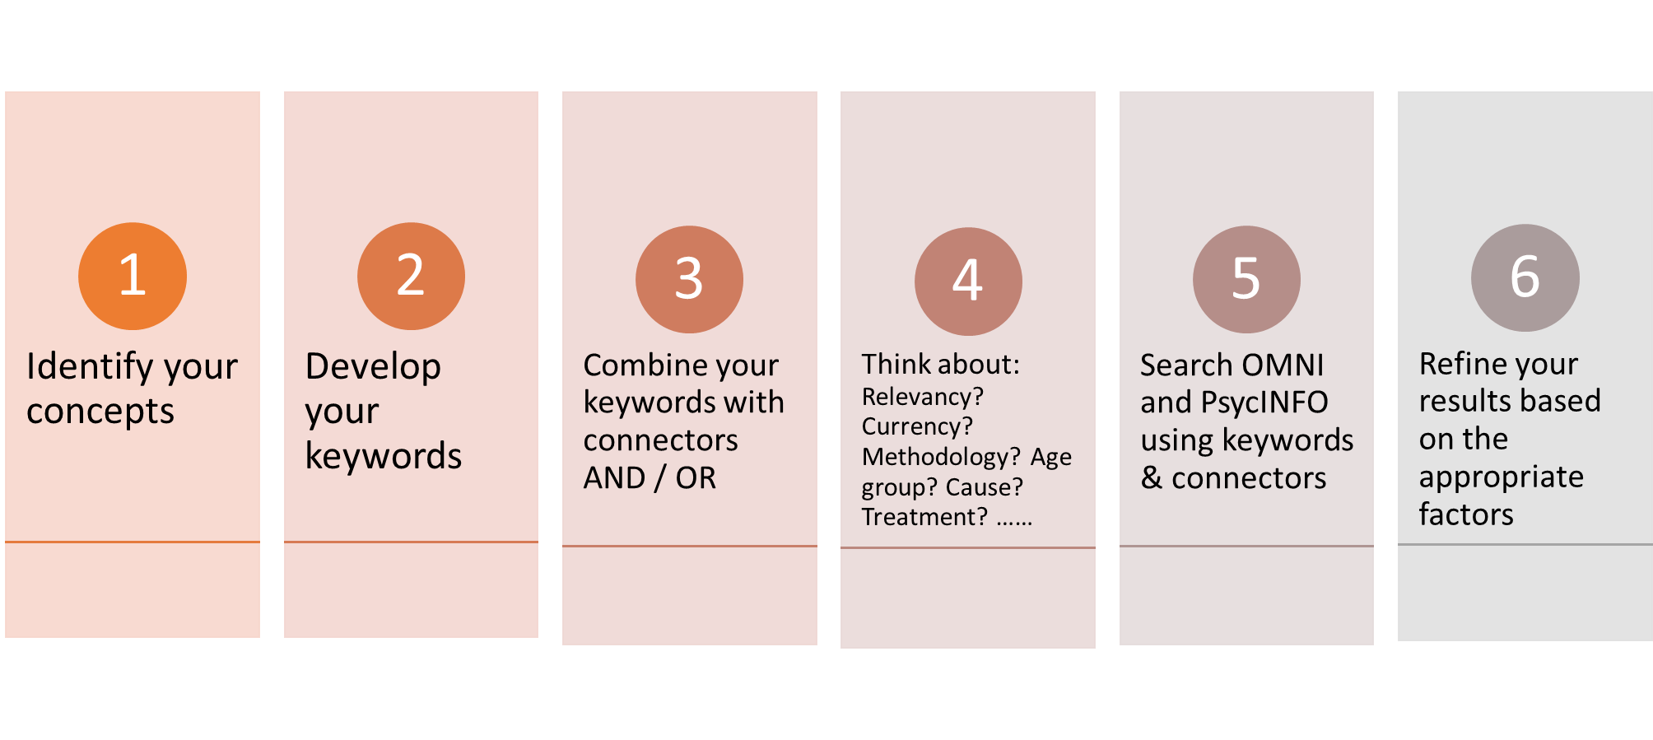
General Search Strategy

Slide 11
Evaluating Information Sources: PARCA
Purpose
Authority
Relevance
Currency
Accuracy

Slide 12

Evaluating Information Sources Video
Evaluating Psychology Sources

Slide 13
Psychology Research Videos
Intro to Library Resources
Topic Searches in Psychology
Evaluating Sources in Psychology
Peer-review for Psychology Students

Slide 14

PsycINFO
library.yorku.ca
  Research Guides
    Health
      Psychology
        Articles
          PsycINFO

Slide 15

Demo
Does yoga have an impact on the severity of depression in seniors?
Keywords:
  yoga
AND
depression
AND
seniors OR elderly OR aged
Topic Searches in Psychology
OMNI
OMNI vs PSYCINFO
Notes:
Note: PsycInfo Thesaurus provides controlled vocabulary terms that are used in PsycInfo database. The Thesaurus feature improves searching.

Slide 16

Academic Integrity
Why cite?
  Zoom Poll Question
    A) Give Credit
    B) Strengthen your Position
    C) Showing Due Diligence
    D) All of the Above
  Why cite? (video)

Slide 17

APA
How to cite?
  SPARK
  Purdue OWL
  Use APA 6th or APA 7th edition?

Slide 18

Questions?
Thank you

