Slide 1
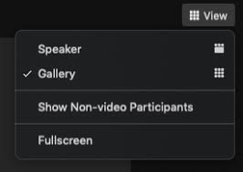
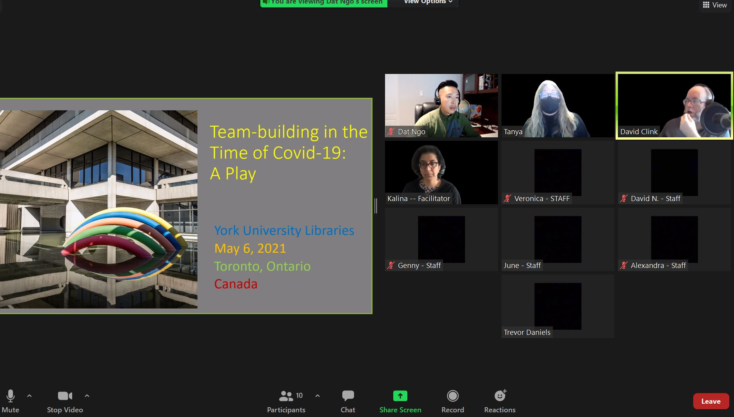
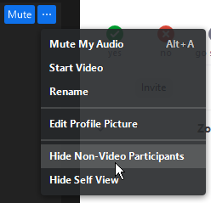
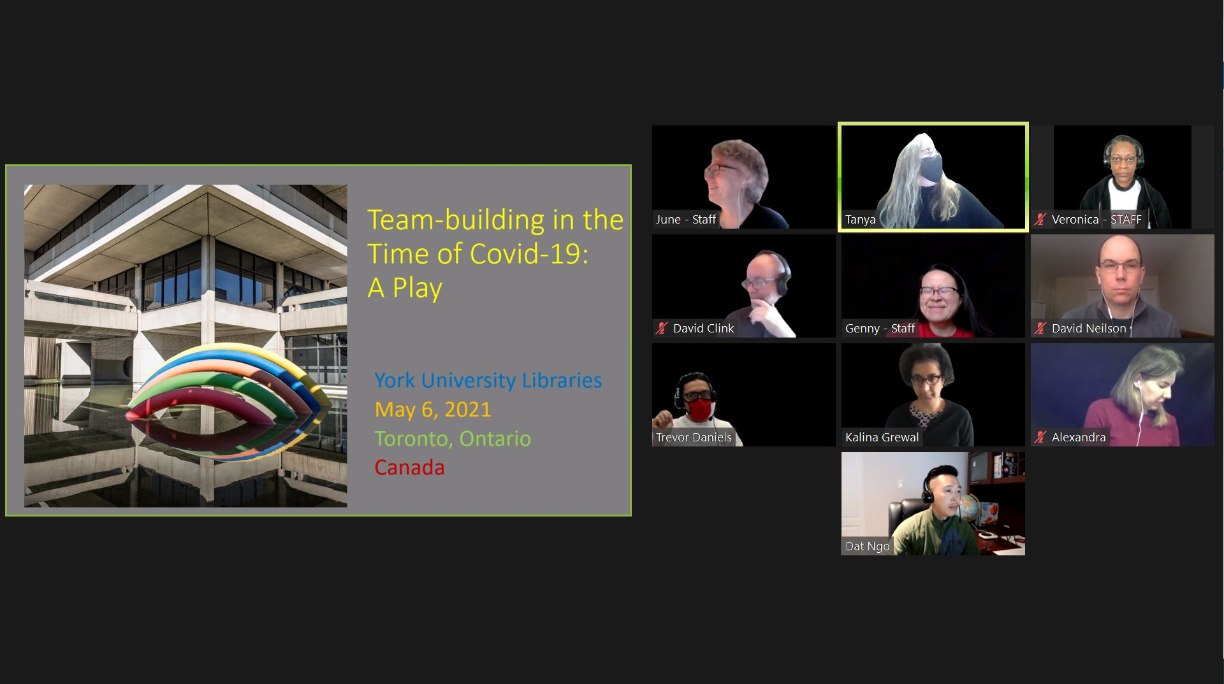
For the best viewing of the play:
Turn off your video and microphone
Set your view to Gallery
Use the slide to split the screen between the Gallery view and the Powerpoint
Click on the 3 dots in the top right corner of any participant with their video off
Select Hide Non-Video Participants
If your screen now looks
like this, sit back, relax and
enjoy the play!

Slide 2
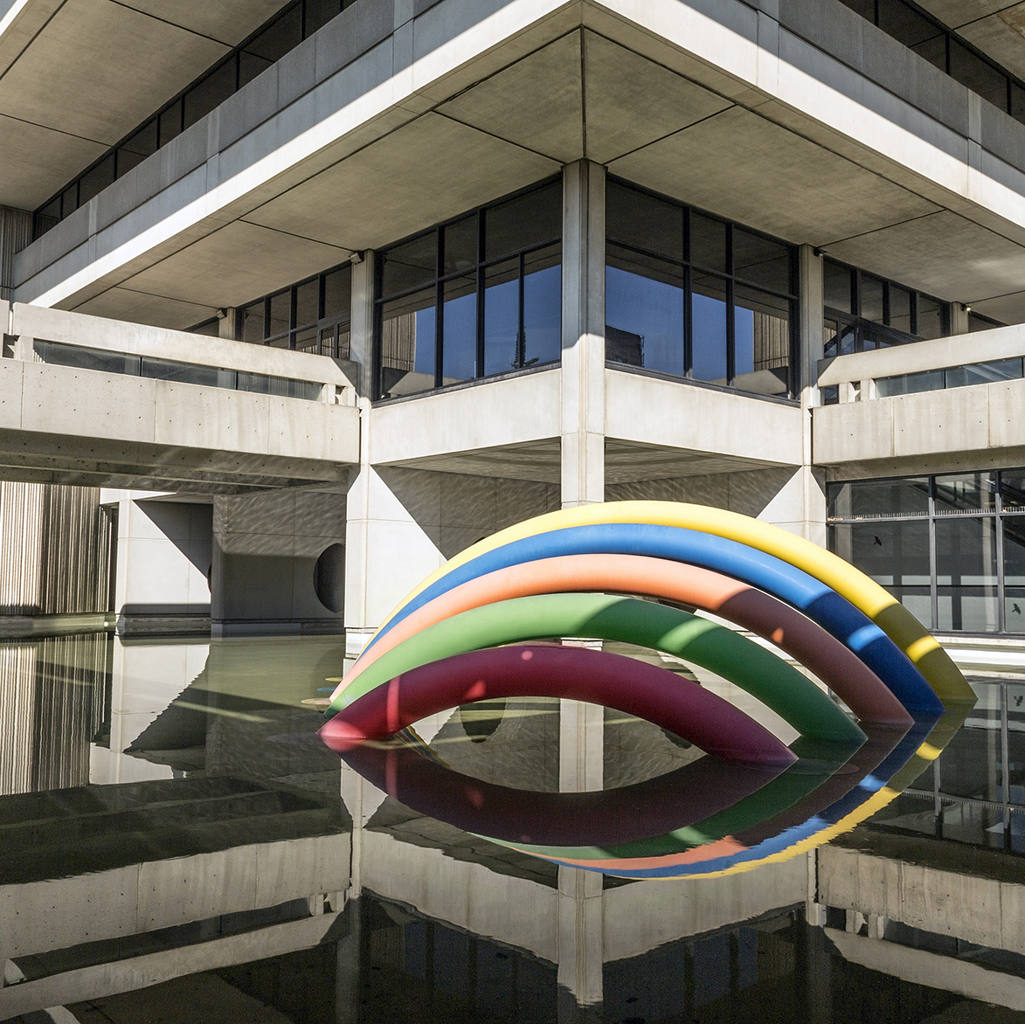
Team-building in the
Time of Covid-19:
A Play
York University Libraries
May 6, 2021
Toronto, Ontario
Canada

Slide 3

The Perfect Library
(an excerpt)
David Clink

Slide 4
The Perfect Library
(an excerpt)
David Clink

Slide 5
Act 1: Scene 1
The Dean Locks Down the Library

Slide 6
Act 1: Scene 2
The Big Ask

Slide 7
Act 2: Scene 1
Isolation in Ontario

Slide 8
Act 2: Scene 2
Isolation to Community

Slide 9
Act 2: Scene 2
Isolation to Community

Slide 10
Act 3: Scene 1
The Rolodex of Achievements

Slide 11
Act 3: Scene 2
Tough Talk about Lockers

Slide 12
Act 4: Scene 1
Kalina’s Proposal

Slide 13
Act 4: Scene 2
David N’s Dark Night
of the Soul

Slide 14
Act 4: Scene 3
Trevor Has Wanderlust

Slide 15
Act 4: Scene 4
Genny Goes Cross Country

Slide 16
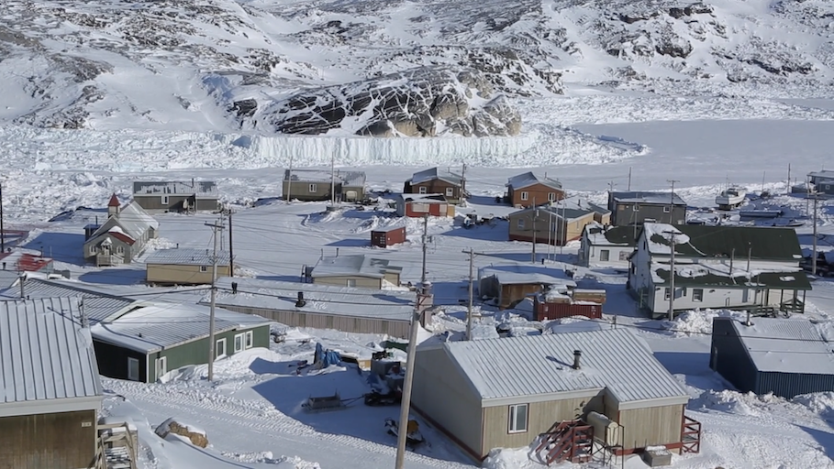
November 25, 2020
Dear CCSD Friends,
We took a memorable and moving journey to Nunavut this week.
Alethea Arnaquq-Baril, the director, writer and producer of Angry Inuk, gave us a glimpse of this vast and beautiful land and some of the people who live there.
The film is set up as a quest for a dialogue with elusive but powerful anti-seal hunting activists. Along the way, people that are quietly passionate about keeping their way of life explain what the seal hunt means to the Inuit.
From Angry Inuk

Slide 17

Through this film we learned that “The North” is not just some general climate and geography found way up there! It is specific. If you want to learn about Nunavut, its history, its people and their lives, watch Angry Inuk.
We are off to Nova Scotia next. Hope to see you there!
Yours,
the CATS (CCSD Armchair Travelers)

Slide 18



December 10, 2020
Dear Friends,
This week we took a road trip to Nova Scotia via two documentaries: The Long Road to Justice: the Viola Desmond Story and Once Upon a Black Halifax. Despite this official “Canada’s Ocean Playground” map to the left, we strayed far away from the usual lighthouses and lobsters tour of the province.
We went back in time, too! About the 1940s to 1960s when it seemed that Nova Scotia’s rustic, maritime charms could have an edge, especially for the Black Loyalists who had settled there since the late 1700s. Have a read – perhaps your eyes and hearts will be opened to the people so rarely mentioned in our history books.

Slide 19

Well, that’s a brief report back on our trip to Nova Scotia last week. Maybe you will get a chance to watch those interesting documentaries sometime. They are worth your time!
We are sticking around the Maritimes a bit longer. Join us in Prince Edward Island next. It’s not just about the potatoes and pigtails!
Sincerely,
The CATS
(CCSD Armchair Travelers)

Slide 20
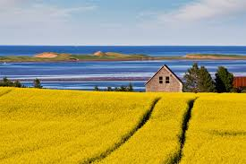
January 13, 2021
Dear CCSD Friends,
We headed to Prince Edward Island last week via the Confederation Bridge! There were great views all around us. Indeed, the beauty of the island is its land and its people.
We met some very interesting, very engaged senior women living out in rural Prince Edward Island –
all courtesy of a special documentary.
Image from Welcomepei.com

Slide 21
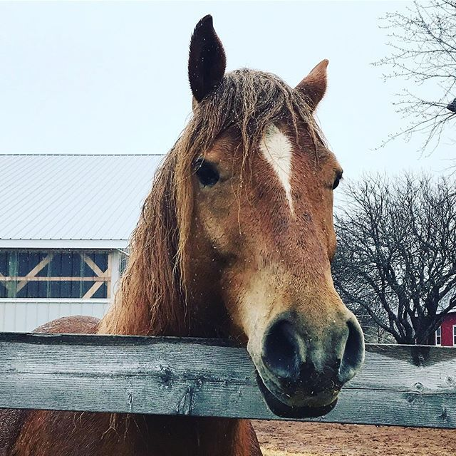
Spoiler alert! Olive does defend her dissertation successfully. Women who are aging in place in rural areas do need supports – and they can rely on their own understanding of what makes them happy and what gives them purpose.
In our conversation, it was clear that all of us are working with assumptions and biases about getting older. Olive and her research participants make it obvious that it can be a rich period of life! An 80+ year old can enjoy riding a John Deere tractor; making art; going to the hairdresser; taking care of their land and animals; contemplating sex; and growing old in their own home.
We are heading west to Quebec next. Hope to see you there!
All the best,
The CCSD Armchair Travelers
(aka the CATS)
@CBCPEI Twitter

Slide 22

Fevrier 4, 2021
Dear CCSD Friends,
We were in La Belle Province this week. More than just poutine and the Bonhomme de Carnival, Quebec has a great number of lovely and eccentric people! We met a few of them in the documentaries: On me prende pour une Chinoise (They think I’m Chinese) and King Lajoie.

Slide 23
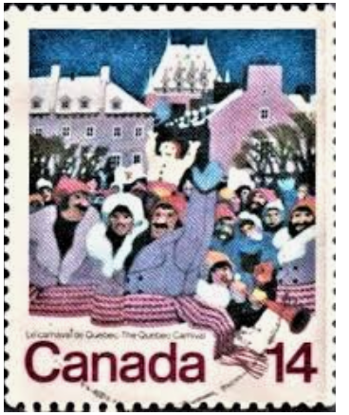
We are coming back to southern Ontario next week! Stay warm and get your hot chocolate ready for some great viewing.
Sincerely,
The Cats
(CCSD Armchair Travelers)

Slide 24
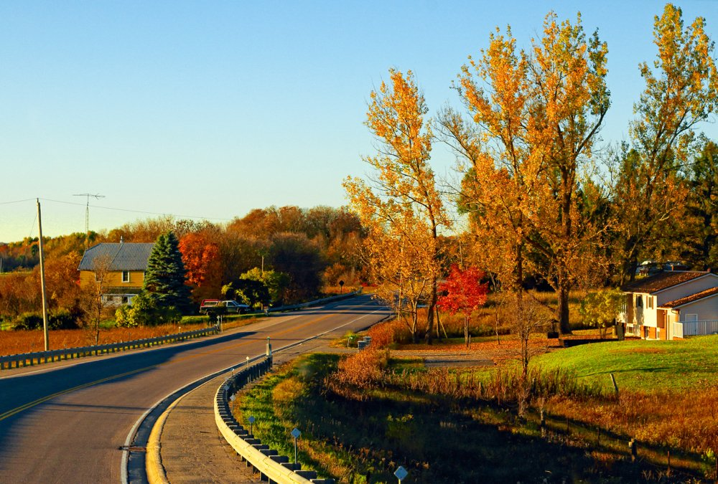

Image sources: Getty Images/iStockphoto and Kiss the Cook Catering
February 17, 2021
Dear CCSD Friends,
Ontario, as a wise license plate once claimed, is “Yours to Discover.” There’s so much of Ontario to discover, in fact, that the CCSD travelers split the province in two. We stuck close to home this time for a pair of videos about Southern Ontario: Speakers for the Dead (2000, dirs. David ”Sudz” Sutherland and Jennifer Holness) and World in a City (2016, dir. Brett Story).

Slide 25
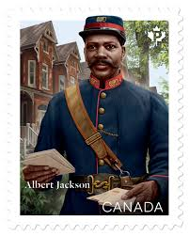


We’re heading out to British Columbia next! Pack your hiking boots, your skis, and your whale-watching binoculars. There’s plenty of room on the bus for everyone! (Yes, we travel by bus. Sorry.)
Sincerely,
The CATs
(CCSD Armchair Travelers)

Slide 26
March 4, 2021
Dear CCSD Friends,
The motto for our visit to British Columbia could have been: “Big province, little videos.”
To sample the breadth of our country’s westernmost province, we watched four short films that gave us a snapshot of the people who live, play, and worship there. From basketball to Buddhists, grizzly bears to grandmothers, our films covered a lot of ground. But the connections were there if you looked for them…

Slide 27

Next up is our second visit to a Canadian territory! We’re heading to the Yukon, a beautiful land where we almost certainly won’t encounter any more bears.
Please come along!
Sincerely,
The CATS

Slide 28
Act 5: Scene 1
The Two T’s Talk Triumph

Slide 29
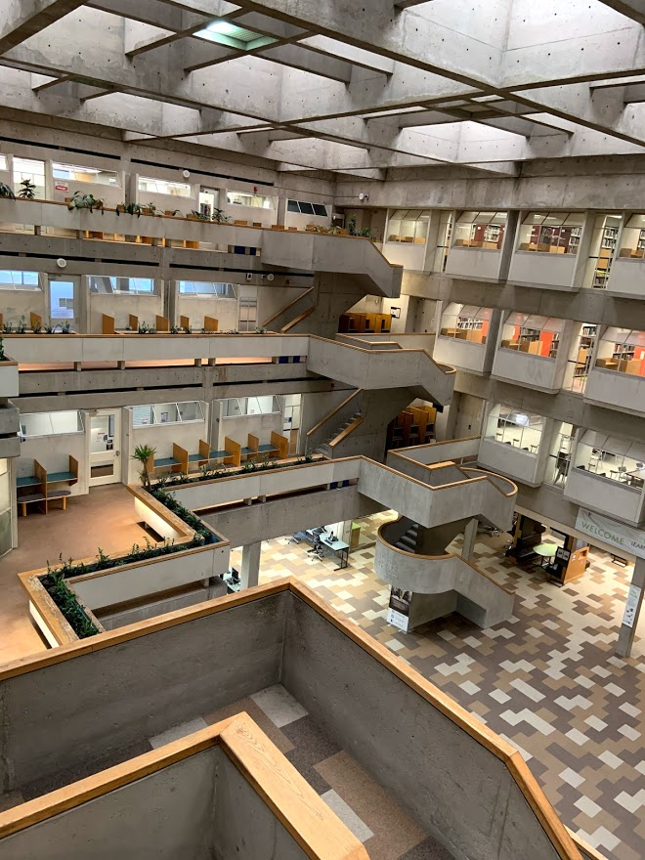
York University Libraries
2020:
A Year in Review

Slide 30
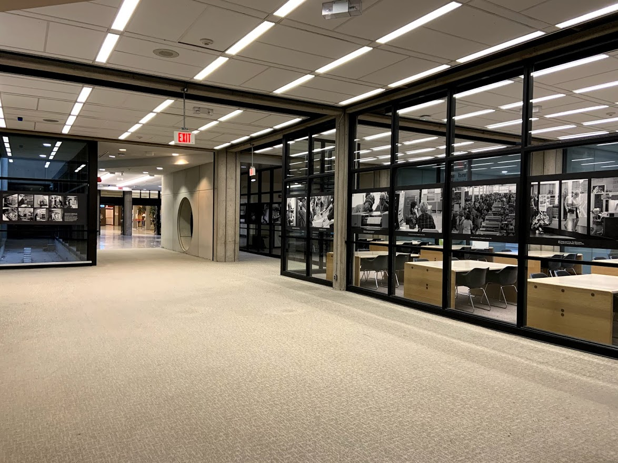
Making the most of a surreal quiet ...
I think being part of the teams working on AODA compliance and updating research guides has given me a sense of accomplishment; I'm a detail-oriented person who likes things that work properly, and the campus shutdown has given us an opportunity to work on projects like this. I only wish we had also taken better advantage of the months-long borrowing freeze and physical absence of patrons to inventory our print collections. It was a unique opportunity that will probably never come again.
Ricardo

Slide 31
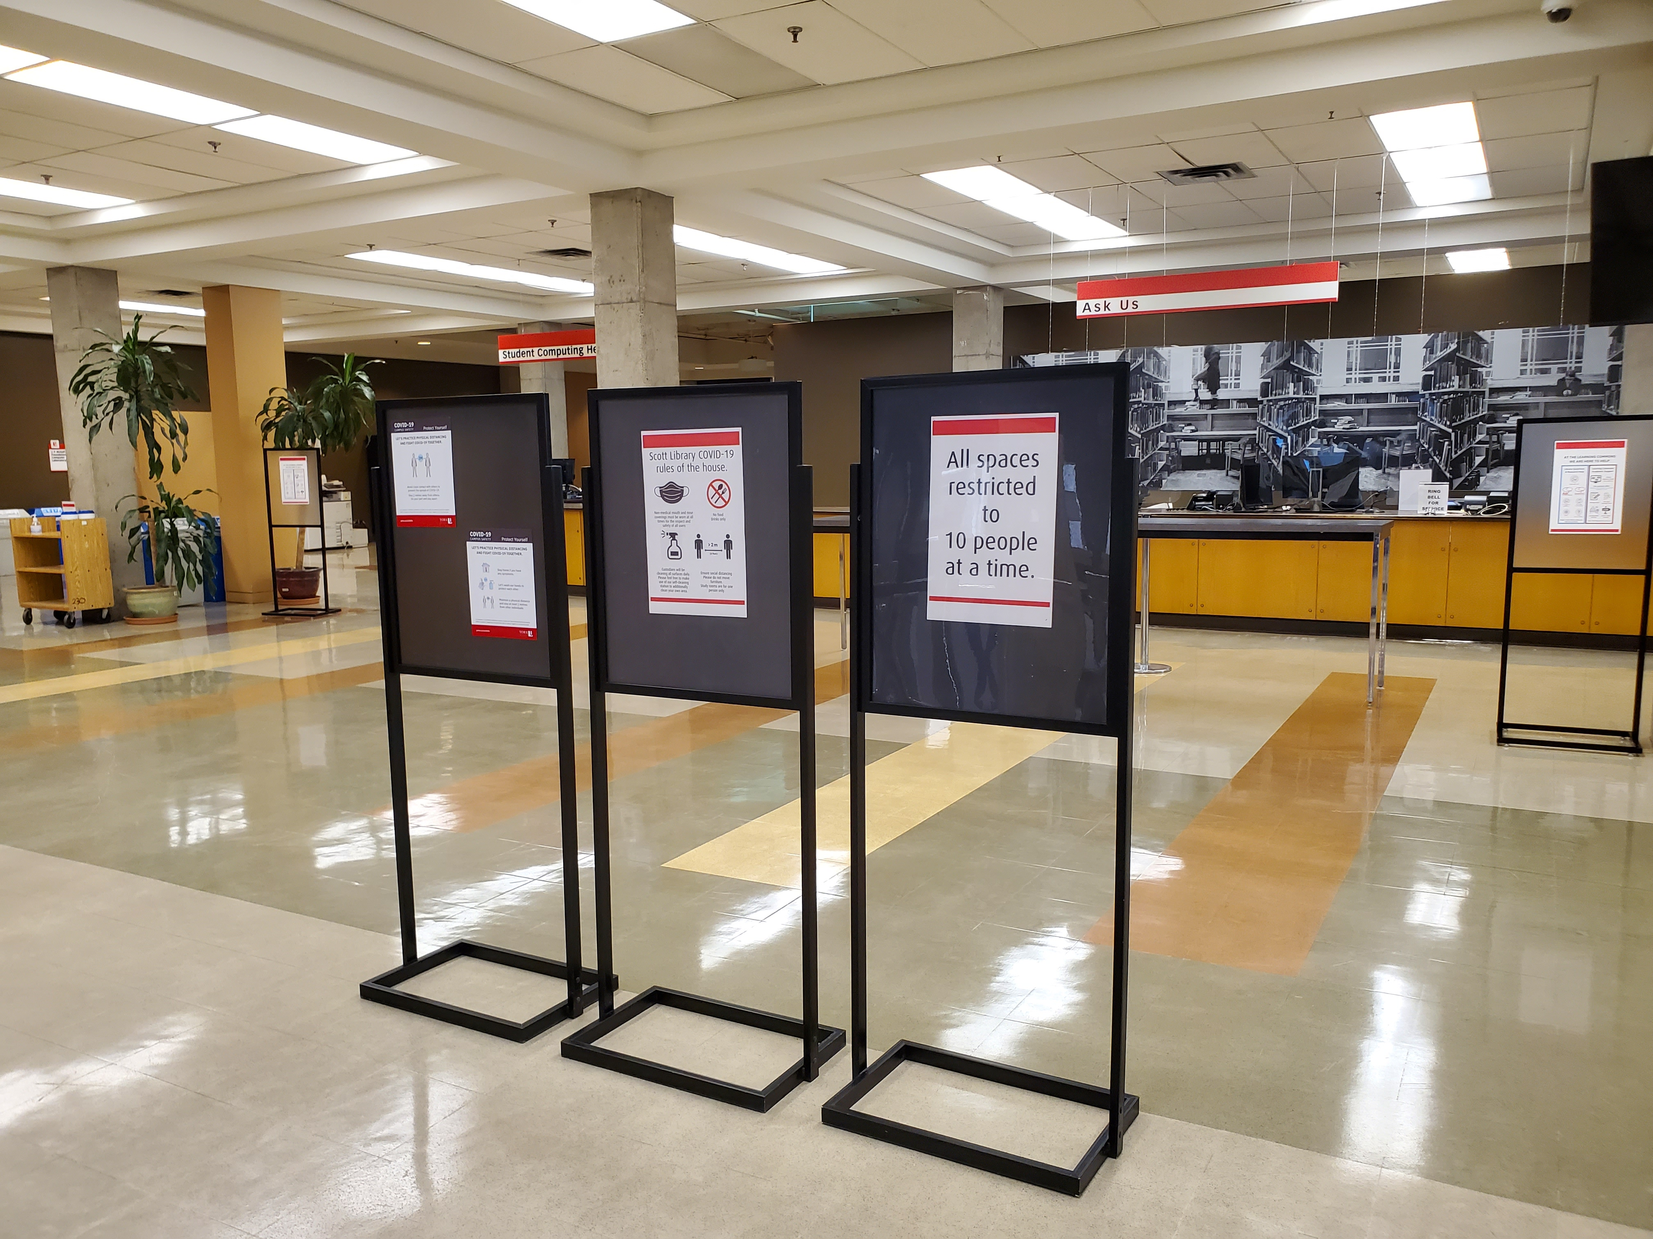
All our services are up ...
What gave me a sense of accomplishment, was how all the staff remembers who do reserves, the Acquisition department and CDA worked together to come up with a way to provide reserve materials for students and provide support for the faculty members. It was a pan-library effort.
Negar

Slide 32
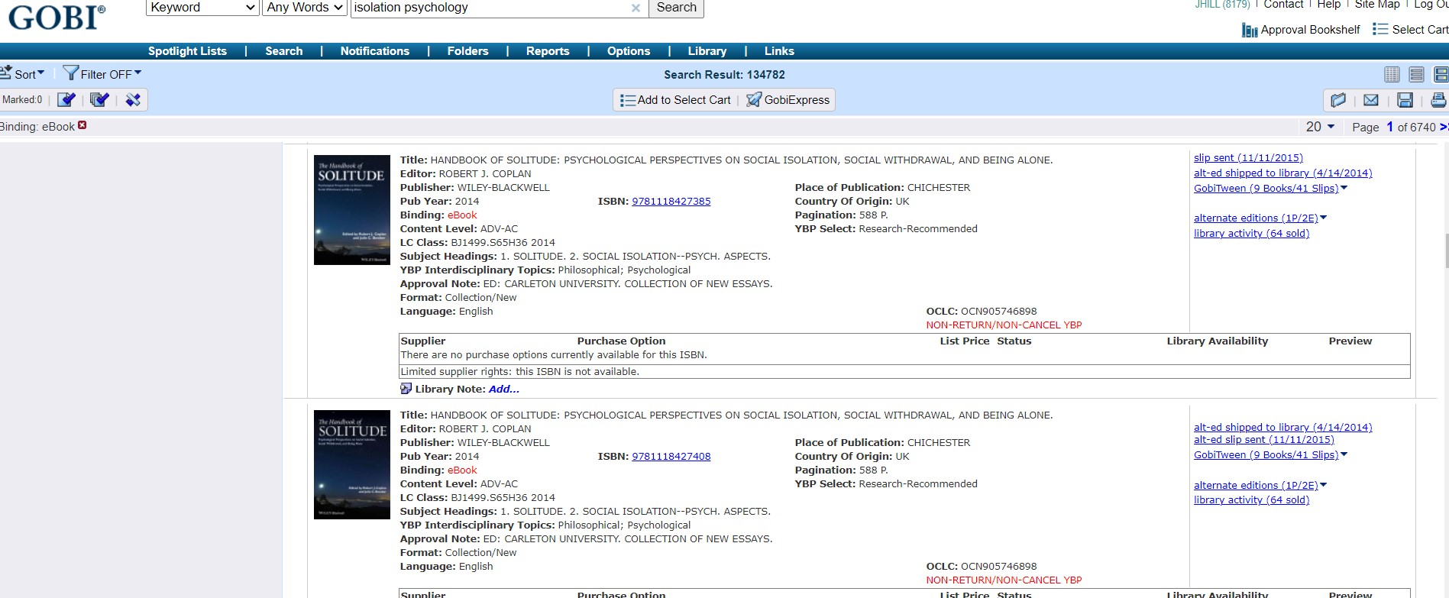
helping to keep our reference service(s) open, providing uninterrupted service, throughout COVID and lockdowns
being flexible, pivoting quickly - learning new tech, sometimes literally on the spot
being part of a stronger, more connected team
staying relatively sane 🙂
I think the list of challenges would be longer (and maybe some of the same points would be on that list too).
Anica
Expanding Services ... in a pandemic

Slide 33
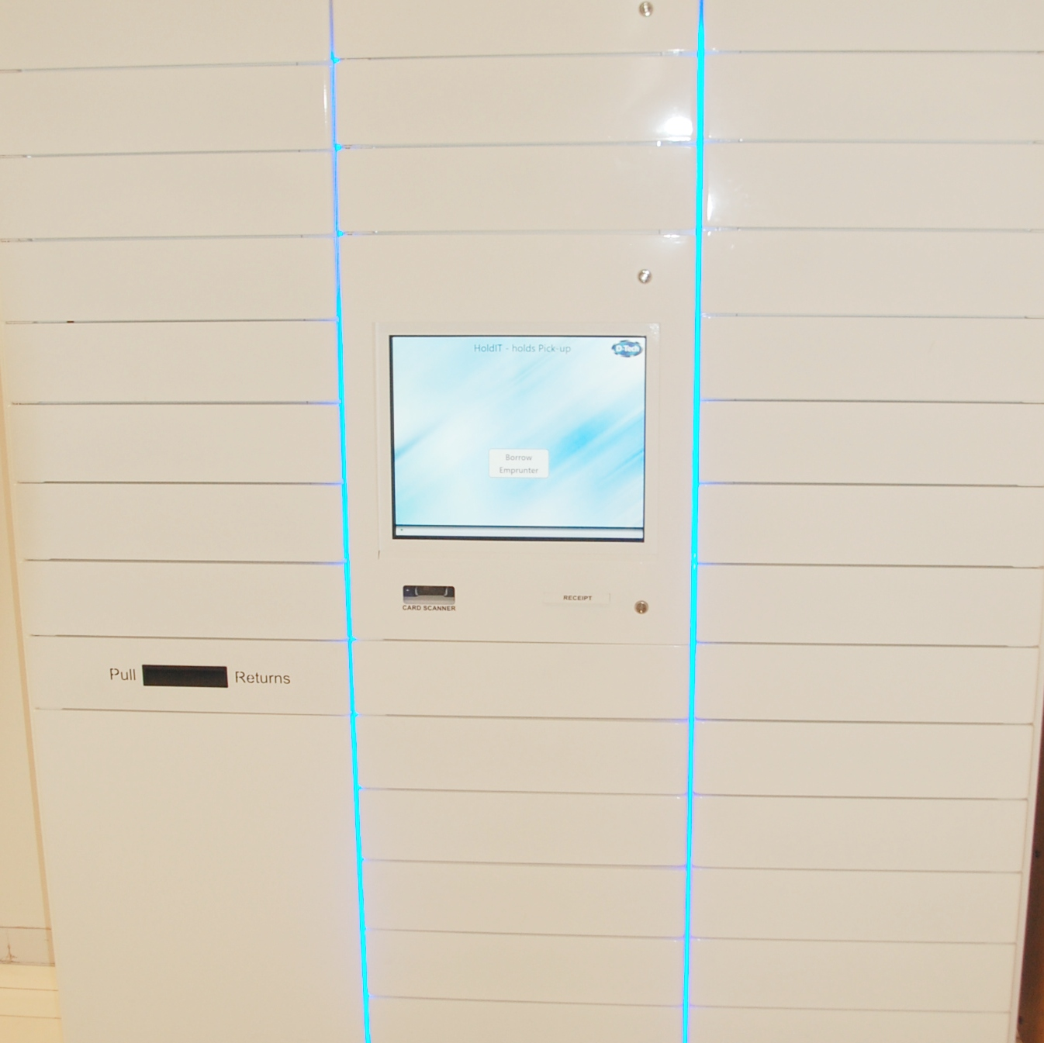
During the COVID year what has given me a sense of accomplishment was working with other coordinators in creating and putting procedures in place for Curbside Service. What started off as a service for faculty and graduate members, developed into a locker system which includes services for undergraduate, staff and RACER I.L.L.
Anna
Lockers ... At both campuses!

Slide 34
During this challenging time, it has been most gratifying for me to work with my colleagues in delivering a curbside pickup service that our library community greatly appreciates.
Susan :)
Curb-side pick up is where it’s at!

Slide 35
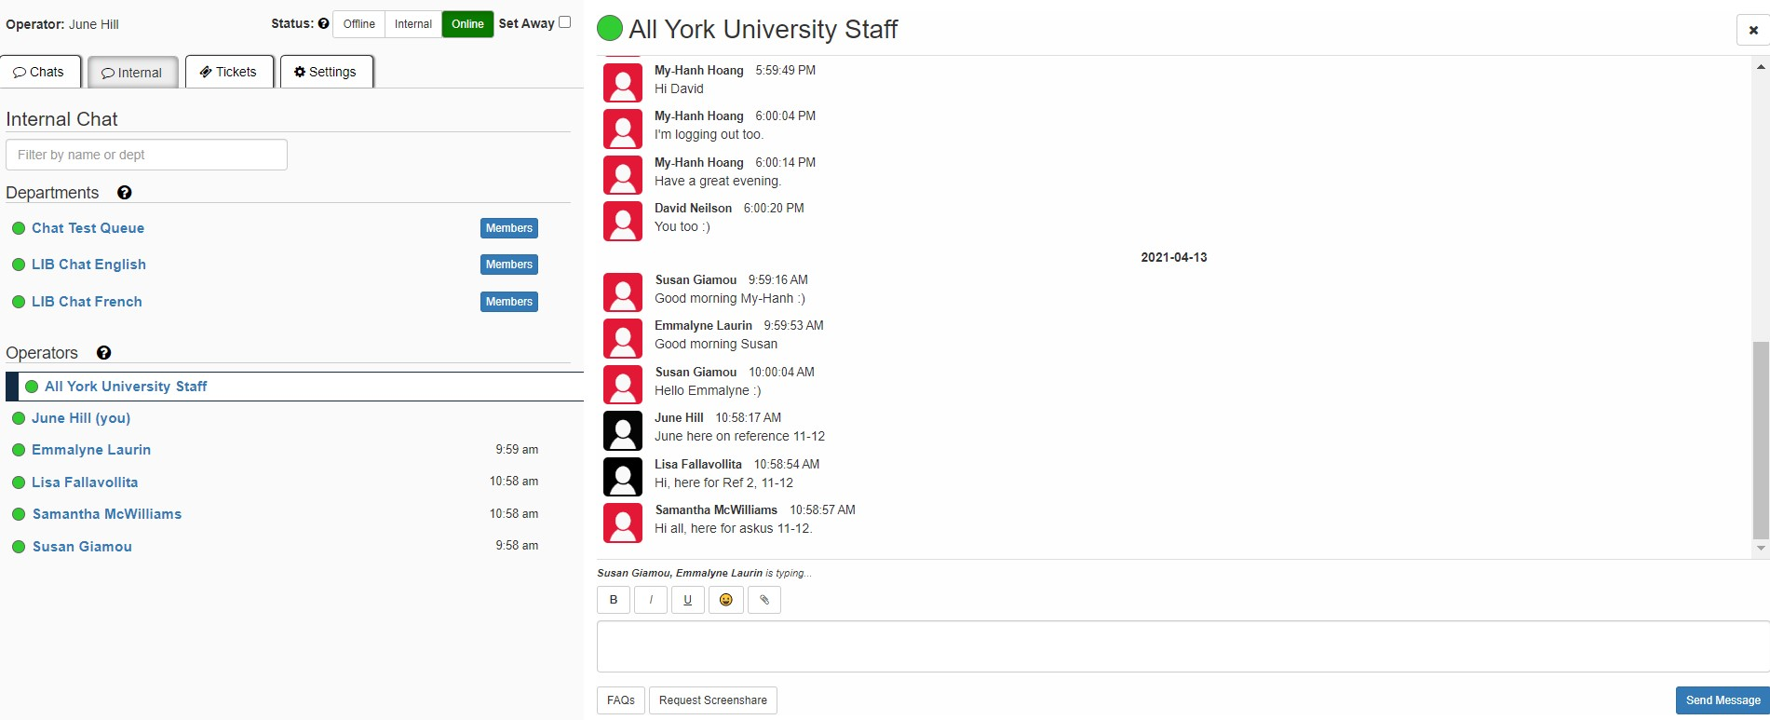
As for the technical proficiency, there was a quick learning curve to get up to speed with the technology of working from home. It was intense for a few months, but I now feel I am more proficient than ever before and can problem solve technical problems more on my own. I invested in my own computer and an iPhone, both of which have contributed to my work life run smoothly.
Thanks for doing this and I hope it turns out great!
Janice
Chat Service: We are ready to help ... from our living rooms.

Slide 36
It seems ironic that it took a pandemic for me to feel less isolated in my work in the library. Working from home gave me the space to get work done without interruption and the many meetings gave me an opportunity to get to know my colleagues better and feel more connected.
Janice
Enjoying the team!

Slide 37
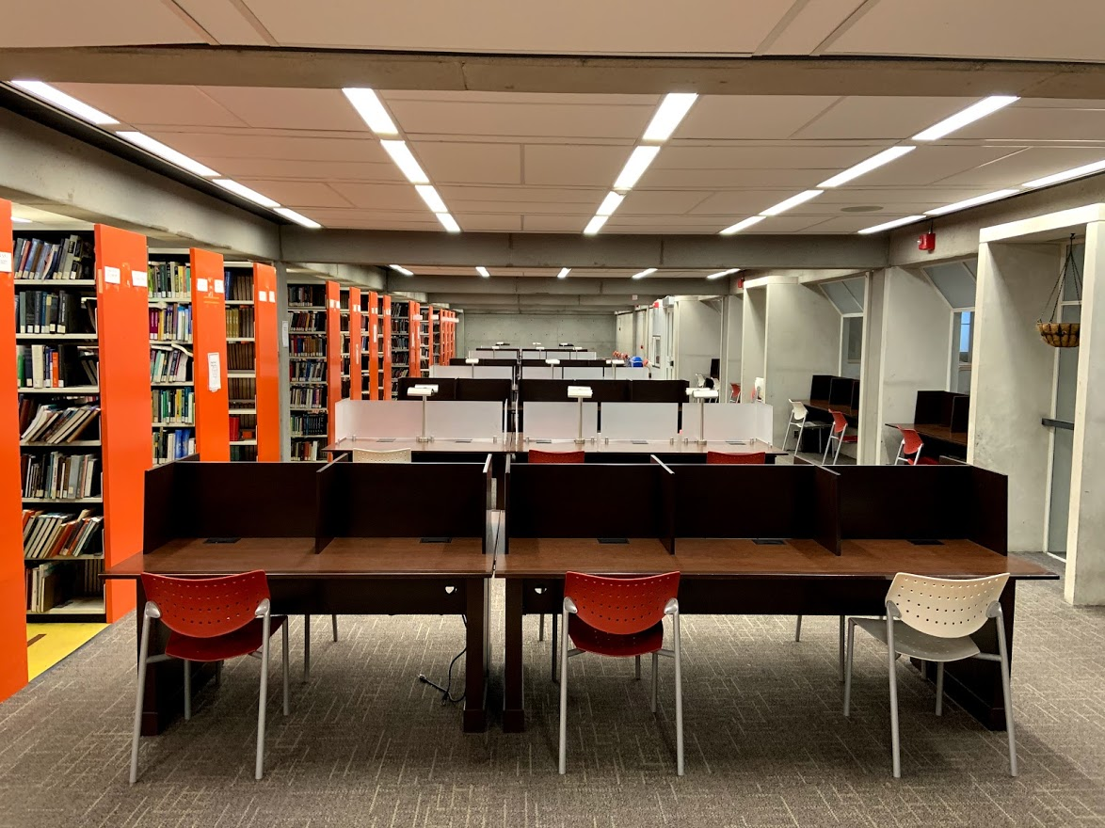
September 2021 ... We’ll be back, stronger than ever.

Slide 38
The Perfect Library
(an excerpt)
David Clink

Slide 39
Sound Credits
In order of appearance:
Kate Kwok. (2015, August 4.) I Vow to the Thee, My Country: Performance by Kate
Kwok. Original music by Gustav Holst and Sir Cecil Spring Rice. Retrieved by
https://www.youtube.com/watch?v=ac2IiRNEr14
SoundEffectsFactory. (2014, April 22.) World War 2 Air Raid Siren Alarm Sound Effect ~Free Sound Effects.
[Sound file]. Retrieved by https://www.youtube.com/watch?v=msX8iULEQgA
SFX. (2016, Jan. 14.) Cell Phone Ringing Sound Effects. [Sound file]. Retrieved by https://youtu.be/8vl19-
XSPk0.
Barradeen. (2019, December 19.) you’re thinking about that person again. Free download. [Sound file].
Retrieved by https://soundcloud.com/barradeen/youre-thinking-about-that-person-again.
Kate Kwok. (2015, August 4.) I Vow to the Thee, My Country: Performance by Kate
Kwok. Original music by Gustav Holst and Sir Cecil Spring Rice. Retrieved by
https://www.youtube.com/watch?v=ac2IiRNEr14

Slide 40
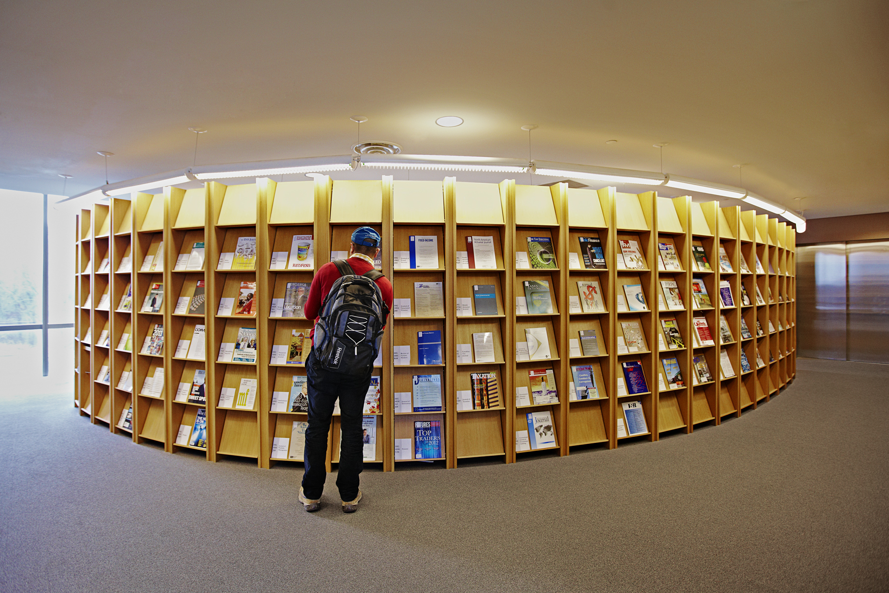
Credits
David Clink
Trevor Daniels
June Hill
Genny Jon
Kalina Grewal
David Neilson
Dat Quoc Ngo
Veronica Pinnock
Tanya Prince
Alexandra Stevenson

Slide 41
The End

