Slide 1
Academic Ableism and Open Access(ibility)
Jay Dolmage (dolmage@uwaterloo.ca) www.accessibilitysymposium.wordpress.com

Slide 2
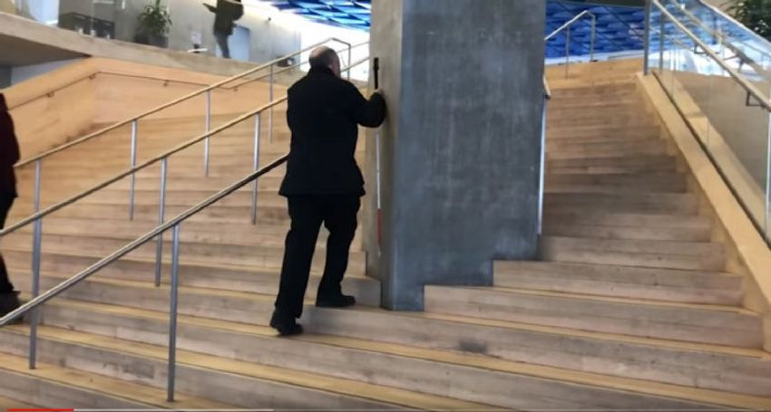
Steep Steps

Slide 3

Retrofit:
Stasis Preserves

Slide 4

Universal Design:
CMHR Exterior

Slide 5

Universal Design:
CMHR Interior

Slide 6
“Universal Design is not a design style, but an orientation to design, based on the following premises:
Disability is not a special condition of a few;
Disability is ordinary and affects most of us for some part of our lives;
If a design works well for people with disabilities, it works better for everyone;
Usability and aesthetics are mutually compatible.”
CMHR Website

Slide 7
Steep Steps

Slide 8
Retrofit:
Stasis Preserves

Slide 9
Universal Design:
CMHR Exterior

Slide 10
Universal Design For Learning:
Multiple means of representation, to give learners various ways of acquiring information and knowledge;
Multiple means of expression, to provide learners alternatives for demonstrating what they know;
Multiple means of engagement, to tap into learners' interests, offer appropriate challenges, and increase motivation.

Slide 11
Three Rules for Open Access(ibility):
A. Give bodies the same attention you give to algorithms
B. Equivalency does not equal equity
C. All texts are translations of translations wanting to be translated

Slide 12
Academic Ableism in Open Access version here: https://www.press.umich.edu/9708836/academic_ableism

