Slide 1
ENVIRONMENT PROJECTS
PROJETS ENVIRONNEMENTAUX
Prepared for: ACW meeting
Préparé pour: la réunion de ACW
By/Par: Sarah Allen
30 April/Avril 2022

Slide 2






Notes:
DeCoPo is an attempt to create a coherent presentation of a number of union initiatives and campaigns that have been pursued by CUPW since the mid 1980s.
These campaigns are:
Service expansion at Canada Post (community use of retail facilities, public access to the internet, and check-ins on elderly and vulnerable people)
Postal Banking with a mandate for social and financial inclusion.
Reducing the GHG emissions and footprint of Canada Post and promoting environmental measures such as public EV charging stations at postal facilities, retrofiting Canada post buildings, and Expanding the use of Canada post as the consolidated last mile delivery system to ease congestion and pollution in our cities caused, in part, by too many delivery trucks that aren’t full to capacity.
In all of these issues the union first conducts research, develops policies, identifies allies and pursues the issues through collective bargaining, public campaigns, political lobbying and through the work of the Union-Management Service Expansion and Innovation Committee (Appendix T of the urban collective agreement) – as well as through the Union-Management environment committee.

Slide 3

CALL TO ACTION!
DeliveringCommunityPower.ca
Send a message that you want to leverage Canada Post’s HUGE potential for action on climate change
Notes:
Take out your phones and check out the Delivering Community Power campaign

Slide 4
ENVIRONMENT COMMITTEE
COMITÉ DE L’ENVIRONNEMENT
June 2020, MacPherson Decision:
“Canada Post would like to work collaboratively with CUPW and representatives from other bargaining agents to determine the strategy going forward to determine the environmental path forward for Canada Post.
The parties believe this is an area where they can work together to develop a strong environmental strategy for the Corporation by reviewing all aspects, including fleet, buildings, products and services.”
*****
Décision de l’arbitre MacPherson rendue en juin 2020 :
« Postes Canada souhaite collaborer avec le STTP et les représentantes et représentants des autres unités de négociation pour établir la stratégie à adopter pour déterminer la voie à suivre pour l’environnement à Postes Canada.
Les parties croient qu’il s’agit d’un secteur où elles peuvent collaborer pour élaborer une solide stratégie environnementale pour l’entreprise en examinant tous les aspects incluant le parc de véhicules, les bâtiments et les produits et services. »
Notes:
-CUPW sits on a joint union-management environment committee of CUPW, APOC, UPCE and CPC – with information and updates sent to CPAA. The committee meets monthly and are focusing our efforts on implementing projects from the environmental action plan. These projects have different levels of involvement and participation from each party. We are in the process of establishing sub-committees for the various on-going projects and we feel this is a step in the right direction for environmental change at Canada Post as well as for our union-management relationship.

Slide 5


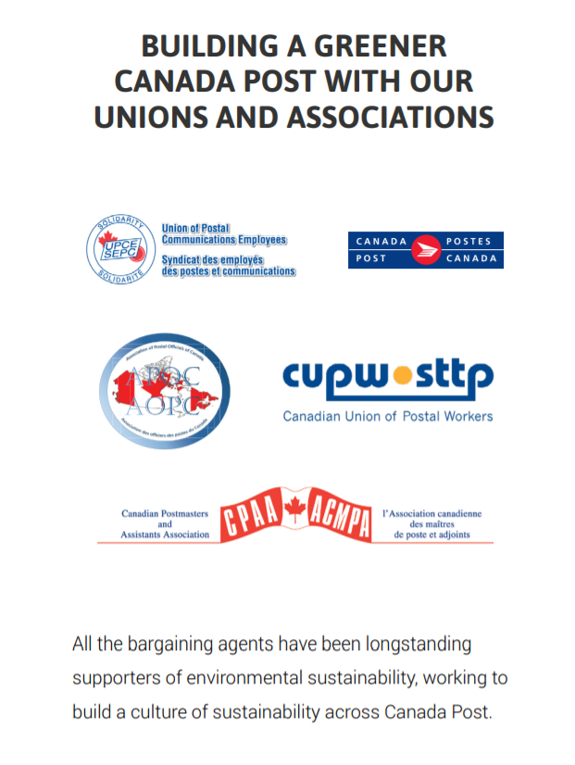

ENVIRONMENTAL ACTION PLAN
.
PLAN D’ACTION ENVIRONNEMENTAL
Notes:
-CUPW signed onto the EAP when it was released in April 2021
-The EAP is a list of targets broken down into CPC’s key pillars
Climate Action
Zero Waste
Sustainable Delivery
Worker Engagement
-CUPW chose to identify project priorities based on project type as most projects are interrelated. Obviously not all projects can be prioritized and worked on immediately.

Slide 6
1.1 Science Based Targets
17.1 General and Job Specific Environmental Training
Buildings and infrastructure
17.2 Sustainable Action Fund
18.2 Host Environmental Events
4.1 Energy Conservation
Tasks for Plants and Depots
EAP
Project
List
6.1 Waste Audit Improvement Plans
Environmental education and tools
9.1 Reusable Equipment Management
Strategies
Fleet and sustainable transportation
9.2 Refurbish Mechanical Parts for
Equipment
2.1 Zero emission delivery pilots
15.3 Plastics in the mail stream
2.2 Alternative Propulsion Vehicles
5.3 RSMC GHG Emissions
15.1 Sustainable Cities, Research
16.1 Sustainable Commuting
16.2 Pilot EV charging stations and events

Slide 7
1.1 Objectifs fondés sur la science
17.1 Formation en environnement générale et propre à l’emploi
Immeubles et infrastructures
17.2 Fonds d’action pour le développement durable
4.1 Tâches d’économies
d’énergie dans les établissements
et les postes de facteurs
18.2 Tenir des activités environnementales
Liste de projets du PAE
6.1 Solutions d’amélioration des audits sur les déchets
Formation et outils en matière
d’environnment
9.1 Stratégies de gestion de l’équipement réutilisable
Parc de véhicules et transport durable
9.2 Réparer les pièces méchaniques pour
le matériel de production
2.1 Nouveaux modèles de véhicules de
livraison zero émission
2.2 Véhicules à propulsion de remplacement
15.3 Présence de plastique dans le flot du courrier
5.3 Émissions de GES des véhicules des FFRS
15.1 Recherche et villes durables
16.1 Moyens de transport durable
16.2 Essai de bornes de recharge pour véhicules
électriques et activités

Slide 8
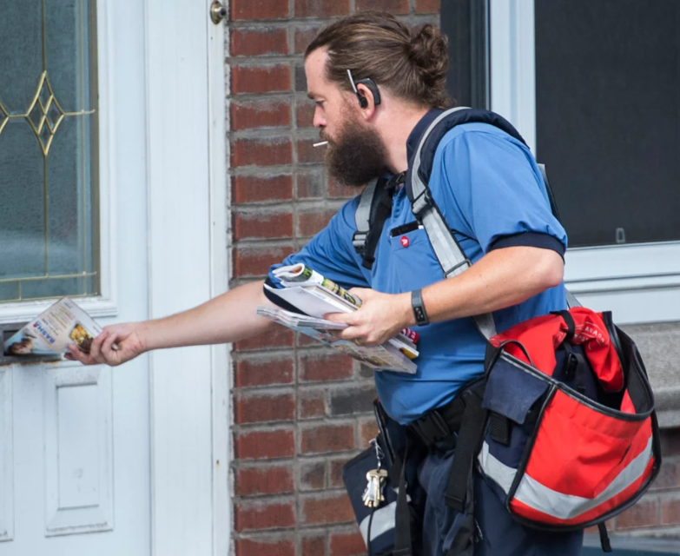
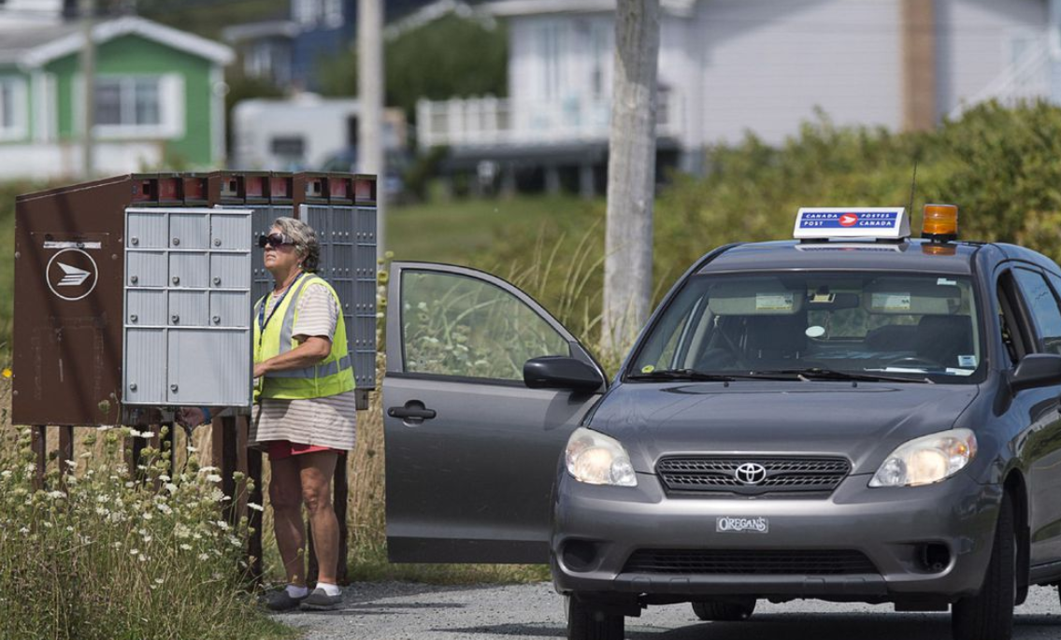
MODES OF DELIVERY RESEARCH PROJECT
.
PROJET DE RECHERCHE SUR LES MODES DE LIVRAISON
Objectives / Objectifs
  To compare impact of last-mile modes of delivery in urban, suburban, and rural areas of Montreal / Comparer l’incidence des modes de livraison du dernier kilomètre dans les régions urbaines, suburbaines et rurales de Montréal
  Examine customer’s mail pick-up behaviors / Examiner les habitudes des clients en matière de ramassage du courrier
  Special focus on RSMC vehicle emissions / S’attarder aux émissions des véhicules des FFRS
Notes:
-In the very early stages of co-creation with CPC
-Building on a study CPC conducted on impacts of last-mile delivery on the environment and traffic congestion in urban Montreal, Canada
-Aims are:
To compare the impact of last-mile modes of delivery in urban, suburban, and rural areas of Montreal
Examine customer’s mail pick-up behaviors
Special focus on RSMC vehicle emissions
-A sub-committee of the EC has been established for this project and we’re beginning work on project planning

Slide 9
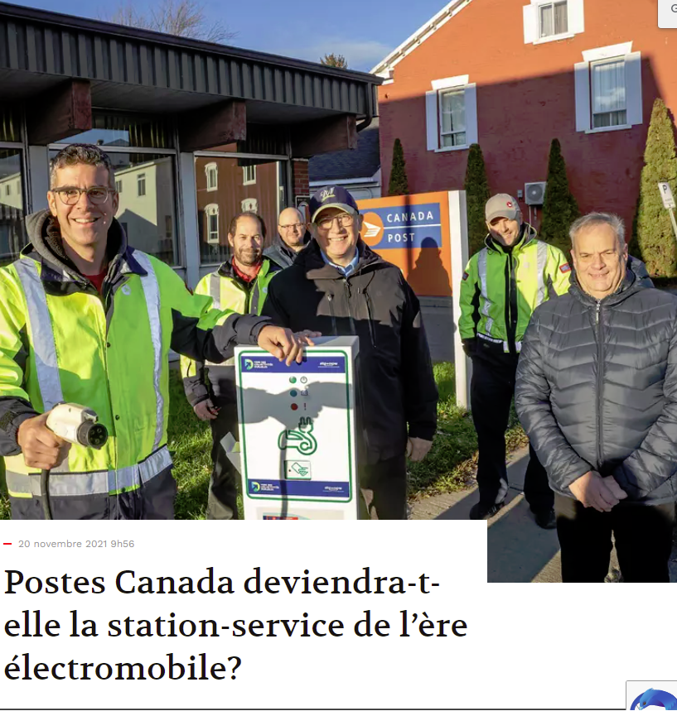
“A DAY IN THE LIFE” VIDEO PROJECT
PROJET VIDÉO « UNE JOURNÉE DANS LA VIE DE… »
A “day in the life” video of RSMC electric vehicle driver Bryan Arseneault in Quebec
Vidéo « Une journée dans la vie de… » Bryan Arseneault, FFRS de la région du Québec, qui conduit un véhicule électrique
Notes:
-An independent project by CUPW
-We hired an independent videographer for this project and we filmed at the end of march in Yamachiche, Quebec. – we hope to have the final products soon.
--We wanted the video to take place in the winter to dispel some of the myths about EVs in the winter months
-It focuses on the benefits of driving an EV and the letter carrier’s struggles with CPC around charging stations at Canada Post locations, we’re hoping this will promote installation at Canada post locations across the country.

Slide 10
SUSTAINABILITY ACTION FUND
FONDS D’ACTION POUR LE DÉVELOPPEMENT DURABLE
$500,000 fund for any CPC worker to submit project applications that work towards accomplishing the EAP’s key pillars
Fonds de 500 000 $ pour permettre aux travailleurs et travailleuses de Postes Canada de présenter des propositions de projets qui contribuent à l’atteinte des principaux objectifs du Plan d’action environnemental (PAE)
Notes:
There is a $50,000 maximum per project
We’re in the 2nd year of the SAF and the application period just started last week and runs for 6 weeks.
- This project is co-created between the bargaining agents and CPC where each bargaining agent has a voice on the SAF selection committee
All of the $500,000 allocated for 2021 was used for worker projects across Canada – the most popular projects were for community gardens, pollinator gardens, bike racks, and recycling and compost options at post offices.
We’re encouraging our members to apply for this round of projects and we’re excited to see what the projects will be this year.

Slide 11
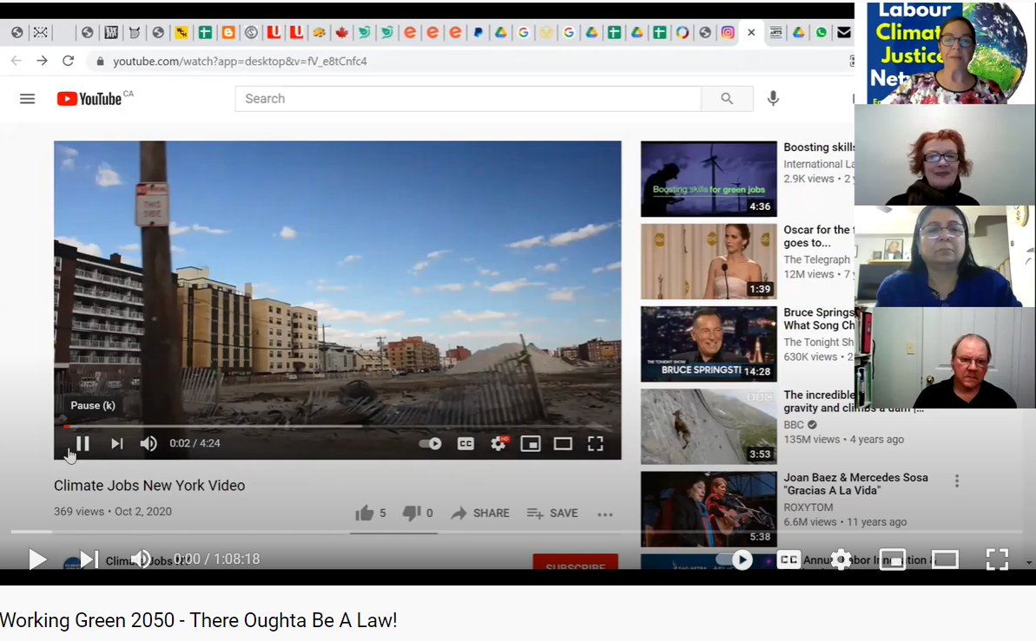

ECO-MESSENGERS
ÉCOMESSAGERS
Our vision is to pilot workplace environmental teams that incorporate environmental education and training
Notre vision : mettre à l’essai en milieu de travail des équipes d’intervention environnementale qui intègrent l’éducation et la formation en environnement.
https://www.youtube.com/watch?v=R979nhKtAgk
Notes:
-After the initial announcement by CPC of “Green Teams” in April 2021, this program was put on hold until CUPW was brought on board and we could come to an agreement of what these environmental teams would look like at the workplace.
-We have had conversations with the Labour Education Centre/Working Green 2050 about what workplace environmental teams can look like – they have done work on environmental curriculums for workplaces and we think this would be a good fit at Canada Post.
-Our vision is to pilot workplace environmental teams that incorporate environmental education and training
-A sub-committee has been established and work on starting conversations around program planning will begin soon

Slide 12

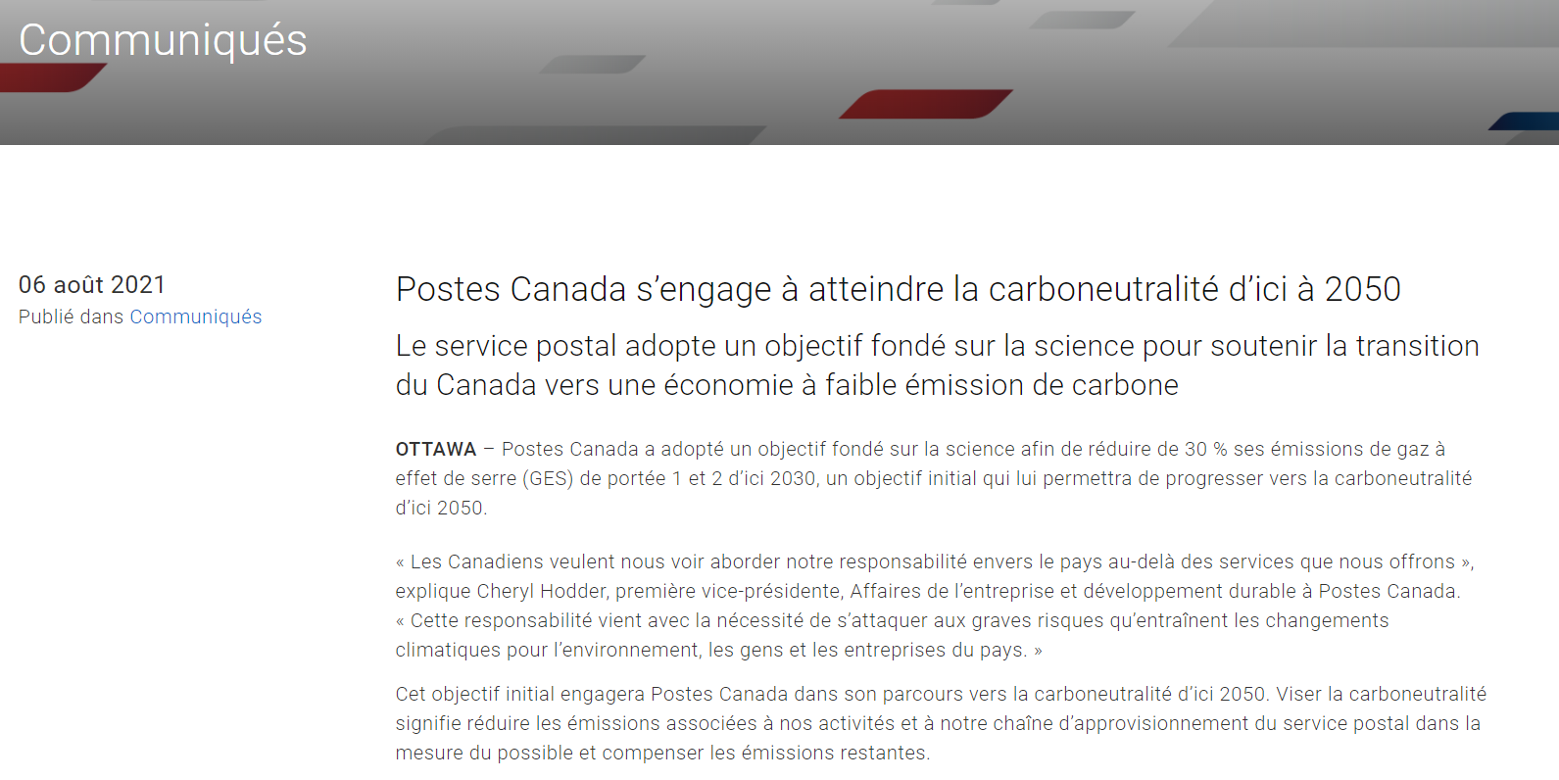
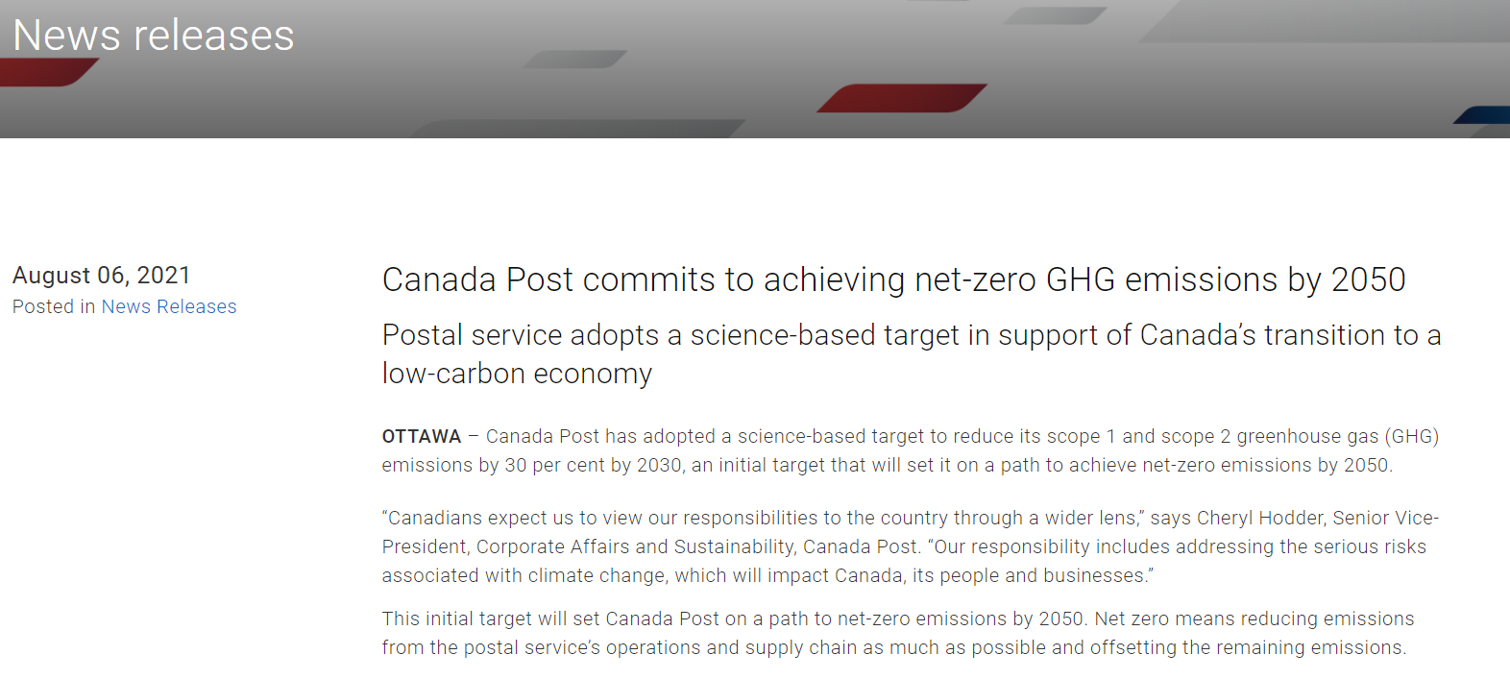
SCIENCE BASED TARGET INITIATIVE
OBJECTIF FONDÉ SUR LA SCIENCE
Notes:
-In May 2021, CPC announced that they set science-based targets for “well below 2 degrees” with 3 main components:
Scope 1 and 2 GHG reduction target of 30% by 2030
To source 100% renewable electricity for its facilities by 2030
Engagement target with top suppliers and subsidiaries: 67% of vendors by spend and 100% of subsidiaries to adopt a SBT by 2025
-CUPW released a statement that these targets were not doing enough, especially because SBTi announced that “WB2” targets were no longer sufficient.
-CPC is now re-evaluating their SBTs for “1.5 degree targets” for scope 1 and 2 emissions
-CUPW is pushing to have RSMC vehicle emissions included in scope 1 emissions so they are not neglected and ignored within scope 3
-This is a consultation process, but CUPW remains strong in our efforts to push for better targets

Slide 13
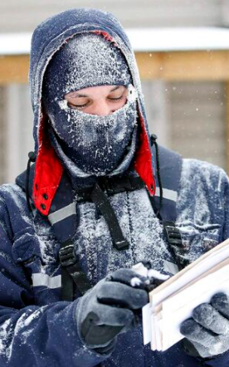
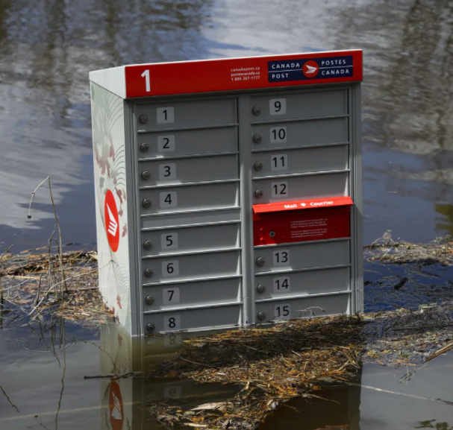
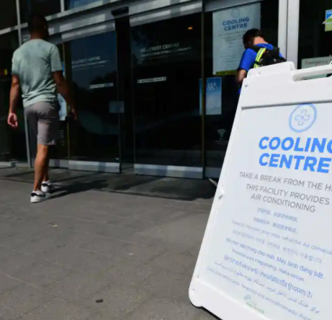
WORKER ADAPTATION AND MITIGATION RESEARCH PROJECT
PROJET DE RECHERCHE SUR DES MESURES D’ADAPTATION ET D’ATTÉNUATION
A new project looking at postal workers and extreme weather
Il s’agit d’un nouveau projet sur les travailleurs et travailleuses des postes et les conditions météorologiques extrêmes
Notes:
-A new project looking at postal workers and extreme weather
-CUPW has noted that CPC fails to account for adaptation and mitigation in its sustainability report and EAP despite the large quantity of workers who face the elements daily
-CUPW will conduct a study to examine worker’s existing adaptation and mitigation strategies when it comes to extreme weather events
-The project objectives:
-To introduce the concepts of adaptation and mitigation to Canada Post in order to protect postal workers
-Elicit changes to Canada Post policy and Canada Labour Code that currently don’t offer protections for outdoor workers and instead relies on employer discretion in the event of extreme weather. This is extremely important given the lack of definition in the Canada Labour Code for what ‘extreme weather’ even is.

Slide 14

MEASURING CUPW EMISSIONS
.
MESURE DES ÉMISSIONS DU STTP
Setting a baseline and working to reduce GHG emissions
Établir une base de référence et travailler à réduire les émissions de GES
Notes:
CUPW is the largest bargaining unit at Canada Post and we represent over 61,000 proud members who care about the future of, not only the Corporation, but also the future of our planet.
We will be setting the example for other labour unions by establishing our emissions baseline and determining ways in which our union can contribute to reducing GHG emissions.
CUPW plays a pivotal role to lead the charge against GHG emissions and has the potential to become a symbol of innovation.
The way we work has changed since the beginning of the pandemic and CUPW wants to understand the environmental impacts of working from home and what this could mean for the future of our work.
This is still in the planning stages, but we’re looking forward to starting this work.

