Slide 1
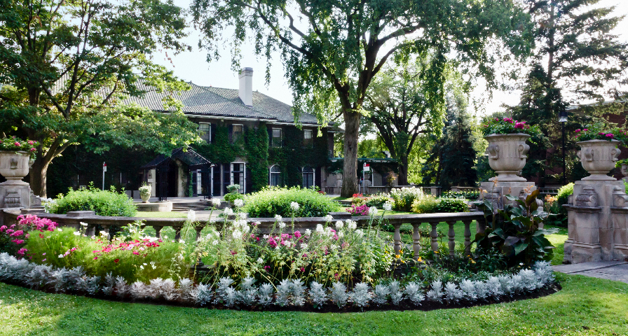
Escape Room: Crime and Trigonometry
Use trigonometry to steal the Mona Lisa!

Slide 2


INTRODUCTIONS
FACILITATOR
MODERATOR
PARTICIPANTS

Slide 3

RULES OF ENGAGEMENT
Do not take screenshots or screen recordings
Raise your hand and use Chat to ask questions
Be respectful of others
Listen attentively
Participate actively
Have fun!
Fast Fashion and Greenwashing

Slide 4
Time | Activities
5 min | Introduction & Group Check-In
10 min | Part I: Introduction of the Game
45 min | Part II: Escape Room
10 min | Part III: Discussion
5 min | Conclusion
75 mins | THANK YOU FOR PARTICIPATING!

Slide 5
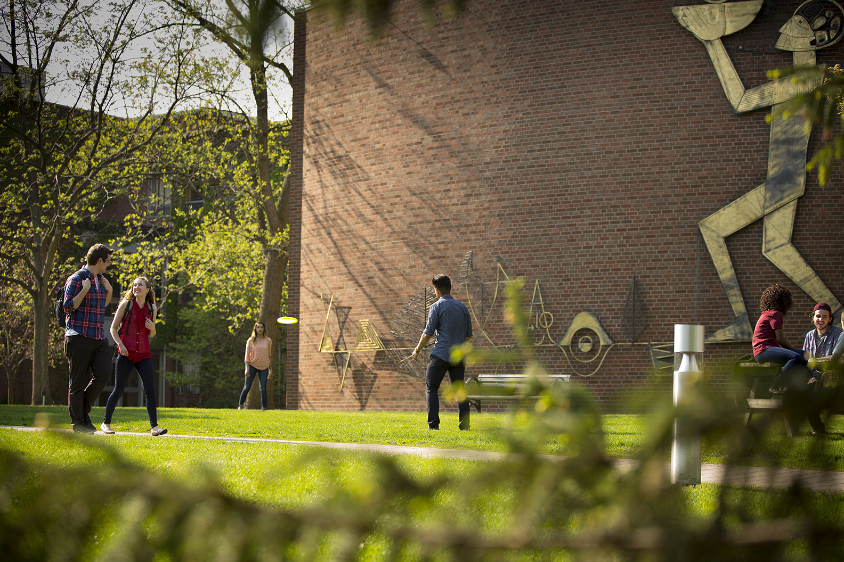
3 LEARNING OBJECTIVES
Develop problem solving skills
Review and solidify trigonometry concepts
Identify real-life applications of trigonometry

Slide 6





Triangles Are Everywhere!
Notes:
Facilitator can express to students that triangles can be found everywhere in our daily lives, such as the examples above. This means that trigonometry can be found and used in these every day circumstances as well.

Slide 7
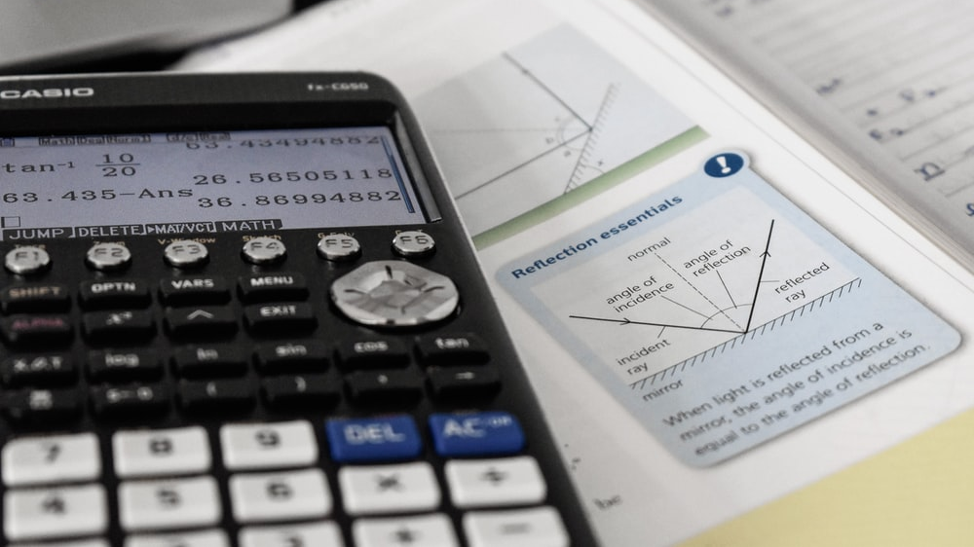
What are some potential careers that may involve trigonometry?

Slide 8

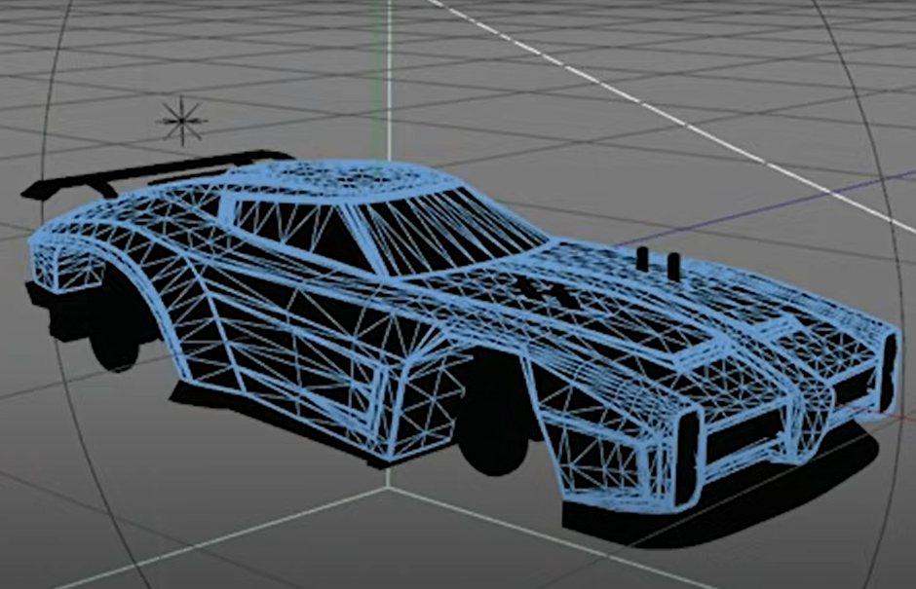
Real Life Applications of Trigonometry!
https://www.youtube.com/watch?v=Kd1y5Gobu8I&t=35s&ab_channel=MarkRodriguez
Notes:
Facilitator can give architecture and animation as two examples of careers that involve the uses of triangles and trigonometry.
The facilitator can then play the following video beginning at 35 seconds https://www.youtube.com/watch?v=Kd1y5Gobu8I&t=35s&ab_channel=MarkRodriguez

Slide 9

Introduction of the Game

Slide 10
Trigonometry Mini Lesson

Slide 11
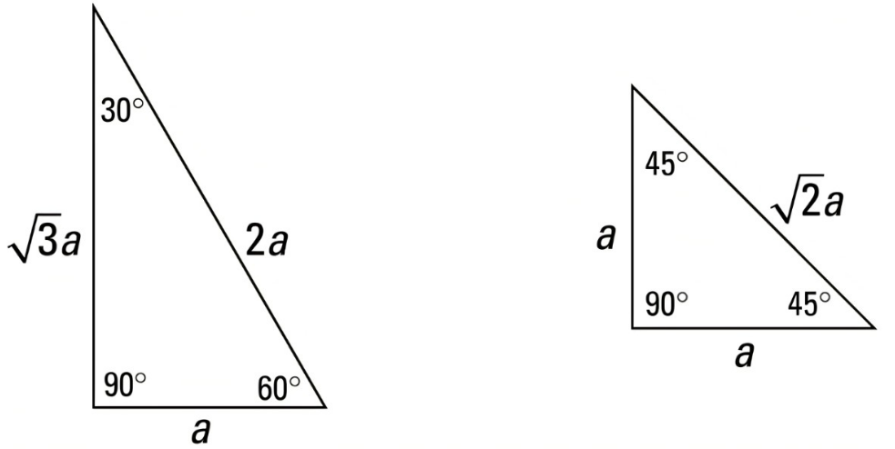
Special Triangles
Right triangles with special proportions
Make calculations easier
When to use:
When you have a triangle with identical angles and proportions to the following triangles
Notes:
Special triangles are certain right triangles that have special proportions for their sides that make calculations easier. They are commonly found in trigonometry and when recognized can be used to solve triangles instead of making additional calculations.

Slide 12
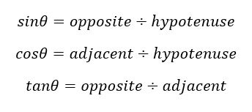
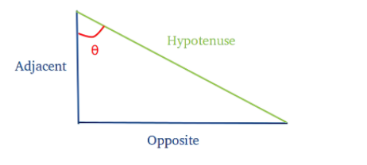
SOHCAHTOA
A mnemonic device used to remember the definitions of sine, cosine, and tangent
When to use:
When you have a right-angled triangle that is not a special triangle
For right-angled triangles only
Notes:
SOHCAHTOA is a mnemonic device used to remember the definitions of the trigonometric functions sine, cosine, and tangent. It is used for right triangles and it represents the following relations : SOH is sine equals opposite over hypotenuse, CAH is cosine equals adjacent over hypotenuse, and TOA is tan equals opposite over adjacent.

Slide 13
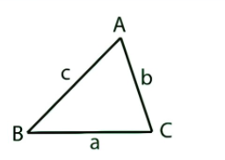

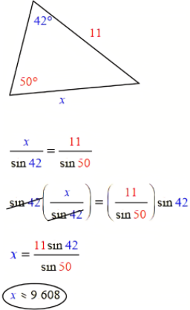
Sine Law
Formula that represents the ratio between the sine of the angles and the lengths of a triangle
Only for non-right triangles
Example: solve for x
When to use:
  When you have a non-right triangle and are given either:
two angles and one side opposite to one of those angles
two sides and an angle opposite one of those sides
Notes:
The sine law is a formula that represents the ratio between the sine of the angles and the lengths of a non-right triangle .It can be used to solve for the angles or lengths of non-right angles where a, b, and c represent the sides and A, B, and C represent the corresponding angles.

Slide 14
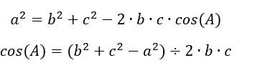
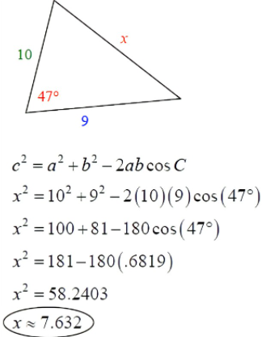
Cosine Law
Formula that represents the cosine of the angles and the lengths of a triangle
Only for non-right triangles
Example: solve for x
When to use:
  When you have a non-right triangle and are given either:
three sides
two sides and the angle between them
Notes:
The cosine law is a formula that correlates the cosine of the angles and the lengths of a non-right triangle. It can be used to solve for the angles or lengths of a non-right triangle where a, b, and c represent the sides and A, B, and C represent the corresponding angles.

Slide 15
Instructions

Slide 16

Instructions
task
Escape room rules
To successfully complete the escape room in the least amount of time.
You have 45 minutes to complete the escape room
You will work in groups of 3-5
If you get stuck on a problem, you have access to one hint that the facilitator will provide to you
In your participant package you have access to a formula sheet and additional resources to help you solve the problems in the escape room

Slide 17
Escape Room!

Slide 18




Escape Room: Crime and Trigonometry
Your goal: to solve the trigonometry problems in order to steal the Mona Lisa
Notes:
Facilitator can open the google forms and share their screen in order to read the instructions with the students.
Moderator can send the google forms link to the students: https://docs.google.com/forms/d/e/1FAIpQLSelRK0ezMGmUbGOqiHA7Kwlu9YZGxu0cTO2L_aUykjd6psxxw/viewform?usp=sf_link

Slide 19
Discussion/Review

Slide 20
Discussion Questions
What types of questions were we asked to solve throughout the escape room? What were some things that you liked or disliked about this way of practicing trigonometry?
What real-life applications of trigonometry did we see in this escape room?
What kind of jobs may need to use trigonometry?
Notes:
In the facilitator notes there are example answers in the cases that the students do not have an answer.

Slide 21
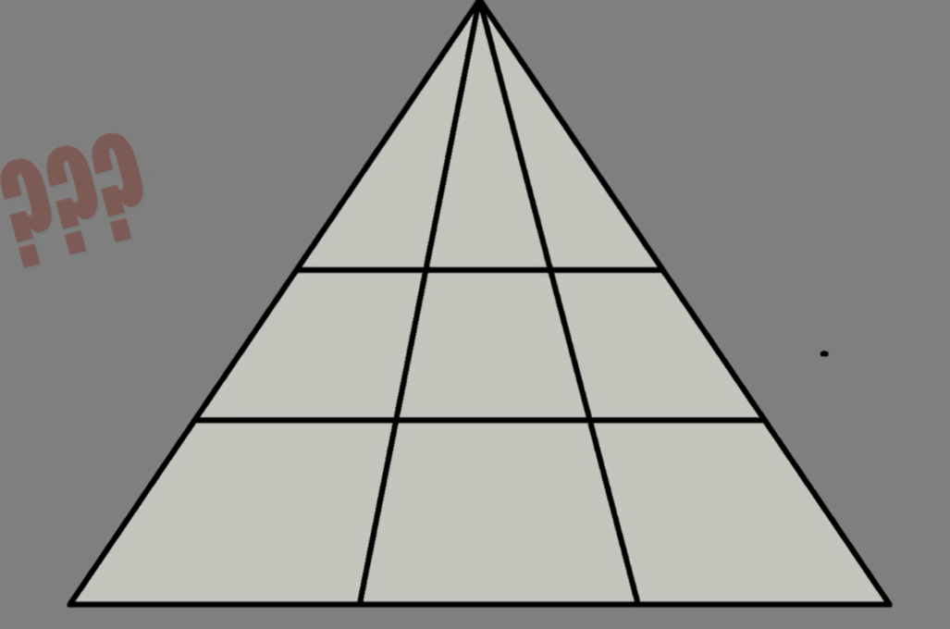
How many triangles are there?
How many different triangles can be made with this shape?
a) 12
b) 18
c) 8
d) 10
Notes:
Optional activity (if time permits)
Video (does not need to be played but can be): https://www.youtube.com/watch?v=SeE8FjuT84w
Answer: 18

Slide 22

Survey!
QUESTIONS ?
destination@glendon.yorku.ca
www.glendon.yorku.ca/destinationreussite
Notes:
Student survey (EN): https://forms.office.com/Pages/ResponsePage.aspx?id=GBNTNBFw1E-H8KQ4FsSb0EwfnQOE4vtJgtg6zg45P9ZURVlGTTNDWlZRUEZLMTU3T0pEWDFFWjUxQy4u
Teacher Survey (EN): https://forms.office.com/Pages/ResponsePage.aspx?id=GBNTNBFw1E-H8KQ4FsSb0EwfnQOE4vtJgtg6zg45P9ZUQUVZWVc0U0oyNDVZQTVBU1dWQUZORlQ5UC4u

Slide 23

THANK YOU!

