Slide 1
Debunking Psychology
Workshop Prepared by-
Mary Jo Daher
Isha Dua
Josée Rivest, Ph.D., C. Psych.

Slide 2
Learning Objectives
Address common misconceptions about psychology
Discover what it is like to study psychology
Discover the kinds of professions psychology students go into
Gain a better idea of whether studying psychology might interest you
2015
Notes:
Ask how many students have studied psych, to give you an idea of the level. If some among them have, you can ask them what are some of the concepts they’ve learned about

Slide 3
• Introduction
• Part 1
Myths and facts about psychology
• Part 2
Designing psychology experiments
• Part 4
• Part 3
Psychology in action
Jobs in psychology
• Conclusion
Agenda
2015

Slide 4
Myths and facts about psychology
PART 1

Slide 5


Myths and Facts About Psychology
Go to
www.menti.com
And enter the code on the screen
Notes:
Either share the participant link below in the chat and then share the mentimeter on your screen, or have participants go to menti.com and enter the code that appears on the first slide of the mentimeter (the code changes periodically, so it will be whatever code there is on the screen on that day). You can access the presenter view by following the link below.
- Participant link: https://www.menti.com/alf3j6evqvnq
- Presenter link: https://www.mentimeter.com/app/presentation/al3w5s76wt44kag1tyeeyhxerj7am9k8

Slide 6
MYTH
“Psychology is not a science”
2015
Notes:
There are a lot of misconceptions and confusion about the field psychology. One of the most common is that, unlike chemistry or biology, it is not a science.
(go to next slide for more on the topic)

Slide 7



Myth #1: where it comes from
I bet you the red liquid will make the blue liquid explode.
Science involves:
Making predictions (hypotheses),
collecting information that can be measured and verified by others (called empirical data),
then drawing conclusions by seeing if the data confirms or refutes our hypotheses.
BUT…
Psychology involves studying things we can’t always see, like thoughts and emotions. How do psychologists measure things they can’t see?
“Ah, as I predicted. My hypothesis was correct!
… now, can someone please call me an ambulance?”
“Seriously, I could really use some help here.”
We’ll find out in a moment!
Photo source: freepik.com
Notes:
The scientific method involves we formulate hypotheses (or predictions), and we collect data in order to confirm or reject our predictions and draw scientific conclusions.​
Unlike chemistry or biology, psychology involves studying things we can’t always see (e.g., thoughts and emotions)

Slide 8

What people think psychology research is like…
“Did our experiment make the participants happier?”
THEY ARE HEALED!
I see no more bad thoughts. Good job!
Why wouldn’t we consider this a scientific experiment?
“You’re right. We need to be scientific about this. Let’s ask Bertha what they’re thinking.”
“I think so. They’re smiling, right? But there’s only one way to be sure…”
SCIENCE!
Photo credit: wayhomestudio, freepik.com
Notes:
Click through the animations to demonstrate what people think psychology research looks like. Although the slide is a caricature, it illustrates the notion that some people have that psychology research lacks rigor. Because mental phenomena are not visible, some mistakenly believe it cannot be studied scientifically. However, psychologists, like other scientists, draw conclusions based on observation and data collected through scientific experiments. As we’ll see in the next section, one of the key tools to designing a sound experiment in psychology starts with defining what we’re studying in observable and measurable terms – what we call “operational definitions”.

Slide 9
Designing PSYCHOLOGY experiments
PART 2

Slide 10
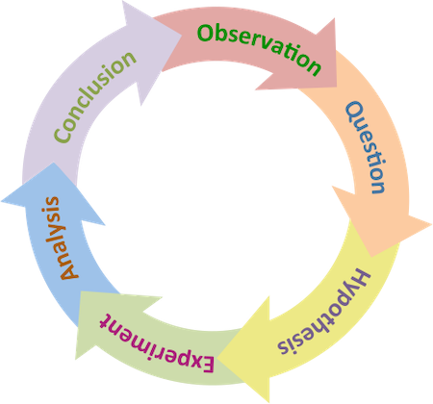
Designing Psychology Experiments
Like in other scientific disciplines, psychology uses the scientific method.
Science requires observation and measurement.
However, unlike the physical sciences, the research subject is often invisible.
Therefore, we must define our variables in a way that we can measure them.
We do that by creating “operational definitions”
THE SCIENTIFIC METHOD
Source: The Biology Primer, Wiki Commons
Notes:
“What distinguishes the sciences from other disciplines is the use of the scientific method.
It’s an approach that allows us to investigate the causes of things we observe in the world.
Unlike other disciplines, where conclusions are achieved through reason alone (e.g., math), science requires us to validate our conclusions by conducting experiments and observing the results.”
Explanation of the diagram: Observations of the natural world leads to questions. Scientific questions generate hypotheses, many of which may be tested through controlled experimentation. Experimentation and analysis allows hypotheses to be confirmed or rejected, which provide information (or conclusions). The process of scientific experimentation leads to more observations and questions.
Give an example of the scientific method for the physical sciences: snow melts in the spring.
One person says it's God,
another says the moon gets closer in spring,
you say it's the temperature that increases in the spring.
Question - is it the temperature - hypothesis (snow will become liquid when I increase the temperature to more than - degrees) - experiment - analysis - results – conclusion

Slide 11

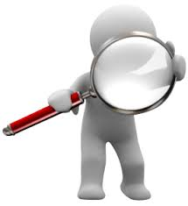
Operational Definitions
What are they?
A way to describe our variables that is:
Observable and
Measurable
Why do you think this would be important?
Source de l’image : unsplash.com
Notes:
Why important:
Necessary for designing experiments
Be able to draw conclusions based on data (vs. opinions or impressions)
Replication of the experiment - to ensure that other people can replicate our experiments and get the same results

Slide 12
Operational Definitions
Examples
VARIABLE
Intelligence
Stress
Depression
OPERATIONAL DEF
IQ score
Level of cortisol
Score on a depression scale
Image source: unsplash.com
Notes:
Ask students to provide an example of an operational definition for each. In other words, what is a tangible measure that can tell us about each of the variables on the left?
Examples of operational definitions:
If you wanted to define intelligence, you could define it as the score on a standardized test (ex. IQ)
If you wanted to observe the effect of stress on recall memory, you could define the level of stress as the amount of cortisol (stress hormone) ingested and recall memory as the number of words or sentences remembered from a text (as observed by Newcomer et al. (1999) in a study about stress and memory).
For depression, you could have participants complete a questionnaire which asks questions about the symptoms of depression they may be experiencing.

Slide 13
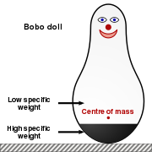
Operational Definitions
Bobo Doll Experiment (Bandura, 1961):
Question: does observing aggression in others make kids more aggressive?
Experiment:
  Kids observed (or not) their parents insult, punch and kick a doll
  Afterward, the parent leaves and the child is left alone with the doll
  The experimenters observe what the child does
Image source: Wikicommons
How do you think the researchers defined aggression so that it was observable and measurable?
Notes:
The image on the right represents the bobo doll used in the Bandura experiment.
After going through the slide, ask participants: How do you think the researchers defined aggression so that it was observable and measurable?
The level of aggression, in this experiment, was operationally defined as the number of times the child insulted, punched and kicked the bobo doll. By doing so, the experimenters took an abstract concept (aggression) and turned it into something observable and measurable.
Here is a clip from the original experiment you can show participants after showing them the question and before explaining the experiment: https://www.youtube.com/watch?v=hHHdovKHDNU&t=75s&ab_channel=thaLionheart

Slide 14
Psychology in action
PART 3

Slide 15

Example of study
INATTENTIONAL BLINDNESS
Simons (2010)
Notes:
Explain (without giving more details): we will watch an experiment about attention and perception. Although we all have some understanding of what we mean by the word “attention”, it remains a complex cognitive (mental) phenomenon and it is important to clearly define it in order to be able to study it. We will return to the question of how the authors defined attention after watching the video.
Link to video: https://www.youtube.com/watch?v=IGQmdoK_ZfY&ab_channel=DanielSimons

Slide 16

INATTENTIONAL BLINDNESS
Definition:
The failure to notice a stimulus/event when your attention is focused on something else
- Neisser, 1979
Notes:
Explain: The phenomenon we saw in the previous video is called “inattentional blindness” and refers to the failure to notice a stimulus/event when your attention is focused on something else (Neisser, 1979)

Slide 17
INATTENTIONAL BLINDNESS
Operational Definitions
The effect of focusing on a complex task on the
rate of inattentional blindness to an unexpected event
How did the researchers define the terms in red?
Counting the number of passes among white vs black t-shirt team while a gorilla walks through the play area
Numbers of individuals (%) who did not see the gorilla, or who did not notice the curtains

Slide 18
INATTENTIONAL BLINDNESS
Real-World Applications
What could be some real-world implications of the study?
In what situations, beyond psychology research, can the ability to formulate operational definitions be useful?
Notes:
What could be some real-world implications of the study?
Driving while talking on the phone or texting
Legal implications (e.g., witnessing a crime you didn’t notice)
This happened in 2011, when police officer Kenny Conley was accused of perjury, when he said he did not see a fellow police officer being assaulted, even though the assault was physically visible from his location. He was busy chasing a suspect and (like in the gorilla experiment) was focused on the chase. He was cleared because it was plausible that this was a case of inattentional blindness. (source)
In what situations, beyond psychology research, can the ability to formulate operational definitions be useful?
Creating questionnaires
Evaluating programs (e.g., defining how to measure a program’s positive impact)
Writing laws in ways that describe measurable and observable behaviours
In education – explaining abstract concepts in clear and tangible ways

Slide 19
JOBS IN PSYCHOLOGY
PART 4

Slide 20
MYTH
“An undergraduate degree is only for people who want to become psychologists or psychotherapists.”
2015

Slide 21
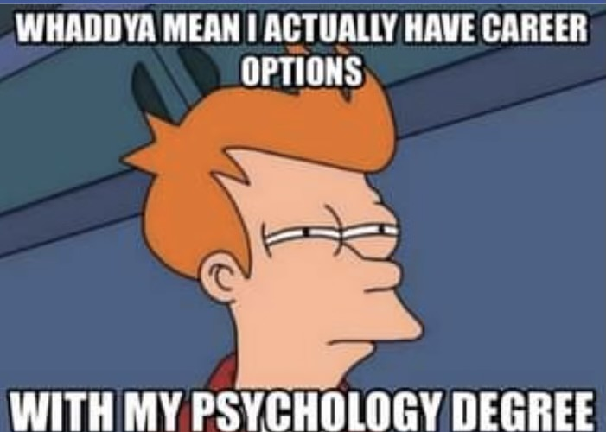
2015

Slide 22

WHAT CAN YOU DO WITH A DEGREE IN PSYCHOLOGY?
Psychology = a range of opportunities
2 main options:
Job market
Graduate studies
Image source: Unsplash
Notes:
A bachelors in psych is not a vocational program, meaning it does not lead to a specific career. However, the skills and knowledge you gain prepare you to perform numerous careers and graduate programs

Slide 23
OPTION 1: JOB MARKET
Skills from a psychology degree:
Understanding behaviour and its physiological, emotional, cognitive and social bases
Research skills, (data collection, analysis, literature reviews, etc.)
Understanding motivation
Academic writing
Presentation skills
Critical thinking
Communication and social skills
Knowledge of mental illnesses
What kinds of jobs do you think the skills you acquire in psychology prepare you for?
Researcher Labour relations Immigration officer Advertising HR Administration Career counsellor | Cultural diversity consultant Supervisor Manager Public opinion researcher Program evaluator Youth worker
Source: Carleton University
Source: Canadian Psychological Association
Notes:
The skills and knowledge gained during a psych degree prepare you for many fields of work and study

Slide 24

OPTION 2: GRADUATE STUDIES
Some of the most common graduate programs after a bachelor in psychology:
Research or Clinical Psychology – Master and Doctorate
Counselling Psychology – Master
Social Work – Bachelor or Master
Occupational Therapy – Master
Education – Bachelor or Master
Law School – Bachelor or JD (Juris Doctor)
Behaviour Therapy – Graduate Certificate
Human Resources – Certificate (earning CHRP)
Source: University of Toronto Scarborough
Notes:
Read through the list of graduate programs psychology students commonly go into after their undergraduate degree. You can mention that, as we can see from the list, there are quite a few more options than becoming a clinical psychologist.
Link for source: https://www.utsc.utoronto.ca/aacc/career-options-after-psychology-and-mental-health-studies#:~:text=Popular%20further%20education%20opportunities%20include,%E2%80%93%20Master%20of%20Arts%20(Psychotherapy)

Slide 25
Clinical services
Psychologist, Ph.D.
No College registration
—cannot “treat patients”
Doctorate (Ph.D.)
Psychologist, Ph.D. C. Psych.
College of Psychologists of Ontario
Doctorate (Ph.D., Psy.D.)
Registered Psychotherapist
Psychiatrist
Master degree or demonstrated competency
4 years BA or BSc +
2 years MA (or equivalent)
NO right to diagnose
NO right to prescribe medication
College of Registered Psychotherapists of Ontario
College of Physicians and Surgeons of Ontario
MD —Doctor in Medecine
4 years BSc (pre-med) +
3-4 years of medical school
5 years residency program
4 years BA or BSc +
5-7 years (MA + Ph.D.)
4 years (pre-doctoral practicum, residency) + 1-year post-doctoral supervised practice
Right to diagnose
NO right to prescribed medication
4 years BA or BSc
+
5-7 years
(MA + Ph.D.)
Minimum 8 months of training in empirically supported psychotherapy
Right to prescribe medication
Right to diagnose
EDUCATION & TRAINING
Source: Most information is from the Ontario’s Mental Health Workforce Training requirements.
Notes:
This slide summarizes the main differences between clinical and research psychologists, as well as psychotherapists and psychiatrists.

Slide 26
Conclusion
Conclusion
SUMMARY
Though psychology touches many aspects of our lives and society, there remain many misconceptions about the field study and its related professions.
Psychology is a scientific discipline and, as in chemistry or biology, psychologists acquire knowledge about the world by applying the scientific method.
Operational definitions allow psychological researchers to study abstract concepts in an experimental manner.
Psychology students go on to work in a wide range of professions and environments
While fun and interesting, the results of psychology experiments also have profound implications for multiple areas in society

Slide 27
Thank you!

