Slide 1

Pitch 1 - UN SDG 12 Responsible Consumption
Content Analysis
© Anne MacLennan, 2024​

Slide 2

The requirements for this UN SDG data assignment is to complete 5 cross tabulations and/or content analysis from the original data sheets uploaded here. There are examples of both content analysis and cross tabulation for each pitch to show you want to do. Please make sure to do a combination, so that your assignment includes 5 but at least one is a cross tabulation and one is a content analysis. Please submit in the place created for UN SDG data assignment on Submit Assignment Here. The PowerPoints are the examples of what to do. Each has a data narrowed down from the original data sheets that follows. Then the original data sheets that you will used for the assignment will be at the end in this UN SDG data assignments Box. What you submit is 5 different spreadsheets as indicated above.
© Anne MacLennan, 2024​​

Slide 3
UN SDG 12
"Goal 12 is about ensuring sustainable consumption and production patterns, which is key to sustain the livelihoods of current and future generations. Our planet is running out of resources, but populations are continuing to grow. If the global population reaches 9.8 billion by 2050, the equivalent of almost three planets will be required to provide the natural resources needed to sustain current lifestyles. We need to change our consumption habits and shifting our energy supplies to more sustainable ones are one of the main changes we must make if we are going to reduce our consumption levels. However, global crises triggered a resurgence in fossil fuel subsidies, nearly doubling from 2020 to 2021. We are seeing promising changes in industries, including the trend towards sustainability reporting being on the rise, almost tripling the amount of published sustainability over just a few years, showing increased levels of commitment and awareness that sustainability should be at the core of business practices. Food waste is another sign of over consumption, and tackling food loss is urgent and requires dedicated policies, informed by data, as well as investments in technologies, infrastructure, education and monitoring. A staggering 931 million tons of food is wasted a year, despite a huge number of the global population going hungry" (DESA, 2024).
Department of Economic and Social Affairs (2024). The sustainable development goals report 2024. United Nations.
© Anne MacLennan, 2024​​​

Slide 4
What is Content Analysis?
Content analysis is a way of generating qualitative data from qualitative data.
It always generates numbers
  Raw qualitative data
  Percentages
Easiest quantitative data
© Anne MacLennan, 2024​​​

Slide 5
What does Content Analysis do?
Make comparisons
Shows or detects trends
© Anne MacLennan, 2024​​​

Slide 6
Categories
The categorization of the data is crucial
The categories must be exhaustive and mutual exclusive
© Anne MacLennan, 2024​​​

Slide 7
Mutually exclusive
1. Means that all the categories have to be separate and clear
  example: 1-10 and 11-20 NOT 1-10 and 10-20 because 10 is in both
2. The data is qualitative mostly to start so to make the
  lines between the categories you need a code book
© Anne MacLennan, 2024​​​

Slide 8
Exhaustive
The categories need to include everything
© Anne MacLennan, 2024​​​

Slide 9
Data Comparisons
Content analysis can reveal a comparison that you expected and confirm your idea
Content analysis can reveal a comparison that is unexpected and force you to think about new data
© Anne MacLennan, 2024​​​

Slide 10
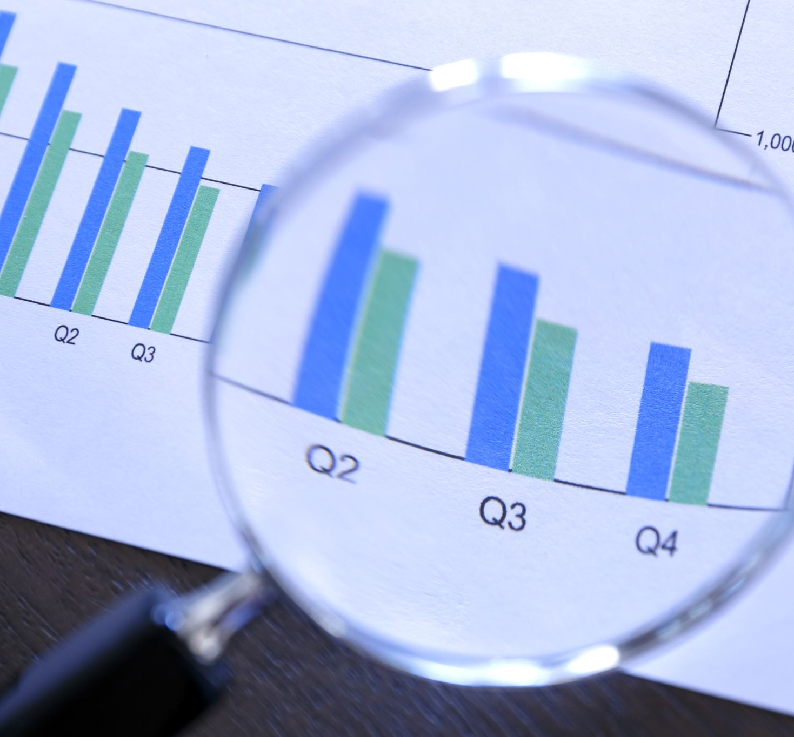
Step 1: Gather a Sample of articles
Gather a list of articles related to your topic
Example: 10 examples of articles related to UN SDG 12: Responsible Consumption
© Anne MacLennan, 2024​​​

Slide 11
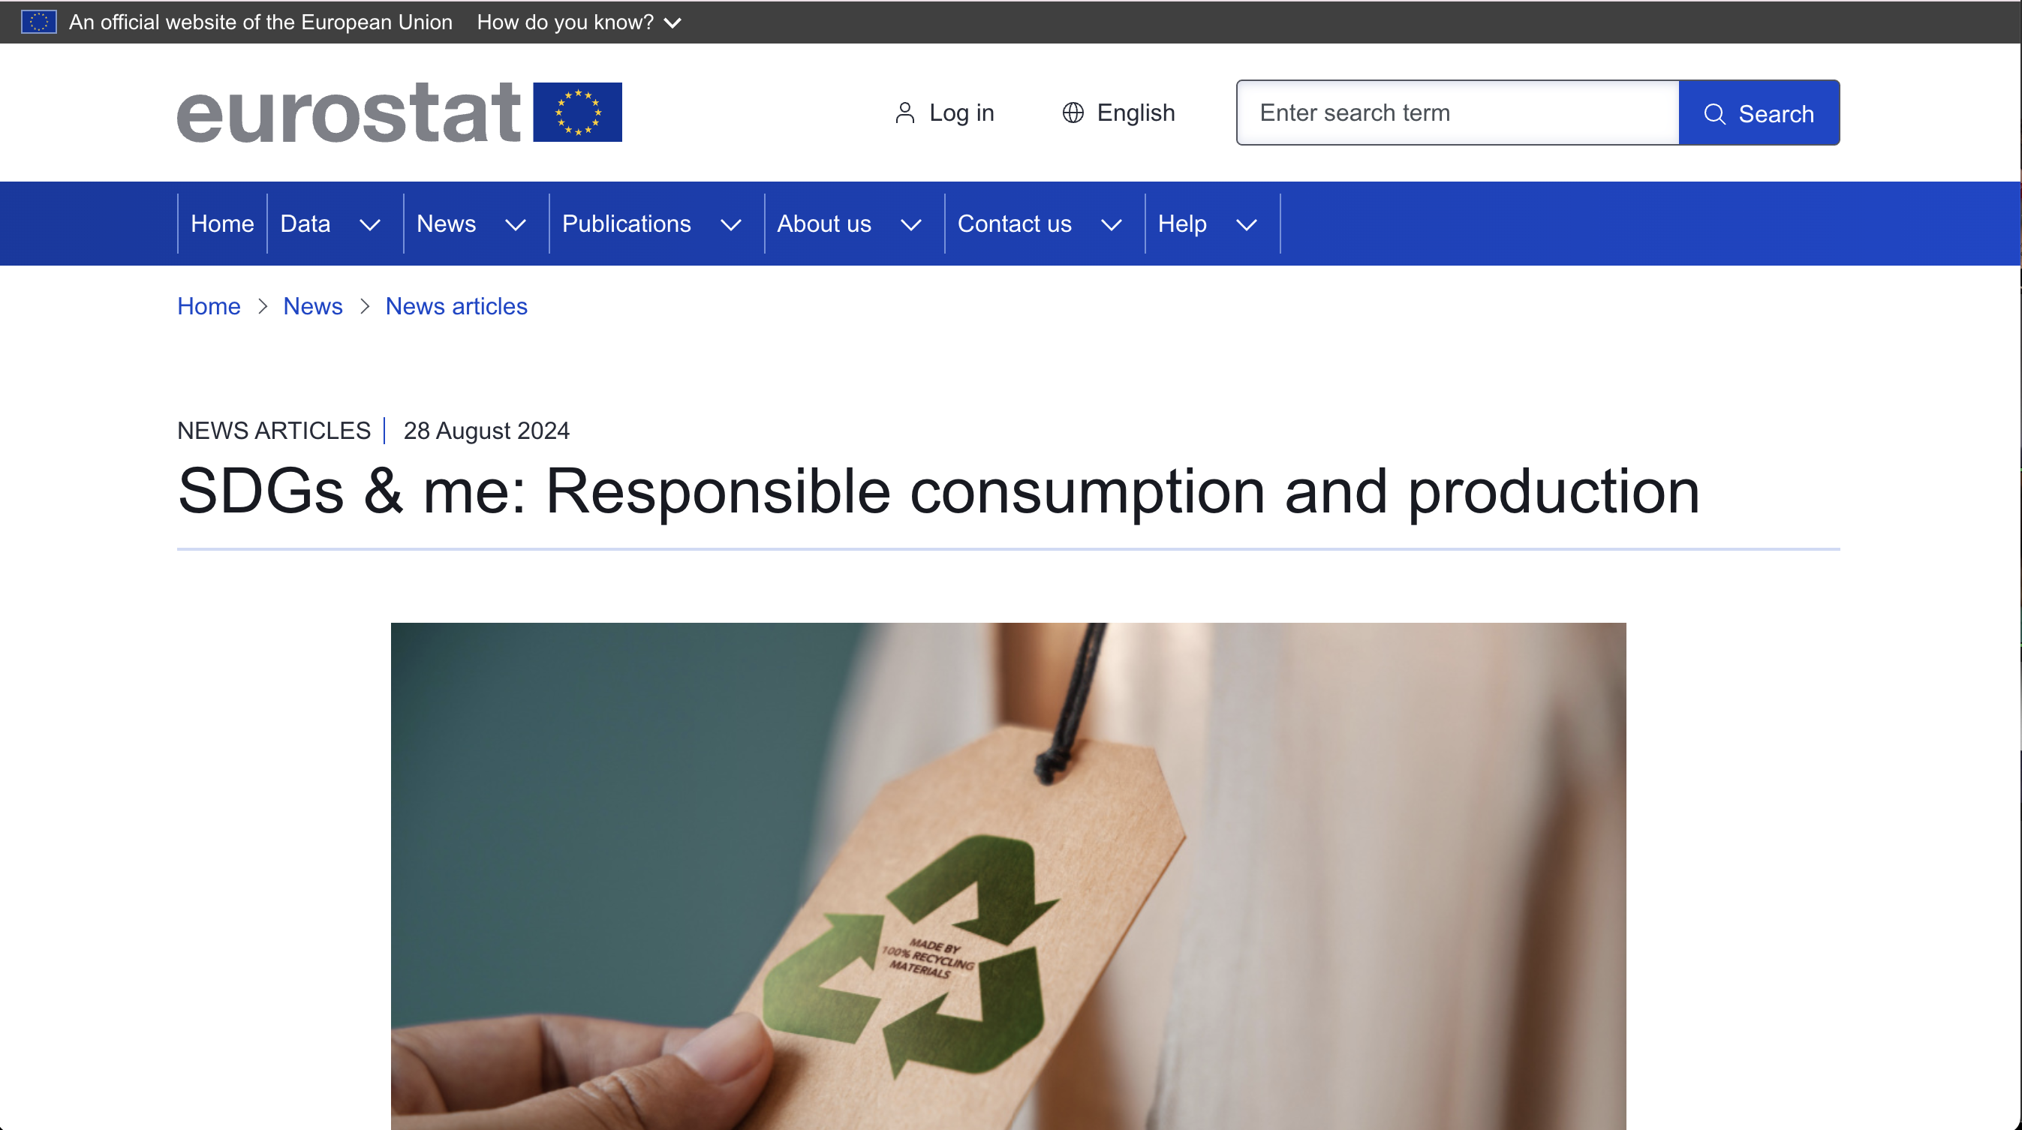
Step 2: Pick out your articles
Gather a list of articles related to your topic
Example: 10 examples of articles related to UN SDG 12: Responsible Consumption
Eurostat. (2024, August 28). SDGs & me: Responsible consumption and production. Eurostat. https://ec.europa.eu/eurostat/web/products-eurostat-news/w/ddn-20240828-1

Slide 12
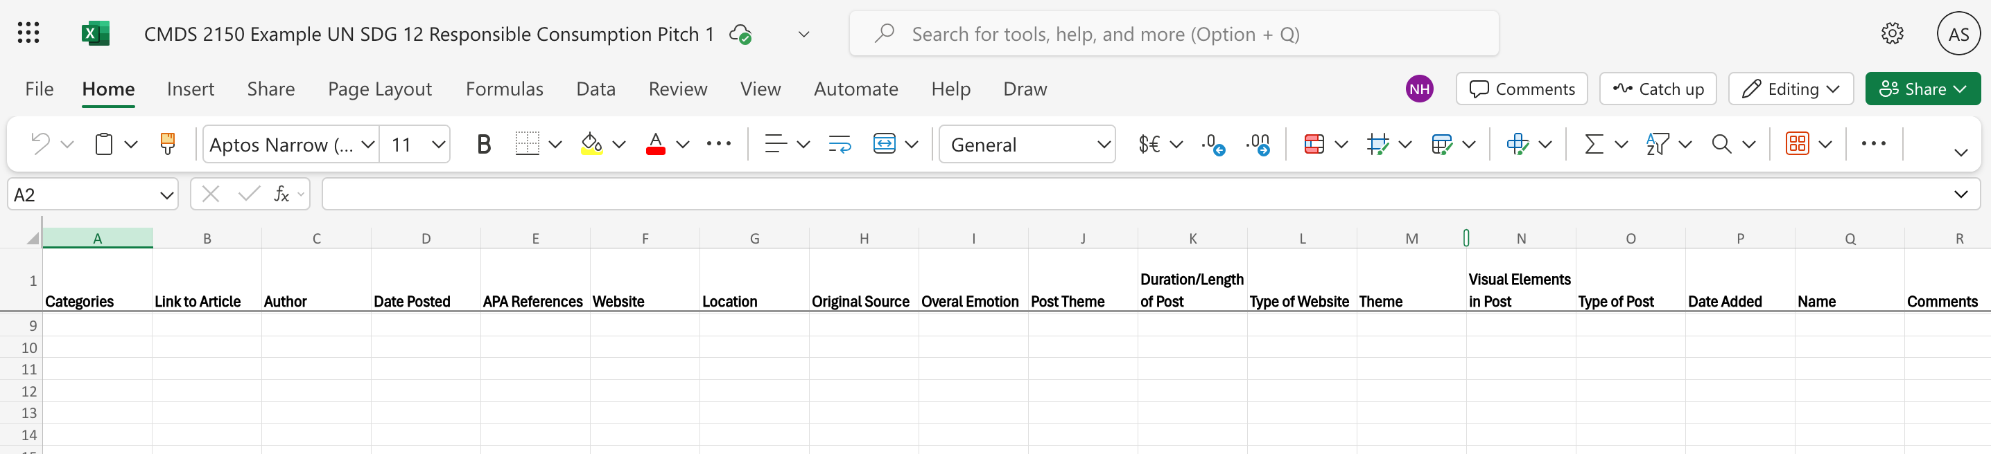
Step 2: Setting up a spreadsheet
Create new file
Add headers to organize data
Setting up the spreadsheet these are excel tips
Organizing the data in categories is part of your content analysis – you would design the categories
© Anne MacLennan, 2024​​​

Slide 13
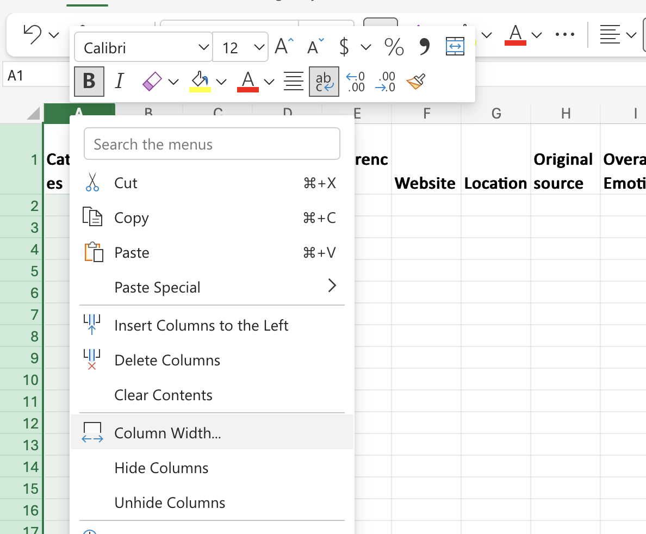
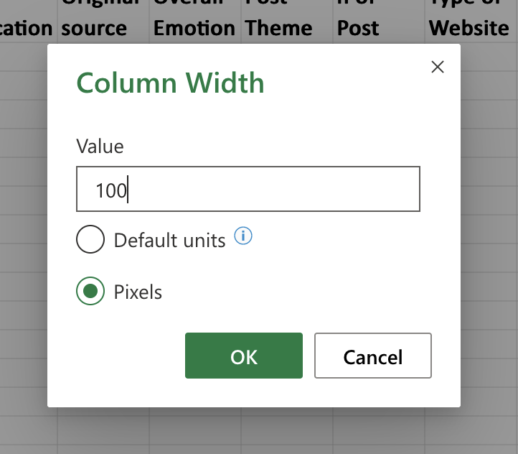
Step 3: Fix column widths
Example: right click on column "A", then click "column width" to adjust
If you want all your widths to be the same, you can do this
This is an Excel tip only
© Anne MacLennan, 2024​​​

Slide 14
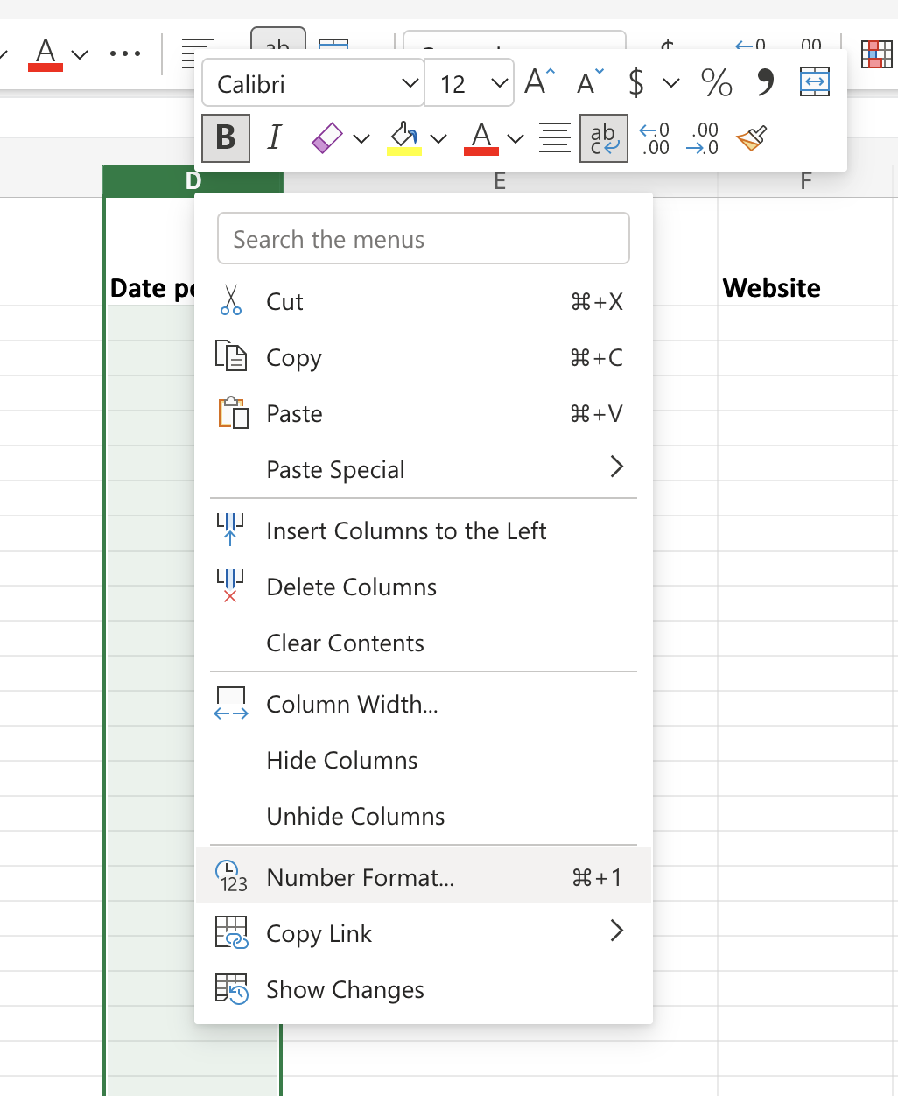
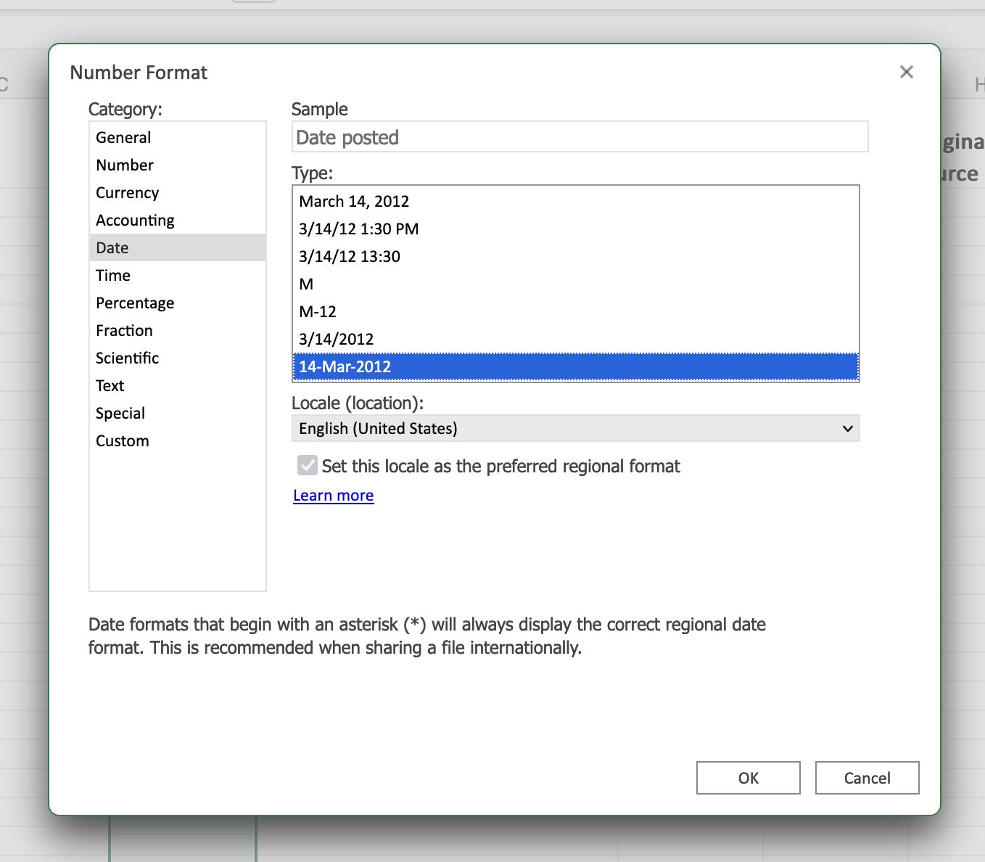
Step 4: Optional - Add a date format
Right click on column, then click "number format" to pick a format
This is an Excel tip only
© Anne MacLennan, 2024​​​

Slide 15
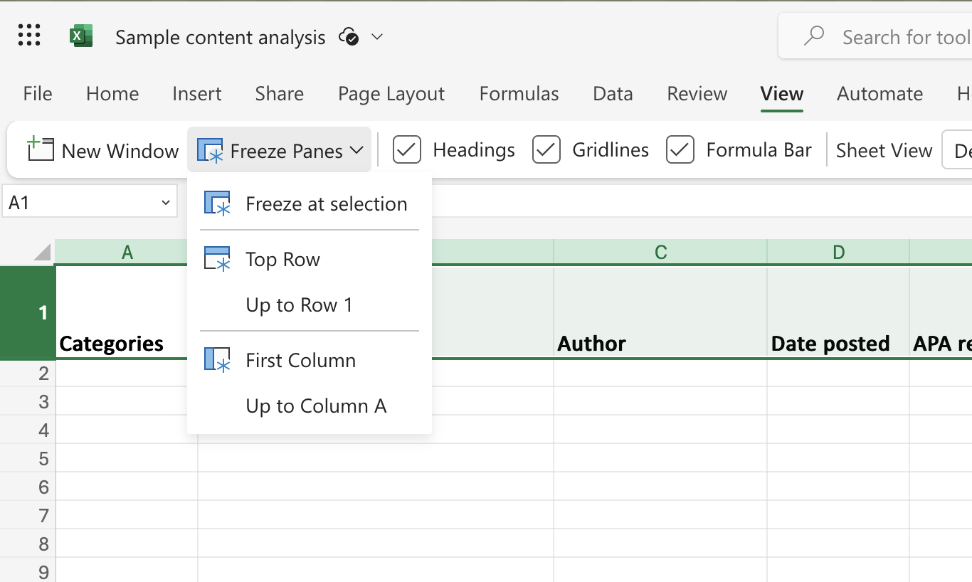
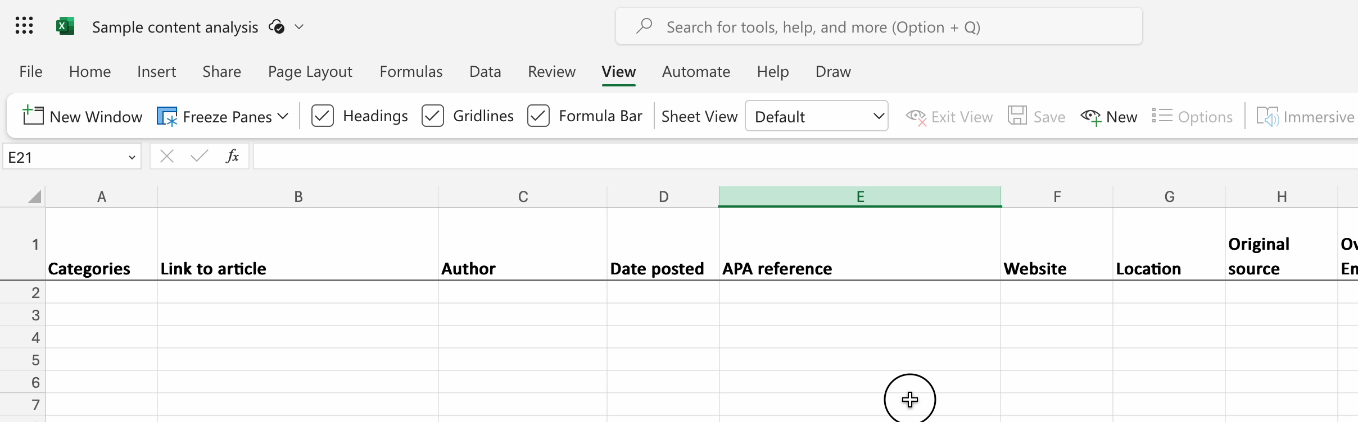
Step 5: Optional – Freeze first row
Right click on row, then click "view", then click "top row" to freeze the top row while scrolling down
This is an Excel tip only
© Anne MacLennan, 2024​​​

Slide 16
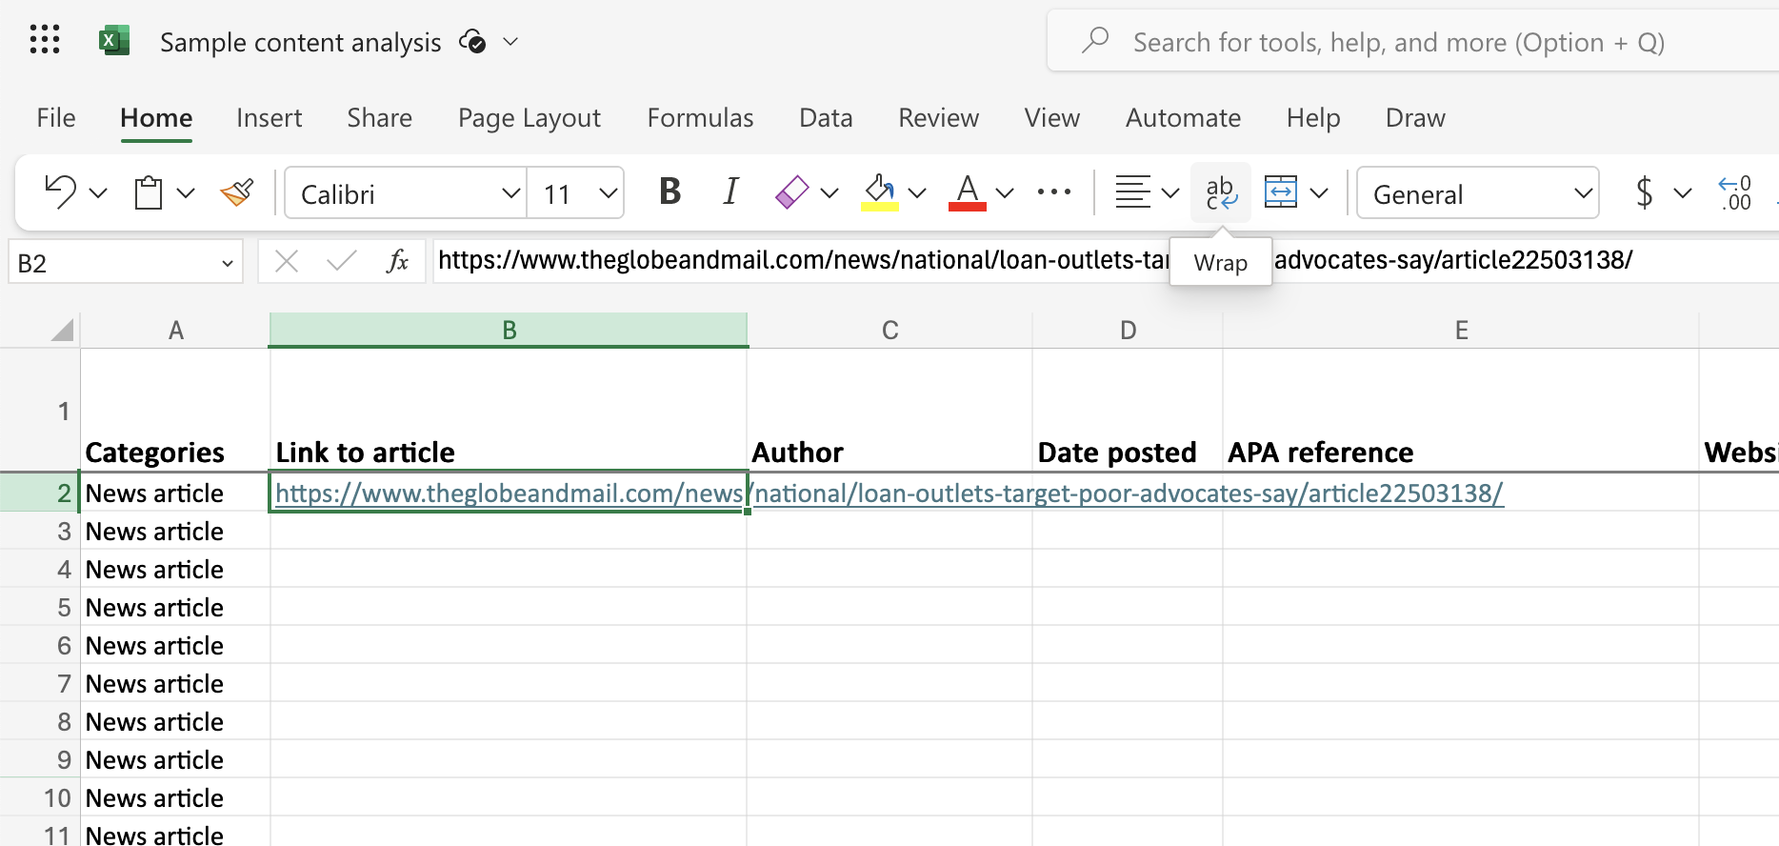
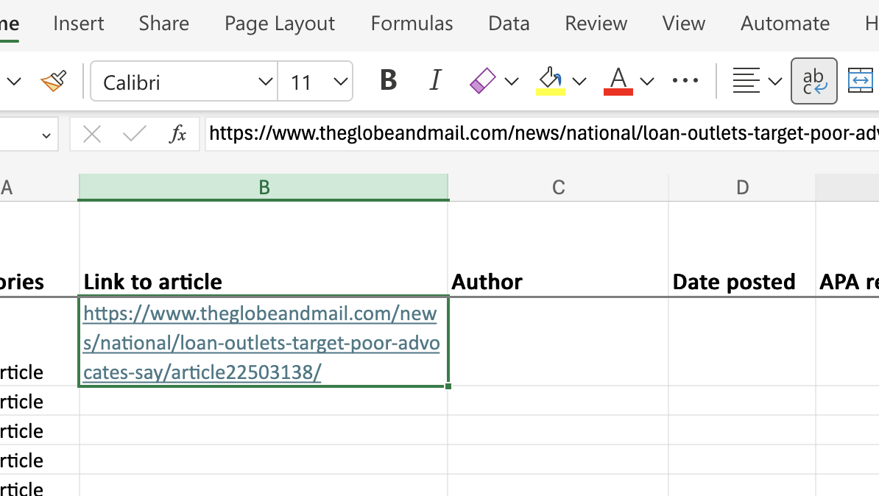
Step 5: Entering data in the spreadsheet
Copy paste and/or write up necessary information into the sheet
If you have a large amount of text for a cell, you can click "wrap" - this is an Excel tip only
© Anne MacLennan, 2024​​​
Beauchesne, E. (2007, November 28). Loan outlets target poor, advocates say. The Globe and Mail.

Slide 17
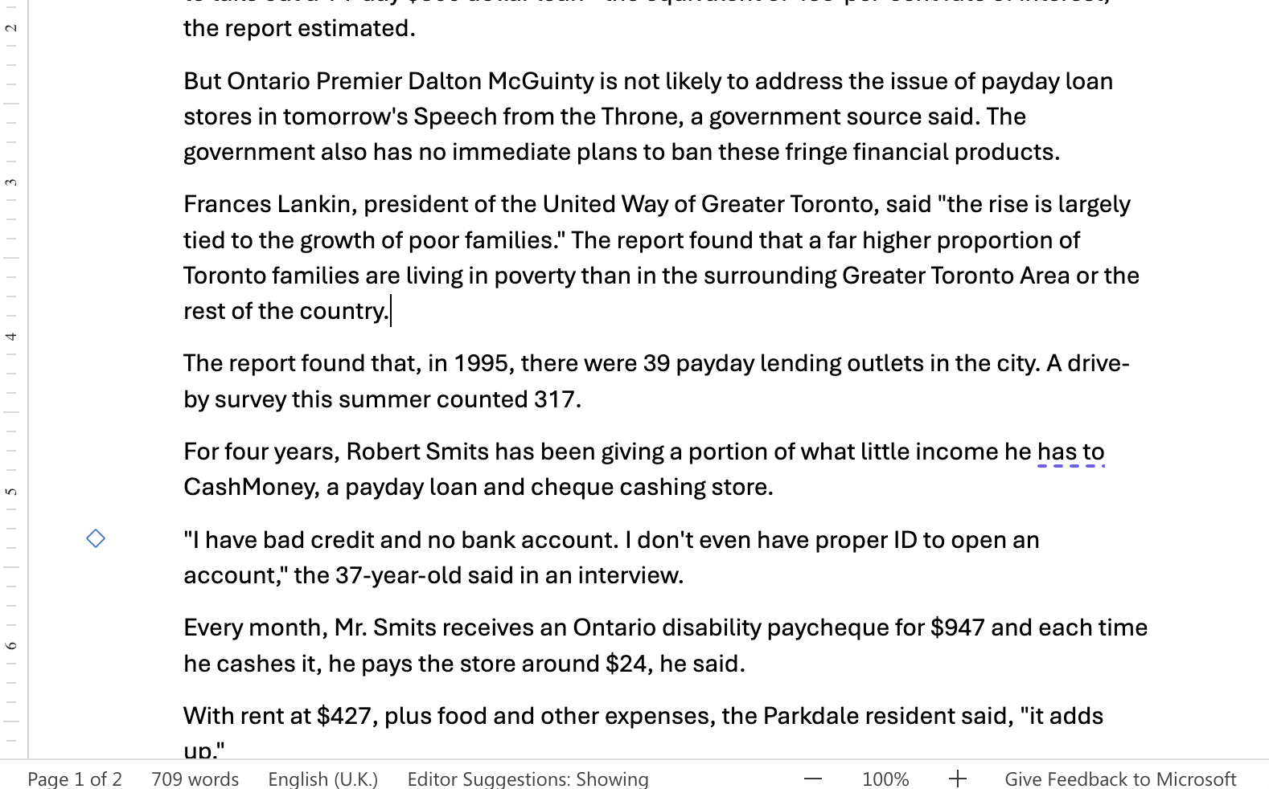
Step 6: Word Count in a Cell
For word count: copy paste the article's body
of text into a Word file to get the word count
This is an Excel tip only
© Anne MacLennan, 2024​​​
Beauchesne, E. (2007, November 28). Loan outlets target poor, advocates say. The Globe and Mail.

Slide 18

Step 7: Column I "Overall Emotion"
For overall emotion: You would need to develop a code book to define what criteria you need to fit in any of your emotions
An example pulled out about Hopefulness and Frustration
Hopeful for the citizens who are affected
Frustration due to the situation
© Anne MacLennan, 2024​​​
Mulcahy, K. (2024, April 16). Province investing $21m in low-income housing as part of budget 2024. CTV News.

Slide 19
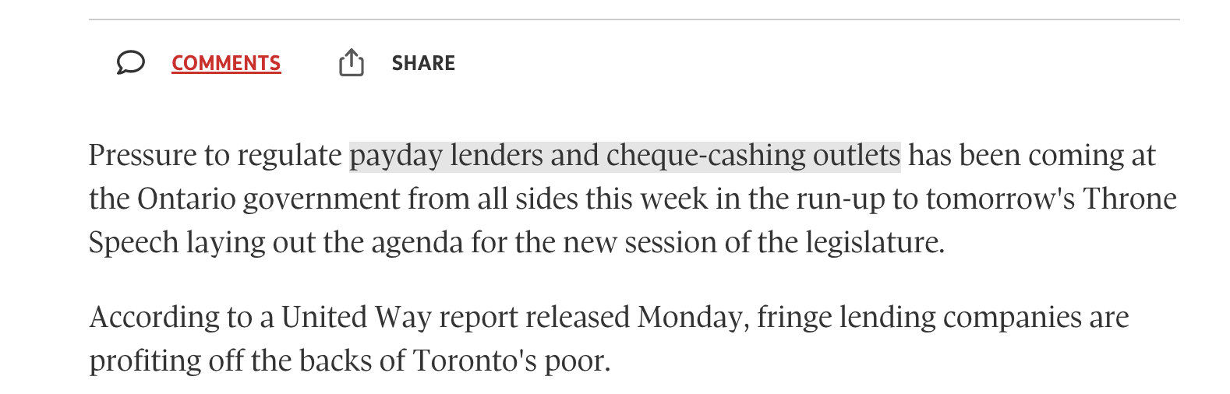
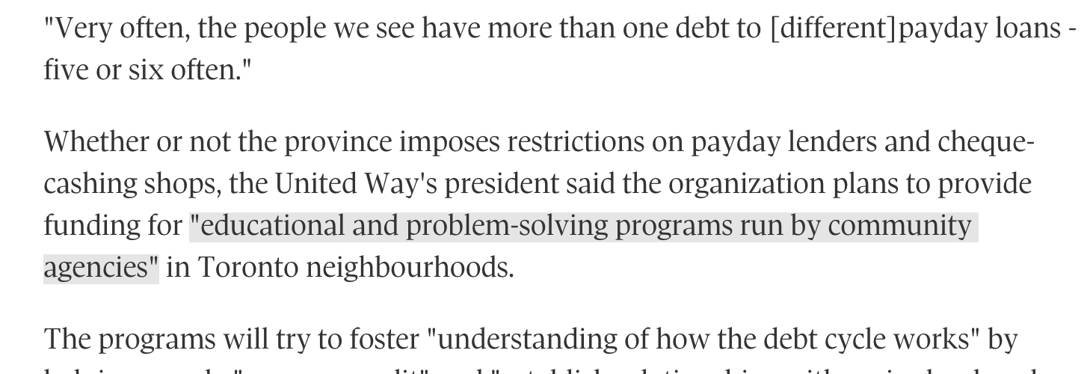
Step 10: Column M "Theme"
For theme: analyze the body of the text to see the major themes, look for key words that indicate that
predatory loaning, industry regulation
financial education and support
© Anne MacLennan, 2024​​​​
Beauchesne, E. (2007, November 28). Loan outlets target poor, advocates say. The Globe and Mail.

Slide 20
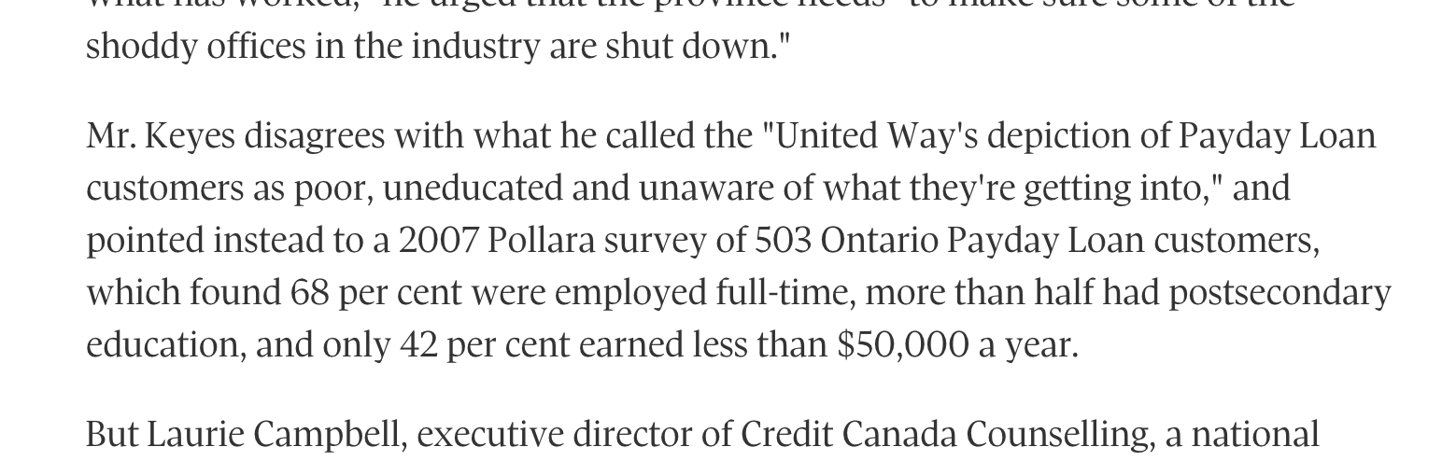
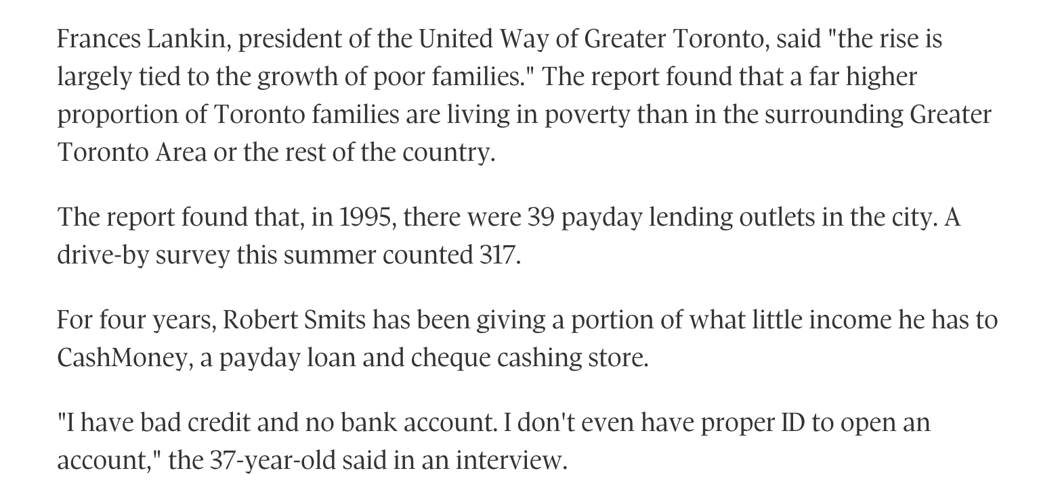
Step 11: Column J "Post Theme"
For post theme: analyze the body of the text to see the language used, and see whether the article is analytical, informative, critical, etc.
An example pulled out about Critical and Informative
Critical of loaners' perspective
Informative of people's financial situations
© Anne MacLennan, 2024​​​​
Beauchesne, E. (2007, November 28). Loan outlets target poor, advocates say. The Globe and Mail. ​

Slide 21
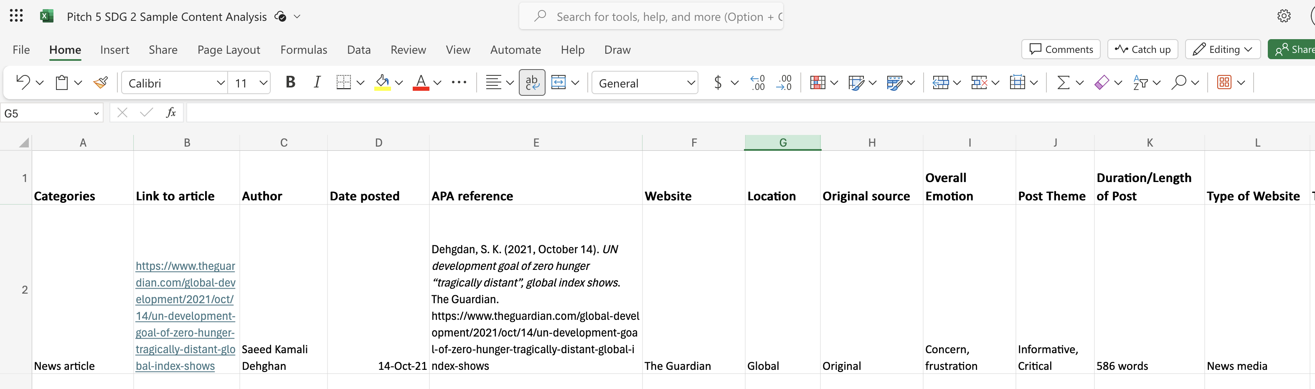
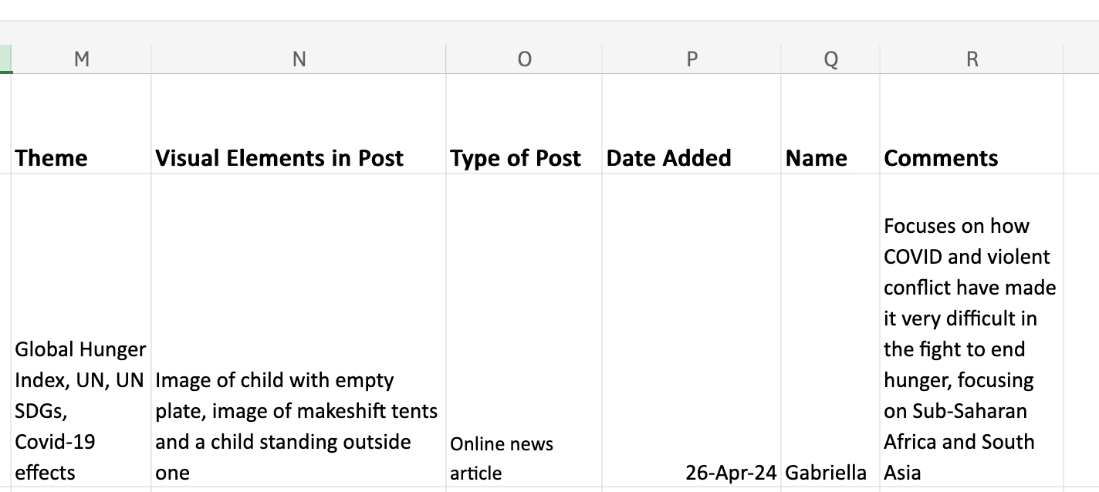
What your sheet should look like
© Anne MacLennan, 2024​​​​​​​​
Dehgdan, S. K. (2021, October 14). UN development goal of zero hunger “tragically distant”, global index shows. The Guardian.

Slide 22
References
Beauchesne, E. (2007, November 28). Loan outlets target poor, advocates say. The Globe and Mail.
Dehgdan, S. K. (2021, October 14). UN development goal of zero hunger 'tragically distant,' global index shows. The Guardian.
Department of Economic and Social Affairs (2024). The sustainable development goals report 2024. United Nations. https://unstats.un.org/sdgs/report/2024/The-Sustainable-Development-Goals-Report-2024.pdf.
Eurostat. (2024, August 28). SDGs & me: Responsible consumption and production. https://ec.europa.eu/eurostat/web/products-eurostat-news/w/ddn-20240828-1
Mulcahy, K. (2024, April 16). Province investing $21m in low-income housing as part of budget 2024. CTV News.
© Anne MacLennan, 2024​​​​

