Slide 1
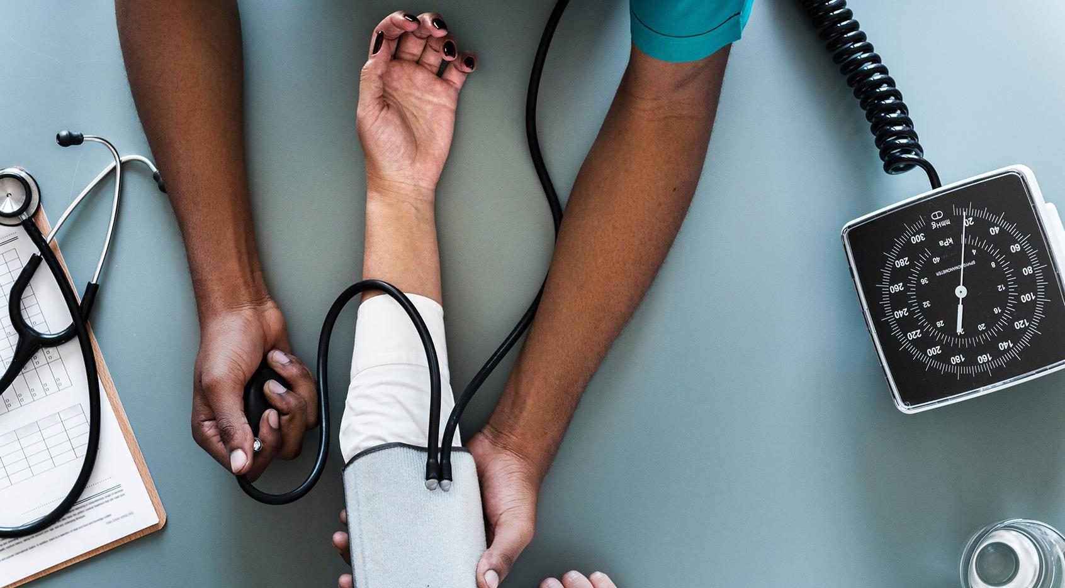
AIF Grant Category 1
York AVP Group
Brenda Orazietti
Assistant Professor, Faculty of Health, School of Nursing
Feb. 3, 2022
Notes:
Nursing education has always had components of experiential learning, with student practicing out in the field, such as in hospitals. But as we realized with the pandemic, that many more online resources were needed at an affordable price to facilitate learning. So that I why I created this project, to create more online methods for students to learn how to nurse various patients. Our placements for students experiential learning were cancelled due to the pandemic, so we had to rely on expensive programs that were already created, such as VSIM by Laerdal.

Slide 2
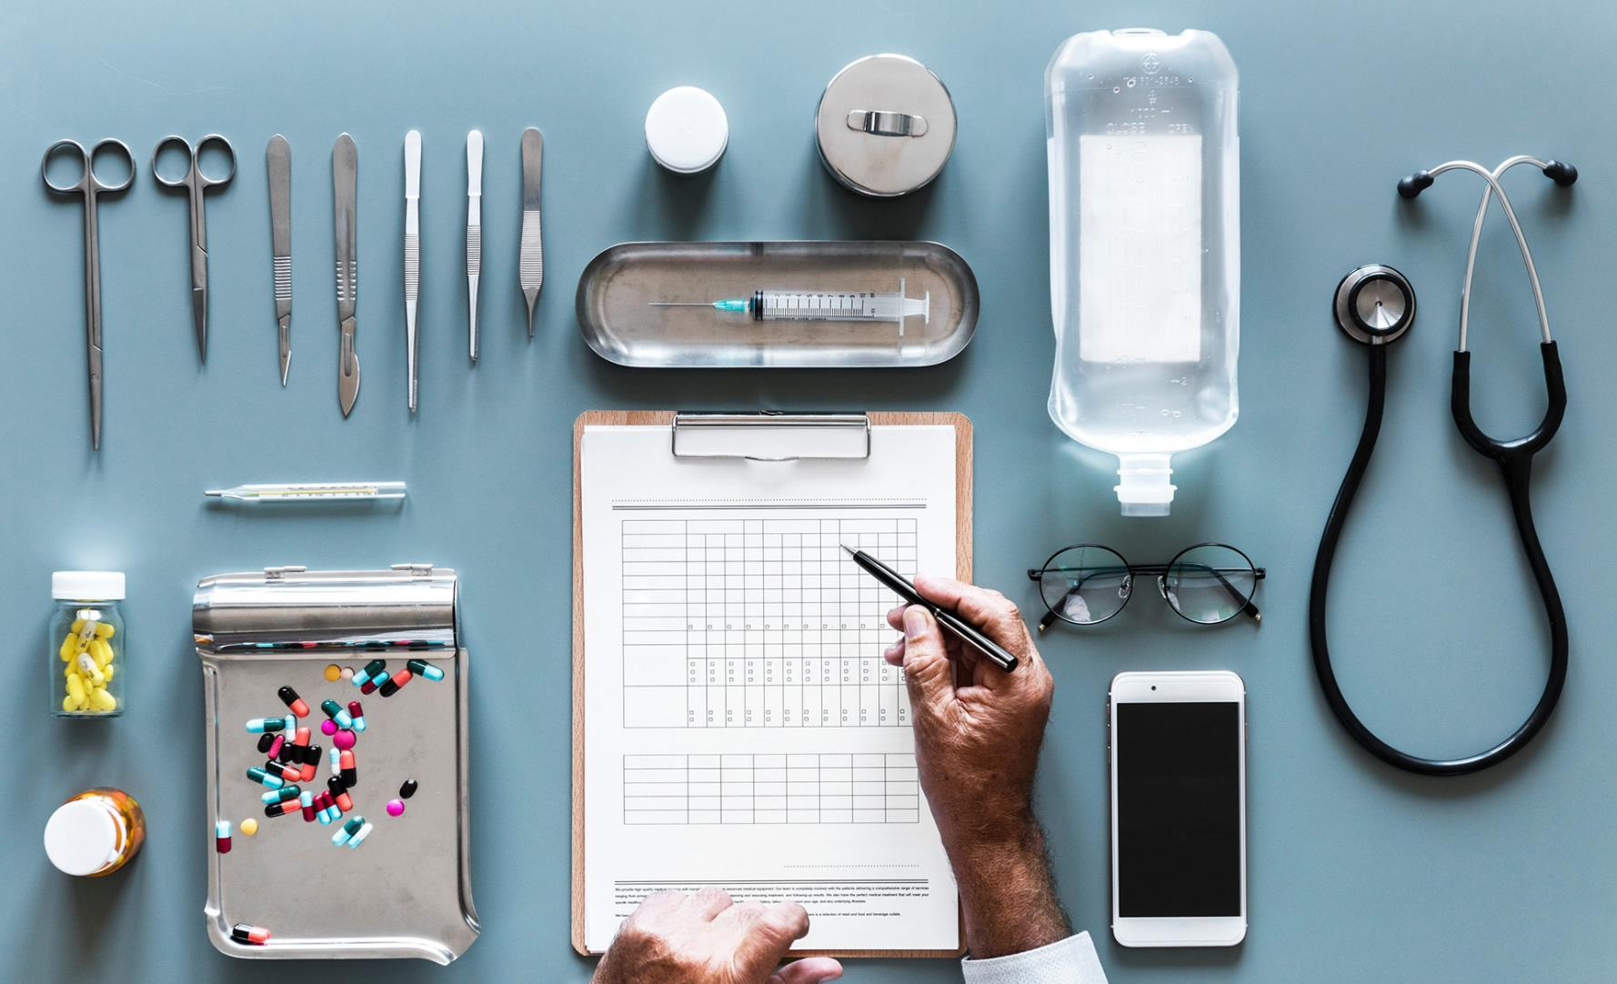
Purpose: To create sustainable, virtual simulation games (VSG’s) for use within our undergraduate nursing curriculum
The VSG’s will integrate current nursing practice & theory to be used to support curricular concepts
The VSG’s allow nursing students to experience situations safely that may not be experienced in placements
Notes:
Learning with simulation is not an adjunct method anymore but a proven effect safe method for teaching and learning nursing.

Slide 3
Created a chart 4 mains sections of the work to be completed
May 2021 Planning | June, July, Aug Writing | Sept. Oct. Nov. Filming | Dec. Jan Feb 2022 Game Assembly
Purchase equipment Connect with people of the team Needs assessment of curriculum Interests & talents of faculty Virtu-Wil National Survey Planned & offered a course on how to create VSG’s for all FT & PT faculty Created VSG’ #1: Adolescent Substance Abuse | Plan topics to be developed Create writing teams: set people up in Google Docs with templates All writing was due Aug. 23 Compete writing the 10 components/steps: 1. learning outcomes 2. learning outcome rubric 3. Case summary 4. Decision Point Map 5. Case Flow 6. Decision Point Map with Rationale 7. Filming Script 8. Reflective Debriefing Questions 9. Prebriefing assignments, readings 10. Resources | Film all the VSG’s that have been peer reviewed Purchase items for scenes Write out scripts onto flip chart paper, 2 sets for each VSG Learn how to create moulage for the set Plan each film set Ask for help from friends to help act, film, assist with filming dates Set filming dates Email team, scripts to practice, roles assign Purchase rapid covid tests Plan food & drinks, order for film days | Download all film clips Save, file, edit Merge game clips into Articulate Story Line 3 and CAN-Sim software Peer review digital work Add in written components Upload to web site
 | 4 VSG’s were peer reviewed prior to filming Content experts were sought to verify information stated
 |  | Set filming dates Email team, scripts to practice, roles assign
 |  | Purchase covid rapid tests
Notes:
I was awarded the Grant of April 26, 2021. The first order of action was to map out a time line chart of work that was to be completed. Started with a GANT chart

Slide 4

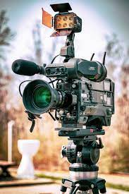
Team Members
Project Lead: Brenda Orazietti
Nurse Writers Film Crew & Actors:
Brenda Orazietti Brenda Orazietti
Irfan Aslam Andria Philips
Andria Philips Catriona Buick
Catriona Buick Sarah Evans
Sarah Evans Joaquin Opoazo
Nancy Sangiuliano Irfan Aslam
Nikole Santic Gae Parps
Jane Tyerman Debbie Laguex
Marian Lucktar-Flude Ishdeep Kullar
                Yosra Ismeal
                Nneoma Mbakwe
                *ADS Media Zubaida Mohameed
                Eric Artusi
                Nicole Chiarantano
Notes:
Collaborators were the 2 presidents of CAN-Sim, Canadian Alliance of Nurse Educators Using Simulation, Jane and Marian.

Slide 5





Part 2: Writing
4 VSGs Written
Liver Failure
Liver Transplant
Postpartum Assessment
Newly Dx Prostate Cancer
4
Notes:
I set up dates and times to write the scripts in teams over zoom. The scripts were complex for liver failure and post partum, and long. Then I set up times to peer review the scripts.

Slide 6
Part 3 : Filming VSG’s
Problem: I had a timeline to complete the work
We are in a pandemic
Not allowed into the university
Couldn’t film in our lab
Notes:
How was I to meet deadlines for the grant, complete the grant, I had no where to film the VSG’s?

Slide 7

Covid-19 Caused me to Panic
Options to Filming:
I. I could write to Dean & Associate Dean for special permission to access the lab to film
This would require a 14 day in advance notice in case of being refused.
I was informed that all on campus research was halted & not allowed
2. I could search for a film set that was a hospital setting. Costly for 1 day of filming is staggering
3. Delay entire project until I can access our lab to film
4. Think outside the box: create my own film set & film crew in my basement
&
to thinking outside the box
Completed filming of 4 VSG’s on time
Notes:
In mid Sept. I was informed that I could in fact come into the lab to film with a crew of 6, but everyone had to wear full PPE. I refused this option, and my filming was completed anyways. I could not see the merit in filming in full PPE.

Slide 8
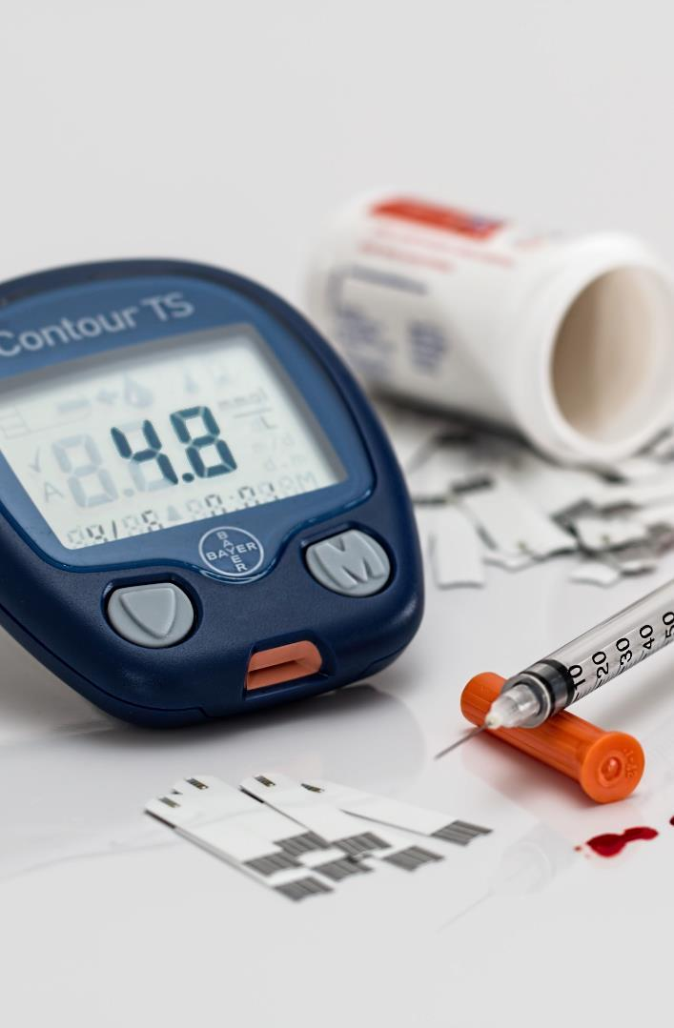



Plan
&
New Dilemma
How to Create a Film Set in my Basement?
Prioritize
Man Power
Money
How/Where to purchase items or make items for moulage
How/Where to purchase items for the film set
Who is going to help me?
I needed actors
I needed a camera operator
I needed a scene taker
I needed a clapper
I needed assistants to flip the charts with scripts
I had funding for equipment
I had funding for the Go-Pro, Articulate, Ipad, batteries, sim cards, accessory pack
I did not have funding to pay people to help me create this!
Notes:
The funding to pay people who assisted me in writing and filming is where the Virtu-Wil grant comes in. I was alotted a budget to pay them.

Slide 9
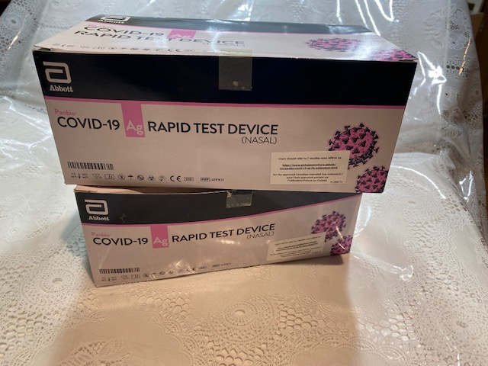
Safety on Set
Everyone took a rapid covid test
&
signed waivers

Slide 10
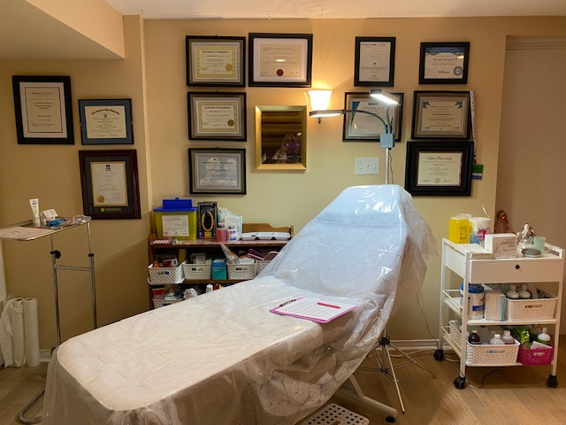
The Set: my basement
I had to think of a way to cover up this wall
ma
Notes:
In the basement of my home, I have a clinic, small business, asethetics. Therefore I wanted to use the blue hospital curtains (I bought 2) to cover up that wall. BUT HOW? I didn’t want to take down my credentials, so I had to think of a work around. The bed, procedure light were used in the film set I found 2 white sheets to use, white pillow case for the “hospital linens”. The procedure light was used for filming, on the actors.

Slide 11

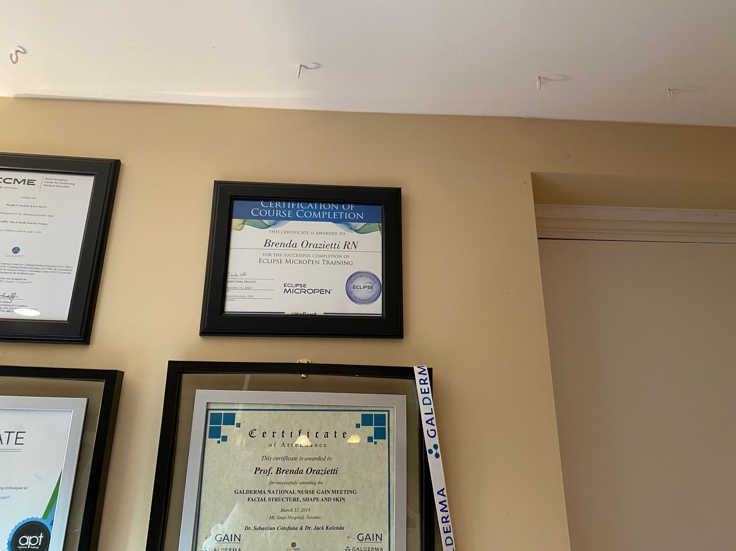
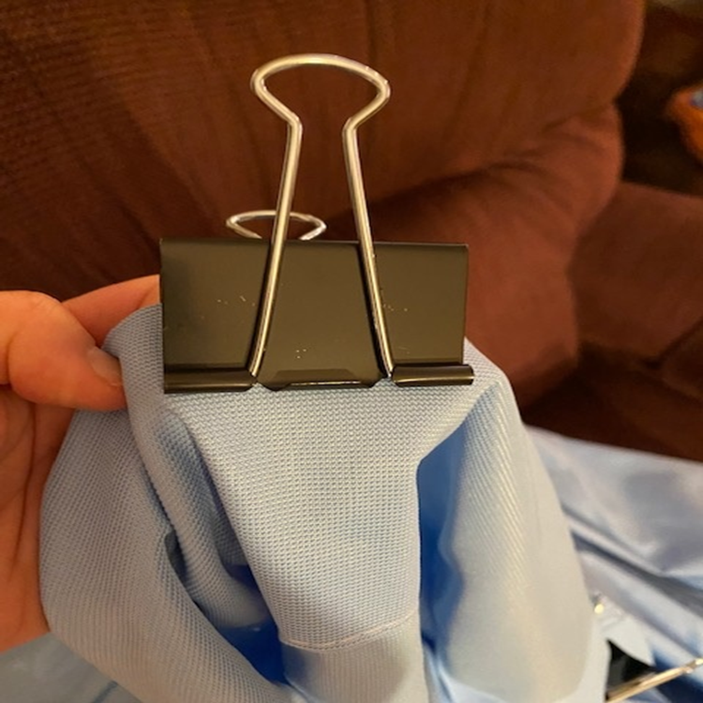
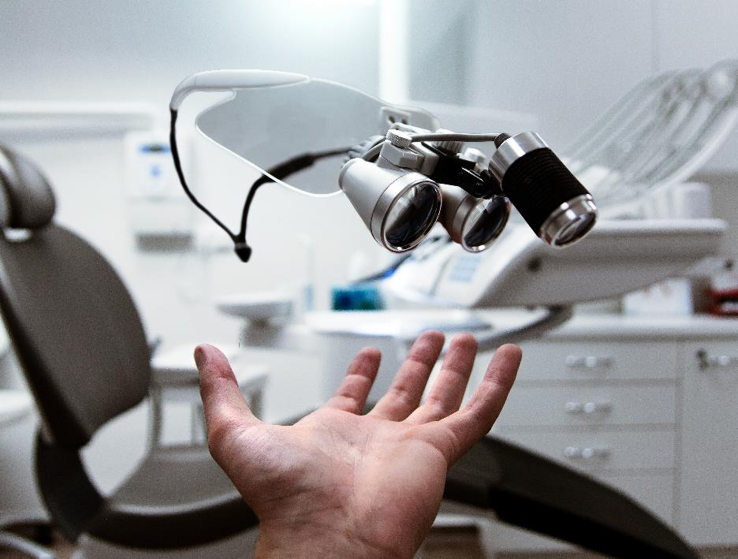
Problem:
How to hang up the hospital curtain?
Saved by Buckle Clips!
Notes:
I wanted to hang the hospital curtain to cover that back wall. I stressed out over this issue more than anything. I tried to tuck in the curtain over the edge of the cantina door, used strings to attach it to the other side of the room, it fell down. Tried using a wall divider…..it was too unstable and tippy, that didn’t work……What did work was to use hooks in my ceiling, attach the hospital curtain with the buckle clip, but use the metal part to hang the curtain onto the hook.

Slide 12
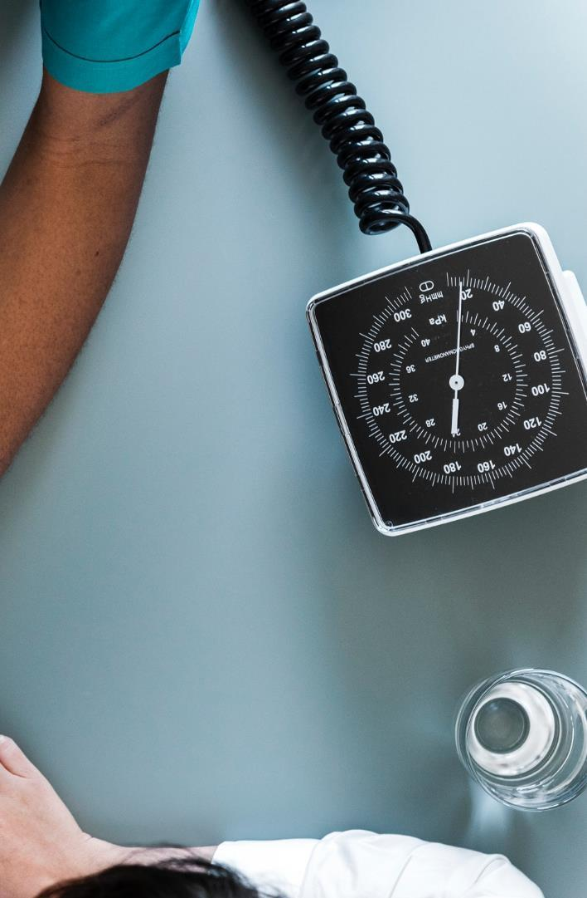



Planning the Film Set
I was able to purchase hospital curtains, IV pole, IV tubing, gowns, breasts, sitz bath, other items I asked friends for (peribottle,large peripad)
Amazon
Friends & Neighbors
I asked a retired nurse & sister, neighbors to help
.
.
Moulage
Used Tumeric powder & H2o for jaundice, bought fabric for arm sleeves for limbs & ascites, sewed it, 2 pouches for H2O zip lock bags, red food coloring & strawberry mashed up for lochia)
Paid for Lunches
Paid out of pocket lunch, fruit, drinks, gift cards, cash all in appreciation of my helpers
.
Notes:
To make jaundiced skin: take a small bowl, sprinkle turmeric the yellow spice into it, add a small amt of H2o, take a makeup brush and paint the actor face, hands and feet.
To make the arms and legs, I purchased gold jersey fabric which is stretchy, this was important to fit bubble wrap around the limbs first and then put the sleeves on for edema. I sewed the arm and leg sleeves to accommodate the edema from the bubble wrap.
To make the abdomen, (ascites) I bought a polycotton, not stretchy fabric, so the water bags would not move around too much. I made 2 pouches, fill 2 large zip lock bags with water to simulate ascites of the abdomen. To simulate an umbilicus that was everted, I took a photo from the internet and taped it on the abdomen, used marker to make stria.

Slide 13
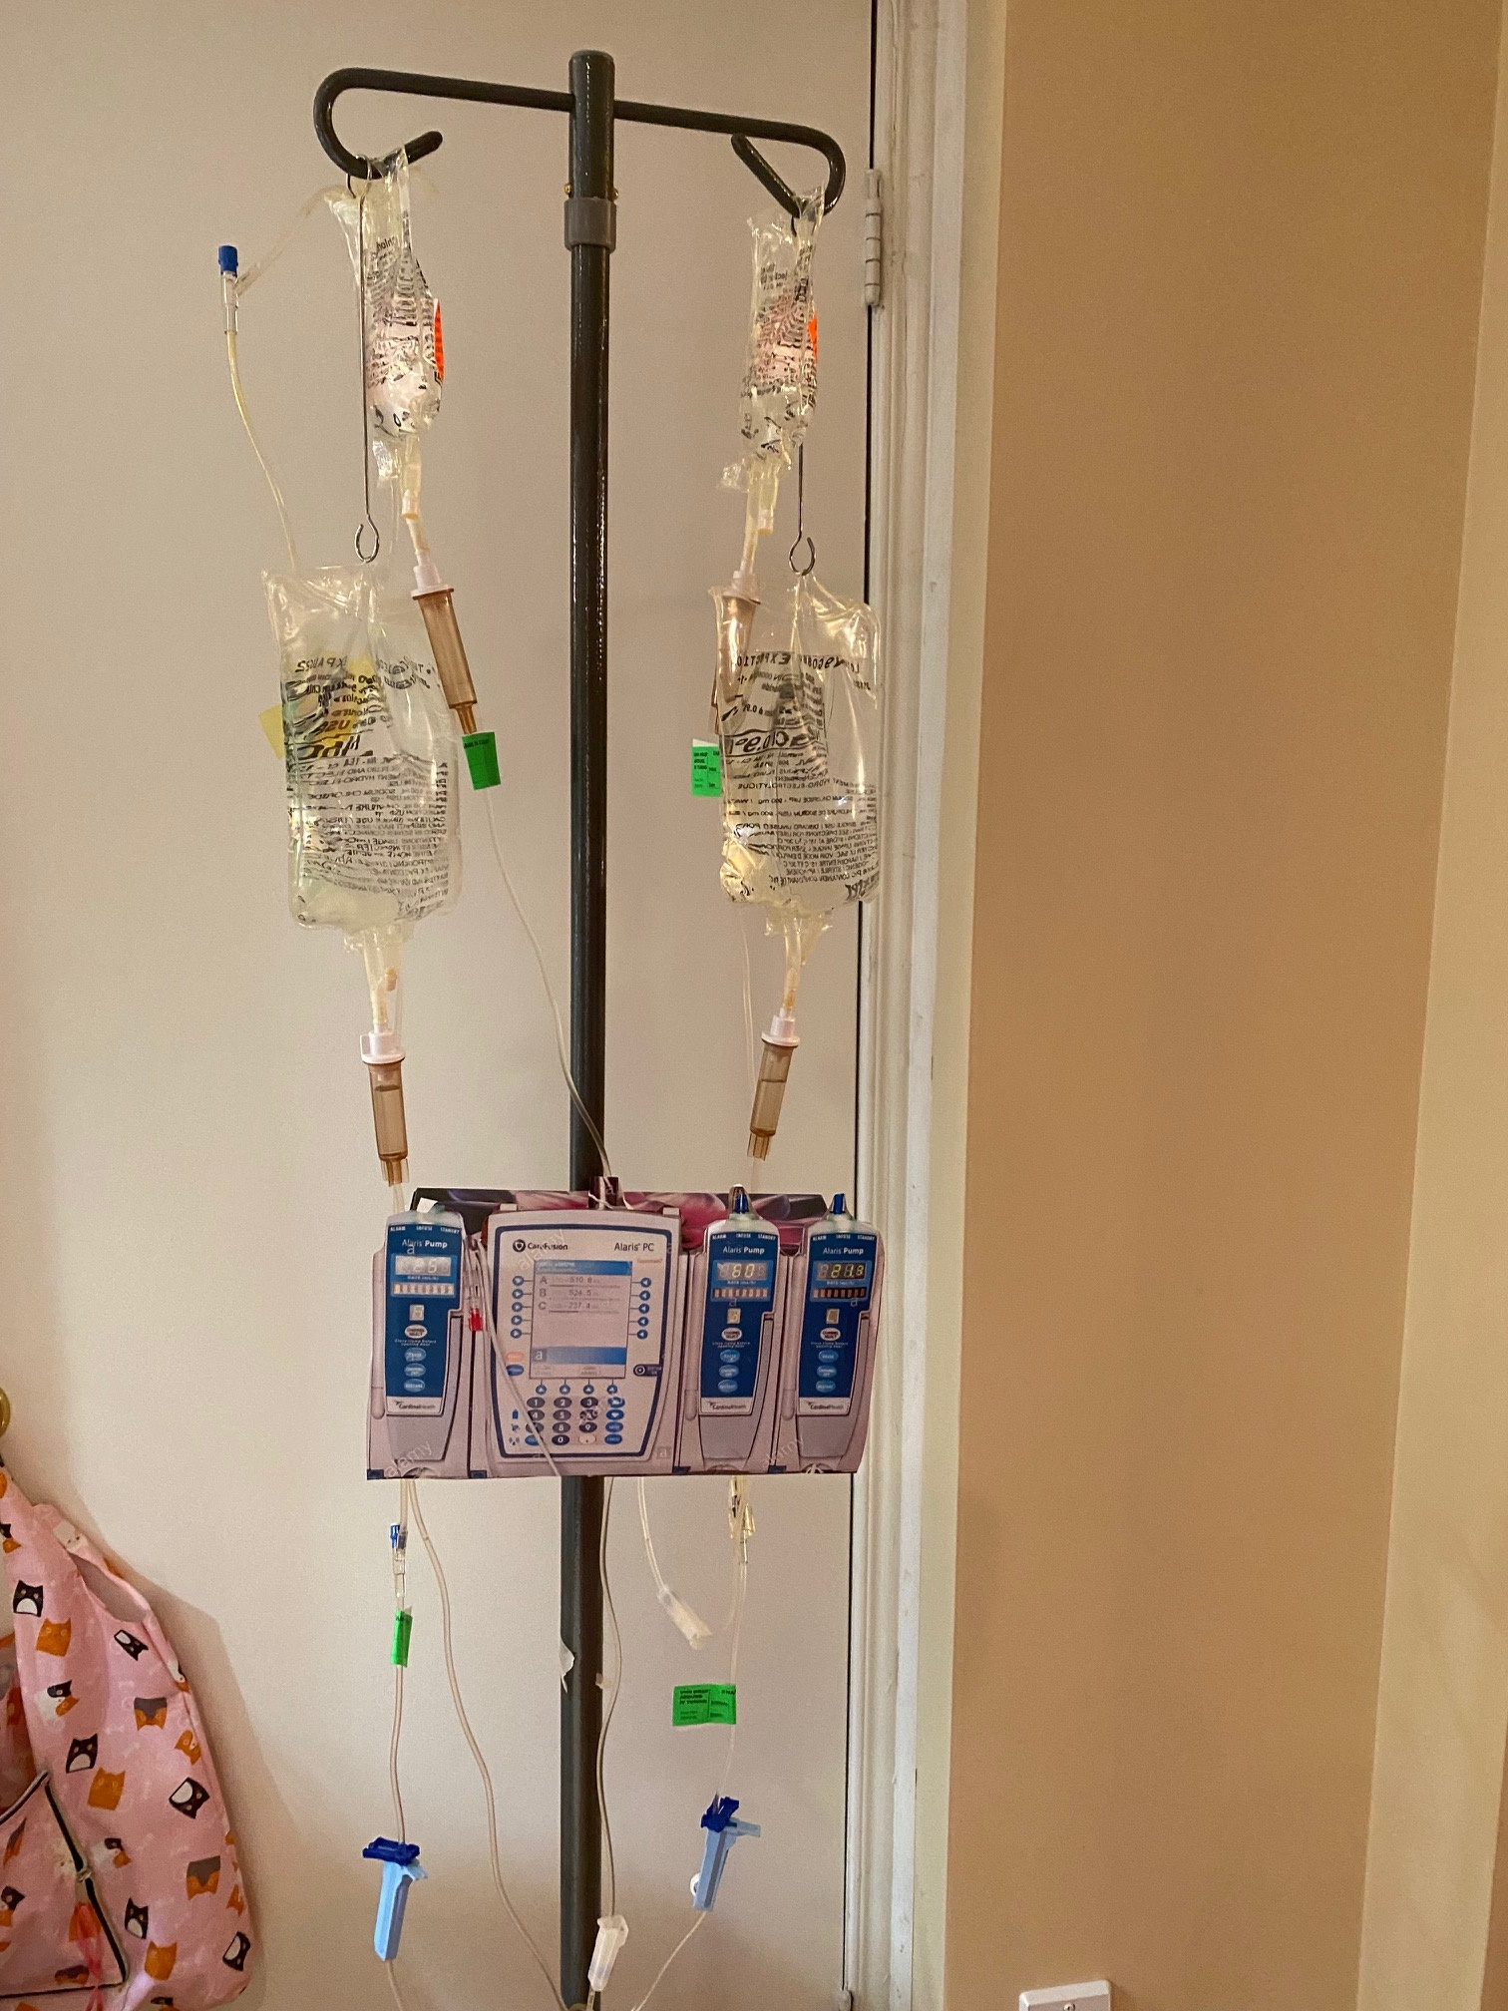
I did not have an IV Pump
I used an empty tissue box, printed an image of IV pumps, taped it on
Notes:
Although this photo may not be the best as you can see the pink top of the cardboard box, on set it was not visible,…..it was an empty Kleenex box, then I found a photo of IV pumps and just printed it out, cut it out, taped it on….the IV’s hang behind the box. It was filmed not as a main focal point in the skit.
I had an Opsite to keep the IV in her arm.

Slide 14
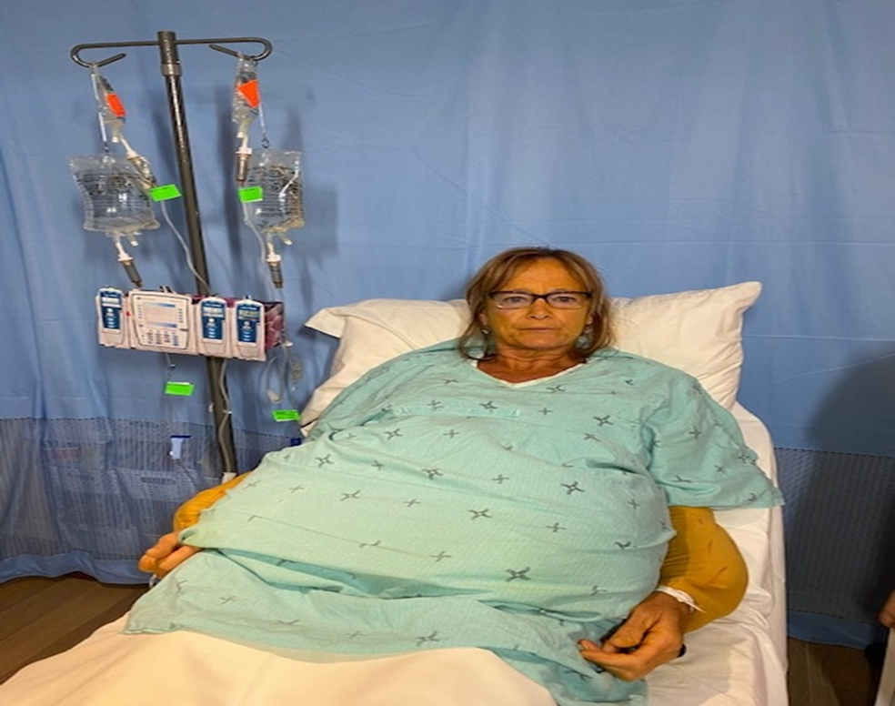
End Stage Liver Failure VSG
Turmeric for jaundice
Red marker for scratches on arms & legs
Gold sewn sleeves for arms & legs with bubble wrap on limbs for edema
IV tubing was behind the tissue box, but taped to her arm with opsite, wasn’t the focal point

Slide 15
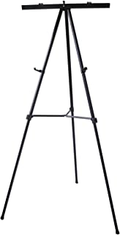
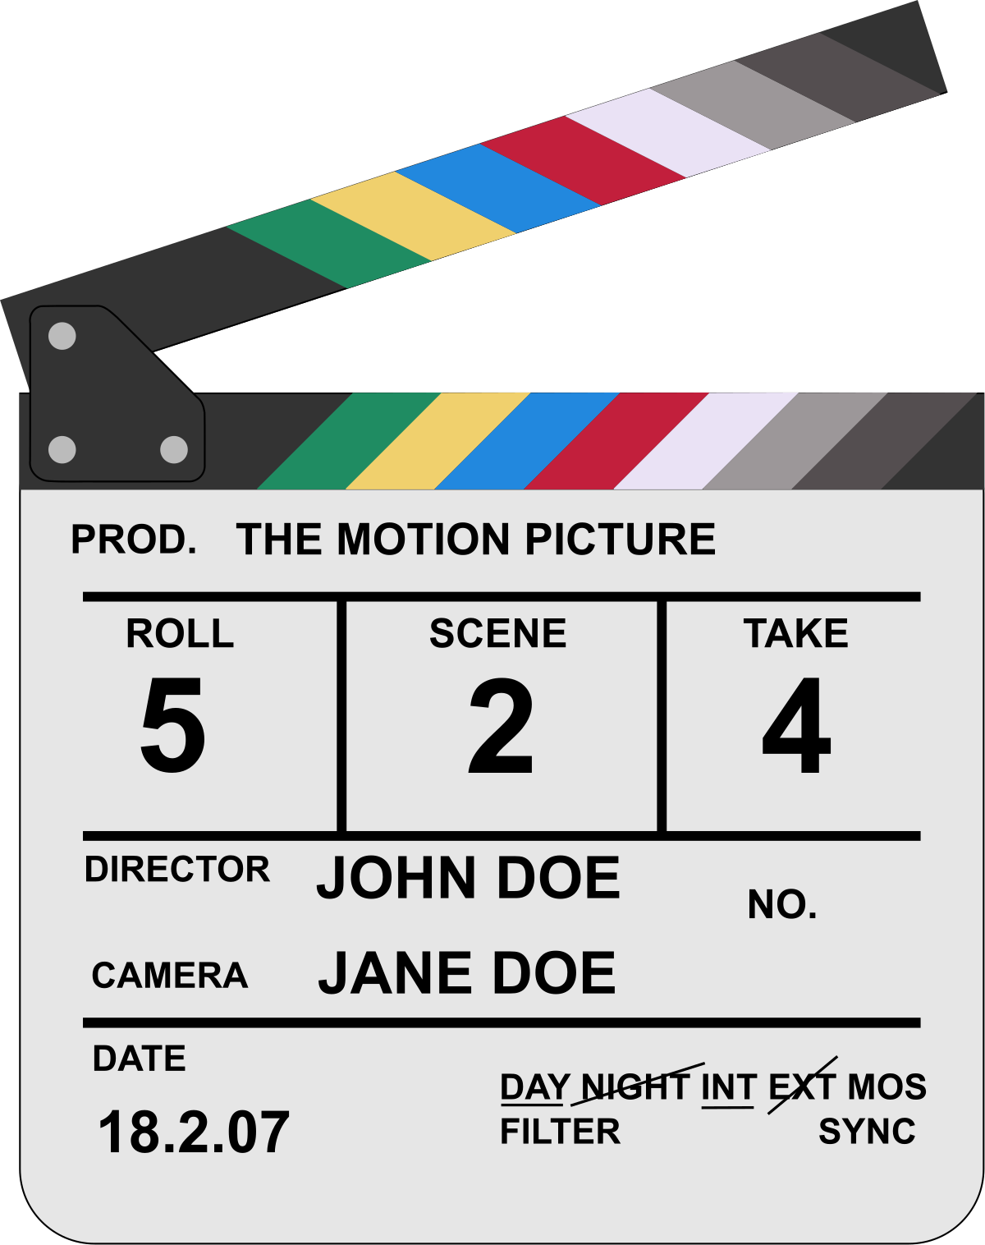
Set Up for the 4 VSG’s
Videographer
Assistants to flip the scripts mid filming, & keep track of lines
Scene taker/use clapper
Scene tracker
Director
Actors
Props:
Moulauge
Curtains
Notes:
I wrote out the scripts 2 times, one on either side of our patient, for actors to read as they were too complex to memorize. They involved several minutes long of filming straight as well. Involved physical assessment, diagnostic tests, drugs, pathophysiology ect.

Slide 16
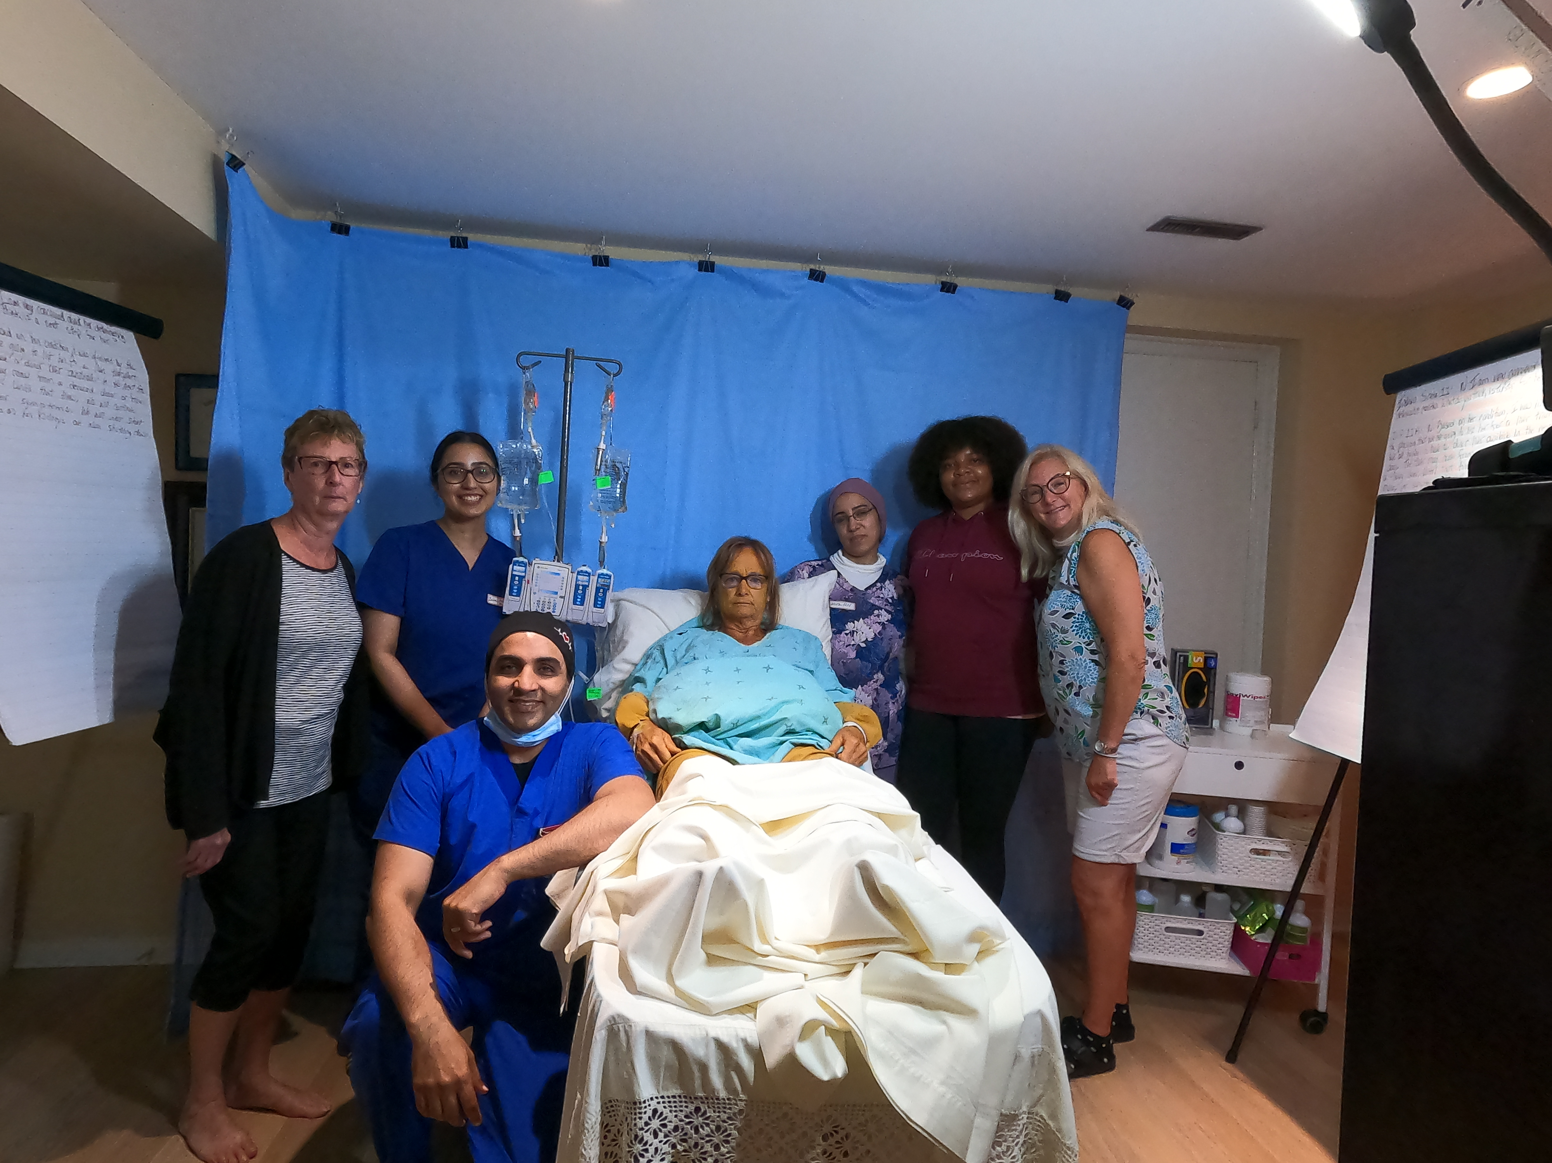

Film Crew for the End Stage Liver Failure VSG
$2B
Ut congue quis tortor eget sodales. Nulla a erat eget nunc hendrerit ultrices eu nec nulla.
Donec viverra leo aliquet, auctor quam id, convallis orci.
Notes:
2 faculty, myself and Irfan Aslam, 2 current nursing students, 1 York alumni, a retired ICU RN and her sister.- took 7 of us to complete this filming. The scripts were so complex that I had to write them out onto flip chart paper twice, and place the stands so that the actors could read it…..to complex and we were not actors.

Slide 17
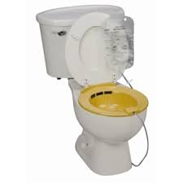
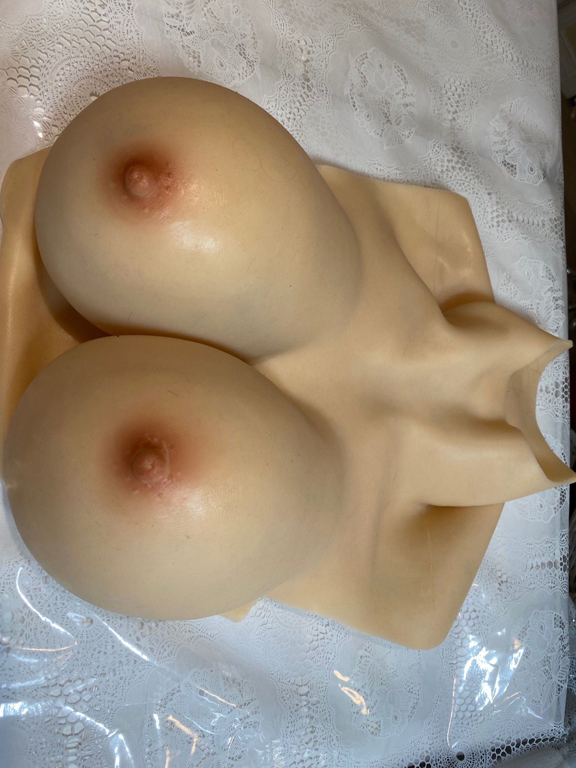
The Post partum Assessment VSG
Delicate matters of privacy, so how do you do a postpartum assessment?
We had to script assessment of nipples, breasts, uterus fundal height and firmness, the perineum, episiotomy, hemorrhoids, lochia
All of this is VERY personal and so hard to sort out how to film/act this out
Ordered the silicone breasts off of Amazon
Ordered sitz bath
Sourced items from friends & around the house:
Large peri-pad
Peribottle
Golf ball
Pen light
Mirror
Printed coloured images (episiotomy, inverted nipple)
Mashed up strawberry & food colouring
Doll, baby banket

Slide 18

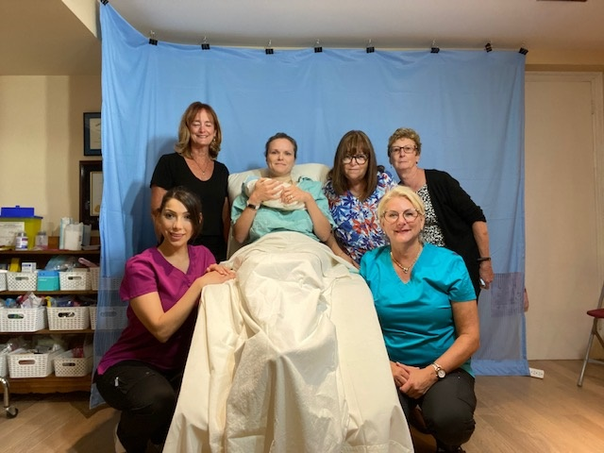
Postpartum Assessment VSG
Film Crew: 3 nursing faculty
Neighbours, friends, retired nurse & sister

Slide 19
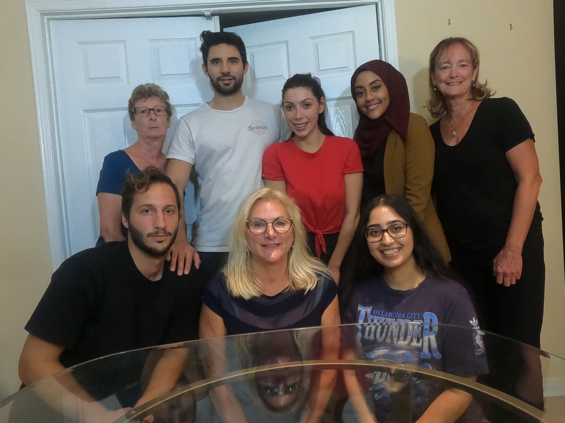
New Diagnosis of Prostate Cancer VSG
Film Crew: difficult to find a male, Eric played prostate cancer client
Freedom to Invent
$2B
$1B
Few Competitors
Etiam aliquet eu mi quis lacinia. Ut fermentum a magna ut eleifend.
Integer convallis suscipit ante eu varius. Morbi a purus dolor.
Notes:
This game was an office/clinic appointment. A desk set up was the set. Table, laptop, papers, flyers were all that was required. Table and chairs outside my home office was used…..my office was behind the double doors.
Film Crew: RN/NP who did the role of transplant nurse coordinator, lady with the scarf Zubaida Mohamed. York current nursing student, neighbors.

Slide 20

-All 5 VSG’s will be housed on this web site
-They are free for nursing faculty to use via a creative commons license & membership to the organization
-Students would be given a link to the VSG to complete the case assigned
Notes:
Last part of this project is to inform all our faculty about the availability of the resources for implementation into their courses. That can be done as an announcement in our SON meetings.

Slide 21
Thank You
Any Questions?
Brenda Orazietti brendao@yorku.ca
4
416-435-3740

