Slide 1

Pitch 6 - UN SDG 1 No Poverty
Doing cross tabulation with data

Slide 2

The requirements for this UN SDG data assignment is to complete 5 cross tabulations and/or content analysis from the original data sheets uploaded here. There are examples of both content analysis and cross tabulation for each pitch to show you want to do. Please make sure to do a combination, so that your assignment includes 5 but at least one is a cross tabulation and one is a content analysis. Please submit in the place created for UN SDG data assignment on Submit Assignment Here. The PowerPoints are the examples of what to do. Each has a data narrowed down from the original data sheets that follows. Then the original data sheets that you will used for the assignment will be at the end in this UN SDG data assignments Box. What you submit is 5 different spreadsheets as indicated above.
© Anne MacLennan, 2024​​

Slide 3
UN SDG 1
“Ending poverty requires a wide-ranging approach that combines comprehensive social protection systems, inclusive economic policies, investments in human capital, measures to address inequality and climate resilience, and international cooperation and partnership” (UN DESA, 2024).
Department of Economic and Social Affairs (2024). The sustainable development goals report 2024. United Nations. https://unstats.un.org/sdgs/report/2024/The-Sustainable-Development-Goals-Report-2024.pdf.
© Anne MacLennan, 2024​​​

Slide 4
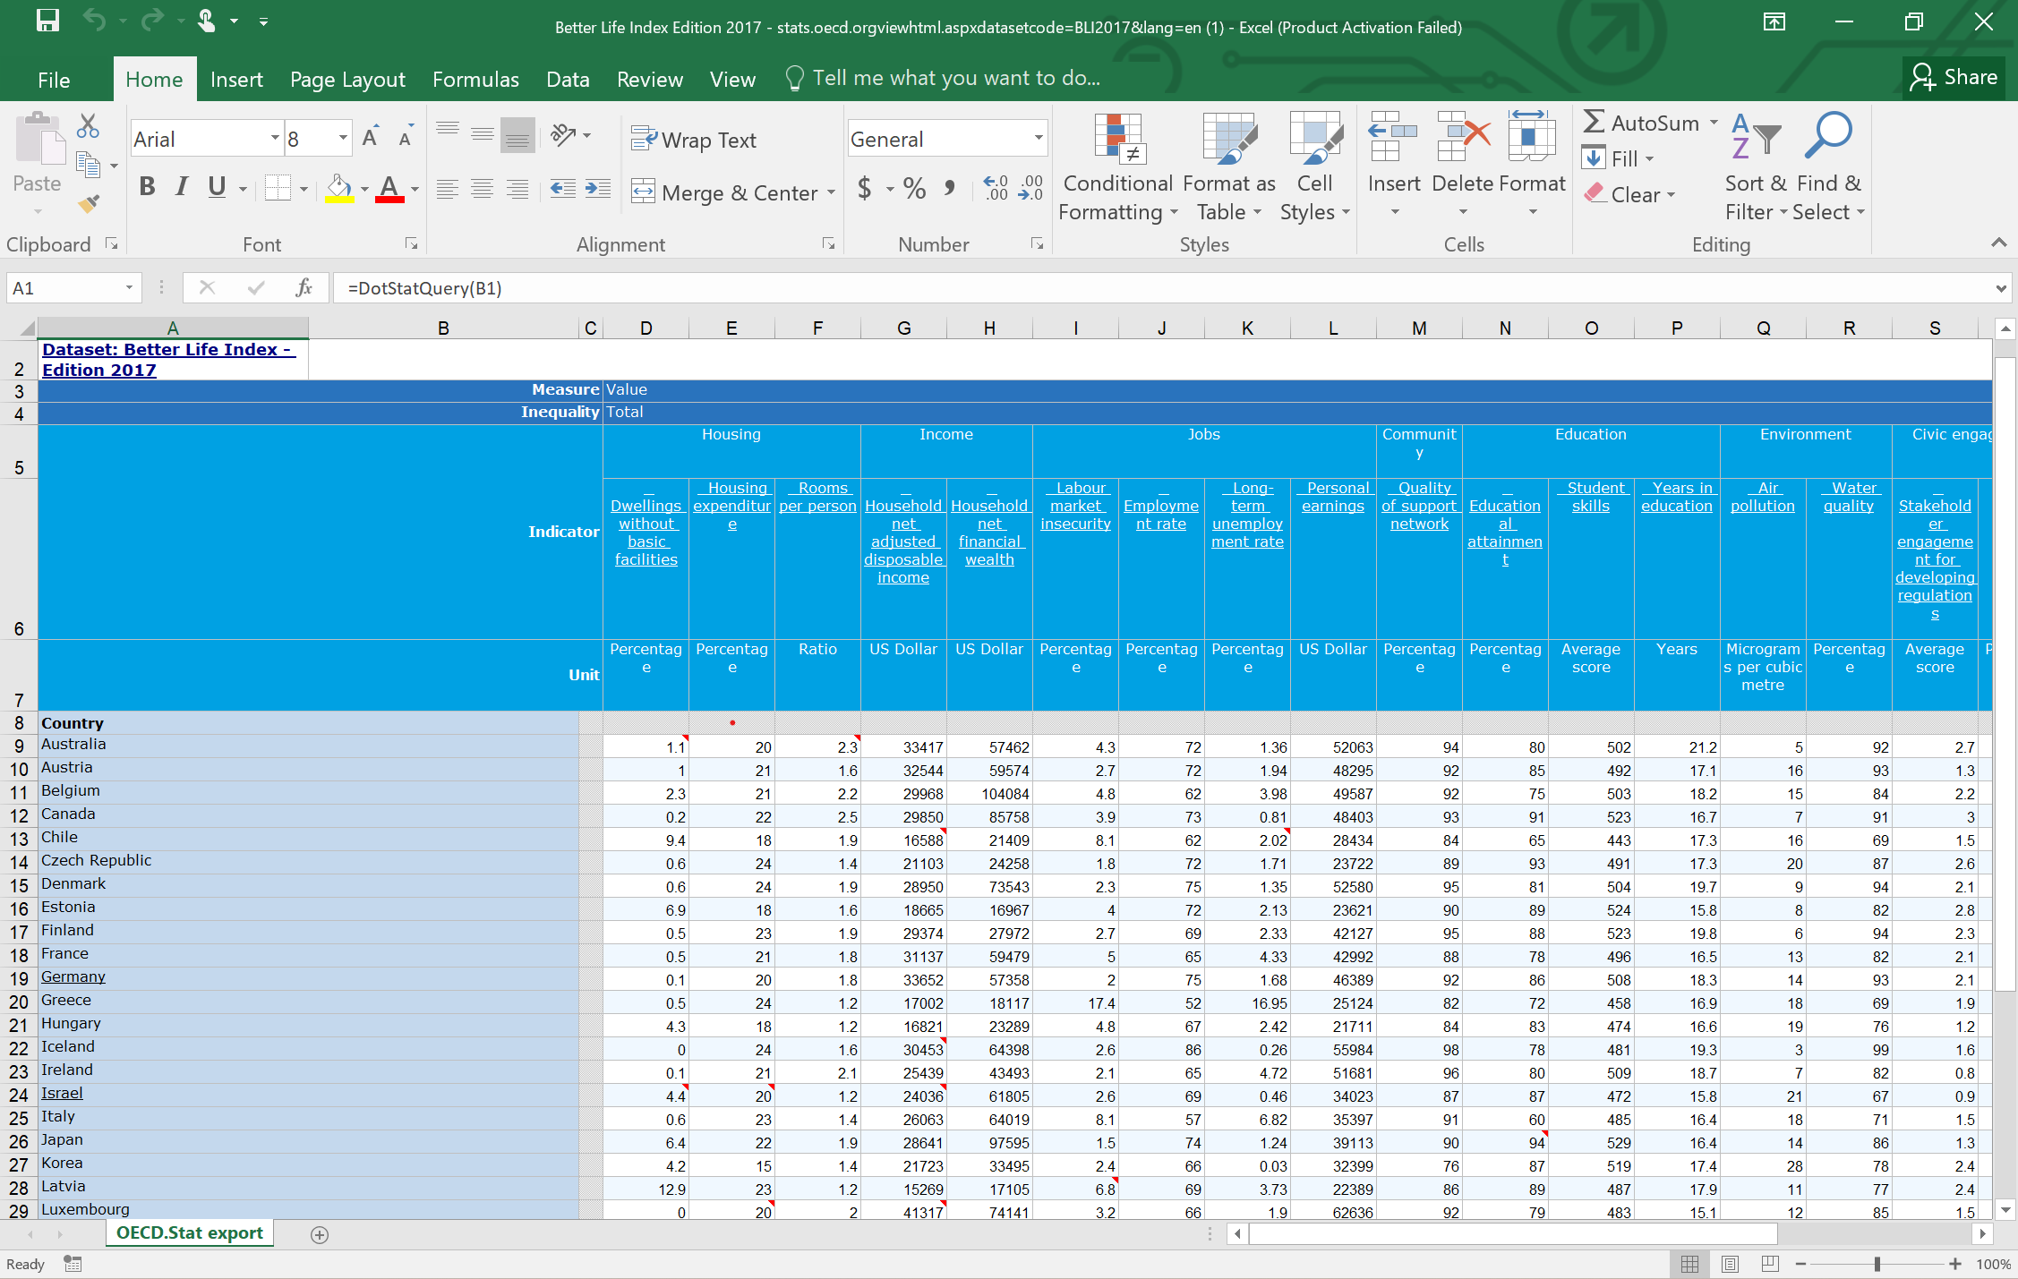
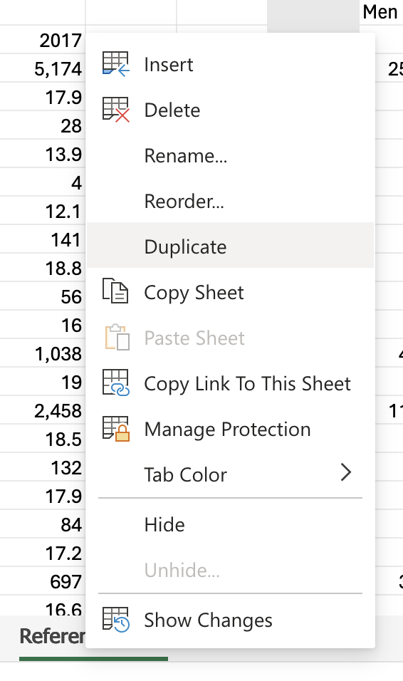
Step 1: Get raw data table and duplicate it for back up
Sakata, S., Aklilu, A. Z., & Pizarro, R. (2024, June 13). Greenhouse gas emissions data: Concepts and data availability. Organisation for Economic Co-operation and Development. https://www.oecd.org/en/publications/greenhouse-gas-emissions-data_b3e6c074-en.html
© Anne MacLennan, 2024​​​

Slide 5
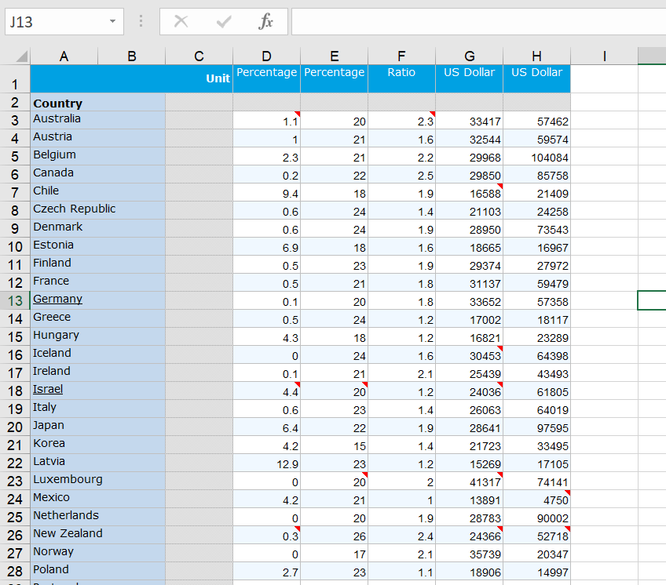
Step 2: Highlight all in the duplicate sheet
Sakata, S., Aklilu, A. Z., & Pizarro, R. (2024, June 13). Greenhouse gas emissions data: Concepts and data availability. Organisation for Economic Co-operation and Development. https://www.oecd.org/en/publications/greenhouse-gas-emissions-data_b3e6c074-en.html
© Anne MacLennan, 2024​​​

Slide 6
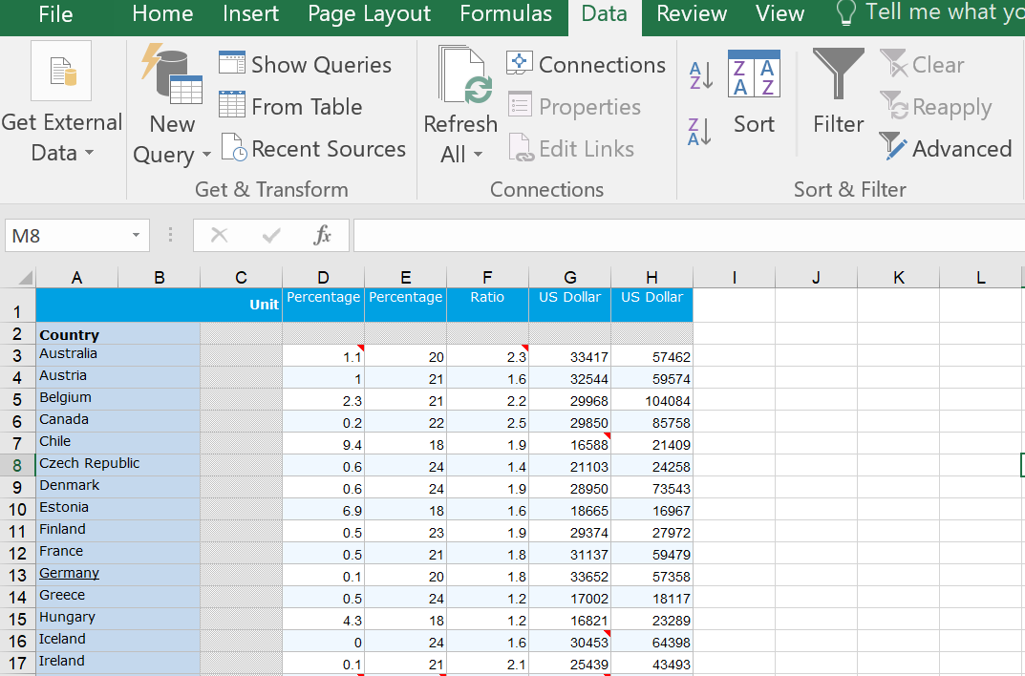
Step 3: Click data and then filter
Sakata, S., Aklilu, A. Z., & Pizarro, R. (2024, June 13). Greenhouse gas emissions data: Concepts and data availability. Organisation for Economic Co-operation and Development. https://www.oecd.org/en/publications/greenhouse-gas-emissions-data_b3e6c074-en.html
© Anne MacLennan, 2024​​​

Slide 7
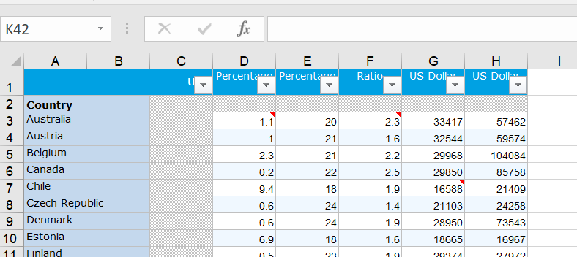
Step 4: Click data and then filter
Make sure the dropdown arrows appear
Sakata, S., Aklilu, A. Z., & Pizarro, R. (2024, June 13). Greenhouse gas emissions data: Concepts and data availability. Organisation for Economic Co-operation and Development. https://www.oecd.org/en/publications/greenhouse-gas-emissions-data_b3e6c074-en.html
© Anne MacLennan, 2024​​​

Slide 8
Cross tabulating
When you cross tabulate what you are doing is comparing at least two variables. You need to pick two variables you want to cross tabulate, such as gender and wages in the workplace.
In step 3, we will select variables by using the select all feature in the filtered columns.
Sakata, S., Aklilu, A. Z., & Pizarro, R. (2024, June 13). Greenhouse gas emissions data: Concepts and data availability. Organisation for Economic Co-operation and Development. https://www.oecd.org/en/publications/greenhouse-gas-emissions-data_b3e6c074-en.html
© Anne MacLennan, 2024​​​

Slide 9
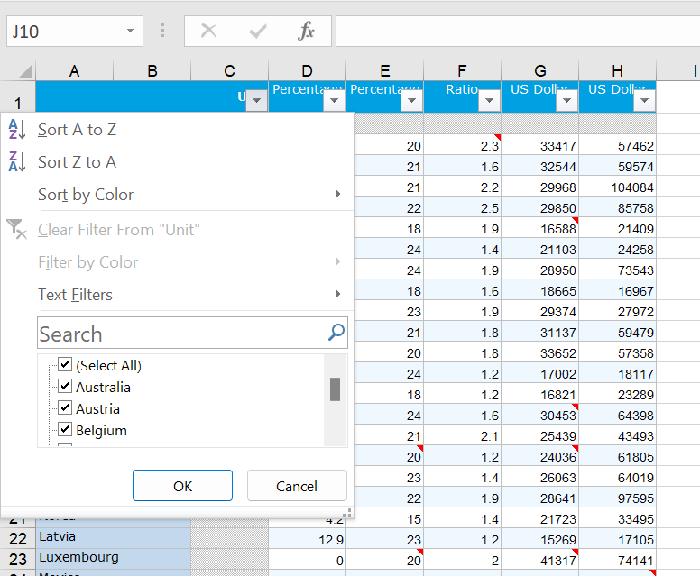
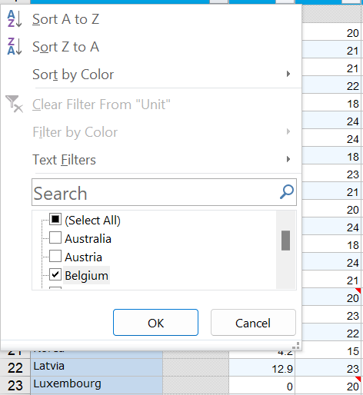
Step 5: Click arrow down to sort column
Make sure to unselect all, then select all relevant input (for this example: Belgium, Canada, Chile, Greece, Korea, Hungary, Mexico, Switzerland, Turkey, United States). Click apply after.
Sakata, S., Aklilu, A. Z., & Pizarro, R. (2024, June 13). Greenhouse gas emissions data: Concepts and data availability. Organisation for Economic Co-operation and Development. https://www.oecd.org/en/publications/greenhouse-gas-emissions-data_b3e6c074-en.html
© Anne MacLennan, 2024​​​

Slide 10
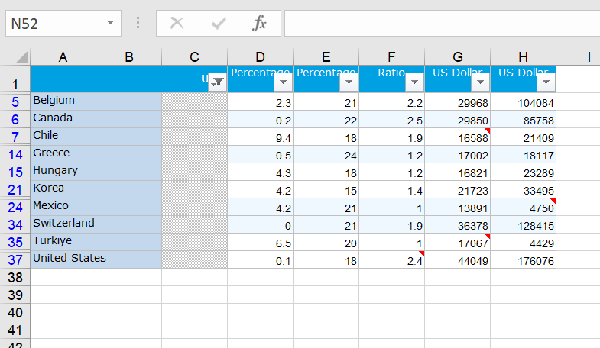
This is how it should look after completing Step 5
Sakata, S., Aklilu, A. Z., & Pizarro, R. (2024, June 13). Greenhouse gas emissions data: Concepts and data availability. Organisation for Economic Co-operation and Development. https://www.oecd.org/en/publications/greenhouse-gas-emissions-data_b3e6c074-en.html
© Anne MacLennan, 2024​​​

Slide 11
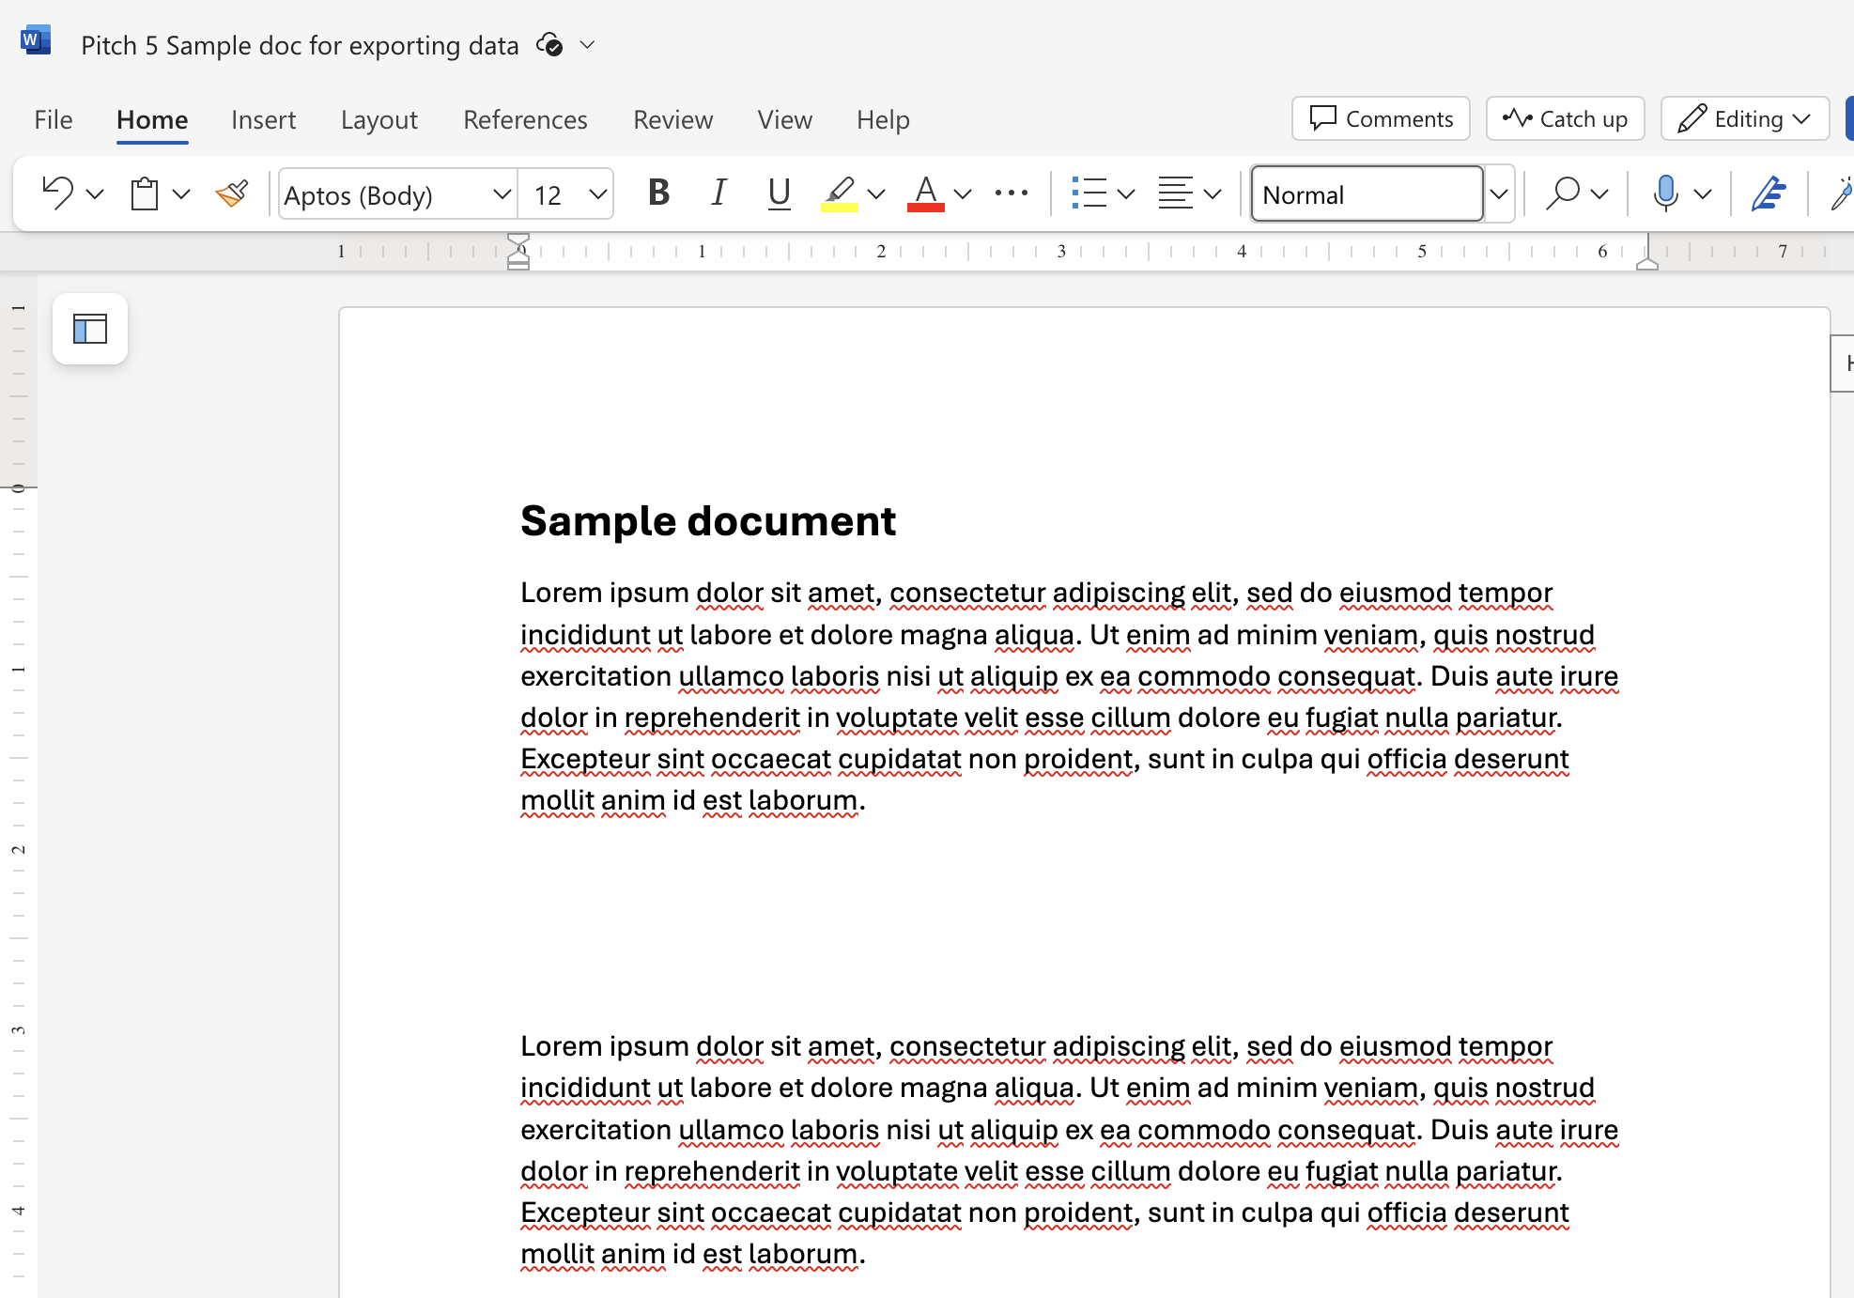
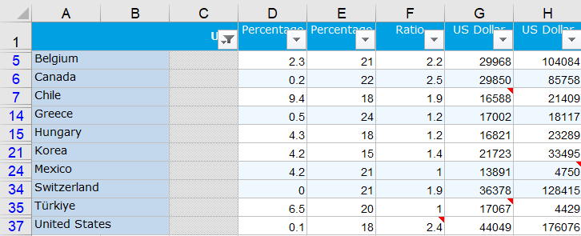
Ways to move data from Excel to Word file
This is an Excel tip only ​​​​​​
Sakata, S., Aklilu, A. Z., & Pizarro, R. (2024, June 13). Greenhouse gas emissions data: Concepts and data availability. Organisation for Economic Co-operation and Development. https://www.oecd.org/en/publications/greenhouse-gas-emissions-data_b3e6c074-en.html
© Anne MacLennan, 2024​​​

Slide 12
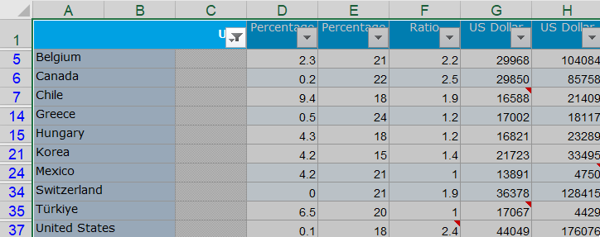
Copy Pasting Step 1: Selecting Data
Click top left cell > hold shift > click bottom right cell to highlight all information
This is an Excel tip only
Sakata, S., Aklilu, A. Z., & Pizarro, R. (2024, June 13). Greenhouse gas emissions data: Concepts and data availability. Organisation for Economic Co-operation and Development. https://www.oecd.org/en/publications/greenhouse-gas-emissions-data_b3e6c074-en.html
© Anne MacLennan, 2024​​​

Slide 13
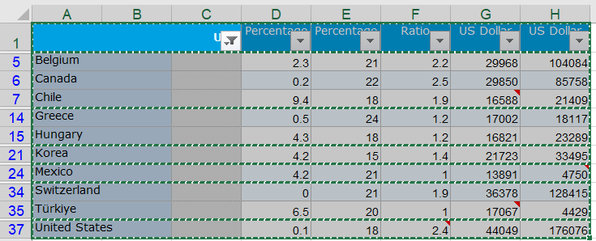
Step 2: Copying and Pasting Data
Ctrl + c (PC) or command + c (Mac) then Ctrl + v (PC) or command + v (Mac) into section in Word file
This is an Excel tip only
Note: marching ants border indicates that the data is copied and ready for pasting
Sakata, S., Aklilu, A. Z., & Pizarro, R. (2024, June 13). Greenhouse gas emissions data: Concepts and data availability. Organisation for Economic Co-operation and Development. https://www.oecd.org/en/publications/greenhouse-gas-emissions-data_b3e6c074-en.html
© Anne MacLennan, 2024​​​

Slide 14
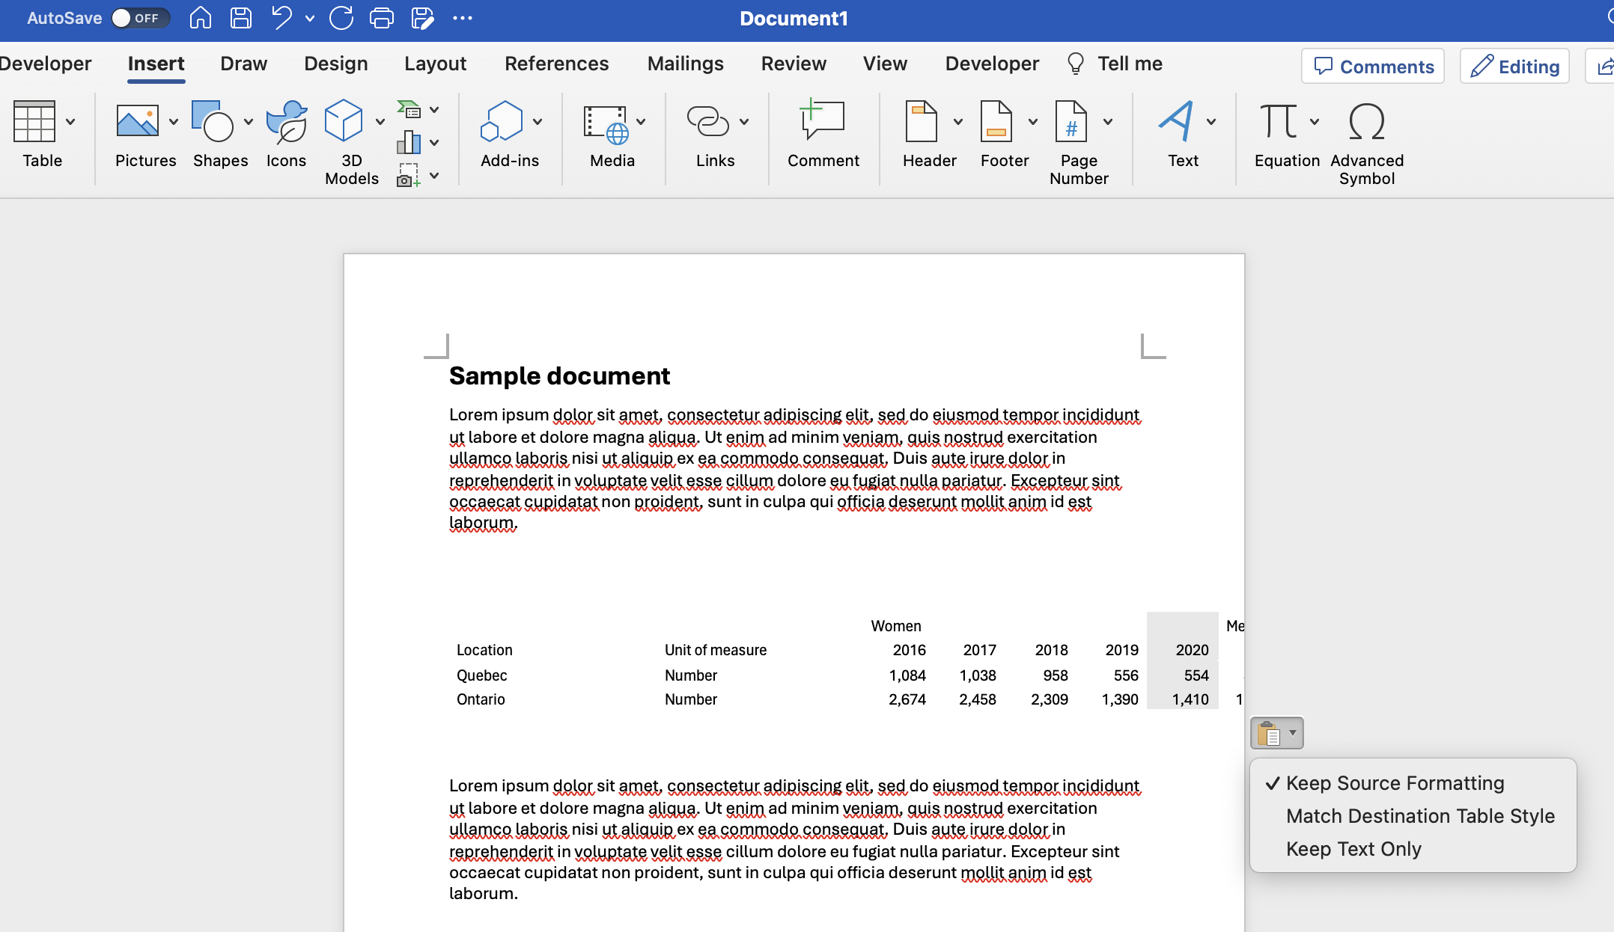
Step 3: Copying and Pasting Data
Ctrl + c (PC) or command + c (Mac) then Ctrl + v (PC) or command + v (Mac) into section in Word file
Sakata, S., Aklilu, A. Z., & Pizarro, R. (2024, June 13). Greenhouse gas emissions data: Concepts and data availability. Organisation for Economic Co-operation and Development. https://www.oecd.org/en/publications/greenhouse-gas-emissions-data_b3e6c074-en.html
© Anne MacLennan, 2024​​​

Slide 15
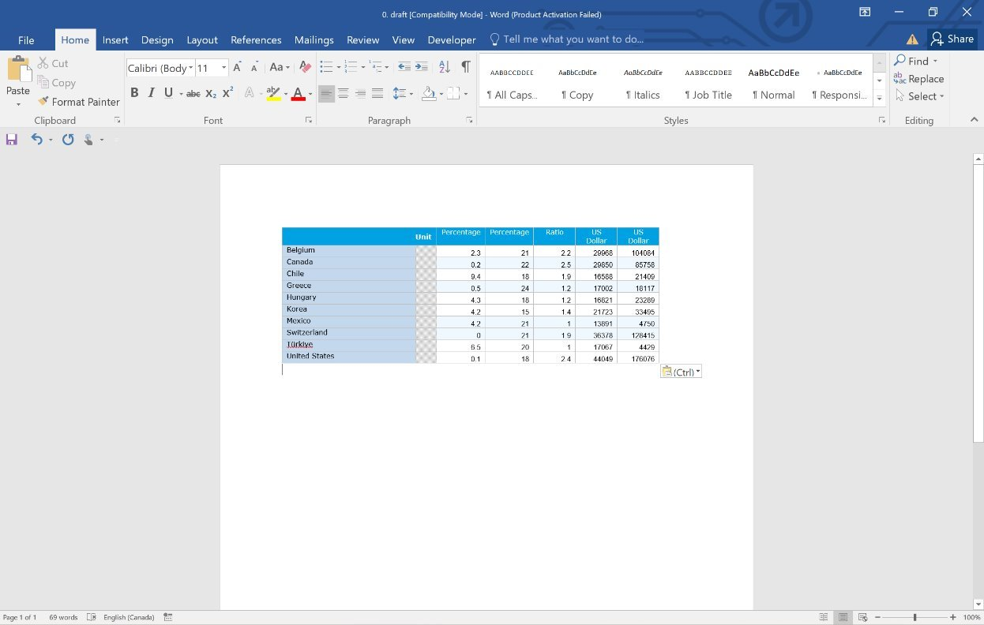
Step 4: Fixing the formatting
Keep source formatting uses the same fonts and styles as the Excel sheet, match destination table style converts the copied data into the document's style
Make changes as needed
Sakata, S., Aklilu, A. Z., & Pizarro, R. (2024, June 13). Greenhouse gas emissions data: Concepts and data availability. Organisation for Economic Co-operation and Development. https://www.oecd.org/en/publications/greenhouse-gas-emissions-data_b3e6c074-en.html
© Anne MacLennan, 2024​​​

Slide 16
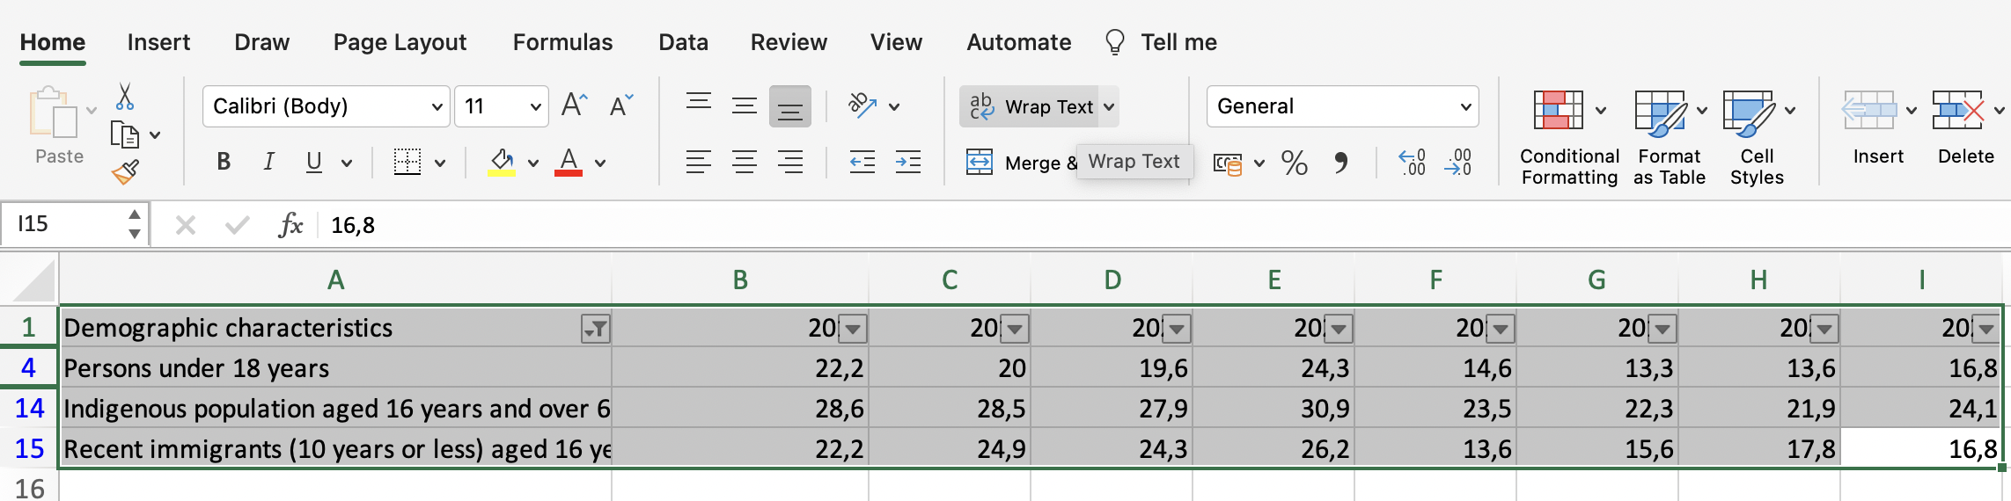
Step 5: Fixing the Formatting
You can copy paste your table into a new file to fix formatting easier
Make sure all text is seen by clicking cell and clicking text wrap button
Sakata, S., Aklilu, A. Z., & Pizarro, R. (2024, June 13). Greenhouse gas emissions data: Concepts and data availability. Organisation for Economic Co-operation and Development. https://www.oecd.org/en/publications/greenhouse-gas-emissions-data_b3e6c074-en.html
© Anne MacLennan, 2024​​​​

Slide 17
Screenshot Step 1: Taking a Screenshot
Windows key + print scr (PC)
Shift + control + command + 3 (Mac)
© Anne MacLennan, 2024​​​​​

Slide 18
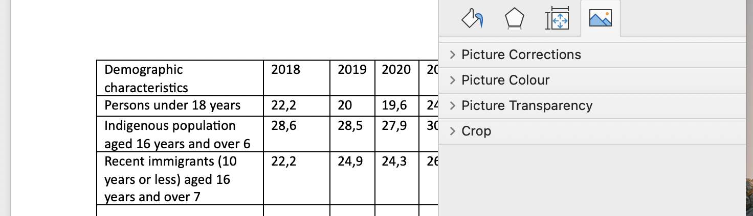
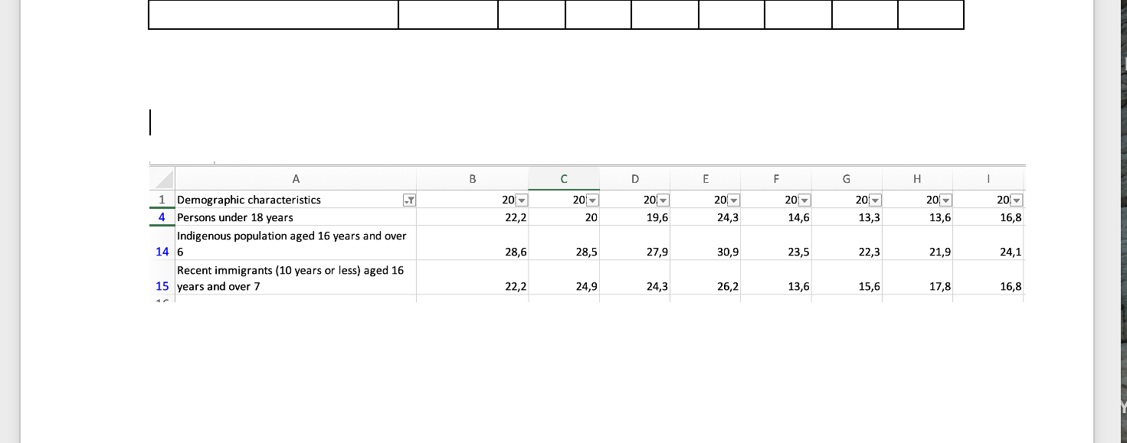
Screenshot Step 2: Pasting a Screenshot
Go to Word document then press
  Ctrl + V (PC)
  Command + V (Mac)
Double click to crop and edit
Edit as needed
Sakata, S., Aklilu, A. Z., & Pizarro, R. (2024, June 13). Greenhouse gas emissions data: Concepts and data availability. Organisation for Economic Co-operation and Development. https://www.oecd.org/en/publications/greenhouse-gas-emissions-data_b3e6c074-en.html
© Anne MacLennan, 2024​​​​​​

Slide 19
References
Department of Economic and Social Affairs (2024). The sustainable development goals report 2024. United Nations. https://unstats.un.org/sdgs/report/2024/The-Sustainable-Development-Goals-Report-2024.pdf.
Sakata, S., Aklilu, A. Z., & Pizarro, R. (2024, June 13). Greenhouse gas emissions data: Concepts and data availability. Organisation for Economic Co-operation and Development. https://www.oecd.org/en/publications/greenhouse-gas-emissions-data_b3e6c074-en.html
© Anne MacLennan, 2024​​​​​​

