Slide 1

Loglines
How to captivate an audience in 40 words or less.

Slide 2

Time | Activity
5 minutes | Presentations and Introduction
10 minutes | Part 1: Quiz: Which film or television series is this?
15 minutes | Part 2: What is a “logline”?
15 minutes | Part 3: Trailers Activity
10 minutes | Part 4: How to Write a Logline with the List Method
15 minutes | Part 5: Write Your Own Logline
5 minutes | Reflections, Thank Yous, and Survey Links

Slide 3

Part 1: Quiz!

Slide 4

Mentimeter: Which Film or Television Series is This?
Quiz!
Notes:
Presenter link: https://www.mentimeter.com/app/presentation/f26ae921d12a7c6ad804b7534d383cc4
Students go to www.menti.com and enter the PIN that appears on the presenter’s screen

Slide 5

Go to mentimeter.com and enter the code 3812 6619 or scan the QR code:

Slide 6

Part 2:
What is a Logline?

Slide 7
A one or two sentence synopsis of a program, script, screenplay, or book, often used to sell the work to a producer or publisher.
(dictionnary.com)

Slide 8
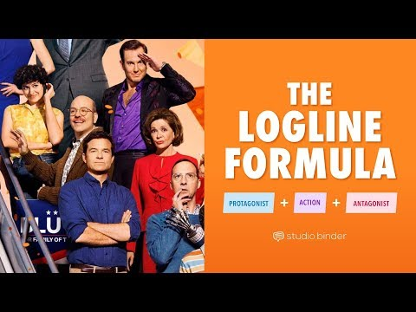
How to Write a Logline:

Slide 9

Story Elements
Inciting incident
Protagonist
Goal
An unexpected and disruptive event that happens to the protagonist and ends the normality of their life thus setting off the main plot of the story.
The main character. The character whose decisions drive the plot of the story forward.
What the protagonist needs to accomplish by the end of the story. It is always linked to the Inciting Incident and (in a good story) cannot be completed until the protagonist undergoes some level of internal change.

Slide 10
Story Elements
Conflict or antagonist
Action
Stake
The character, force, or thing that works against the protagonist, preventing them from accomplishing their goal.
What the protagonist does to accomplish their goal.
The consequences of the protagonist not accomplishing their goal.

Slide 11

The Logline Formulas
Formula A (Character-led):
Formula B (Story-Led):
  Inciting Incident
  + Protagonist
  + Action
  + Antagonist
  Protagonist
  + Action
  + Antagonist
  + Goal
  + Stake

Slide 12

The Logline Formulas
Neither logline formula is better than the other.
Choose whichever formula works best for your personal writing style. Different stories will be showcased best by different logline formulas.
There is no real way of knowing which formula will work best until you've tried out a few different versions or drafts.
For the purposes of today’s workshop, you need only to write one or two drafts. Today's about learning how to write a logline, not how to write the best logline.

Slide 13
The Logline Formulas
Loglines should always be forty (40) words or less.
  Like an elevator pitch, but for a story.
Loglines should always be written in present tense.
  This helps to place the reader "in the action" and make the story feel more exciting and interesting.

Slide 14
Logline a:
Logline B:
When her younger sister is chosen to compete in a televised death-match for the entertainment of the elite, an impoverished teenage archer volunteers to replace her, making her a media darling, and an enemy of the corrupt government.
An impoverished teenage archer captures the public’s heart, but the government’s enmity, while she fights to survive a televised death-match so she can return home to care for her younger sister and ill mother.
Story-led
Character-led

Slide 15
Logline A:
Inciting Incident
When her younger sister is chosen to compete in a televised death-match for the entertainment of the elite, an impoverished teenage archer volunteers to replace her, making her a media darling, and an enemy of the corrupt government.
Protagonist
Action
Antagonist

Slide 16
Logline B:
Protagonist
Action
An impoverished teenage archer captures the public’s heart, but the government’s enmity, while she fights to survive a televised death-match so she can return home to care for her younger sister and ill mother.
Antagonist
Goal
Stake

Slide 17

Part 3: Trailers Activity

Slide 18

Trailers Activity
In groups:
Scan the QR code to access the links for the activity.
Follow the links and view your group's assigned trailer.
Using either logline formula, write a logline for the story advertised by the trailer you chose.
After 10 minutes, 2-3 groups will share their loglines with the class.
Loglines: How To Captivate an Audience in Forty Words Or Less.

Slide 19

Part 4:
The List Method

Slide 20

The List Method
During the next activity we will work together as a class to create our very own original logline.
We will go through all story elements, one at a time, and create a list of ideas for each element.
Before moving on to the next story element we will choose ONE idea from the list we just created and use that as a basis for the next list.

Slide 21
The List Method
For example, if we choose "Beach" as our Story World/Setting then all the ideas we suggest for the Protagonist must be characters that you could find in a beach setting. Each new element must add to the previously chosen elements in a logical manner.
You will have 60 seconds per story element to suggest as many ideas as possible. So, try not to overthink your suggestions! Just suggest ideas as they pop into your head!
Be respectful and supportive while making suggestions AND of other people's suggestions. Any meanness will not be tolerated.

Slide 22
Some very good writing advice:
Something is better than nothing; done is better than perfect.
Loglines: How To Captivate an Audience in Forty Words Or Less.

Slide 23
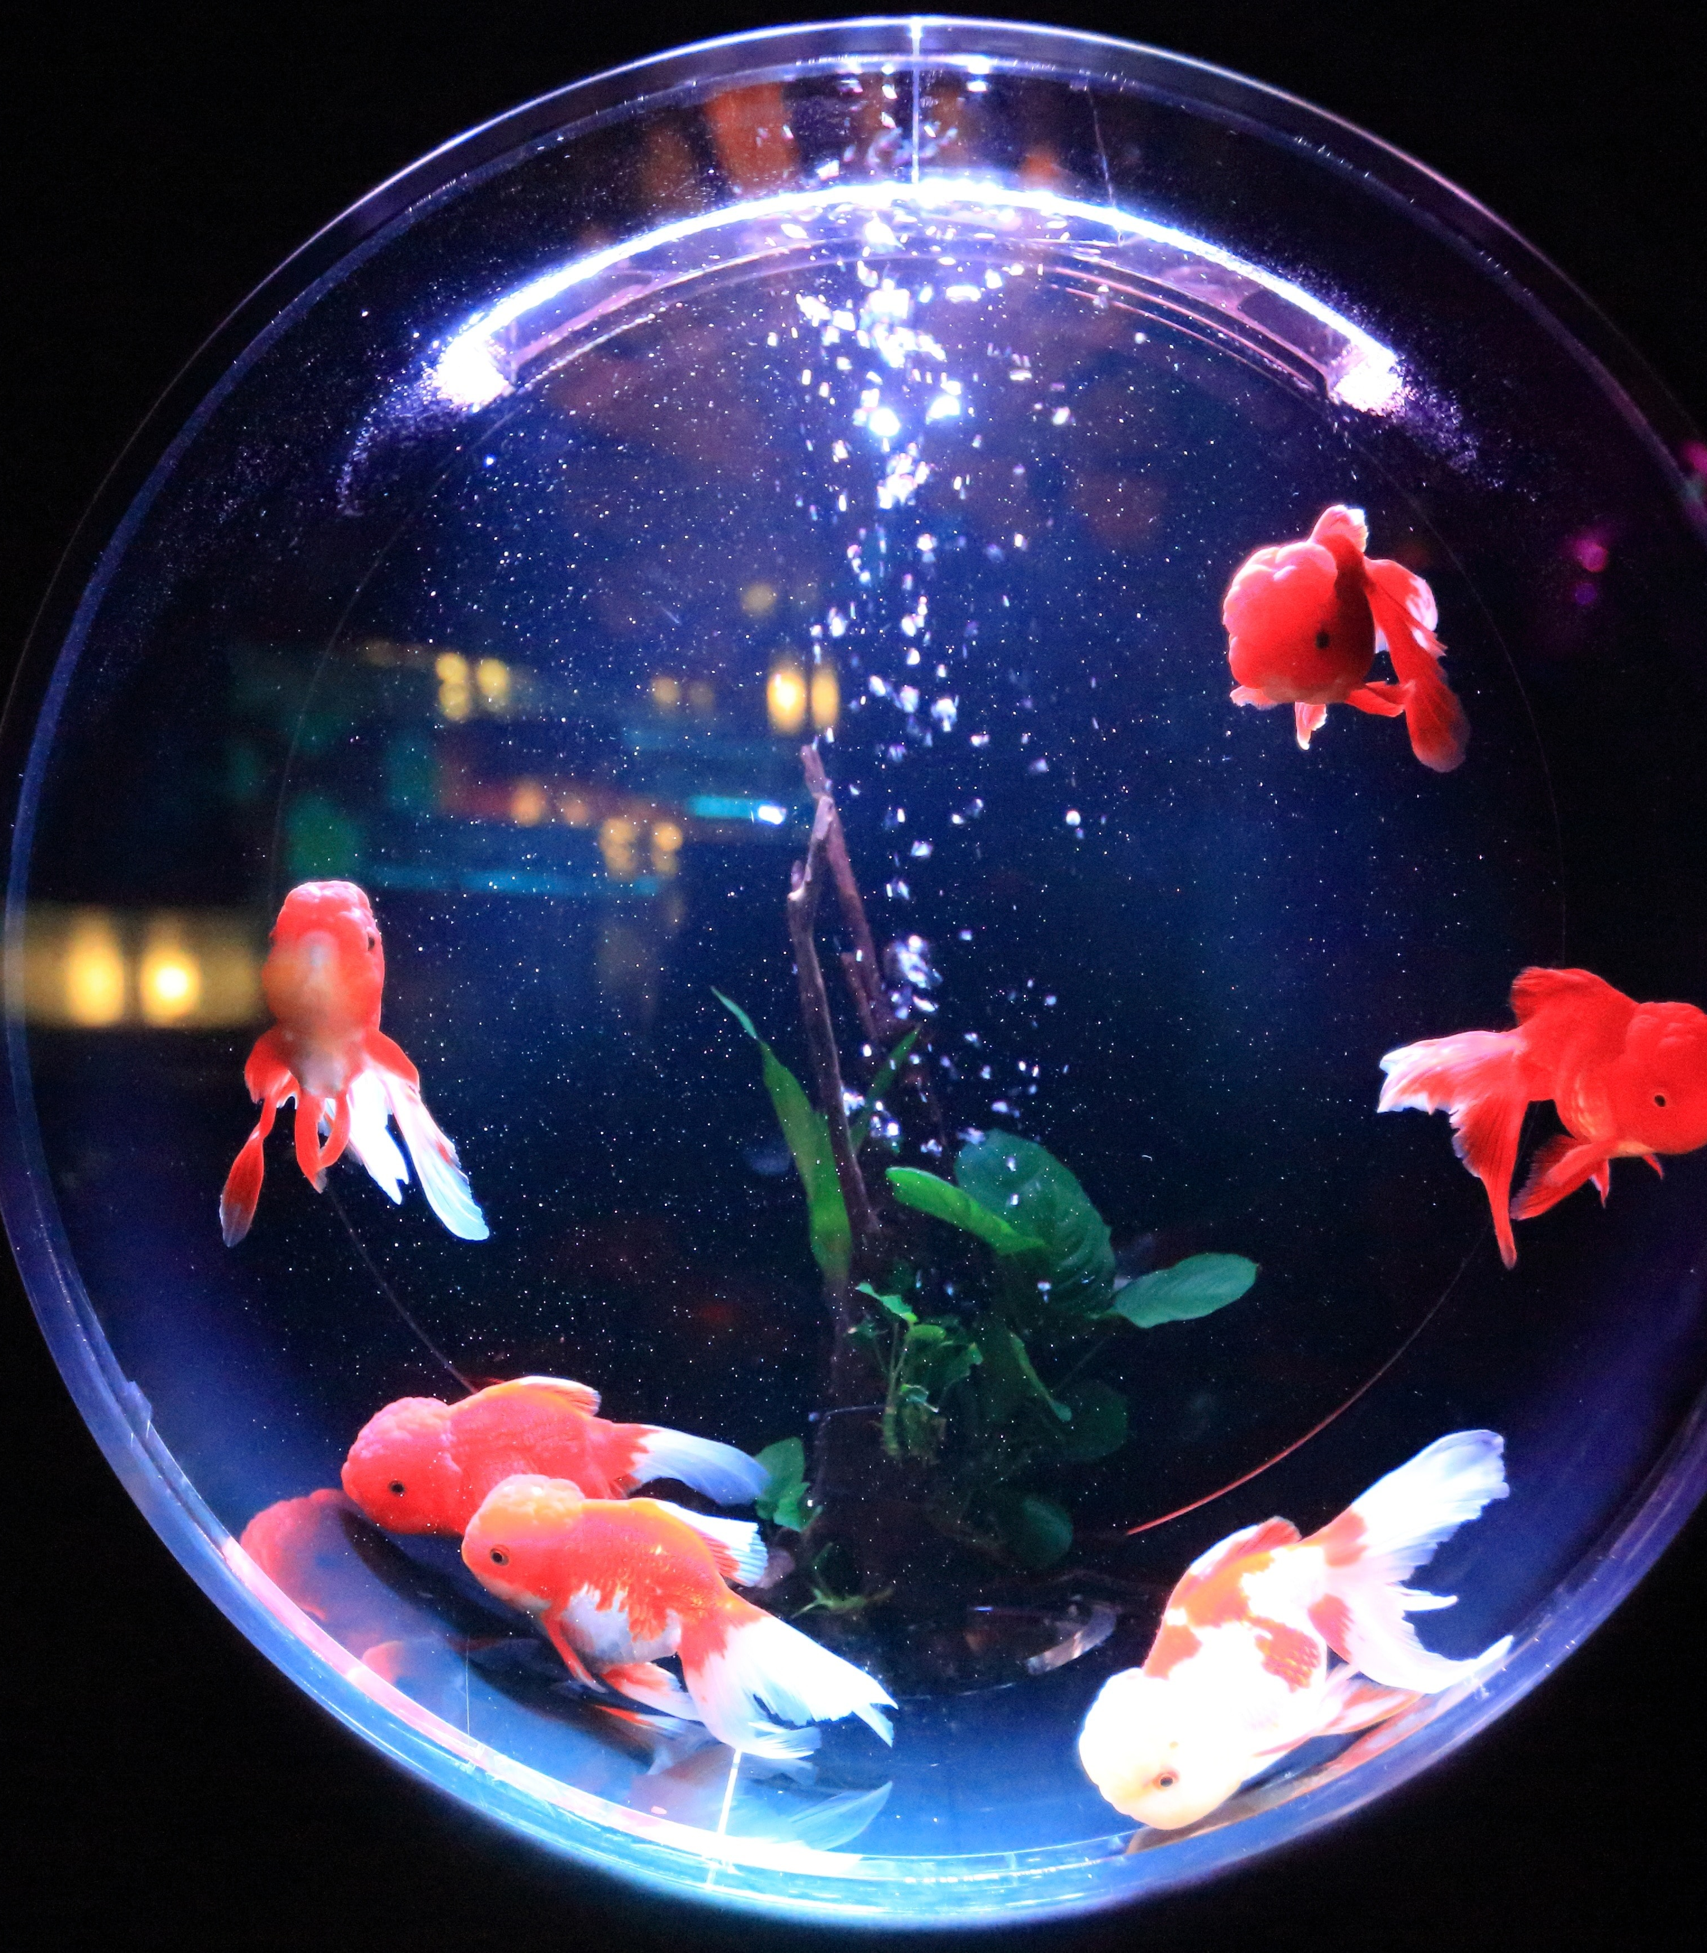
ROUND 1: STORY WORLDS/SETTINGS
The time and/or place where the story happens.

Slide 24

ROUND 2: PROTAGONISTS
Main characters who could exist in your chosen story world or setting.

Slide 25

ROUND 3: GOALS
What does your protagonist need to accomplish before the story is over?

Slide 26

ROUND 4: CONFLICTS OR ANTAGONISTS
Who or what is preventing your protagonist from achieving their goal?

Slide 27

ROUND 5: STAKES
What bad thing will happen if the protagonist does not achieve their goal?

Slide 28

ROUND 6: INCITING INCIDENTS
What event happens to the protagonist that disrupts their normal life?

Slide 29

FINAL ROUND: LOGLINE!
Let's combine all those story elements together into one logline.

Slide 30

Part 5:
Write Your Own Logline

Slide 31

Write Your Own Logline
10 minutes to think of an original story idea for any format (TV series, film, video game, novel, etc).
You may use the list method to generate ideas or write a logline for an idea you already have.
You must have one original logline by the end of the 10 minutes. (Even if you think it's terrible.)
Remember: Something is better than nothing; done is better than perfect.

Slide 32


Market Access Strategy for Official Language Minority Communities (OLMC) Fund
A fund available to professional artists belonging to an Official Language Minority Community (Anglophones within Quebec or Francophones outside of Quebec).
Up to 60, 000$ to help with:
  Market research
  Mentorship and professional development
  Translation
  Etc.
Any type of professional artist can apply, meaning if you can create a project based on the logline you wrote today you could apply for this grant.
Loglines: How To Captivate an Audience in Forty Words Or Less.

Slide 33

Review
What are some new things you learned today?
Loglines: How To Captivate an Audience in Forty Words Or Less.

Slide 34
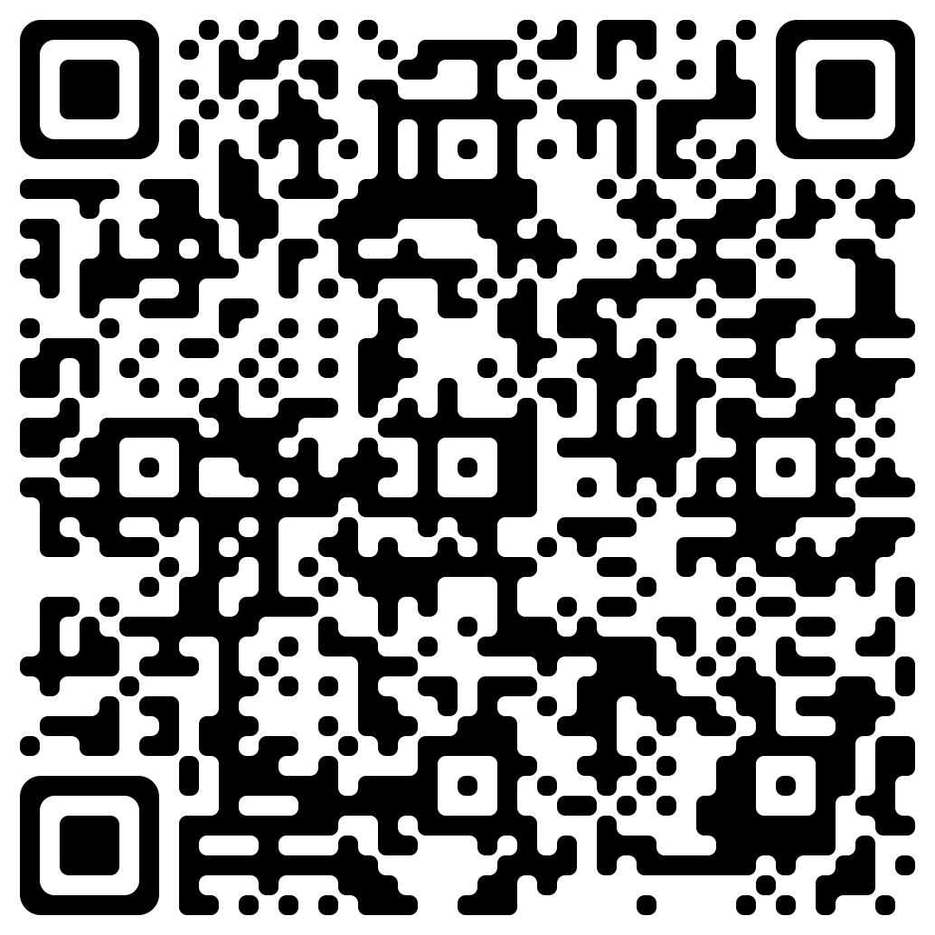

Survey, Final Thoughts, Questions
Loglines: How To Captivate an Audience in Forty Words Or Less.

Slide 35

THANK YOU!

