Slide 1
Rhythm, ‘Rhyme,’ and Preparatory Repetition in an Instrumental Genre
Cross-disciplinary and Multi-cultural Perspectives on Musical Rhythm
Third International Rhythm Workshop
NYU Abu Dhabi Institute, March, 10-21, 2017
Jay Rahn, York University
jayrahn@yorku.ca

Slide 2
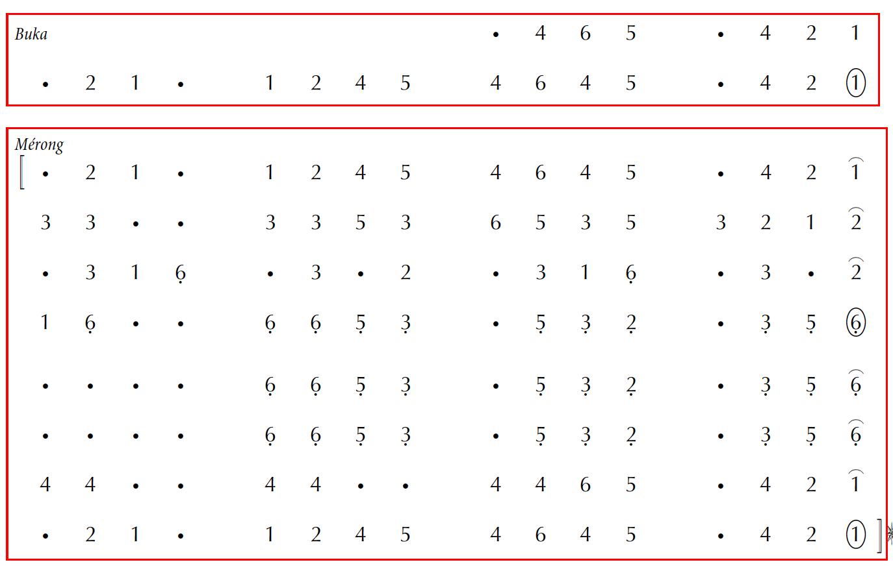
Buka and Mérong

Slide 3
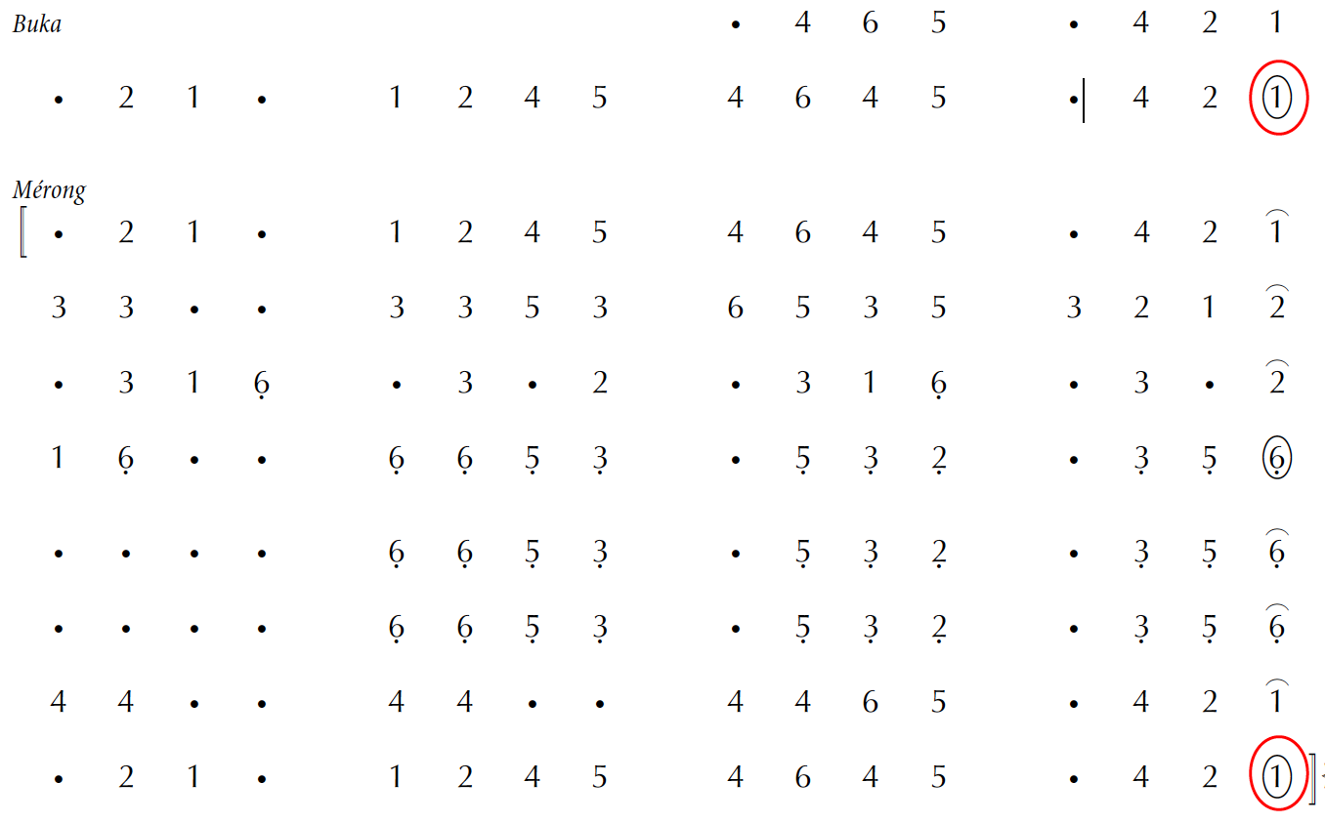
Gong Tones at End of Buka and Mérong

Slide 4
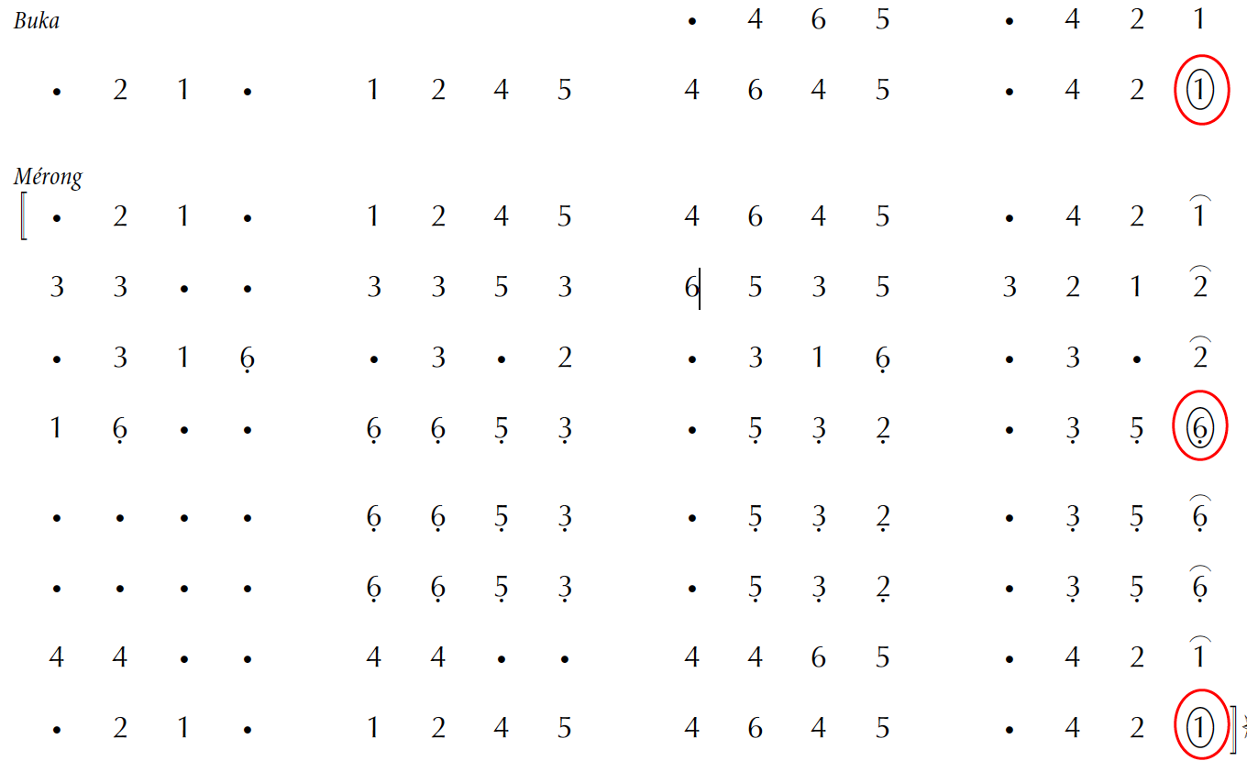
Another Gong Tone in Middle of Mérong

Slide 5
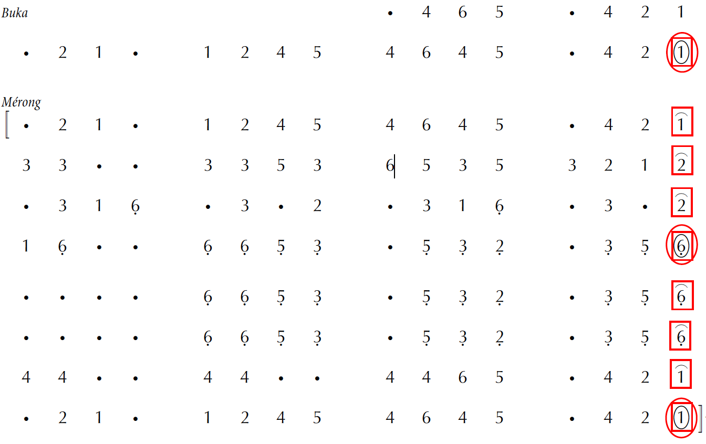
Kenong Tones between Gong Tones (inclusive)

Slide 6
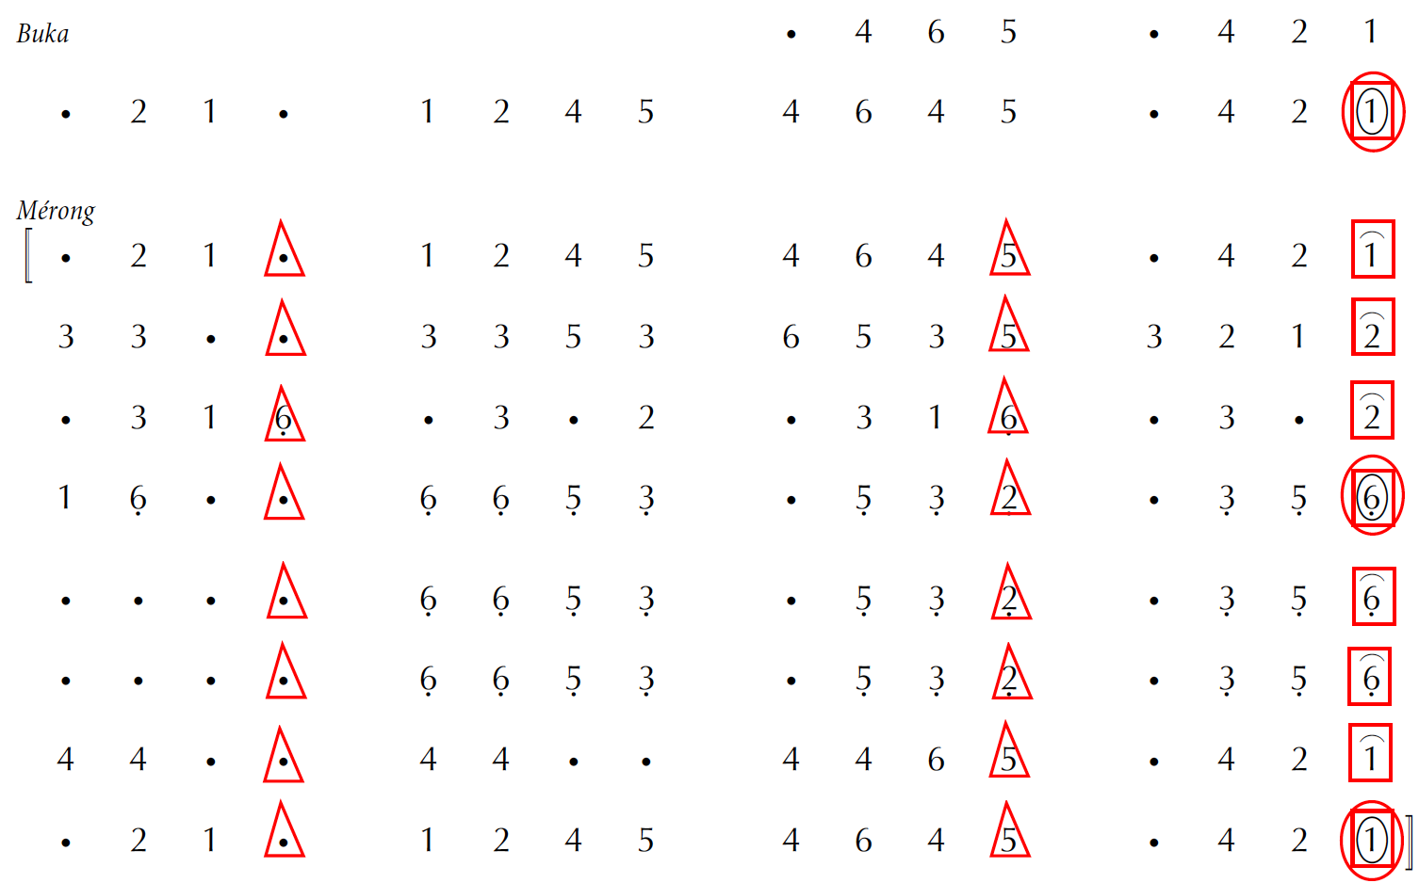
Kethuk Tones between Kenong Tones (exclusive)

Slide 7
According to Pak Cokro …
“The majority of buka are taken from the ending, the tail.”

Slide 8
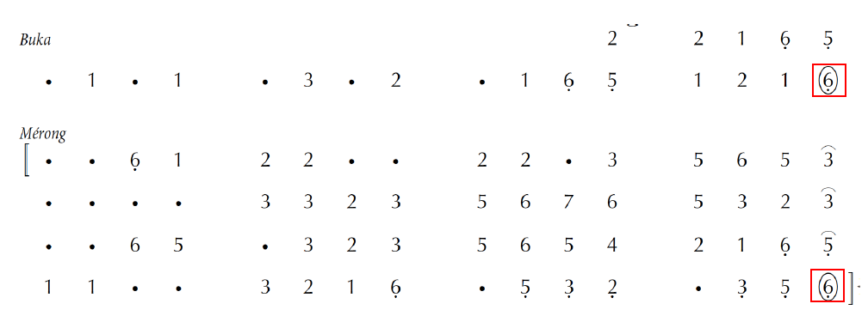
‘Rhyme’ at End of Buka and Mérong: 99%

Slide 9
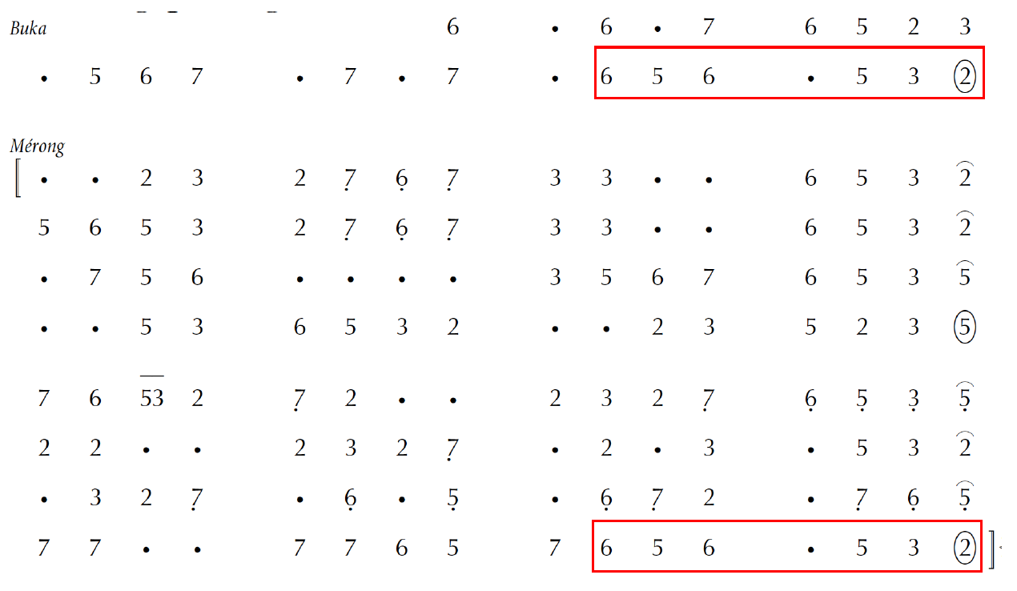
7-beat ‘Refrain’ at End of Buka and Mérong

Slide 10
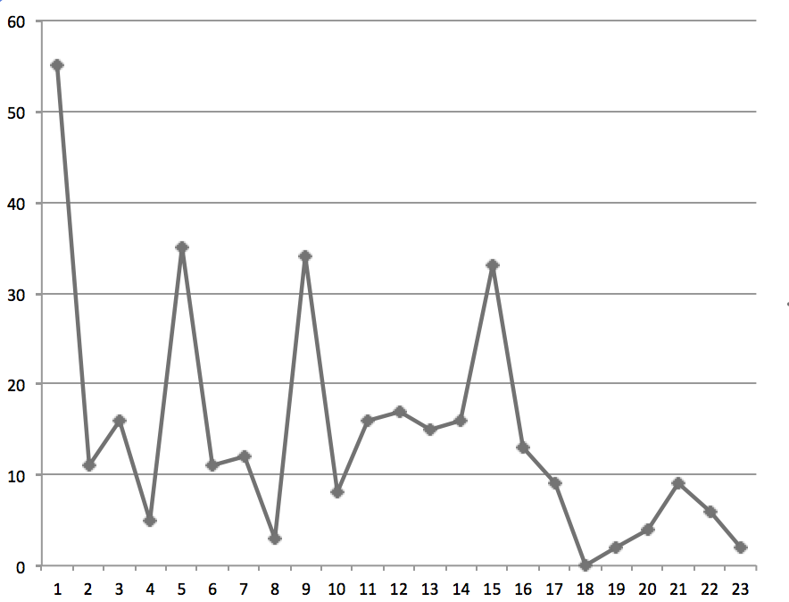
x-axis: ordinal number of beats (1st, 2nd , 3rd …) from the gong tone at which a buka/mérong rhyme or refrain begins y-axis: number of mérongs

Slide 11
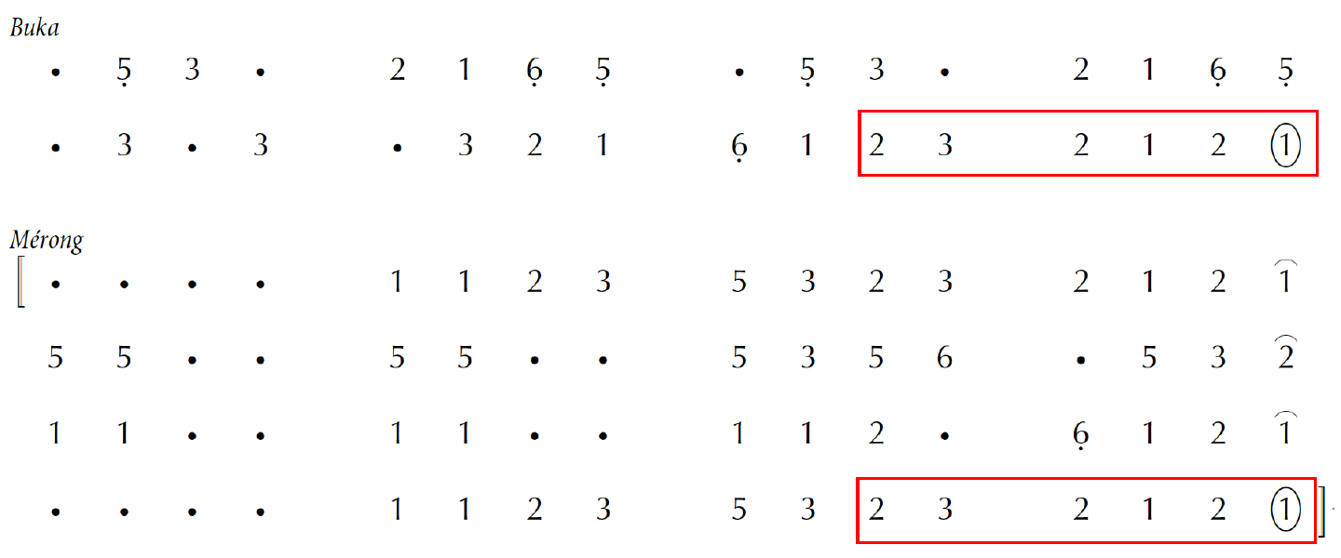
6-beat Buka/Mérong ‘Refrain’ in a 4-Nongan/16-Beat Mérong

Slide 12
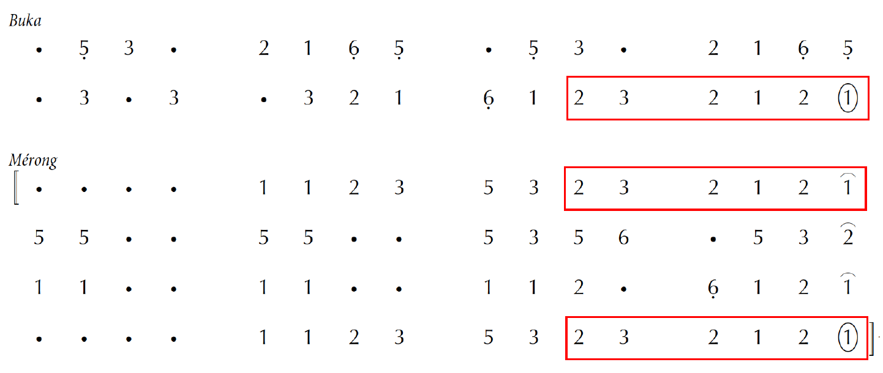
‘Internal Refrain’ at End of Mérong’s First Nongan

Slide 13
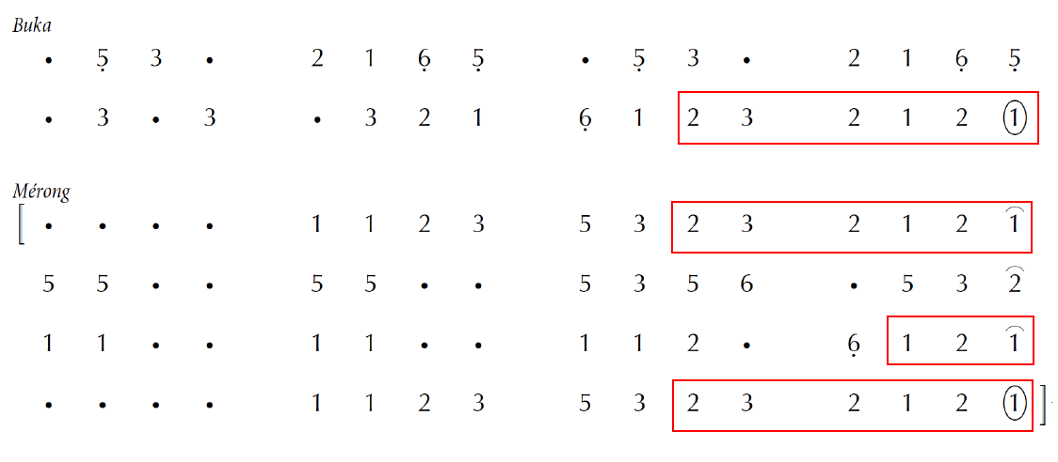
3-Beat ‘Refrain’ at End of 3rd Nongan

Slide 14
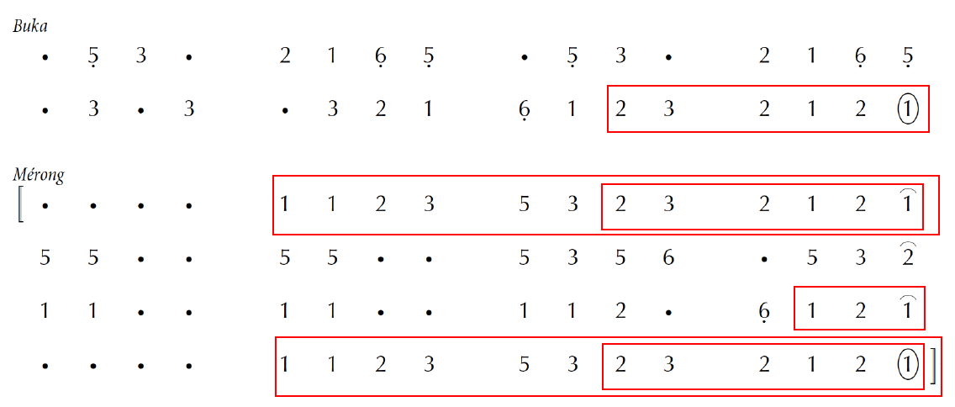
More Extensive ‘Refrain’ between
End of First Nongan and End of Mérong

Slide 15
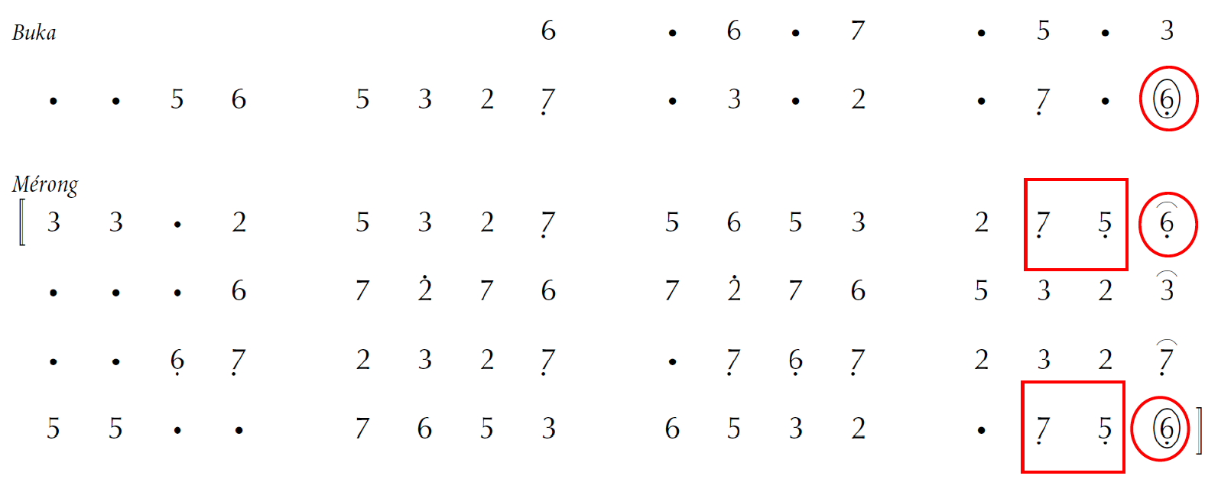
Preliminary Analysis:
Precise ‘Rhyme’ and ‘Refrain’

Slide 16
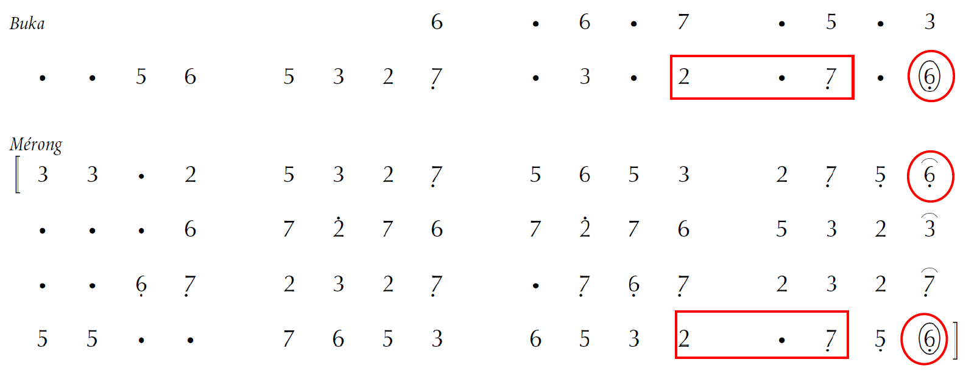
Intervening ‘Weak’ Beat

Slide 17
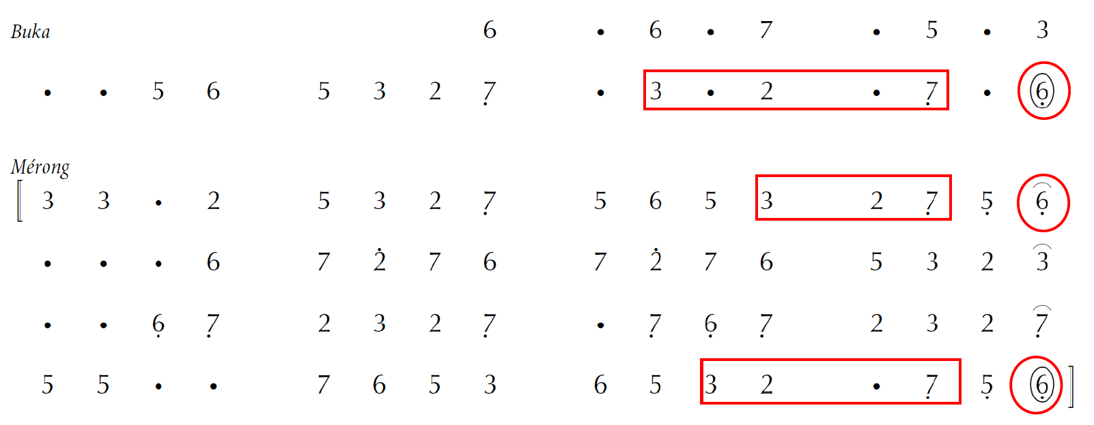
‘Metrical Displacement’

Slide 18
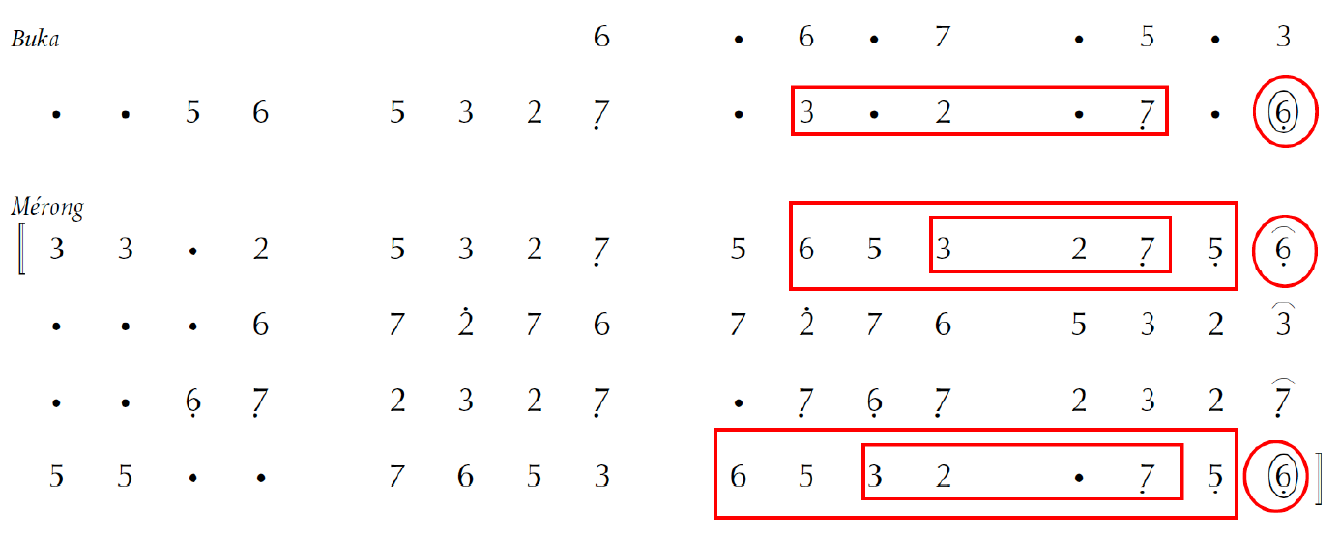
Further ‘Metrical Displacement’

Slide 19
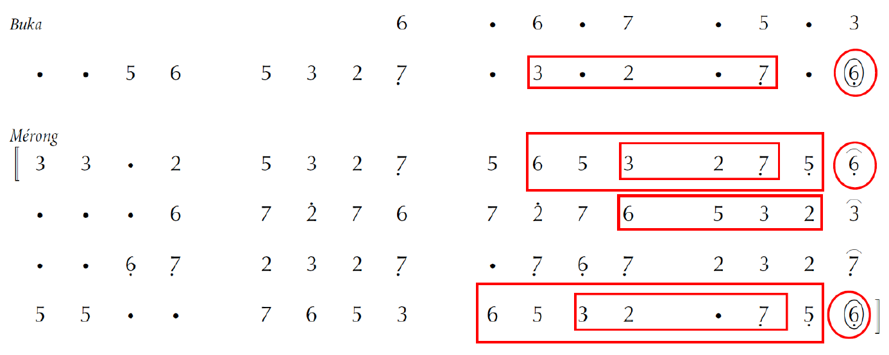
‘Deceptive Refrain’

Slide 20
Analytical Method
Garden path?
Step time: pélog scales
→ Step time + Measured time: time intervals
Start at most prominent times
Work backwards in time
Confirm ‘findings’ via recurrence

Slide 21
Thanks!
Any questions? Comments?

