Slide 1
Finding and documenting the locations of Residential Schools in Canada
Rosa Orlandini
Associate Librarian (Maps and GIS)
York University, Tkoronto
May 31st, 2019

Slide 2
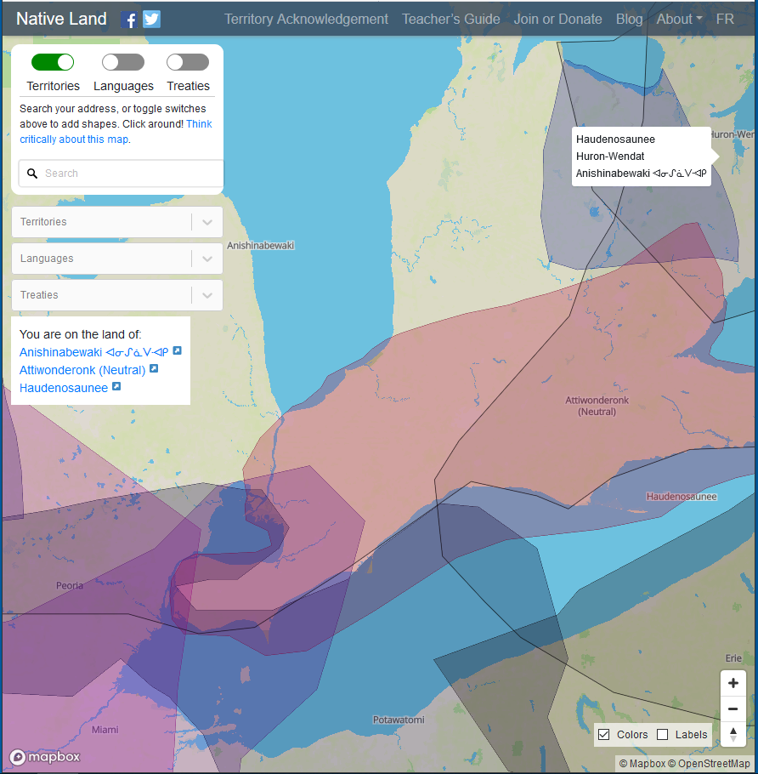
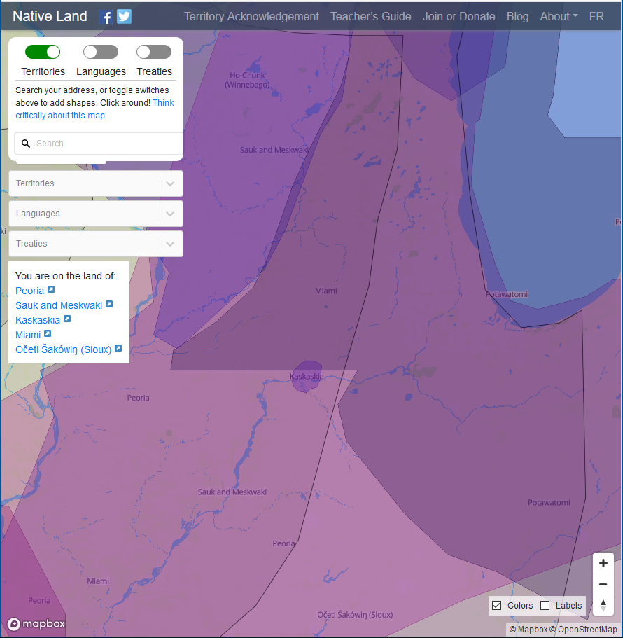
Source: https://native-land.ca/
Notes:
Introduction slide

Slide 3
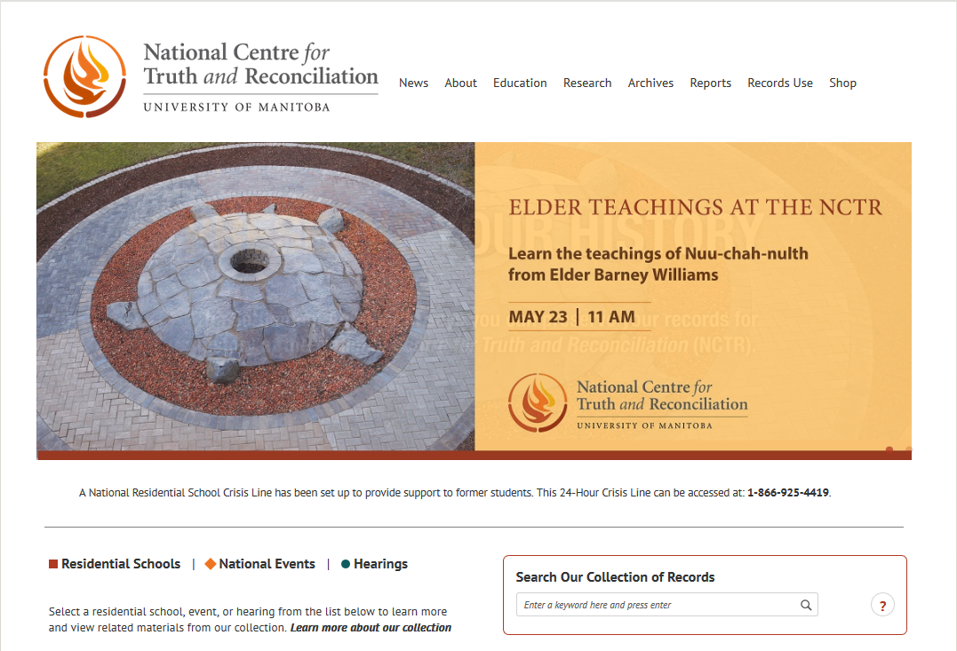
Source: https://nctr.ca/map.php

Slide 4
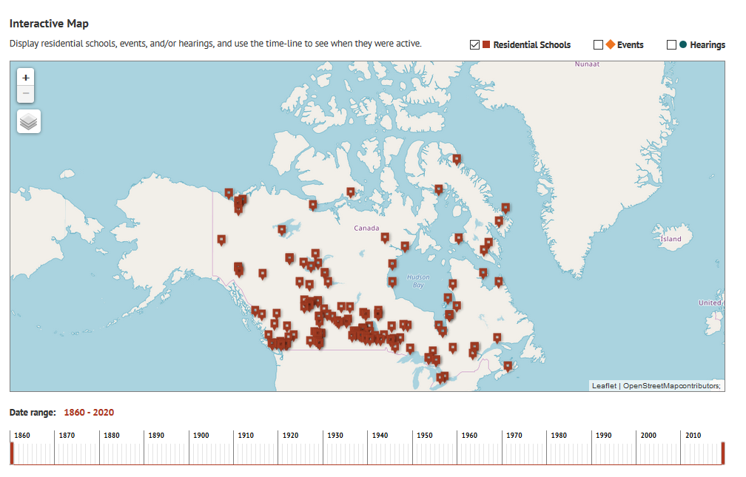
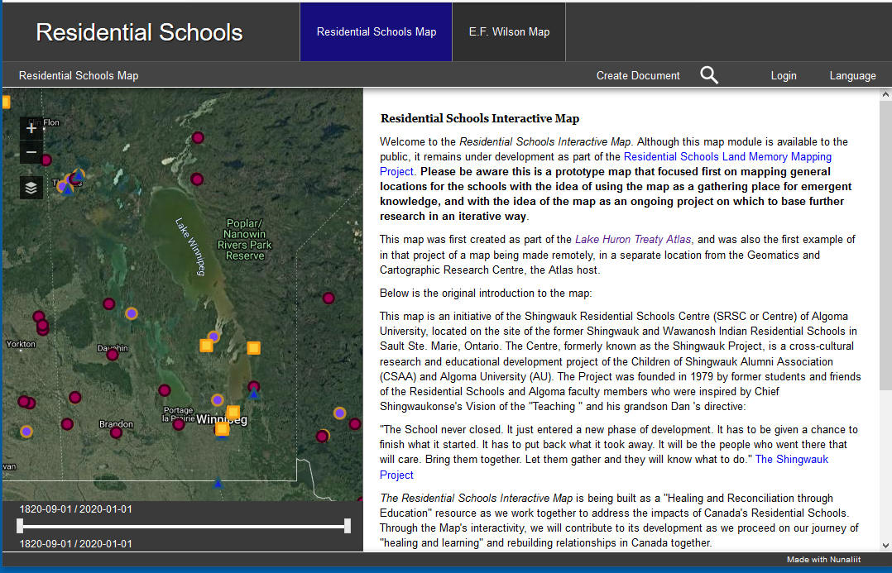


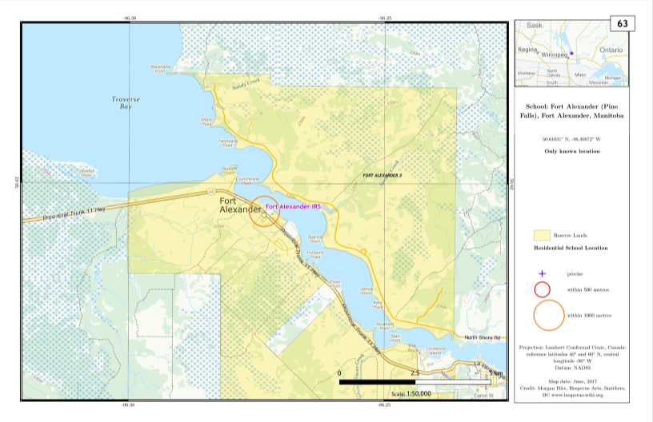
Partnerships
NCTR Archives Director: Raymond Frogner
https://nctr.ca/map.php
RSIM Project Lead: Stephanie Pyne Ph.D
https://lhta.ca/residentialschools/index.html
Atlas of Indian Residential Schools in Canada : Morgan Hite
http://hesperus-wild.org/GIS_carto/IRS.html

Slide 5
Objectives
Create a geospatial dataset that describes and visualizes each residential school location
Create a bibliography of cartographic and text base sources that describe/visualize residential school locations.
Share my findings with partners and provide access to the bibliography and geospatial dataset

Slide 6
Methodology
Compare and review location information and documentation for the school provided by NCTR, Hite, and Pyne
Determine if there is more than one location for the school
Find additional primary and secondary sources that describe and visualize the school location
Determine the latitude and longitude coordinates for school location and update the geospatial dataset
Create bibliographic and archival descriptions for each source used to determine the school location
Review the geospatial dataset of school locations & (quality control, editing, data verification)
Publish and describe the geospatial datasets & bibliography

Slide 7
Cartographic & Textual Sources

Slide 8
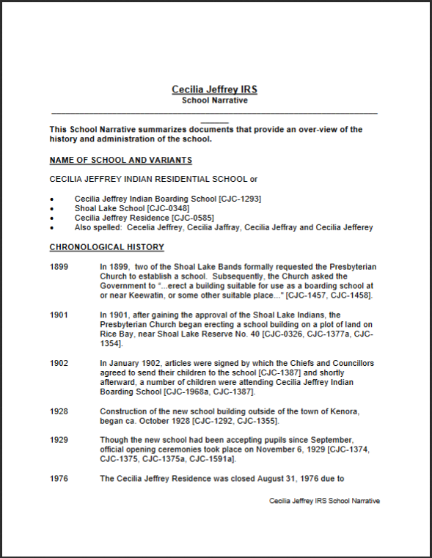
NCTR School Narratives
Cecilia Jeffrey IRS School Narrative, page 2 of 13.
Source: NCTR https://nctr.ca/School narratives/EAST/ON/CECILIA JEFFREY.pdf

Slide 9
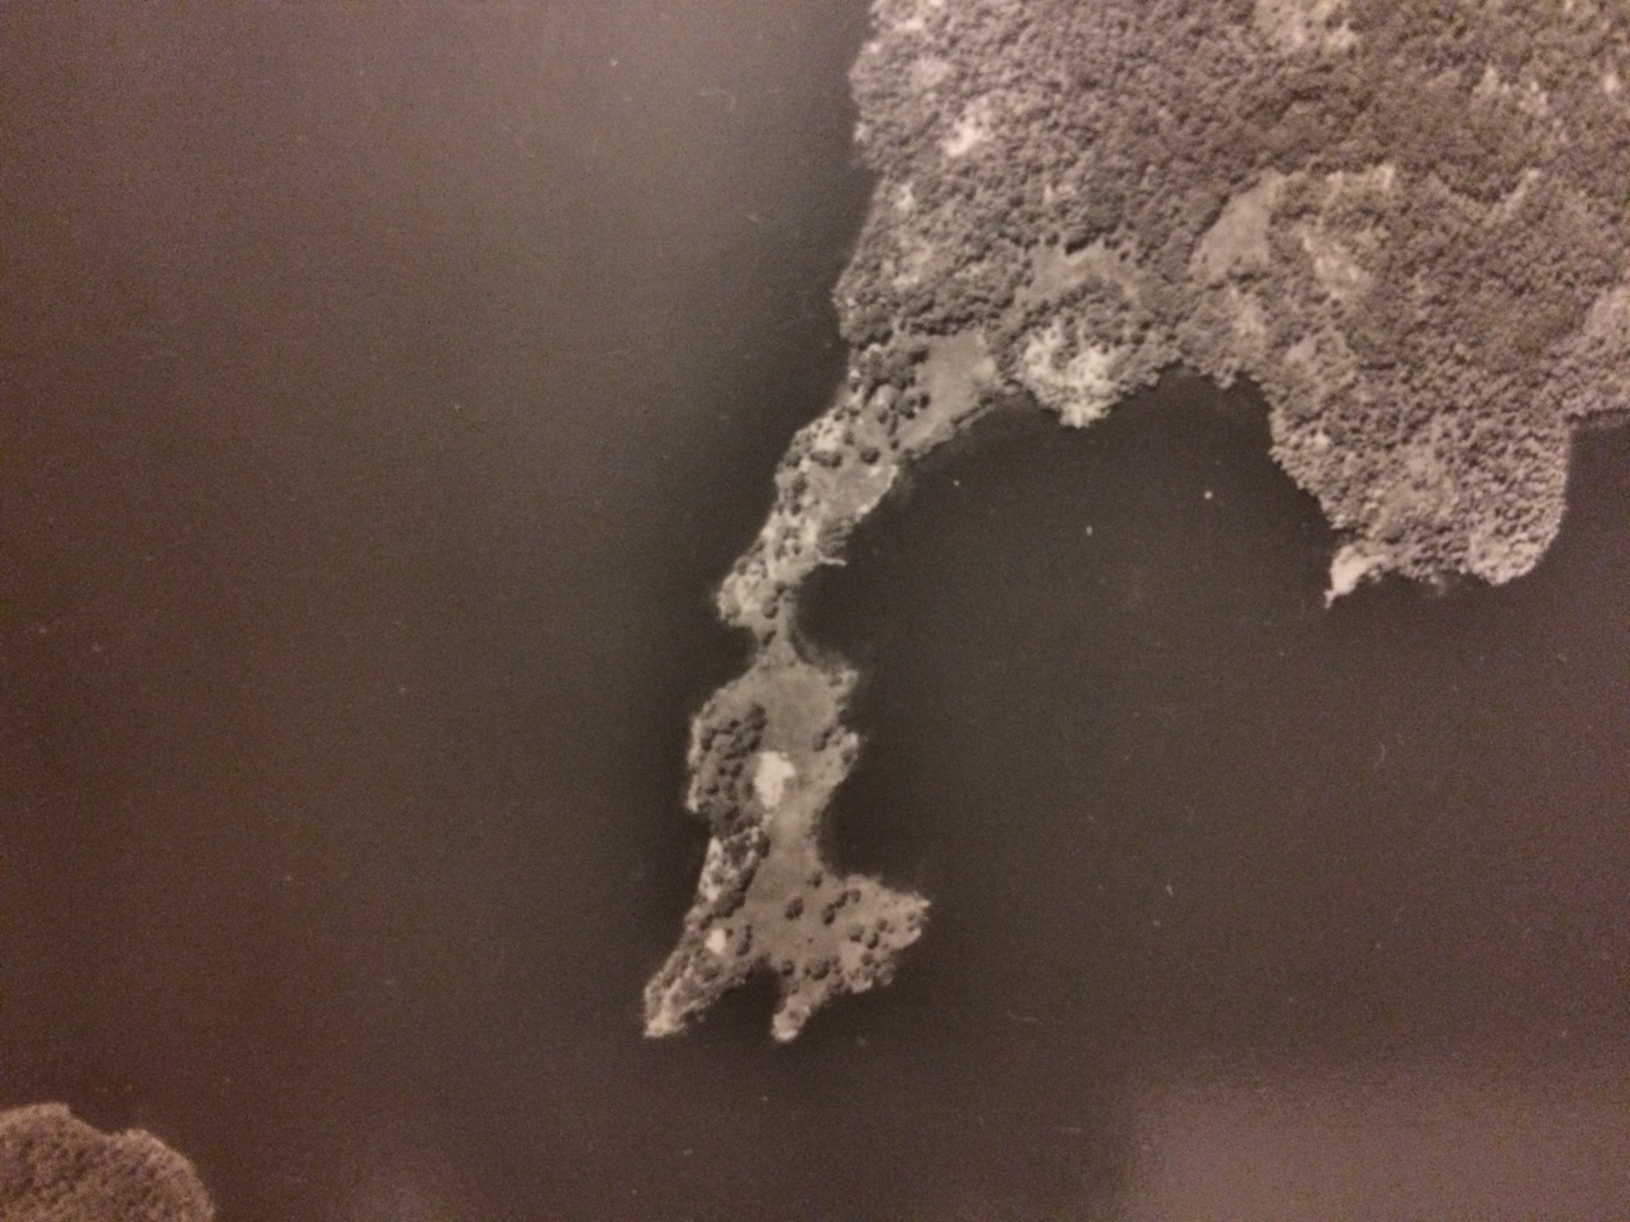
Aerial Photographs
Section of an aerial photograph showing the first location of Cecilia Jeffrey Residential School, Lake of the Woods, Treaty 3.
Source: Archives of Ontario, Forest Resource Inventory Fonds, FRI 1965 -R20-4924-119.

Slide 10
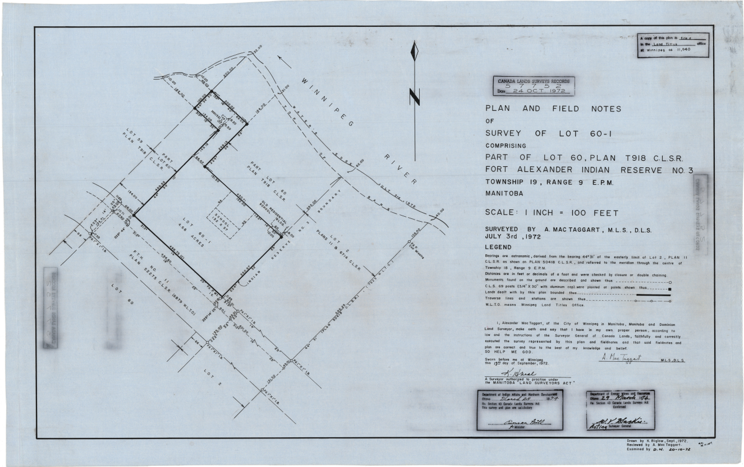
Canada Land Survey Plans
Canada Land Survey Plan 55752CLSR MB. Plan shows the location of the Residential School Building in Fort Alexander, Treaty 1.
URL:http://clss.nrcan.gc.ca/clss/plan/detail?id=57752+CLSR+MB

Slide 11
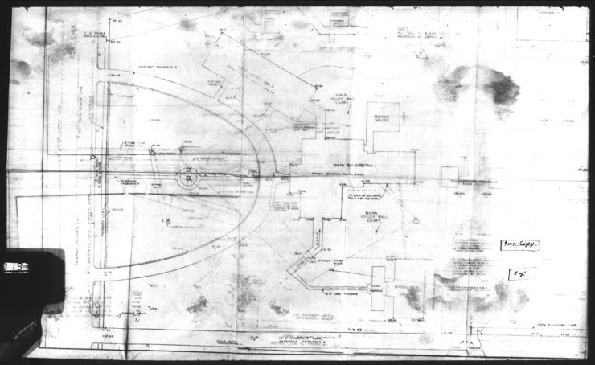
Engineering Site Plans
Portion of a “Site Plan: Proposed Addition Academy Road, Winnipeg”. [Assiniboia Residential School, Winnipeg, Treaty One]
Source: Library Archives Canada and Canadiana. RG 10, Volume 8621, File 506/6-1-019, Pt. 2. Microfilm c14238, images 1030 to 1033.
URL:http://heritage.canadiana.ca/view/oocihm.lac_reel_c14238/1032?r=0&s=1

Slide 12
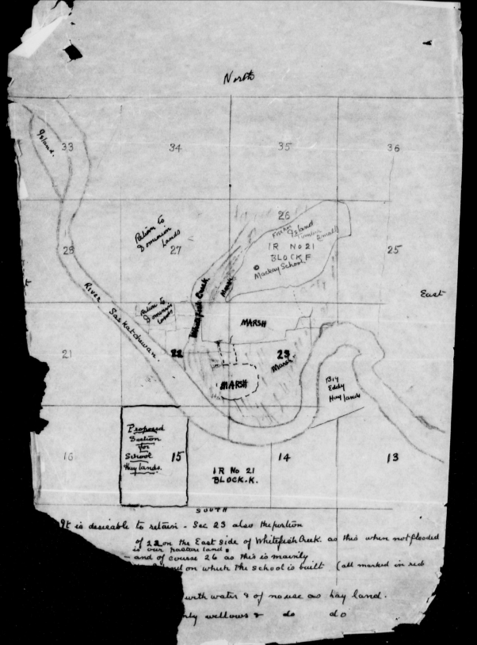
Manuscript Maps
[Sketch map of the first location of the Mackay Indian Residential School and proposed locations for hay land for the school. 1925.]. Opaskawaya First Nation , Treaty Five.
Source: Library Archives Canada. RG10, Volume 6265, file 580-9, part 1. Microfilm c-8657, page 1079.
Url:http://data2.collectionscanada.gc.ca/microform/data2/dm09/d09/006003/c-8657/pdf/c-8657-01079.pdf

Slide 13
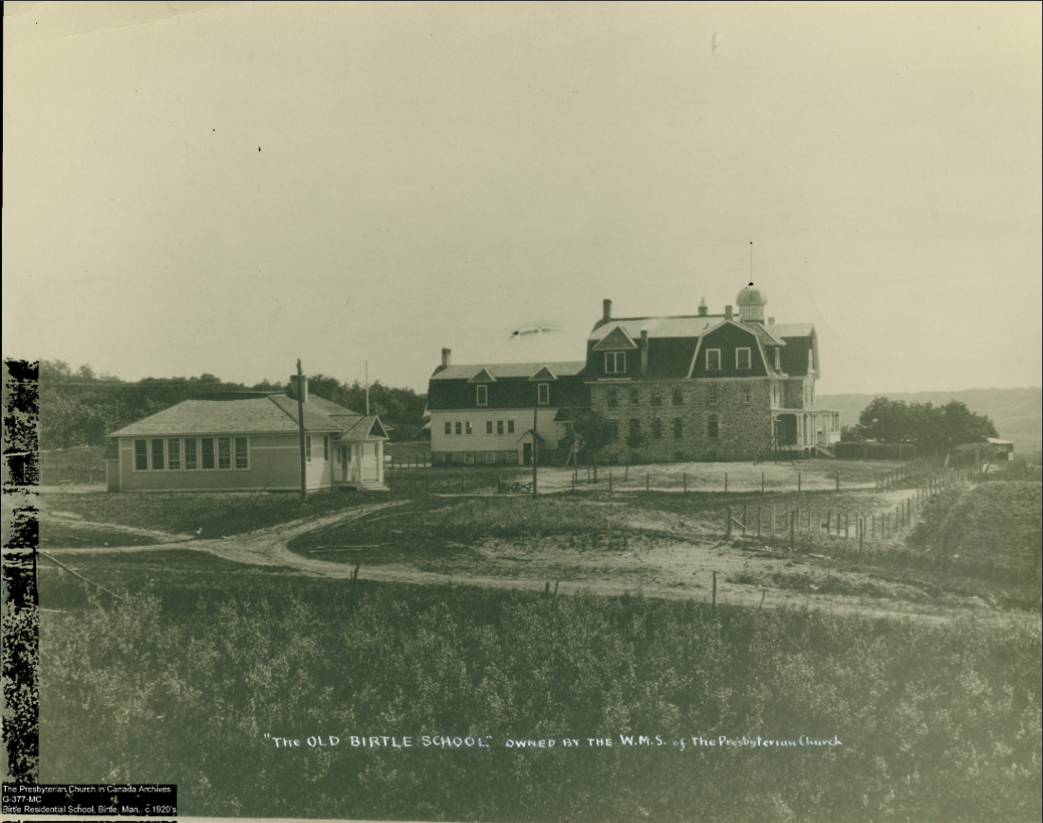
Photographs
“’The Old Birtle School’ Owned by the W.M.S. of the Presbyterian Church”. Photo showing the second location of the Birtle Residential School, Birtle, Treaty 2.
Source: Presbyterian Church in Canada Archives. G-1-SC to G-3778-FC. Access via NCTR.
URL:https://nctr.ca/AIMS_BASE_PDF/13C/13c-c002086-d0163-001.pdf

Slide 14
Textual Sources
Manuscript Letters
Journal Articles
Newspaper and Magazine Articles
Residential School Yearbooks
Provincial and Territorial Government Reports
Local History Books
Media Reports
Museum Websites
Church Archives

Slide 15
Results

Slide 16
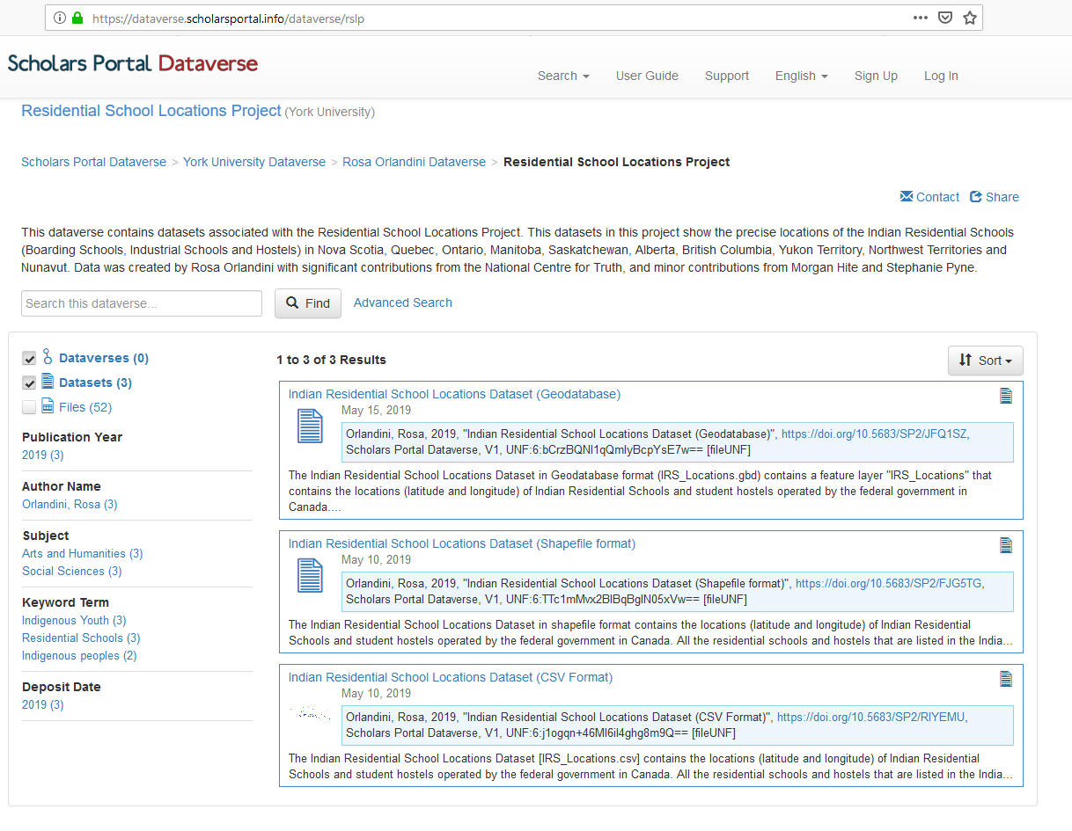
Version 1 available via Scholars Portal Dataverse
CSV Format (with latitude and longitudes) https://doi.org/10.5683/SP2/JFQ1SZ
Shapefile format (for use in GIS) https://doi.org/10.5683/SP2/FJG5TG
Geodatabase format (for use in GIS) https://doi.org/10.5683/SP2/RIYEMU
URL: https://dataverse.scholarsportal.info/dataverse/rslp

Slide 17
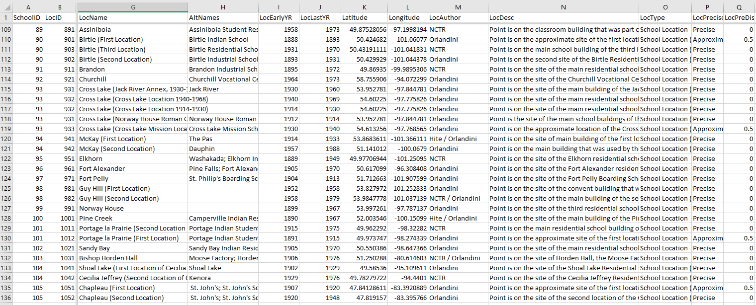
Excerpt of the locations dataset [IRSlocations.csv] in Excel

Slide 18
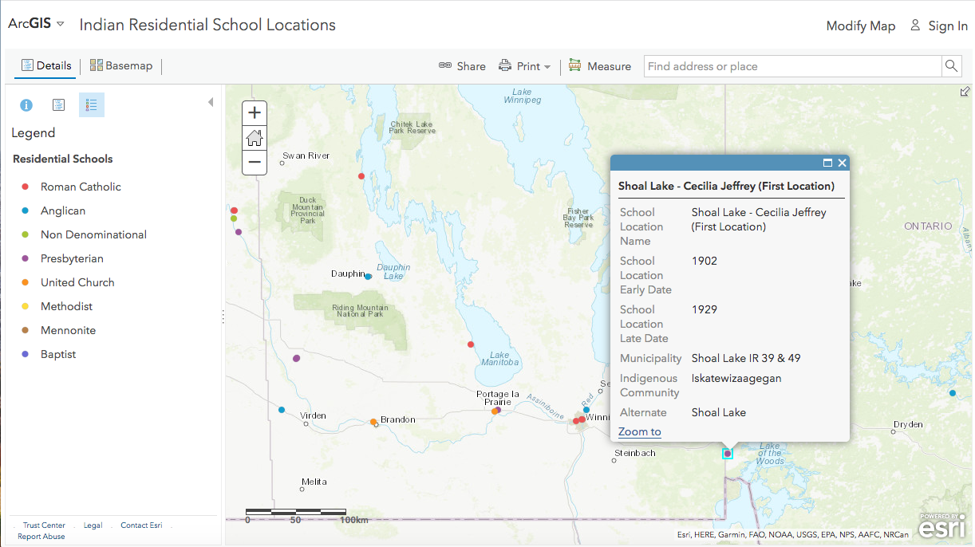
Sneak preview of the dataset in an interactive map http://arcg.is/0m14DP

Slide 19
Selected findings:
Locations found for all of the 139 Residential schools listed in the Indian Residential School Settlement Agreement
6 additional schools that were not on the IRSSA list 181 Unique locations of residential schools.
30 schools moved locations more than once, one school moved more than 4 times!
Precise location of the school site could not be determined for 18 schools.

Slide 20
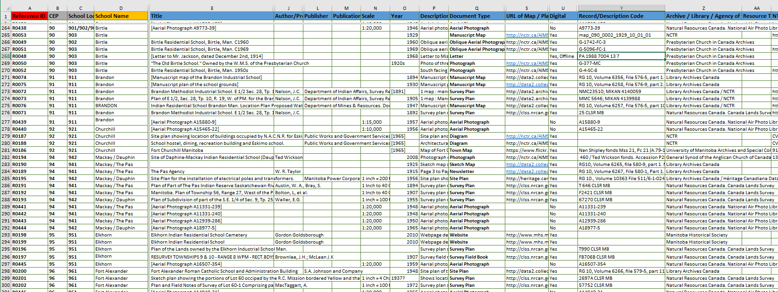
Bibliography (References Dataset) – Preliminary version
Available upon request. Contact rorlan@yorku.ca for access.

Slide 21
Future Plans
Release of the Interactive Map (June 2019)
  Release of Bibliography
  Research Publications
  Continue working with the NCTR and establishing relationships with local knowledge keepers to find the locations of the 18 schools that have approximate locations
  Update the dataset as needed.

Slide 22
Discussion & Reflection

Slide 23
Releasing Data …why now?
Truth and Reconciliation in the School Curriculum
Updating NCTR interactive maps
Maps and data will help NCTR and their partners to find the unmarked graves of missing children
Researchers engaged in research about history and legacy of residential schools

Slide 24
“If it doesn’t feel uncomfortable, it’s not real reconciliation”
Pam Palmater
https://www.uregina.ca/external/communications/feature-stories/current/2018/02-12.html

Slide 25
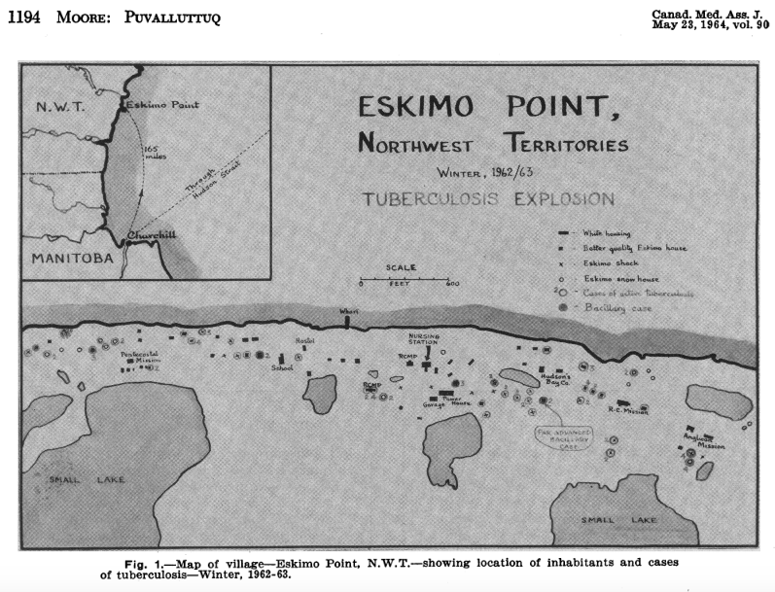
Emotionally Challenging Maps
Sketch map of the tuberculosis epidemic in Arviat, Northwest Territories.
Source: Moore, P.E. “Puvalluttuq: an epidemic of tuberculosis at Eskimo Point, Northwest Territories.” Canadian Medical Association Journal, vol. 90, no. 21, 1964, pp. 1193-1202.
https://www.ncbi.nlm.nih.gov/pmc/articles/PMC1927161/

Slide 26
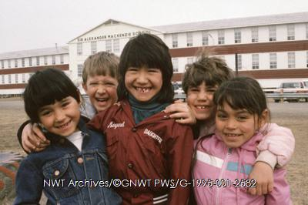
Decolonizing my research practice
Inuvik students [in front of Sir Alexander Mackenzie School. Photo taken by Tessa Macintosh]. NWT Archives.

Slide 27
What I am thinking about recently….
How can information in this dataset contribute to re-traumatizing individuals and communities?
How can information contained in this dataset contribute to healing?
To what degree is my research project and outputs are centred on my views as a settler and my privilege (whiteness)?
Relationship between land and Residential School sites

Slide 28
Acknowledgements
Raymond Frogner
Ry Moran
Stephanie Pyne
Morgan Hite
Anna St.Onge
Jessie Thistle
Carolyn Podruchny
Cecilia Haig-Brown
Bonnie Devine
Debra O-Rourke
Stacey Laforme
Eugene Arcand
Nicole Courrier
Camille Callison
Ruth Koleszar-Green
Eve Tuck
National Centre for Truth and Reconciliation
Indigenous Mapping Workshop
Archives of Ontario
Archives of Manitoba
Provincial Archives of Saskatchewan
History of Indigenous Peoples Network
Library Archives Canada
National Air Photo Library
Toronto Reference Library
York University Libraries
Clara Thomas Archives and Special Collections
Presbyterian Church in Canada Archives
United Church of Canada Archives
Hudson Bay Archives
British Columbia Archives
Yukon Archives
NWT Archives
Air Photo Library - Conservation Manitoba
Government of Nunavut
Canada Lands Survey
Anglican Church of Canada Archives
Centre du patrimoine : Société historique de Saint-Boniface
Mora Gregg
Shingwauk Residential Schools Archive
Historical Topographic Map Digitization Project
University of Calgary Libraries
Robyn Grant-Moran
Bibliothèque et Archives nationales du Québec
University of Manitoba Libraries

