Slide 1

Pitch 1 – UN SDG 12 Responsible Consumption
Doing cross tabulation with data

Slide 2

The requirements for this UN SDG data assignment is to complete 5 cross tabulations and/or content analysis from the original data sheets uploaded here. There are examples of both content analysis and cross tabulation for each pitch to show you want to do. Please make sure to do a combination, so that your assignment includes 5 but at least one is a cross tabulation and one is a content analysis. Please submit in the place created for UN SDG data assignment on Submit Assignment Here. The PowerPoints are the examples of what to do. Each has a data narrowed down from the original data sheets that follows. Then the original data sheets that you will used for the assignment will be at the end in this UN SDG data assignments Box. What you submit is 5 different spreadsheets as indicated above.
© Anne MacLennan, 2024​​

Slide 3
UN SDG 12
"Goal 12 is about ensuring sustainable consumption and production patterns, which is key to sustain the livelihoods of current and future generations. Our planet is running out of resources, but populations are continuing to grow. If the global population reaches 9.8 billion by 2050, the equivalent of almost three planets will be required to provide the natural resources needed to sustain current lifestyles. We need to change our consumption habits and shifting our energy supplies to more sustainable ones are one of the main changes we must make if we are going to reduce our consumption levels. However, global crises triggered a resurgence in fossil fuel subsidies, nearly doubling from 2020 to 2021. We are seeing promising changes in industries, including the trend towards sustainability reporting being on the rise, almost tripling the amount of published sustainability over just a few years, showing increased levels of commitment and awareness that sustainability should be at the core of business practices. Food waste is another sign of over consumption, and tackling food loss is urgent and requires dedicated policies, informed by data, as well as investments in technologies, infrastructure, education and monitoring. A staggering 931 million tons of food is wasted a year, despite a huge number of the global population going hungry" (DESA, 2024). ​
Department of Economic and Social Affairs (2024). The sustainable development goals​ report 2024. United Nations.
© Anne MacLennan, 2024​​​

Slide 4
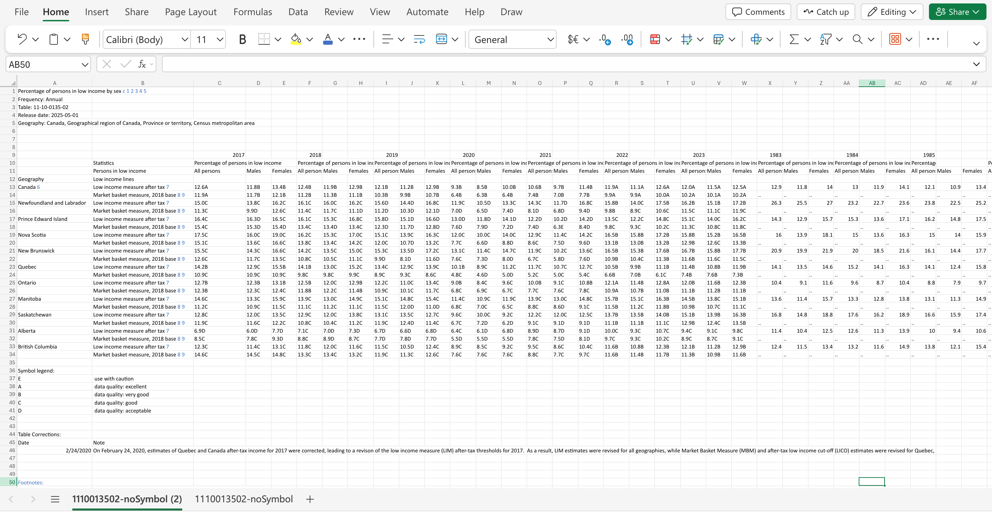
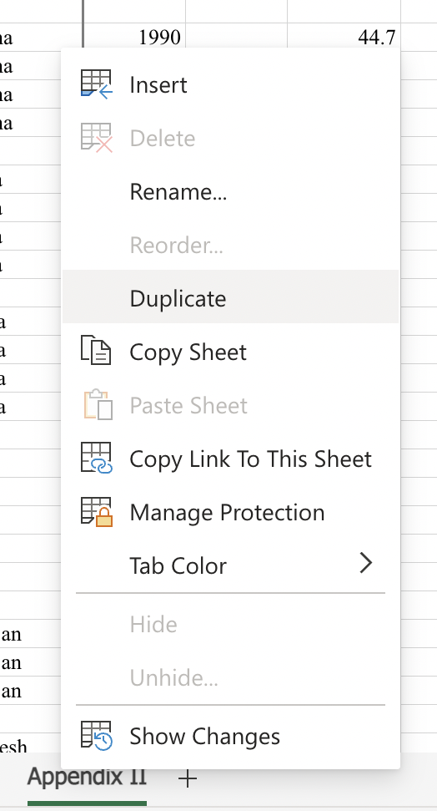
Step 1: Get raw data table and duplicate it for back up
Example is from Statistics Canada
© Anne MacLennan, 2024
Statistics Canada. (2025, May 1). Table 11‑10‑0135‑02: Percentage of persons in low income by sex. Statistics Canada. https://www150.statcan.gc.ca/t1/tbl1/en/tv.action?pid=1110013502.

Slide 5
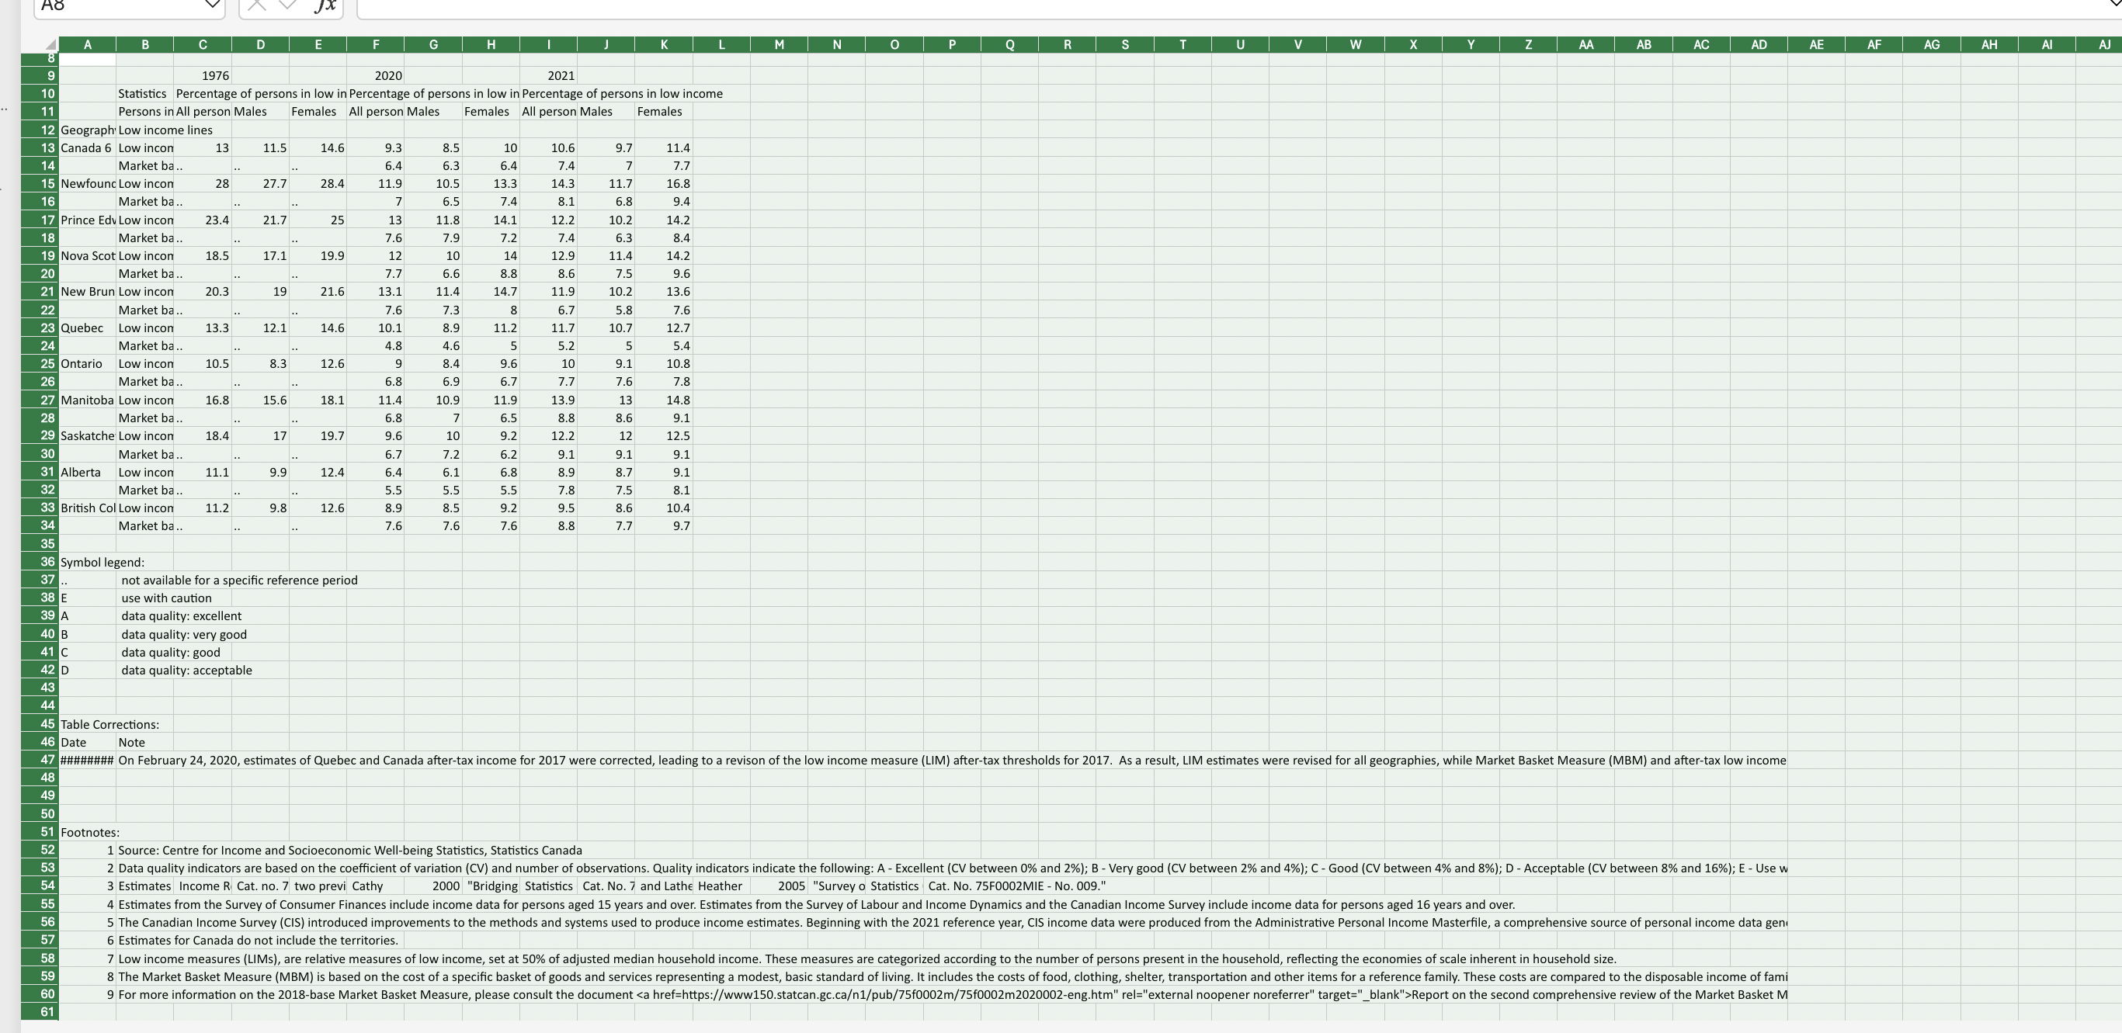
Step 2: Highlight all in the duplicate sheet
Example is from Statistics Canada​
This is an Excel tip only
© Anne MacLennan, 2024
Statistics Canada. (2025, May 1). Table 11‑10‑0135‑02: Percentage of persons in low income by sex. Statistics Canada. https://www150.statcan.gc.ca/t1/tbl1/en/tv.action?pid=1110013502.

Slide 6
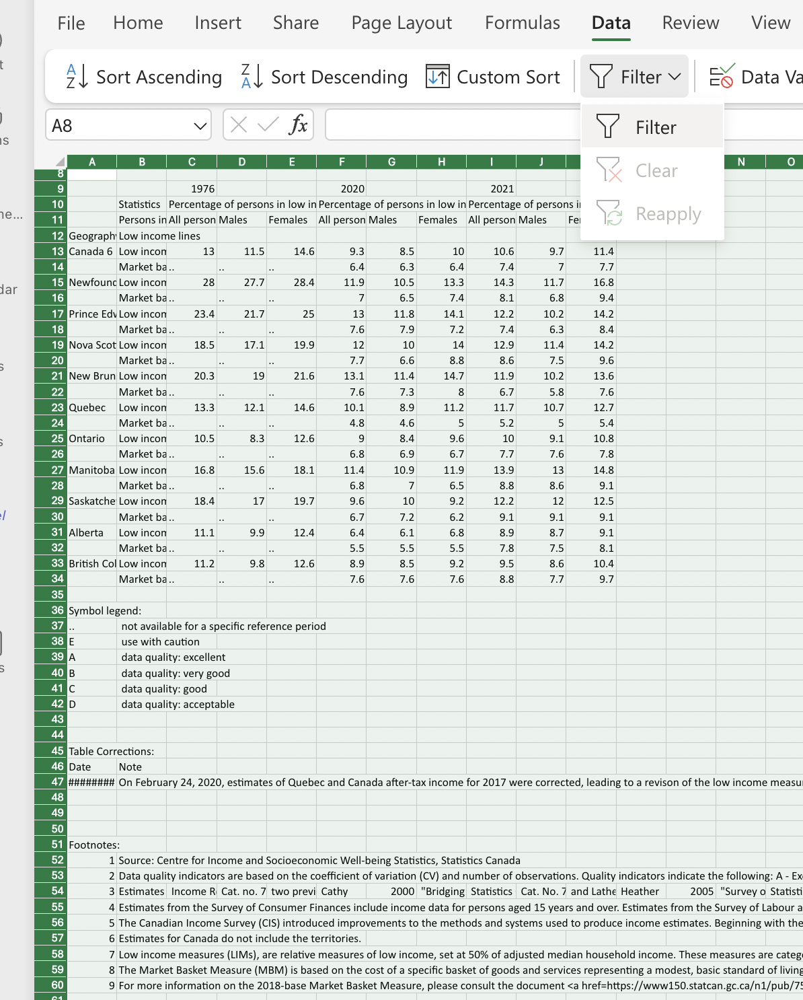
Step 3: Click data and then filter
This is an Excel tip only
Statistics Canada. (2025, May 1). Table 11‑10‑0135‑02: Percentage of persons in low income by sex. Statistics Canada. https://www150.statcan.gc.ca/t1/tbl1/en/tv.action?pid=1110013502.
© Anne MacLennan, 2024

Slide 7
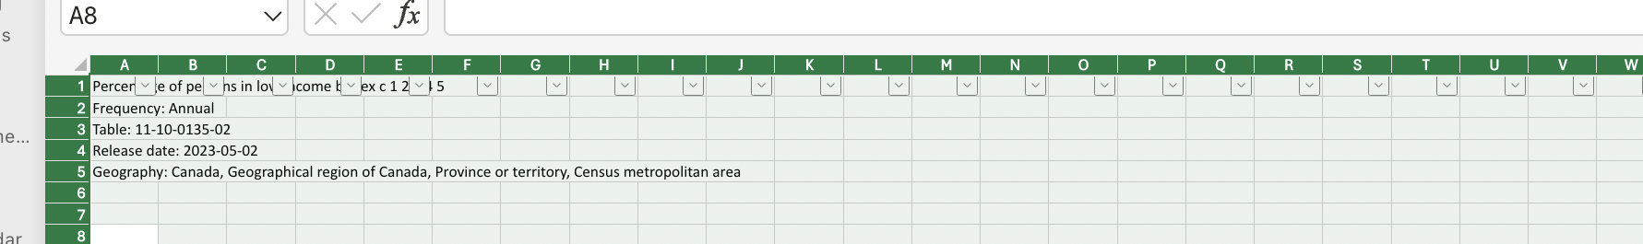
Step 4: Click data and then filter
Make sure the dropdown arrows appear
This is an Excel tip only ​
© Anne MacLennan, 2024​
Statistics Canada. (2025, May 1). Table 11‑10‑0135‑02: Percentage of persons in low income by sex. Statistics Canada. https://www150.statcan.gc.ca/t1/tbl1/en/tv.action?pid=1110013502.

Slide 8
Cross tabulating
When you cross tabulate what you are doing is comparing at least two variables. You need to pick two variables you want to cross tabulate, such as gender and wages in the workplace.
In step 3, we will select variables by using the select all feature in the filtered columns.
© Anne MacLennan, 2024​

Slide 9
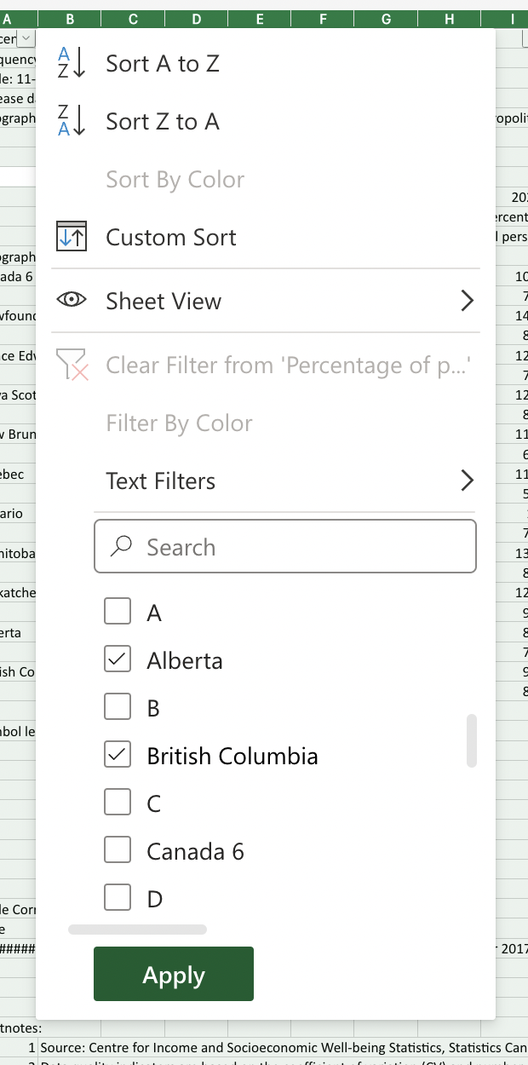
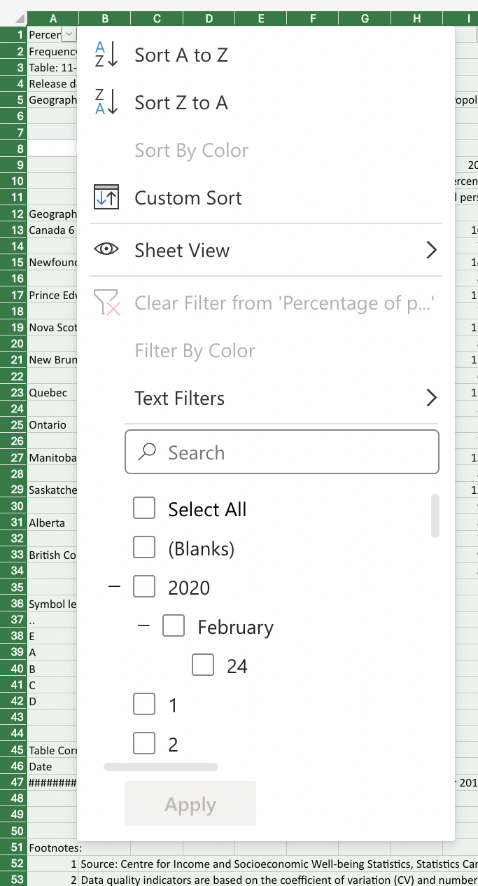
Step 5: Click arrow down to sort column
This is an Excel tip only ​
© Anne MacLennan, 2024​

Slide 10
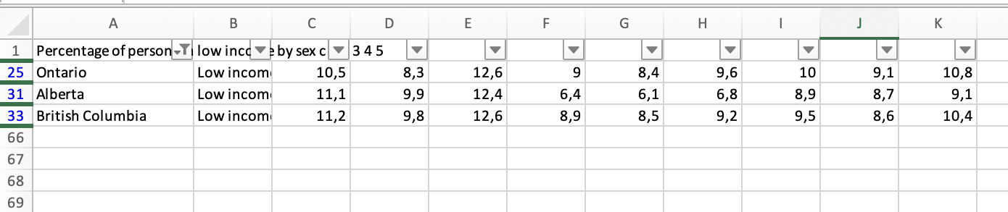
This is how it should look after completing Step 5
​
This is an Excel tip only ​​
© Anne MacLennan, 2024​
Statistics Canada. (2025, May 1). Table 11‑10‑0135‑02: Percentage of persons in low income by sex. Statistics Canada. https://www150.statcan.gc.ca/t1/tbl1/en/tv.action?pid=1110013502.

Slide 11
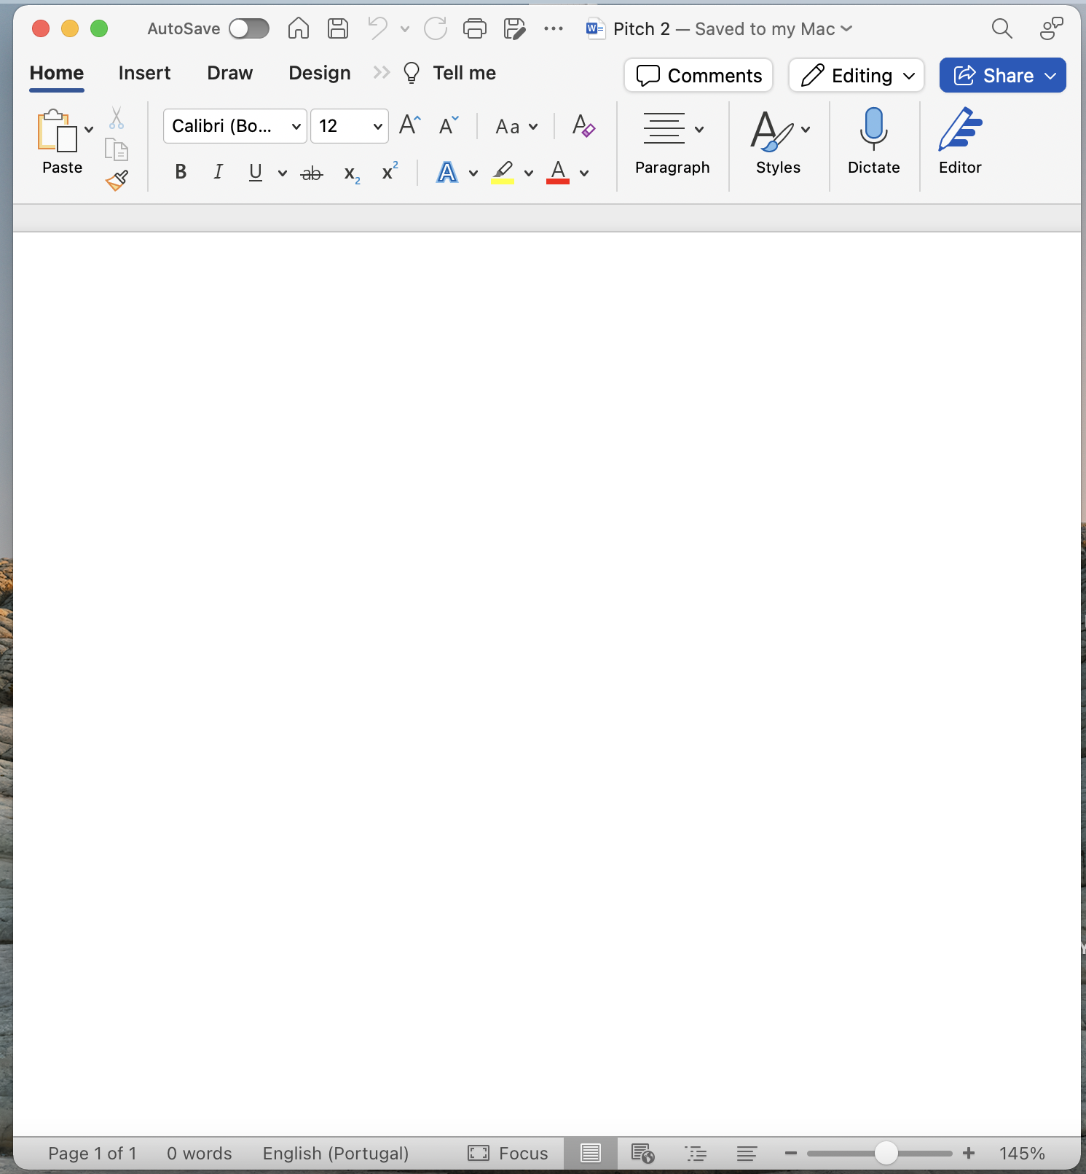
Steps to move data from Excel to Word file
This is an Excel tip only ​
© Anne MacLennan, 2024​
Statistics Canada. (2025, May 1). Table 11‑10‑0135‑02: Percentage of persons in low income by sex. Statistics Canada. https://www150.statcan.gc.ca/t1/tbl1/en/tv.action?pid=1110013502.

Slide 12
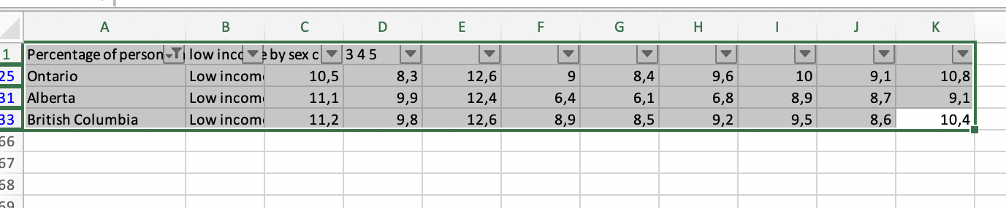
Step 1: Selecting data
Click top left cell > hold shift > click bottom right cell to highlight all information
This is an Excel tip only
© Anne MacLennan, 2024​
Statistics Canada. (2025, May 1). Table 11‑10‑0135‑02: Percentage of persons in low income by sex. Statistics Canada. https://www150.statcan.gc.ca/t1/tbl1/en/tv.action?pid=1110013502.

Slide 13
Step 2: Copying and pasting data
Ctrl + c (PC) or command + c (Mac) then Ctrl + v (PC) or command + v (Mac) into section in Word file
This is an Excel tip only
Statistics Canada. (2025, May 1). Table 11‑10‑0135‑02: Percentage of persons in low income by sex. Statistics Canada. https://www150.statcan.gc.ca/t1/tbl1/en/tv.action?pid=1110013502.
Note: marching ants border indicates that the data is copied and ready for pasting
© Anne MacLennan, 2024​

Slide 14
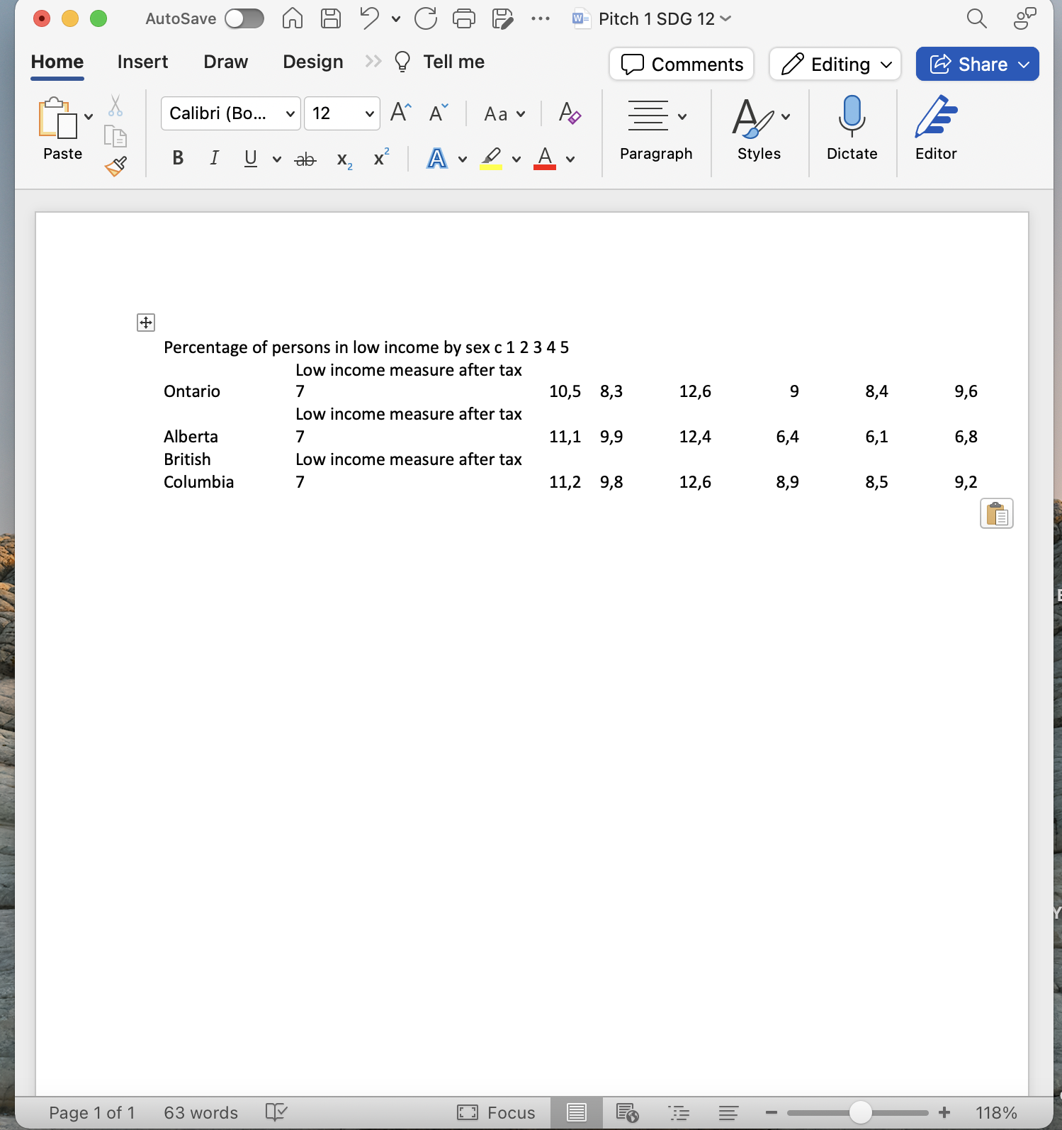
Step 3: Copying and pasting data
Ctrl + c (PC) or command + c (Mac) then Ctrl + v (PC) or command + v (Mac) into section in Word file
This is an Excel tip only
© Anne MacLennan, 2024​
Statistics Canada. (2025, May 1). Table 11‑10‑0135‑02: Percentage of persons in low income by sex. Statistics Canada. https://www150.statcan.gc.ca/t1/tbl1/en/tv.action?pid=1110013502.

Slide 15
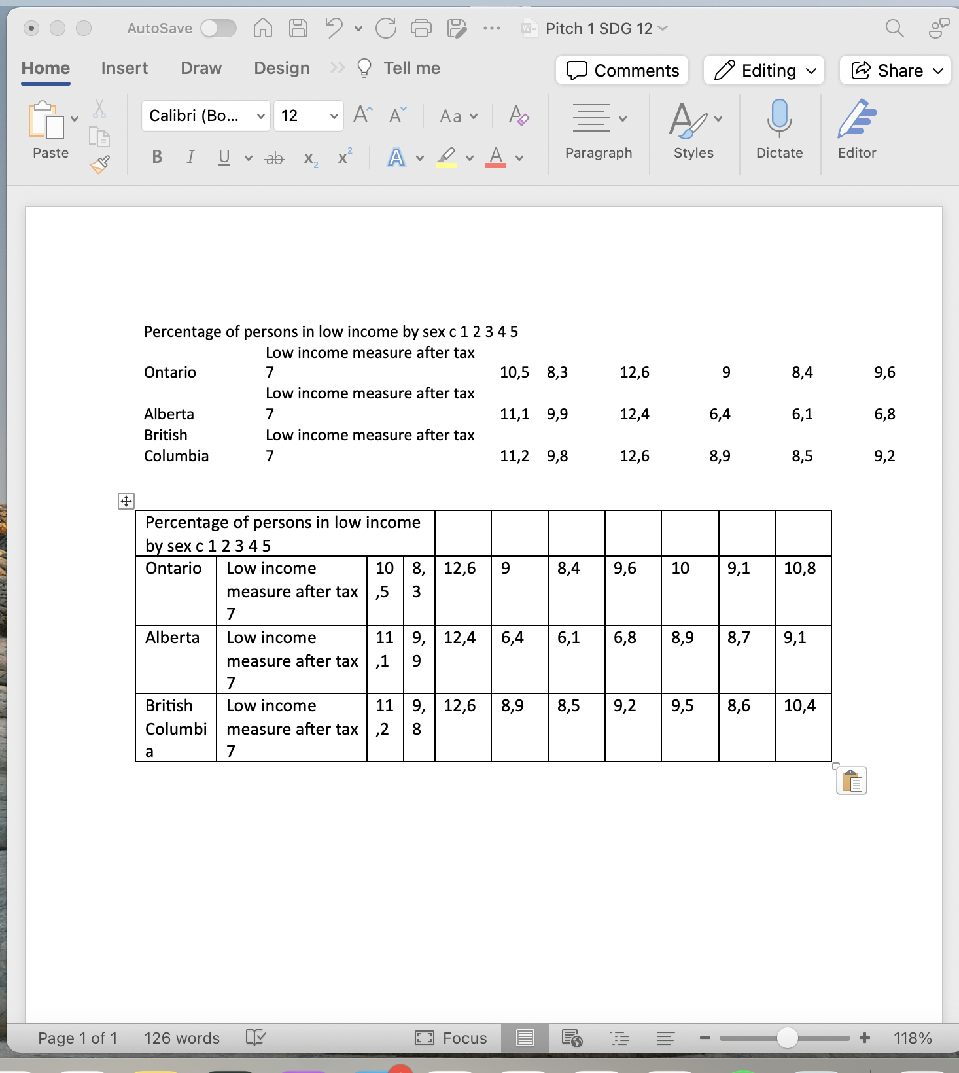
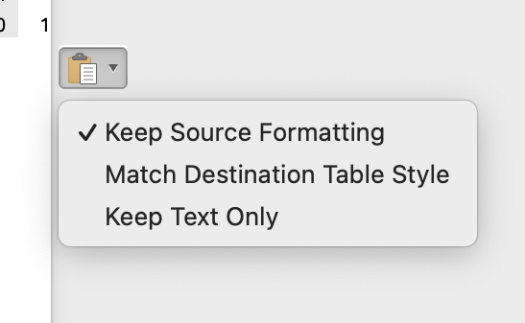
Step 4: Fixing the formatting
Keep source formatting uses the same fonts and styles as the Excel sheet, match destination table style converts the copied data into the document's style
Make changes as needed
This is an Excel tip only
© Anne MacLennan, 2024​
Statistics Canada. (2025, May 1). Table 11‑10‑0135‑02: Percentage of persons in low income by sex. Statistics Canada. https://www150.statcan.gc.ca/t1/tbl1/en/tv.action?pid=1110013502.

Slide 16
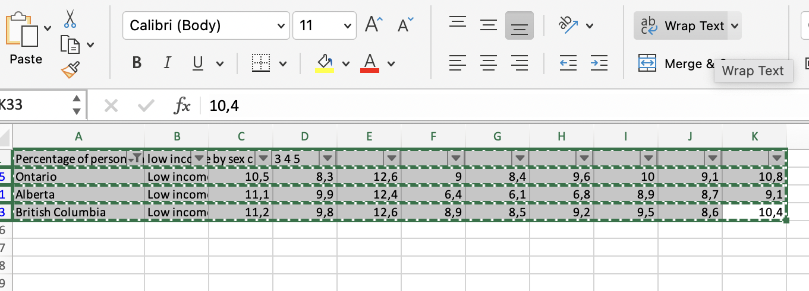
Step 5: Fixing the formatting
You can copy paste your table into a new file to fix formatting easier
This is an Excel tip only
Make sure all text is seen by clicking cell and clicking text wrap button
© Anne MacLennan, 2024​
Statistics Canada. (2025, May 1). Table 11‑10‑0135‑02: Percentage of persons in low income by sex. Statistics Canada. https://www150.statcan.gc.ca/t1/tbl1/en/tv.action?pid=1110013502.

Slide 17
Screenshot Step 1: Taking the screenshot
Windows key + print scr (PC)
Shift + control + command + 3 (Mac)
This is an Excel tip only
© Anne MacLennan, 2024
Statistics Canada. (2025, May 1). Table 11‑10‑0135‑02: Percentage of persons in low income by sex. Statistics Canada. https://www150.statcan.gc.ca/t1/tbl1/en/tv.action?pid=1110013502.

Slide 18
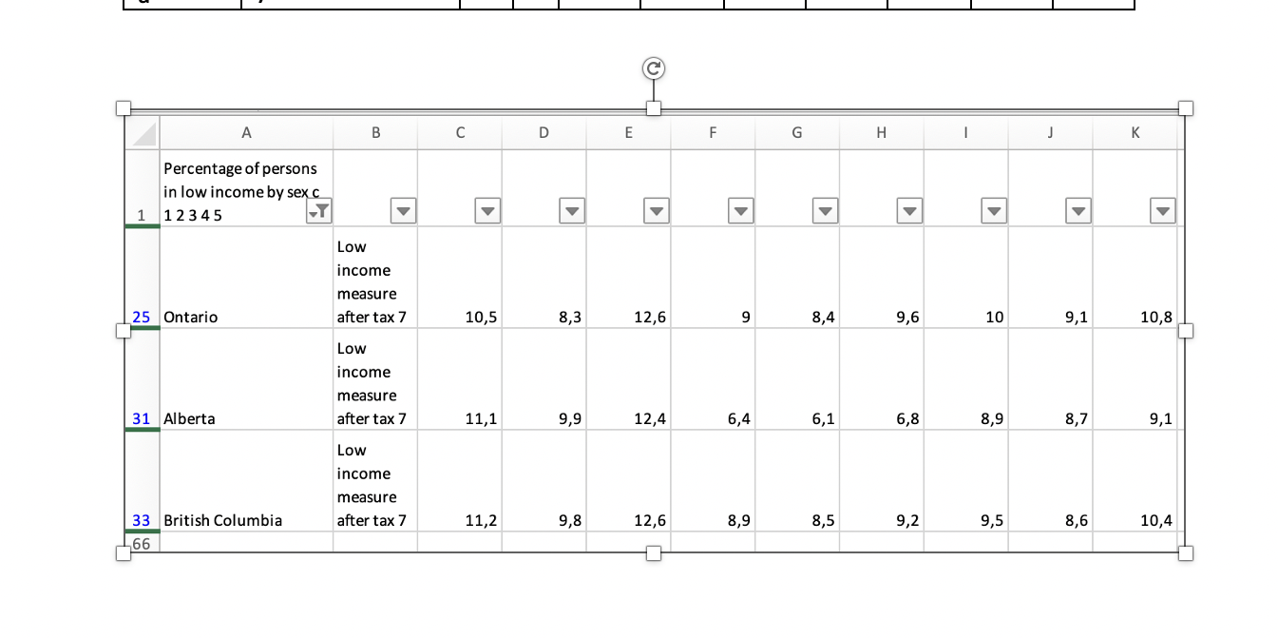
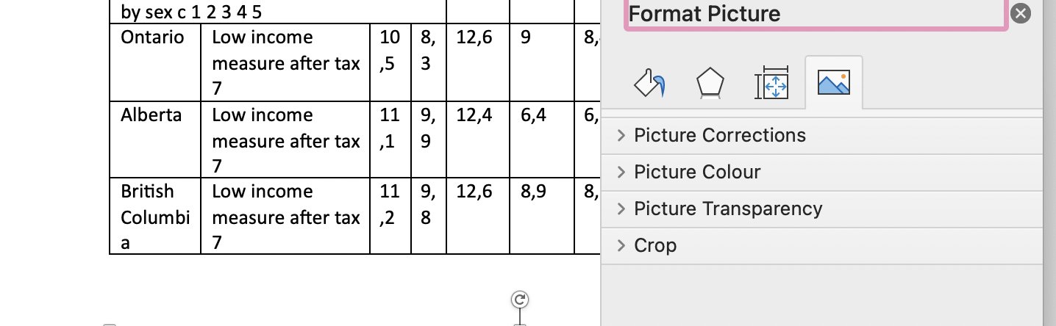
Step 2: Pasting the screenshot
Go to Word document then press
  Ctrl + V (PC)
  Command + V (Mac)
Double click to crop and edit
Edit as needed
Statistics Canada. (2025, May 1). Table 11‑10‑0135‑02: Percentage of persons in low income by sex. Statistics Canada. https://www150.statcan.gc.ca/t1/tbl1/en/tv.action?pid=1110013502.
© Anne MacLennan, 2024​

Slide 19
References
Department of Economic and Social Affairs (2024). The sustainable development goals report 2024. United Nations. https://unstats.un.org/sdgs/report/2024/The-Sustainable-Development-Goals-Report-2024.pdf.
Statistics Canada. (2025, May 1). Table 11‑10‑0135‑02: Percentage of persons in low income by sex. Statistics Canada. https://www150.statcan.gc.ca/t1/tbl1/en/tv.action?pid=1110013502.

