Slide 1
WizFolio & RefWorks
Rajiv Nariani
Library Forum at YUL: 9th March 2010

Slide 2
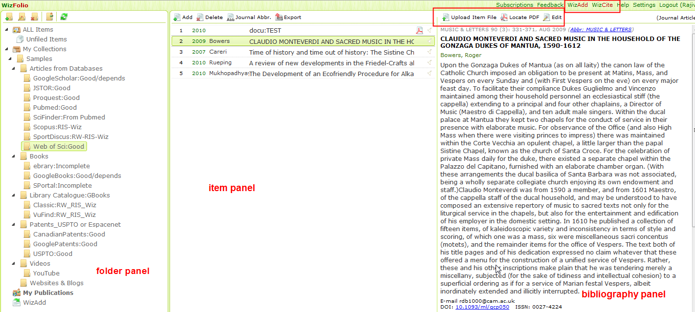
Interface
Notes:
WizFolio is a web-based reference management software using the latest Web 2.0 technologies. It can be used to manage and share journal references, web pages, pictures, videos, and all kinds of information. It comes with two productivity plug-ins – WizAdd and WizCite.
WizFolio comes with productivity plug-in, WizCite, to insert references into Microsoft Word 2003 and 2007. The citation style editor allows on the fly customization and instant preview for changes made. After a simple installation, a WizCite icon will appear in the Add-Ins tab in Word 2007 or on the toolbar in earlier versions of Word. WizCite online tutorials: see here.
WizCite next release includes support for Google Docs, Mac Word and Open OfficeWizFolio comes with productivity plug-in, WizCite, to insert references into Microsoft Word 2003 and 2007. The citation style editor allows on the fly customization and instant preview for changes made. After a simple installation, a WizCite icon will appear in the Add-Ins tab in Word 2007 or on the toolbar in earlier versions of Word. WizCite online tutorials: see here.
WizCite next release includes support for Google Docs, Mac Word and Open Office

Slide 3
Good

Slide 4
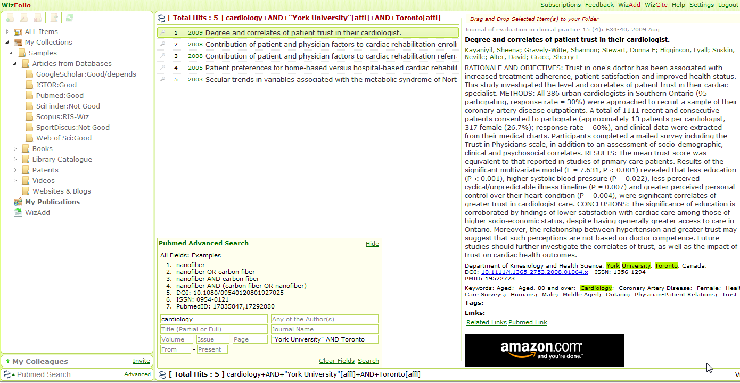
PubMed – searching through WizFolio

Slide 5
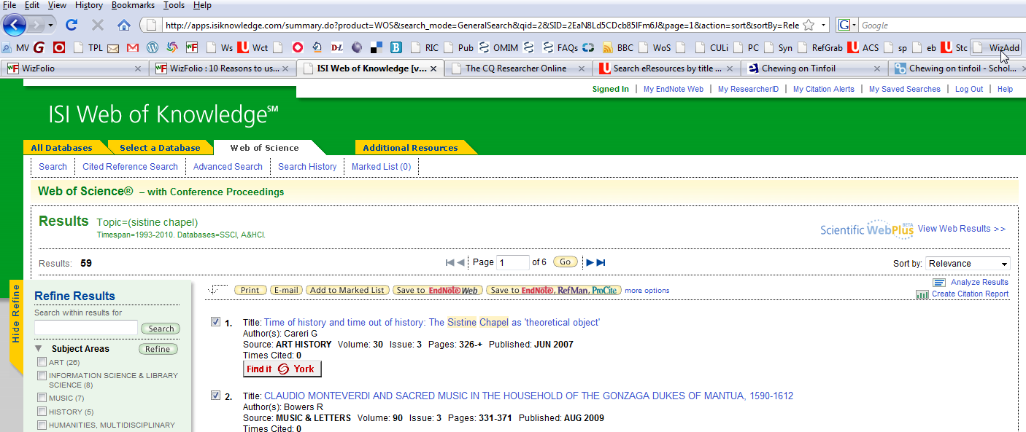
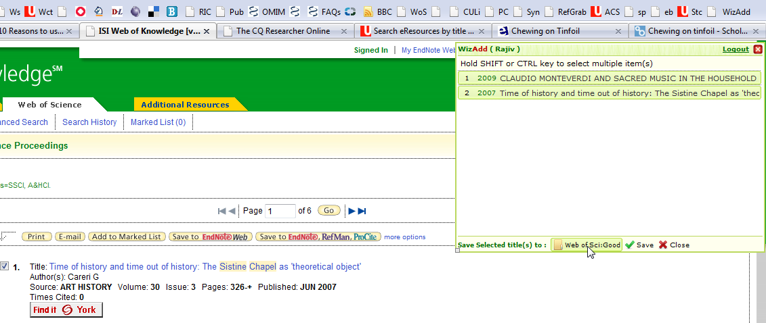
Web of Science – One click

Slide 6
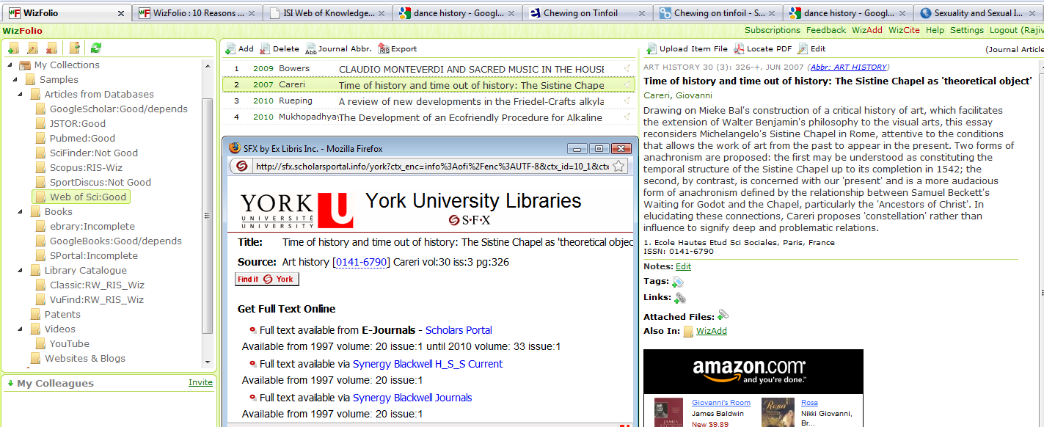
Web of Science... SFX

Slide 7

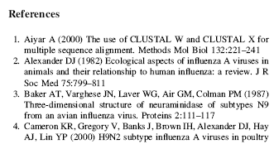
Locates metadata for Citing PDF documents
Notes:
Try copying this in WizFolio using the Add feature:
1. Aiyar A (2000) The use of CLUSTAL W and CLUSTAL X for
multiple sequence alignment. Methods Mol Biol 132:221–241
2. Alexander DJ (1982) Ecological aspects of influenza A viruses in
animals and their relationship to human influenza: a review. J R
Soc Med 75:799–811
3. Baker AT, Varghese JN, Laver WG, Air GM, Colman PM (1987)
Three-dimensional structure of neuraminidase of subtypes N9
from an avian influenza virus. Proteins 2:111–117

Slide 8
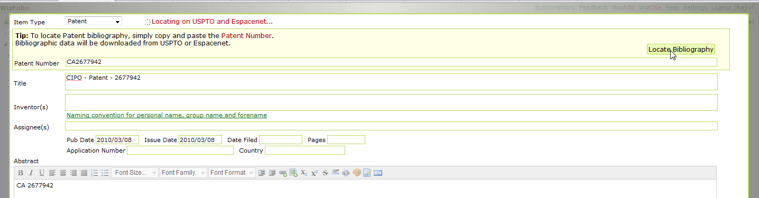
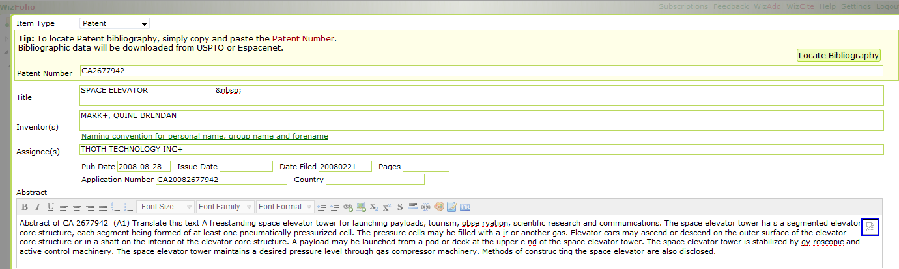
Patents
Notes:
Patent information from USPTO or European patent database or Canadian Patent database

Slide 9
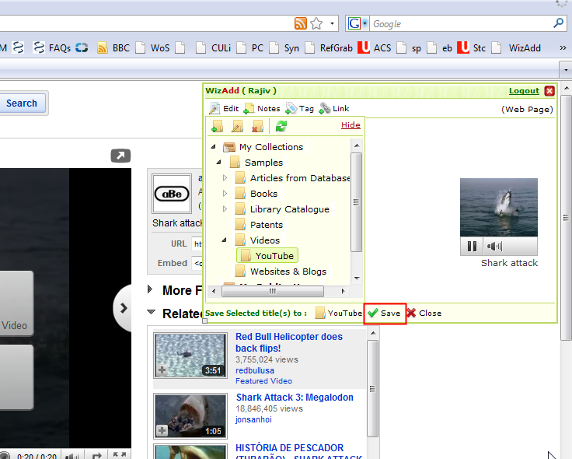
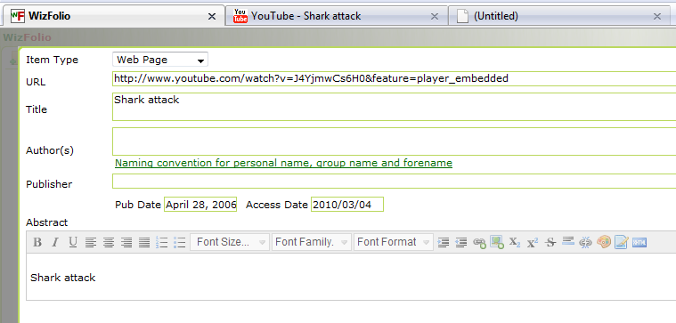
YouTube

Slide 10
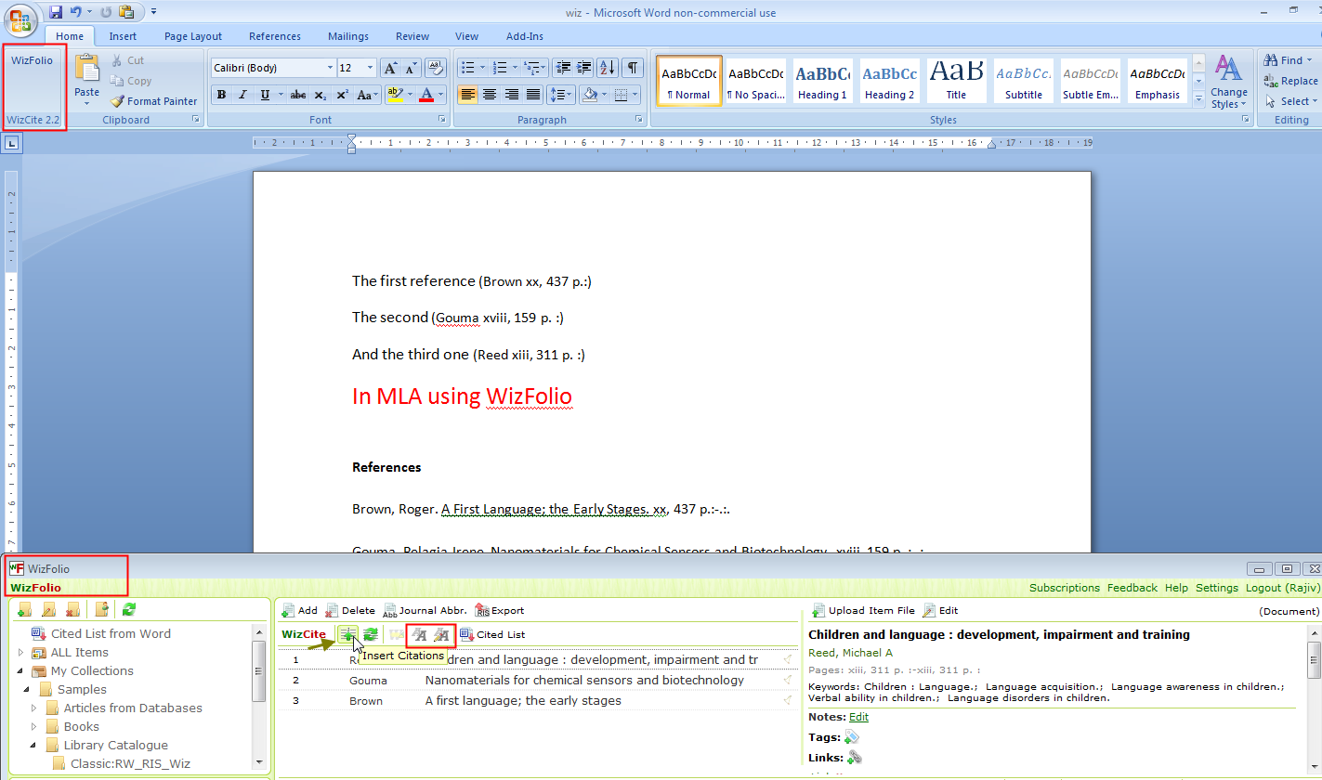
Cite them....using WizCite
Notes:
Install WizCite and WizAdd

Slide 11
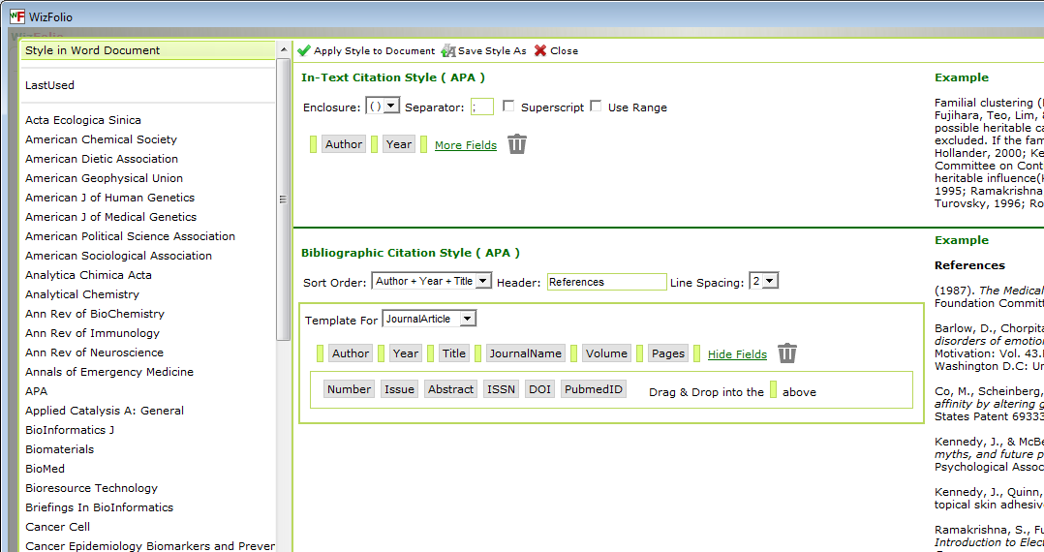
Styles supported....

Slide 12
Not Good...lacking elements..

Slide 13
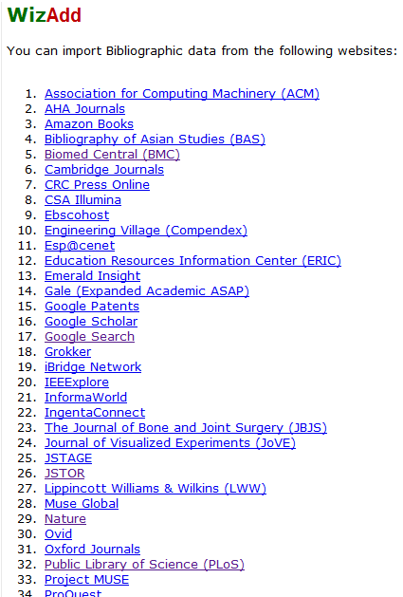
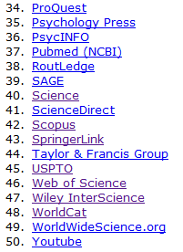
Other databases supported

Slide 14
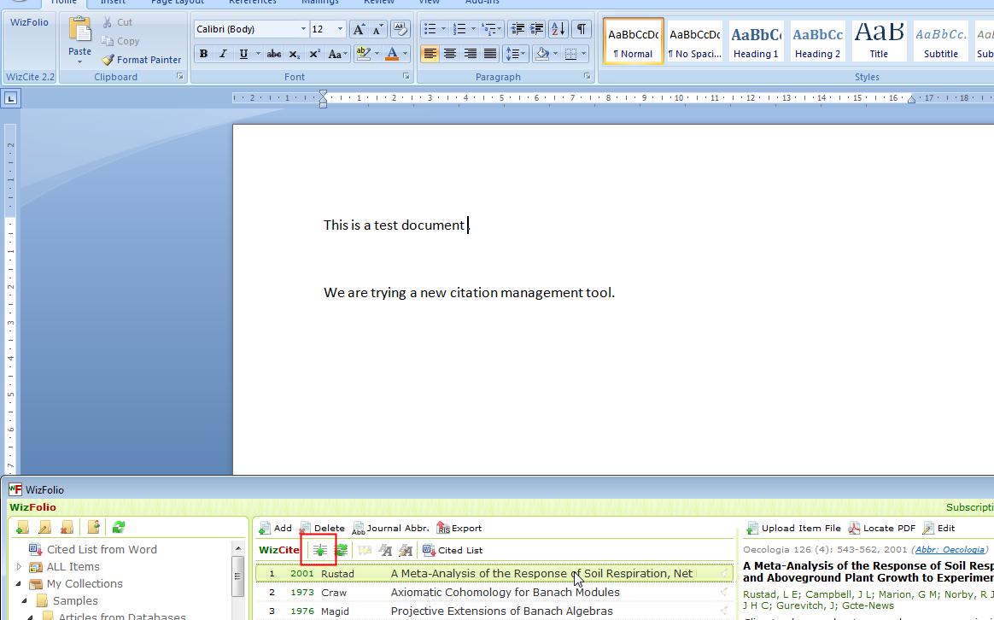
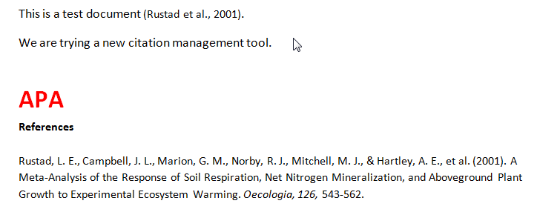
JSTOR:
Global warming
WizFolio
WizFolio
RefWorks
Notes:
Try searches in JSTOR and export to WizFolio and format in APA. Compare with Refworks. See omissions.

Slide 15
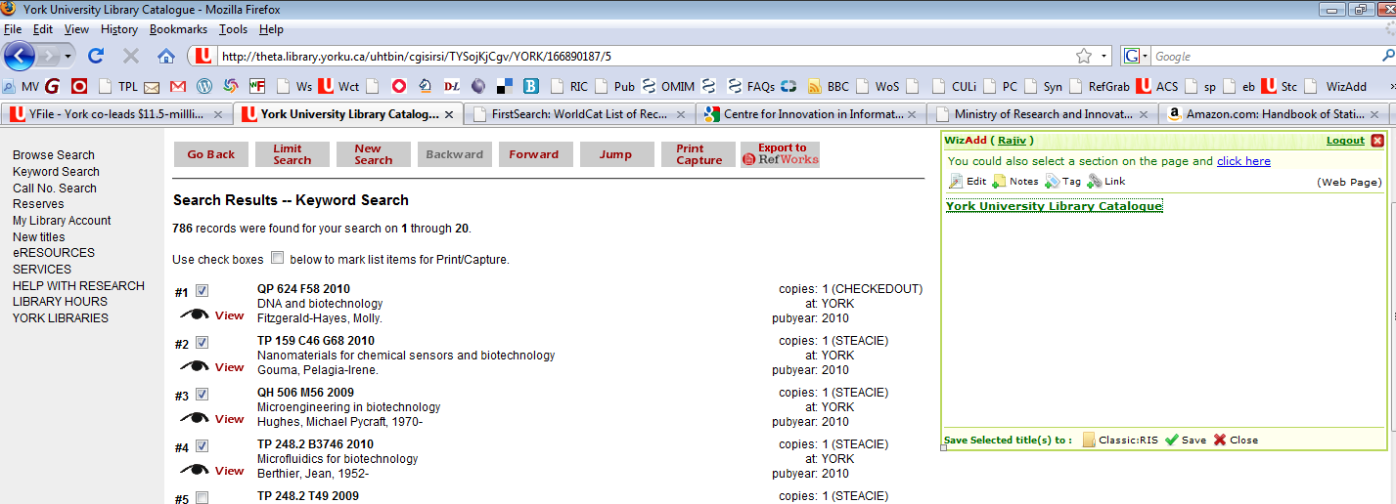
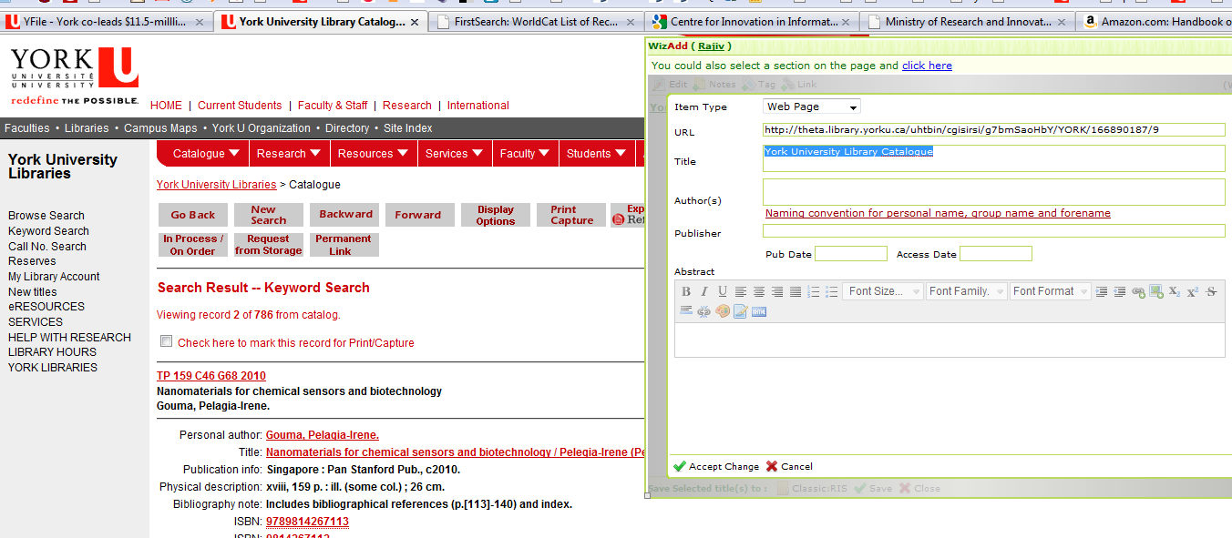
C
L
A
S
S
I
C
Notes:
Metadata for books is from Google books (GB).

Slide 16
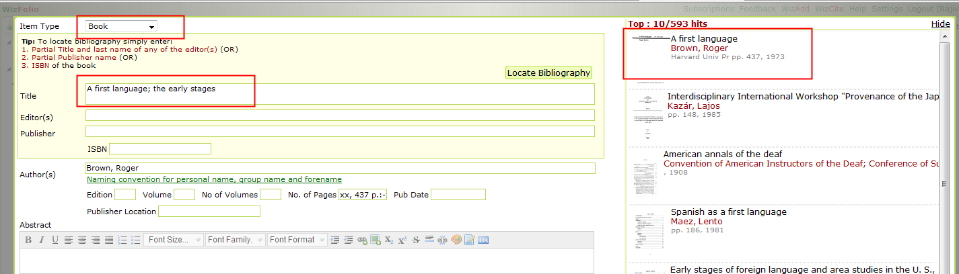
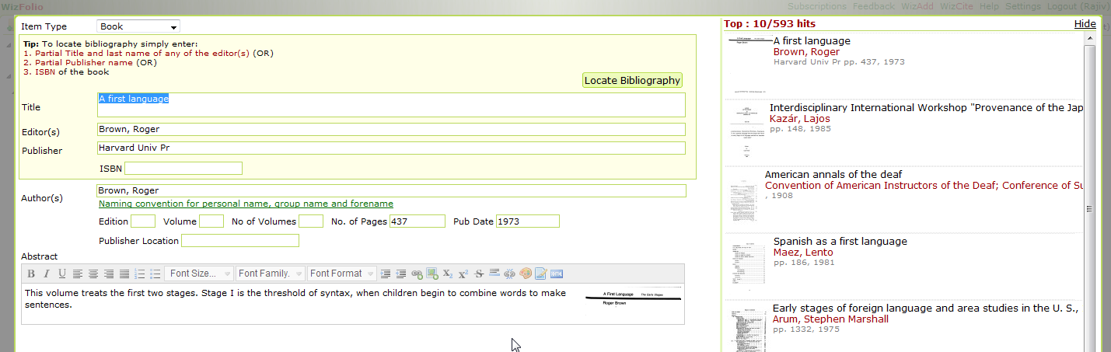
VuFind to WF – data from GB
Open WorldCat?? Or make it compatible with YU.
Notes:
Can this metadata be from Open WorldCat?

Slide 17
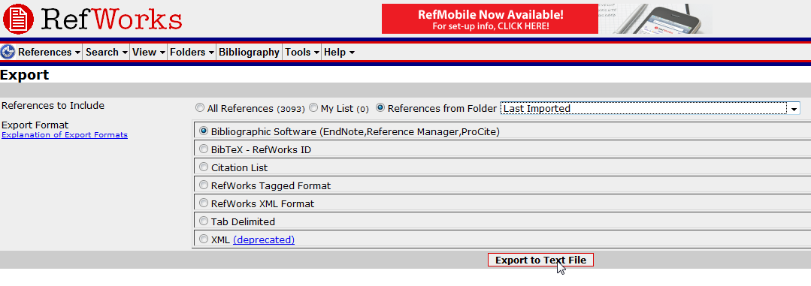
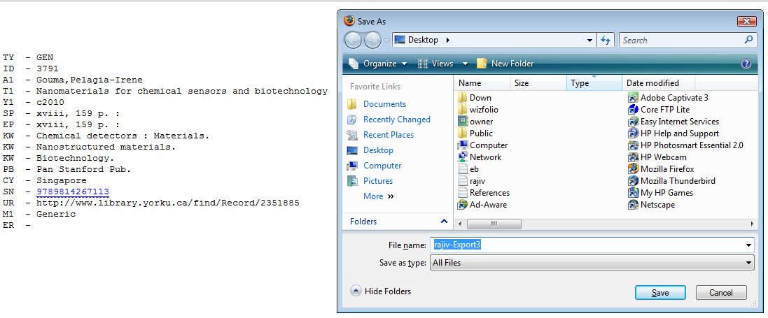
Or ...Export from RW – and then bring into WizFolio...
Notes:
Circuitous!

Slide 18
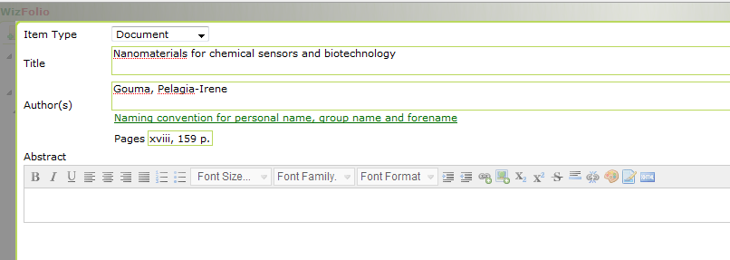
Manual... Copy details
Notes:
Cumbersome!

Slide 19
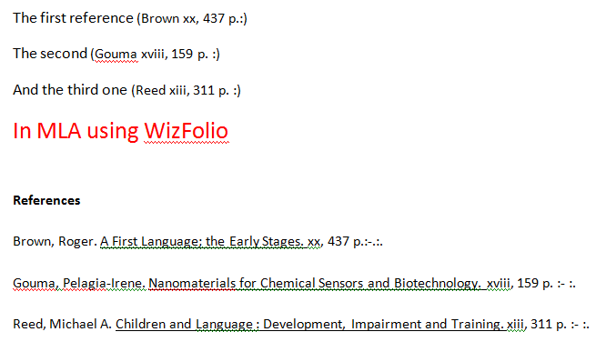
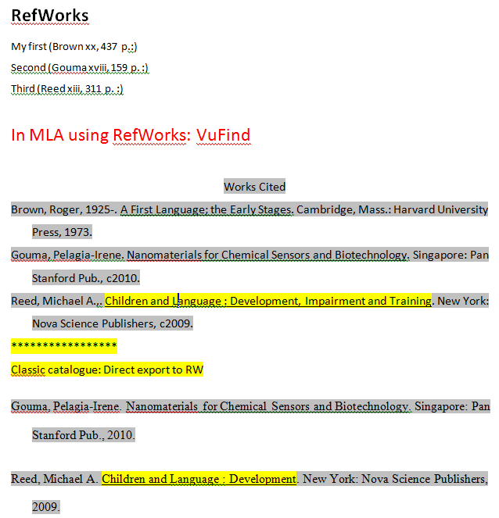
MLA
Notes:
If data is not got from google books then MA citation is lacking in many elements in WizFolio.

Slide 20
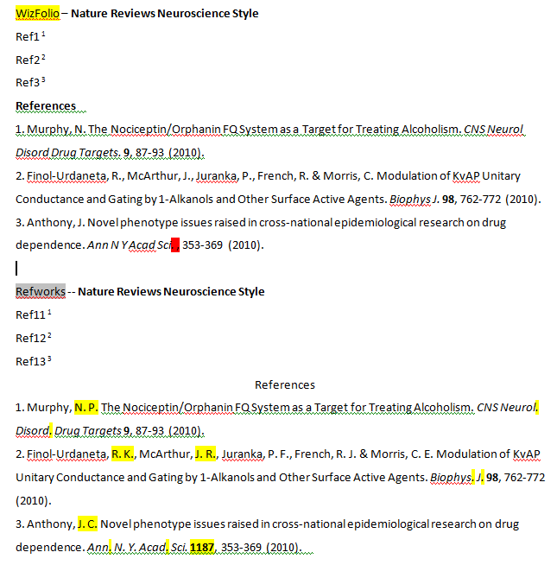
Notes:
Omissions!

Slide 21
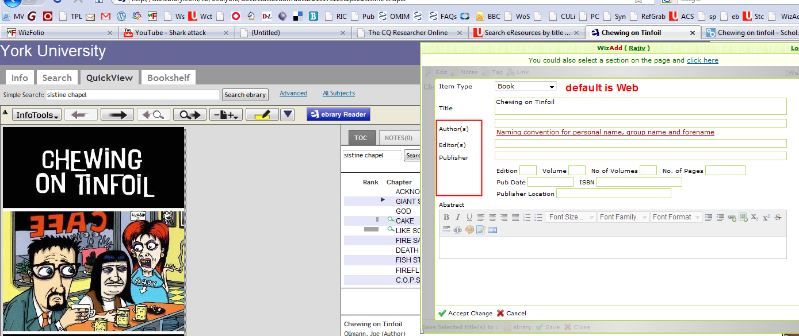
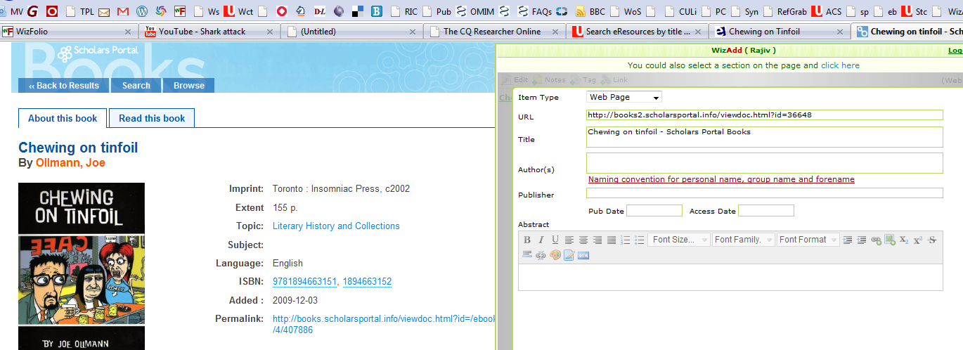
Notes:
Change default to Books from Web page in WizFolio.

Slide 22
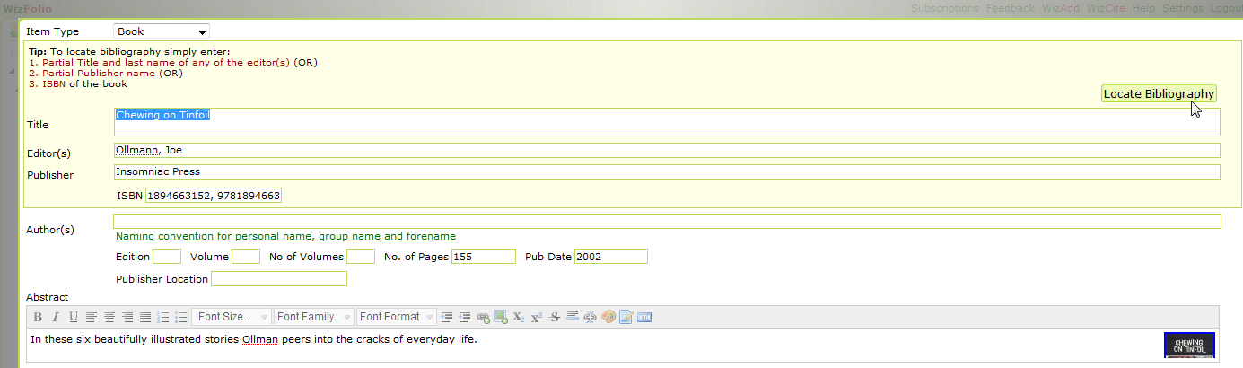
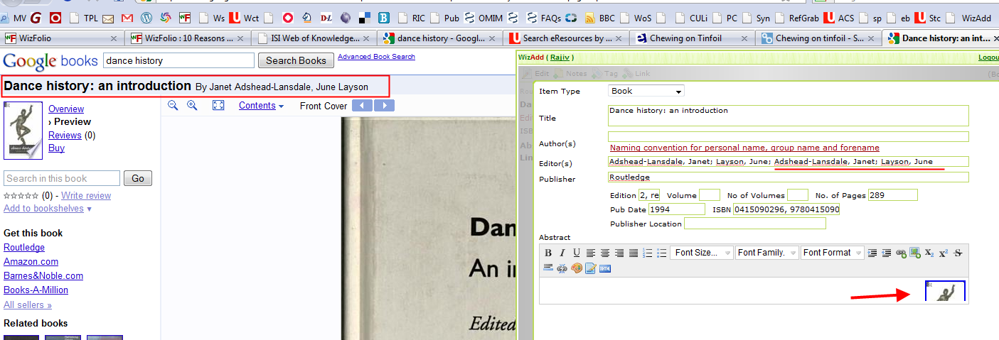
Google Books: ok...depends
Notes:
Mistakes when metadata is from Google books! See Editor field.

Slide 23

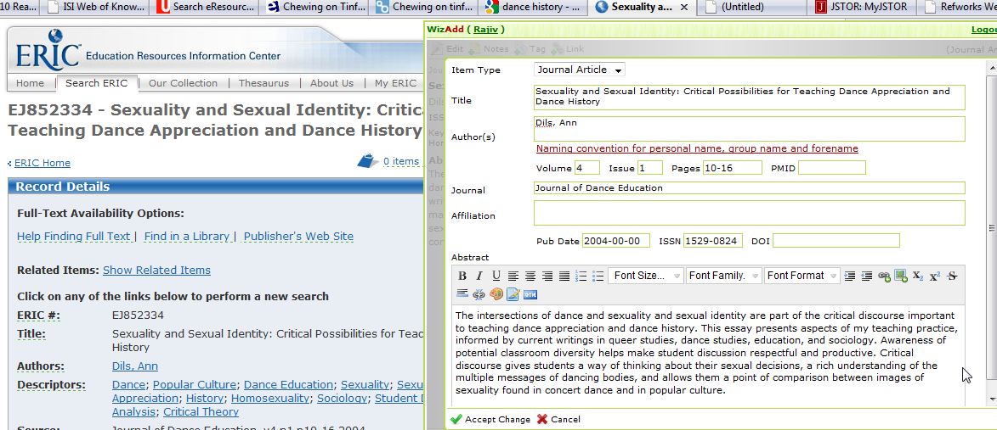

Slide 24
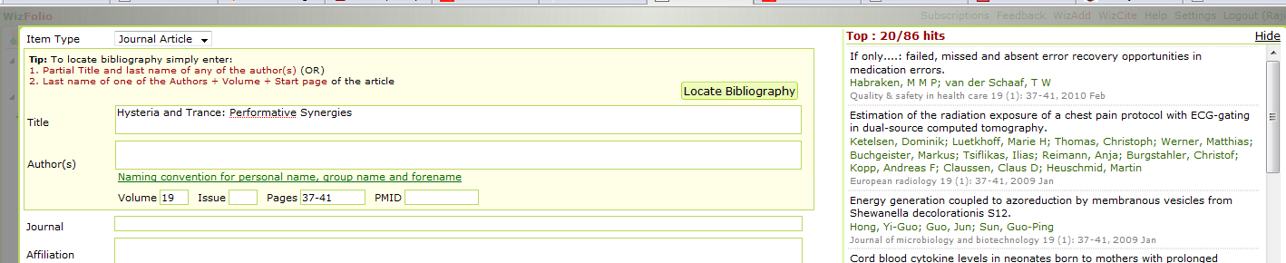
WizFolio: Analysis
Good for Pubmed, Web of Science and blogs, patents and other supported databases (need to check)
Easy to edit citations
Easy to get metadata for PDF (if in Pubmed)
Mistakes in ref. styles APA, MLA, Nature Reviews Neuroscience: RW, WF
WF – not compatible with library catalogue
Work-in-progress.....
Notes:
Metadata exported only if the record exists in Pubmed (when using the add/copy/paste feature in WizFolio).

Slide 25


