Slide 1

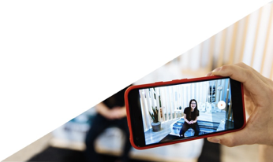


Smartphone Accommodation Resource Toolbox
Hosted : Contact North- Dec 2020
Title: Enhancing Student Learning Through the Creation of Videos Using Smartphones at York University
Presentation Overview
1. Why SmART? From accommodation to inter/intradisciplinary resource
2. What is SmART? Connecting experiential learning with e-learning
3. Case Studies Exploring the needs / use in e-class
4. How SmART Works? - Students; Instructors; Digital Citizenship …take the SmART tour
5. Open for discussion: How can you contribute to SmART? Join our community of practice

Slide 2
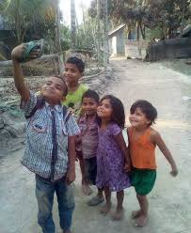
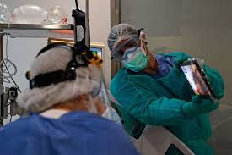
I've learned that people will forget what you said, people will forget what you did, but people will never forget how you made them feel. Maya Angelou

Slide 3
Smartphone Accommodation Resource Toolbox
This project is Funded by AIF (Academic Innovation Fund)York University 2018-20
Team
Lead: Iris Epstein; RN; PhD Faculty of Health, School of Nursing; York University
Co-Lead: Kurt Thumlert; PhD Faculty of Education (IRDL)
Melanie Baljko PhD Lassonde School of Engineering
Collaborators: James Andrew Smith PhD, Lassonde School of Engineering
Yelin Yu, Teaching Commons
Natasha May, Teaching Commons
Mavoy Bertram, Nurse Practitioner, School of Nursing
Elisheva LightStone, Registered Nurse (RN); MN Seneca College
Danielle Robinson PhD, AMP-D
Post Doc (Year 1 - 2018) – Evadne Kelly AMP-D
Justeena Zaki-Azat, Psychology
Acknowledgement: We would like to thank the students and faculty for their contribution and support (Melika Shadman (Eng); Lorivie Balaqui (Nrsg); Kai ya Chang (Nrsg); Brenna Johnson (Nrsg); Virginia Larrain (Nrsg); Jade Nguyen (Nrsg); Alex Golan (Nrsg); Laura Nicholson (Nrsg); Marija Bal (Nrsg); Melanie Dauncey (Nrsg), Deanna Barlette (Nrsg); Lisa Sandlos (Dance); Jennifer Bolt (Dance)……

Slide 4
Smartphone Accommodation Resource Toolbox
Join Our Community of practice
Email – iepstein@yorku.ca
https://iris.lab.yorku.ca/

Slide 5
Smartphone Accommodation Resource Toolbox
Getting to know you- Lets do the poll
Do you use/create video in your teaching learning ?
Do you ask your students to use/create their smartphone in teaching/learning?
Notes:
Connecting Elearning with Experiential Learning
Soft and hard skills
The shift from Experiential Learning to Elearning Was in the framework of Accomodation – Memory Aid (rewatch videos), Space limitations to take learning beyond the classroom.
Creating a ‘Community of Practice’
Video Portfolios, Models, Pedagogy
Adding to SmART :
SmART research opportunities
The need for elearning resources that
support practical ‘hands-on’ skills
learning (through video documentation
and interactive feedback).
Simulation, embodied performance, professional practice-based skills,
studio-based modelling & documentation of situated techniques and/or creative processes.
Do you use video technology in your classroom?
How do you use it?
Do you use your smartphone in your classroom?
How do you use your smartphone in the classroom?

Slide 6
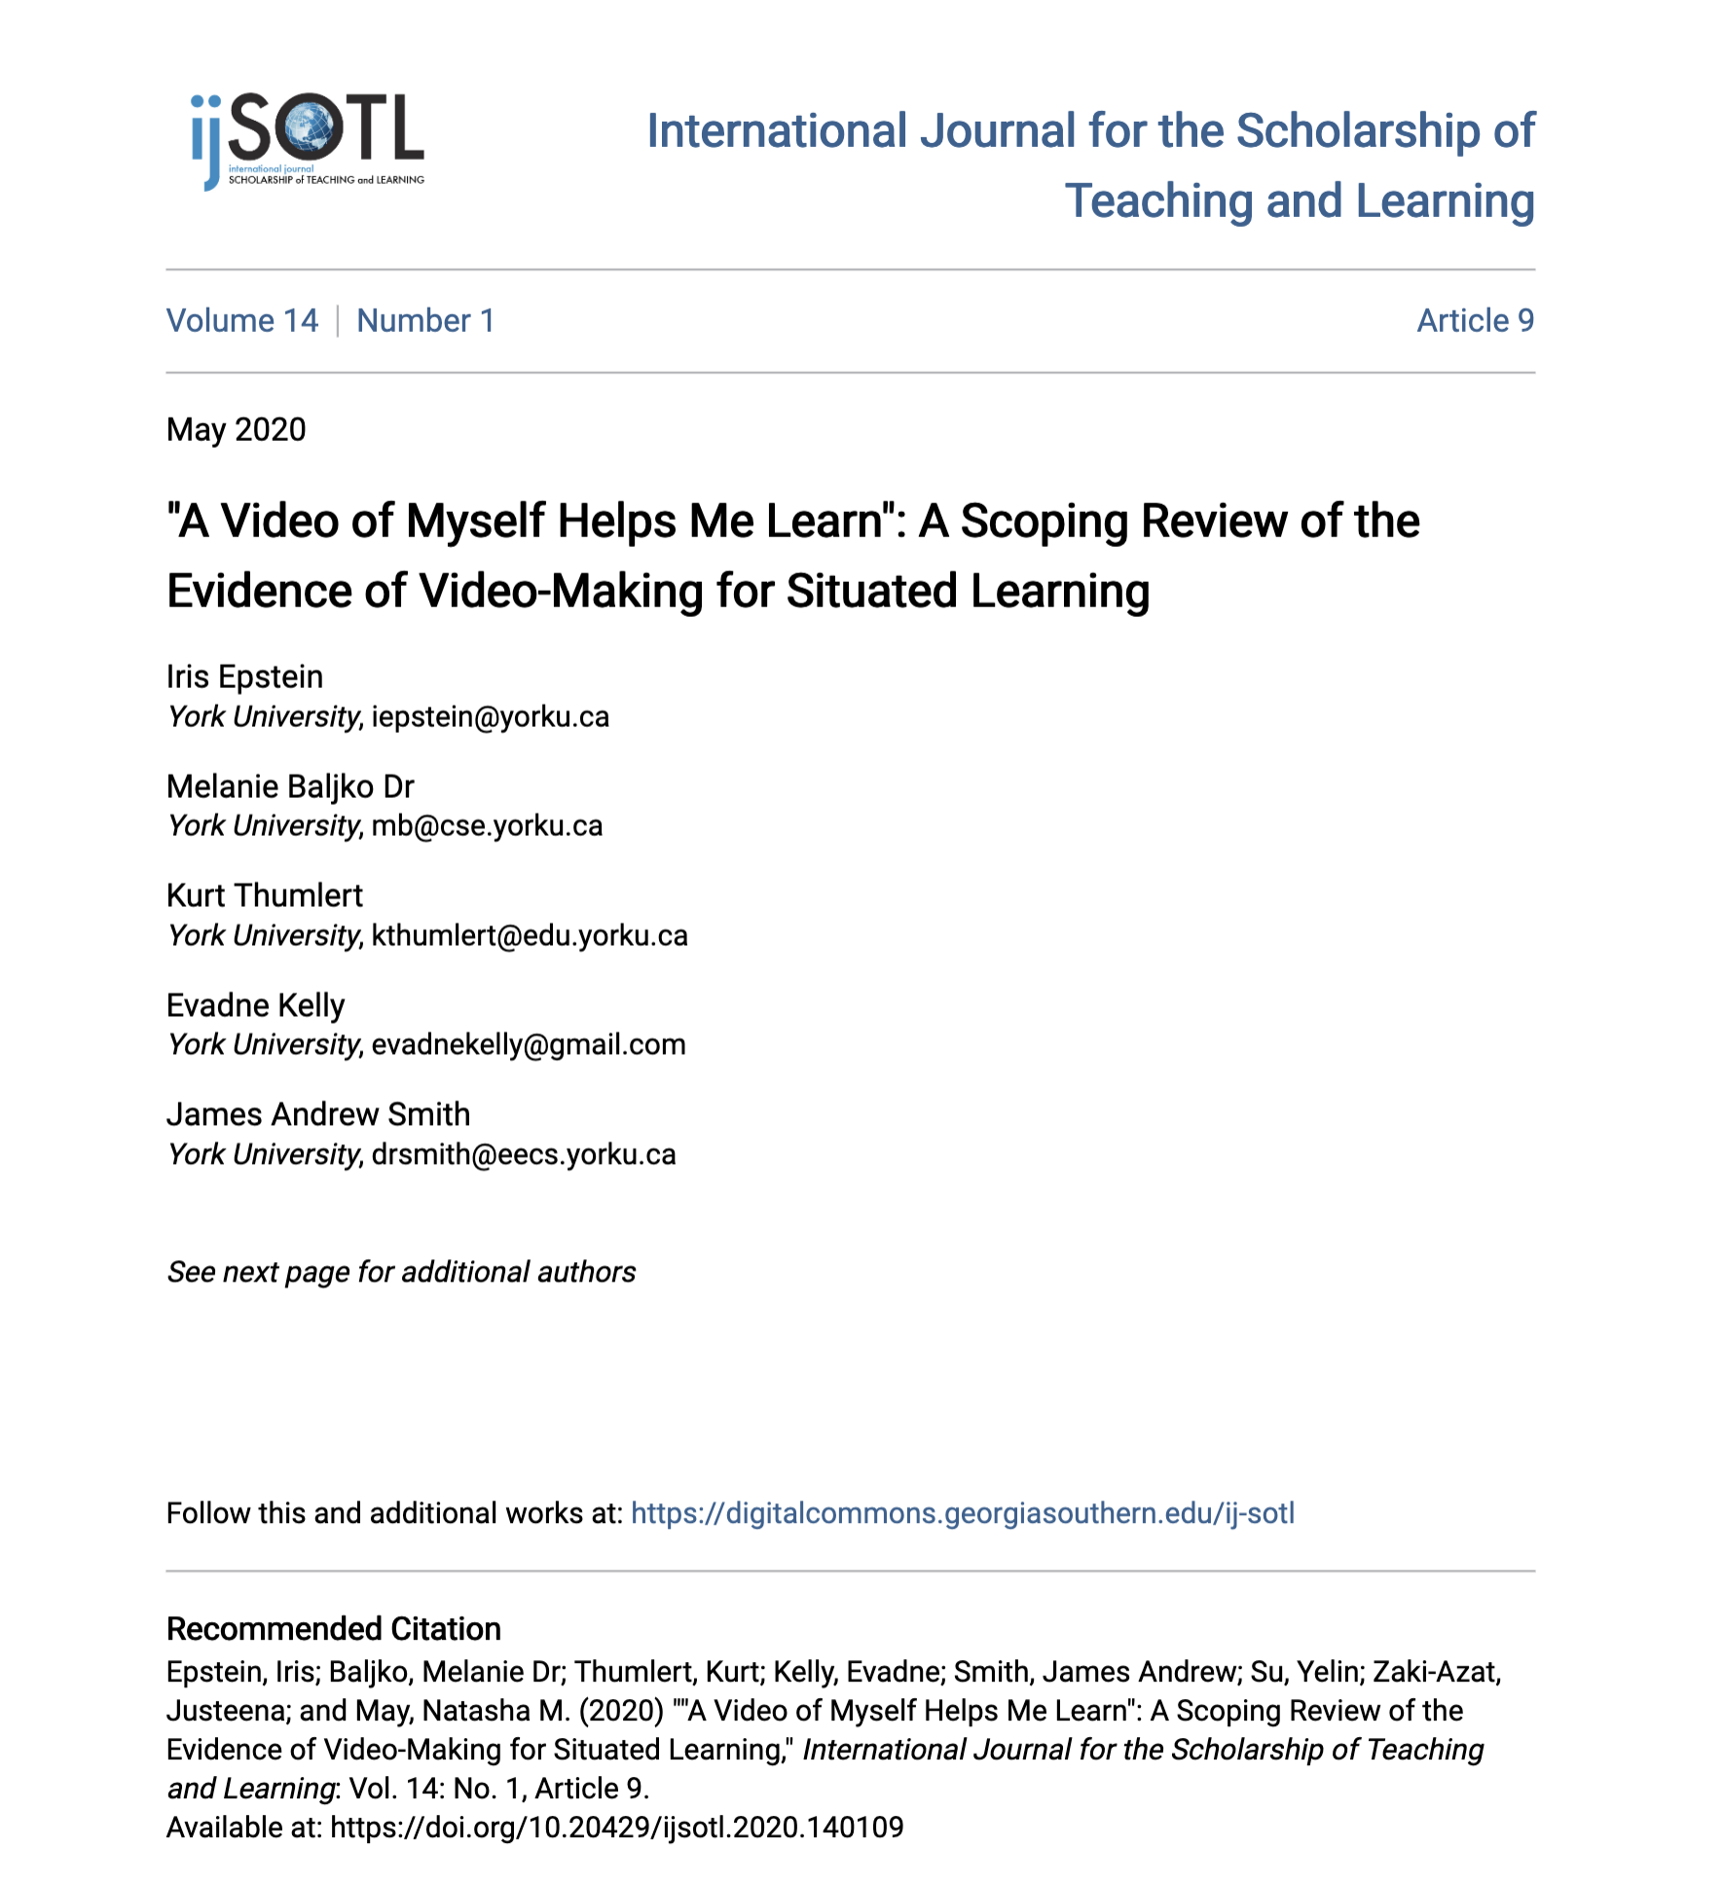
Principles Guides Us
Peer feedback
Provides possibilities within an assignment
Actively involve students in assignment design
Create a community of learners
Digital citizenship and accountability
Solving a problem together–problem-based learning
Active experiential learning
Watch and re watch
References: 1; 4; 7; 6

Slide 7
Smartphone Accommodation Resource Toolbox
What is SmART?
Notes:
The shift from Experiential Learning to Elearning Was in the framework of Accomodation – Memory Aid (rewatch videos), Space limitations to take learning beyond the classroom.
Goals:
- Connecting Elearning with Experiential Learning. The need for elearning resources that support practical ‘hands-on’ skills learning (through video documentation and interactive feedback).
- For Soft and hard skills
Creating a ‘Community of Practice’, Video Portfolios, Models, Pedagogy
Simulation, embodied performance, professional practice-based skills,
studio-based modelling & documentation of situated techniques and/or creative processes.

Slide 8
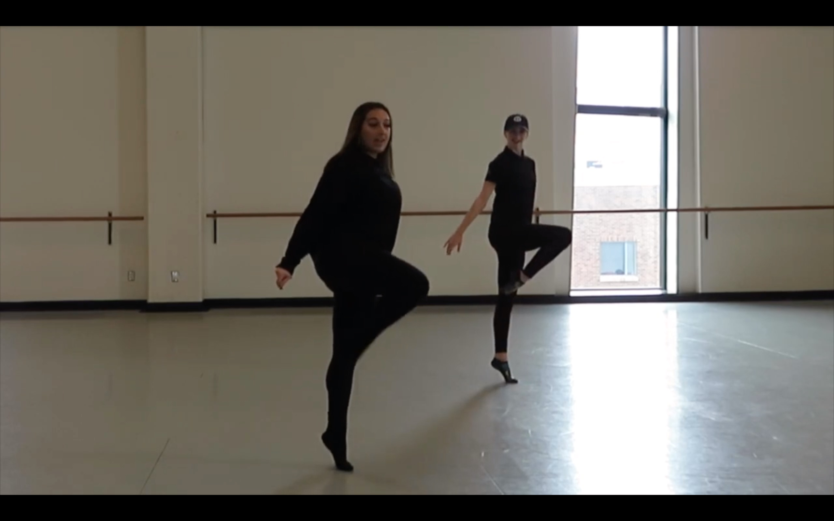
Smartphone Accommodation Resource Toolbox
Case Study 1
You are a university student and you missed the performance test in one of your skill-based courses. Your professor wants you to submit a video recording of yourself performing the skill to accommodate you. Where do you start?
Notes:
Dance case study. Dance choreography assignment.

Slide 9
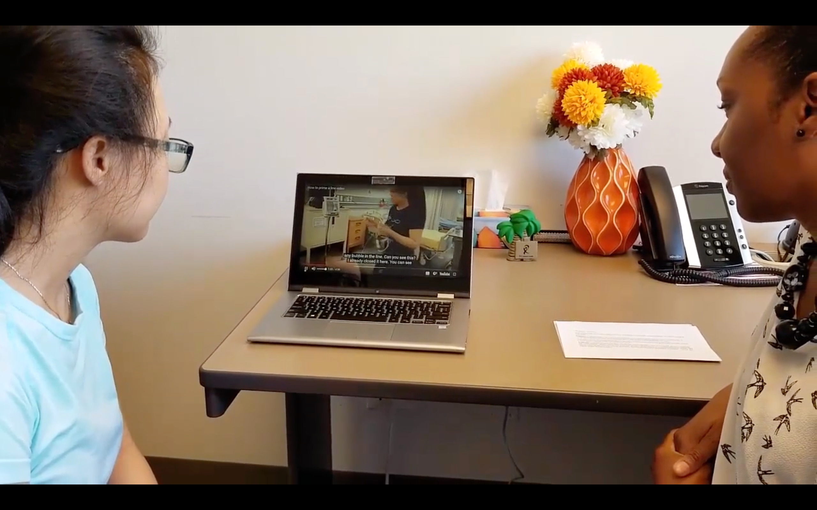
Smartphone Accommodation Resource Toolbox
Case Study 2
You are a new professor and you are teaching a skill-based course. You have given them a video making assignment and want to grade them and give good feedback. What do you do?
Notes:
You’re a new teacher and you decided to give a video assignment who missed the test.
Before we look at the next case, what issues in these last 2 cases do you see arising with using your smartphone video production tools?
Sociotechnical Issues

Slide 10
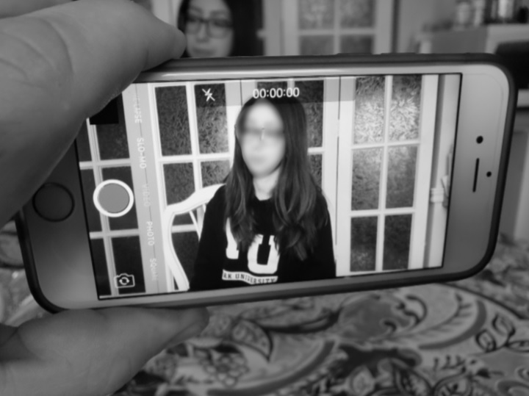
Smartphone Accommodation Resource Toolbox
Case Study 3
You are a nursing student who needs to record yourself performing a skill on a mock patient to submit to your professor. Your friend agrees but is concerned about this video getting lost or going public. What do you do?
Notes:
Potential Challenges
Technical
Ethical Challenges - Copyright and ethical issues

Slide 11
Research
(Find the need)
Design
(Create Content)
Launch
(Usability Testing)
Smartphone Accommodation Resource Toolbox
Phases
Notes:
Individual and flexible paths directing them to the resources they need. Let’s take a tour of the Smart Website!

Slide 12
Smartphone Accommodation Resource Toolbox
How SmART works?
Safe Savvy Social
http://smart-toolbox.eecs.yorku.ca/
Notes:
Individual and flexible paths directing them to the resources they need. Let’s take a tour of the Smart Website!

Slide 13
Smartphone Accommodation Resource Toolbox
Join Our Community of practice
Email – iepstein@yorku.ca
https://iris.lab.yorku.ca/

