Slide 1

Pitch 2 – UN SDG 13 Climate Action
Doing cross tabulation with data

Slide 2

The requirements for this UN SDG data assignment is to complete 5 cross tabulations and/or content analysis from the original data sheets uploaded here. There are examples of both content analysis and cross tabulation for each pitch to show you want to do. Please make sure to do a combination, so that your assignment includes 5 but at least one is a cross tabulation and one is a content analysis. Please submit in the place created for UN SDG data assignment on Submit Assignment Here. The PowerPoints are the examples of what to do. Each has a data narrowed down from the original data sheets that follows. Then the original data sheets that you will used for the assignment will be at the end in this UN SDG data assignments Box. What you submit is 5 different spreadsheets as indicated above.
© Anne MacLennan, 2024​​

Slide 3
UN SDG 13
"Climate change is a real and undeniable threat to our entire civilization. The effects are already visible and will be catastrophic unless we act now. Through education, innovation and adherence to our climate commitments, we can make the necessary changes to protect the planet. These changes also provide huge opportunities to modernize our infrastructure which will create new jobs and promote greater prosperity across the globe" (DESA, 2024).​
Department of Economic and Social Affairs (2024). The sustainable development goals​ report 2024. United Nations.
© Anne MacLennan, 2024​​​

Slide 4
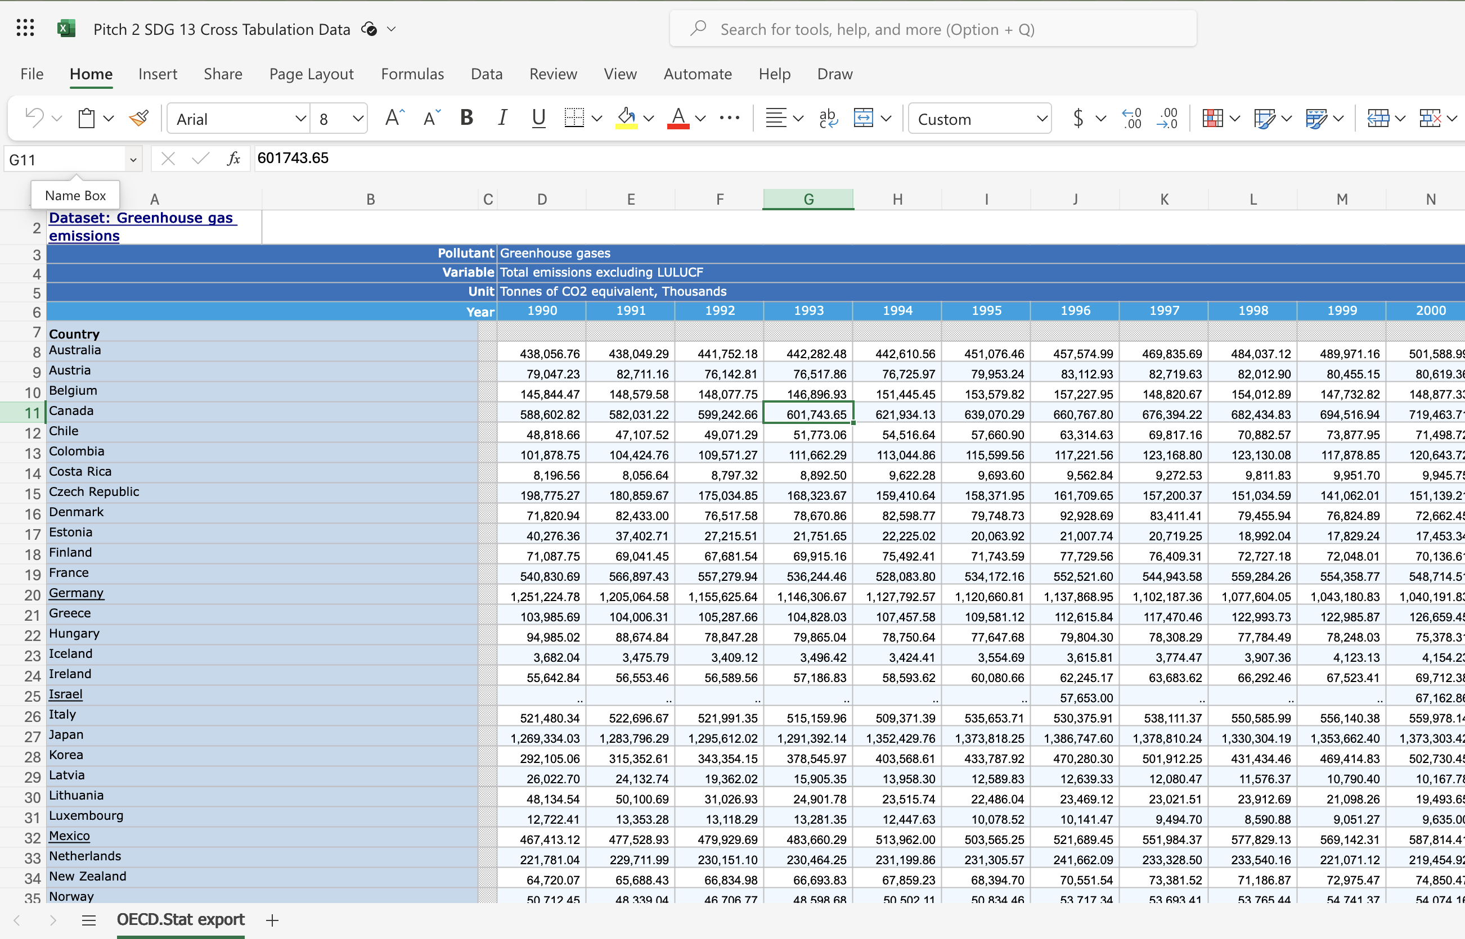
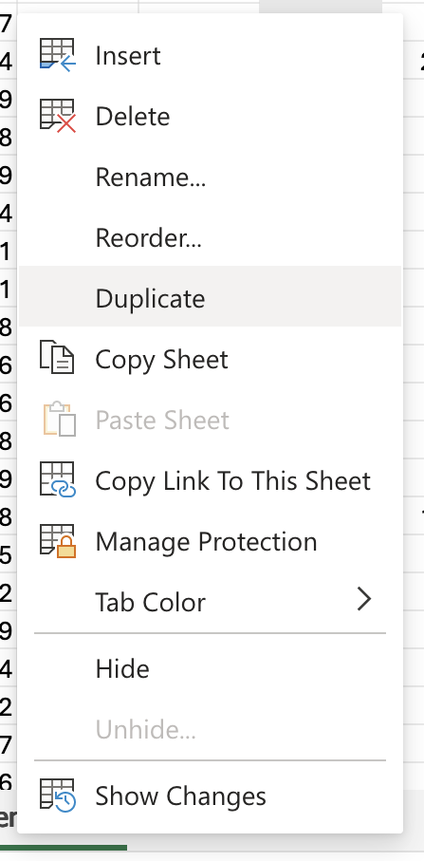
Step 1: Get raw data table and duplicate it for back up
Right click on sheet name
Sakata, S., Aklilu, A. Z., & Pizarro, R. (2024, June 13). Greenhouse gas emissions data: Concepts and data availability. Organisation for Economic Co-operation and Development. https://www.oecd.org/en/publications/greenhouse-gas-emissions-data_b3e6c074-en.html
© Anne MacLennan, 2024​​​​

Slide 5
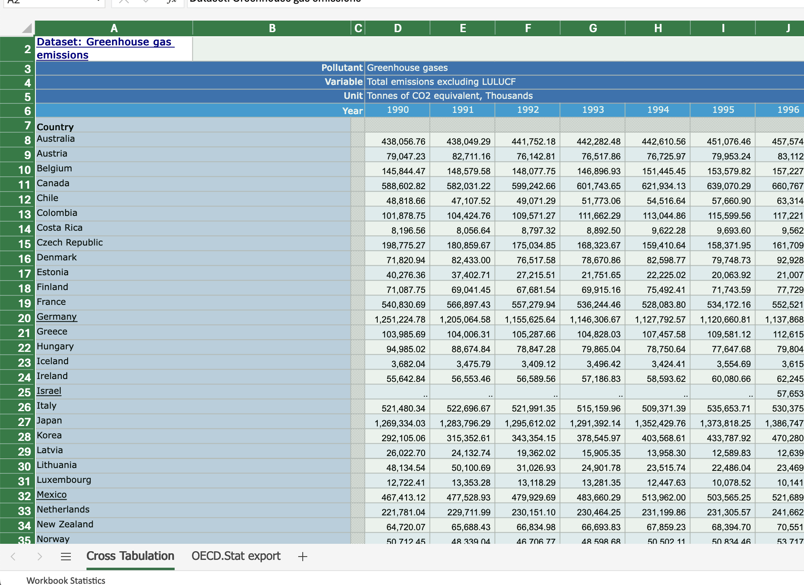
Step 2: Highlight data in the duplicate sheet
The way to highlight an Excel sheet is to go to this cell (box) and click on it. Then the whole sheet will be highlighted.
This is an Excel tip only
Sakata, S., Aklilu, A. Z., & Pizarro, R. (2024, June 13). Greenhouse gas emissions data: Concepts and data availability. Organisation for Economic Co-operation and Development. https://www.oecd.org/en/publications/greenhouse-gas-emissions-data_b3e6c074-en.html
© Anne MacLennan, 2024

Slide 6
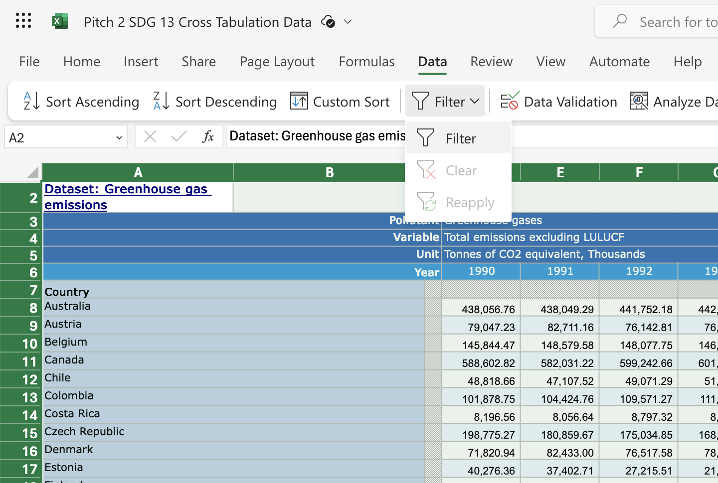
Step 3: Click data and then filter
Sakata, S., Aklilu, A. Z., & Pizarro, R. (2024, June 13). Greenhouse gas emissions data: Concepts and data availability. Organisation for Economic Co-operation and Development. https://www.oecd.org/en/publications/greenhouse-gas-emissions-data_b3e6c074-en.html
© Anne MacLennan, 2024​​

Slide 7
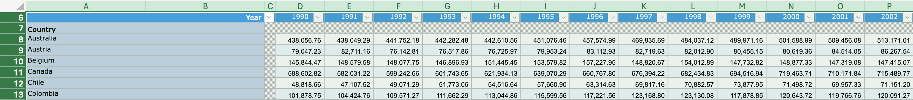
Step 4: Click data and then filter
Make sure the dropdown arrows appear
Sakata, S., Aklilu, A. Z., & Pizarro, R. (2024, June 13). Greenhouse gas emissions data: Concepts and data availability. Organisation for Economic Co-operation and Development. https://www.oecd.org/en/publications/greenhouse-gas-emissions-data_b3e6c074-en.html
© Anne MacLennan, 2024​​

Slide 8
Cross tabulating
When you cross tabulate what you are doing is comparing at least two variables. You need to pick two variables you want to cross tabulate, such as gender and wages in the workplace.
In step 3, we will select variables by using the select all feature in the filtered columns.
© Anne MacLennan, 2024​​

Slide 9
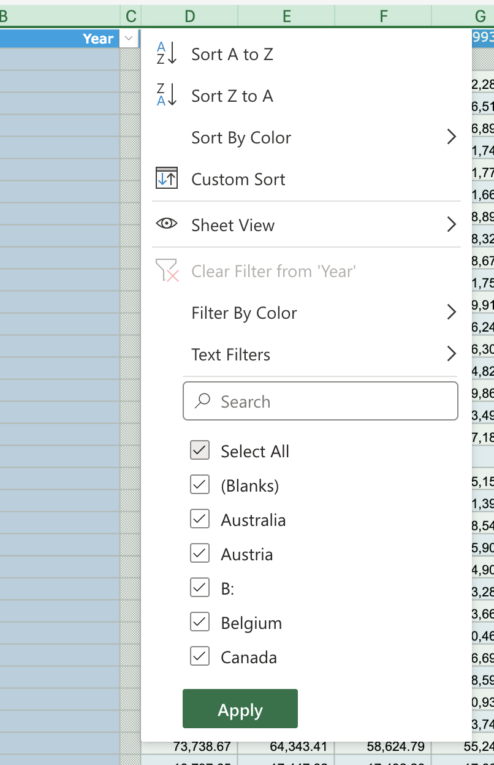
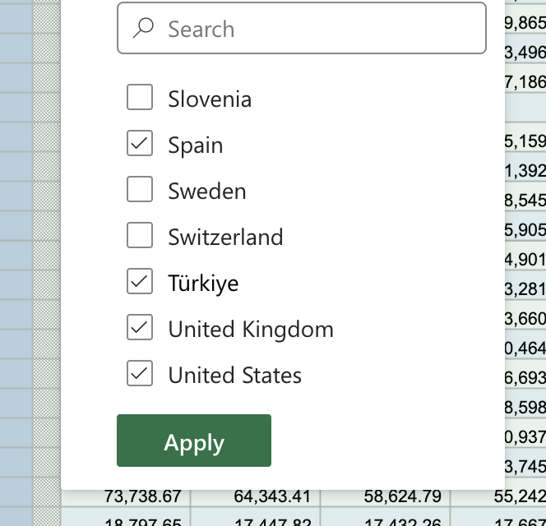
Step 5: Click arrow down to sort column
Make sure to unselect all, then select all relevant input (for this example, Ontario and Quebec). Click apply after.
Sakata, S., Aklilu, A. Z., & Pizarro, R. (2024, June 13). Greenhouse gas emissions data: Concepts and data availability. Organisation forEconomic Co-operation and Development. https://www.oecd.org/en/publications/greenhouse-gas-emissions-data_b3e6c074-en.html
© Anne MacLennan, 2024​​

Slide 10
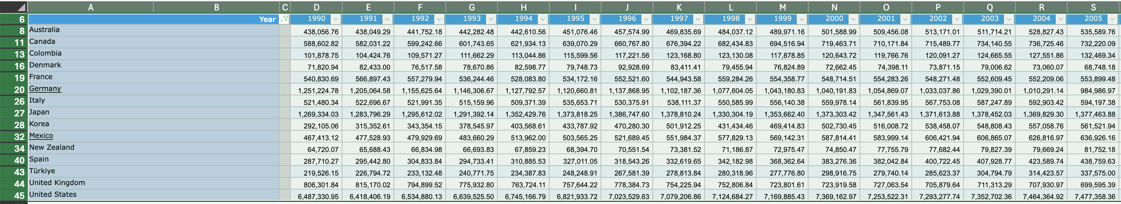
This is how it should look after completing Step 5
Sakata, S., Aklilu, A. Z., & Pizarro, R. (2024, June 13). Greenhouse gas emissions data: Concepts and data availability. Organisation forEconomic Co-operation and Development. https://www.oecd.org/en/publications/greenhouse-gas-emissions-data_b3e6c074-en.html
© Anne MacLennan, 2024​​

Slide 11
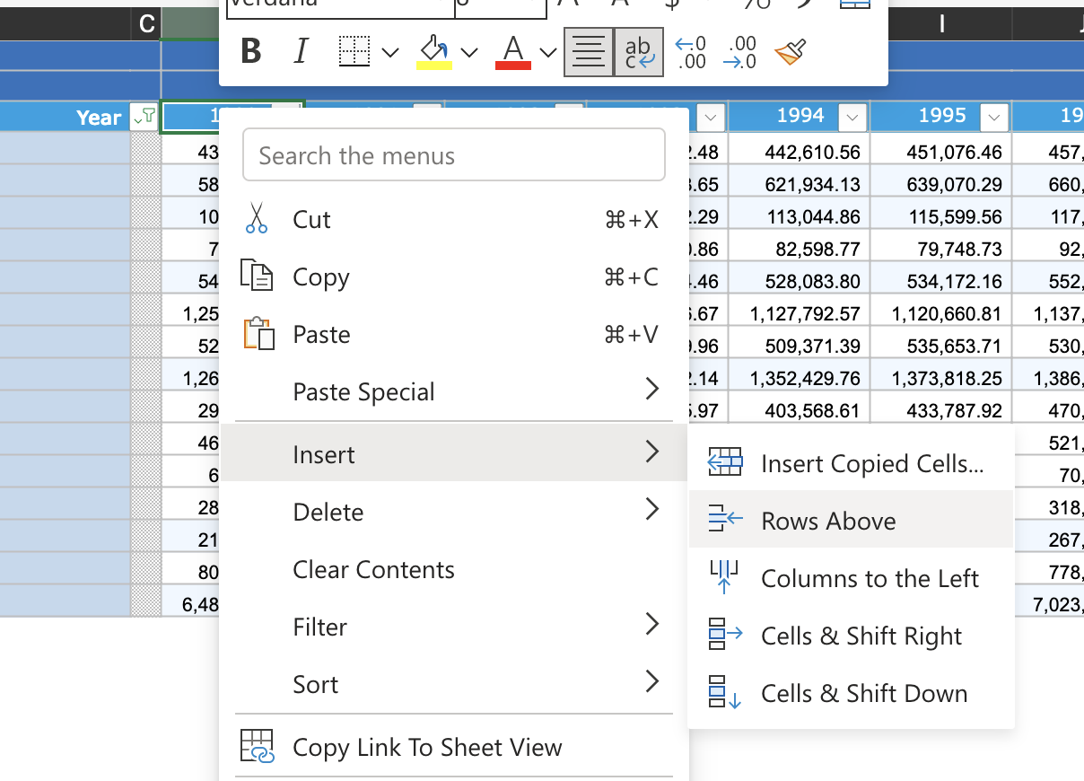
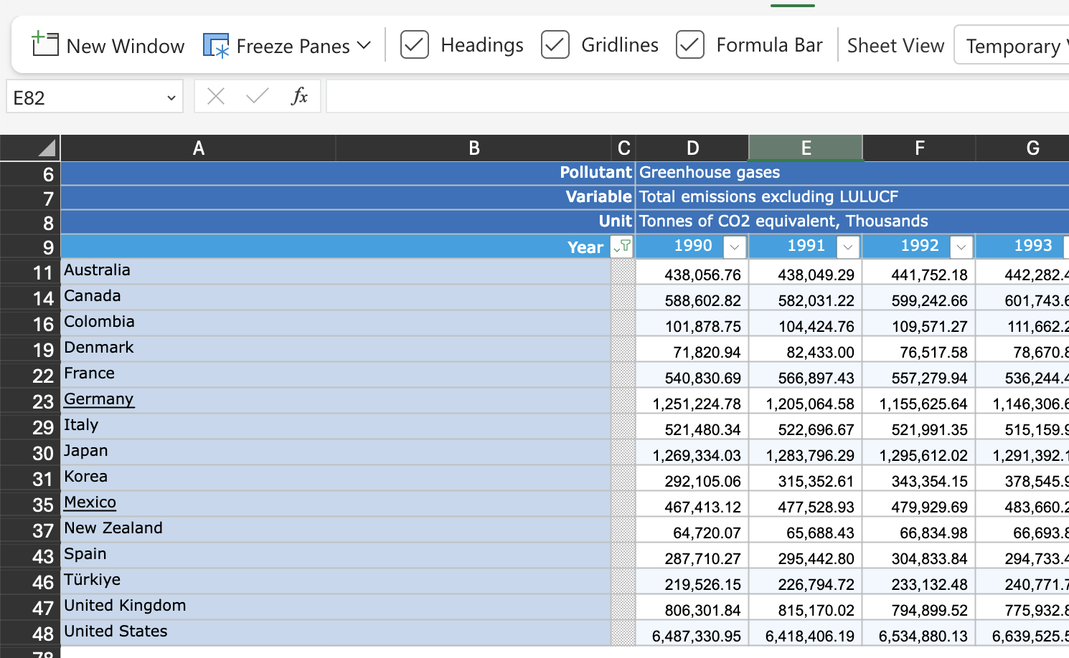
Step 6: Fix headers and formatting
Cross check duplicate sheet (the one you're working on) with the original sheet for important information
Insert rows above for headers that were removed
Add back missing information, delete columns with data that isn't needed
Sakata, S., Aklilu, A. Z., & Pizarro, R. (2024, June 13). Greenhouse gas emissions data: Concepts and data availability. Organisation for Economic Co-operation and Development. https://www.oecd.org/en/publications/greenhouse-gas-emissions-data_b3e6c074-en.html
© Anne MacLennan, 2024​​

Slide 12
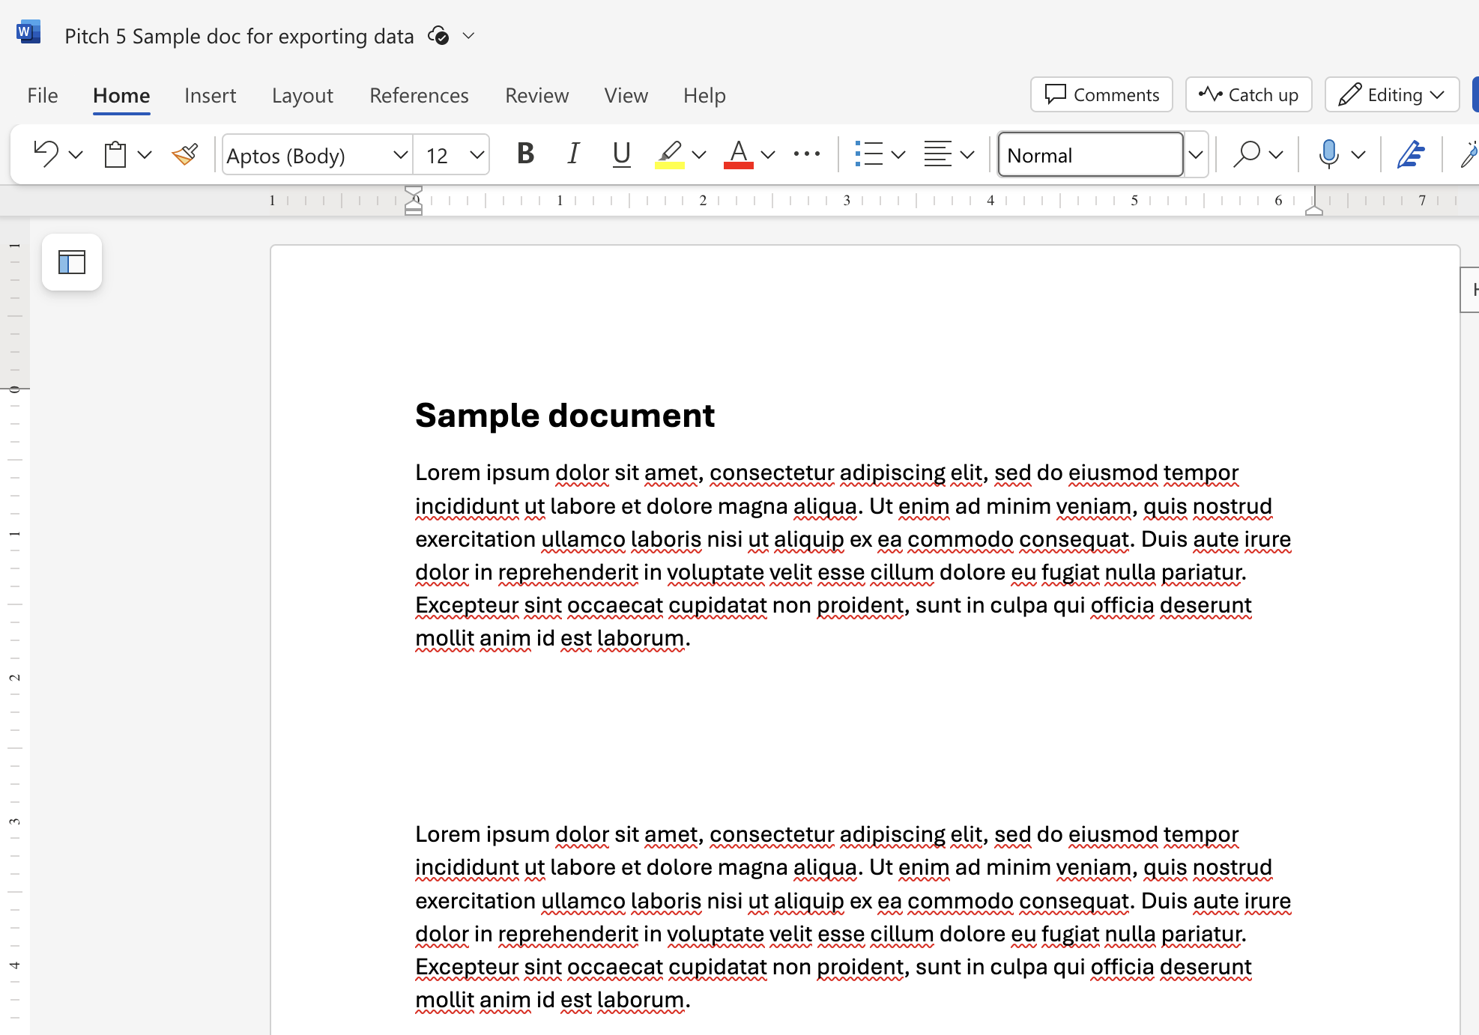
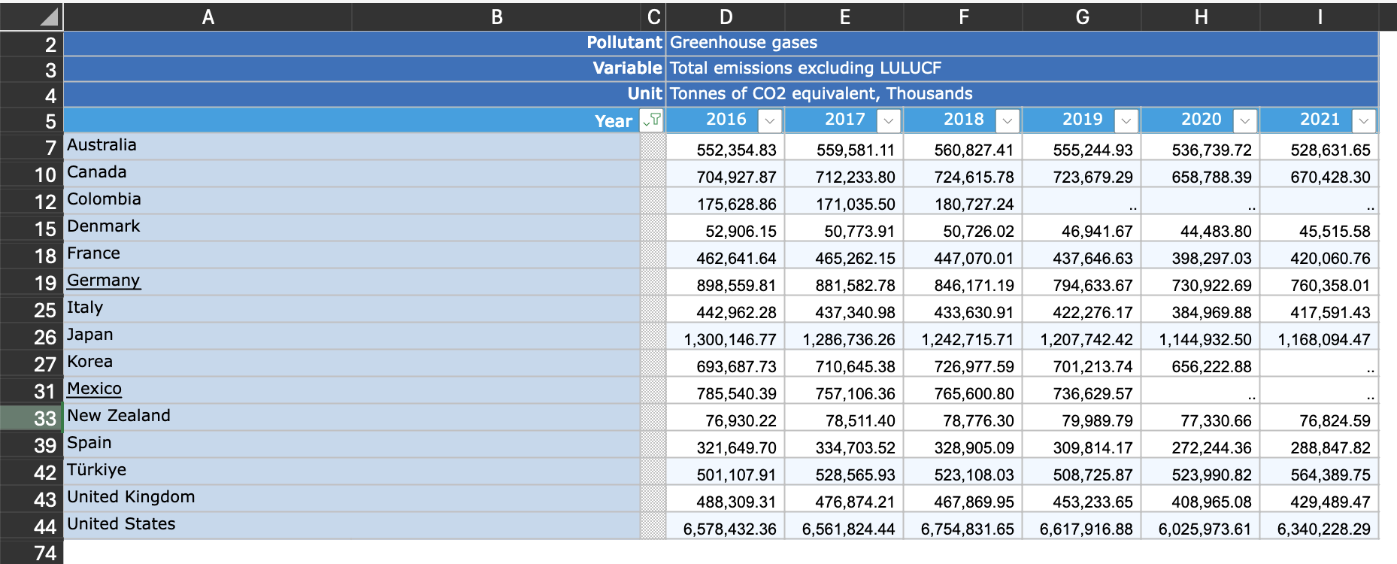
Ways to move data from Excel to Word file
This is an Excel tip only ​​
Sakata, S., Aklilu, A. Z., & Pizarro, R. (2024, June 13). Greenhouse gas emissions data: Concepts and data availability. Organisation forEconomic Co-operation and Development. https://www.oecd.org/en/publications/greenhouse-gas-emissions-data_b3e6c074-en.html
© Anne MacLennan, 2024​​

Slide 13
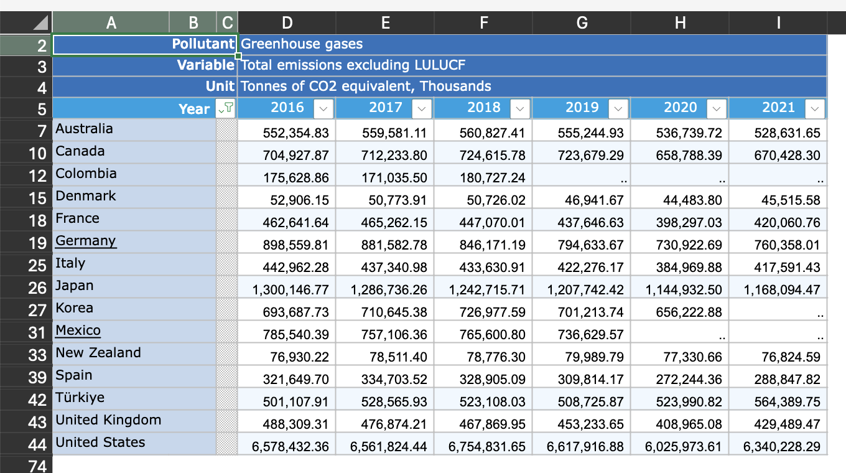
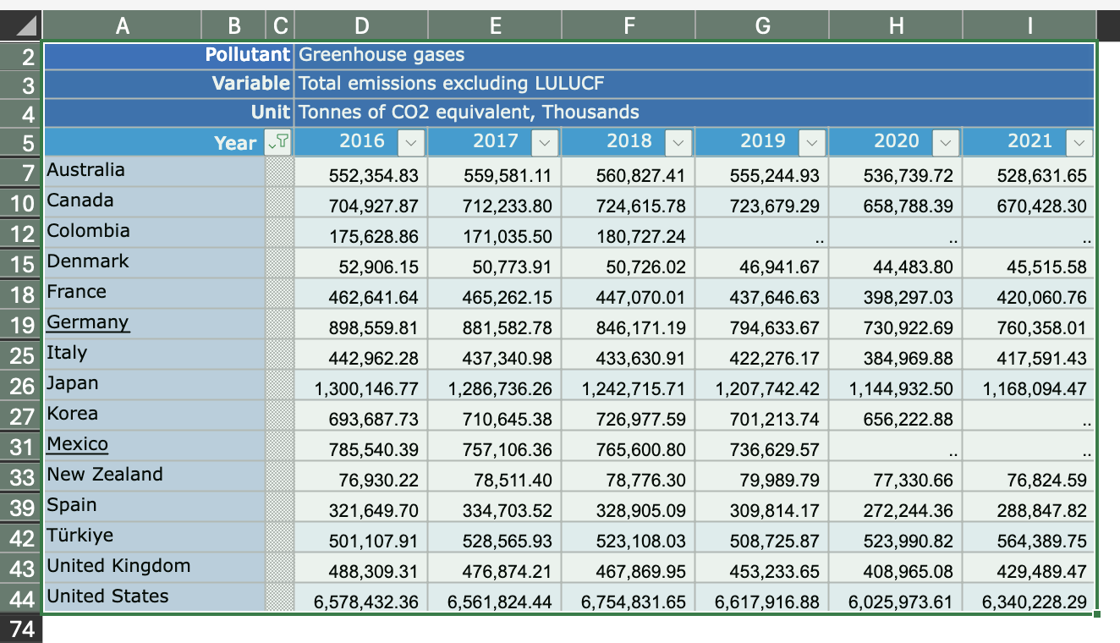
Step 1: Selecting Data
Click top left cell > hold shift > click bottom right cell to highlight all information
This is an Excel tip only
Sakata, S., Aklilu, A. Z., & Pizarro, R. (2024, June 13). Greenhouse gas emissions data: Concepts and data availability. Organisation forEconomic Co-operation and Development. https://www.oecd.org/en/publications/greenhouse-gas-emissions-data_b3e6c074-en.html
© Anne MacLennan, 2024​​

Slide 14
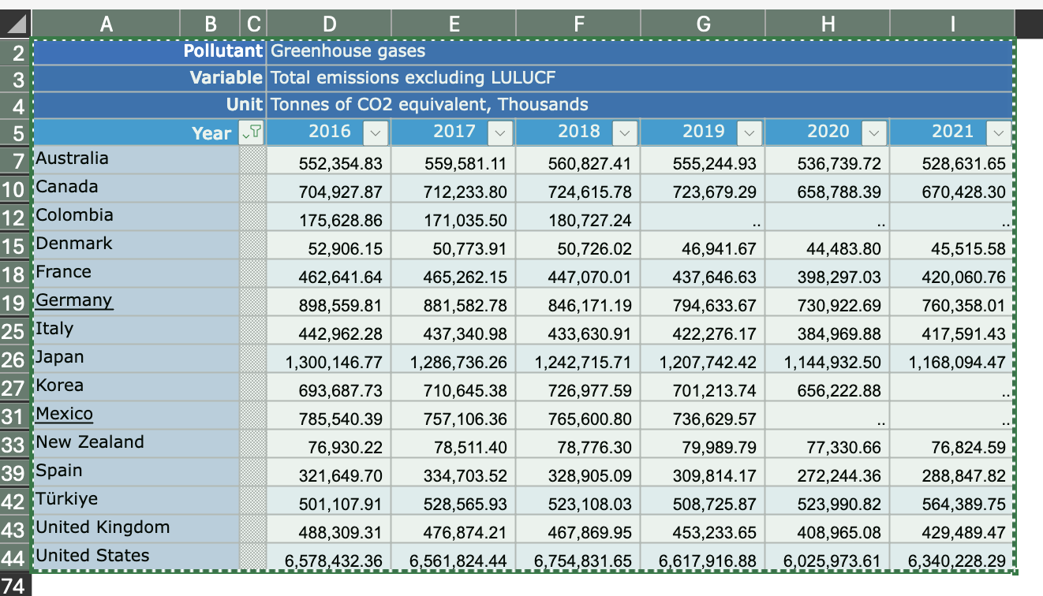
Step 2: Copying and Pasting Data
Ctrl + c (PC) or command + c (Mac) then Ctrl + v (PC) or command + v (Mac) into section in Word file
This is an Excel tip only
Sakata, S., Aklilu, A. Z., & Pizarro, R. (2024, June 13). Greenhouse gas emissions data: Concepts and data availability. Organisation forEconomic Co-operation and Development. https://www.oecd.org/en/publications/greenhouse-gas-emissions-data_b3e6c074-en.html
Note: marching ants border indicates that the data is copied and ready for pasting
© Anne MacLennan, 2024​​​

Slide 15
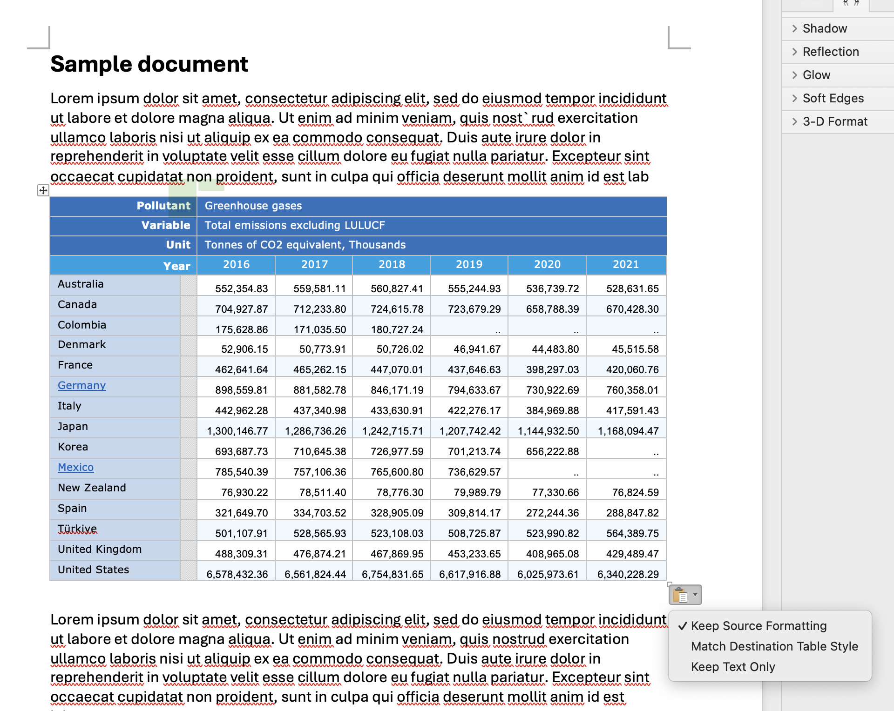
Step 3: Copying and Pasting Data
Ctrl + c (PC) or command + c (Mac) then Ctrl + v (PC) or command + v (Mac) into section in Word file
Sakata, S., Aklilu, A. Z., & Pizarro, R. (2024, June 13). Greenhouse gas emissions data: Concepts and data availability. Organisation forEconomic Co-operation and Development. https://www.oecd.org/en/publications/greenhouse-gas-emissions-data_b3e6c074-en.html
© Anne MacLennan, 2024​​​

Slide 16
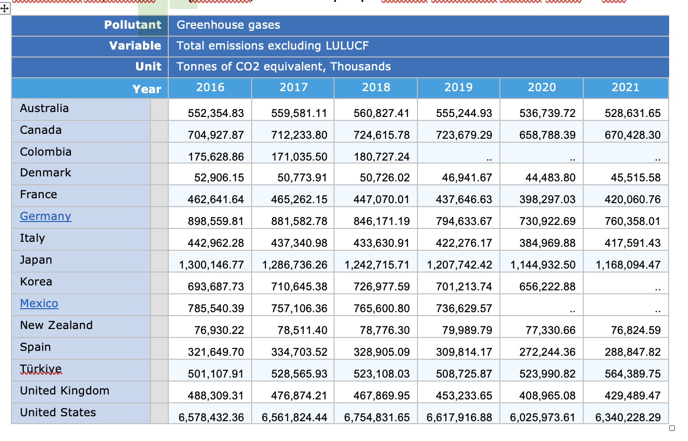
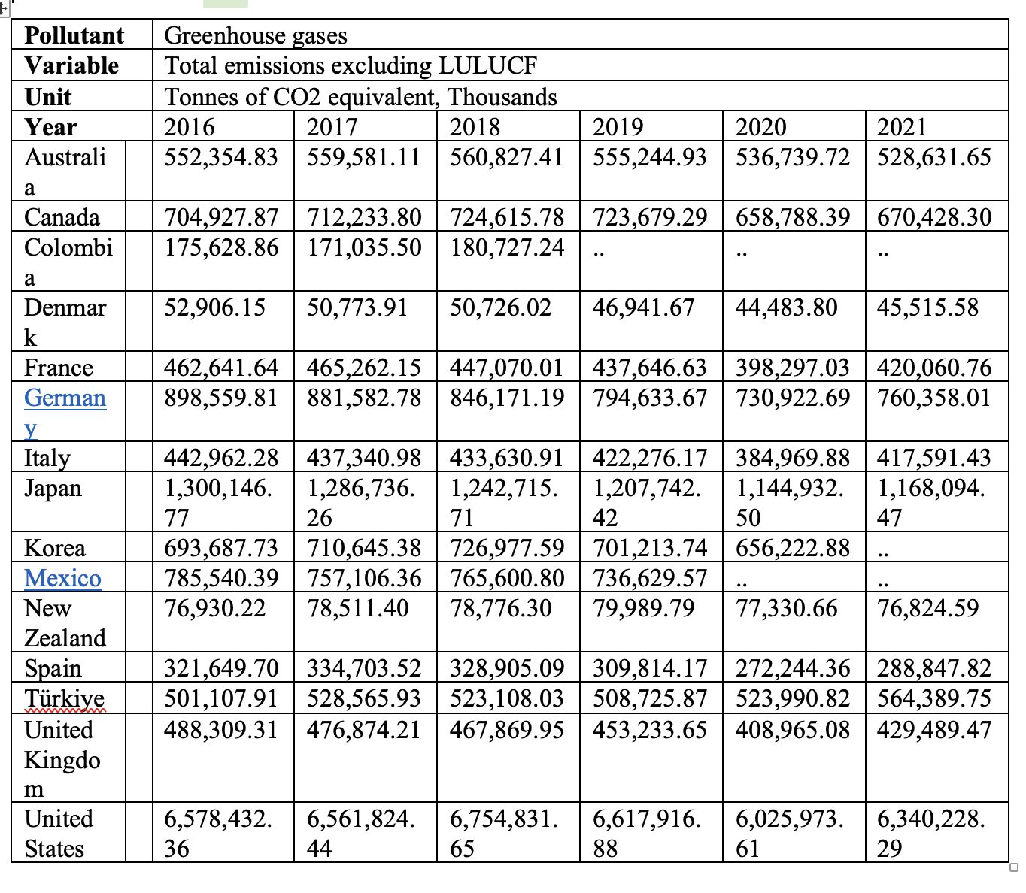
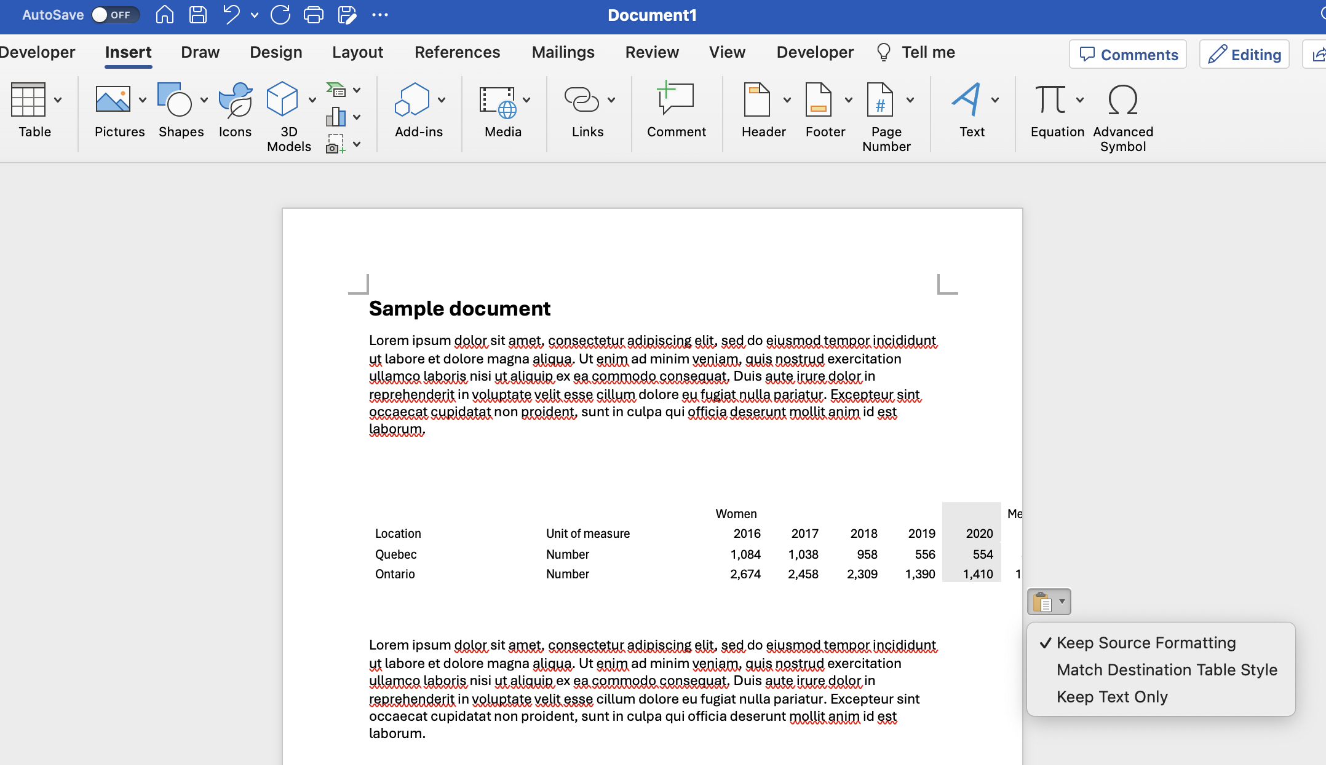
Step 4: Fixing the Formatting
Keep source formatting uses the same fonts and styles as the Excel sheet, match destination table style converts the copied data into the document's style
Make changes as needed
Sakata, S., Aklilu, A. Z., & Pizarro, R. (2024, June 13). Greenhouse gas emissions data: Concepts and data availability. Organisation forEconomic Co-operation and Development. https://www.oecd.org/en/publications/greenhouse-gas-emissions-data_b3e6c074-en.html
© Anne MacLennan, 2024​​​

Slide 17
Screenshot Step 1: Taking the Screenshot
Windows key + print scr (PC)
Shift + control + command + 3 (Mac)
© Anne MacLennan, 2024​​​

Slide 18
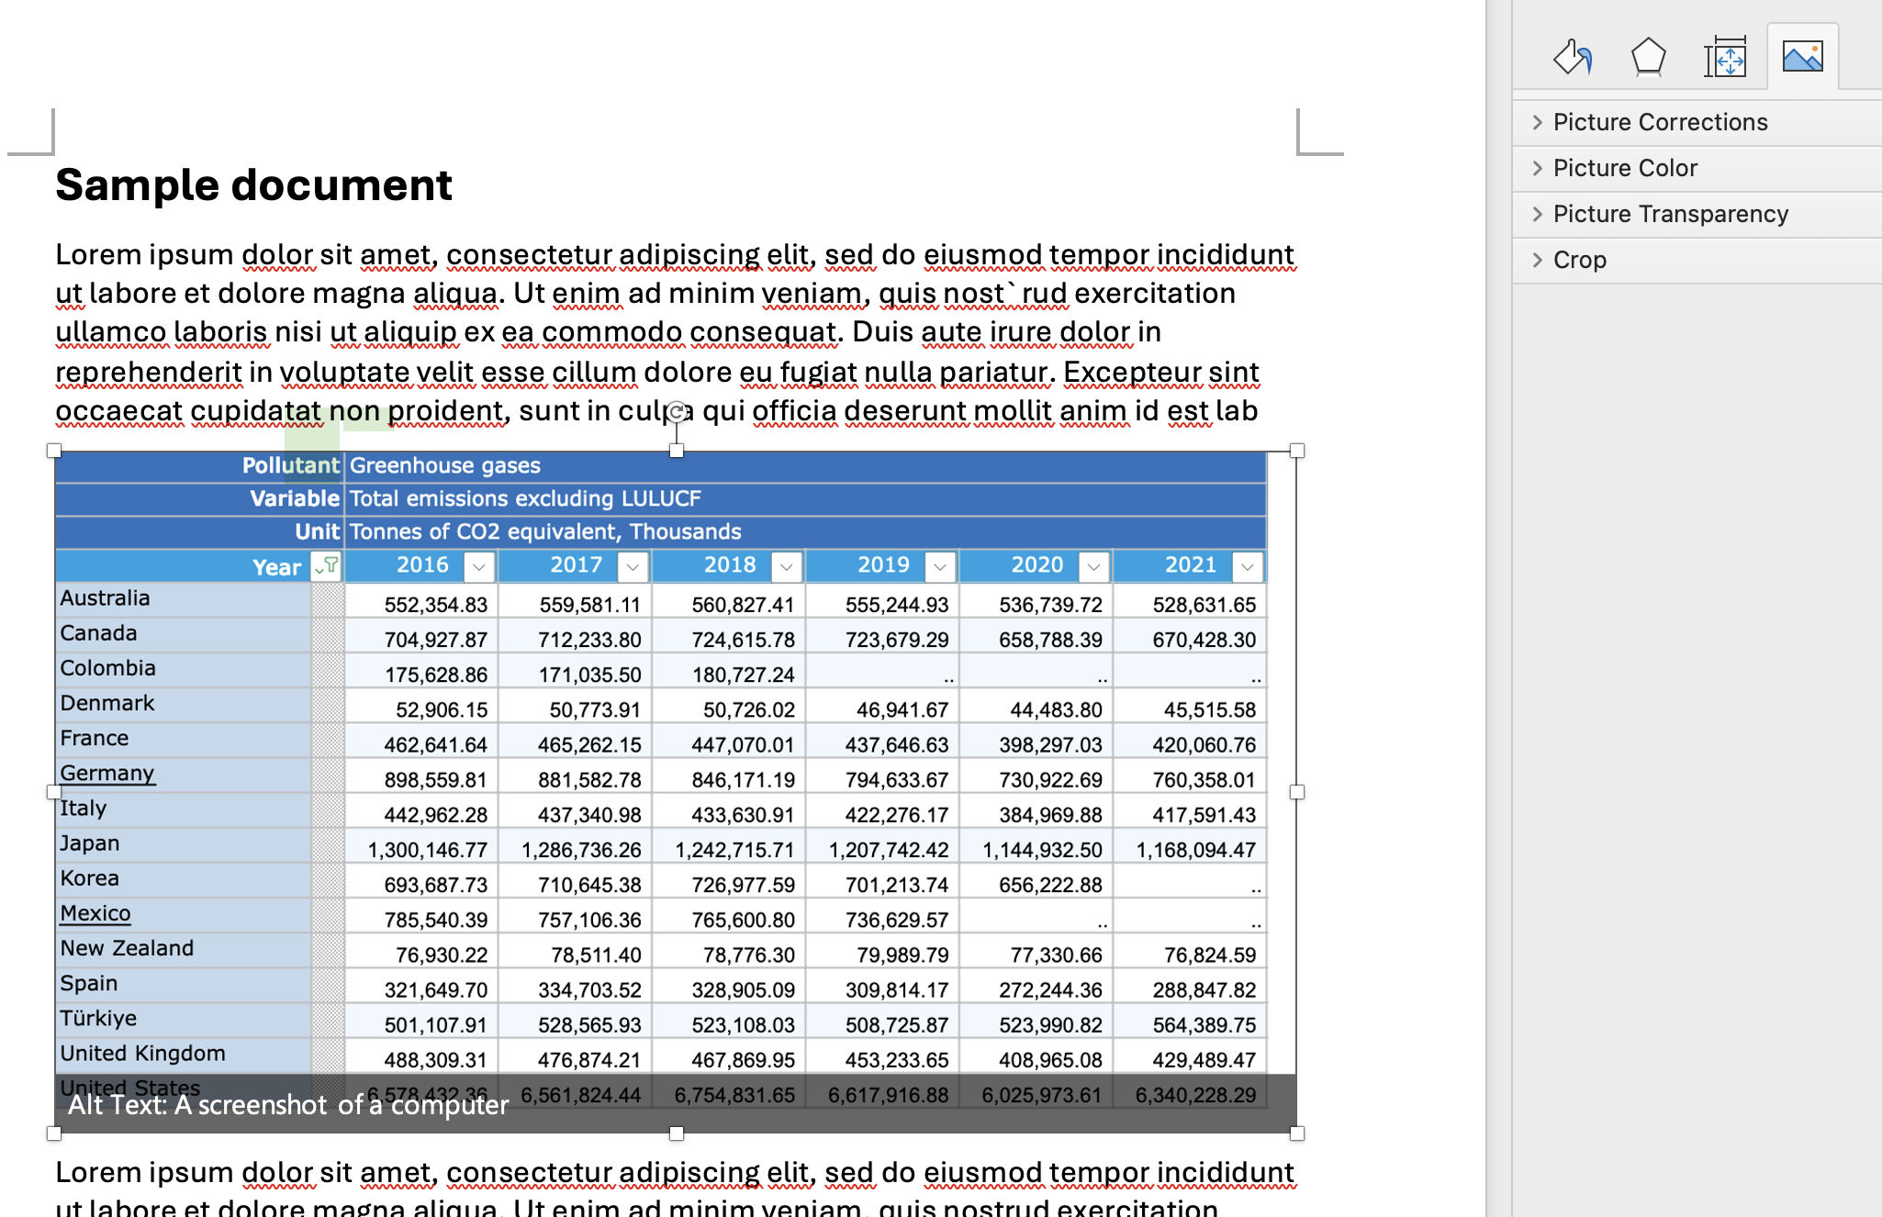
Step 2: Pasting the Screenshot
Go to Word document then press
  Ctrl + V (PC)
  Command + V (Mac)
Edit as needed
Double click to crop and edit
Sakata, S., Aklilu, A. Z., & Pizarro, R. (2024, June 13). Greenhouse gas emissions data: Concepts and data availability. Organisation forEconomic Co-operation and Development. https://www.oecd.org/en/publications/greenhouse-gas-emissions-data_b3e6c074-en.html
© Anne MacLennan, 2024​​​

Slide 19
References
Department of Economic and Social Affairs (2024). The sustainable development goals report 2024. United Nations. https://unstats.un.org/sdgs/report/2024/The-Sustainable-Development-Goals-Report-2024.pdf.
Sakata, S., Aklilu, A. Z., & Pizarro, R. (2024, June 13). Greenhouse gas emissions data: Concepts and data availability. Organisation forEconomic Co-operation and Development. https://www.oecd.org/en/publications/greenhouse-gas-emissions-data_b3e6c074-en.html.

