Slide 1
Archiving ACW: Preserving the work of ACW and related grants
Presentation to ACW Team Meeting April 30 2022

Slide 2
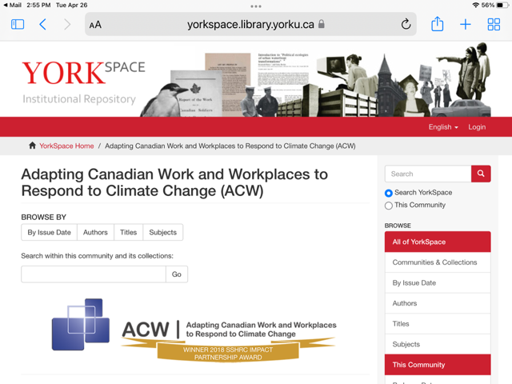
Introducing ACW on YorkSpace https://yorkspace.library.yorku.ca

Slide 3
Why YorkSpace?
A variation of D-Space, the academic institutional repository software used by 39 Canadian universities and 100’s in the U.S. and Europe
Built for the purpose
Open access to anyone
Stability (links will never break or change)
“High Discoverability” (all documents rank high on Google searches because of prestige of the platform)
Permanence – “in perpetuity” with protection from political interference

Slide 4
A quick tour of ACW on YorkSpace:

Slide 5
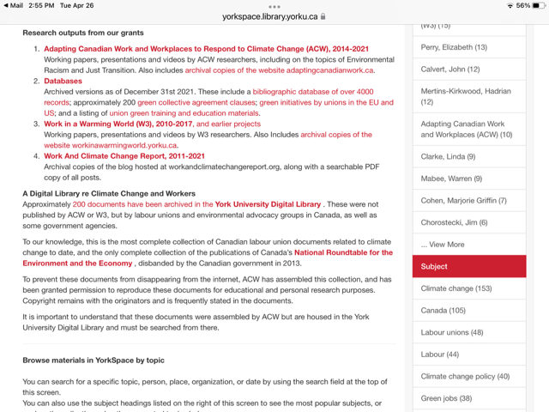
What we have archived & how it is organized
154 items: working papers, presentations, videos, and website and database captures

Slide 6
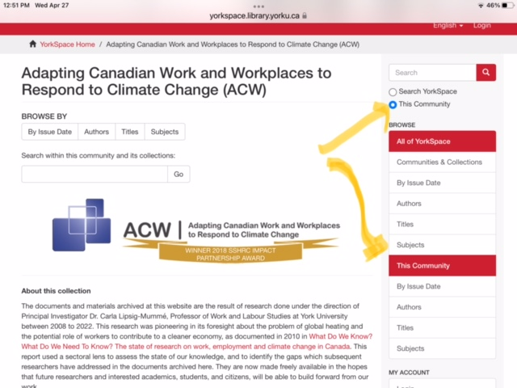
Searching YorkSpace

Slide 7
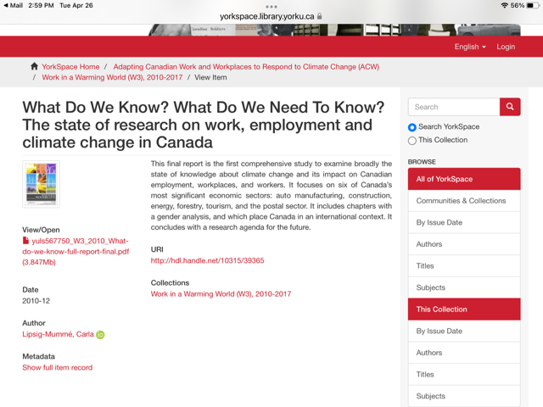
Sample record:
Each item is searchable and downloadable

Slide 8
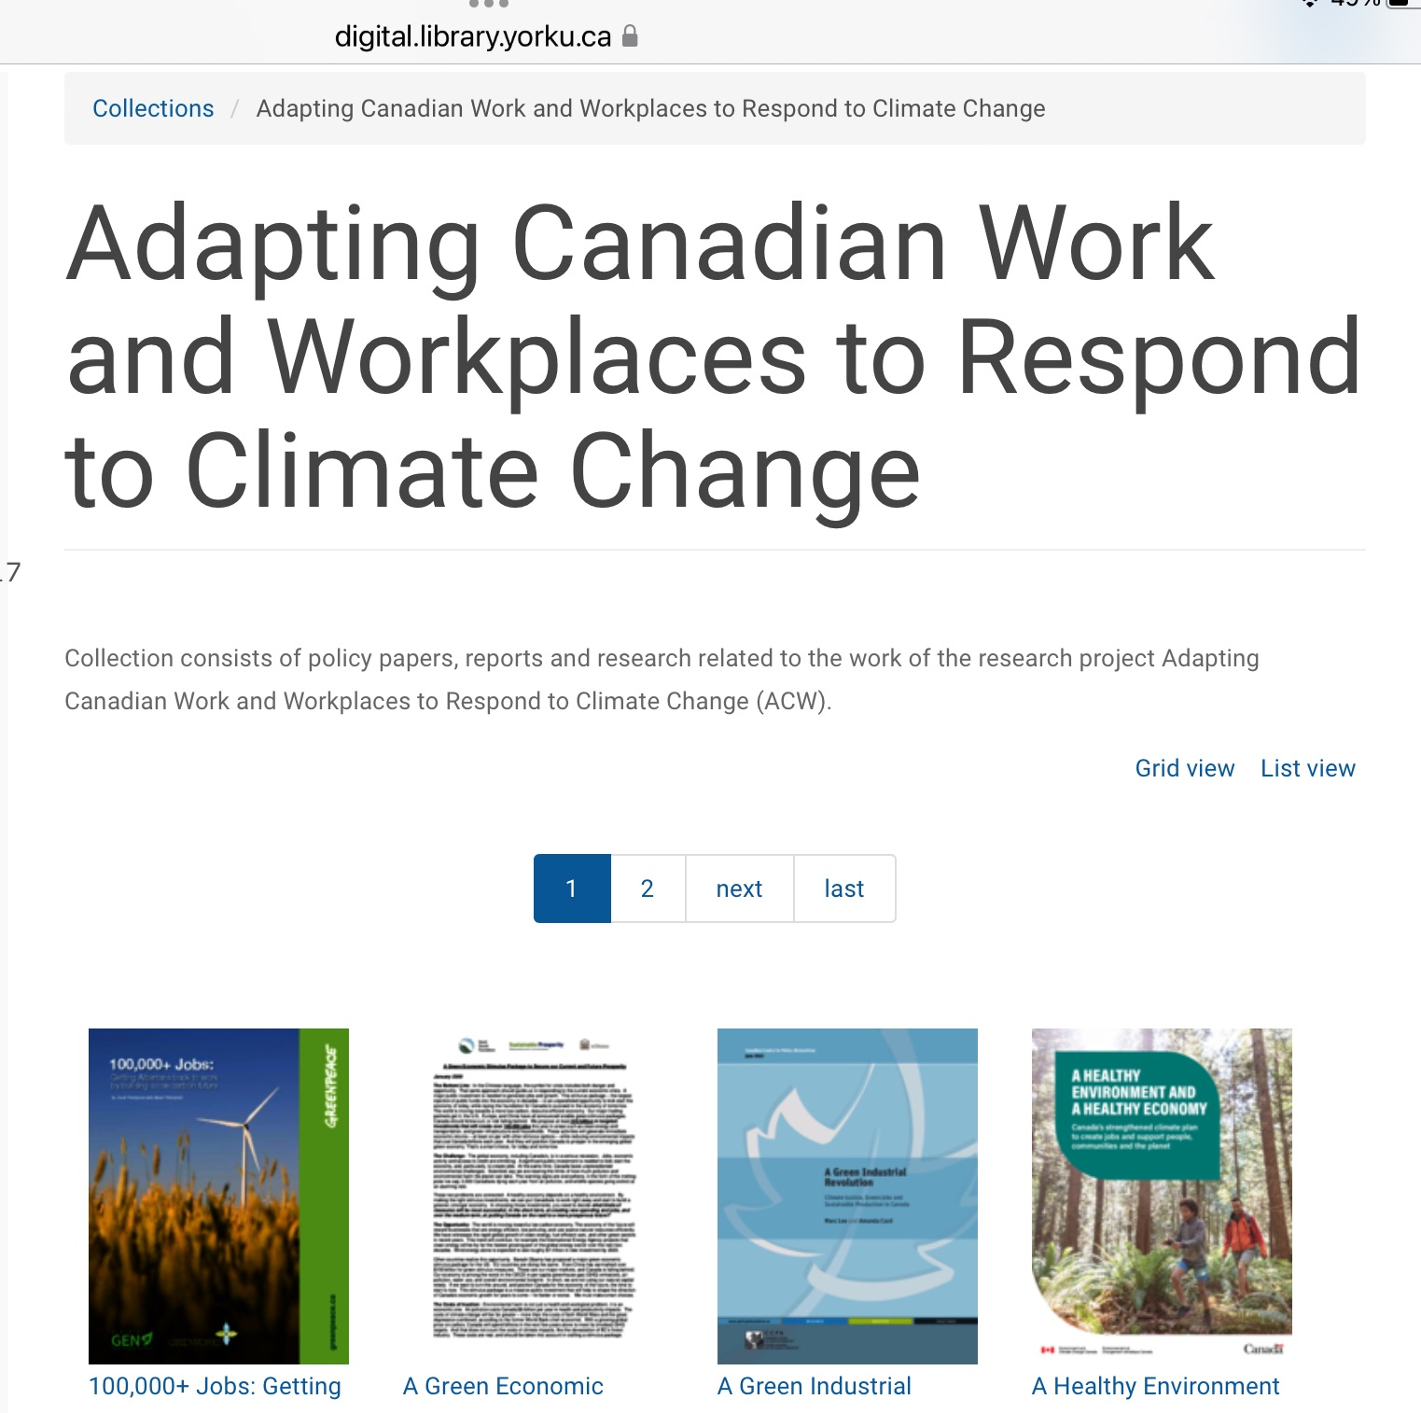

Digital Library of non-ACW reports

Slide 9
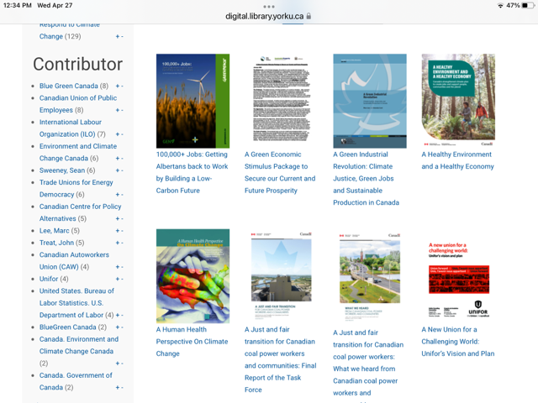
Contents of ACW Digital Library
Copyright clearance obtained to download/cite these documents
As many labour union docs as I could get clearance for; also government docs, environmental groups, etc.
Many would otherwise disappear from the internet
These links will remain stable, so good to use this site if you are citing documents

Slide 10
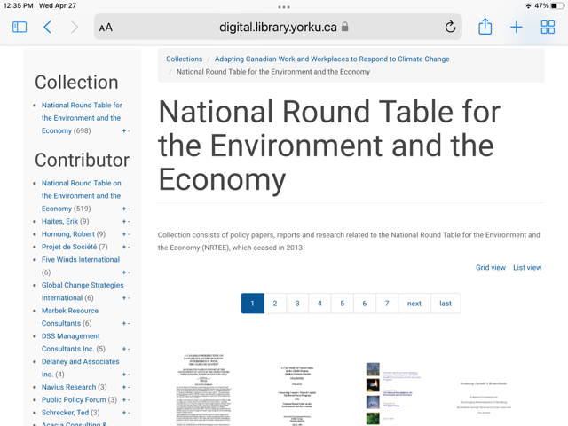
Also Included in the ACW Digital Library:
The National Round Table was disbanded by Harper in 2013 and even the National Library has only a small collection of their documents
ACW was given a complete collection (698 reports) and our Digital Library makes them available for download

Slide 11
Final thoughts:
To find the ACW archive, easiest to just Google: Yorkspace ACW
We will be sending out the link and information to everyone on the ACW mailing list to encourage people to use the resources
Problems with navigating it or finding information:
  Contact me at Elizabeth.perry493@gmail.com
  Questions?

