Slide 1
European Green Deal > Fit for 55 Package > social dimension
ACW conference
Toronto, 30 April 2022
Bela Galgoczi, European Trade Union Institute, Brussels
bgalgoczi@etui.org

Slide 2
The clock is ticking: the fundamental revision of our growth model is a compelling necessity
The IPCC AR6 report (WG1) made it clear that we are on the verge of the abyss and the 1.5C warming scenario is slipping away; COP26 only demonstrated this
What is clear: A fundamental revision of our energy and resource depleting growth model is necessary in order to reach net-zero carbon economy by 2050, less clear, what this means
The Commission`s EGD initiative – €1 trillion Sustainable Europe Investment Plan (for 10 years), €150bn Just Transition Mechanism (over next MFF) – JT Fund (17bn) + InvestEU + EIB – relaunch it under the new reality

Slide 3
New geopolitical situation with high stakes
Russia` aggression highlighted the EU`s long term fossil fuel dependence and the need to get out of it
the new geopolitical situation resulted in a price shock that makes the transition more difficult in the short term and at the same time it makes it even more inevitable and speeds it up
Address its worst effects without jeopardizing climate ambition
REPowerEU in the centre of policy debate
New emphasis on just transition

Slide 4
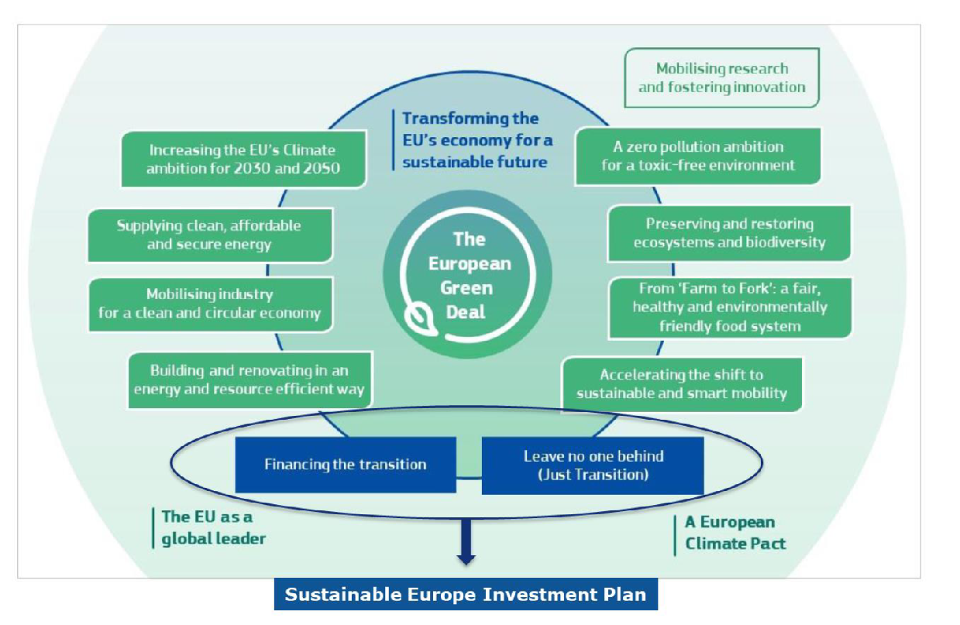
The EU Green Deal

Slide 5
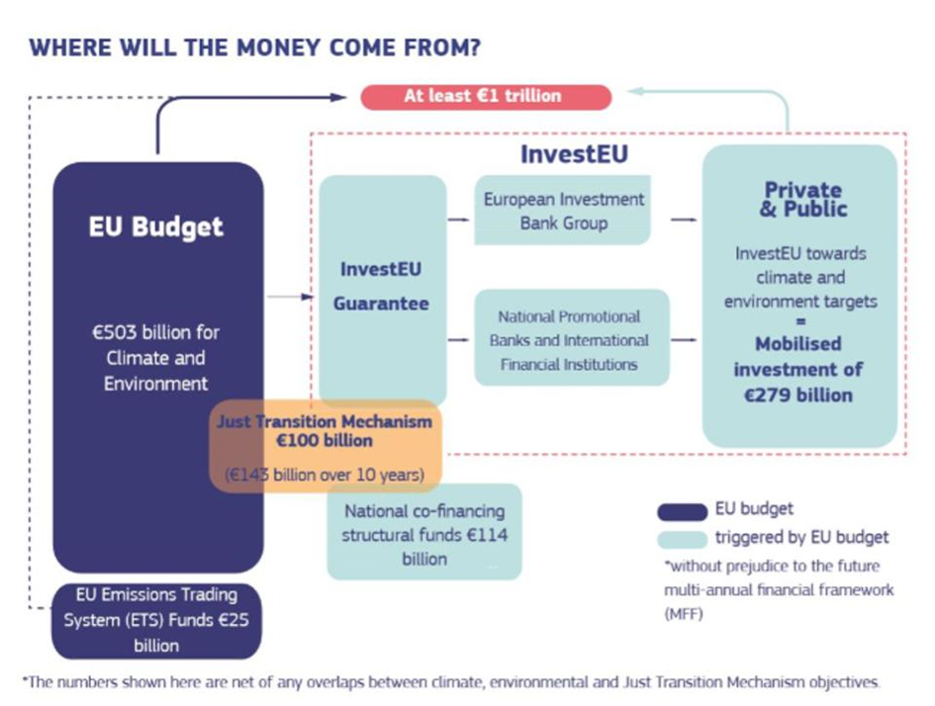
The European Green Deal and its financing – Sustainable Europe Investment Plan

Slide 6
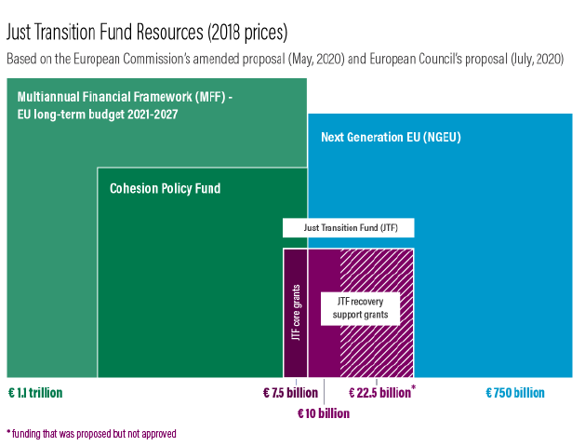
Just Transition Fund resources

Slide 7
EGD and investments
Economic sustainability and EGD: European climate policy in the past decade was chronically under-financed, targets and declarations were ambitious, but fulfilment was lagging behind, examples renewable energy investments, building retrofitting programmes
Even the current Investment Plan is much lower that the roughly 300bn€ yearly investment need identified by the Commission for reaching EU climate policy objectives
Next question: how much of these planned investments are additional investments (not from reallocations from other EU funds?

Slide 8
The Fit for 55 package, July and December 2021 European Green Deal
FF55 was seen as a moment of truth in EU climate policy and in the European Green Deal agenda
It was proof that the EGD is not just talk, it is serious, it is concrete and it also hurts..
At the same time it brought to social aspects of the green transition into the centre of policy debate
The launch of ETS2 for transport and buildings is the first time that the carbon price directly affects the population
The prospective launch of the Social Climate Fund reflects on this recognition

Slide 9
Main elements of EGD launched by the Commission
10 December 2020: European Battery Alliance
9 December 2020: European Climate Pact
19 November 2020: Offshore renewable energy
14 October 2020: Renovation wave
08 October 2020: EU strategies for energy system integration and hydrogen
20 May 2020: EU Biodiversity Strategy for 2030
20 May 2020: ‘Farm to fork strategy’
11 March 2020: Circular Economy Action Plan
10 March 2020: European Industrial Strategy

Slide 10
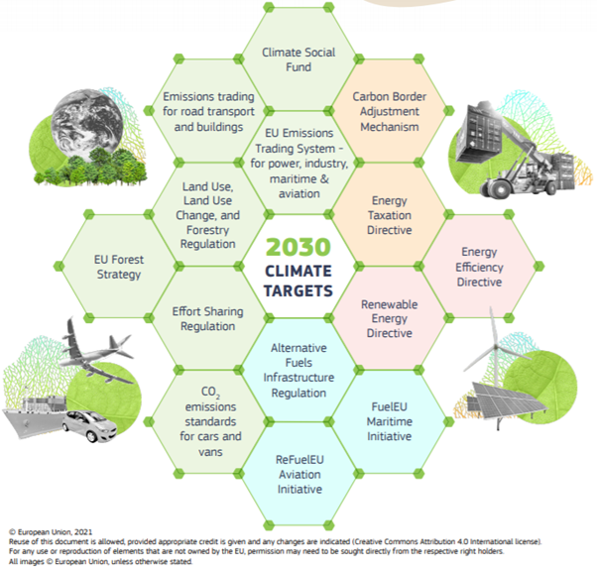
The Fit for 55 package
I

Slide 11
Fit for 55 package: implementation of the Green Deal – now it is getting to be serious
Fit for 55 December package | Legislative proposals
Gas & hydrogen | Proposal for a revised gas markets and hydrogen directive and annex Proposal for a revised gas markets and hydrogen regulation and annex
Methane | Proposal for a methane emissions regulation
Buildings & real estate | Proposal for a Directive on the energy performance of buildings and annexes

Slide 12
SOCIAL SUSTAINABILITY:
Just transition – more important than ever
Just transition is about `just burden sharing`, with different dimensions:
  Addressing climate and environmental justice
  Dealing with distributional effects of climate policies (FiT, carbon price, ETS design during the transition
  managing job transitions + regional restructuring
  JT is to avoid a `JOBS <> ENVIRONMENT` dilemma
  In wake of COVID and in the middle of a profound shift in geopolitics due to Russia`s assault on Ukraine, just transition is more important than ever

Slide 13
Sectoral specifics of decarbonisation/ just transition
Effects of decarbonisation on employment and working conditions can be very different by sector, therefore dedicated industrial policy and just transition approaches are necessary.
For example, for the fossil fuel energy sector, jobs will be lost and massive employment losses are on way. Automobile industry: massive changes ahead with shrinking employment and massive restructuring including reskilling over 2.4 M jobs.
Construction sector:
Retrofitting/renovation of building stock targeting at 350 EUR bn/year via Invest EU. How realistic is it to move from 0.2% deep renovation rate to 3% needed to targets? Still, a `winner` of decarbonisation policies, but large scale restructuring and training/retraining needs.

Slide 14
Climate action and distributional effects
The often degressive distributional effects of climate policies cannot be neglected, the `Fit for 55` package is a primary example and will be a test case
At national level households are financing the enrgy transition by much higher electricity prices than for industry with alarming levels of energy poverty in certain MS
The newly planned emission trading system for buildings and transport will increase the effects on households and the compensation via the Climate Social Fund is unsatisfactory
Affordability of clean vehicles, access to charging stations raises the danger of emerging new inequalities (between countries and within countries)

Slide 15
The Fit for 55 package: weak social dimension
The Just Transition Fund with limited resources, dedicated mostly to helping coal regions. This is very important but has a very limited scope. The newly announced Social Climate Fund has a very specific target: to fend off the detrimental distributional effects of a future ETS2 for buildings and transport, but even for that it may not be enough. Its €72.2 billion capacity spread over seven years will be insufficient to address the problems ahead, and its administration is likely to pose challenges for the institutional capacity of some Member States. Sectors that are highly affected, such as the automotive sector and energy intensive industries, do not have dedicated instruments and a fund.

Slide 16
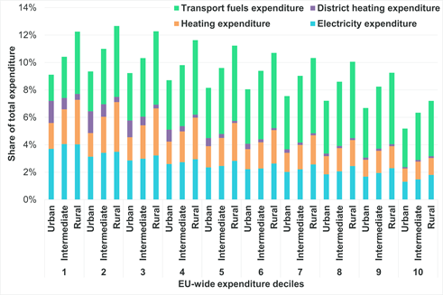
Share of transport fuels in household expenditure by income deciles in the EU27

Slide 17
Addressing transport poverty
Simulations for the prospective ETS2 show that when revenues from a higher carbon price are being recycled at 100% to the lowest 50% income groups, the lowest decile receives a welfare gain of 2.5% and only the highest five deciles pay somewhat more
If the Social Climate Fund recycles 25%, the lowest income group marginally benefits, but the middle-income deciles have the biggest burden
If carefully designed, these polluter pays instruments can both fight inequality and the climate crisis
This also delivers lessons for dealing with market-based price hikes

Slide 18
Council recommendation December 2021
The proposed Council Recommendation on ensuring a fair transition is a ‘toolbox’ for Member States to manage the outlined employment and social effects, based on already existing tools. Implementation will be monitored via the European Semester. It recommends that states take measures to provide active support for quality employment; ensure access to quality and inclusive education, training and life-long learning; the fairness of tax-benefit and social-benefit systems; and access to affordable essential services and housing.
The social dimension of the EGD therefore remains significantly underdeveloped compared to the other hard-law Fit for 55 initiatives.

Slide 19
ETUI study on the employment effects of decarbonization for energy intensive industries
Differences in the employment effect between technology scenarios with given emissions reduction target > at the level of the whole economy: no dramatic effects. In each of the technological pathways however there is a negative employment effect for the EIIs themselves.
Technology scenarios: innovation (hydrogen); CCS; circular economy
The circular economy scenario shows higher (although not dramatic) employment loss for the whole economy, but ca. a 3% loss of employment in energy intensive industries
CBAM, while positive effect on employment, due to revenues that affect the whole economy, not for industry. Abolishing free emission allocations - while fully justified - can result in a price shock and negative employment effects, transition periods may be considered.

Slide 20
Possible employment effects: EU27 EII-s

Slide 21
An environmental labour studies approach
Implementing just transition in reality (under concrete socio-economic and institutional conditions)
A policy environment is needed that is facilitating change (covers the risk and parts of the cost of a change that is of a common interest)
This includes a new role for the state
In order to make the claim of ‘just transition with climate ambition’ a reality, a supportive political economy context is necessary: an ‘eco-social state’

Slide 22
Role of actors in JT
Trade unions and works councils need to adapt their vast experiences with managing restructuring in an advance looking way to the concrete cases of restructuring cases due to decarbonisation
comprehensive and coherent policy framework needed
Public responsibility in facilitating a transformation that is of public interest - JT Fund, regional, industrial policy)
Timely information and consultation
Social dialogue, social plans, employment transitions, training
Big differences in concrete JT strategies by sector
  Decarbonisation (in sectors) has different interlinkages to other megatrends (as e.g. digitization /auto/, demography /mining/)

