Slide 1


Exploring Open Education Across the Hemispheres
York University Libraries
June 6, 2023
These slides, authored by Stephanie Quail, Sarah Coysh, & Priscilla Carmini, are available under a CC BY 4.0 international license

Slide 2



About Us
Priscilla Carmini
(She/Her/Hers)
Scholarly Communications Librarian
Sarah Coysh
(She/Her/Hers)
Associate Dean, Digital Engagement & Strategy
Stephanie Quail
(She/Her/Hers)
Scholarly Communications Librarian

Slide 3
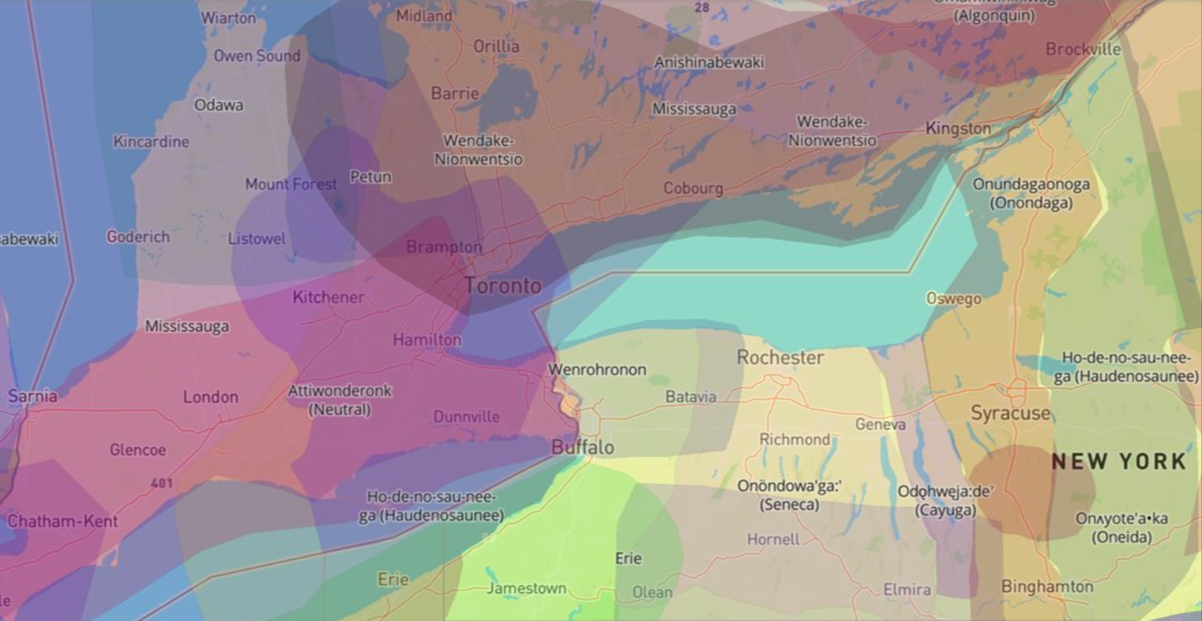
Land Acknowledgement
Go to the Native Land website: https://native-land.ca/

Slide 4

Quick Ice Breaker
Let’s get to know each other by answering a few questions using the tool, Mentimeter!

Slide 5
Agenda
Learning Outcomes
Define OER
Develop OER searching skills
Describe OER benefits for students & faculty
Discuss open licensing models
Higher Ed & Student Debt
OER 101
Open Licensing
Finding & Locating OER
Group Activity: Compile a List of Open Education Resources for the HUC Community

Slide 6
Higher Education & Student Debt
1

Slide 7
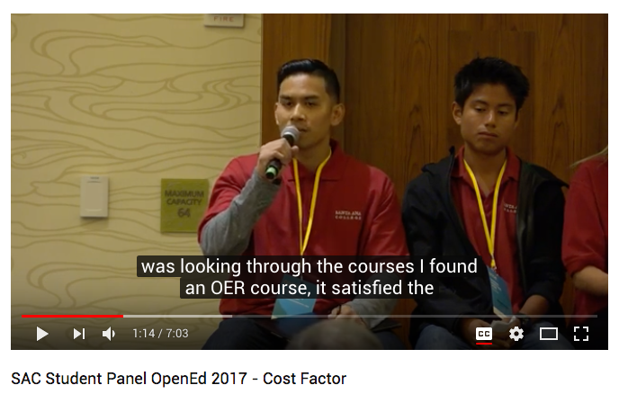
Student Perspectives on Textbooks
As you watch this video, think about the following questions:
What types of barriers did this student face?
How did OER help him overcome these barriers?
Do you see students at your institution facing similar barriers?
Source: (Santa Ana College, 2017)

Slide 8
Student Debt in Canada
Many university students have to work double, triple and in some cases six times the number of hours in minimum-wage jobs to afford tuition costs compared to 40 years ago… Source: Moore, 2014, para. 1.

Slide 9
Student Debt in the United States
More than half of all survey respondents indicate they continue to have anxiety about paying for school, monthly expenses, and would have trouble finding $500 in case of an emergency. Source: The Trellis Foundation's Student Financial Wellness Survey, 2021, p. 11

Slide 10
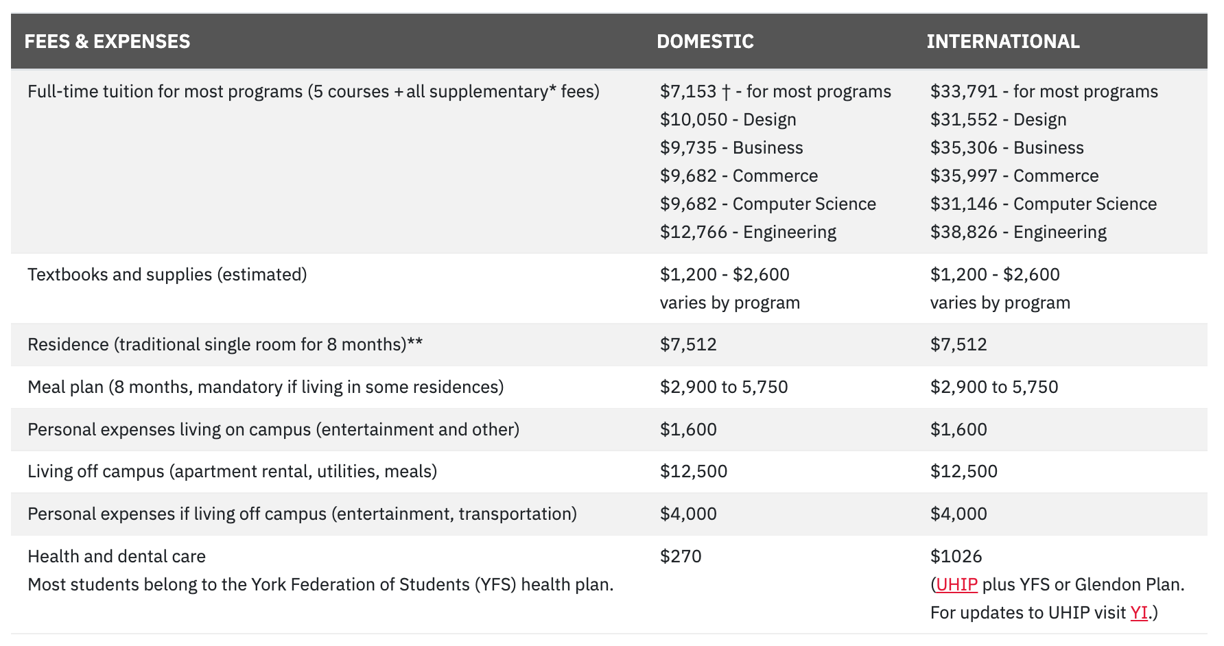
The Cost of a YorkU Undergrad
Source: (York University, n.d.)

Slide 11
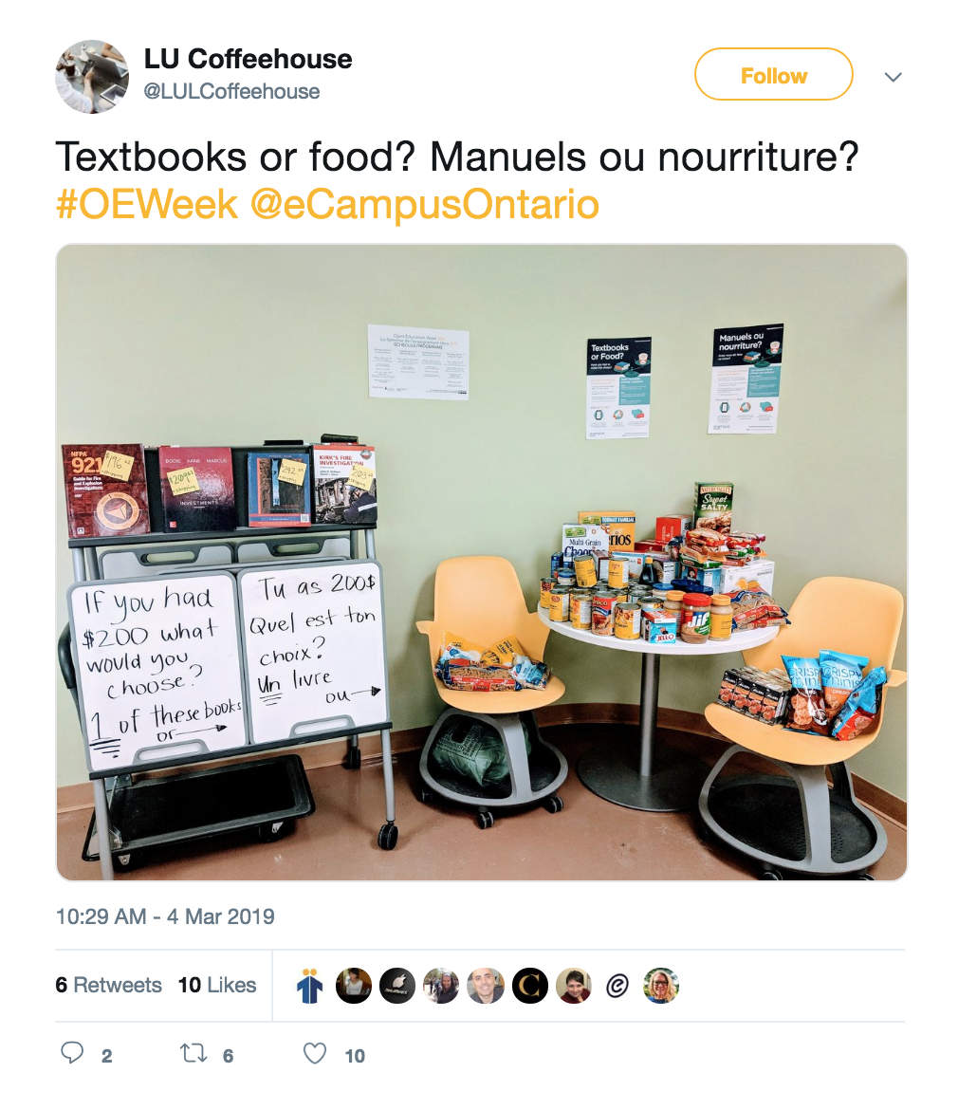
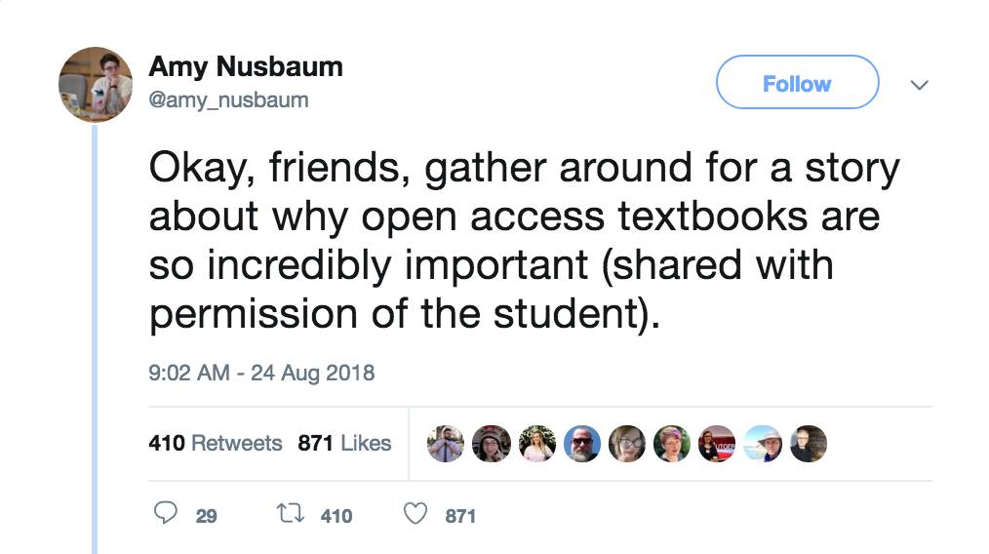
Course Materials: The Final Barrier?
Source: (LU Coffeehouse, 2019)
Source: (Amy Nusbaum, 2018)

Slide 12

Question: What are some additional challenges or barriers that students experience at your institution?

Slide 13
Open Educational Resources 101
Menti Poll!
2

Slide 14
UNESCO’s OER Definition
Open Educational Resources are teaching, learning and research materials in any medium – digital or otherwise – that reside in the public domain or have been released under an open license that permits no-cost access, use, adaptation and redistribution by others with no or limited restrictions. Source: (UNESCO, n.d.)

Slide 15

Part 1: Open Educational Resources Definition
FREE plus PERMISSIONS
Sources: (Allen via The Association for Learning Technology's YouTube channel, 2017) & (Wiley, n..d. A)

Slide 16
Part 2: Open Educational Resources Definition
FREE +
Of cost
Of barriers
5R Permissions
Retain
Reuse
Revise
Remix
Redistribute
Sources: (Allen via The Association for Learning Technology's YouTube channel, 2017) & (Wiley, n..d. A)

Slide 17
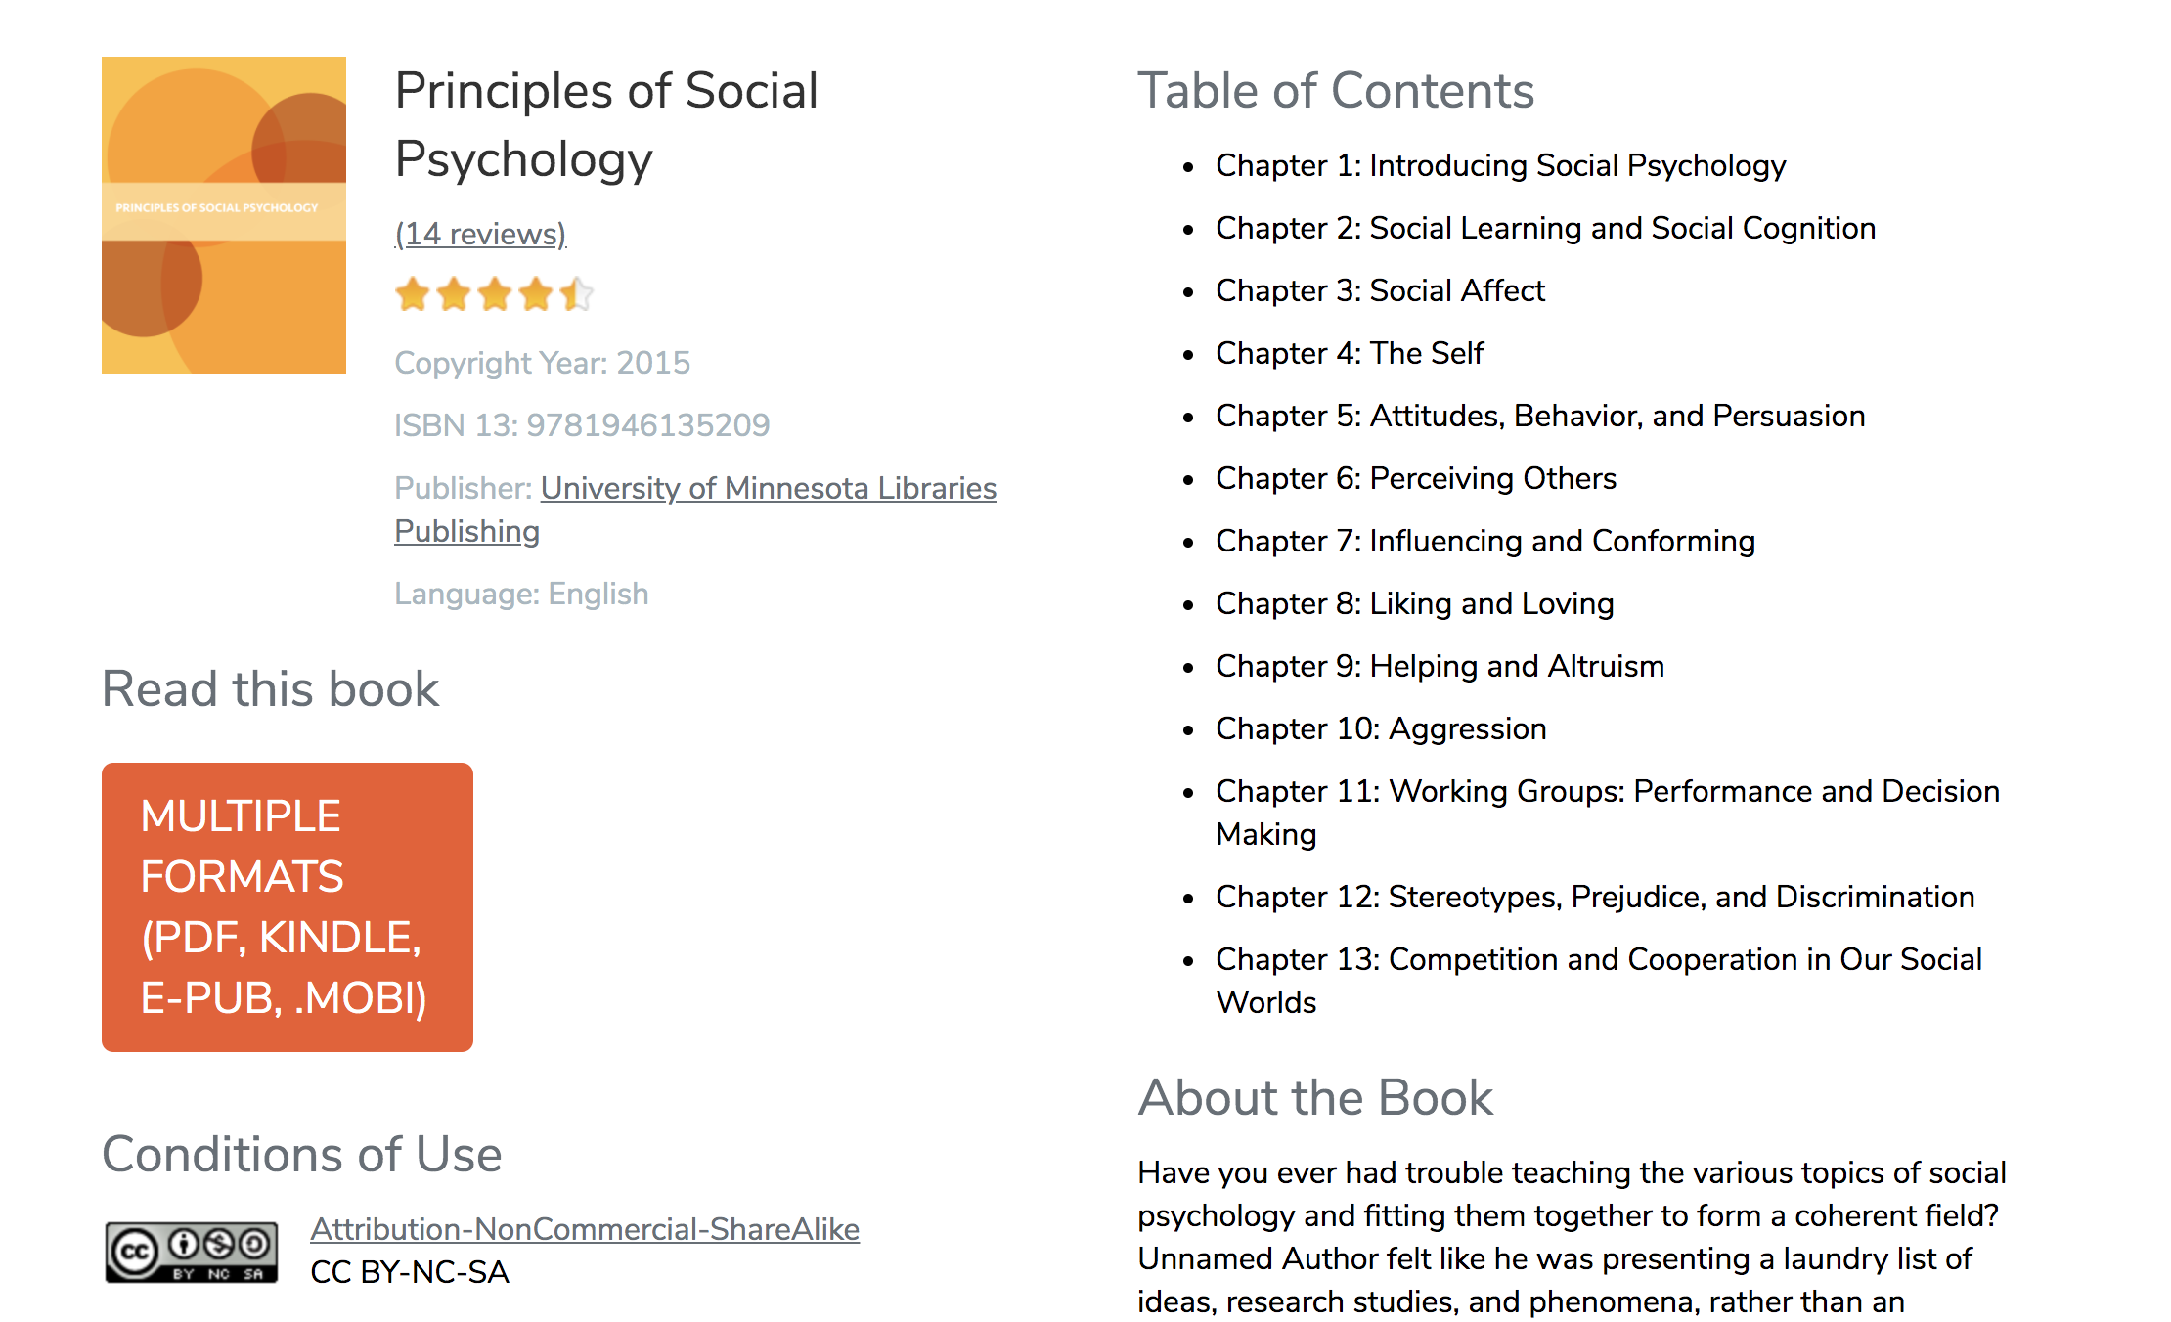
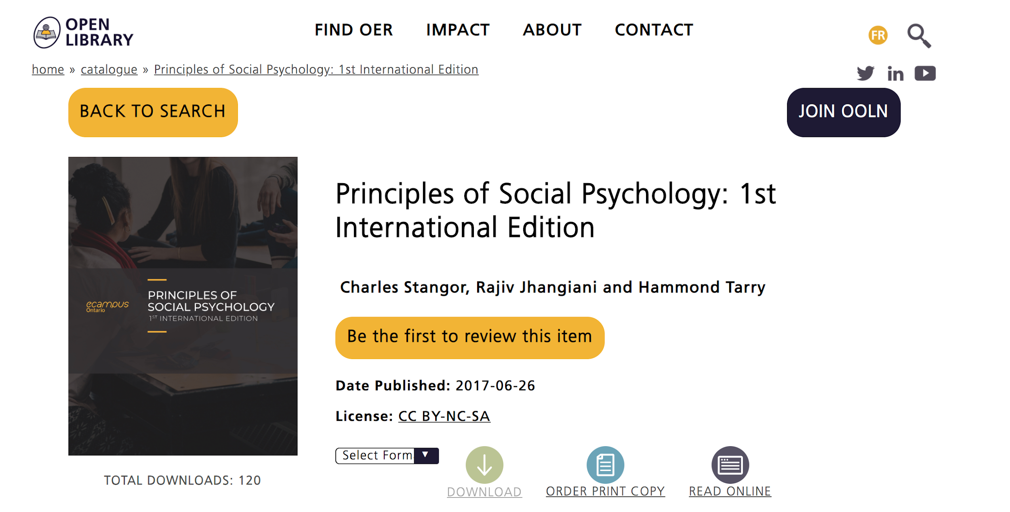
Open Textbook Examples
Principles of Social Psychology - American open textbook available via Open Textbook Library (University of Minnesota)
Principles of Social Psychology: 1st International Edition - International version of the textbook via eCampusOntario’s open library

Slide 18
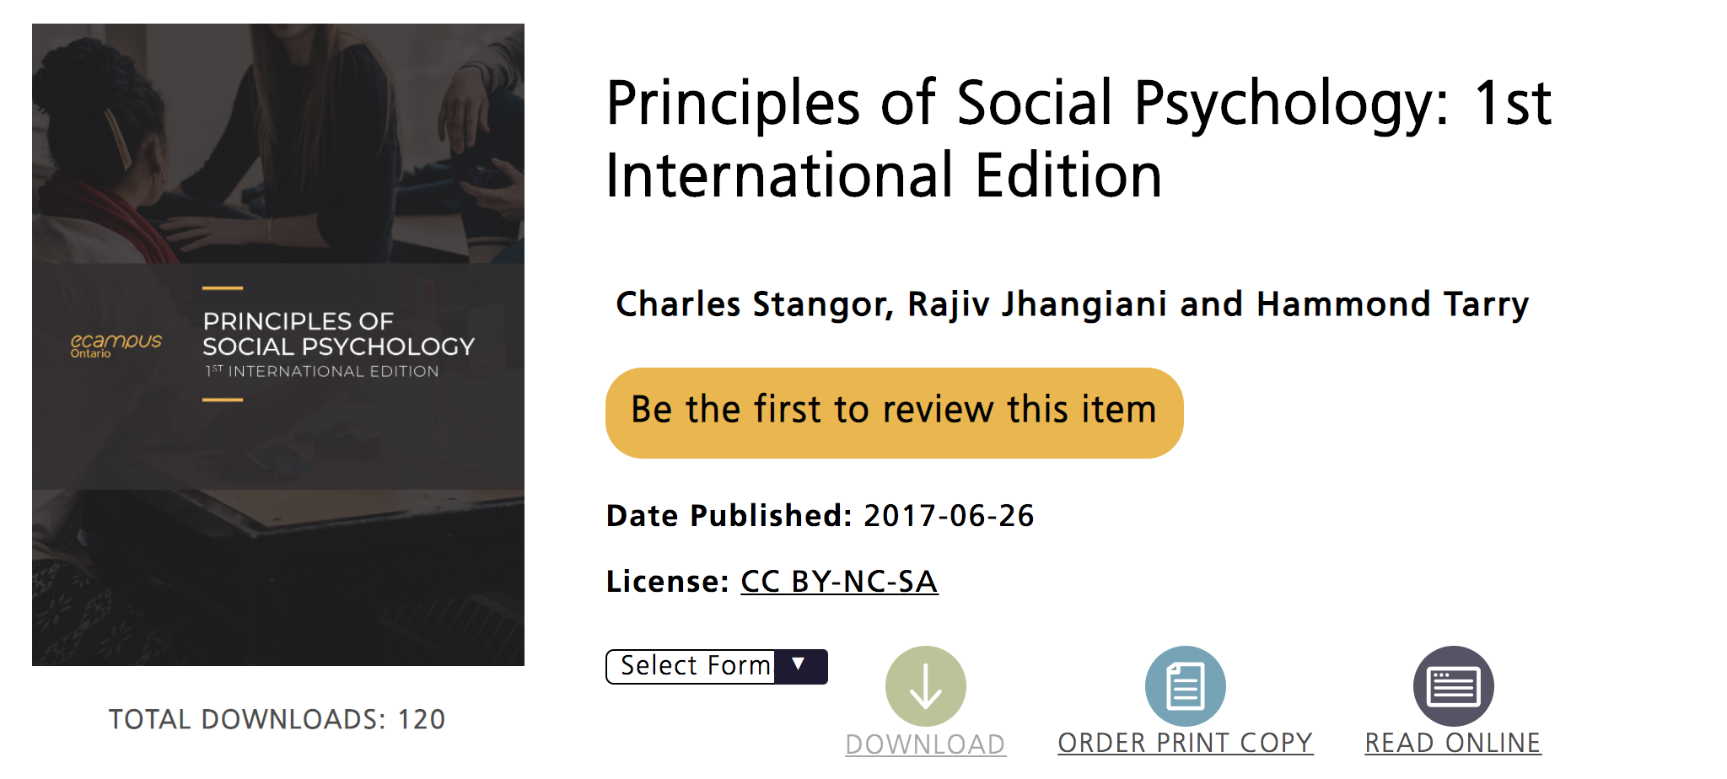
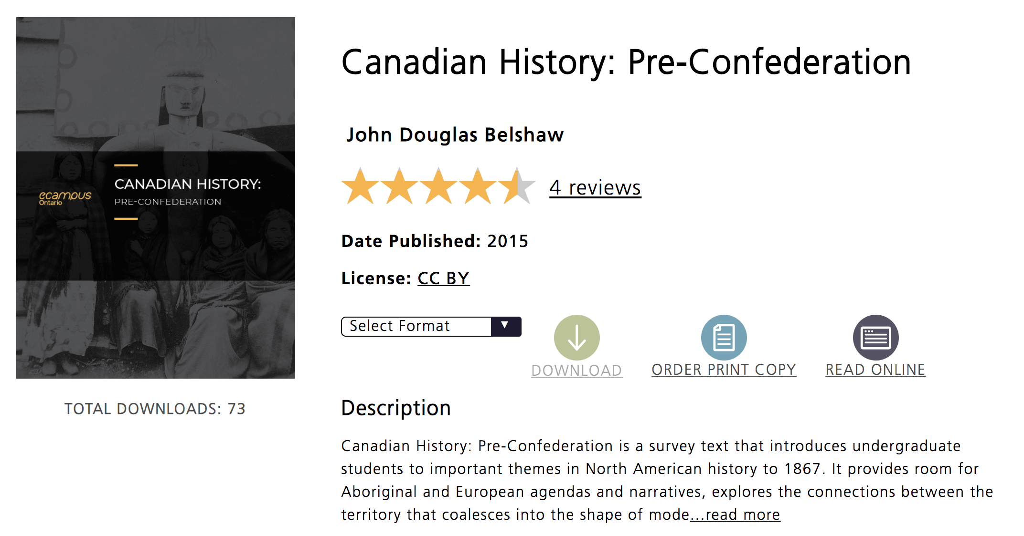
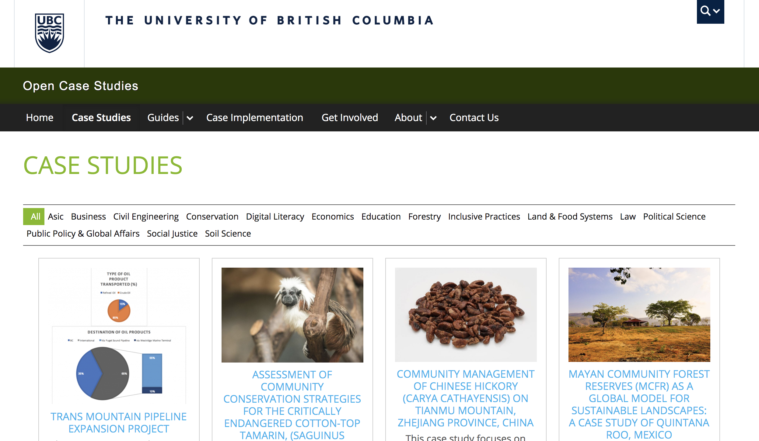
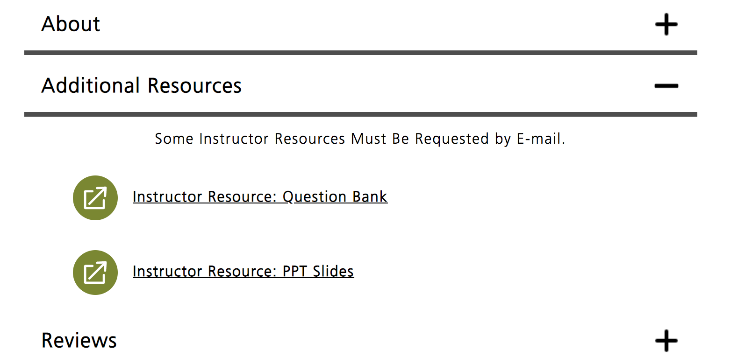
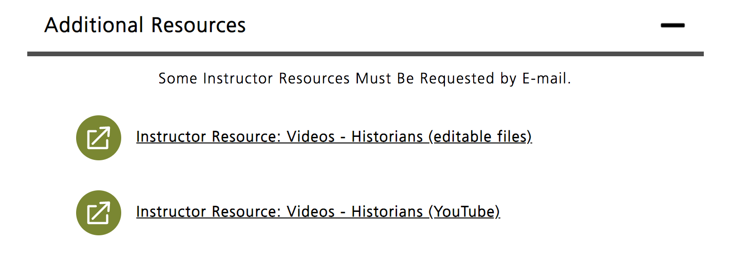
Open Ancillary Examples
Ancillaries for Principles of Social Psychology: 1st International Edition - includes PPT slides & question bank
Ancillaries for Canadian History: Pre-Confederation - includes video content, as well as editable video files
Open Case Studies at UBC - Cases have a sustainability focus & cover wide range of subjects

Slide 19
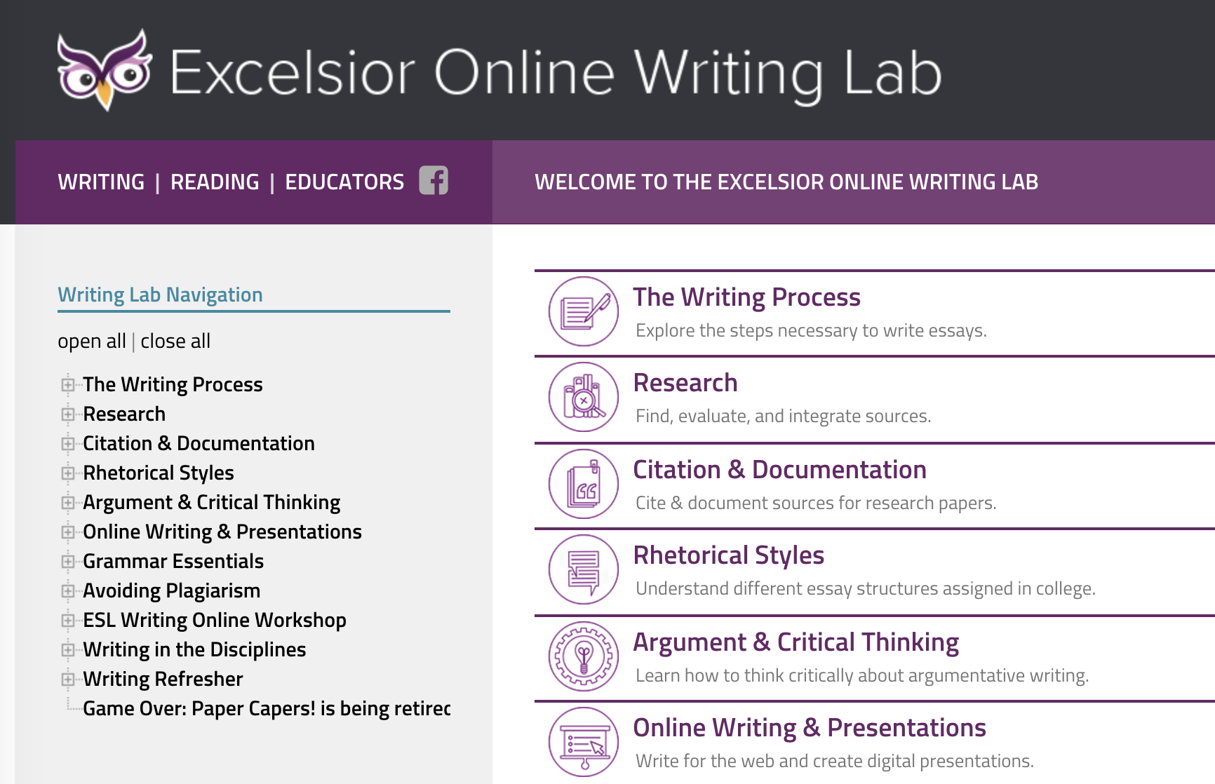
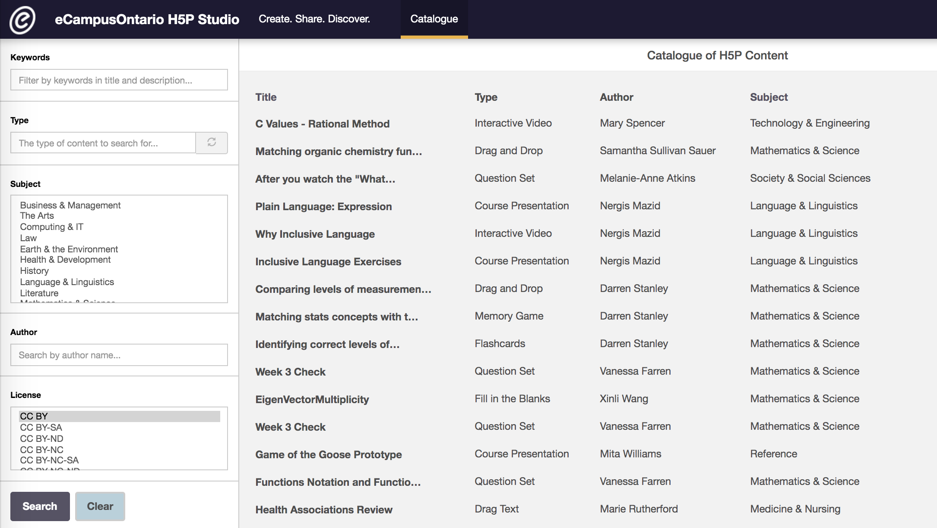
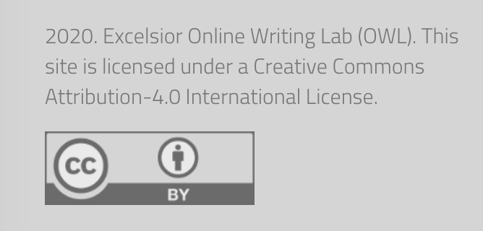
Open Module Examples
Excelsior Online Writing Lab - University-level open modules on writing, research, academic integrity, & more
eCampusOntario’s H5P Studio - Interactive modules from Ontario university & college faculty

Slide 20
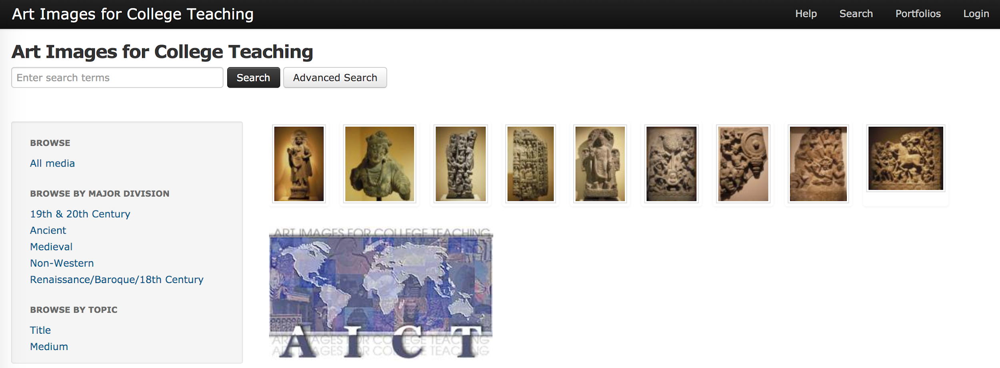
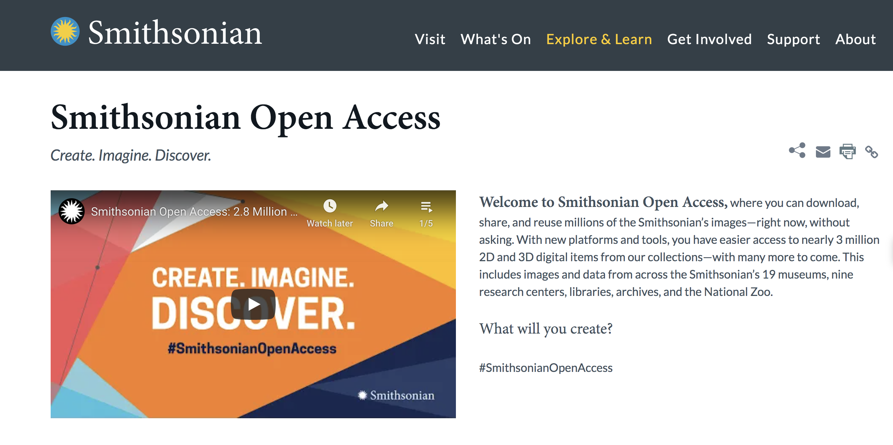
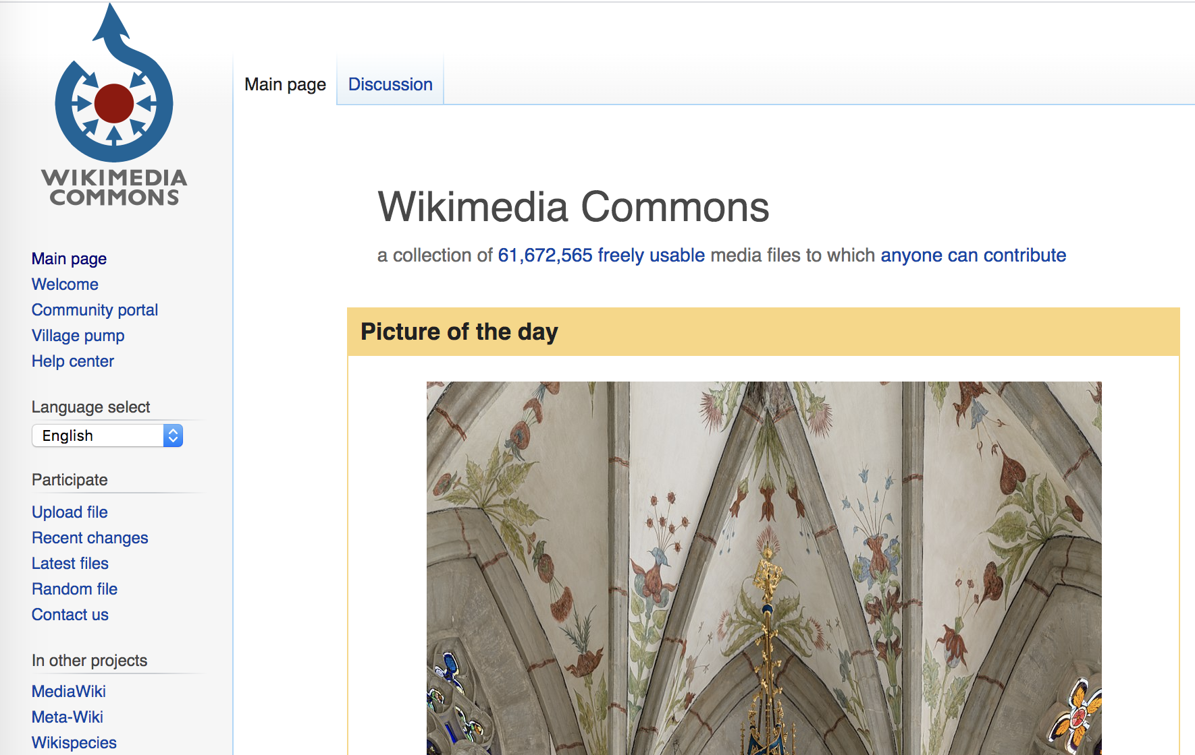
Open Image & Media Examples
Art Images for College Teaching - An art image collection for teaching & research from University of Michigan Library
Smithsonian Open Access - Access to almost 3 million digital 2D and 3D images from their collections
Wikimedia Commons - Over 60+ million images, sound clips, & videos

Slide 21
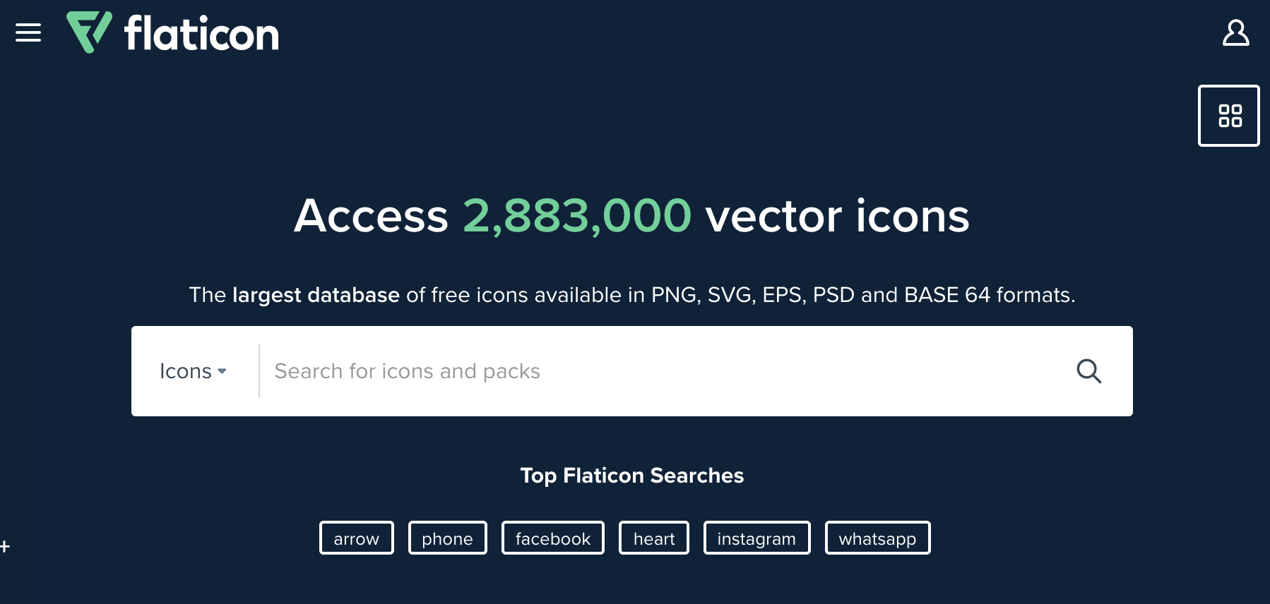
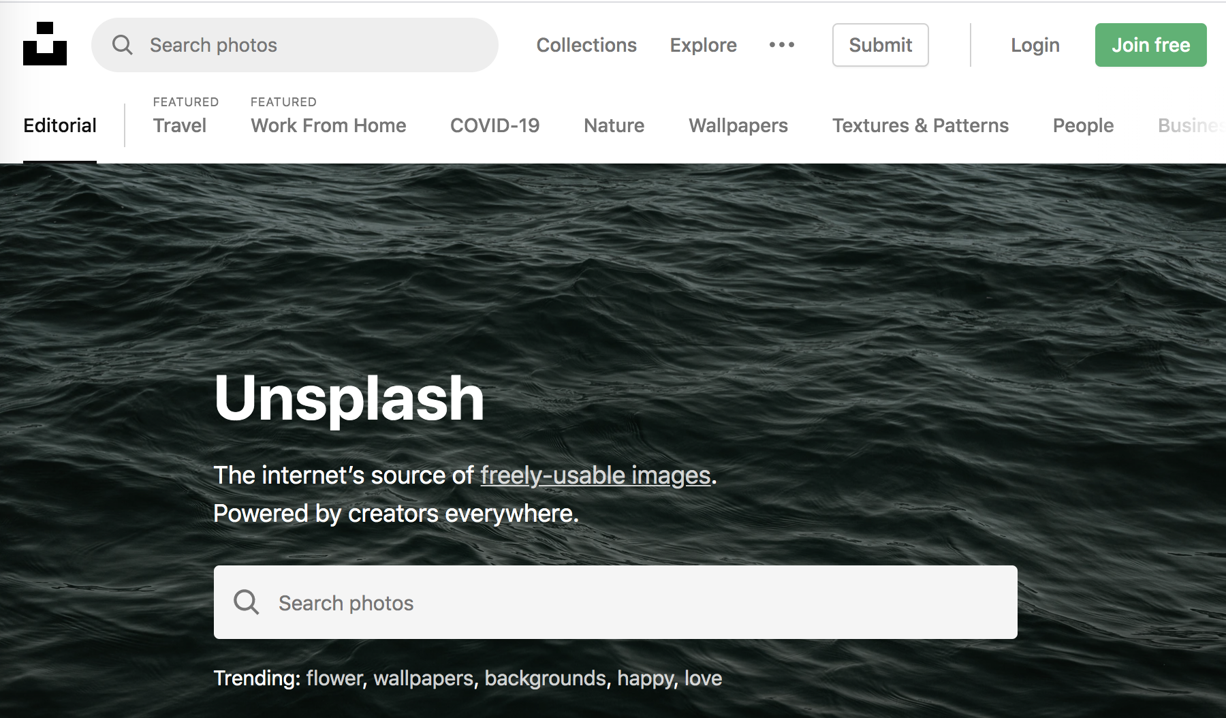

Open Resources for Designing Teaching Materials
Slides Carnival - Openly licensed PPT and Google Slide deck themes
Flat Icon - Openly licensed icons
Unsplash - Openly licensed high-quality photography

Slide 22

Discussion: OER Examples
In your breakout room, discuss:
Can you think of any other resources you’ve used that were OER?
How did you know they were OER and not just free resources?

Slide 23
Open Licensing
3

Slide 24
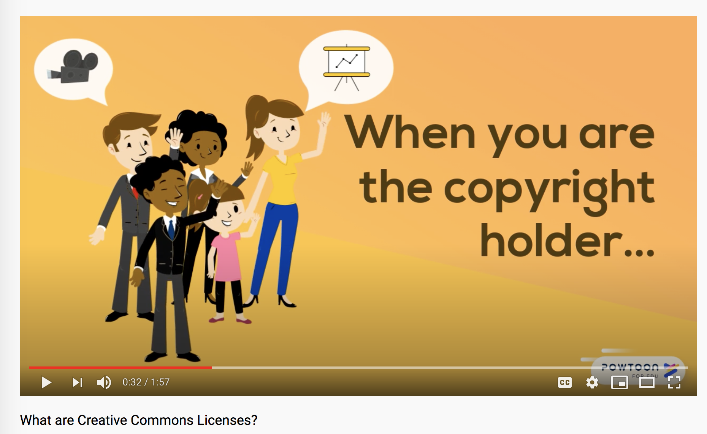
What are Creative Commons Licences
Before we watch!
Let’s answer a Mentimeter question.
Source: (University of Guelph Library, 2018)

Slide 25
Introduction to Creative Commons Licences
Creative Commons (CC) licences work within existing copyright legislation
There are 6 CC licenses & CC0 Public Domain Designation
Licenses more permissive than traditional "all rights reserved" copyright model
Creators use CC licenses to clearly label how others can exercise their 5R rights

Slide 26
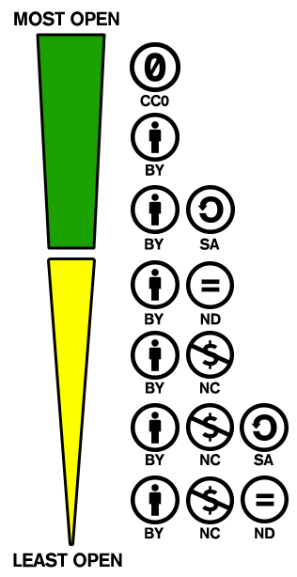
From Most Open to Least Open
←CCO: Public Domain Designation
← CC BY-ND: Creates Open Access work not OER
← CC BY-NC-ND: Creates Open Access work not OER

Slide 27
Which Creative Commons Licences Create OER?
CC Licence | Is this OER? | Is it safe to use in my OER work?
CC BY | Yes | Yes
CC BY-SA | Yes | Yes
CC BY-NC | Yes* | Maybe. What are the odds that the licensor will interpret your use as commercial? Are you willing to take that risk?
CC BY-NC-SA | Yes* | Maybe. What are the odds that the licensor will interpret your use as commercial? Are you willing to take that risk?
CC BY-ND | No | No
CC BY-NC-ND | No | No
Table reproduced from (Wiley, n.d. A, slide 15)

Slide 28
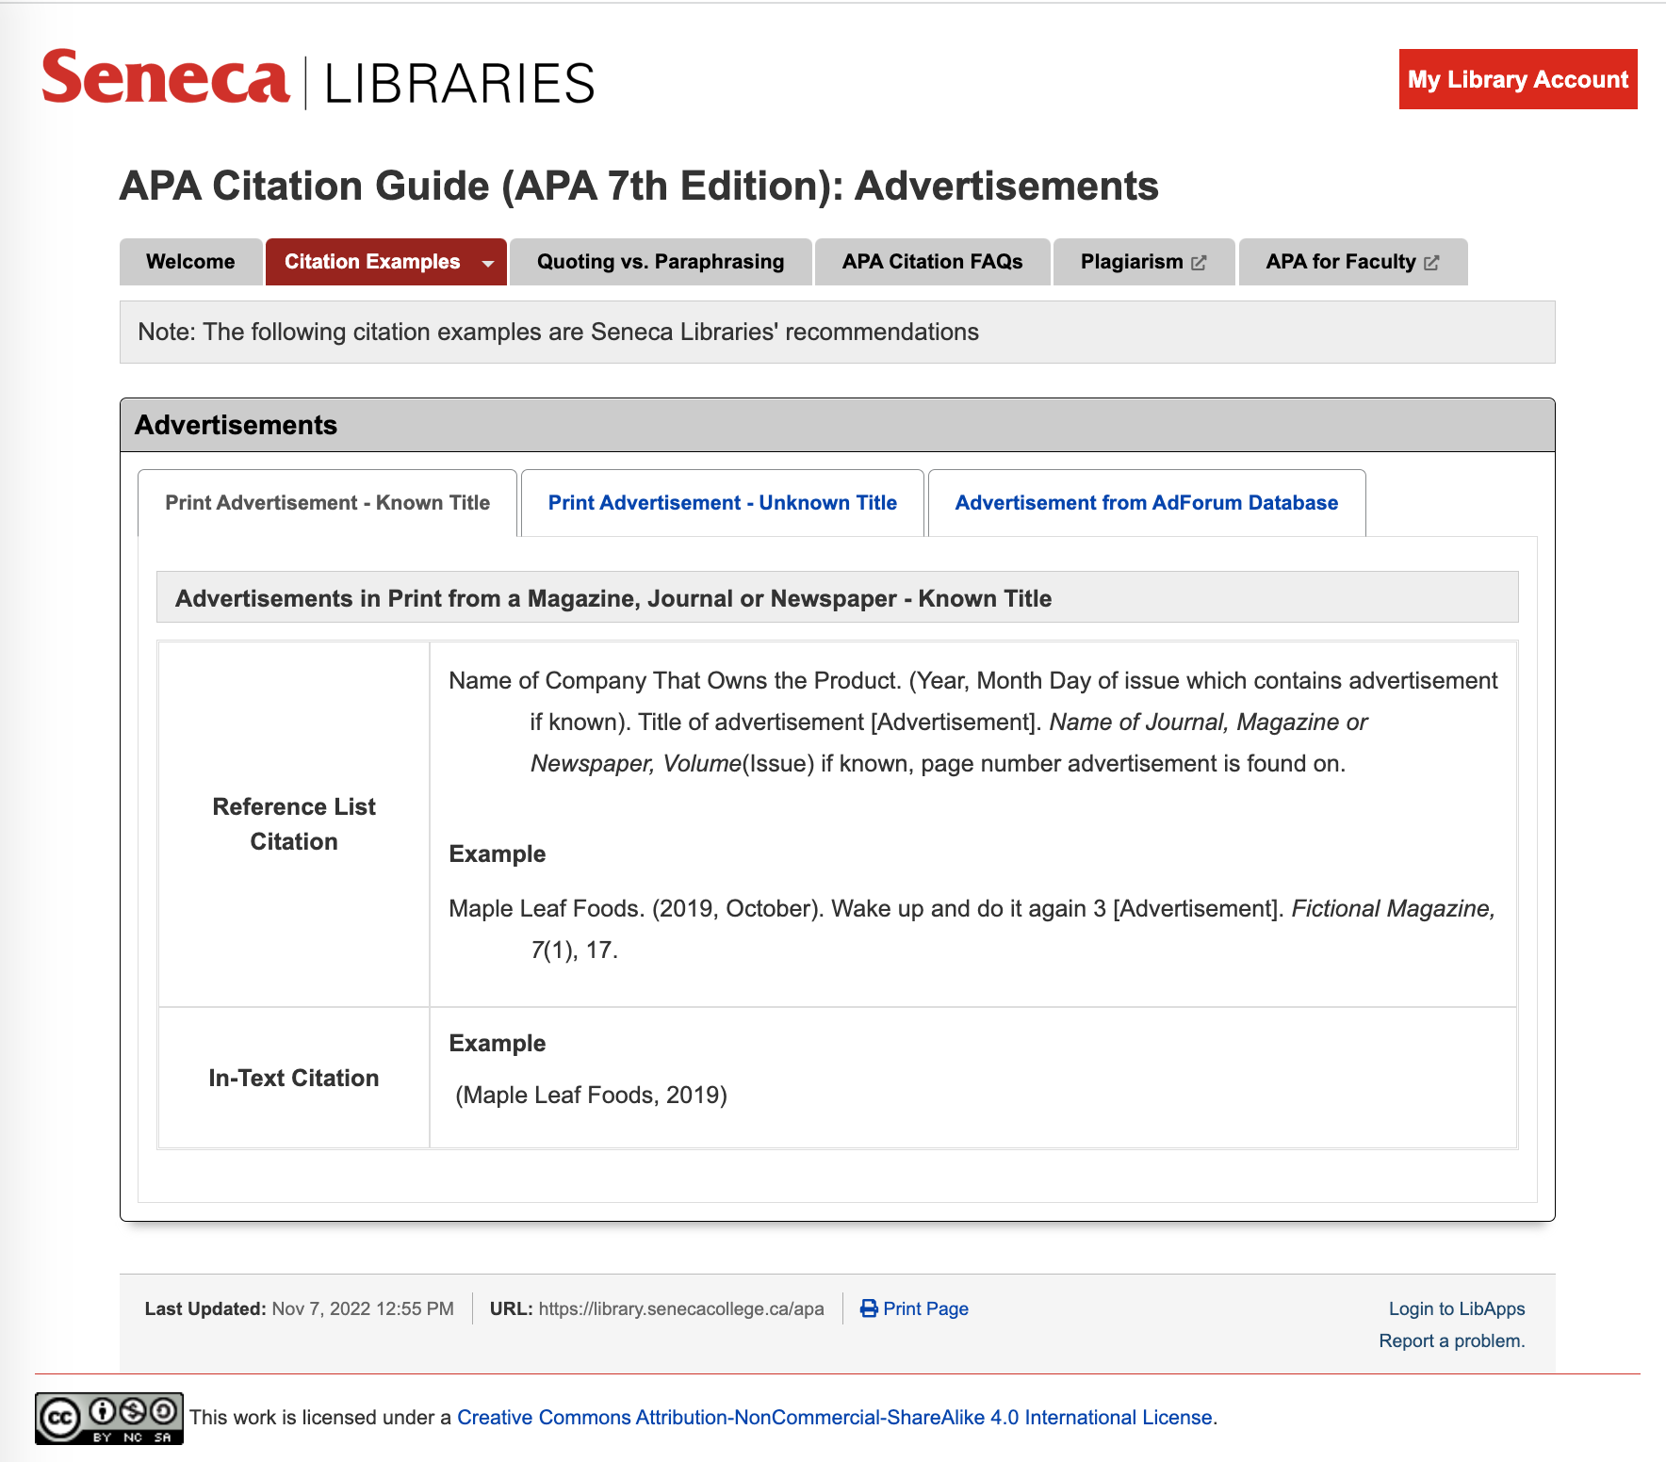
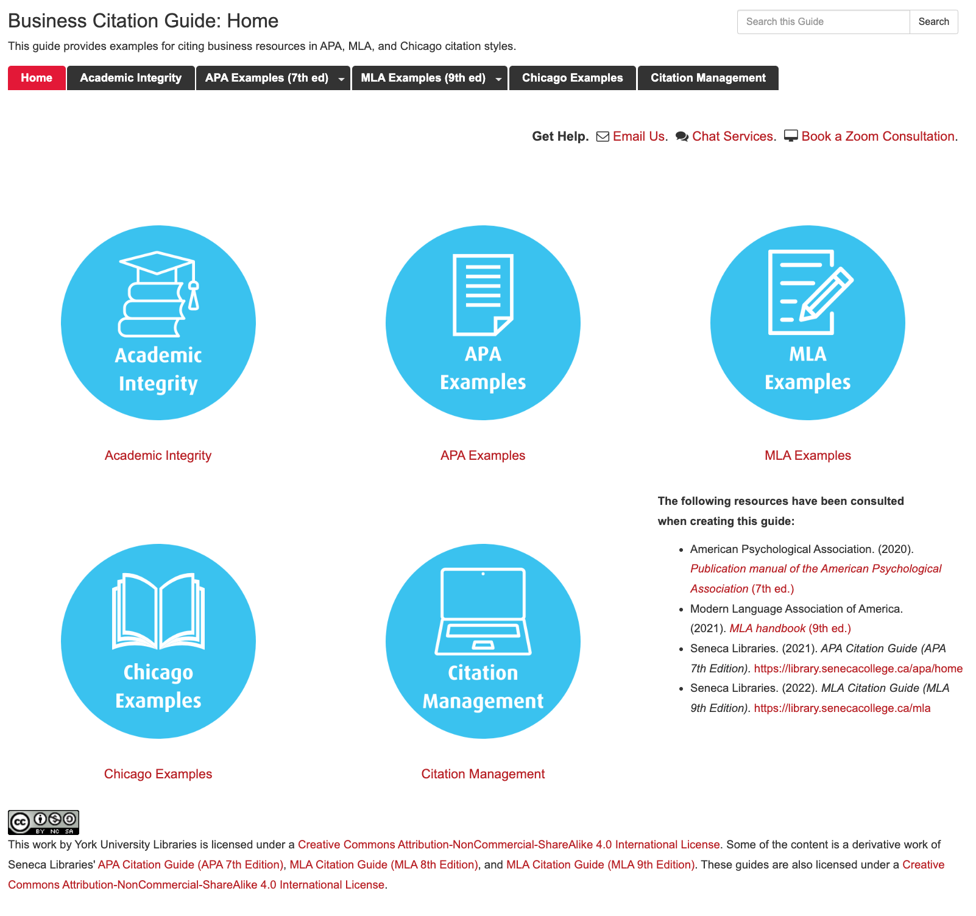
Example: Citation Guides
(CC BY-NC-SA)
Access Seneca's APA Citation Guide
Access YorkU Libraries' Business Citation Guide

Slide 29
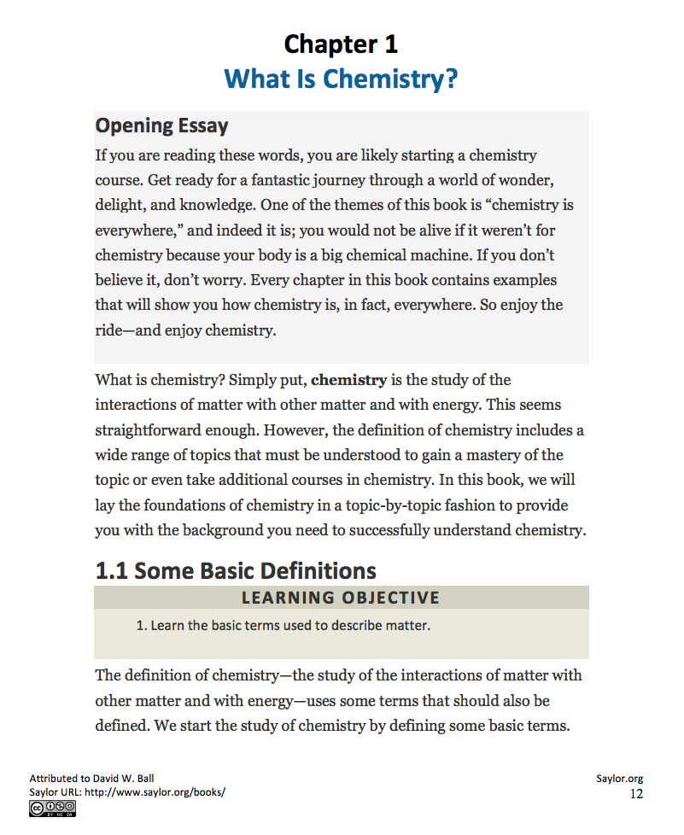
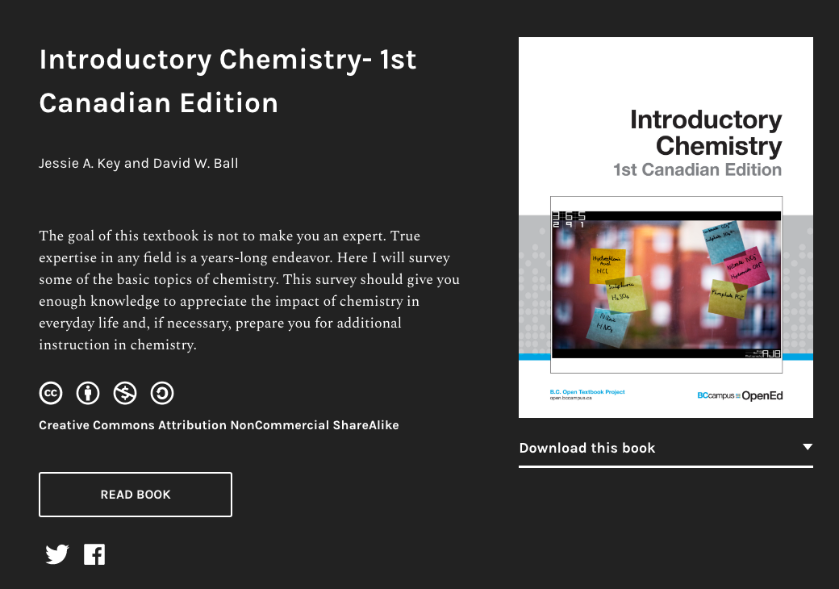
Example: Revising an Open Textbook (CC BY-NC-SA)
Original version of open textbook Revised Canadian edition of open textbook

Slide 30
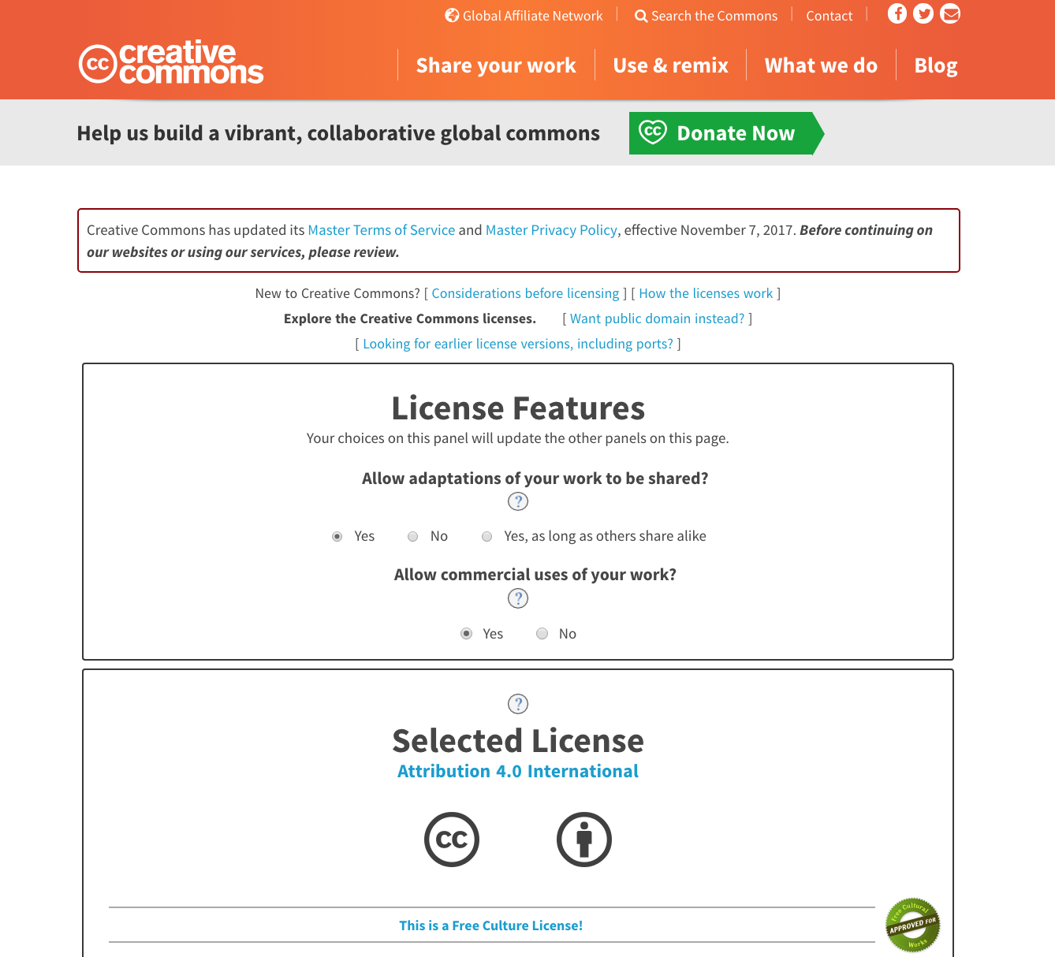
Selecting a Licence for Your Work
Answer two simple questions to find out which Creative Commons licence works best
Embed the information on your resource & inform others of their rights
Creative Commons' Licence Selector Tool

Slide 31
31
Mentimeter Quiz

Slide 32
Finding & Locating OER
4

Slide 33
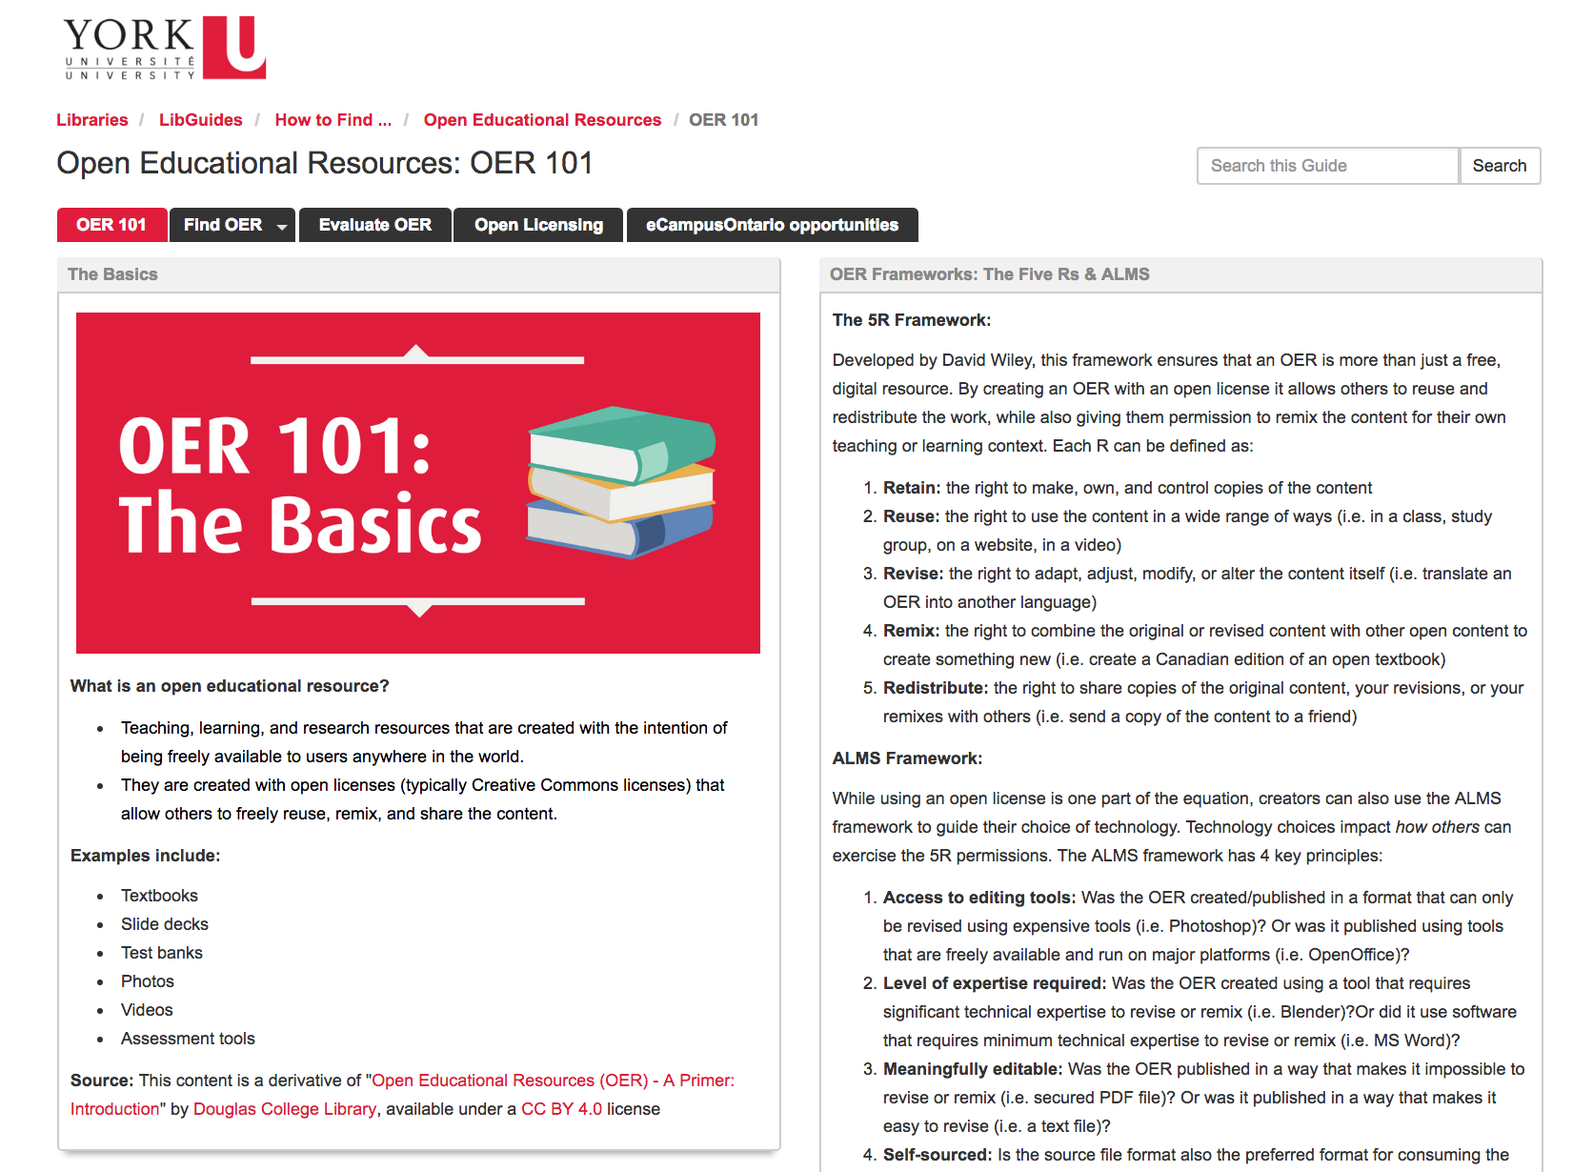
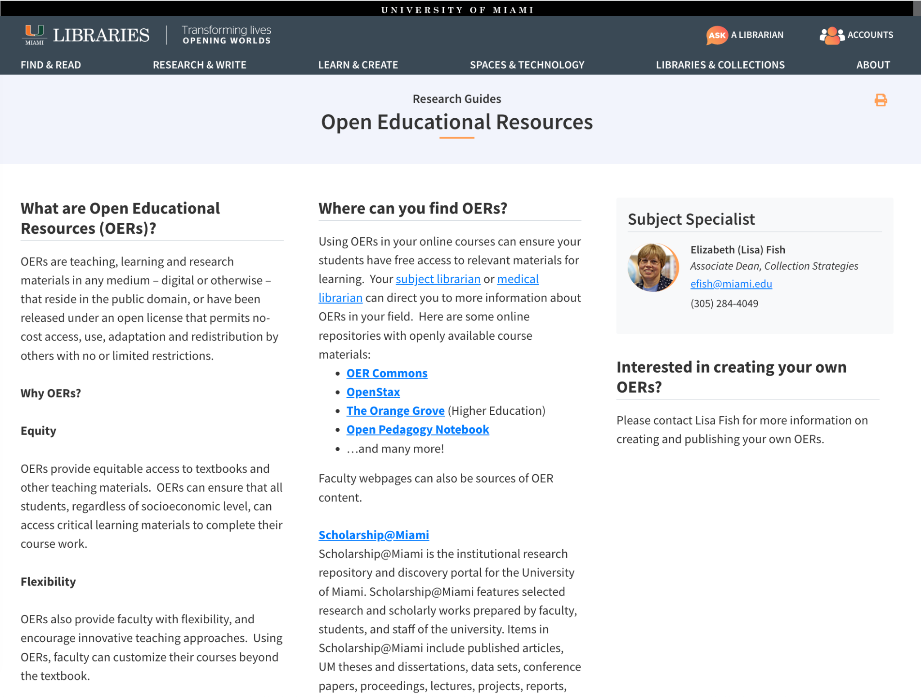
Search Strategy #1:
Start with OER Guides
York University Libraries’ OER Guide
University of Miami Libraries’ OER Guide

Slide 34
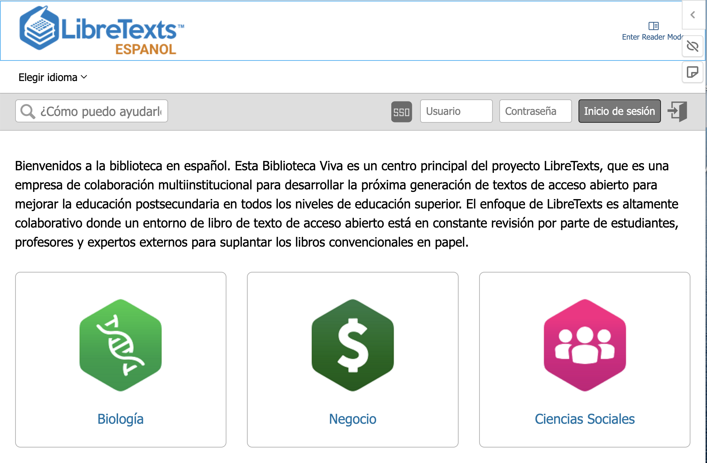
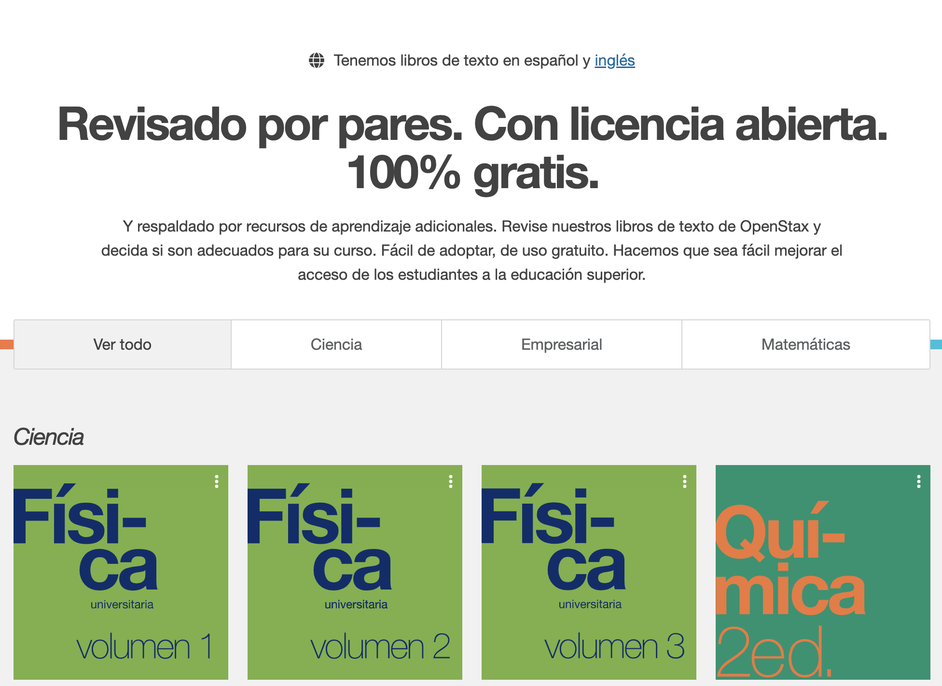
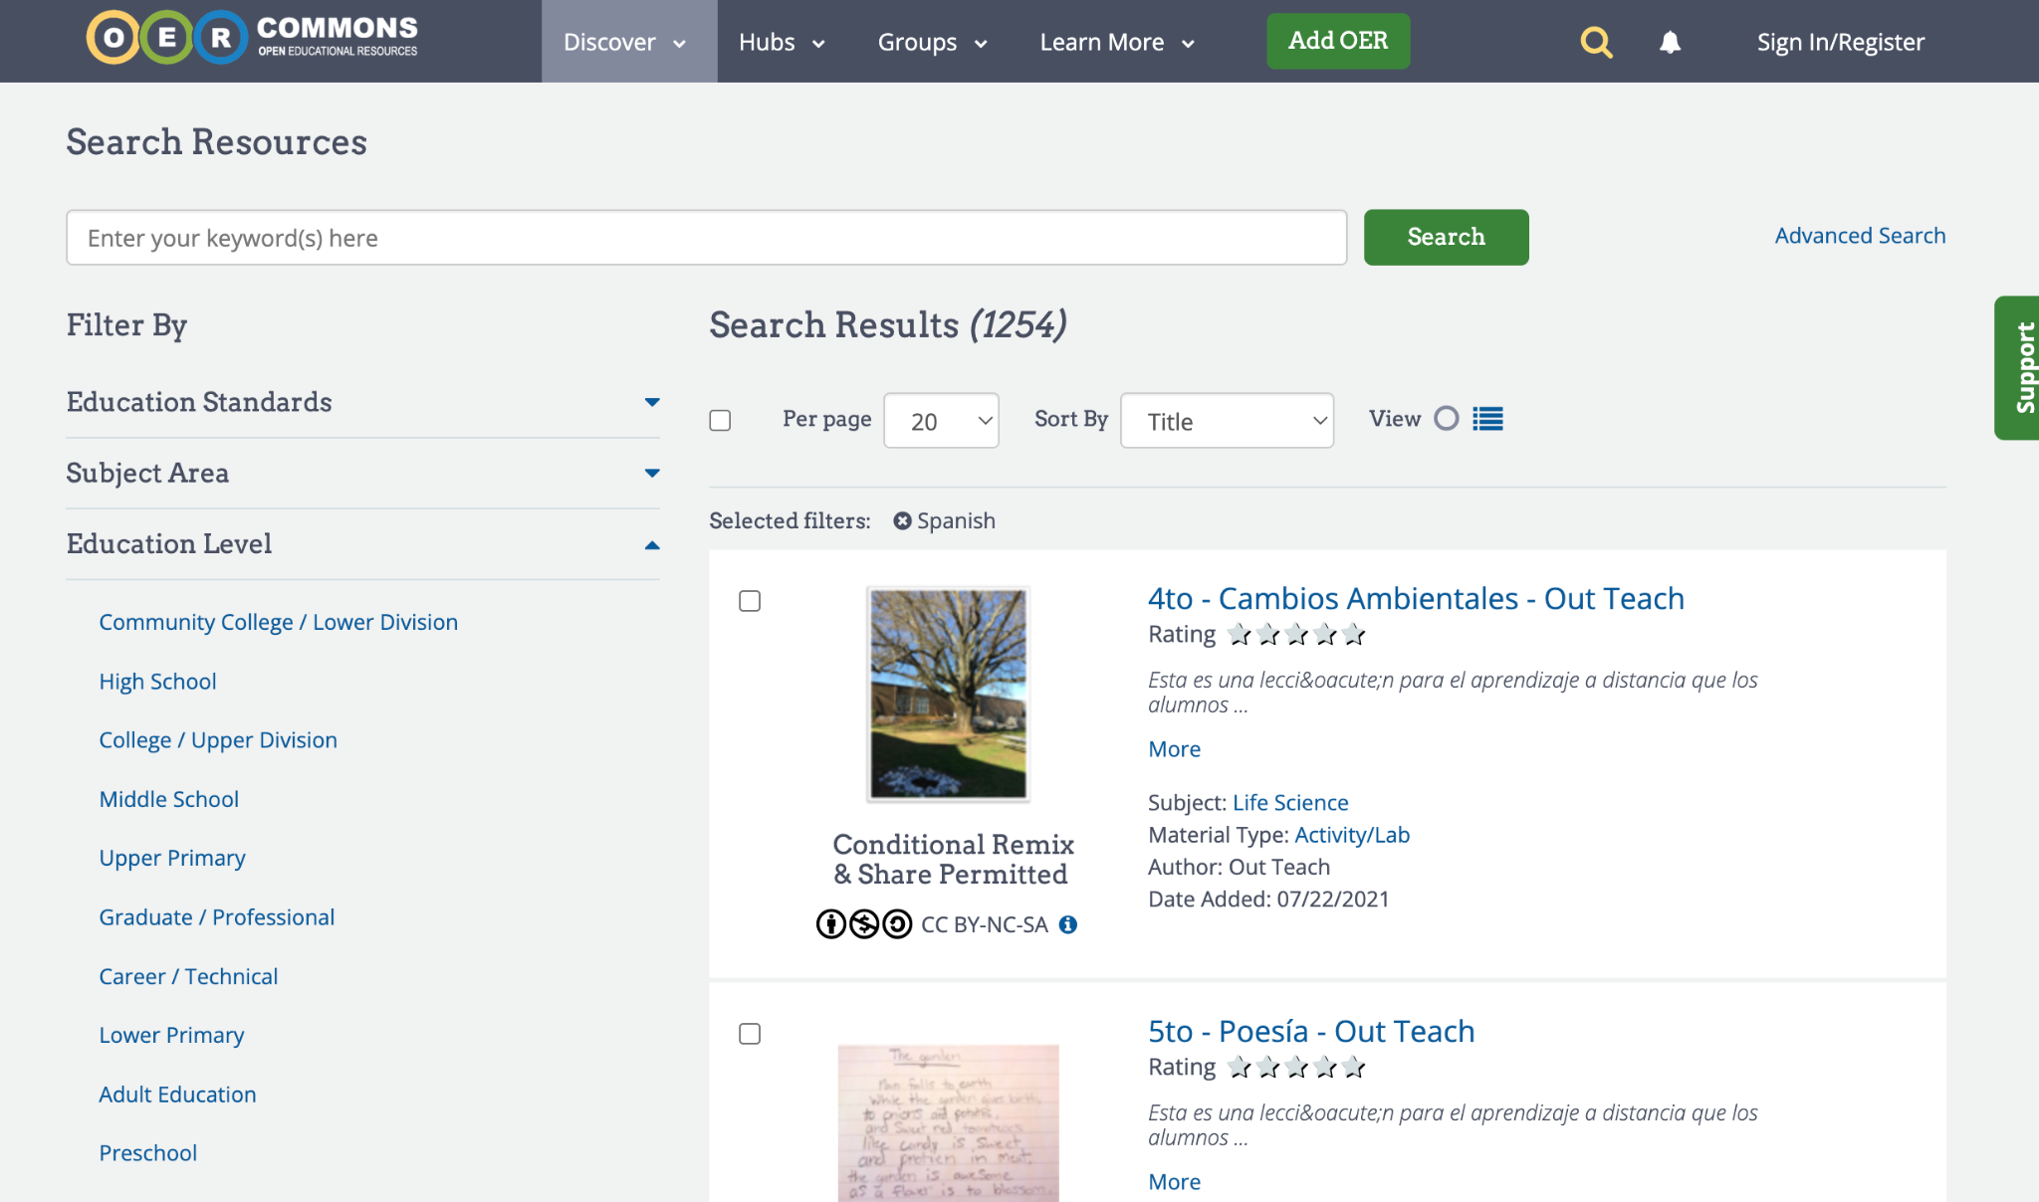
Search Strategy #2: Using Language Filters for Major OER Collections
OER Commons’ content filtered by Spanish language
LibreText's Spanish Collection
OpenStax’s Spanish Collection

Slide 35
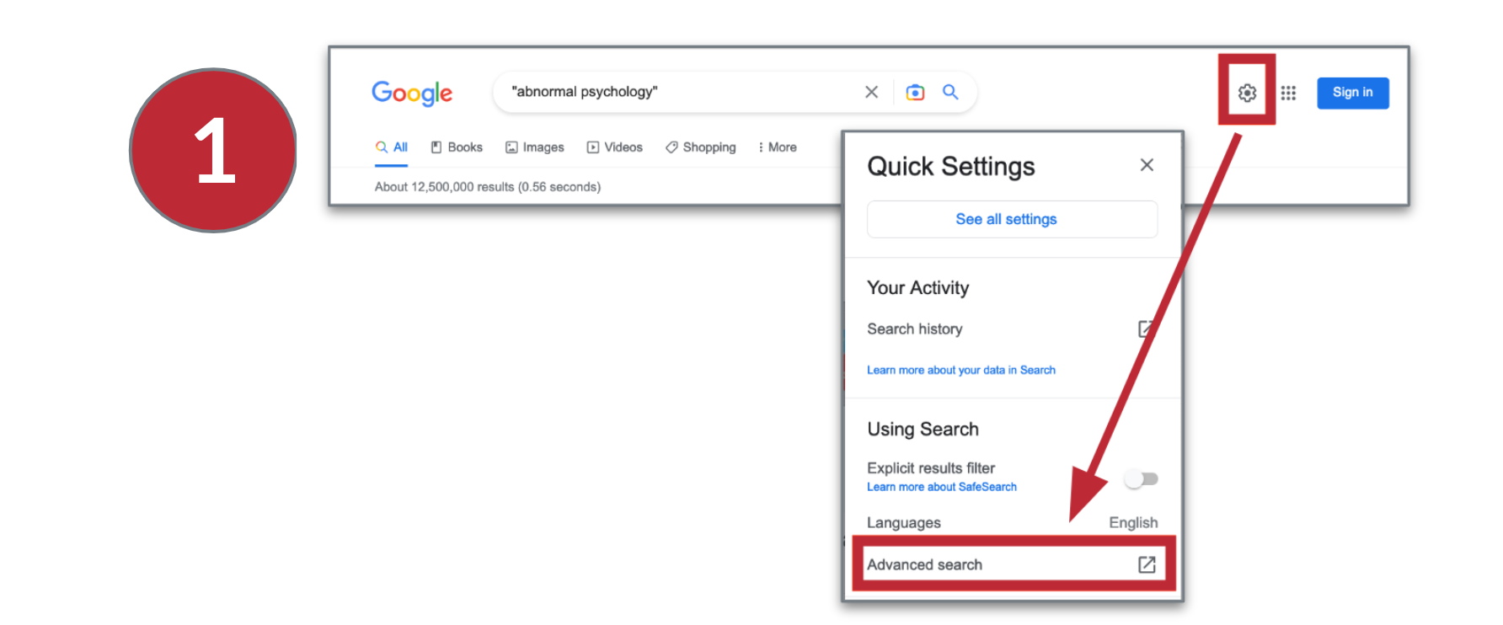
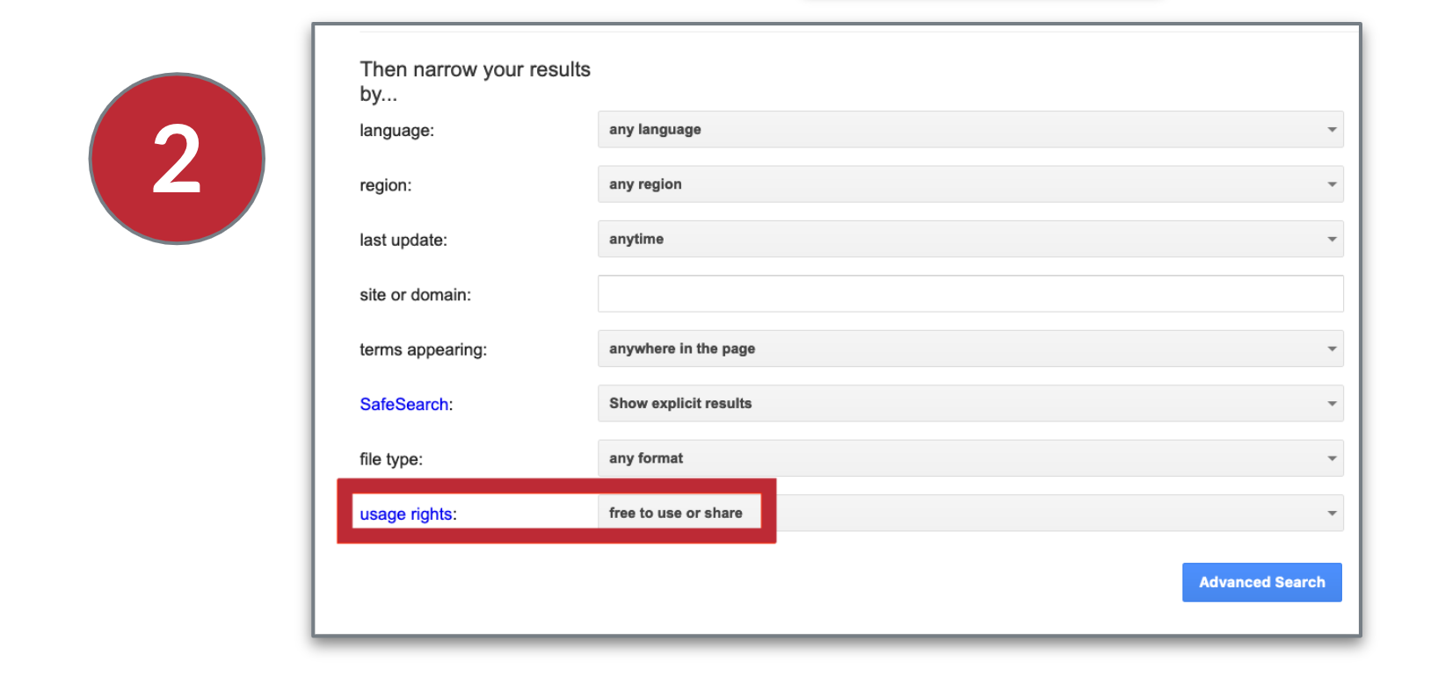
Search Strategy #3: Google Search Filtered by Usage Rights
Google’s Advanced Search feature lets you filter results by usage rights.
This filter limits your results to works with certain licenses listed on the webpage (usually Creative Commons licences)
Search Tip → Start with “free to use or share” to retrieve the broadest set of results.
Source: (Elder, 2019)

Slide 36
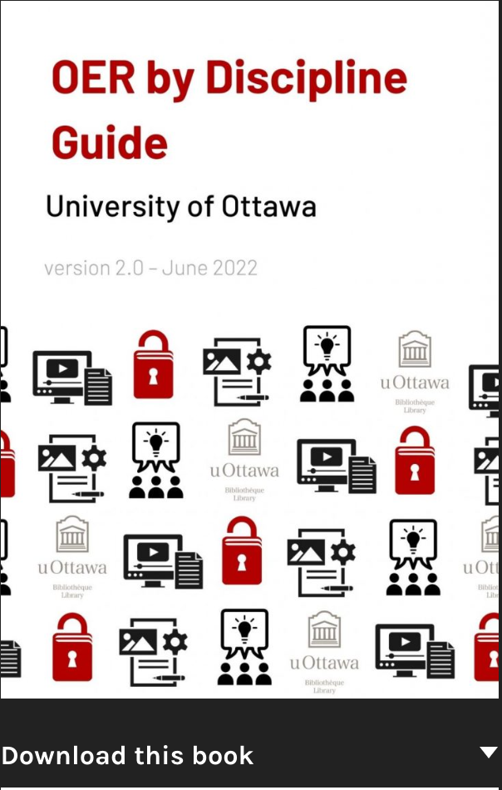
Search Strategy #4: OER By Discipline / Adoption Guides
Example: The University of Ottawa Library’s OER by Discipline Guide maps to program areas at the university
Example: BCCampus, a nonprofit organization that supports OER usage in the province of British Columbia, Canada, has created an OER Adoption Finder

Slide 37
Search Strategy #5: Other Spanish OER or Open Access Collections
Procomun
Pressbooks’ Collection of Spanish-language OER / Open Access Books
OAPEN’s Spanish-language open access books
Universidad de Costa Rica’s Repositorio Kérwá
Inter-American Development Bank’s Open Access Resources
OER Creation Projects
  Proyecto EDIA
  CREA

Slide 38
An Example of an OER Search Strategy
Barbara teaches abnormal psychology. She wants to find videos, readings, & case studies that are OER. Here is a broad search strategy she follows:
Searches Open Textbook Library for “Psychology.” Reviews Table of Contents for to find chapters/sections for her course.
Searches OASIS, a federated OER search for “abnormal psychology.”
Searches YouTube for videos on specific topics related to Abnormal Psychology. She uses the post-search Creative Commons filter.
Lastly, conducts an Advanced Search in Google for “Abnormal Psychology”.
By the end, Barbara compiles the following OER list for Abnormal Psychology
Source: (Elder, 2019).

Slide 39
39
Group Activity
Link to Resource Document

Slide 40
Thank You!
York University Libraries
June 6, 2023
These slides, authored by Stephanie Quail, Sarah Coysh, & Priscilla Carmini, are available under a CC BY 4.0 international license

Slide 41
Slide & Image Credits
Slide theme by: Presentation template by SlidesCarnival available under a CC BY 4.0 International license / Modified by Stephanie Quail
Slide 1 & 40 : Photo by Marina Leonova on Pexels / Available under Pexels licence
Slide 3: Map from Native Land website
Slide 4: Photo by Karolina Grabowski on Pexels / Available under Pexels licence
Slide 12: Photo by Liza Summer on Pexels / Available under Pexels licence
Slides 15 & 16: Untitled image by harishs on Pixabay / Available under a Pixabay license
Slide 22: Photo by Karolina Grabowski on Pexels / Available under Pexels licence
Slide 26: Image from Creative Commons, available under Creative Commons Attribution 4.0 International
Slide 27: Creative Commons licence buttons by Creative Commons / Available under a Creative Commons Attribution 4.0 International licence
Slide 35: Photo by Amy Hirschi on Unsplash / Available under Unsplash licence
Slide 36: Photo by Fauxels on Pexels / Available under Pexels licence
Slides 7, 10, 11, 17-21, 24, 28-30, 33-36: Screenshots of various resources taken by S. Quail
Slide 1 & 40: Magnifying icon by Freepik on Flaticon / Available under a Flaticon license

Slide 42
References - Part 1
Slide 7: Santa Ana College. (2017, November 16). SAC student panel OpenEd 2017 – Cost factor [Video file]. YouTube. https://www.youtube.com/watch?v=sZ6mTgQxG7A&feature=youtu.be / Available under a Creative Commons Attribution licence
Slide 8: Moore, H. (2014, April 15). Soaring tuition costs force students to work more hours: analysis. CBC. Retrieved from http://www.cbc.ca/news/canada/manitoba/soaring-tuition-costs-force-students-to-work-more-hours-analysis-1.2610095
Slide 9: Fletch, C., Webster, J., Cornett, A., Niznik, A., Gardner, T., & Knaff, C. (2022, Nov). Student financial wellness survey: Fall 2021 semester results. Trellis Research. https://www.trelliscompany.org/wp-content/uploads/2022/11/SFWS-Report-Fall-2021.pdf
Slide 10: York University. (n.d.). Undergraduate tuition fees. In Future students. Retrieved November 2021, from https://futurestudents.yorku.ca/tuition
Slide 11: LULCoffeehouse. (2019, March 4). Textbooks or food? Manuels ou nourriture? #OEWeek @eCampusOntario [Twitter post]. Retrieved from https://twitter.com/LULCoffeehouse/status/1102637276167839745
Slide 11: Amy_nusbaum. (2018, August 24). Okay, friends, gather around for a story about why open access textbooks are so incredibly important (shared with permission of the student). [Twitter post]. Retrieved from https://twitter.com/amy_nusbaum/status/1033021736512413696
Slide 14: UNESCO. (n.d.). Open educational resources (OER). Retrieved May 22, 2023, from https://en.unesco.org/themes/building-knowledge-societies/oer

Slide 43
References - Part 2
Slides 15 & 16: Allen, N. via The Association for Learning Technology’s YouTube channel [ALT]. (2017, April 5). Communicating “open” [Section of video file – 1:08:31-1:29:54]. In OER17 sessions: 1458 | 1462 | 1483 | 1584. Retrieved from https://www.youtube.com/watch?v=pBpLQNsAj_g&t=68m30s
Slides 15 & 16: Wiley, D. (n.d. B). Defining the “open” in open content and open educational resources. Retrieved May 22, 2020, from http://opencontent.org/definition/
Slide 24: University of Guelph Library. (2018, September 21). What are Creative Commons licenses? [Video file]. YouTube. https://www.youtube.com/watch?v=srVPLrmlBJY / Available under a Creative Commons Attribution-NonCommercial-ShareAlike 4.0 International licence
Slide 27: Wiley, D. (n.d. A). Creative Commons, the 5Rs, and OER [Google Slides presentation]. https://docs.google.com/presentation/d/15DhTr6A5i6PYWtUriyvxGJYCriobgm_BxvxdL2yoI9g/edit#slide=id.g4b305805a9_0_22
Slide 35 & 38: Elder, A. (2019). The OER starter kit. Iowa State University Digital Press. https://iastate.pressbooks.pub/oerstarterkit/chapter/introduction/

