Slide 1
Tuning by Ear in Antiquity: Acoustics of Plucked Strings and Closed Pipes
Jay Rahn, York University, Toronto
Tonal Systems and Music Notation in Mesopotamian and Related Cultures Symposium
University of Würzburg
September 20, 2018

Slide 2
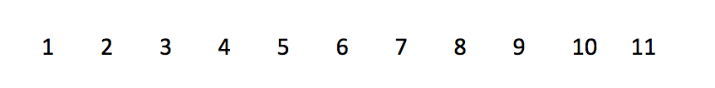
11 pairs of simultaneous tones

Slide 3
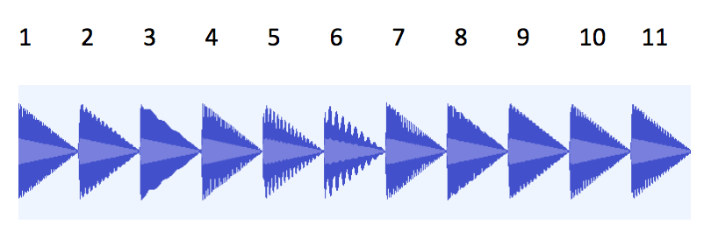
Changes in energy/loudness during each of the 11 pairs of simultaneous tones

Slide 4
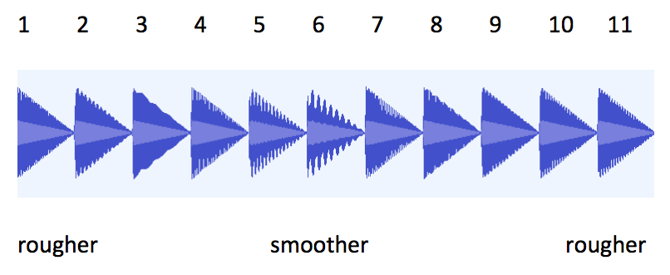
Rougher to smoother to rougher

Slide 5
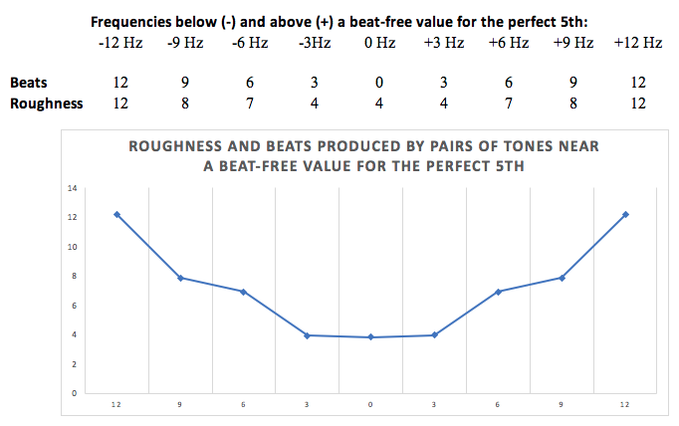

Changes in roughness and beats per second

Slide 6
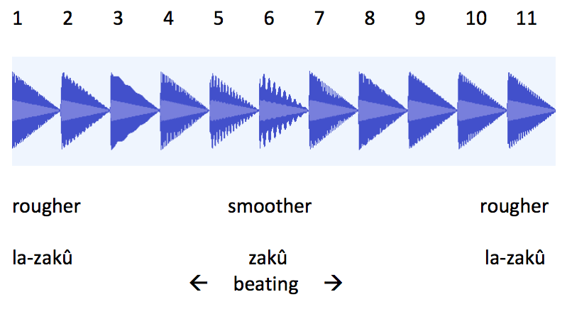
rougher/la- zakû vs smoother/zakû

Slide 7
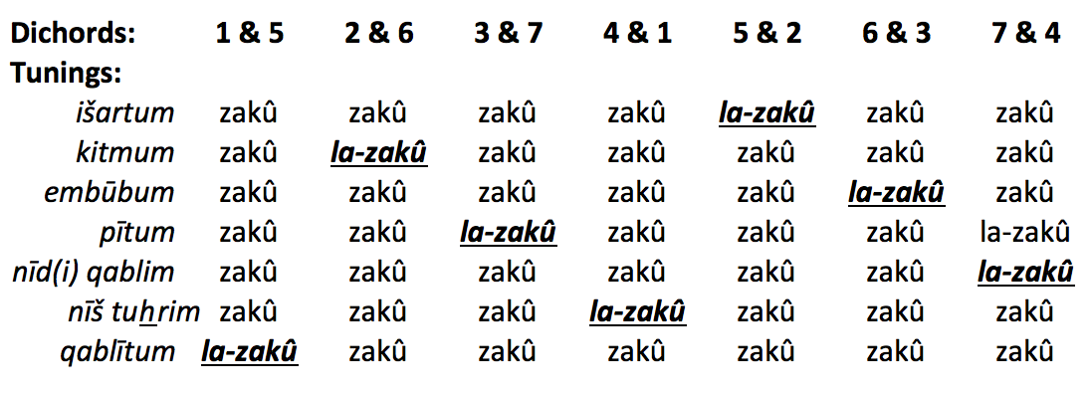
Sevenfold cycle of string-pairs

Slide 8
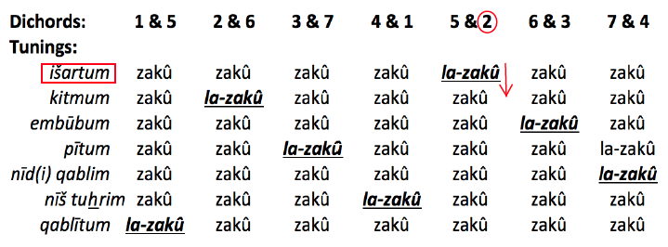
In išartum tuning, loosening string 2 changes strings 5 & 2 from la-zakû to zakû

Slide 9
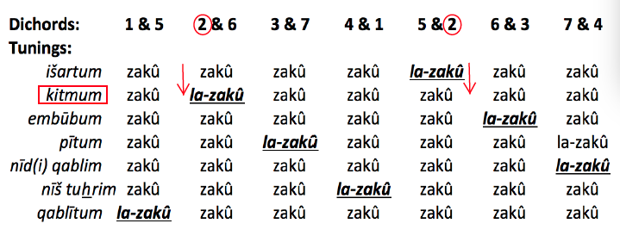
Simultaneously, loosening string 2 changes strings 2 & 6 from zakû to la-zakû, and the tuning has changed from išartum to kitmum

Slide 10
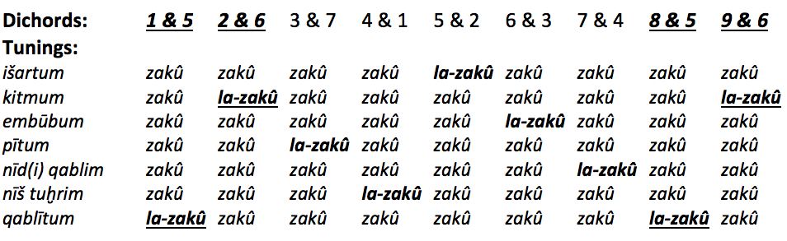
Continuation of seven-fold cycle to
8th and 9th strings

Slide 11
3 possible combinations of
4-, 5-, and 8-string pairs that are zakû
8-string 4- and 5-string zakû complements
modulus
~1200 cents (2:1) ~498 cents (4:3) ~702 cents (3:2)
~702 cents (3:2) ~316 cents (6:5) ~386 cents (5:4)
~884 cents (5:3) ~386 cents (5:4) ~498 cents (4:3)

Slide 12
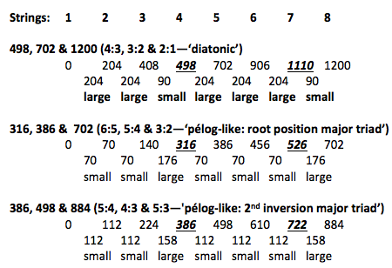
‘Ideal’ sizes of the steps in the three possible realizations of išartum tuning (in cents)
Cents values for the strings of the la-zakû dichords are highlighted.
Gradual, uninterrupted change from la-zakû to zakû is possible in each realization.

Slide 13
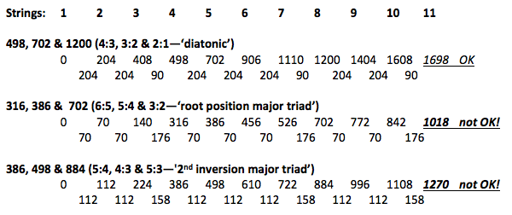
Anomalous 11-string intervals in two of the three possible tunings

Slide 14
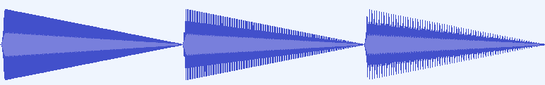
zakû 11ths (?) in 3 tunings: diatonic ‘root-position major triad’ ‘2nd-inversion major triad’

Slide 15
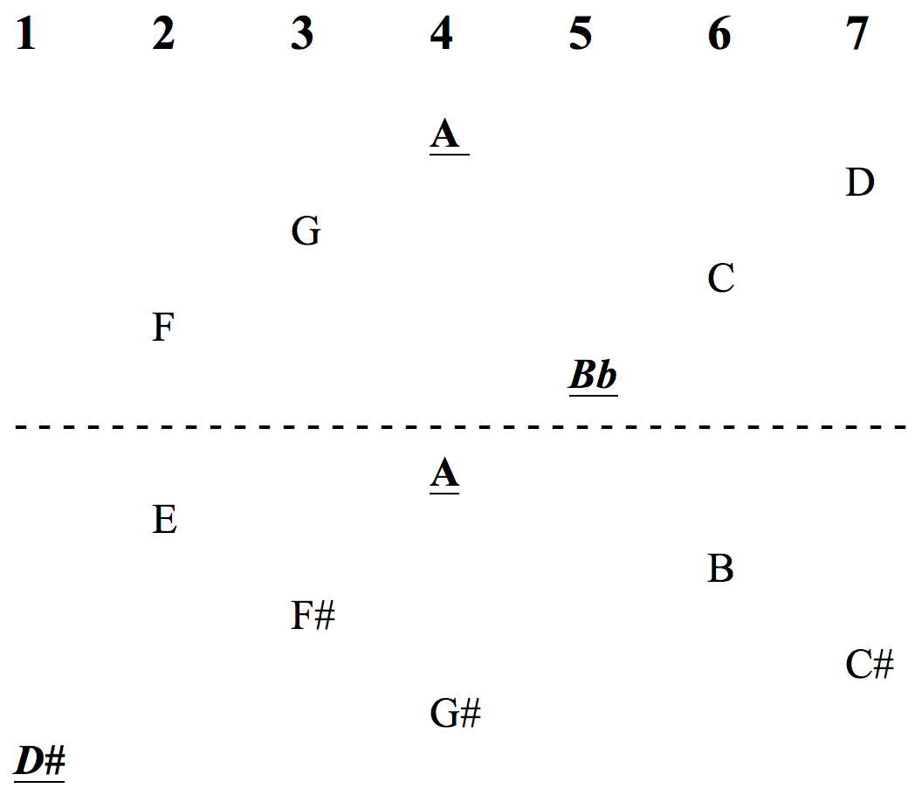
Aristoxenus’s realization of a ‘D#-Bb’ interval on
7 strings of a lyre

Slide 16
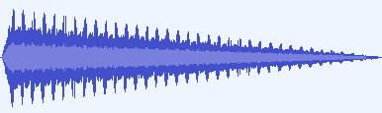
‘D#-Bb’ fifth of 678 cents in the middle register, beating at a rate of 12 beats per second

Slide 17

Small and ‘ideal’ 5ths produced by two pipes

Slide 18
Conclusion
An acoustical and perceptual assessment of what is known concerning pre-monochord tunings
a) reveals that they could have been realized by ear
b) admits the possibility of basins of low roughness and beating as guides to tuning
c) counters a view that would impose precise ratios on the tunings that resulted.

