Slide 1
Marrakesh Treaty:
getting our game face on
Katya Pereyaslavska
Scholars Portal, OCUL
sli.do/OCUL
Notes:
As the number of countries who have ratified the Marrakesh Treaty continues to grow, the question of building an effective exchange of accessible texts across our national borders has been raised by the OCUL accessibility community. My aim is to start a dialogue about practical implications of how we can grow our international partnerships, what technology and policy implications need to be considered in order to position our community to take full advantage of this provision in an effort to support our users with print disabilities more fairly and effectively. I will need your feedback and ideas which I could communicate back to OCUL executive and our working groups in order to set a list of priorities for accessibility in the coming few years.
Throughout this presentation I will be polling the audience in order to capture a sense of collective direction which will help to inform OCUL accessibility priorities in the next few years. To do this please navigate to sli.do/OCUL to respond to a few simple questions.

Slide 2
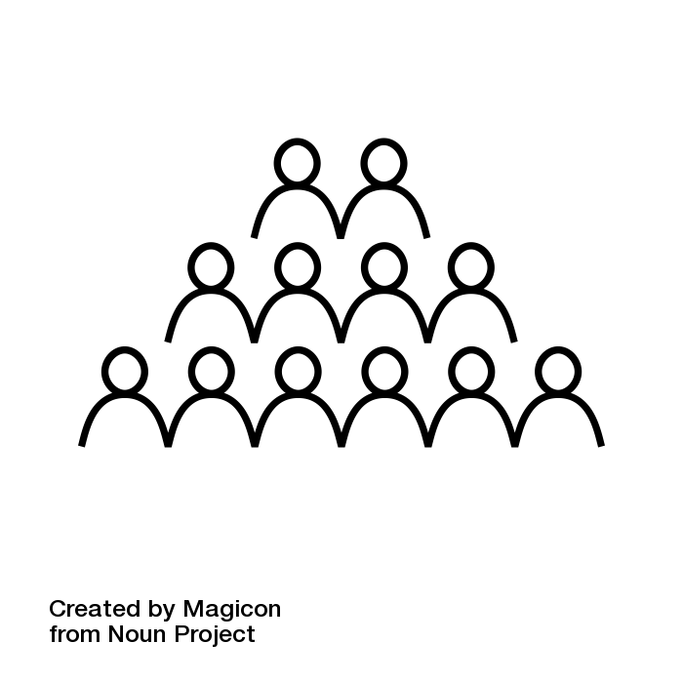
what's all the buzz?
sli.do/OCUL
Notes:
The Marrakesh Treaty to Facilitate Access to Published Works by Visually Impaired Persons and Persons with Print Disabilities (commonly known just as the ‘Marrakesh Treaty’, the ‘Marrakesh provision’ or just the ‘Treaty’) is an intellectual property treaty adopted in Marrakesh, Morocco, on 28 June 2013.
There are two important provisions in the treaty for libraries. The first is that it allows libraries to act as “authorized entities” or producers/distributors of accessible materials. The second is that it enables the international exchange of accessible texts.
This treaty came into full effect on 30 September 2016, following its ratification by twenty states, the twentieth being Canada. The number of states which have ratified the Treaty continues to grow and presently at 48.
sli.do/OCUL

Slide 3


Informig: why does this matter?
Reading
By Hadi Davodpour, IR
Public Domain
By National Park Service, US
In the National Park Service Collection
Public Domain
sli.do/OCUL
Notes:
Canadian research libraries provide access to information to a diverse user base, including people with print disabilities. While not every organization has policies and procedures to define their role as a producer of accessible content, libraries have an obligation to support individual requests to make their content accessible to patrons with specific needs.
This means scanning print materials where a digital copy is unavailable, turning image PDFs into readable OCRd files and converting formats to be more compatible with a specific device or software that a given user may rely on to access content.
Providing access to collections can also mean working with publishers to acquire digital copies of print materials and where they are not available, finding solutions through collaboration with agencies and services like Canadian National Institute for the Blind (CNIB), Center for Accessible Post Secondary Educational Resources (CAPER-BC), Accessible Content ePortal (ACE) or Alternative Educational Resources Ontario (AERO), to name just a few.
Workflows around provision can be pretty complex, making it hard for institutions to adhere to one single set of standards, quality, metadata and be fair to the requesting patron providing them with access within a fair period of time. Being able to trade content across national borders opens up access to a wealth of materials which have previously been off limits.

Slide 4
Kon-Mari method
Tidy up your messes
Find a reasonable way of organizing and keeping the good stuff
Follow some kind of a consistent system
Share your standards to achieve national level consistency across other institutions
Bit.ly/OCUL_Marrakesh
Notes:
So if the prospect of international exchange of materials sparks joy and you feel ready to borrow someone else’s content, you should take a minute to reflect as to whether you are able to loan any of your stuff in exchange.
I’d like everyone who is involved with production of accessible formats to think about the accessible content their institution retains. In order to move forward with any kind of collaboration we need to clean up old messes and adhere to a reasonable standard. Ive created a quick self audit cheat sheet you can use as a part of this reflection, just follow the link on this slide by going to Bit.ly/OCUL_Marrakesh
How many files are you currently “hoarding”?
How good are they?
How many duplicates are there?
What types of formats do you produce?
How many unusable formats are there?
How are they organized, if at all?
How are they named and is there consistency across all content following a single naming convention?
Because the question you should ask yourself is, if you’d like to share what you’ve got in order to borrow what someone else has, will it be an embarrassing or an empowering exercise? In other words, will they be grateful for it or will they just be worried about you?
Tidy up your messes
Find a reasonable way of organizing and keeping the good stuff
Follow some kind of a consistent system
Be proud of the quality of your content and how well its organized

Slide 5
opportunities
What makes us prepared?
National vs international
Identifying partnerships
sli.do/OCUL
Notes:
OCUL members are well positioned to take advantage of the Marrakesh treaty and I feel that a few things need to happen before doing so collectively:
1. Make sure the country you’d like to trade with has ratified the Treaty. Check WIPO list for an update on which countries have ratified the treaty.
2. Review existing content and compile a collection ready to share
2. Set a standard on the national level – this might require setting up a CARL group to broaden our reach, expertise and introduce a set of standards on the national level
3. Compile collections or curate subsets of collections by theme or quality or formats
4. Identify potential partners and reach out to establish an effective dialogue. Share your standards and discuss means of sharing
5. When you receive a request from your student think more broadly about your options and try an international loan if content is less time sensitive.
IFLA’s Marrakesh Treaty Implementation Guide for Librarians is an excellent resource which is now openly available and provides clear FAQ style guidelines for libraries on what and how they can share across national borders under the Treaty provision. I strongly encourage you to read it and disseminate it to your colleagues.

Slide 6

activating
What can you do?
What can we do?
sli.do/OCUL
Notes:
The following are a number of questions which can help us to establish a sense of direction in the coming years:
How will the implementation of the Marrakesh Treaty change the current accessibility landscape across OCUL libraries?
- This is a question which refers to our needs as a community as well as independent institutions and how they can be fulfilled via this treaty
2. What policy language can be developed to help OCUL community ensure balanced and fair approach to copyright and accessibility and factor in a protocol for international exchange?
- I feel that there is an opportunity to organize a review and create a suggested workflows/policy language for OCUL institutions who are ready to move forward with building international partnerships
3. Who will be taking the lead and how can we ensure maximum benefit from partnerships we build?
- There is an OCUL accessibility community and the ACE service working group but we need to think more broadly as to who needs to be involved in the bigger conversation to establish a successful protocol for cross border exchange of accessible texts
4. What other collaborative opportunities exist to help mobilize national level initiatives to advance cost saving and innovation in the area of equitable access to information?
- I don’t know whether this is something we could do via CARL and other consortia but I think it might be valuable to build some type of national network of libraries which want to loan and borrow internationally.
5. What tools and technologies are available to us to facilitate an international exchange? Such as ACE platform for content delivery or Own Cloud.

Slide 7

Thank you!
Tweet @katya_pereyas
Email katya@scholarsportal.info
Notes:
Thank you all for your feedback and participation throughout this presentation.

