Slide 1
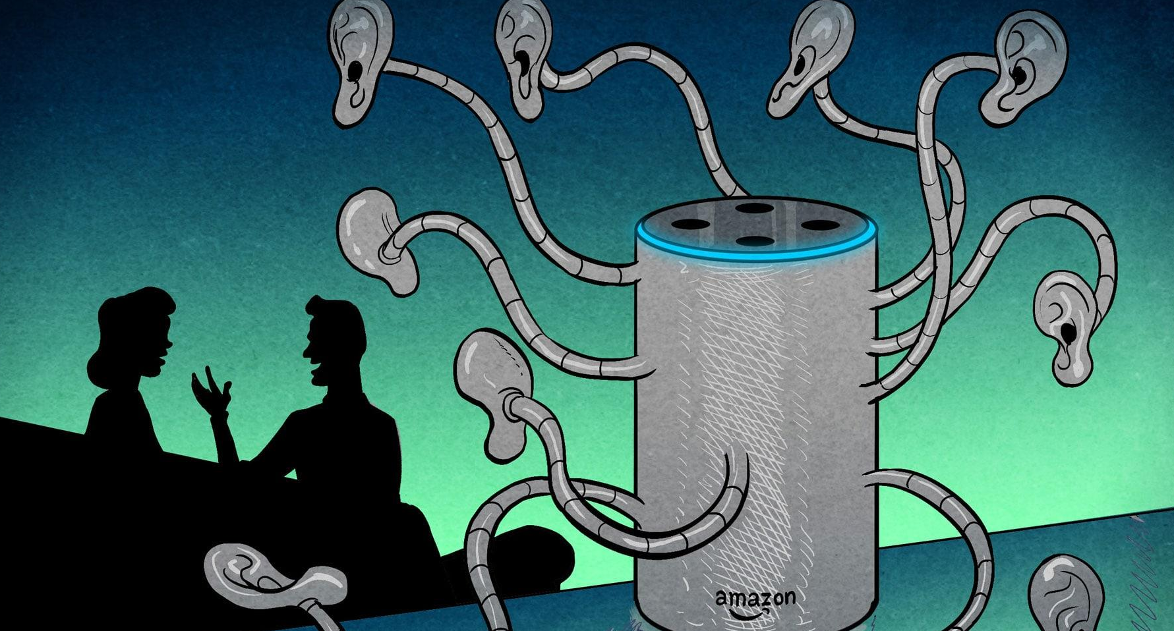
“Hey Alexa, where does my data go?
Exploring Data Privacy &
Surveillance Capitalism
Created by Carmina ioia under the supervision
of professor alison harvey

Slide 2

Activity 1: Kahoot
    Getting Familiarized to Surveillance Capitalism
Activity 2: Short Video + Reflection
    If You’re Not Paying For The Product, You Are The Product
Activity 3: Algorithmic Autobiographies And Fictions
    Get To Know Your AI Self
Activity 4: Alternative Creations
    Is there a better future in sight?

Slide 3

Kahoot: Getting to know Surveillance Capitalism
Answer questions as best you can!
Notes:
Direct link: https://create.kahoot.it/share/surveillance-capitalism-activity-1/bfbdf4fa-8510-4f32-a7e2-e0f9fe90822b
Nb: there are explanations and examples for the facilitator for each question in the Kahoot in the master document, under the section with all the Kahoot questions at the end of the document. If this is your first time facilitating, I recommend you take a peak to be prepared to answer any student questions during the Kahoot

Slide 4

Mentimeter: If You’re Not Paying For The Product, You Are The Product
Video + reflections
Notes:
Presenter link: https://www.mentimeter.com/app/presentation/f26ae921d12a7c6ad804b7534d383cc4
Students go to www.menti.com and enter the PIN that appears on the presenter’s screen

Slide 5

Algorithmic Autobiographies
Get to know your AI self!

Slide 6

Access ad interests
Jot down what stands out
Draw a picture of your online selves
  No artistic skills required
  Pictures will reflect only a fraction of your online selves
  Exploring these categories can be intimate and personal
  At the end, drawings will be displayed in front of the class
Notes:
Ask participants to go to Appendix 1 in their part packs and go through ALL the following instructions before having them begin:
Tell them they need to select a platform listed which they use (FB, Google or Insta) and follow the instructions to access and review the data collected on them (5-8 minutes)
Ask them to jot down notes about interest categories stand out to them: e.g., categories they identify with, confusing categories, categories that they don’t identify with...
Once they have a few written down, ask them to draw a picture of their online (algorithmic) selves. (10 minutes)
Participants can be as creative as they like. They chose what traits to focus on.
Can be accurate or based completely on inaccurate data that was collected on them. They chose.
Reassure them by stating:
Absolutely no artistic skills are required (pictures can be sketches, stick figures, outlines, or as detailed as you wish)
The picture will most likely reflect only a fraction of their listed interests; there are usually too many to encompass in one picture
Exploring these categories can feel a bit personal, so only depict aspects they feel comfortable sharing.
Drawings will be displayed to the rest of the class at the end (for those who are comfortable).
4) Before start, show the examples on the following slide.

Slide 7

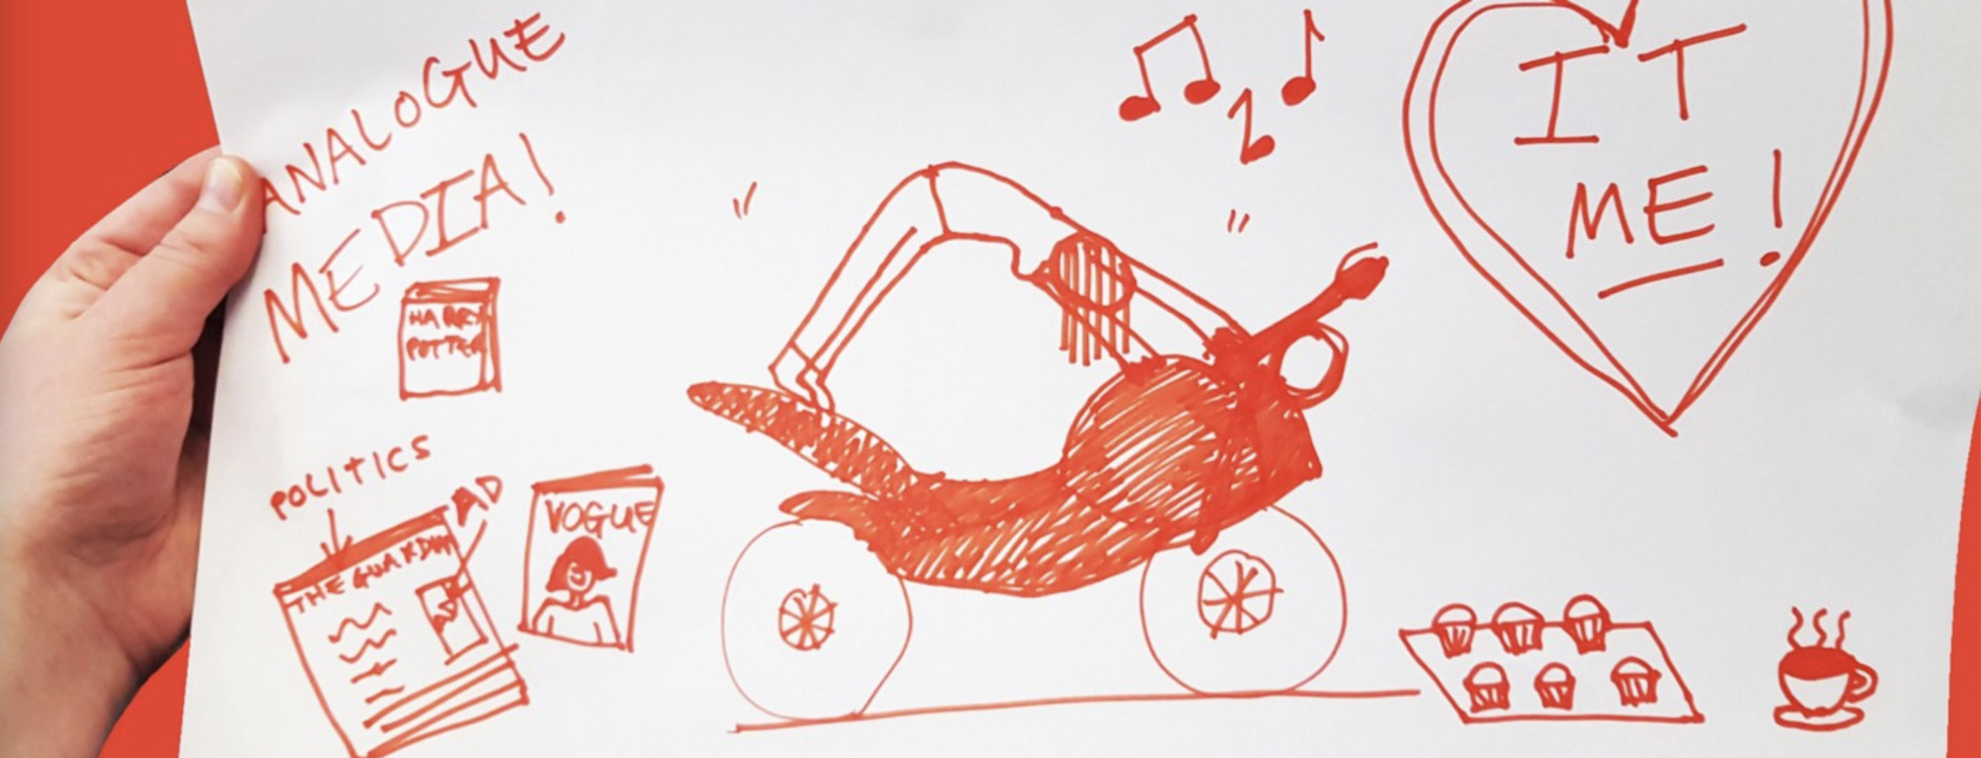
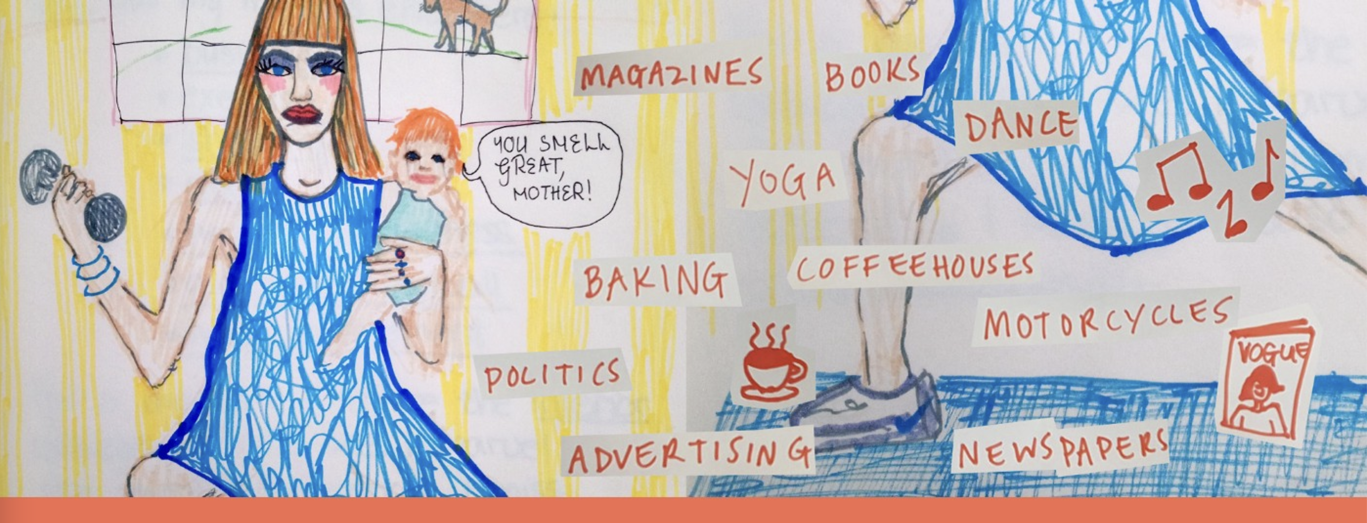
examples
Notes:
As they can see, drawings don’t need to be perfect. These are only intended to get them thinking. Their drawings may be very different.
Go through the next slide as well, then have them start.

Slide 8

Helpful Questions:
What does your algorithmic self look like?
What is their age and gender, if any?
What energy do they radiate?
Do you identify with most or all the categories listed about you?
Do you think your categories are an accurate representation of who you are offline?
Don’t have social media? No data points showing up? No worries!
Draw what you imagine your algorithmic self would look like OR
Draw an algorithmic identity that you think is the opposite of yourself OR
Draw the algorithmic identity of someone you admire, an online personality (social media star, YouTuber, video gamer, etc.), or your favourite character from a book, movie, or TV show.
Notes:
Give them about 10 minutes
Part way through, you can tell explain a bit about the process through which Instagram shows you ads: Instagram has revealed a teeny bit of insight into the process of how their ads work, but remember, this is largely a concealed process. “We want to show you ads from businesses that are interesting and relevant to you, and to do that, we use information about what you do on Instagram and Facebook (our parent company) and on third-party sites and apps you use," its site reads, continuing: “For example, you might see ads based on the people you follow and things you like on Instagram, your information and interests on Facebook (if you have a Facebook account), and the websites and apps you visit.”**

Slide 9

PENCIL’S DOWN!
What does your algorithmic self look like?
Notes:
Have participants who feel comfortable share their drawings and explain them to the group.
Example discussion questions:
Can you think of some consequences or risks of companies compiling huge data pools of what they think we like based on our internet patterns/habits/searches?
Possible examples: data breach and exposure of information to hackers and thieves, identity theft, gathering “wrong” or inaccurate data (bias), companies, organizations and governments hoarding data to use for nefarious purposes, etc.
What can be some political implications of companies knowing our preferences, values, etc.?
Possible examples: fuels political polarization, the spreading of political disinformation campaigns to individuals who are likely to side with a specific candidate based on their views, misleading and dehumanizing posts about political opposition, potential threat to democracy, etc.
What would happen if Facebook or Google didn’t know who we were; each time we logged onto our profiles, it would be a blank slate? How would logging in to these platforms change your user experience if they didn’t collect your data/you wouldn’t have this curated experience? Think about what the internet may have looked like at its beginning stages.
Possible examples: more equitable reach for every post, not as addictive, most likely not free or different business model, GAFAM not having as much influence in advertising, politics, marketing, etc. (this question is hypothetical, no right or wrong answers)

Slide 10

Alternative Creations
Is there a better future in sight?
Notes:
In the next slides, you’ll explore possible alternatives and solutions

Slide 11
How are we feeling?
I’m throwing my hands up; this is the way it is!
Angry, scared, or worried: every platform is non-consensual & there is a false choice between exclusion and being harvested!
Motivated to face this problem head on & find a way to secure my information.
Notes:
There are example responses to all three of these answers in the master document. They are also copied below, but you do not need to read them out. They are FYI.
Example follow up if many students chose the first option:
So, I see that many participants chose the first option, which is pretty fair! This does seem overwhelming or whatever action we take won’t matter because of the size of some of these corporations. But if we think problems can’t be solved just because our opponent is larger than us, than virtually all problems in the past shouldn’t have been solved; however, they were! It’s important to remember that there's power in numbers, whether individually or in large groups. Since this is an issue that faces anyone who is connected to the Internet, that’s a significant amount of people! Our main goal is to create a future where users don’t have to make a choice between being online and having your information harvested or switching offline forever, but instead to have safer systems available either for purchase or through better technology funding (which we’ll talk about later), inevitably making online experiences safer for all.
Example follow up if many students chose the second option:
So, I see many participants have chosen the second option, which is to be expected! This situation is indeed angering, worrying, and frightening! At this point, there’s a choice between being part of the systems and tools and apps that harvest your data or simply being excluded from the online world. This is a false choice, because many people can't afford to be excluded from the online world, which is very understandable in this highly connected world. Our main goal is to create a future where users don’t have to make that choice, but instead to have safer systems available either for purchase or through better technology funding (which we’ll talk about later), inevitably making online experiences safer for all.
Example follow up if many students chose the third option:
So, I see many participants have chosen the third option which is really exciting! It shows that this workshop has ignited some sort of spark, however big or small, in most of you to try and change the systems that we’re a part of. That, of course, won’t be easy, but it’s one of the challenges we’re faced with in communications! Our main goal is to create a future where users don’t have to make a choice between being online and having your information harvested or switching offline forever, but instead to have safer systems available either for purchase or through better technology funding (which we’ll talk about later), inevitably making online experiences safer for all.
Example follow up if there are mixed answers:
So, there are quite a variety of answers! Some seem overwhelmed with this topic, others might be angry or scared, which is completely normal! But the important thing to keep in mind is that if enough people are worried or scared or fed up with something, that will hopefully lead into a movement where more and more people start to care, in turn, changing entire systems together! Our main goal is to create a future where users don’t have to make a choice between being online and having your information harvested or switching offline forever, but instead to have safer systems available either for purchase or through better technology funding (which we’ll talk about later), inevitably making online experiences safer for all.

Slide 12

Continue to educate
yourself and others!
Notes:
There are many activists, online tools, and alternative apps that are pushing for more equitable and secure online spaces and have users’ best interests in mind. You’ll each go home with your own guide that lists various academics you can follow or documentaries you can watch about data privacy and surveillance capitalism. Overall, the most essential thing we can all do is to get educated and to educate others; that’s how it all starts! It’s free and there’s so much to discover. Believe it or not, we had much more content and examples for this workshop but had to drastically cut down to keep within the time constraint! I’ll describe a few points mentioned on the take-home guide to serve as a little tester of what’s on it!
Before we dive in, I would like to highlight some important points about data security.

Slide 13
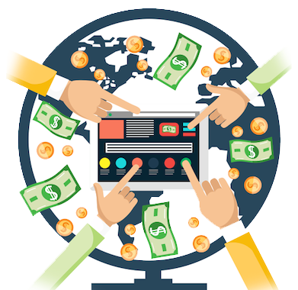


Change the way
technology is funded
Focus on laws and regulations
Notes:
Although educating consumers about how they’re data is used is a priority (how many of you knew what companies can do with your data before this workshop?), there are certainly other options to explore to better this problem. Firstly, we must change the way technology is funded. Historically, artificial intelligence and other technologies have been funded through one of two ways: warfare or large corporations maximizing their profits. Warfare might seem out of place in this situation, but, for example, the Internet as we know it today was invented by the US Department of Defense due to fear of the Soviet Union attacking telephone communication after launching the first man-made satellites ever. Secondly, by knowing how these systems work, we can change and/or update local and national privacy laws (make them stricter) by voting in candidates that have concrete reform plans. It’s important to remember that each country has different privacy laws. For instance, under GDPR (an EU law regulating data privacy), blood type, race & ethnicity, and opinions, comments, and social status are all regarded as personal data, while under Canada’s equivalent, PIPEDA, they are not.

Slide 14
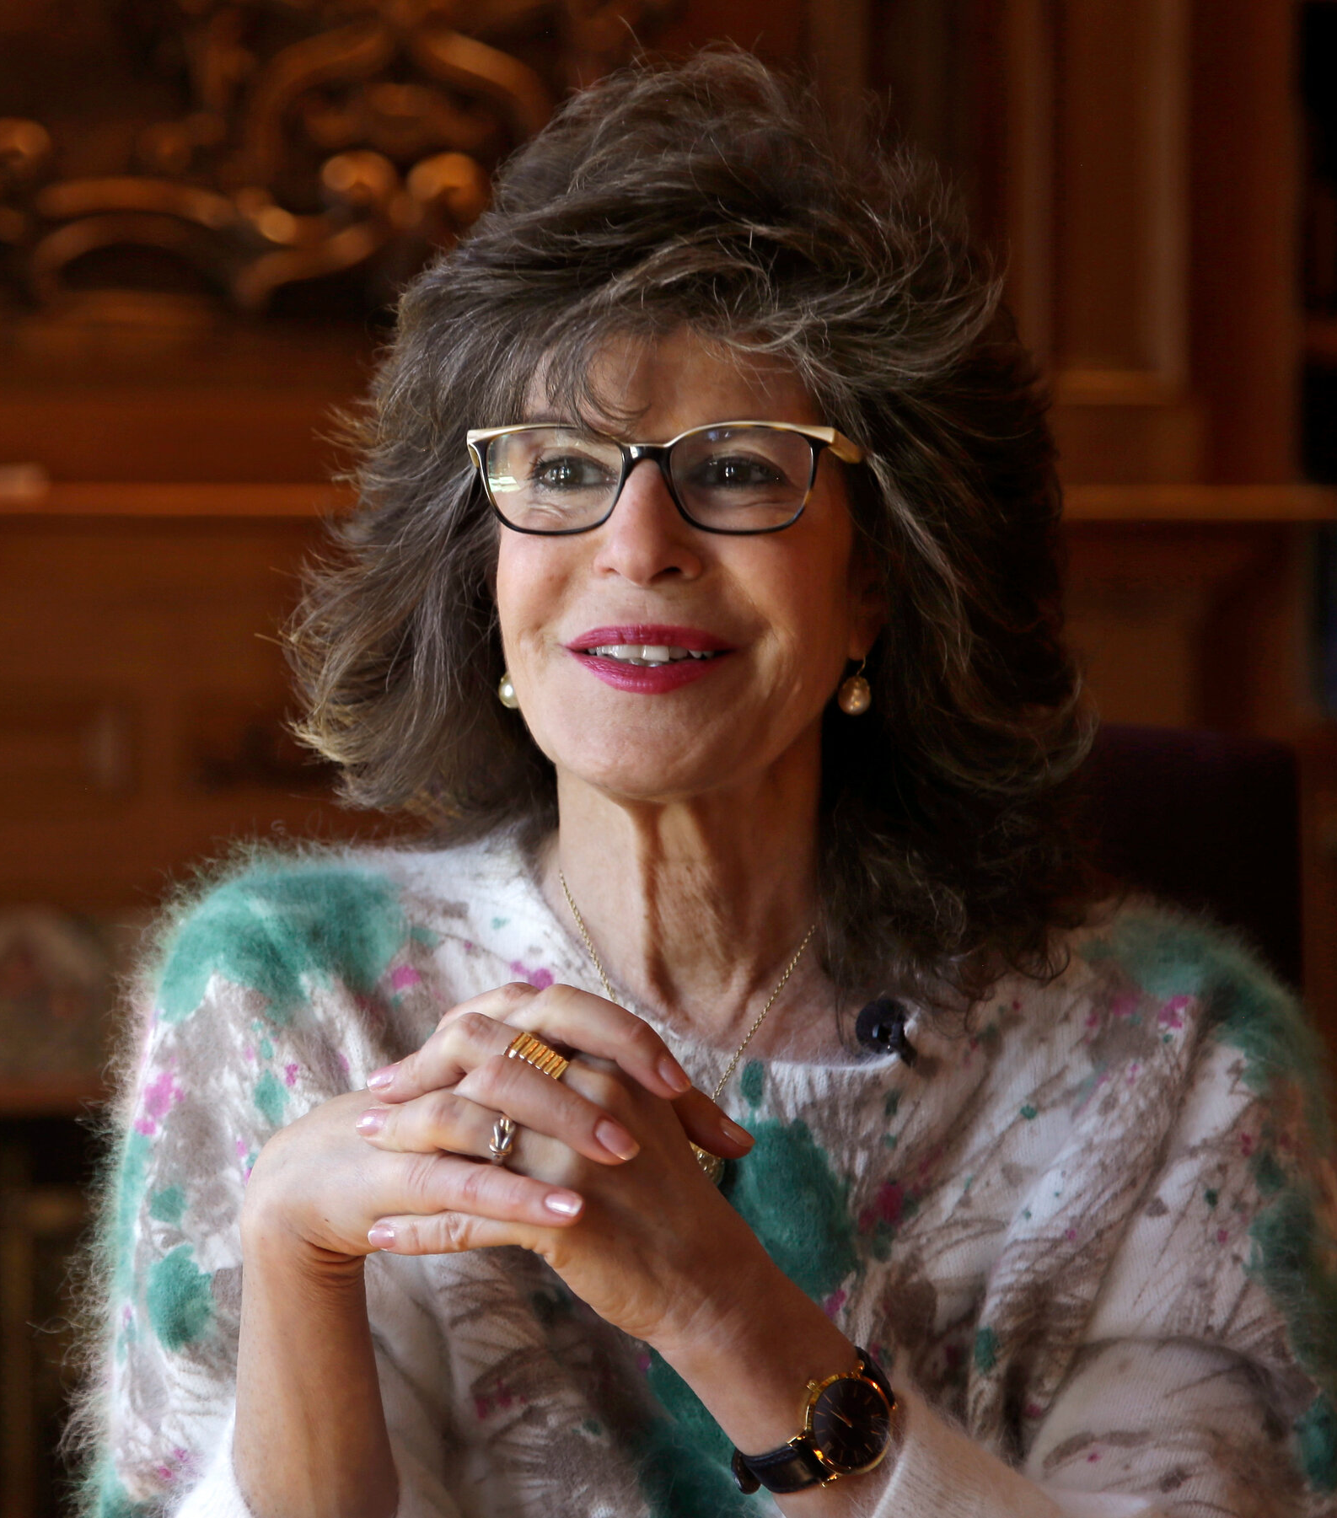
Shoshana Zuboff
Coined the term surveillance capitalism
Authored numerous books & articles, digestible video content on YouTube
Notes:
People to follow: Shoshana Zuboff
Although others before her studied the topic, Zuboff coined the term surveillance capitalism. She’s an author, Harvard professor, and social psychologist, among others, and has written extensively (books, newspapers, blogs, etc.) on surveillance capitalism. She has many digestible and easy to follow videos speaking extensively about her work available on YouTube.

Slide 15
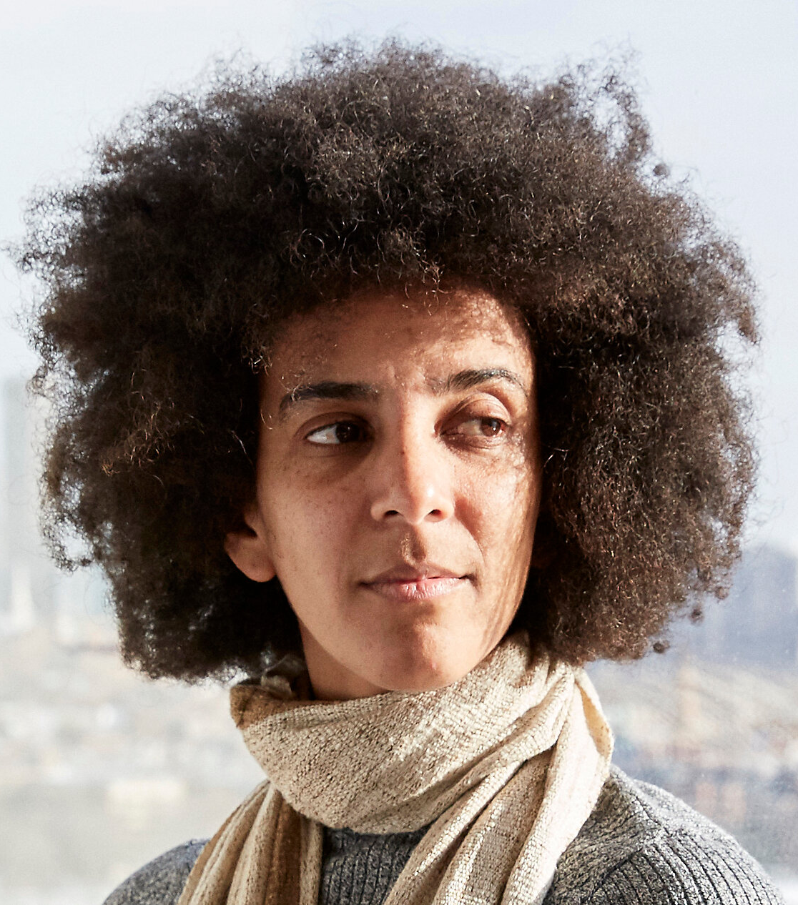
Ex-Google executive
Advocate for diversity in technology
Timnit Gebru
Notes:
People to follow: Timnit Gebru
Gebru, an advocate for diversity in technology, is a computer scientist specialized in algorithmic bias and data mining. She was the face of a large scandal in 2020 where she was fired as executive of Google’s Ethical Artificial Intelligence Team after she was forced to retract a research paper on AI ethical problems within Google’s search engine. She is now the co-founder of Black in AI.

Slide 16

The Social Dilemma
(Netflix)
How social media creates addiction, manipulates people’s views, emotions & behaviours, +
Notes:
Movies to watch: The Social Dilemma (Netflix)
A must watch! This docudrama explores how social media’s design cultivates addiction, manipulates people’s views, emotions, and behaviour, and how it spreads conspiracy theories and disinformation, all in the name of maximizing profit.

Slide 17






Mozilla Firefox, DuckDuckGo, TOR (The Onion Router)
Simple & essential switch-overs to make for a more secure online experience
Notes:
Mozilla, DuckDuckGo, TOR
Switching to Mozilla Firefox from Google or Safari, DuckDuckGo from Chrome, or using TOR as the ultimate browser are simple changes to make that significantly protect your online data. Firefox flaunts its’ a “browser that protects what’s important” and the “doesn’t sell you out” while DuckDuckGo was created to help search-users reclaim their online privacy. TOR (short for The Onion Router) is a free, open-source browser that helps you surf the internet anonymously. VPNs are a great alternative to TOR.

Slide 18
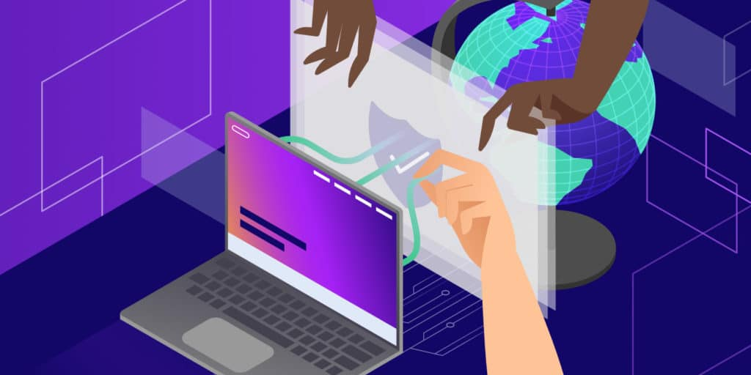
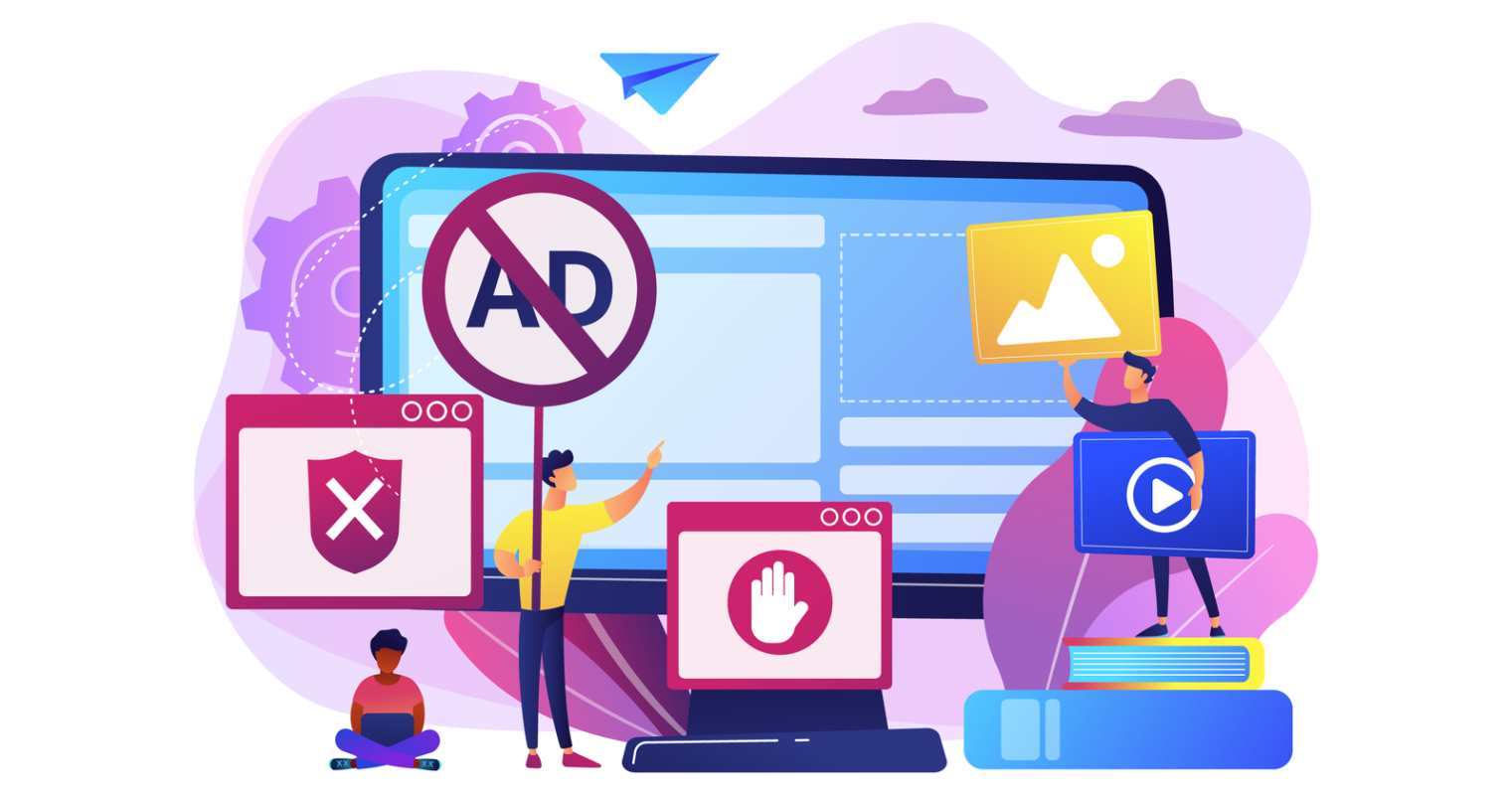
Ad Blockers & VPNs
(Virtual Private Network)
Essential if you have a computer/laptop
Enabling an ad blocker = no more over-stimulating ads
Enabling VPN = hides IP address + provides encryption
Notes:
The importance of VPNs and ad blockers
If you don’t already use ad blockers or VPNs, make sure to download them as soon as you get home! Ad blockers ensure you don’t see flashy ads online that can be distracting and over-stimulating. Once you have an ad blocker enabled, you won’t be able to go back! VPNs, or Virtual Private Networks, hides your IP address provide you with secure encryption when surfing the web. Essentially, a VPN is a filter that turns all your data into gibberish disguising your online activities, physical location, and data! Regardless of what browser you use, trusted ad blockers and VPNs are listed in your take-home participant guide.

Slide 19

Thank You!
Notes:
I hope that piqued your interest in exploring the participant guide! There are plenty more tips available in it, including how to protect your iPhone or Android devices by simply switching off a few toggles in your settings!
This brings us to the end of the workshop. I hope you enjoyed learning about surveillance capitalism and data privacy. We hardy scratched the surface on a huge, intricate topic, so be sure to stay curious, ask questions, and explore how you can better protect your online selves!
Ask the participants if they have any final questions or comments, thank them for their participation and ask them to complete the participation survey:
a) Student survey (EN): https://forms.office.com/Pages/ResponsePage.aspx?id=GBNTNBFw1E-H8KQ4FsSb0EwfnQOE4vtJgtg6zg45P9ZURVlGTTNDWlZRUEZLMTU3T0pEWDFFWjUxQy4u
b) Teacher Survey (EN): https://forms.office.com/Pages/ResponsePage.aspx?id=GBNTNBFw1E-H8KQ4FsSb0EwfnQOE4vtJgtg6zg45P9ZUQUVZWVc0U0oyNDVZQTVBU1dWQUZORlQ5UC4u

