Slide 1
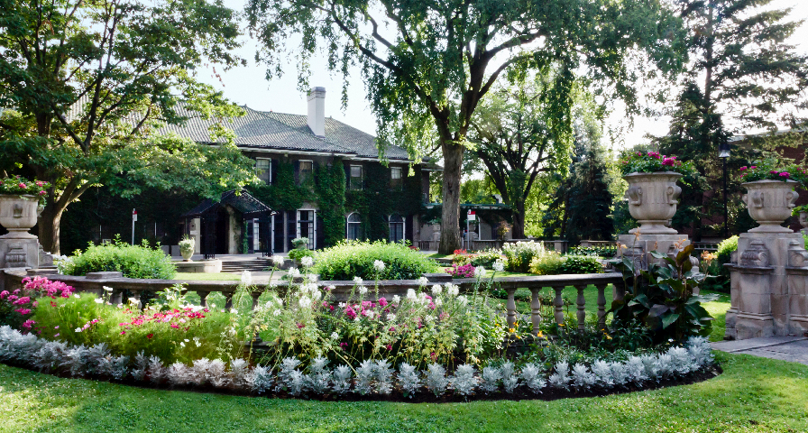
Translation:
Unlock your communication
potential

Slide 2
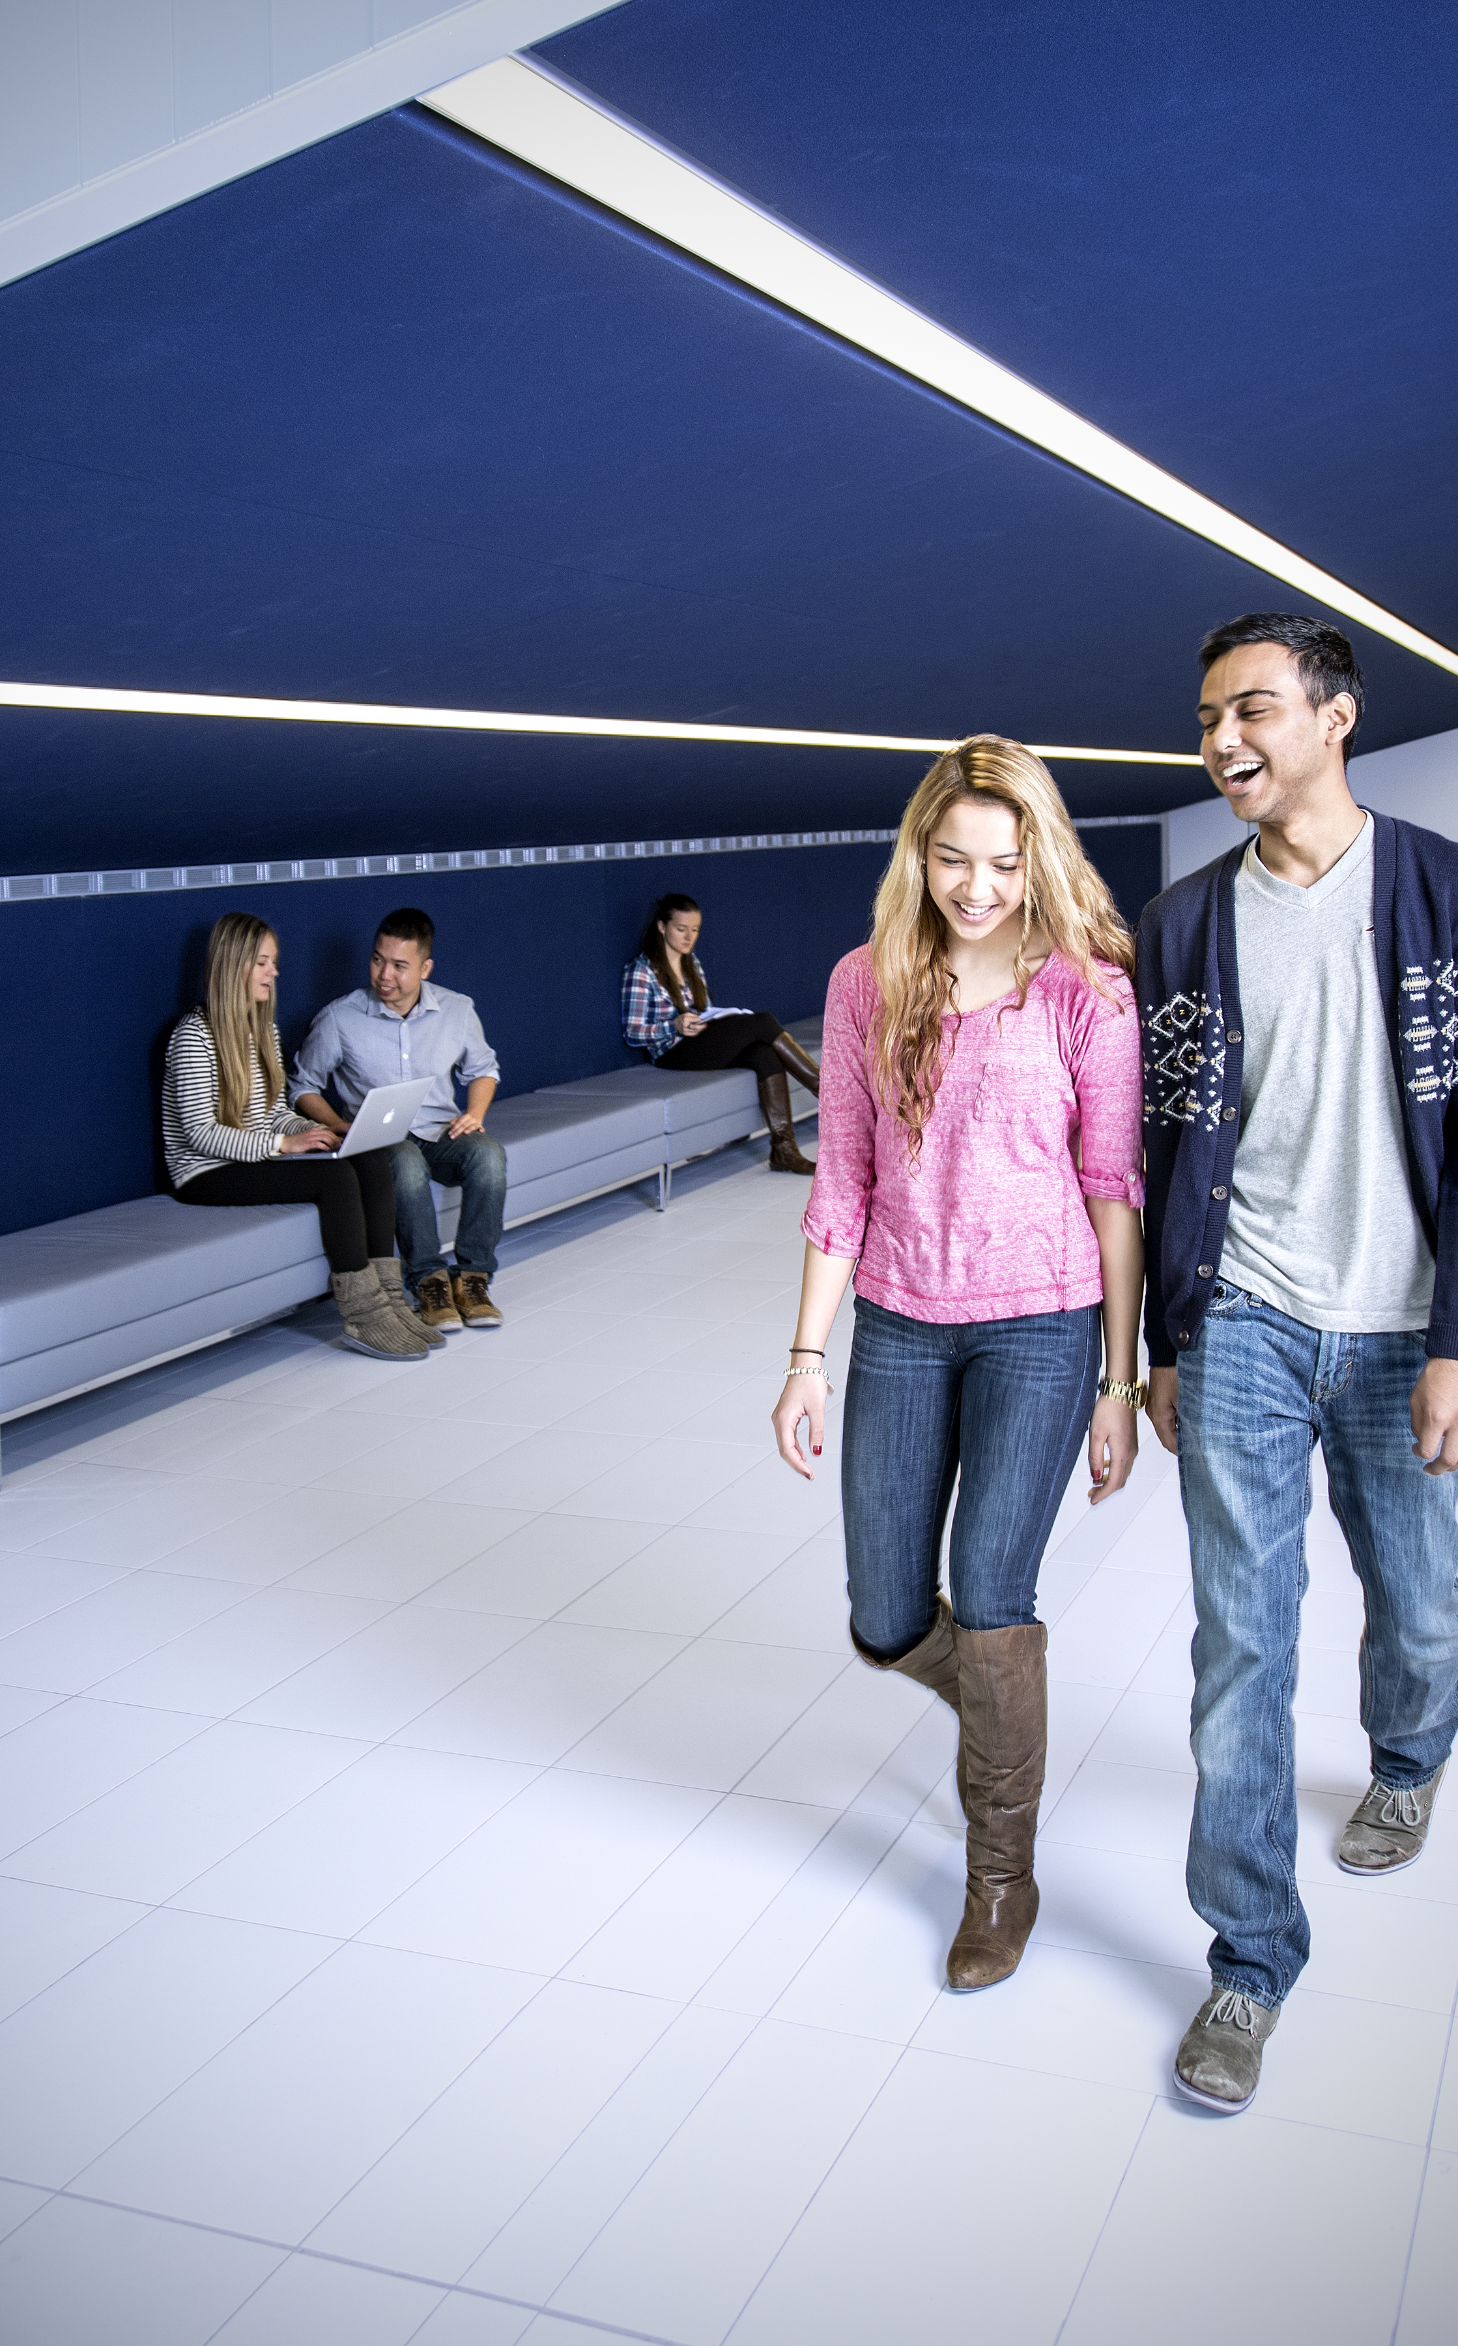

INTRODUCTIONS
FACILITATOR
MODERATOR
PARTICIPANTS

Slide 3

RULES OF ENGAGEMENT
Do not take screenshots or screen recordings
Raise your hand and use Chat to ask questions
Be respectful of others
Listen attentively
Participate actively
Have fun!
Translation: Unlock your communication potential

Slide 4
Time | Activities
5 min | Introduction and Ice-breaker
10 min | How Translation Touches Our Lives
20 min | The Evolution of Translation
15 min | What Makes a Good Translator?
20 min | A Translation Contest!
5 min | Conclusion
75 mins | THANK YOU FOR PARTICIPATING!

Slide 5
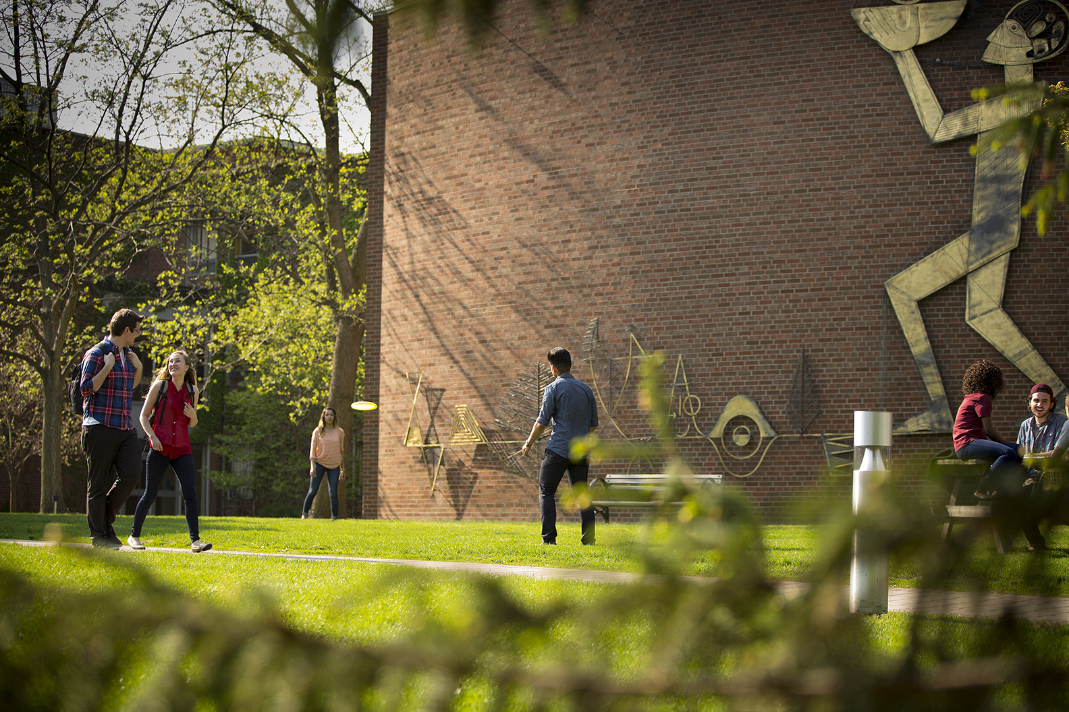
3 LEARNING GOALS
Gain a broader understanding of the hidden ways translation touches our lives.
Identify ways translators' work has changed over time, and how computer-assisted tools are used to support the translator.
Acquire practical experience translating.

Slide 6
How Translation Touches
Our Lives

Slide 7
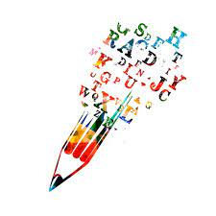
What is a Translation?
Translations are text-based – in other words – they usually involve some form of writing
This is distinct from interpreting, which involves speaking
Notes:
Translation and interpretation are often conflated by the general public, who think the job of a translator involves exchanging spoken messages between speakers of two or more different languages. But this is in fact the role of an interpreter: for examples, think of cross-language voiceovers in news interviews or recordings of government debates, or in meetings.
Translation is specifically about the written word: documents, articles, books, ads, and all other types of media that involve writing.
Both roles have to do with navigating communication across languages and cultures, and have overlapping skillsets, but they are distinct.

Slide 8
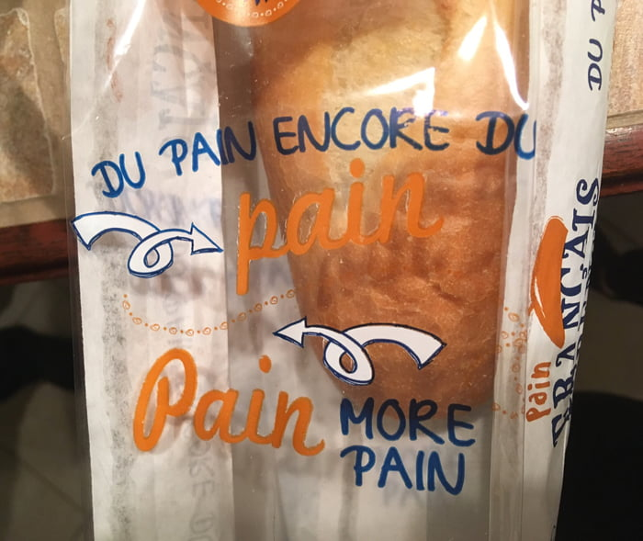
Hiding in Plain Sight
Do you always know if what you are seeing is translated?
It is not always obvious that a work is translated. Except when mistakes are made.
… would you like some “pain”
with your bread?
Notes:
Ask the question “Do you always know if what you are seeing is translated? Why do you think we might not recognize translations when we see them?”
It is not always obvious how translation touches our lives, because if a translation is good, we will not usually realize that it is translated. A good translation does not stand out. It allows us to take in and experience what we are reading, watching or playing without being distracted by where it originated. We think it was created for us.
Translations do not often advertise themselves as such, and good translations don’t stand out. In media, we don’t often see announcements of translations on the covers of books or in the promo material for video games. Thus, the fact that it is a translation can remain hidden and rarely noticed—unless it’s badly done
Some of the best advertising for professional translation services are the many photos of funny mistranslations people have gathered online. For example, the picture on the right literally says “Bread, more bread” in French, but “Pain, more pain” in English. Google “translations gone wrong” to find more.
Optional: show additional humorous photos (attached) and see if students can figure out what went wrong.

Slide 9
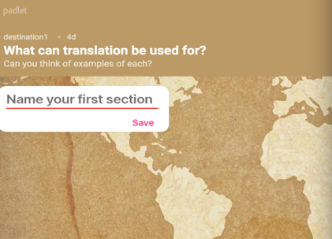
Activity 1 : Where do we find translations?
Translation is everywhere!
Let’s brainstorm
Notes:
IF IN PERSON: create 3 columns on the whiteboard or flipchart and write the following at the top of each column: 1) Things we translate (e.g., restaurant menus), 2) Specific examples, 3) What are some of the reasons we translate?
IF ONLINE: send the following Padlet link to participants for them to access: https://padlet.com/GLConEd/1whts1vsq62oblsv
Ask participants to access the padlet page and share that same page on your screen for the group to see:
You can access the user account with the following details:
- username: destination@glendon.yorku.ca,
- password: Smallmighty
Go through the columns one by one: 1) ask them what types of things we translate, then 2) ask if they can think of specific examples they’ve encountered, and 3) ask them to think of some of the reasons we translate
Explain how to use padlet and ask the participants to answer the first question
•If they are having difficulties, some categories that you can mention are video games, movies, TV shows and books but you could also think about more mundane things, like news media, government documents, packaging, instruction manuals…
Ask the participants to answer the second question
•If they are having difficulties, ask “What are some movies or TV shows that you watched with subtitles or dubbing? What books have you read that were translated? And can you think of any other examples of translated media?”
•Feel free to add a few examples of translated media that you are familiar with to use as examples, like maybe: House of Spirits, by Isabelle Allende (Book, Spanish to English); Squid Game (TV show, Korean to English), the Witcher game series (Polish to English); Naruto by Masashi Kishimoto (manga, Japanese to English)
•Another example could be the instructions to build a desk that were in French and English or the cereal box with one side in English and the other in French.
Ask participants:
“Why do we translate?”
We translate to convey meaning, emotion or to inform. It is necessary because it allows to spread new information, ideas and knowledge across the world. It enables effective communication between different cultures. But different actors have different reasons for seeking translations. For example: Governments translate to serve diverse populations or to work with other countries; Cultural and artistic groups translate to reach bigger audiences; Businesses want to sell products globally or expand their operations to international markets so they can make more money; Religious organizations have historically translated to spread their faith and facilitate missionary activities.
To conclude the activity:
Read through the responses, comment on what you see and invite participants to elaborate on their answers.
Conclude by using the Padlet to explain how translation allows different languages and cultures to interact with each other. Example:
“Just a quick look at this list makes it clear that we are engaging with translated works almost every day. And although there is still a long way to go, it is becoming more multi-directional, meaning although there is still a lot of English-language content being translated into every other language, there is more and more content from other languages having an international reach as well.”
“Translation is fundamentally about bringing different languages and cultures into contact with each other by taking media from one culture and making it appear within another. When done well, it is seamless, and you can have a generation of kids growing up never realizing that all their favourite Pokemon have different names in the original language.”

Slide 10
The Evolution of Translation

Slide 11
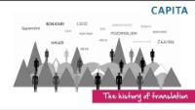
Notes:
There is a distinct lack of knowledge about translators and translation in general.
This video describes the evolution of translation: https://www.youtube.com/watch?v=Ukqmyv50ijY

Slide 12
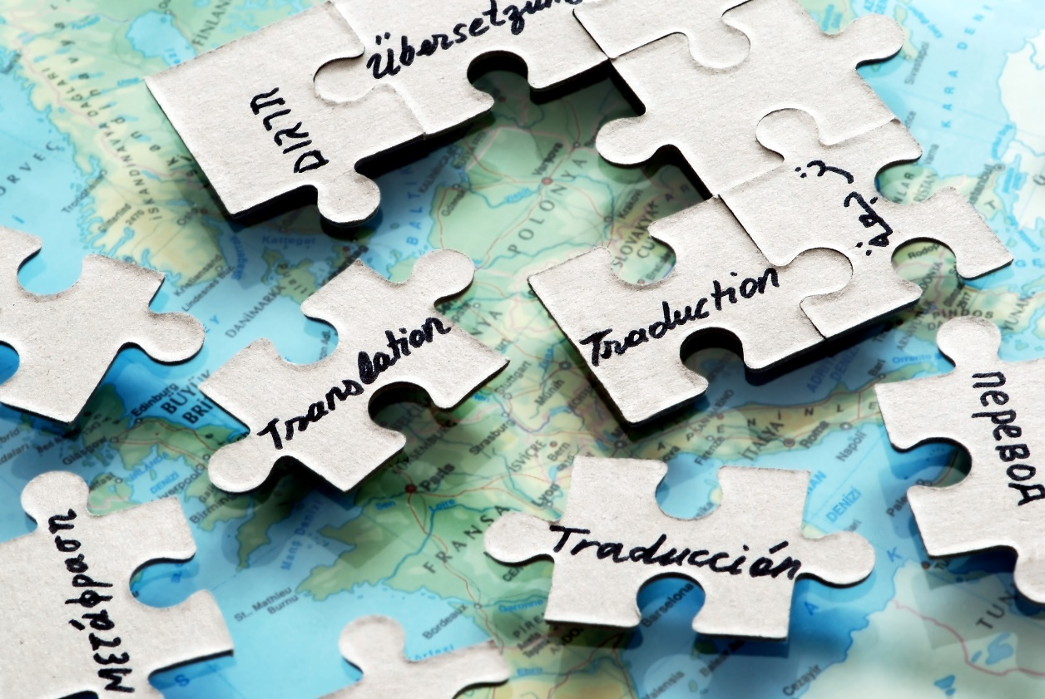
Discussion Questions
Based on the video, what do you think were the most important changes over time in how translation is done?
What else stood out to you?

Slide 13
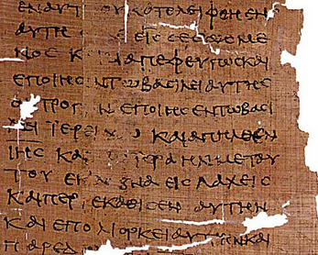
Early Translation
Early biblical translation
Each translation was written out by hand and could take months or even years to produce one copy
Translation flourished where there was increased contact and trade between different linguistic groups
Notes:
As the video mentioned, most early intercultural communication was oral interpretation because of the lack of writing technology and knowledge. Examples of ancient written translations are few and far between.
One of the most translated texts in western culture is the Christian Bible. The earliest still-existing translation of the Old Testament was done by Jewish scholars from the original Hebrew into ancient Greek. It is called the “Septaguint,” for the 70 translators who worked on it. Legend says that each translator was locked in a separate room and worked independently, but all of them came up with identical translations. This story probably isn’t completely true, because different translators almost never translate the same text in the same way. But the main idea is that, at this time in history, all translations were done by hand and copied in the same way over and over and over again! It was a very tedious process that could take months, or even years, to produce one translation.
Translation flourished especially in areas where there was increased contact and trade between different linguistic groups.

Slide 14
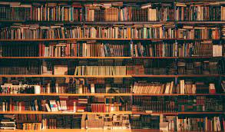
Technological Development
The printing press changed everything: no more copying by hand!
In the 20th century, rapid technological advancement changed the process of translating from handwriting to typewriting to computers
Notes:
Let’s take a quick tour through translation history in one slide!
The printing press was the first big technological invention that revolutionized translation. Forms of book-printing automation date back to 9th century China, but in European history Johannes Gutenberg is often credited with inventing the printing press around 1436. At that time in the 15th century, reading and writing was a tool of the elite: among them, rulers, priests, and scholars. They controlled information and the general population did not have ready access to learning or reading materials. The printing press changed everything and eventually made previously unattainable written texts available to the masses. As literacy rates increased, there was a growing demand for and proliferation of written material that required translation.
Each technological advancement since the printing press has helped shape the field of translation. This became more pronounced in the 20th century with the invention of computers. Before computers, translators used paper dictionaries to help them with translation, and had to do their research in libraries or go out and find an expert to explain highly specialized language, depending on the type of translation (such as a book on medicine). Translators would still write by hand or use a typewriter to produce documents.
Computers, and especially the internet, once again changed everything. But let’s discuss this one together, since computers are much more familiar to you.

Slide 15
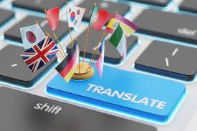
Translation Today
Computer-assisted translation (CAT) tools: powerful software programs used in professional translation
Machine translation
Online glossaries, references and information
Notes:
CAT Tools: Translators don’t often work in word processors like Microsoft Word anymore. We now have specialized software programs, called CAT or computer-assisted translation tools, which are developed to facilitate professional translation. They provide a side-by-side view of the original document and the new document, and add lots of options and tools to make the process quicker, more efficient, and more consistent.
We also have access to online encyclopedias, dictionaries and glossaries that make finding the right word much easier than looking through pages of a large paper book. Governments and international bodies like the European Union have created glossaries that translators can access at the touch of their fingertips. The internet saves so much time.
Machine Translation: You might have used something like Google Translate or DeepL before, where you write a sentence in the original language and ask the computer to translate it for you. Machine translation is like this, but there are much more sophisticated systems used in the professional world. While machine translation used to result in extremely clunky and just plain wrong results, things have improved a lot in recent years due to advances in artificial intelligence and deep learning technology. However, humans are always the last line of defense when it comes to making sure everything is correct and fits the context. And in some situations (translating creative works like poetry or advertising, for instance), machine translation is not even a little bit useful.

Slide 16



Group Activity: Impact of Technology
How do you think changes in technology may have impacted the field of translation?
What are some of the advantages or disadvantages of machine translation?
What do you think a human translator can do that a computer cannot?
Notes:
Impact of Technology slide: Divide participants in groups of 3-4 and ask them to discuss the above question regarding the differences in translation 30 years ago compared to now (3 minutes), then ask each question and elicit an answer from one group for each answer (not every group might have an opportunity to answer, but you can ask if the others have anything to add).
“How do you think these changes may have impacted the field of translation?”
Sped up translation and increased the amount of volume we are able to translate in the same amount of time
Made information more accessible
Reduced costs associated with translation
Reduced the need to translate repeated and provided more consistency in terminology
Technology has also created new fields for translation
” What do you think are some of the advantages or disadvantages of machine translation?”
Machine translation enables rapid translation in a greater volume than before
Some translations can be done entirely by machine (e.g., lengthy internal workplace policies)
Translators can find work post-editing machine translation
Translators can spend more time on cultural nuances and finding the right words for the right context
What do you think a human translator can do that a computer cannot?
Humans can exercise judgement in deciding what makes most sense given the context; machines don’t have consciousness to make judgement calls!
Machines translate mostly word-for-word while humans can also translate for meaning and taking context into account. For example: student council could be avis d’étudiant or conseil d’étudiant and it all depends on the context of the sentence and the client’s preference.

Slide 17

Will Computers Replace Human Translators?
The short—and the long—answer is no!
Computers are tools that help translators work faster
Machine translation can’t do everything
There is a higher demand for translation than there are translators to meet the need!
Notes:
One of the most common misconceptions about translation is that computers are replacing humans in the process.
But are they? The short answer is no.
•Translators have always made use of the best technology available to help them work more efficiently.
•All these tools do mean that translators are working faster than ever before, as they use machine translations as a starting point and review/correct. But right now, the amount of text to be translated is increasing so rapidly that it more than compensates.
•Translators are in high demand due to globalisation and the increase in migration. As the world becomes increasingly interconnected between nations as well as markets, the demand in translators also rises
People are still far superior at capturing nuance and adapting information to context.
Ex: Can you imagine a machine translated perfume commercial?

Slide 18
What Makes a Good Translator?

Slide 19

What Makes a Good Translator?
What does a translator need to know in order to do a good job?
Translators need to know much more than just two languages!
Writing skills are essential – all translators are writers. But what else?
Notes:
We’ve talked a little about what translations are and how the practice of translation has evolved over time. Now let’s talk about the people involved: translators! If you thought about pursuing translation yourself, what type of skillset might be required.
Popcorn-style discussion question: If you had to guess, what do you think a translator needs to know in order to do their job well?
Give students some time to respond. Answers are likely to include “They need to the languages they are translating from and to.” and potentially some other ideas.
Sometimes people think all a translator needs is to speak two languages and they’re good to go. But this isn’t true, and there are a lot of other skills involved in being a translator. Think about what we discussed in our last section (computers)? If translators are using computers to do their work, what computer knowledge do they need? What about when they encounter words they’ve never seen before?
Writing skills, as another example, are extremely important for translators, since most do a significant amount of writing as part of their job. In fact, it can be said that all translators are writers. But what else? Let’s take a look at some ideas about the translator skillset on the next slide.

Slide 20
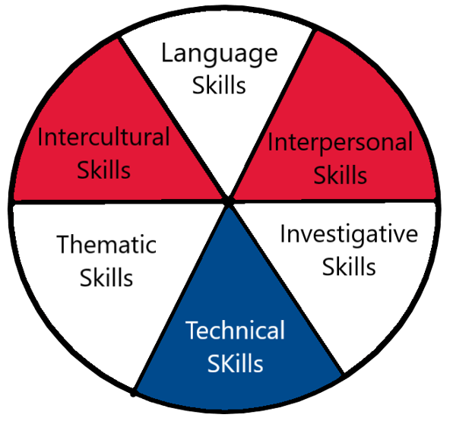
Skills of a Successful Translator
Notes:
One of the most well-known articulations of translator skillsets comes from Europe. The EU commissioned a group of translation professors to develop a list of everything someone needs to know to do the job, and they produced a document called Competences for professional translators, experts in multilingual and multimedia communication.
They talk about six different areas translators need to excel in to be good at what they do:
they need language skills—perhaps the most obvious—to understand what they are being asked to translate (from what is known as the source language) and then rewrite it in another language (known as the target language)
they need interpersonal skills (often known as people skills, interpersonal skills are all about interacting with others in a professional way)
They need intercultural skills (to bridge the gap between two or more cultures)
They need thematic skills (to understand special topics as they translate them)
They need investigative skills (to do research and find answers, since no one can know everything)
They need technical skills (to use the computer tools at their disposal)
Let’s look at some specific skills and see if we can guess which area they fall into. We’ll be using the Kahoot app for this activity.

Slide 21

Activity 2: Mentimeter Quiz!
STEP 1: Go to Menti.com
STEP 2:​​ Enter the PIN displayed on the screen.
Notes:
Launch the Kahoot! game, as a fun way to use their own reasoning to reflect on the various skills and knowledge translators need to succeed in the work.

Slide 22
Why Do Translators Do What They Do?
They love language
They love learning
They love working (mostly) independently
They love solving problems and puzzles
Notes:
Why do translators choose to do what they do for work?
They love language and being able to develop and maintain their language skills through their job.
Translators also get to learn about all sorts of different topics and fields when they translate for different clients. People with curiosity and an interest in lifelong learning are attracted to becoming translators.
Many (but definitely not all) translators work freelance, which means they are their own bosses, set their own hours, and work independently — although there is still a lot of interaction with others involved in the process. This type of flexibility appeals to them.
Another way of thinking about translation is as problem — or puzzle-solving. Every text to be translated is its own mystery which requires investigation, creative thinking, and problem-solving in order to move from one language to another. Many translators love the feeling of finding just the right word or phrase and finally solving the puzzle of a text.

Slide 23
A Translation Contest

Slide 24
Let’s Have a Little Translation Contest
The process:
  Work in teams on two translations
  Submit your group translation at menti.com
  We’ll review them together and vote on our favorite solutions

Slide 25
Translation Success Criteria
Accuracy: Accuracy Does the translation reflect the content and intent of the original?
Readability: Does the translation read smoothly? Is it idiomatic (sounds natural) or unidiomatic (sounds awkward)?
Creativity: Creativity In some cases, direct accuracy is hard to achieve and creativity is crucial. Does such a translation creatively adapt the ideas to retain the effect of the original?
Notes:
Accuracy Does the translation reflect the content and intent of the original? Sometimes accuracy means finding equivalent words between the two languages. Sometimes the message is more important than the exact words. This is why intercultural skills are so important. You must know how to reach the new audience the same way the original message reaches the original audience. Rather than accuracy at the word level, accuracy can also mean that the message has the same impact on the new audience, for example to entertain, to inform, or to sell something.
Readability Does the translation read smoothly? Is it idiomatic (sounds natural) or unidiomatic (sounds awkward)? A good translator always makes sure the translation is readable and natural sounding in the new language. This is why you often don’t know you’re dealing with a translation because it comes across as natural in your language.
Creativity In some cases, as we discussed for accuracy, direct word-for-word accuracy is hard to achieve. Creativity is crucial. Does such a translation creatively adapt the ideas to retain the effect of the original?
Let’s look at a few examples before we attempt our own translations.

Slide 26
Activity 3: Translation Contest
STEP 1: Go to www.menti.com
STEP 2:​​ Enter the PIN displayed on the facilitator’s screen
STEP 3:​​ Submit your group translations

Slide 27
Round 1: An academic research paper
"La traduction automatique des textes faciles à lire et à comprendre (FALC) :
une étude comparative"
https://www.erudit.org/en/journals/meta/2022-v67-n1-meta07277/1092189ar/
Notes:
Ask students: what would you say were the biggest challenges in translating this sentence? (They might have had difficulty understanding the text, especially the specialized words (terminology))
Which of the three criteria are most relevant to this text?
Round 1 sample response: Machine translation of easy-to-read (EtR) texts: a comparative study.
Accuracy criteria -- This text has two set terms, which translators need to be able to recognize and translate appropriately – students may be inclined to translate “la traduction automatique” as “automatic translation,” but the appropriate English term is machine translation. Similarly, easy-to-read (EtR) texts is a specific term, which was found in the bilingual abstract of the paper (linked in works cited).
This translation shows the importance of language skills (to understand the French and provide the English translation); investigative skills (to research and find the right English words, also known as terminology); and technical skills (to use computer tools to support the translation).

Slide 28
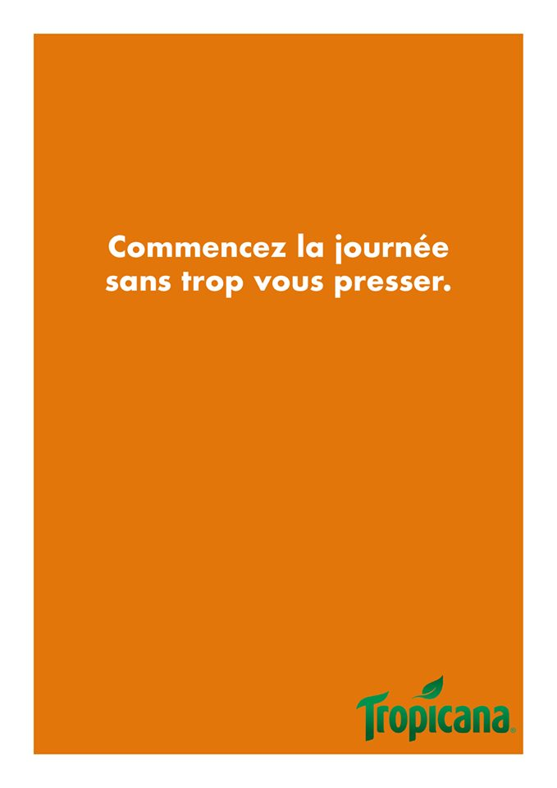
Round 2: An advertising slogan
Notes:
Ask students:
what would you say were the biggest challenges in translating this sentence?
Which of the three criteria are most relevant to this text?
Round 3 sample response: Start each day without feeling the squeeze!
Creativity criteria --
This is one where there is REALLY no one right answer, only whatever creativity inspires the reader
Creative wordplay like in this advertising slogan are very difficult to translate, and sometimes requires what’s called “transcreation,” meaning the translator will invent an original wordplay that doesn’t literally the content of the original text, and basically only translates the intent of promoting a product with clever wordplay.
The ideas behind Tropicana as a breakfast drink, a great way to start the morning, and freshly squeezed are communicated using different words in French and English, but the message comes across equally effective. Oranges are never explicitly mentioned but rather communicated subtly with the simple, orange-coloured background.
This translation shows the importance of intercultural skills (does Tropicana sell freshly squeezed orange juice in the other culture? Maybe they only sell freshly squeezed Lemonade in the other culture and therefore the background colour might have to be yellow. Does your target audience drink orange juice for breakfast? If not, you might have to find a creative solution to encourage them to drink it some other time); language skills to be able to pick up on the subtle message and be able to find a clever wordplay in the new language; interpersonal skills (you’ll always communicate with others around any given translation project. As one example in this case you may have to work with graphic designers to modify the background colour if only Lemonade is sold in the target locale in order for the advertisement to have the same impact, etc).

Slide 29
Time to Vote!
What did you like more or less about each translation?
Which one in Round 1 and Round 2 was the most
accurate, readable and creative?
Vote on Menti !
Notes:
The faciliator or moderator will either show the Menti slides where the students put their translated reponses or put the student translations in the chat with the Group # so students can reference the translations easily and vote for the group whose translation they liked the best.

Slide 30
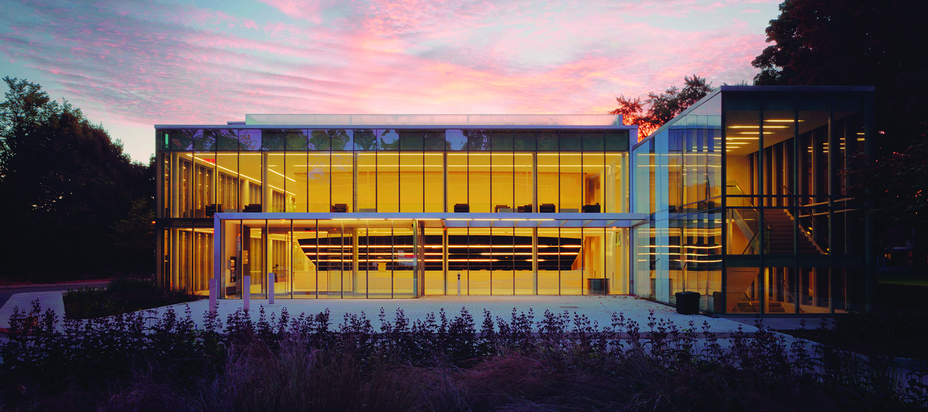
SURVEY, FINAL THOUGHTS & THANK YOU
QUESTIONS ?
destination@glendon.yorku.ca
www.glendon.yorku.ca/destinationreussite

Slide 31
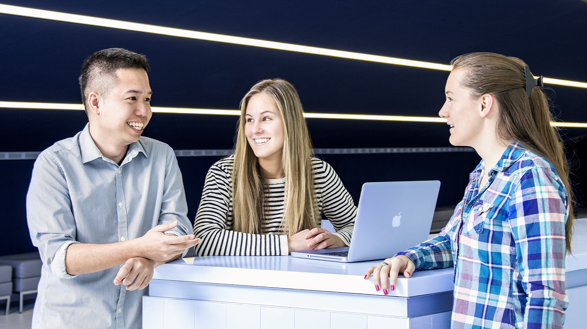
THANK YOU!

