Slide 1

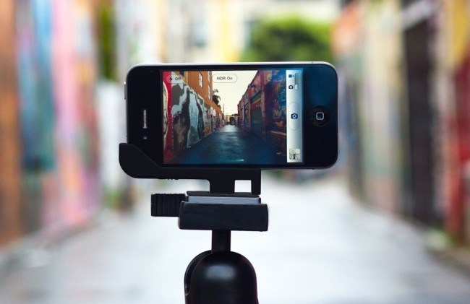


Smartphone Accommodation Resource Toolbox
Why use video in teaching and learning?
Do you use videos for teaching and learning?
Do you create your own videos for instructional purposes
(or for fun)?
How do you use video pedagogically in your discipline?
Do you use videos to model practical skills learning or embodied performance?
What are the barriers for using video?

Slide 2

Smartphone Accommodation Resource Toolbox
Presentation Overview
1. Why SmART? From accommodation to interdisciplinary resource.
2. What is SmART: Connecting experiential learning with e-learning.
3. How SmART Works -Students; Instructors; TAs; Course Developers
…take the SmART tour
4. Looking back and looking forward: the future of SmART as a community of practice.
5. Open for discussion: What would you want to see in SmART?

Slide 3
Smartphone Accommodation Resource Toolbox
SmART Story
From accommodation to interdisciplinary resource.
Notes:
SmART is an online platform developed to support innovative teaching and (e)learning through the use of smartphone video production and interactive feedback tools. Originally created as an accommodation resources for students with performance anxiety, SmART is now emerging as multidisciplinary platform that provides guidance for using video in courses where hands-on knowledge and the simulation/modelling of practical skills are elemental to course aims (e.g., in nursing, art/dance, engineering – or any disciplinary context where students are learning through situated and embodied practice, including simulation). SmART provides resources for video making ‘best practices’ (as well as guidelines for ethics, privacy, and data security) and a suite of tutorials for course instructors to learn the art of providing interactive audio/video feedback using a variety of software tools, as well as modules that show students how to create low-cost ‘task trainers’ (DIY props and manikins) for videos that require simulation and modelling (e.g., in health sciences, nursing, and engineering). This project was informed by our own research study, and a subsequent article based on this study, ‘Using smartphone video to teach and learn a practice-based skill: A scoping review’ (second author), is currently under review at The Canadian Journal for the Scholarship of Teaching and Learning).

Slide 4
Smartphone Accommodation Resource Toolbox
Notes:
SmART is an online platform developed to support innovative teaching and (e)learning through the use of smartphone video production and interactive feedback tools. Originally created as an accommodation resources for students with performance anxiety, SmART is now emerging as multidisciplinary platform that provides guidance for using video in courses where hands-on knowledge and the simulation/modelling of practical skills are elemental to course aims (e.g., in nursing, art/dance, engineering – or any disciplinary context where students are learning through situated and embodied practice, including simulation). SmART provides resources for video making ‘best practices’ (as well as guidelines for ethics, privacy, and data security) and a suite of tutorials for course instructors to learn the art of providing interactive audio/video feedback using a variety of software tools, as well as modules that show students how to create low-cost ‘task trainers’ (DIY props and manikins) for videos that require simulation and modelling (e.g., in health sciences, nursing, and engineering). This project was informed by our own research study, and a subsequent article based on this study, ‘Using smartphone video to teach and learn a practice-based skill: A scoping review’ (second author), is currently under review at The Canadian Journal for the Scholarship of Teaching and Learning).

Slide 5
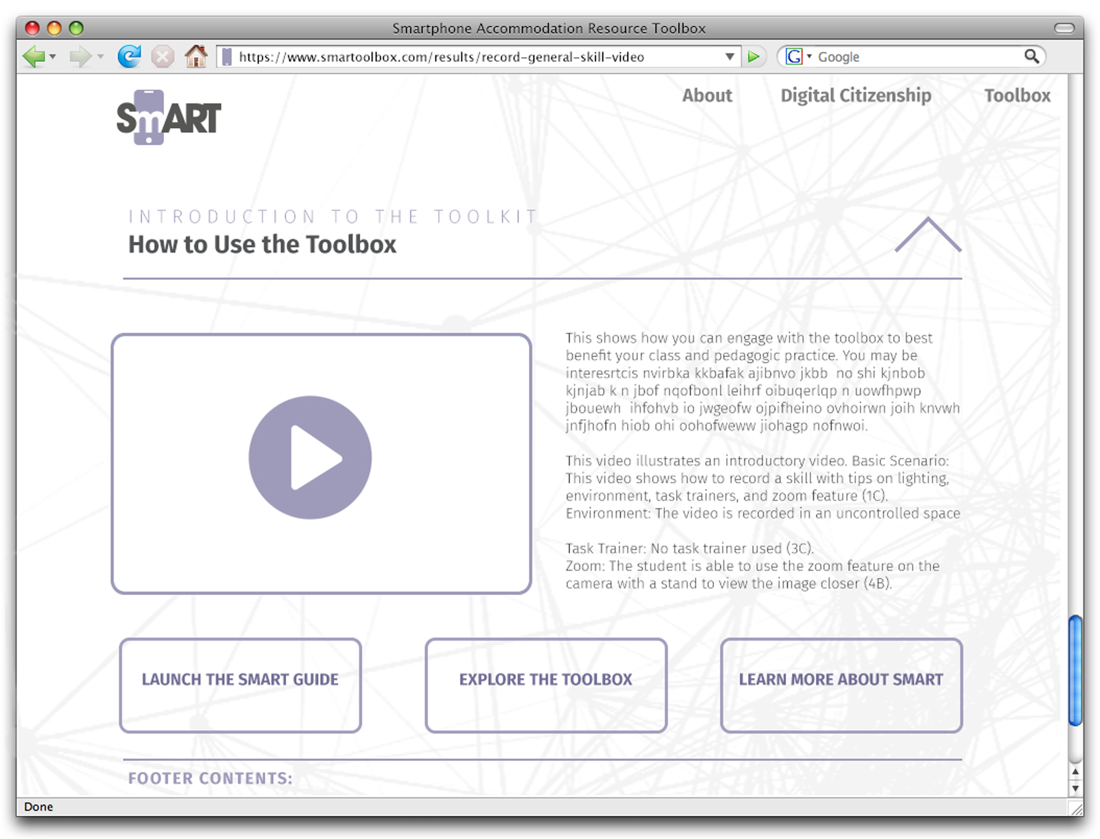
Smartphone Accommodation Resource Toolbox
Landing Page

Slide 6
Smartphone Accommodation Resource Toolbox
Landing Page
Introductory Video
welcome / overview
SmART Guide
Interactive Support Tool

Slide 7
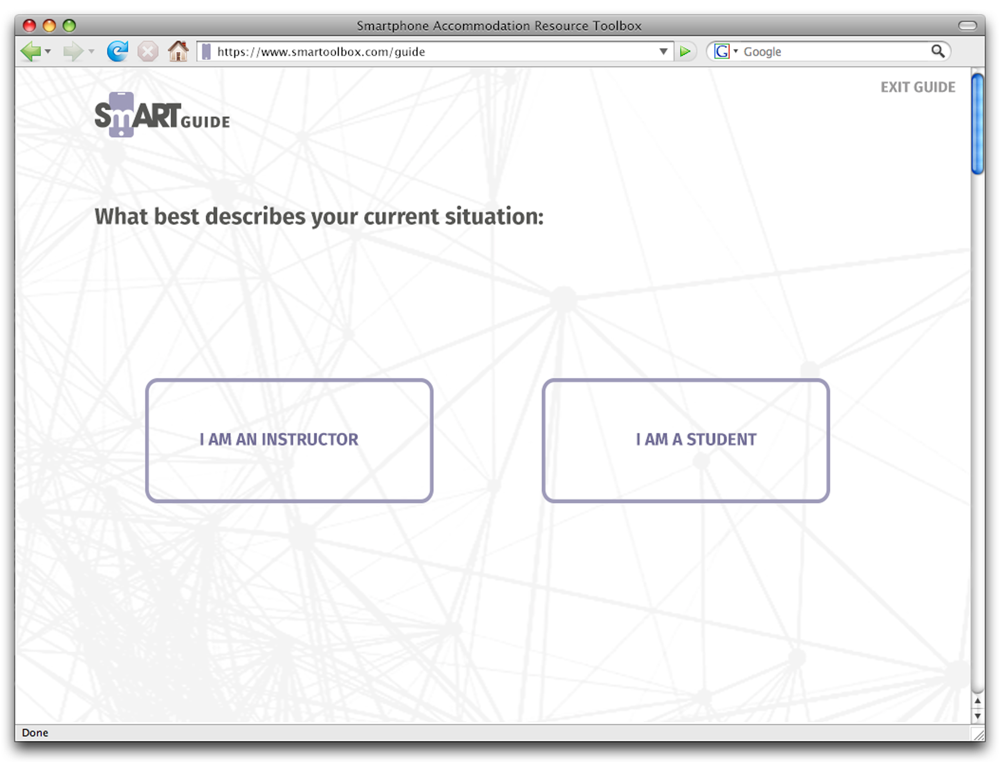
Smartphone Accommodation Resource Toolbox
SmART Guide
Interactive Support Tool
Intake Form
Generates a Curated Playlist of Videos
and Supporting Resources

Slide 8
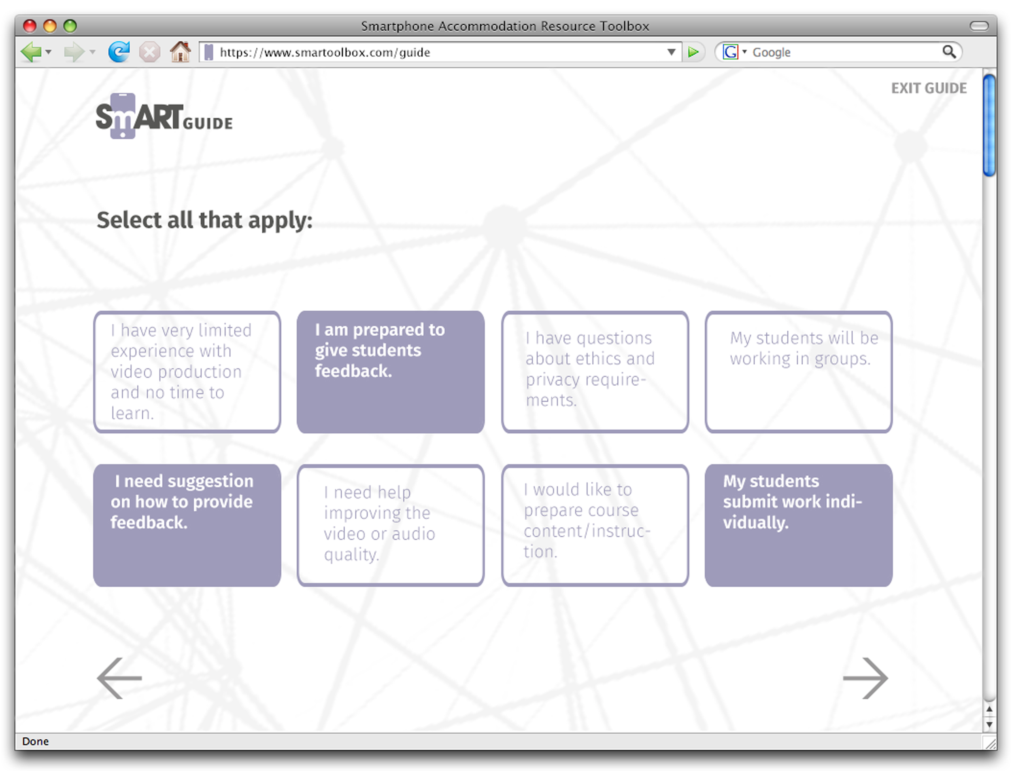
Smartphone Accommodation Resource Toolbox
SmART Guide
Interactive Support Tool
Intake Form
based on ‘persona’ e.g. student,

Slide 9
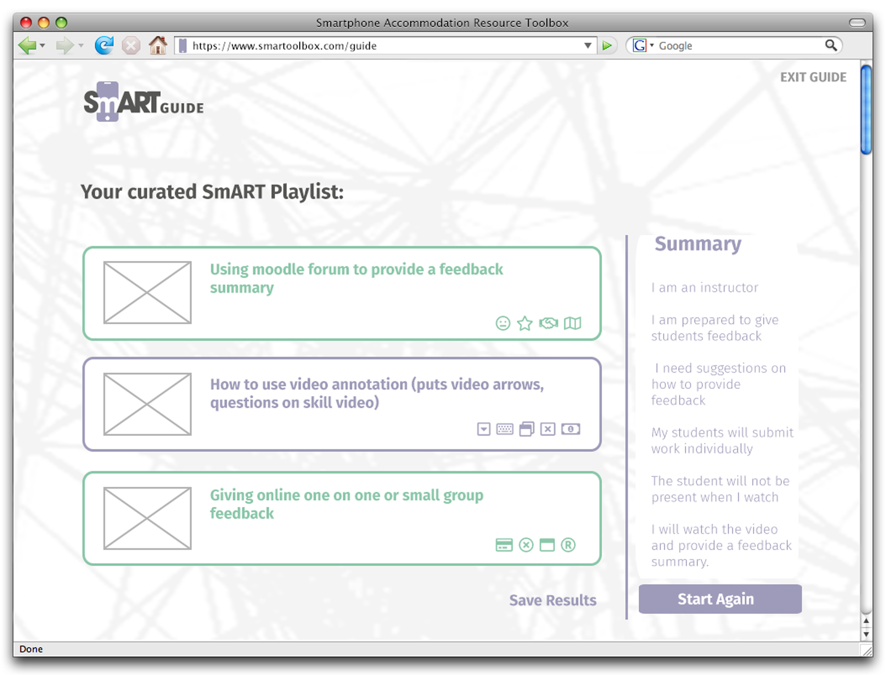
Smartphone Accommodation Resource Toolbox
SmART Guide
Interactive Support Tool
Generates a Curated Playlist
based on ‘persona’ e.g. student,
instructor, TA, or course designer;
specific user or course needs; class
& genre of video (documenting a
practical skill, narrative, feedback),
comfort with technology & software;
Support for creating props (simulation
‘task trainers’,) etc.

Slide 10
Smartphone Accommodation Resource Toolbox
Landing Page
Introductory Video
welcome / overview
SmART Guide
Interactive Support Tool
Explore…
Find Your Own Resources

Slide 11
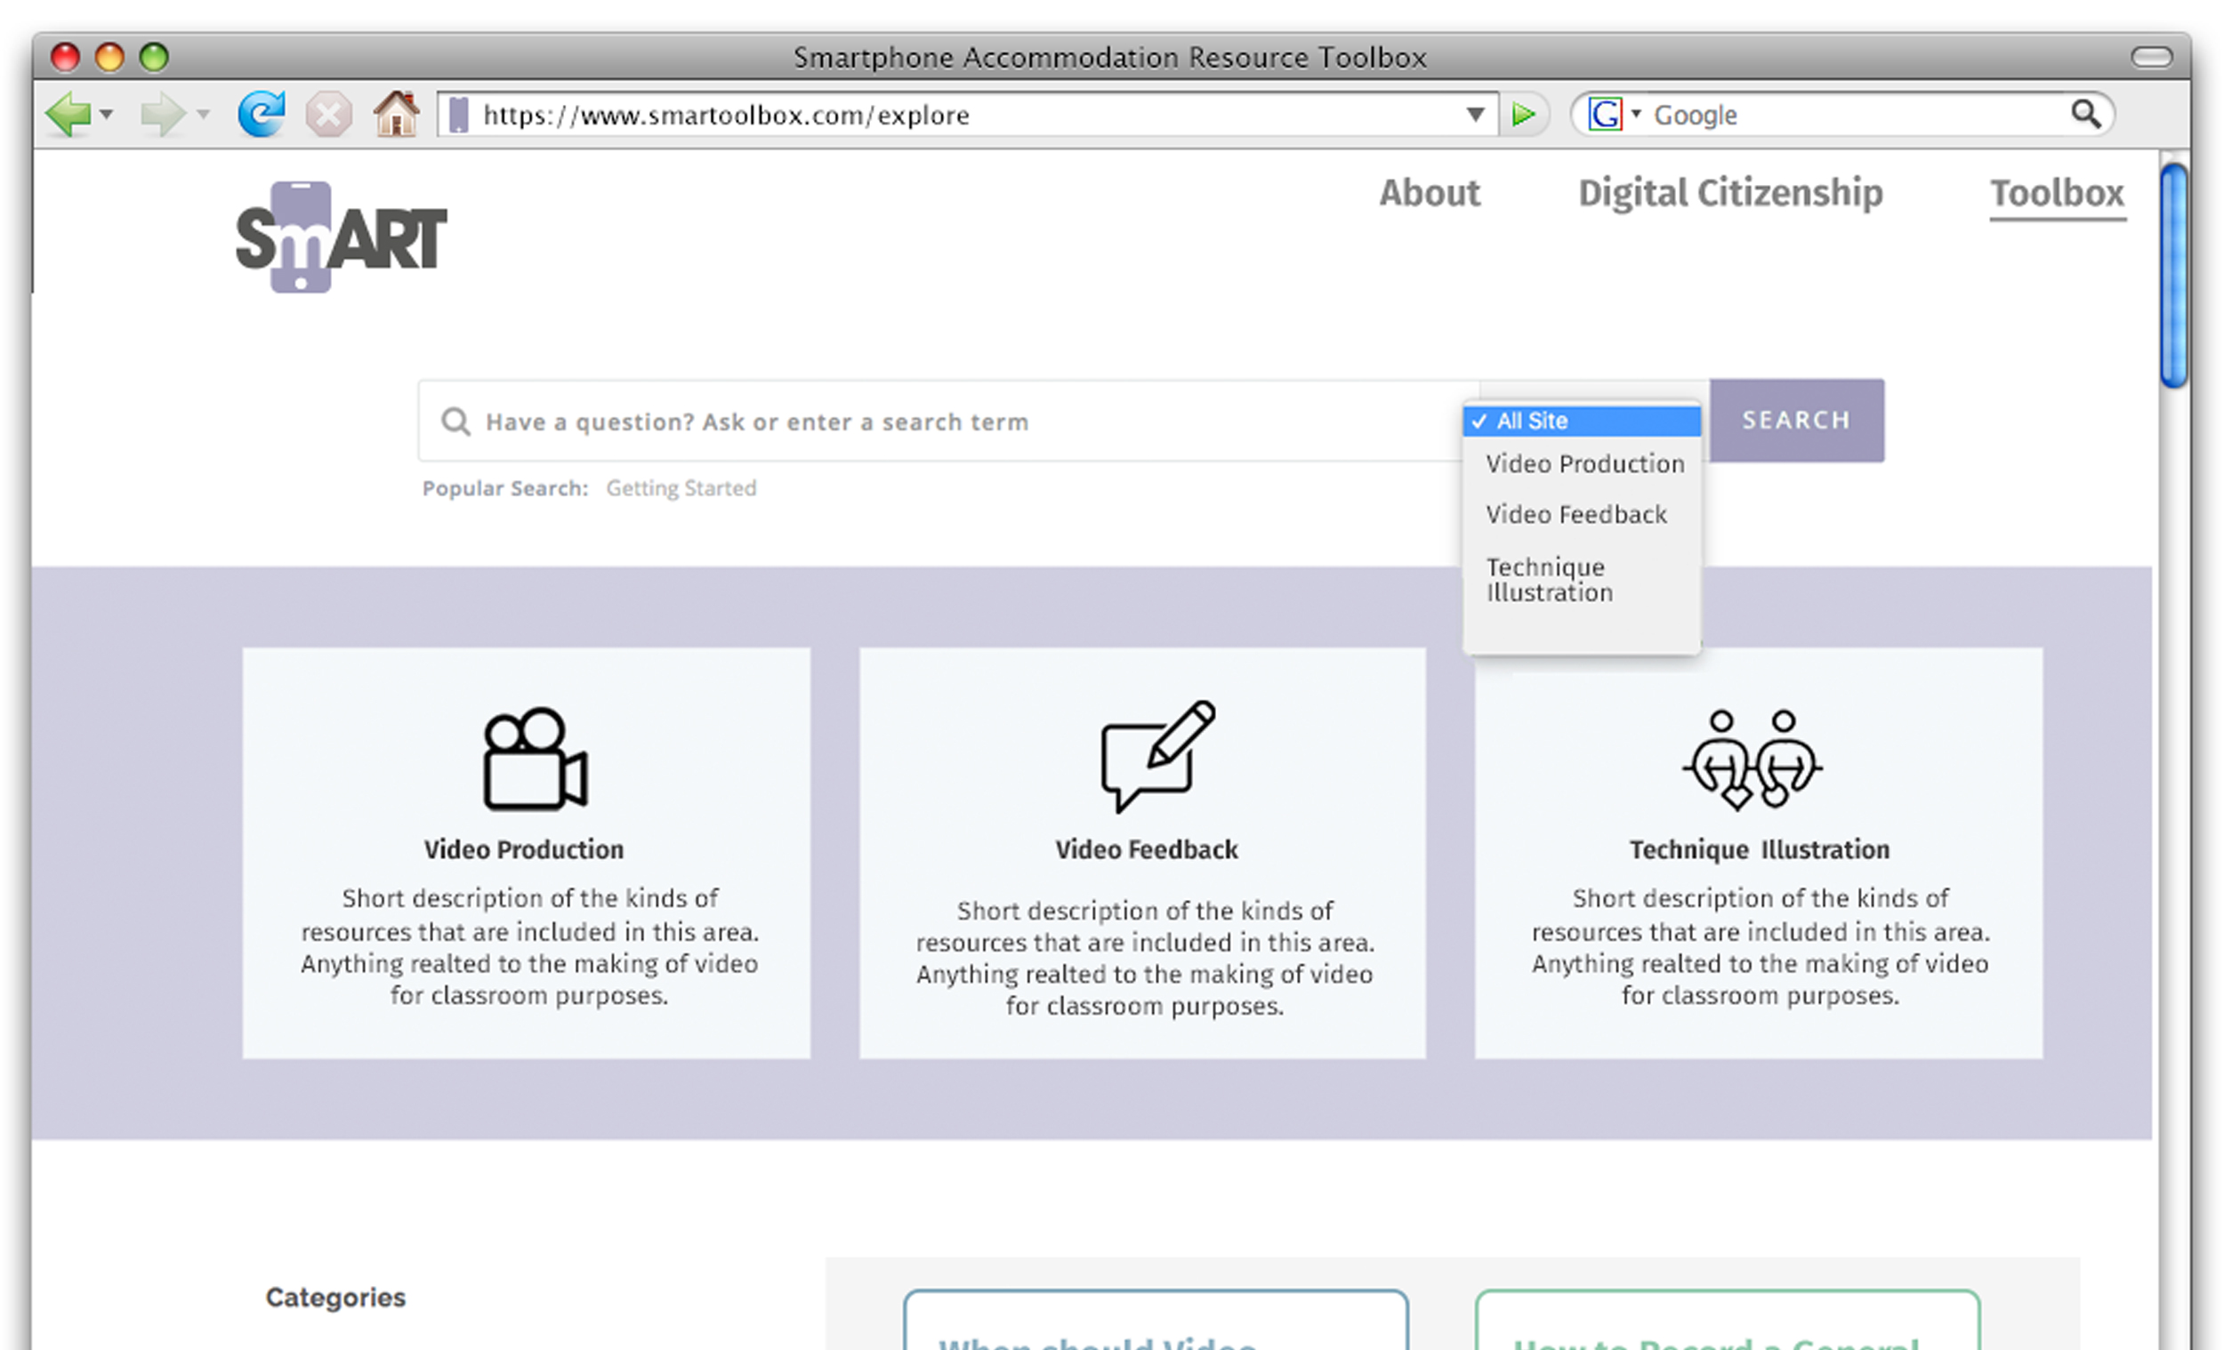
Smartphone Accommodation Resource Toolbox
Ethics ‘Best Practices’
Privacy / Data Security
Media Release Forms
Copyright Guidelines
Accessible on every page with
‘decision tree'
Video Production

Slide 12
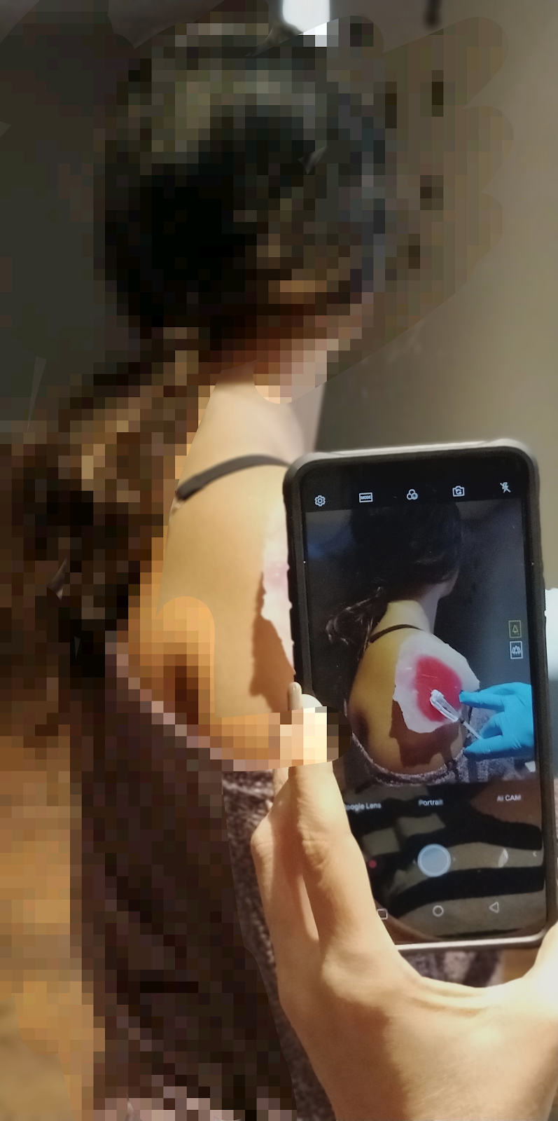
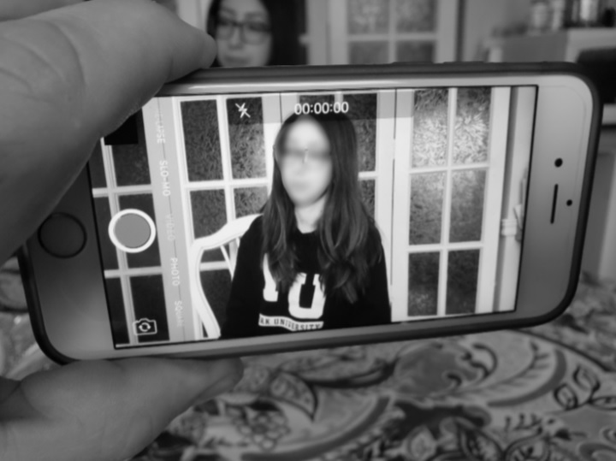
Smartphone Accommodation Resource Toolbox
Video making Ethics Best Practices
e.g., what is 'identifying information'?

Slide 13
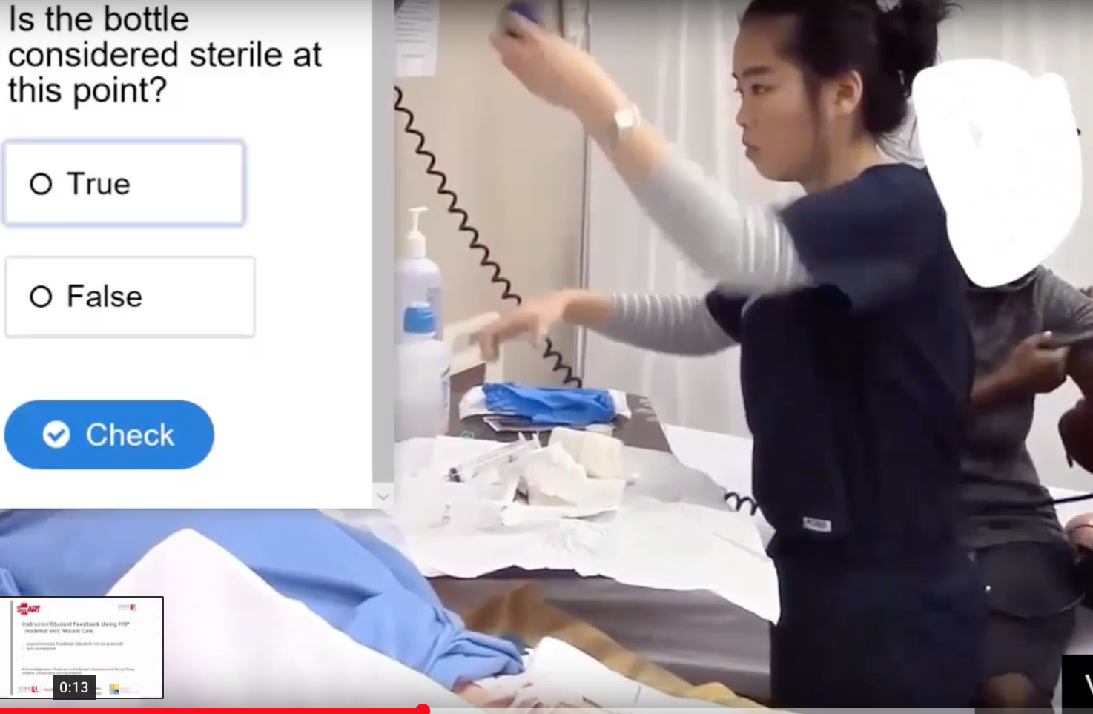
Smartphone Accommodation Resource Toolbox
Video making ethics best practices
e.g., what is 'identifying information'?

Slide 14
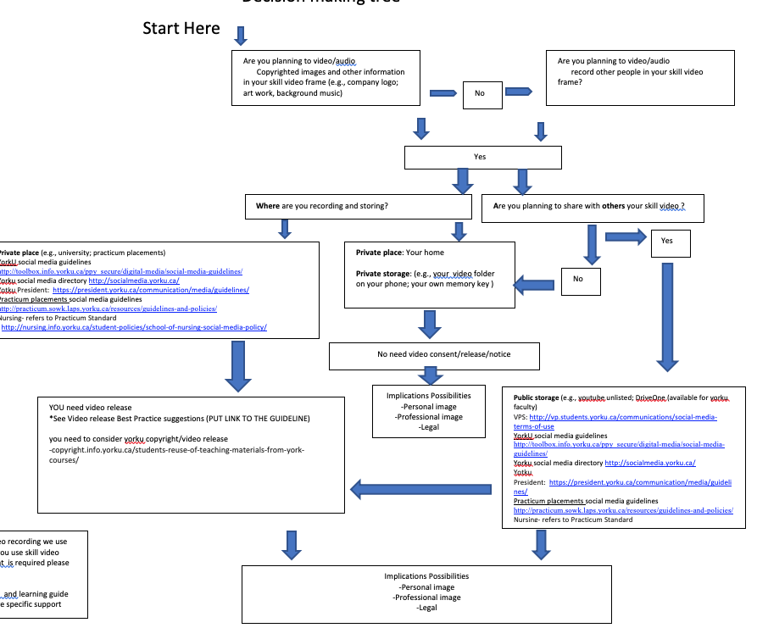
Smartphone Accommodation Resource Toolbox
Video making ethics best practices
When you need media release: A decision making tree

Slide 15
Smartphone Accommodation Resource Toolbox
Techniques Illustration:
-Samples Syllabi (Models Pedagogical
uses and ‘Best Practices’; assessment)
-Video making tips/tricks
‘How to’ Info-graphics
-Task Trainers (Simulation)- How to
create yourself cost effective models
to teach and learn skills
-Scenarios: diverse pedagogical
scenarios and case studies for usig
SmART in and outside classroom

Slide 16
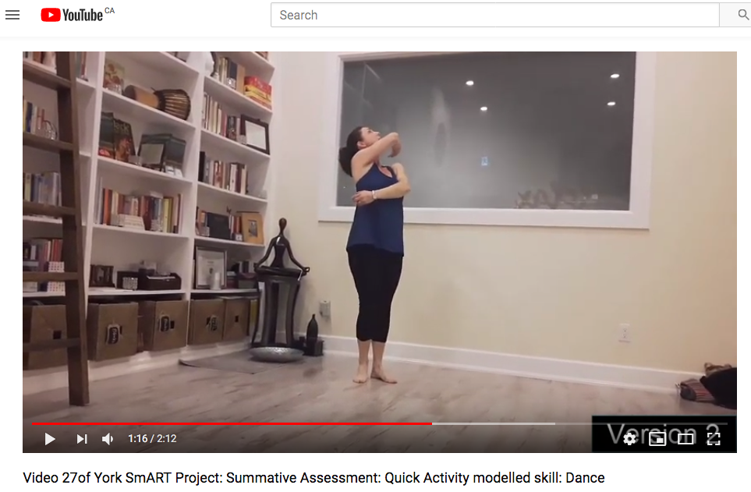
Smartphone Accommodation Resource Toolbox
Technique illustration: Scenario 1
** A single / target dose of video **
A modeling studio-based activity: Dance Performance Video
Show video: https://youtu.be/oSuMWRMFLAI

Slide 17
Smartphone Accommodation Resource Toolbox
Video Feedback

Slide 18
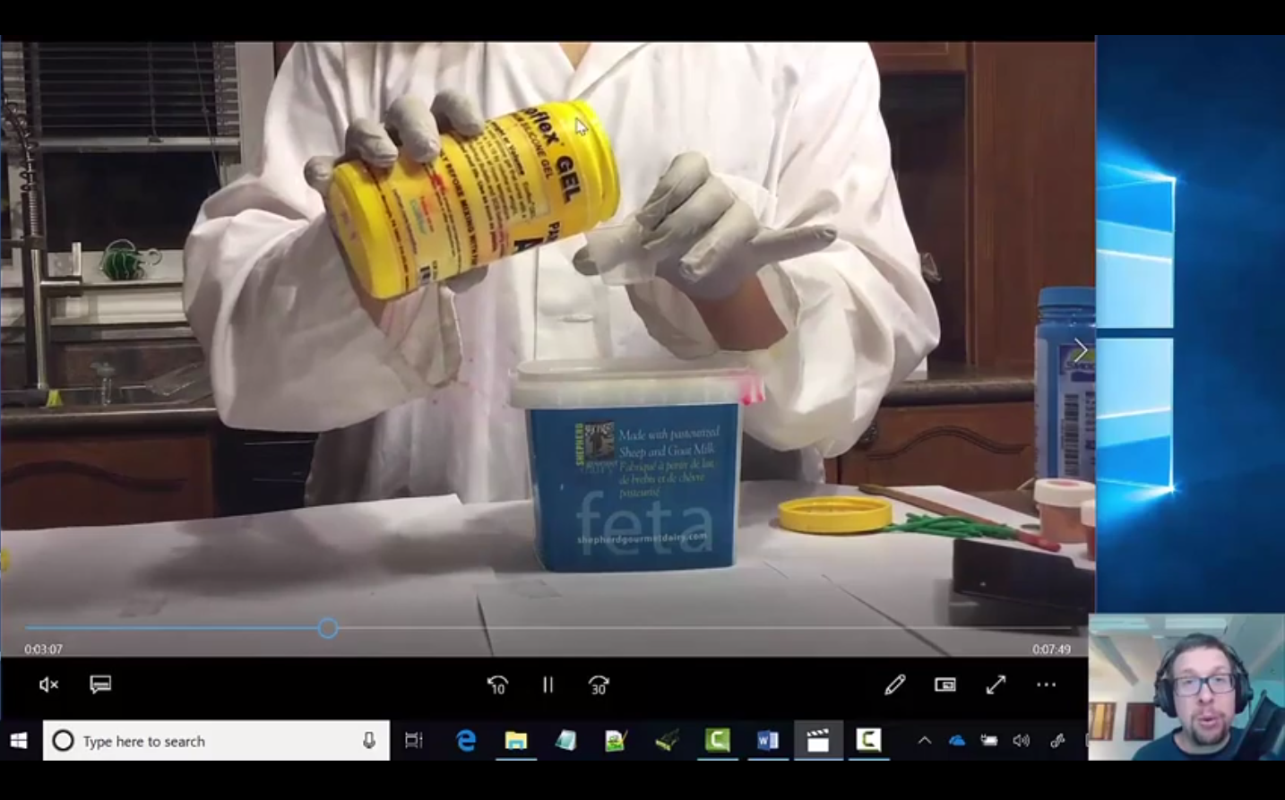
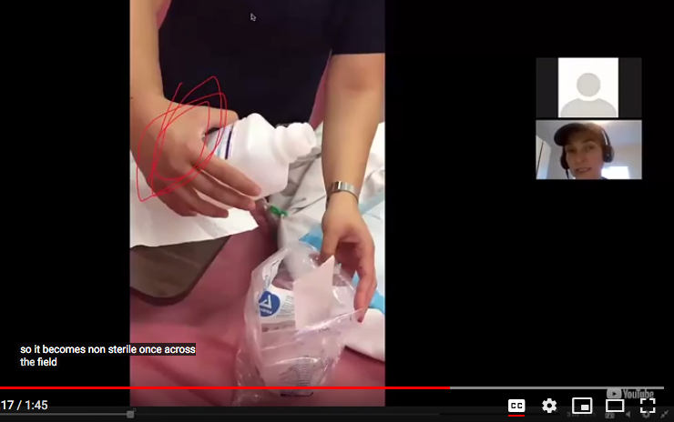
Smartphone Accommodation Resource Toolbox
Interactive Video Feedback
***Hands up ***– Engineering example : Making a model (task trainer) to practice skills
https://www.youtube.com/watch?v=UJnSpsNF4QE&feature=youtu.be
***Hands up ***– Nursing example: Opening a sterile filed (show 1:14 min)
https://www.youtube.com/watch?v=fdJeJxj3DUc&index=13&list=PLxSQe9Xw7Ze1GXfygV8xi3dX4XS1tBwhR

Slide 19
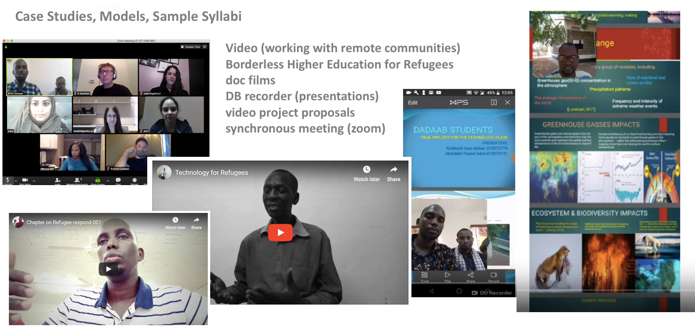
Smartphone Accommodation Resource Toolbox

Slide 20
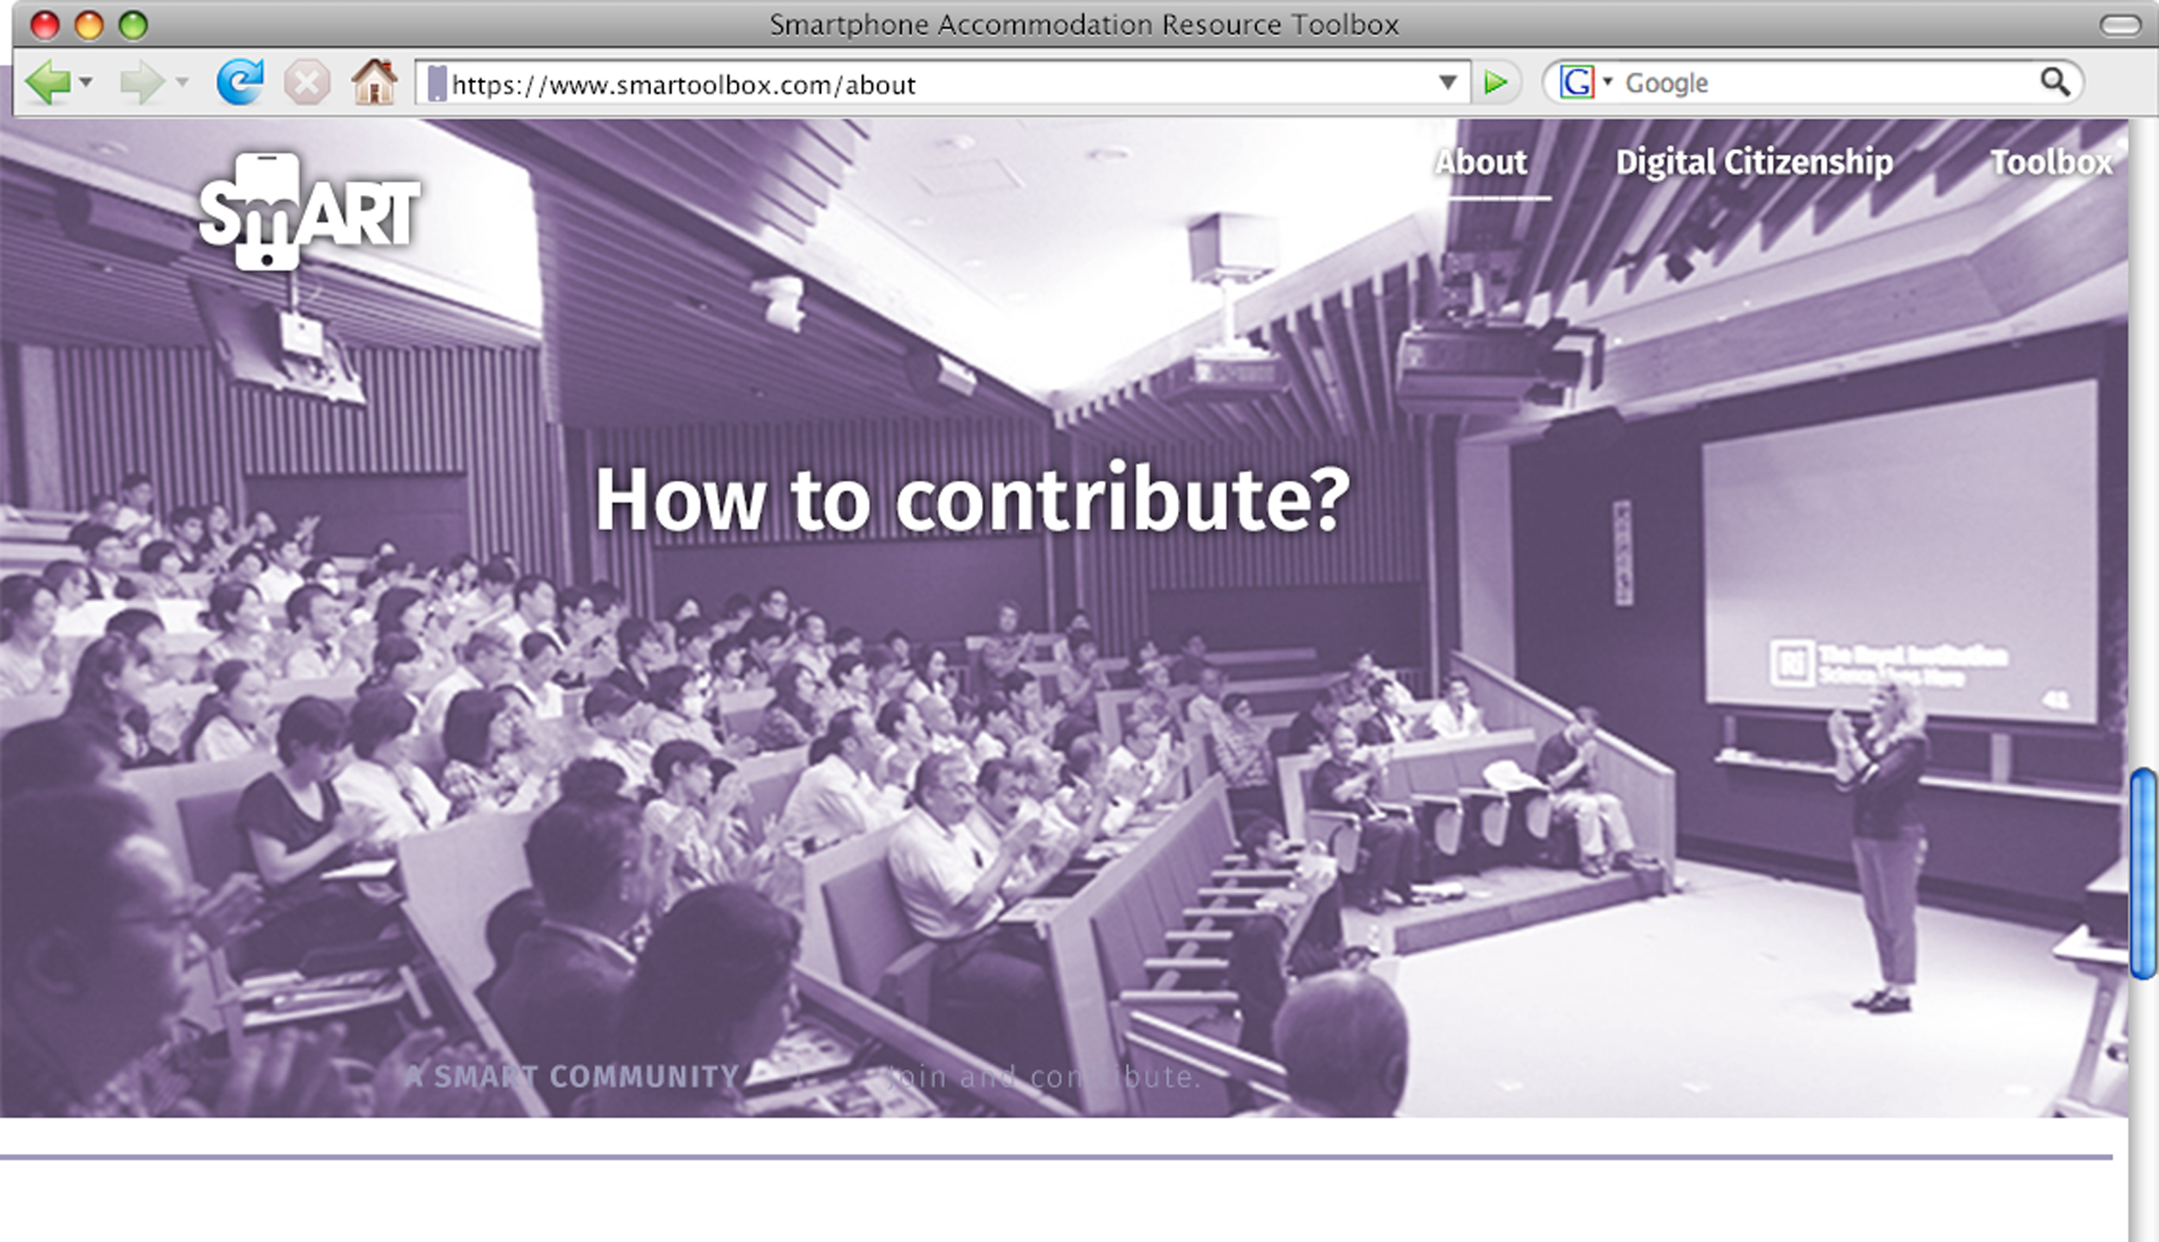
Smartphone Accommodation Resource Toolbox
Connecting e-Learning with Experiential Learning
Creating a ‘Community of Practice’
Video Portfolios, Models, Pedagogies
Adding to SmART :
SmART research opportunities
The need for elearning resources that
support practical ‘hands-on’ skills
learning (through video documentation
and interactive feedback).
Simulation, embodied performance, professional practice-based skills,
studio-based modelling & documentation of situated techniques and/or creative processes.

Slide 21
Smartphone Accommodation Resource Toolbox
Your Turn….
What would you like to see in SmART?
What would you need or want from a resource like this?
How can SmART address your needs (in your discipline)?
What do you do now that might contribute to SmART? Suggestions for us!

Slide 22
Smartphone Accommodation Resource Toolbox
This project is Funded by AIF (Academic Innovation Fund)York University 2018-20
Cross-Disciplinary Team
Lead: Iris Epstein; RN; PhD Faculty of Health, School of Nursing
Co-Lead: Kurt Thumlert; PhD Faculty of Education (IRDL)
Melanie Baljko PhD Lassonde School of Engineering
Collaborators: James Andrew Smith PhD, Lassonde School of Engineering
Yelin Yu, Teaching Common
Natasha May, Teaching Common
Mavoy Bertram, Nurse Practitioner, School of Nursing
Elisheva LightStone, Registered Nurse (RN); MN Seneca College
Danielle Robinson PhD, AMP-D
Post Doc (Year 1 - 2018) – Evadne Kelly AMP-D
Acknowledgement: We would like to thank the students and faculty for their contribution and support (Melika Shadman (Eng); Lorivie Balaqui (Nrsg); Kai ya Chang (Nrsg); Brenna Johnson (Nrsg); Virginia Larrain (Nrsg); Jade Nguyen (nrsg); Alex Golan (Nrsg); Laura Nicholson (Nrsg); Marija Bal (Nrsg); Melanie Dauncey (Nrsg), Deanna Barlette (nrsg); Lisa Sandlos(dance); Jennifer Bolt (Dance)……

