Slide 1
The Churchill Community of Knowledge
An open Access Digital Archive
Netta Untershats
Jeevika Sivakumaran

Slide 2
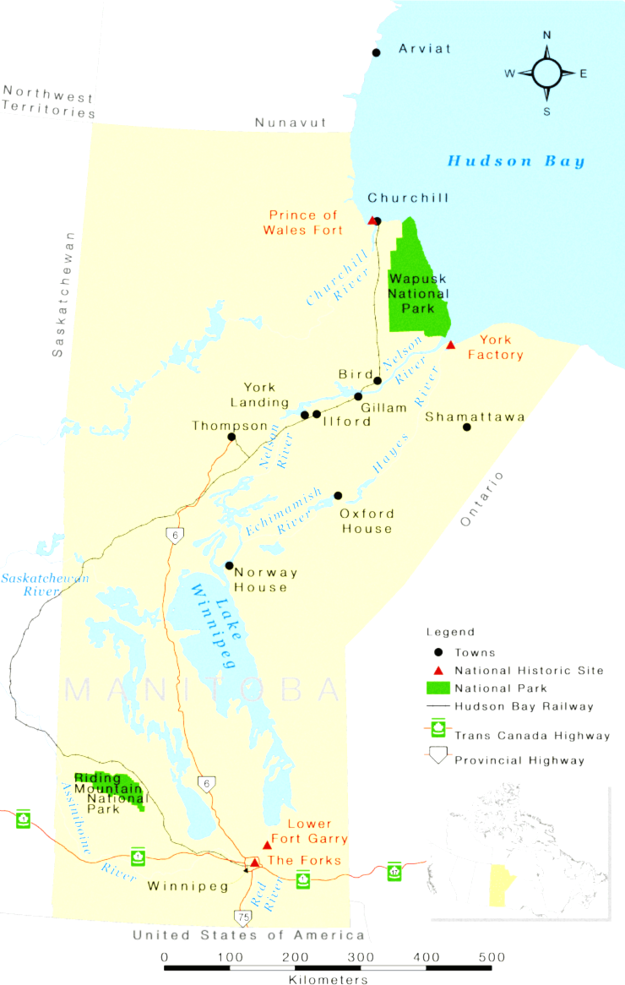
outline
CREATING THE DIGITAL ARCHIVE
YORK UNIVERSITY’S INSITUTIONAL REPOSITORY
THE CHURCHILL COMMUNITY OF KNOWLEDGE
JEEVIKA’S RESEARCH PROJECT
Notes:
A digital archive was created to commemorate the life and legacy of Dr. R. L. Jefferies. This project grew into the Churchill Community of Knowledge, in partnership with the Churchill Northern Studies Centre (CNSC) to preserve the research of the area.
These archives are housed on York University’s institutional repository, Yorkspace.

Slide 3
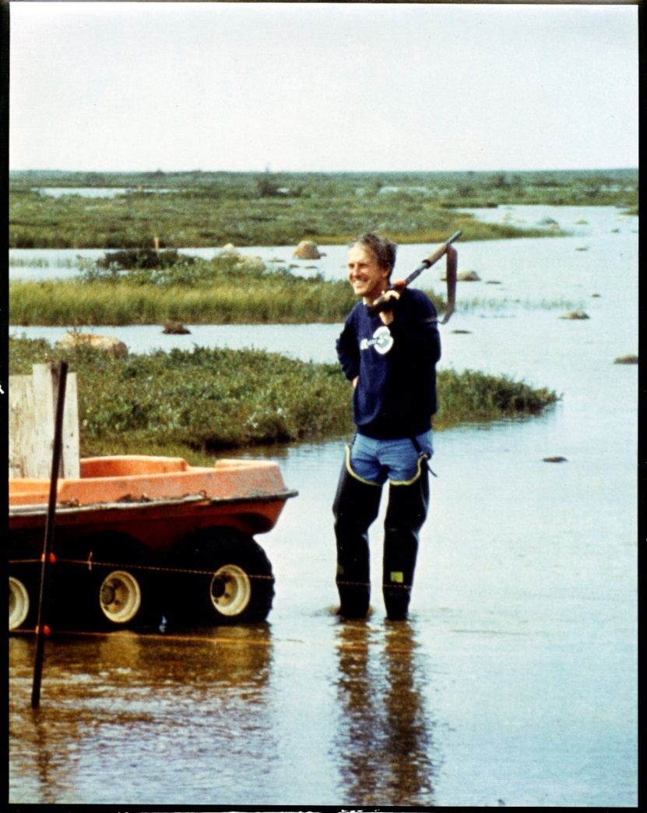
Creating the Digital Archive
An archive commemorating
the life and research legacy of Prof. Robert L. Jefferies in and around Churchill
grew into the Churchill Community of Knowledge digital archive
Jefferies did research from 1978-2009 on plant-herbivore interactions on Hudson Bay salt-marshes
Notes:
A digital archive was created to commemorate the life and legacy of Dr. R. L. Jefferies. This project grew into the Churchill Community of Knowledge, in partnership with the Churchill Northern Studies Centre (CNSC) to preserve the research of the area.
These archives are housed on York University’s institutional repository, Yorkspace.

Slide 4
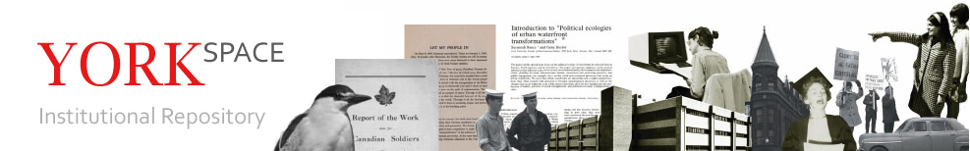
York University’s OPEN ACCESS Institutional Repository
Institutional Repository
  Self-archived digital media in academic libraries
  Permanent, stable urls
  Prioritized & Supported by Google searches
Open Access
  No pay-wall: accessible free-of-charge, and free of most copyright and licensing restrictions
  Creative Commons Licenses most common
Notes:
These collections are housed in Yorkspace, York University’s institutional repository

Slide 5
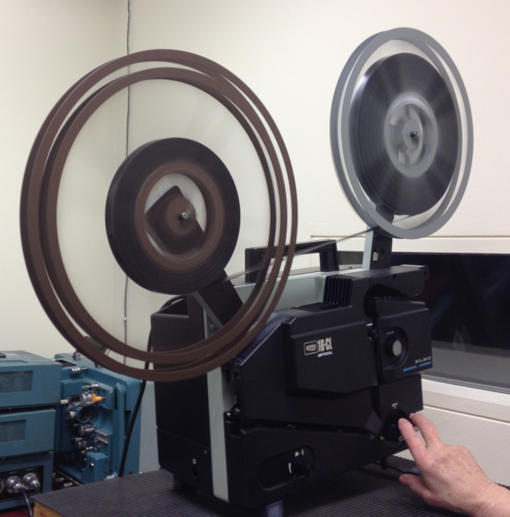
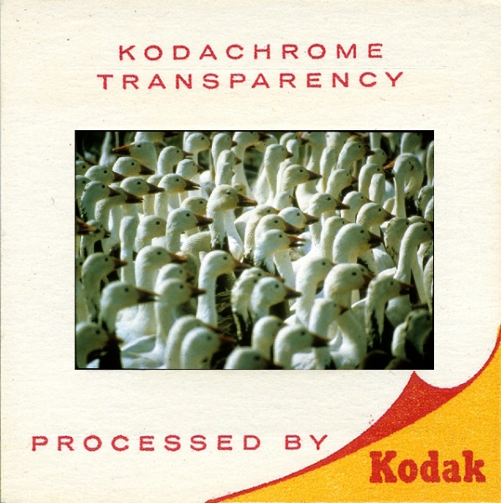
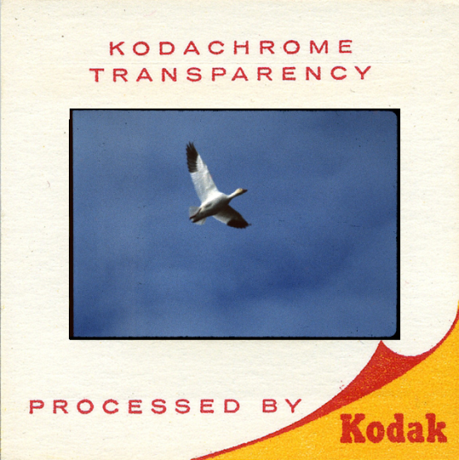
HISTORICAL ARTEFACTS
Digitizing media allowed preservation of data from as early as 1967, when this ecological study began

Slide 6
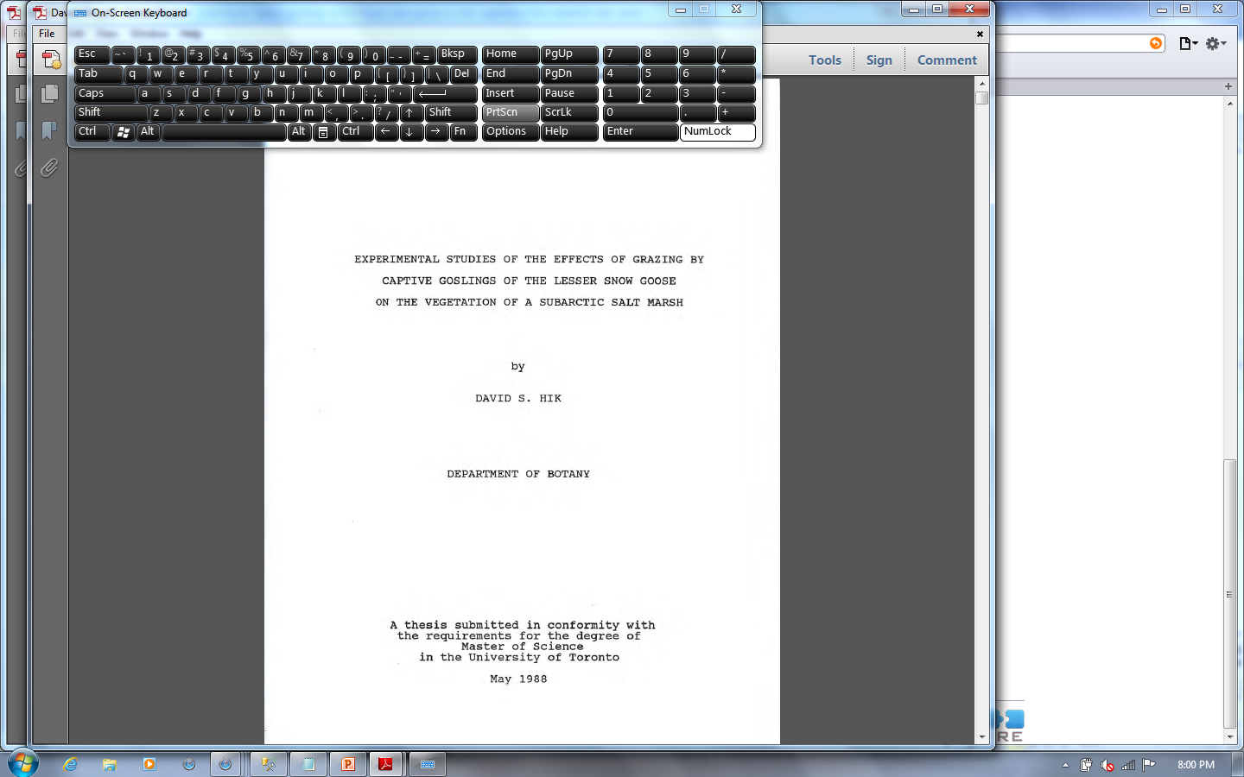
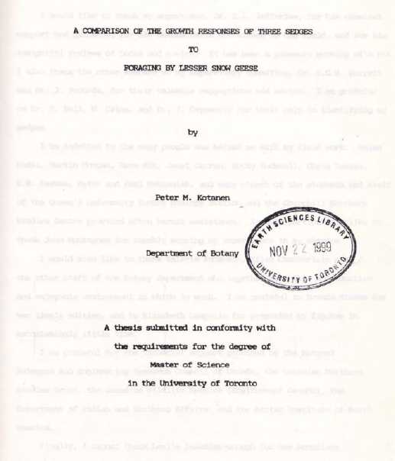
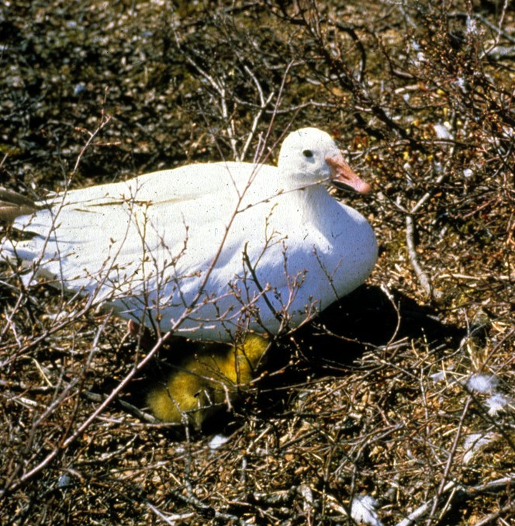
Research
Dozens of Research Articles and Theses from M.Sc. And Ph.D. students
Photo Submitted by Peter Kotanen

Slide 7
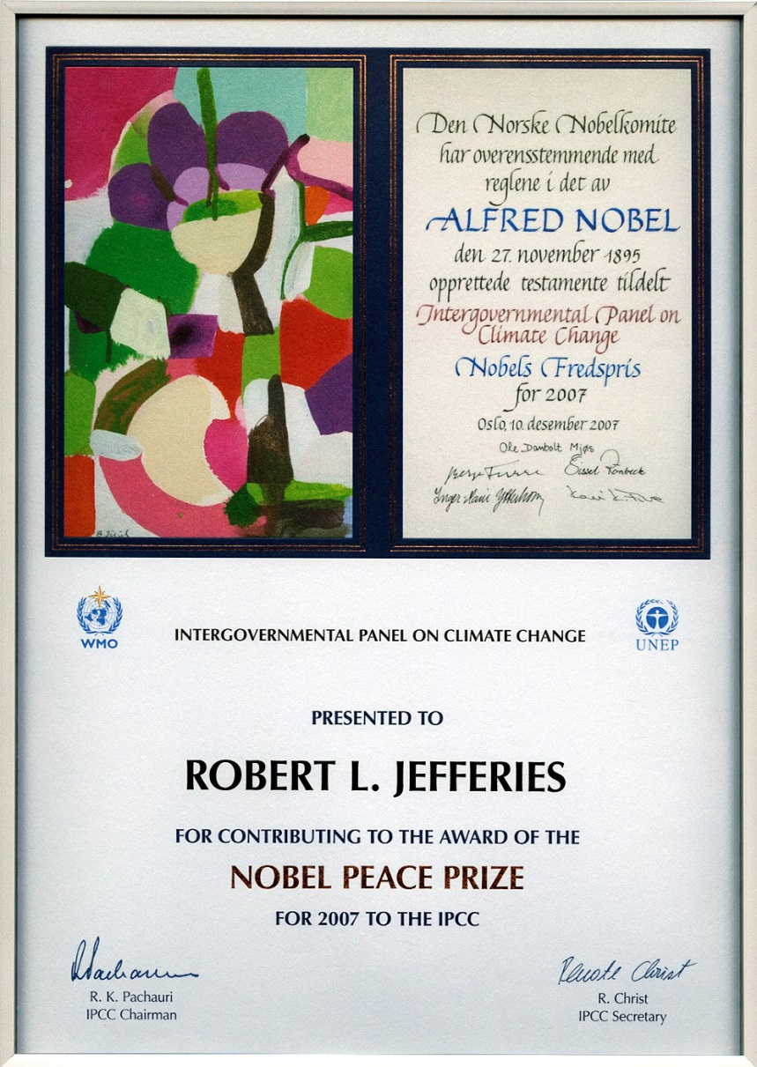
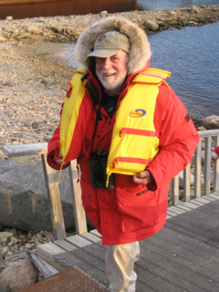
Researcher Spotlights
Media Releases
Awards
Curriculum Vitae
Key Publications
Dr. Fred Cooke
Submitted by Sue Jefferies

Slide 8
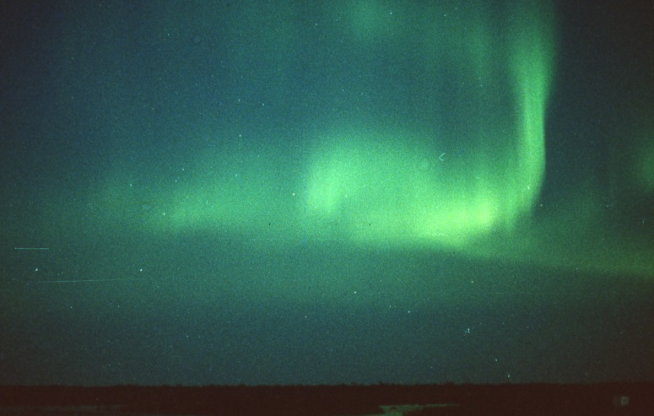
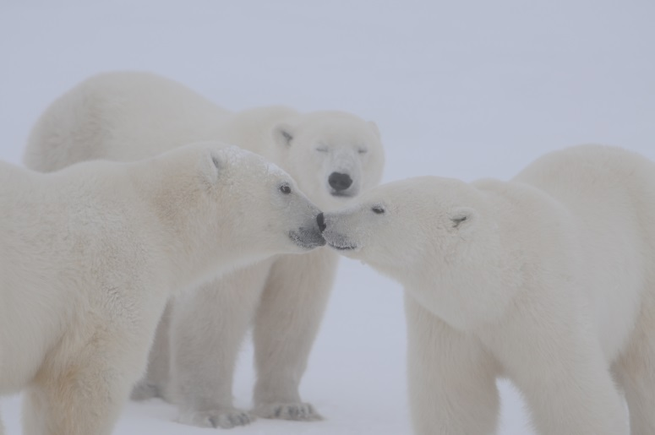
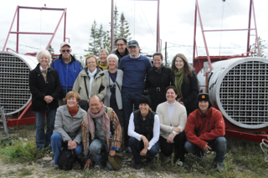
WAPUSK NATIONAL PARK
Churchill & Environs
BOB JEFFERIES SYMPOSIUM

Slide 9
MY RESEARCH PROJECT
Jeevika Sivakumaran
Outline
Fixing metadata
Uploading new items with metadata
Digitizing items for the archive

Slide 10
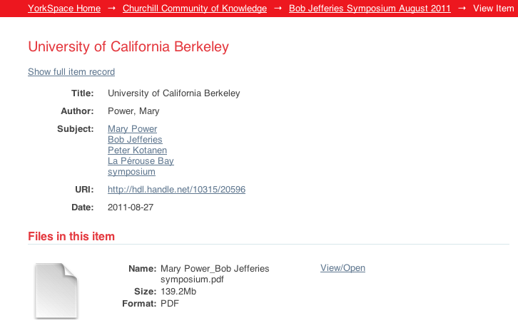
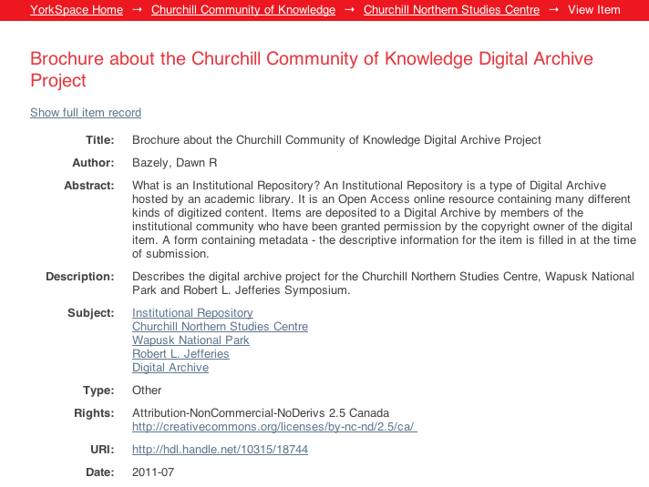
Fixing existing metadata
What are good and bad metadata?
BAD METADATA
GOOD METADATA

Slide 11
UPLOADING NEW ITEMS WITH METADATA
WHAT ITEMS CAN BE SUBMITTED?
Written Material
  Books, Articles, Reports, Notes
Images
  Photographs, Kodachrome slides, Presentations
Video and Recordings
Data
  Digital or Scans of Field Data Books
Items are deposited once proper copyright ownership has been established.
Complete the metadata form and digitize the item, if necessary.
Convert the work to an open format eg.
  MP3
  PDF

Slide 12
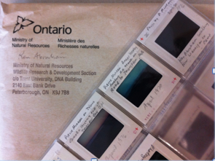
digitizing
Digitizing Kodachrome slides
Purpose is to preserve the Kodachrome images before it chemically degrades
Now we can edit, print and share images!
Notes:
Highly specialized Kodachrome scanner used

Slide 13


