Slide 1
Building Accessibility Infrastructure
Brick by Brick:
Library eResources Accessibility Project (LEAP)
Assessing the Accessible Content Provider Landscape in North America
Tuesday January 29th 2019 1:15 P.M. - 2:30 P.M.
York University, Harry Crowe Room

Slide 2
Library eResources
Accessibility Project (LEAP)
Siobán Linnen - Virtual Reference and Accessibility
Ontario Colleges Library Service
Corinne Abba (pronouns: she/her) - AODA Coordinator
GBC Diversity, Equity, and Human Rights Services
This presentation is available in alternative formats upon request.
Notes:
CORINNE: Hello everyone, thank you for joining us today. My name is Corinne, and together with my colleague, Sioban, we would like to share with you our work on LEAP, the Library eResources Accessibility Project, an initiative that seeks accessible solutions for library eresources.

Slide 3
Accessible Events
Please help us ensure that this event is accessible to you with regards to:
Environment
Comfort
Interactions
Expectations
Presentation Format
Notes:
CORINNE: First things first, we want to ensure that this session is accessible to you
Is everyone comfortable in this space?
Today our session will involve two panel presentations followed by a group discussion
Throughout we endeavour to be inclusive of the full range of diversity with respect to ability, language, culture, gender, age and other forms of human difference.
We thank our conference organizers and our live captioners for contributing to the accessibility of this session.
This powerpoint presentation is available in alternate formats upon request.
If you experience any barriers to access please let us know - thank you.

Slide 4
Agenda: Brick by Brick
Context: Where We Are Coming From
Vision: What We Are Building
Opportunities: Where We Are Going and How We Can Collaborate
Notes:
CORINNE:
Today, Sioban and I would like to start by providing some context for LEAP, where we are coming from, with some rationale for this work.
We would also like to establish our vision and describe what we are building to meet and exceed accessibility requirements for library databases.
And finally we would like to discuss where we are going, next steps in the project and how we can collaborate with you and our wider community, going forward.

Slide 5

Meet Jey
Jey is a third year business student who uses screen reader software. Jey needs to find articles using the library databases to complete their assignment.
Notes:
CORINNE
The first step though, is to identify the gaps or barriers in our library service.
Meet Jey. Jey is a third year business student who uses screen reader software. Jey needs to do a basic keyword search to find articles using the library’s main interface.
Have you ever experienced a database results page using screen reader software? We will try to replicate this experience with an audio clip using JAWS; we have also provided a transcript for those who cannot access the audio.
This might start to give you a sense of the experience, keeping in mind the variability of any user’s experience.
Image: College students in computer lab. Photography. Britannica ImageQuest, Encyclopædia Britannica, 25 May 2016.
quest.eb.com/search/154_2879937/1/154_2879937/cite. Accessed 2 Mar 2017.

Slide 6
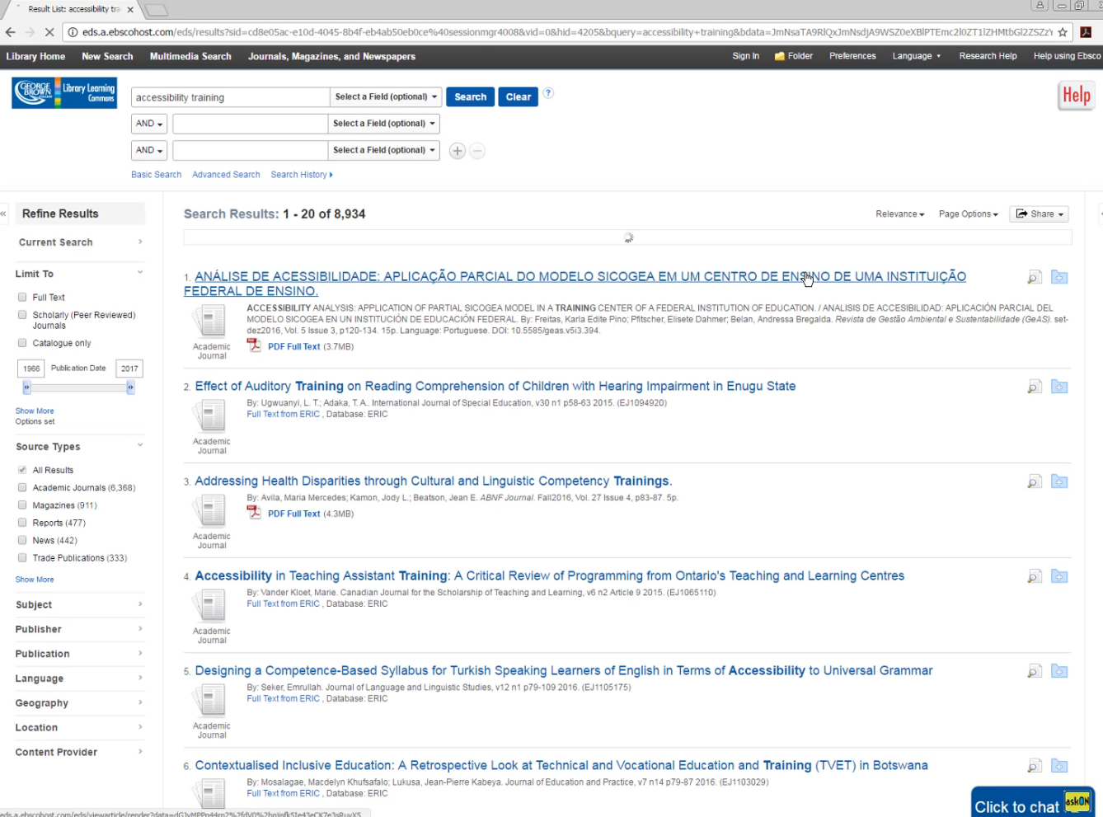
Search Results: Audio Transcript (1/2)
Search button pressed.
Page has 12 regions, 27 headings, and 100 links.
Result list: Accessibility training:
George Brown College Library Learning Commons Navigation Region
Heading Level 2 Folder Access and Help Sign and Menu Folder, Menu Preferences, Menu Language, Menu SubMenu, Research Help Menu, Help using Ebsco, Help using Ebsco.
Menu Heading Level 2, Browse Resources, Toolbar, Library, Home Menu, New Search Menu, Multimedia Search Menu, Journals, Magazines and Newspapers, Menu Navigation Region and Manner Link Accessibility Information and Tips, Revise Date: Zero Seven / 2015
Heading Level 1 Result List: Accessibility Training Search Search Region Graphic Library Logo Search
Notes:
<<PLAY AUDIO CLIP>>
Transcript included on slides 6-7

Slide 7
Search Results: Audio Transcript (2/2)
Heading Level 2 E-B-S-C-O Search List of Three Items Please Enter Search Term, Left Paren, Right Paren. Alt Plus Two Edit As Pop Up Accessibility Training Select a Field, Left Paren, and Optional Right Paren, Button and Button, Please Enter Search Term Left Paren, Right Paren, Edit as Pop Up, Select a Field Left Paren, and Optional Right Paren, and Button, List and Link as Row, Link Remove Row, Search Button, Clear Button, Link Graphic Search Help , Left Paren opens a new Window, Right Paren list of Three Items link basic search, Link Advanced Search, Link Search History, List and Search, Search Region and Link Graphic Library Logo Banner and Name Region List of Three Items Relevance Button Page Options Button Alert, Save and Share Results Region Share, Button Alert, Save and share Results Region and List.
Heading 2 Search Results: 1-20 of 8934 Heading Level Two Results List, List of 20 items, 1. Link ANÁLISE DE ACESSIBILIDADE: APLICAÇÃO PARCIAL DO MODELO SICOGEA EM UM CENTRO DE ENSINO DE UMA INSTITUIÇÃO FEDERAL DE ENSINO. Alt Plus One Online Research Help Dialog This is An Invitation from askON Staff to Chat For Help, Press Escape or Select No Thanks to Dismiss Dialog. Clickable Click Button to Chat, No Thanks Button.
Notes:
CORINNE:
Does this process surprise you? (Mortify you? Horrify you?)
What you just heard or read is all the pieces of information, codings, headings, etc, that is processed through a screen reader. For this example, it takes us two minutes to reach the first article on the list of results (and that first article isn’t even in English, so the patron likely wouldn’t have found it helpful).
It is likely that an adept screen reader user would speed up the speaking voice, use the tab function to skip over those headings and reach the content much faster than us - But the question is, why should they have to? The burden of our inaccessible resources should never fall to our patrons.

Slide 8
The Solution: LEAP
Purpose: to assist Ontario college libraries in ensuring the accessibility of electronic resources, in alignment with the AODA’s 2020 legislative deadline. O. Reg. 191/11, s. 18 (1)/(3).
To understand accessibility features and database limitations
To establish the tools required to mitigate or minimize the impact of these gaps on our patrons
Notes:
CORINNE:
What is the solution to this barrier? We propose LEAP!
The primary purpose of LEAP is to assist Ontario college libraries in ensuring the accessibility of electronic resources by meeting and exceeding the legislative deadline under the AODA in support of accessible electronic resources.
LEAP will help us better understand the accessibility features and limitations of specific databases and will give library staff the tools required to mitigate or minimize that impact on our students.
In the meantime Jey can seek support from library staff to help them navigate the database as needed.
____________________________________________________________________________________________________
NOTES, as needed:
By January 1, 2020 “The libraries of educational or training institutions that are obligated organizations shall provide, procure or acquire by other means an accessible or conversion ready format of [...] digital or multimedia resources or materials for a person with a disability, upon request.”
O. Reg. 191/11, s. 18 (1)/(3).
In broadest terms the AODA’s 2020 deadline for educational libraries can be applied to all digital or multimedia resources and we are obligated to make them accessible, even those we may not control but make available through contractual relationships, including library databases.
But this is all the AODA says on the matter, it doesn’t specify how we should determine whether or not a resource is accessible; it remains up to us to identify gaps and establish solutions.
So, What are the gaps?
What does the AODA say about library resources? By January 1, 2020, the libraries of educational and training institutions “shall provide, procure or acquire by other means an accessible or conversion ready format of digital or multimedia resources or materials for a person with a disability, upon request.”
191/11, s9(2) Information that the obligated organization does not control directly or indirectly through a contractual relationship is excluded from the AODA Information and Communication Standards with the exception of s.15 Educational and Training Resources and Materials AND s.18 Librarians and Educational and Training Institutions.

Slide 9
Vision
Development of a custom tool that the college libraries can use to assess the accessibility of electronic resources that will allow us to collaborate on and share assessments results.
Notes:
SIOBAN:
The vision
In 2015, the college libraries and OCLS undertook an environmental scan to understand accessibility requirements, identify guidelines and best practices, and gain an understanding of what other libraries were doing, both within the college sector in Ontario and beyond.
We didn’t find any existing solutions that would meet our specific needs, and so the recommendation from the environmental scan was to build a custom tool that the colleges could use to assess eresources themselves, and that would allow them to collaborate on and share assessments.
NOTES:
While initial costs, time commitment, and human resources requirements are higher with this option, a custom site will allow us to meet all or most of our tool requirements.
Developing our own tool will also reduce reliance on third party applications which, when pieced together as a makeshift solution, make it less sustainable in the long-term.
A custom tool allows for potential use by wider audiences.
And finally Drupal supports web accessibility standards.

Slide 10
The LEAP Tool
An assessment tool that guides library staff through the process of assessing an electronic resource
  Based on an established set of accessibility criteria
  Embeds instructional content
A repository of completed assessment reports that can be accessed by participating libraries
Notes:
SIOBAN:
What will this tool look like? Our vision was that the tool would have two main components:
The first is a tool that guides library staff step by step through the process of manually assessing an electronic resource. This assessment process will be based on an established set of accessibility criteria to ensure that the results of the assessment are accurate and reliable, and the tool itself will embed instructional content so that library staff, regardless of experience or expertise, can easily complete assessments.
The second component is a repository of assessment reports. As library staff move through the assessment, they will input the results of their assessment into the form, and a score will be tallied automatically by the tool. The results and score of the completed assessment will be captured in a report that will be housed in a repository that can be accessed by library staff from any of the participating libraries.

Slide 11
Criteria Development
GOAL: ONE LIST OF CORE CRITERIA
Gathered and assessed criteria from existing standards
Researched and discussed accessibility needs
Identified priority criteria for inclusion; finalized list
Sorted into main categories: interface appearance, navigation, structure and content
Notes:
SIOBAN:
Since we are building not only a tool but an assessment process, an important early step for our LEAP Steering Committee was to compile a list of criteria from a range of web accessibility standards, and then assess:
The criteria that we think absolutely needs to be included,
The criteria that we think isn’t relevant to eresources,
And the criteria that might be out of scope
This process went alongside our in-depth research to make sure we understood what accessibility needs each criteria is supposed to address.
We worked from a list of over 100 criteria and narrowed that down to 33 criteria, which we grouped into specific categories addressing the appearance, navigation, structure and content of any given database
Ultimately we needed to come up with one list of core criteria that could be used to form the basis for our assessment process.
____________________________________________________________________________________________________________________________________
NOTES, as needed: Standards included
Web Content Accessibility Guidelines 2.0;
Section 508 Amendment to the Rehabilitation Act;
Barrier Free Walkthrough;
Tatomir Accessibility Checklist;
ASCLA: Association for Specialized and Cooperative Library Agencies Think Before You Buy Guide; and
Matterhorn Protocol 1.02.

Slide 12
Assessment Process & Instructional Content
Developed a systematic process to assess eresource accessibility
Created instructional content
Tested instructional content with end users
Created additional documentation
Notes:
SIOBAN:
Once we had established our core list of criteria, the next step was to develop a systematic process to assess eresource accessibility according to those criteria. Accessibility criteria can be quite technically complex for non-experts to evaluate so it was important to us to develop an easy to follow assessment process, supported by detailed instructions that guide the evaluator through the end-to-end process.
This instructional content, based on our core list of criteria, was organized into four draft modules.
We ran two user testing phases with our Steering Committee as well as library staff from our AODA committee. During these phases our testing group used the four modules to go through the assessment process of actual eresource products and provided valuable feedback to us about both the testing process and the instructional content.
We also created documentation to support the tool, which will be embedded directly within the tool
** a LEAP Guide for our library staff members who would be using the tool
** a tool index listing the various tools and software that staff would need to use to carry out assessments

Slide 13
Testing Modules
Module 1: Interface Appearance
Module 2: Interface Navigation
Module 3: Interface Structure
Module 4: Content
Notes:
SIOBAN:
As I mentioned there are four modules in total, grouped in the same way as our list of core criteria:
Module 1: interface appearance
Module 2 Interface navigation
Module 3 interface structure
Module 4 content
These modules currently exist in draft form as google forms but we wanted to show those to you here so you can start to visualize how the assessment component will work.

Slide 14
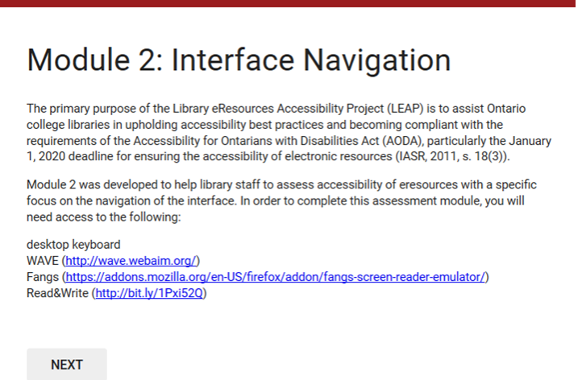
Notes:
SIOBAN:
This is our draft module 2: interface navigation
Each module will be set up as a multi-page form. There will be a brief introduction at the beginning of each module, which you can see here, along with a list of all of the tools that will be required to complete the module.
Before they begin a module, library staff can provide this list to their IT staff to ensure that they have all of the software or extensions needed.
The modules are then broken down into a series of tests, which are based on the list of accessibility criteria developed by the LEAP steering committee.

Slide 15
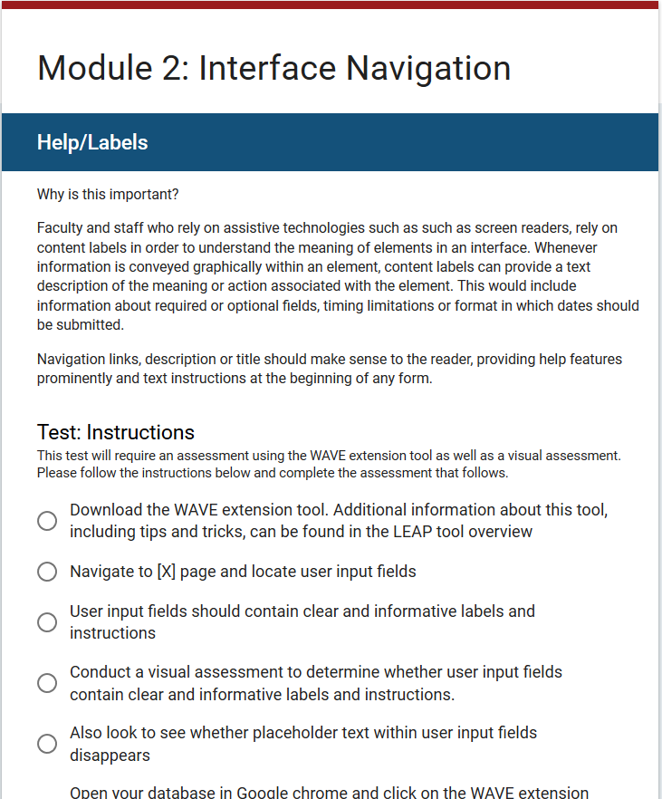
Notes:
SIOBAN:
Here’s an example of one of the tests
Each test starts out with some background information that will help the evaluator understand why this particular criteria is important and what they will need to look out for in order to properly assess the eresource.

Slide 16
Notes:
SIOBAN:
Following that there are instructions that the evaluator needs to follow to do the test. So for example, this test instructs the evaluator to download a specific extension, locate specific fields, and conduct a visual assessment.

Slide 17
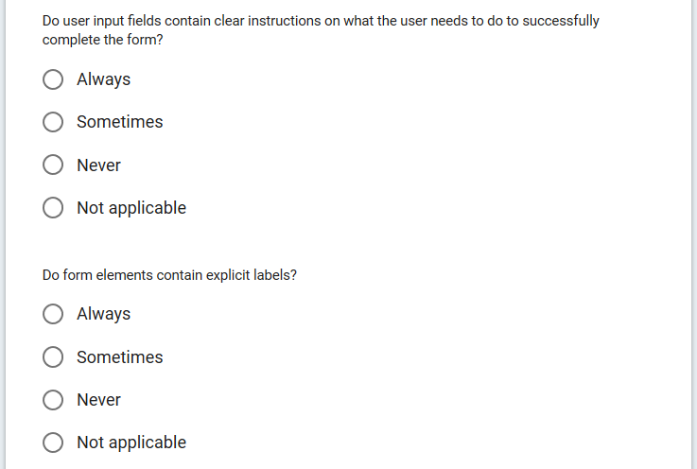
Notes:
SIOBAN:
And then after that, there are assessment questions for the evaluator to answer and input the results of their evaluation.
For example, the first question in this particular test reads “Do user input fields contain clear instructions on what the user needs to do to successfully complete the form?” And then the evaluator can select “always, sometimes, never, or not applicable”
Our goal is to make sure that each test is easy to follow, that library staff know exactly what to look for and how to look for it, and that result input and scoring is consistent.
Each module contains several tests, and on average during user testing each module took about 30 minutes to an hour to complete. However, as staff become familiar with the process and with the tools they are using throughout the assessment, the time it takes to complete an assessment would likely decrease.
A key requirement for our tool is the ability to save work and return, as well as to move forward and back, skip tests and return to them, to make it easier for staff to undertake an assessment.

Slide 18
Tool Development
Core development will take place in 2019 with potential for a phase 2 if necessary
Tool will be built using Drupal and will consist of an assessment tool, a repository, user and admin dashboards, and potentially other features e.g., forum space
Tool will be accessible, consistent with AODA workplace standards
Notes:
SIOBAN:
We are now at the stage where we are ready to begin building the LEAP tool. We Issued an RFP and have awarded the contract to an Ontario developer. We anticipate building the tool in the winter and spring of 2019, with user testing in the summer and potentially a second phase of development to follow.
The decision was made to build a tool using drupal, which allows us to meet all or most of our tool requirements, including web accessibility standards, and because it integrates with other tools currently used by OCLS and college staff.
The tool will consist of the assessment modules, a repository of completed assessments, as well as user and admin dashboards and potentially other features such as a forum space.
Accessibility Checklist https://www.drupal.org/node/465106

Slide 19
Next Phases
Tool implementation at local level
Recommendations for shared workflow
Competency building and staff training
Tool launch and communication
Tool assessment and potential to expand beyond college sector
Notes:
SIOBAN: In addition to building the tool itself, there are other key deliverables that remain, and we are in the process of assembling working groups to begin this work in the spring.
tool implementation at the local level to incorporate the tool into procurement processes;
recommendations for a shared workflow, outlining proposed responsibilities for various stakeholders, to allow for collaboration and sharing and ensure that the collection of assessments is reviewed and refreshed periodically;
Competency building, change management and training for college library staff who will be using the tool;
And finally, tool launch and communications with the college libraries, with workflow beginning at the local level

Slide 20
Value Added
Evaluating a library’s existing eresource collection
Assessment during trials and acquisitions process
Sharing findings with vendors to advocate for changes that promote accessibility
Working with licensing groups to develop language to include in licence agreements
Translating results into user support
Notes:
CORINNE:
In terms of use of the LEAP Tool, we envision
Library staff evaluating their existing collections and integrating it in the acquisitions workflow so that accessibility is considered during database trials going forward
Sharing findings with vendors and advocating for changes that promote accessibility, and better vendor agreements.
Translating our evaluation results into user support, including providing summaries of accessibility features and issues for each library database.
Building competencies among library staff, to establish a stronger foundation for addressing accessibility issues

Slide 21
Project Success
Opportunities for collaboration; acknowledging the value of outreach beyond the library
Nurturing accessibility champions; and contributing to a community of practice;
Developing collaborative standards; sharing best practices
Integrating accessibility as a part of everyday workflows
Notes:
CORINNE:
As we look forward to envision project success, we look to you and the wider community for opportunities for collaboration.
To support the success of our library patrons, we want to continue to build a community of practice by finding solutions for everything
For us, this means nurturing accessibility champions, appealing to experts, developing collaborative standards and sharing best practices and integrating accessibility into our every day workflows.
________
Slide content created in collaboration with Katya Pereyaslavska

Slide 22
Thoughts for Panel Discussion
Do you see a need at your institution for access to a tool or service like LEAP?
What opportunities for collaboration do you envision for your organization?
What is your library doing to meet the AODA January 2020 deadline?
Notes:
CORINNE: We look forward the panel discussion that follows and would like to pose these questions to get us thinking about next steps.

Slide 23
Thank you!
Corinne Abba Siobán Linnen
cabba@georgebrown.ca slinnen@ocls.ca
This presentation is available in alternative formats upon request.
Notes:
SIOBAN and CORINNE

