Slide 1

Pitch 7 UN SDG 10 - Reduced
Inequalities
Doing cross tabulation with data

Slide 2

The requirements for this UN SDG data assignment is to complete 5 cross tabulations and/or content analysis from the original data sheets uploaded here. There are examples of both content analysis and cross tabulation for each pitch to show you want to do. Please make sure to do a combination, so that your assignment includes 5 but at least one is a cross tabulation and one is a content analysis. Please submit in the place created for UN SDG data assignment on Submit Assignment Here. The PowerPoints are the examples of what to do. Each has a data narrowed down from the original data sheets that follows. Then the original data sheets that you will used for the assignment will be at the end in this UN SDG data assignments Box. What you submit is 5 different spreadsheets as indicated above.
© Anne MacLennan, 2024​​

Slide 3
UN SDG 10
"Addressing inequality both within and among countries necessitates equitable resource distribution, investment in education and skills, social protection measures, efforts to stop discrimination, support for marginalized groups, and international cooperation for fair trade and financial systems." (DESA, 2024).​
Department of Economic and Social Affairs (2024). The sustainable development goals report 2024. United Nations. https://unstats.un.org/sdgs/report/2024/The-Sustainable-Development-Goals-Report-2024.pdf.
© Anne MacLennan, 2024​​​

Slide 4
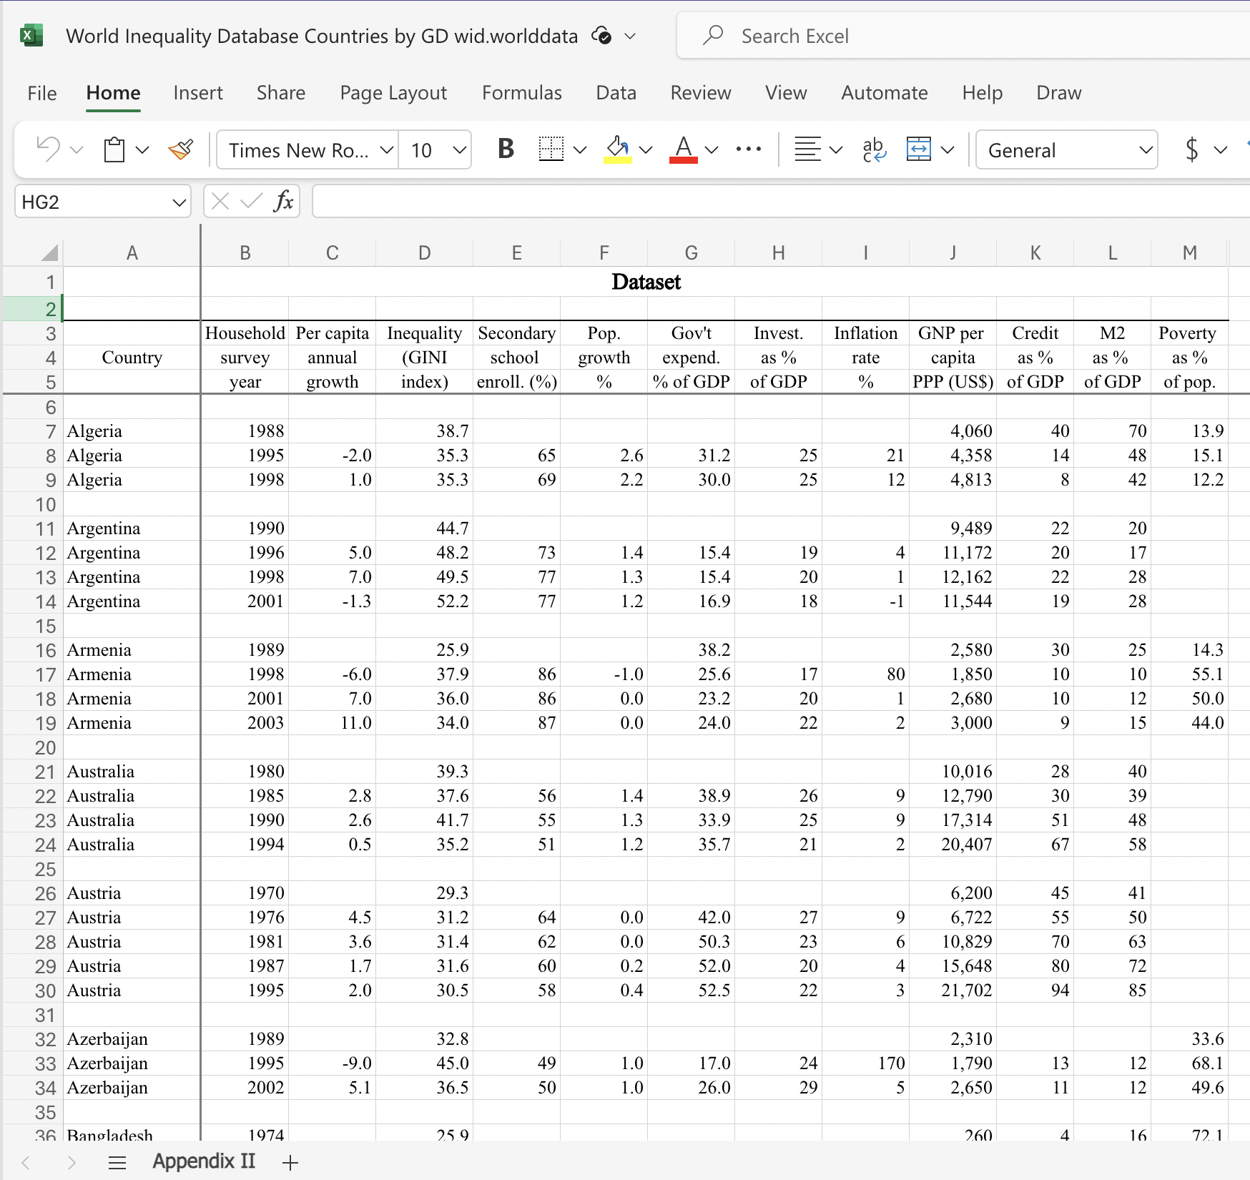
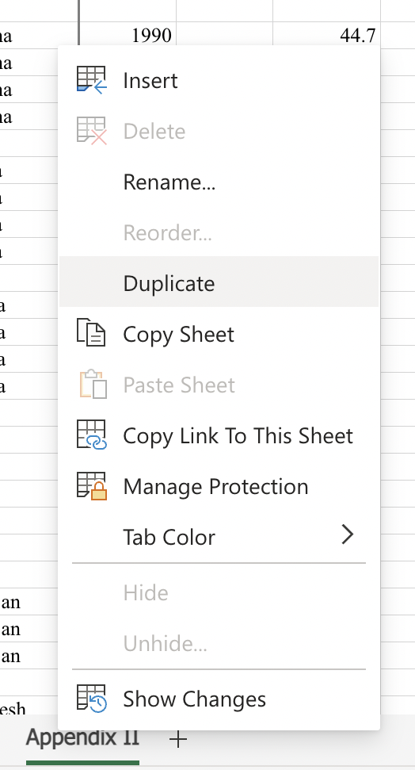
Step 1: Get raw data table and duplicate it for back up
Example is from World Inequality Database
© Anne MacLennan, 2024​​
World Inequalities Database. https://wid.world/

Slide 5
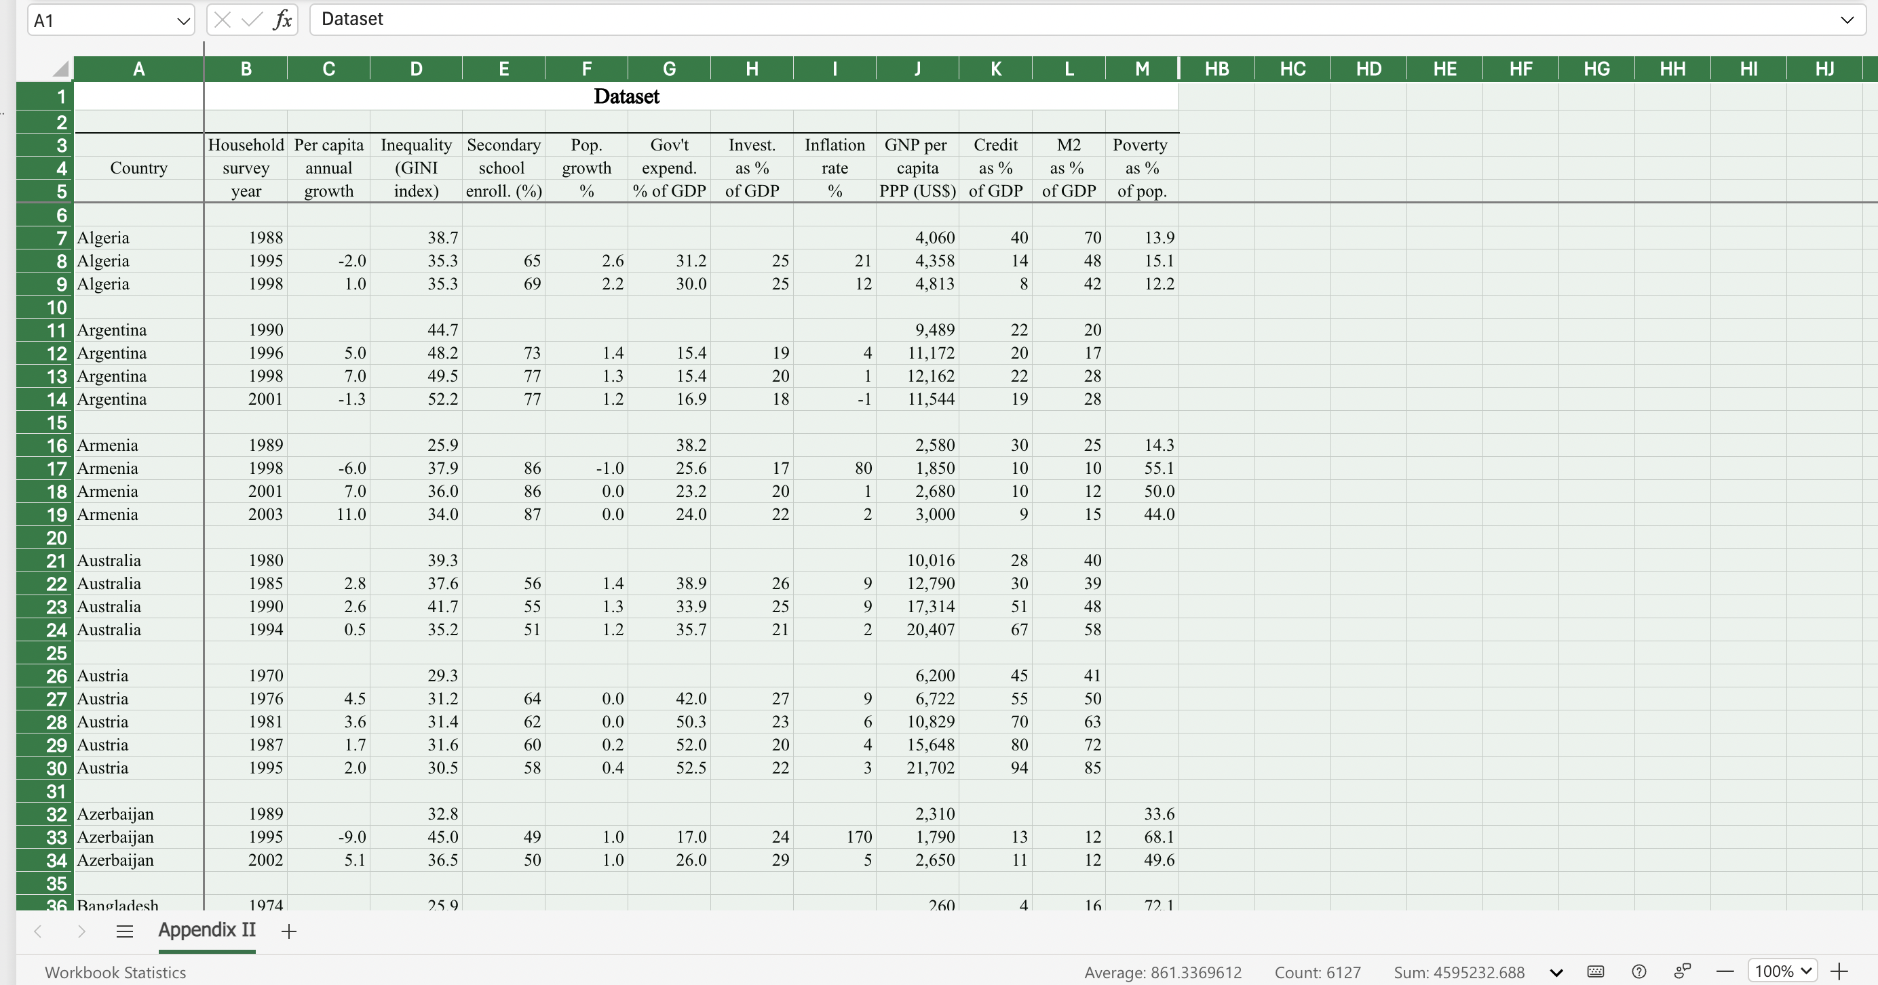
Step 2: Highlight all in the duplicate sheet
The way to highlight an Excel sheet is to go to this cell (box) and click on it. Then the whole sheet will be highlighted. ​
This is an Excel tip only ​
© Anne MacLennan, 2024​​
World Inequalities Database. https://wid.world/

Slide 6
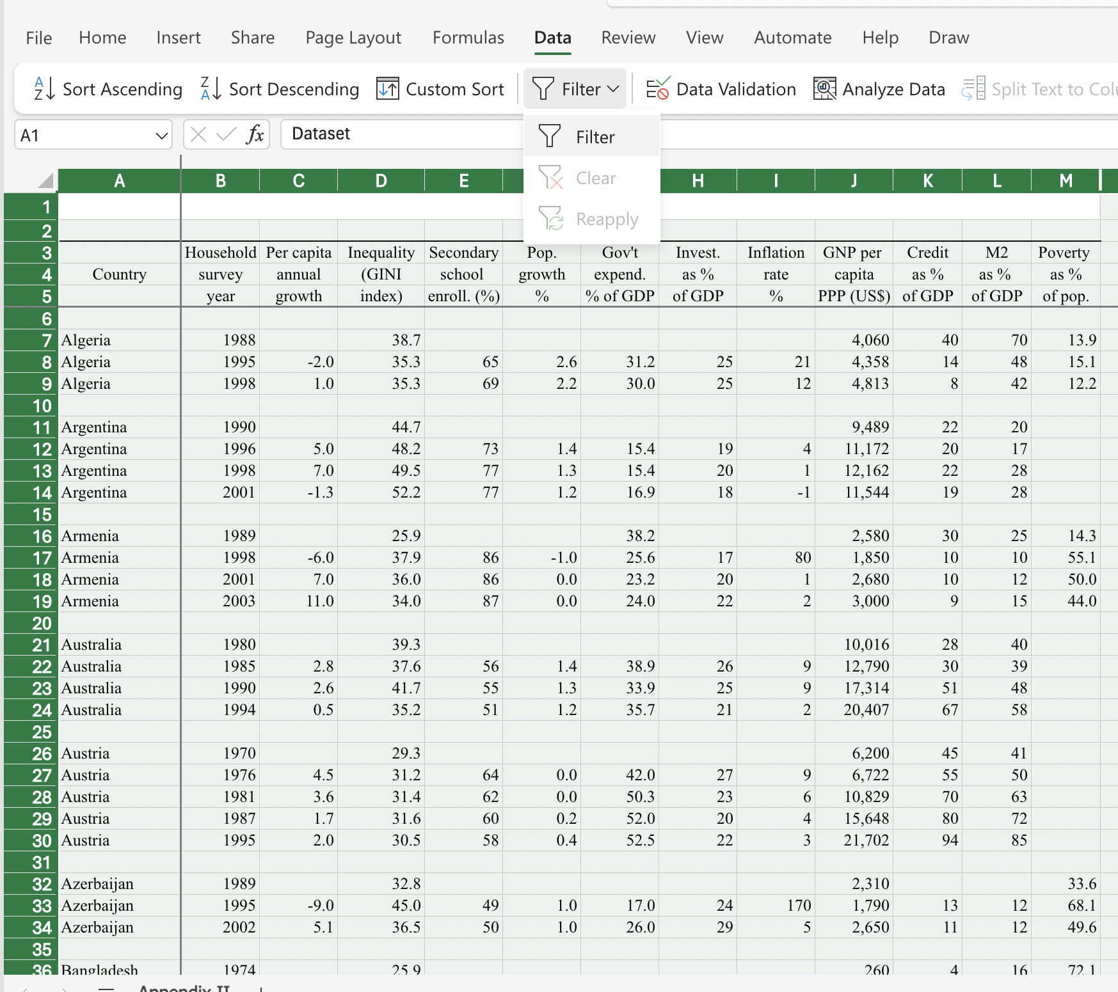
Step 3: Click data and then filter
© Anne MacLennan, 2024​​
World Inequalities Database. https://wid.world/

Slide 7
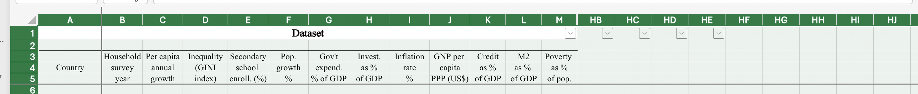
Step 4: Click data and then filter
Make sure the dropdown arrows appear
© Anne MacLennan, 2024​​
World Inequalities Database. https://wid.world/

Slide 8
Cross tabulating
When you cross tabulate what you are doing is comparing at least two variables. You need to pick two variables you want to cross tabulate, such as gender and wages in the workplace.
In step 3, we will select variables by using the select all feature in the filtered columns.
© Anne MacLennan, 2024​​

Slide 9
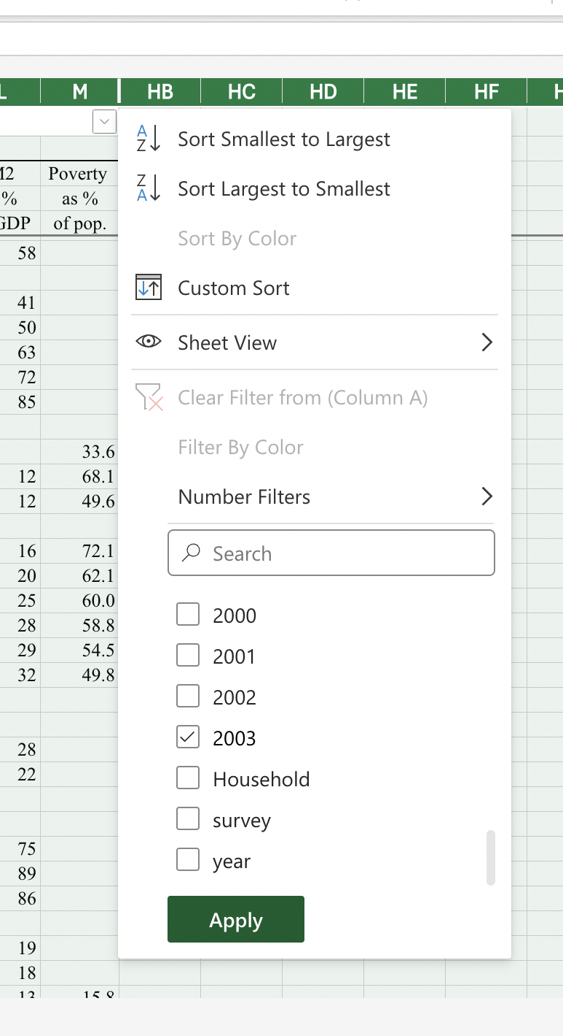
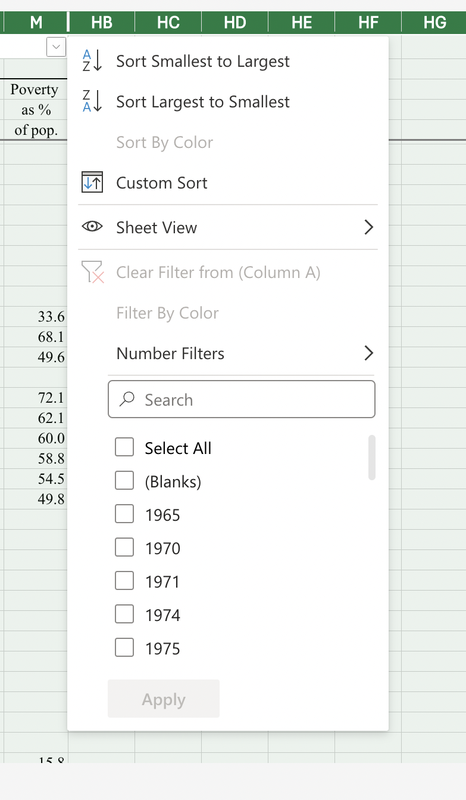
Step 5: Click arrow down to sort column
© Anne MacLennan, 2024​​
World Inequalities Database. https://wid.world/

Slide 10
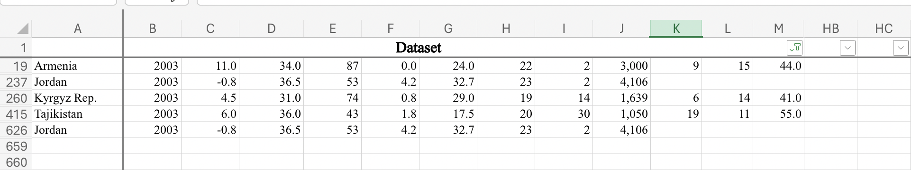
This is how it should look after completing Step 5
© Anne MacLennan, 2024​​
World Inequalities Database. https://wid.world/

Slide 11
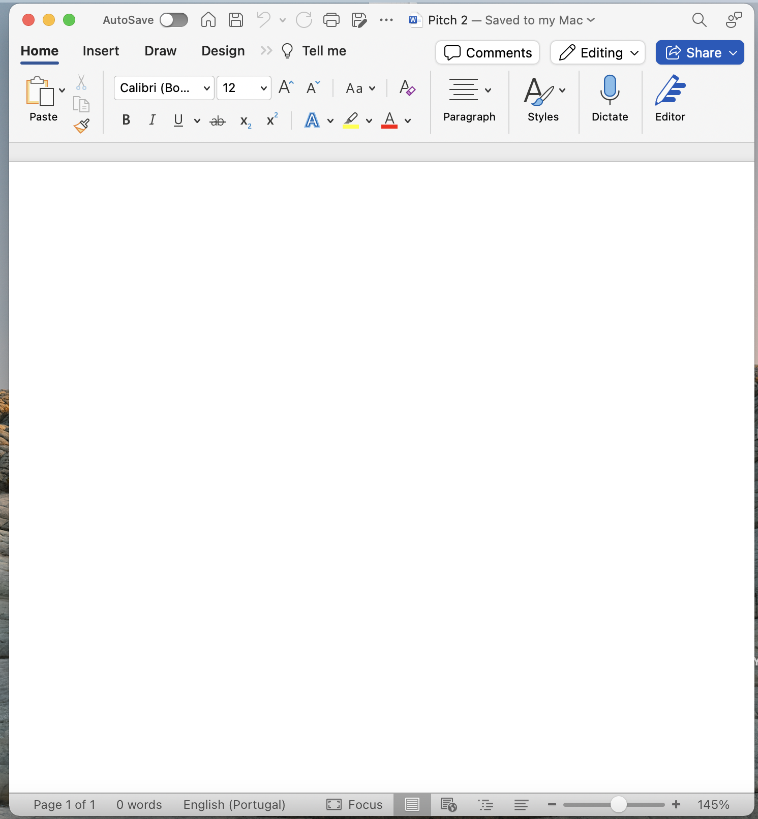
Ways move data from Excel to Word file
This is an Excel tip only ​​​​​
© Anne MacLennan, 2024​​
World Inequalities Database. https://wid.world/

Slide 12
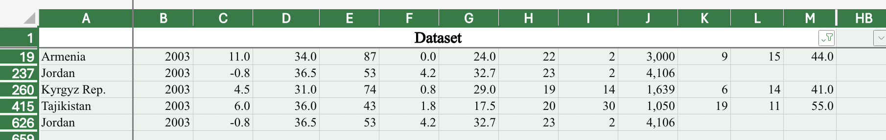
Copy Pasting Step 1: Selecting Data
Click top left cell > hold shift > click bottom right cell to highlight all information
This is an Excel tip only
© Anne MacLennan, 2024​​
World Inequalities Database. https://wid.world/

Slide 13
Step 2: Copying and Pasting Data
Ctrl + c (PC) or command + c (Mac) then Ctrl + v (PC) or command + v (Mac) into section in Word file
This is an Excel tip only
Note: marching ants border indicates that the data is copied and ready for pasting
© Anne MacLennan, 2024​​
World Inequalities Database. https://wid.world/

Slide 14
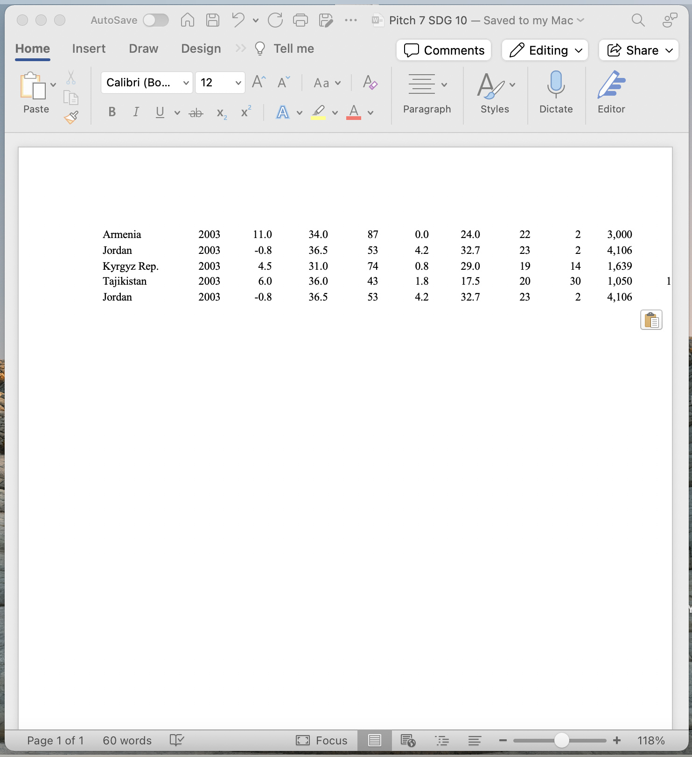
Step 3: Copying and Pasting Data
Ctrl + c (PC) or command + c (Mac) then Ctrl + v (PC) or command + v (Mac) into section in Word file
© Anne MacLennan, 2024​​
World Inequalities Database. https://wid.world/

Slide 15
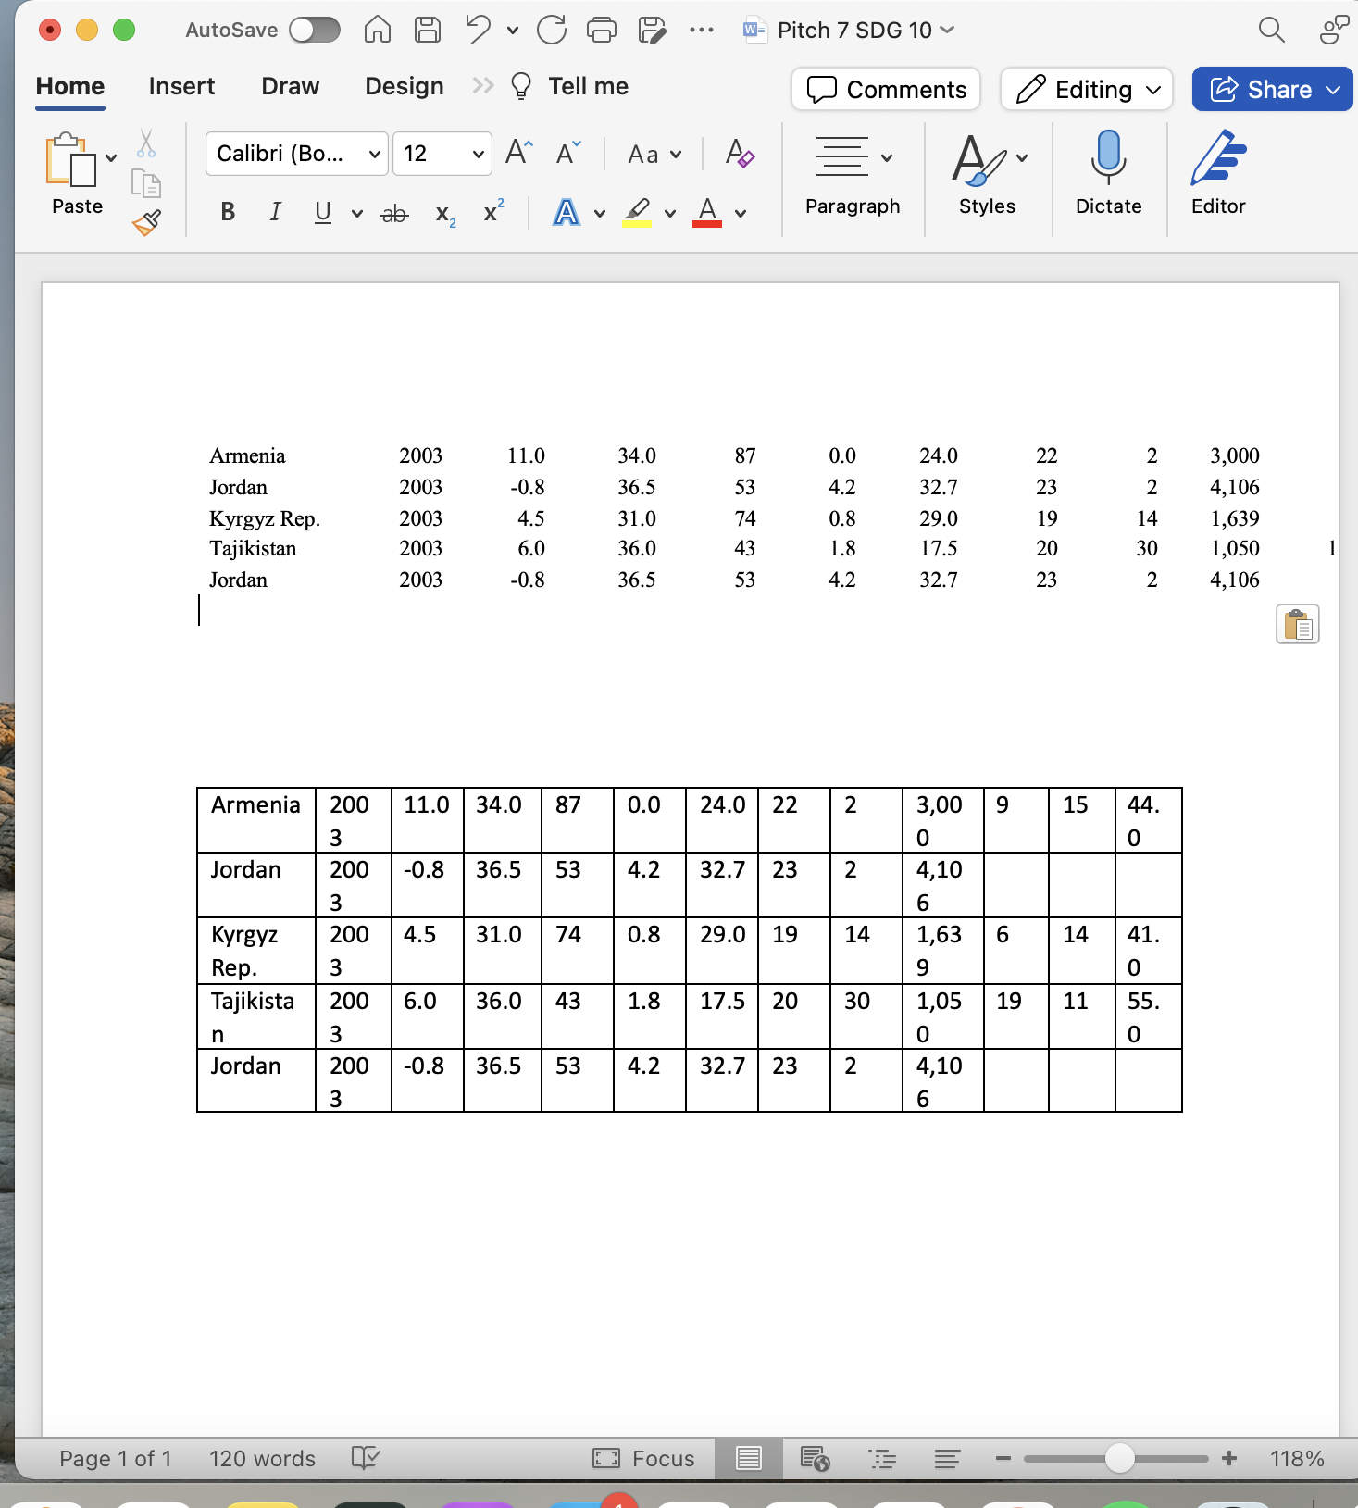
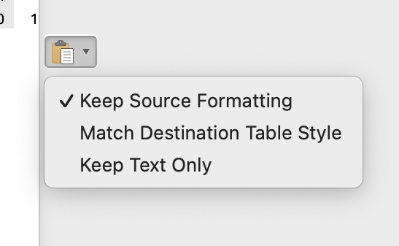
Step 3: Fixing the formatting
Keep source formatting uses the same fonts and styles as the Excel sheet, match destination table style converts the copied data into the document's style
Make changes as needed
© Anne MacLennan, 2024​​
World Inequalities Database. https://wid.world/

Slide 16
Screenshot Step 1: Taking the screenshot
Windows key + print scr (PC)
Shift + control + command + 3 (Mac)
© Anne MacLennan, 2024​​

Slide 17
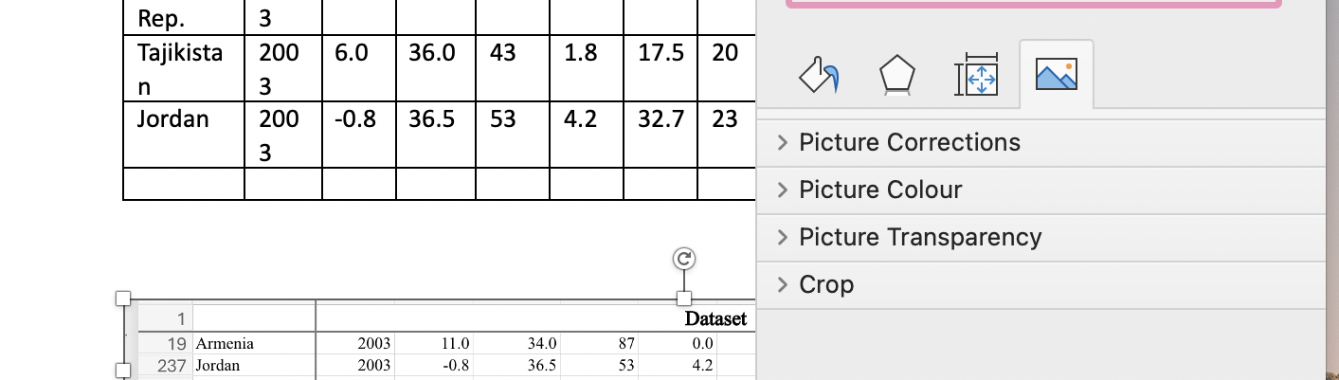
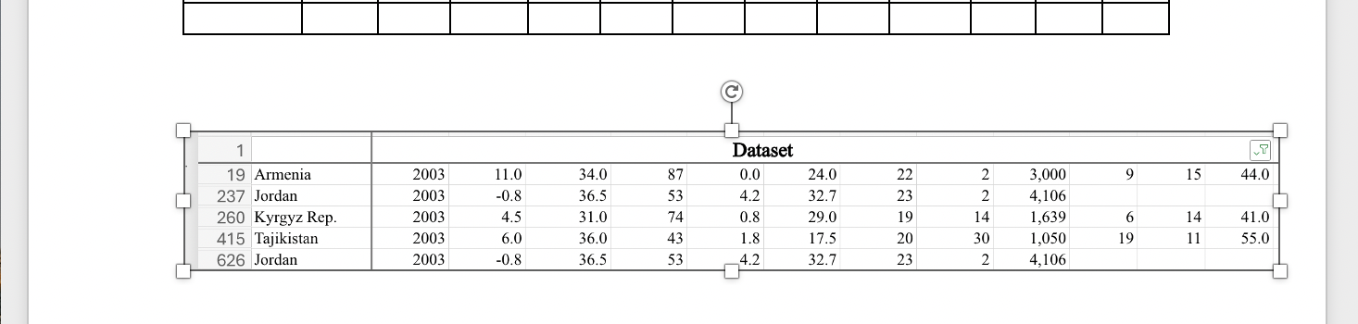
Step 2: Pasting the screenshot
Go to Word document then press
  Ctrl + V (PC)
  Command + V (Mac)
Double click to crop and edit
Edit as needed
© Anne MacLennan, 2024​​
World Inequalities Database. https://wid.world/

Slide 18
References
Department of Economic and Social Affairs (2024). The sustainable development goals report 2024. United Nations. https://unstats.un.org/sdgs/report/2024/The-Sustainable-Development-Goals-Report-2024.pdf.
World Inequalities Database. https://wid.world/
© Anne MacLennan, 2024​​​

