Slide 1

Pitch 2 - UN SDG 5 Gender Equality Content Analysis
© Anne MacLennan, 2024​

Slide 2

The requirements for this UN SDG data assignment is to complete 5 cross tabulations and/or content analysis from the original data sheets uploaded here. There are examples of both content analysis and cross tabulation for each pitch to show you want to do. Please make sure to do a combination, so that your assignment includes 5 but at least one is a cross tabulation and one is a content analysis. Please submit in the place created for UN SDG data assignment on Submit Assignment Here. The PowerPoints are the examples of what to do. Each has a data narrowed down from the original data sheets that follows. Then the original data sheets that you will used for the assignment will be at the end in this UN SDG data assignments Box. What you submit is 5 different spreadsheets as indicated above.
© Anne MacLennan, 2024​​

Slide 3
UN SDG 5
"Strong and sustained commitments to changing biased social norms, eliminating harmful practices and abolishing discriminatory laws are urgently needed. Enhancing women’s roles in leadership and decisionmaking and adequately scaling up investments in gender equality on national, regional and global scales are top priorities" (DESA, 2024).
Department of Economic and Social Affairs (2024). The sustainable development goals report 2024. United Nations.
© Anne MacLennan, 2024​​​

Slide 4
What is Content Analysis?
Content analysis is a way of generating qualitative data from qualitative data.
It always generates numbers
  Raw qualitative data
  Percentages
Easiest quantitative data
© Anne MacLennan, 2024​​​

Slide 5
What does Content Analysis do?
Make comparisons
Shows or detects trends
© Anne MacLennan, 2024​​​

Slide 6
Categories
The categorization of the data is crucial
The categories must be exhaustive and mutual exclusive
© Anne MacLennan, 2024​​​

Slide 7
Mutually exclusive
1. Means that all the categories have to be separate and clear
  example: 1-10 and 11-20 NOT 1-10 and 10-20 because 10 is in both
2. The data is qualitative mostly to start so to make the
  lines between the categories you need a code book
© Anne MacLennan, 2024​​​

Slide 8
Exhaustive
The categories need to include everything
© Anne MacLennan, 2024​​​

Slide 9
Data Comparisons
Content analysis can reveal a comparison that you expected and confirm your idea
Content analysis can reveal a comparison that is unexpected and force you to think about new data
© Anne MacLennan, 2024​​​

Slide 10

Step 1: Gather a Sample of articles
Gather a list of articles related to your topic
Example: 10 examples of articles related to UN SDG 5: Gender Equality
© Anne MacLennan, 2024​​​

Slide 11
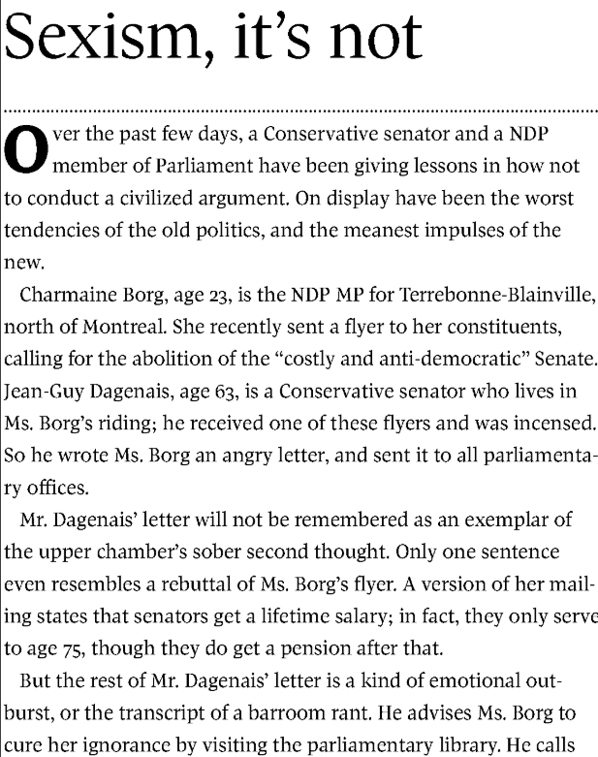
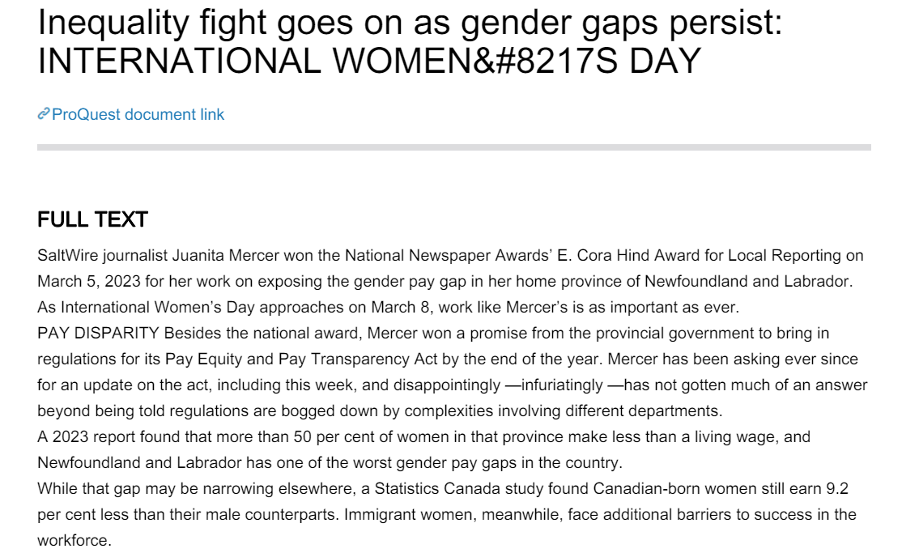
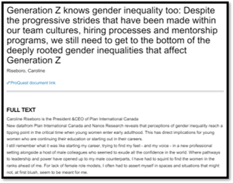
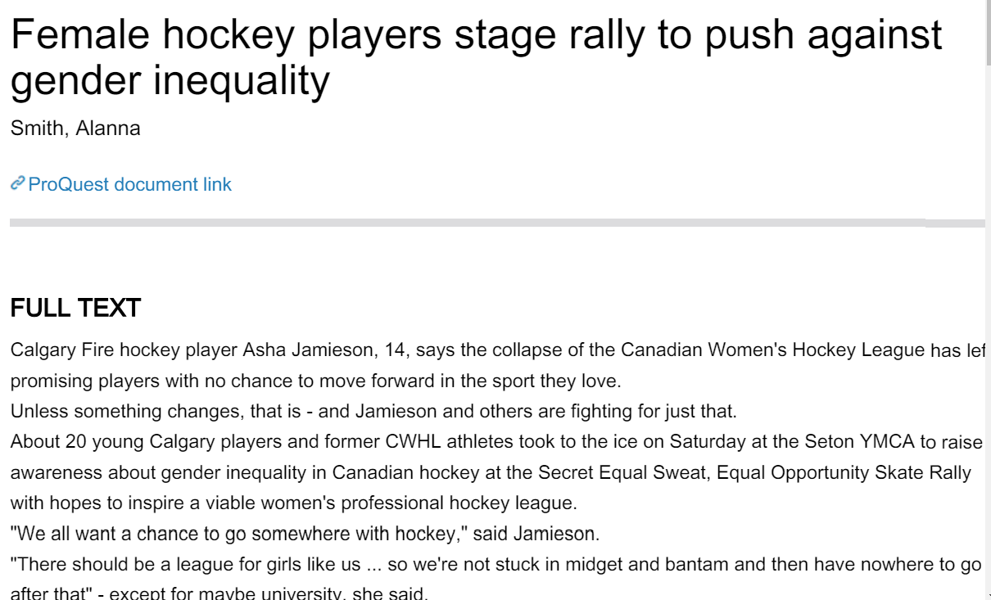
Step 2: Pick out Your Articles
Gather a list of articles related to your topic
Example: Give 10 Examples of articles related UN SDG 5: Gender Inequality
Inequality fight goes on as gender gaps persist. (2024, Mar 06). The Chronicle Herald.
Riseboro, C. (2019). Generation Z knows gender inequality too: Despite the progressive strides that have been made within our team cultures, hiring processes and mentorship programs, we still need to get to the bottom of the deeply rooted gender inequalities that affect Generation Z. The Globe and Mail.​
Sexism, it's not. (2013, December 11). The Globe and Mail, p. 20.
[In ProQuest Historical Newspapers: The Globe and Mail]
© Anne MacLennan, 2024​​​​
Smith, A. (2020, Jan 06). Female hockey players stage rally to push against gender inequality. The Calgary Herald​.

Slide 12
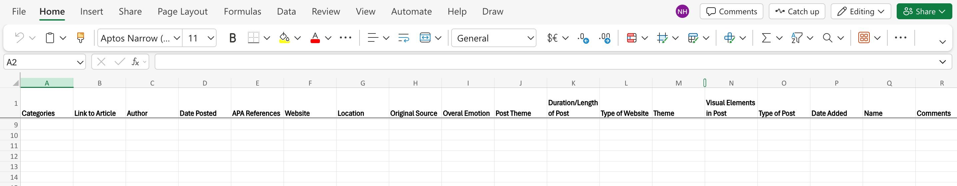
Step 3: Set up a Spreadsheet
Setting up the spreadsheet these are excel tips​
Organizing the data in categories is part of your content analysis – you would design the categories ​
© Anne MacLennan, 2024​​​​

Slide 13
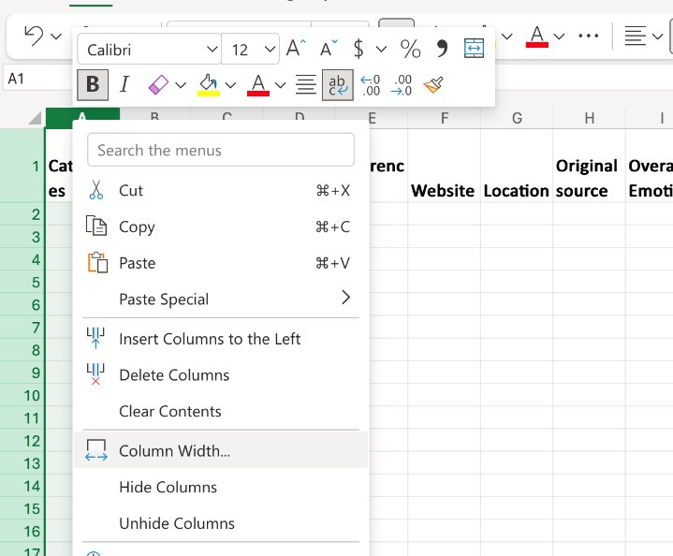
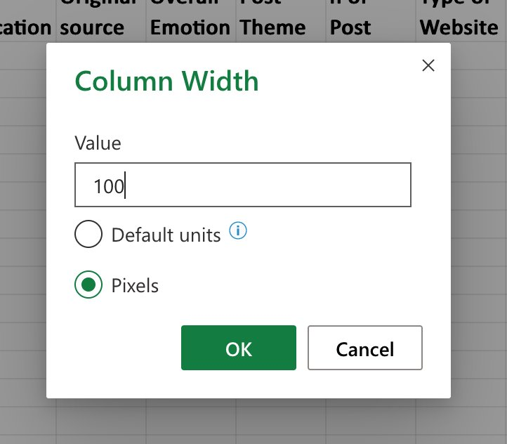
Step 4: Fix column widths
Example: right click on column "A", then click "column width" to adjust
If you want all your widths to be the same, you can do this
This is an Excel tip only
© Anne MacLennan, 2024​​​​

Slide 14
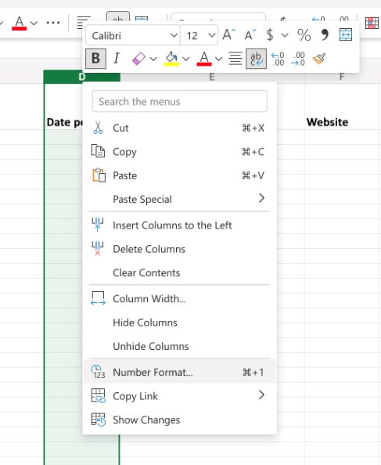
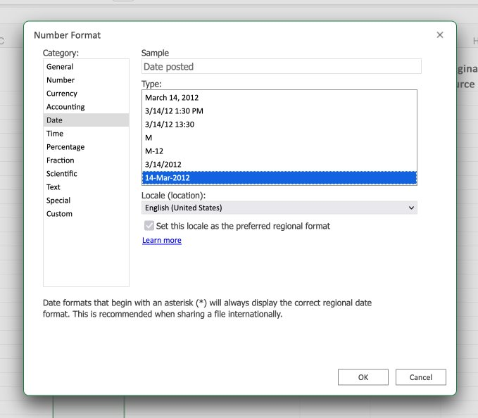
Step 5 Optional - Add a date format
Right click on column, then click "number format" to pick a format
This is an Excel tip only
© Anne MacLennan, 2024​​​​

Slide 15
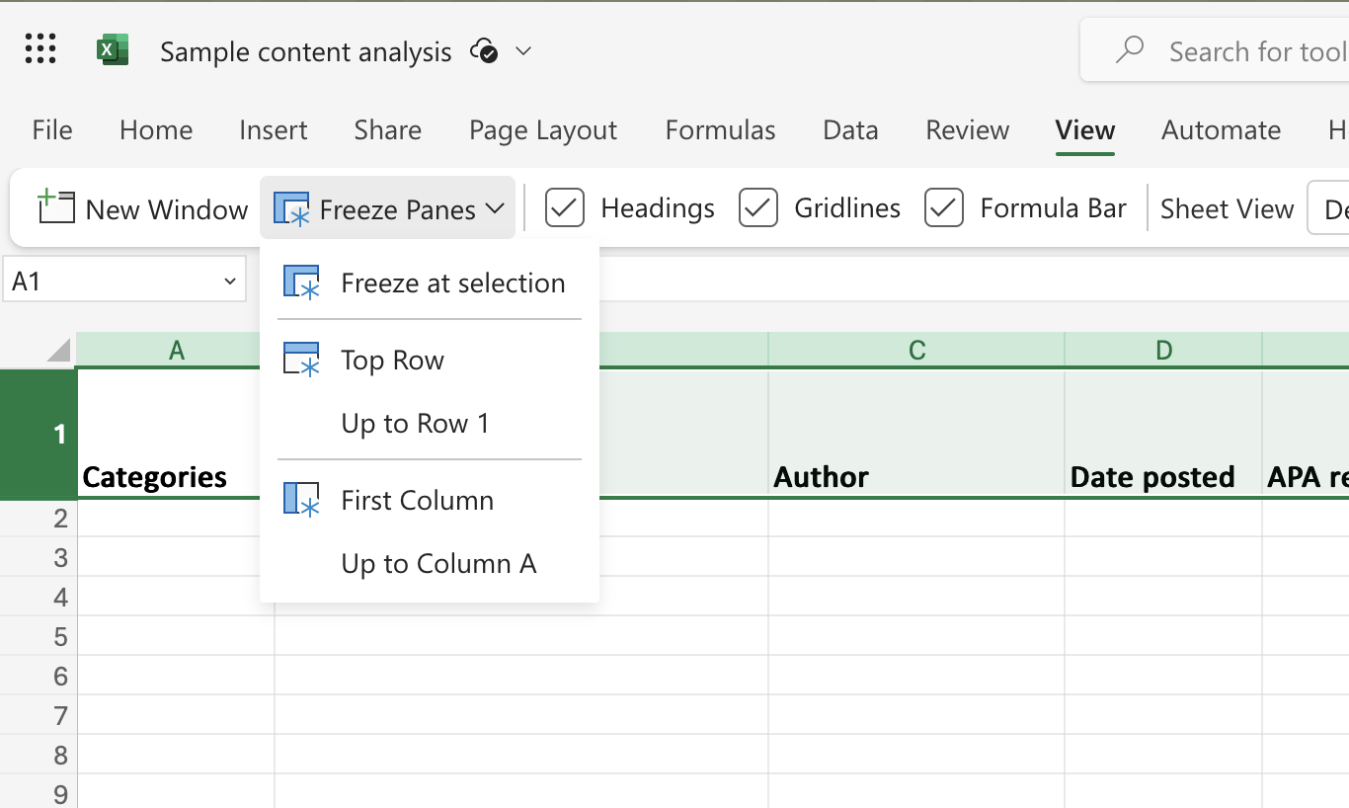
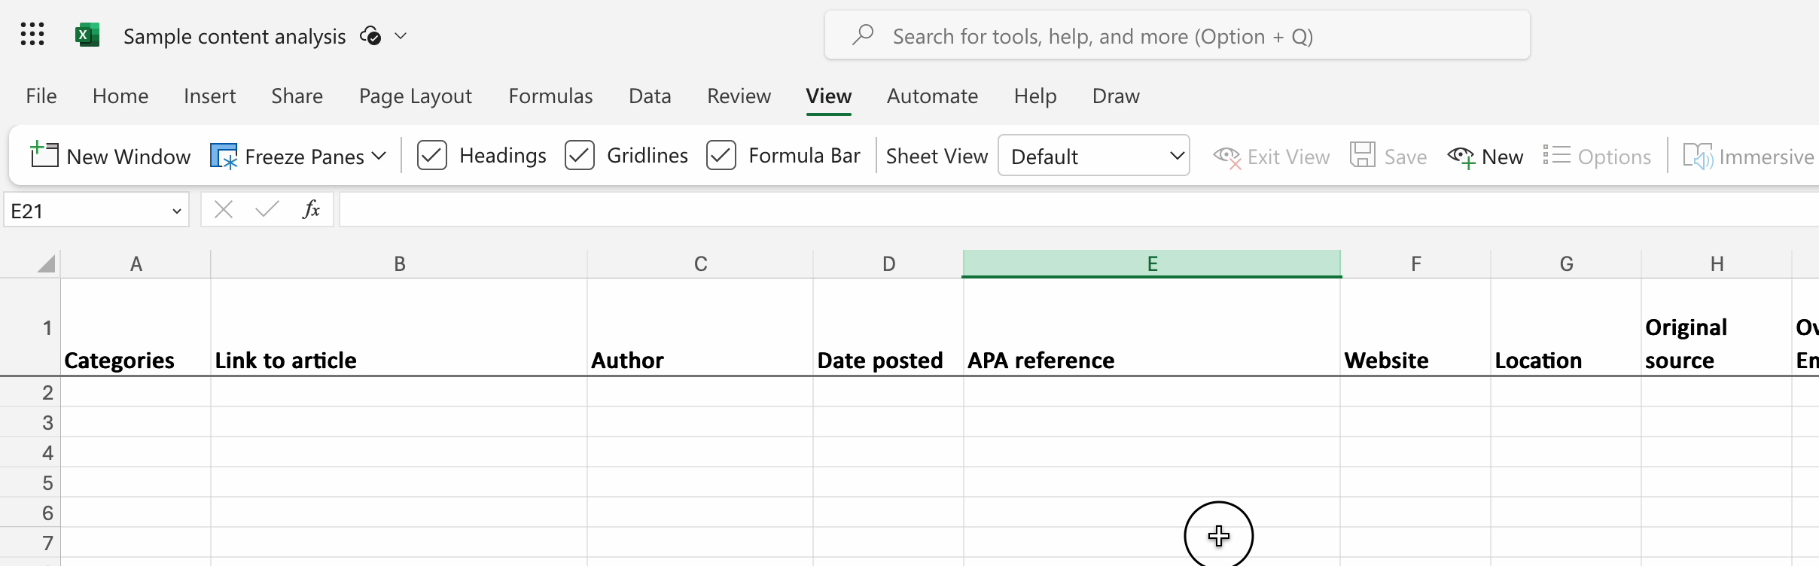
Step 6: Optional – Freeze first row
Right click on row, then click "view", then click "top row" to freeze the top row while scrolling down
This is an Excel tip only
© Anne MacLennan, 2024​​​​

Slide 16
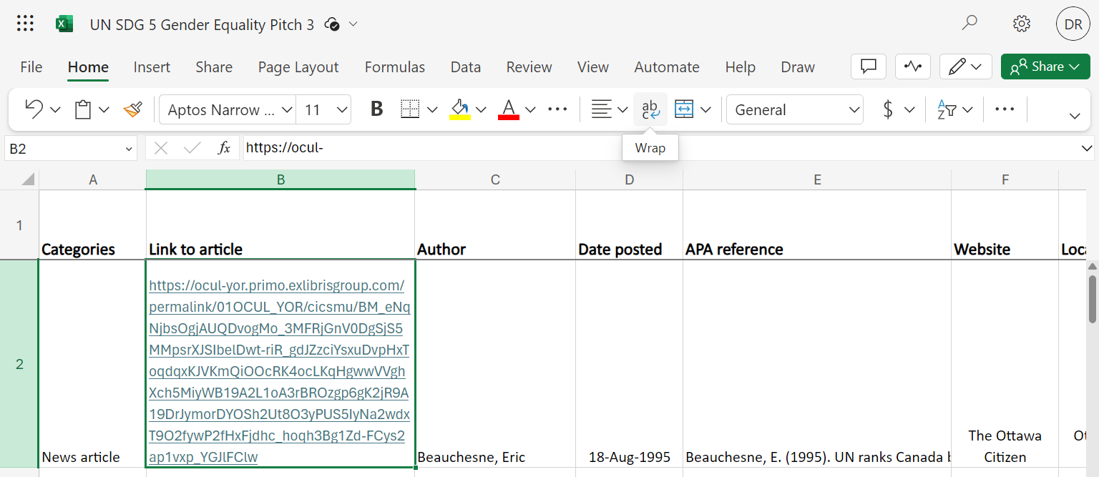
Step 7: Entering data in the Spreadsheet
Copy paste and/or write up necessary information into the sheet
If you have a large amount of text for a cell, you can click "wrap" - this is an Excel tip only
Beauchesne, E. (1986). UN ranks Canada best place to live, again; Inequality of women drops country to no. 9: Final edition. The Ottawa Citizen .
© Anne MacLennan, 2024​​​​

Slide 17
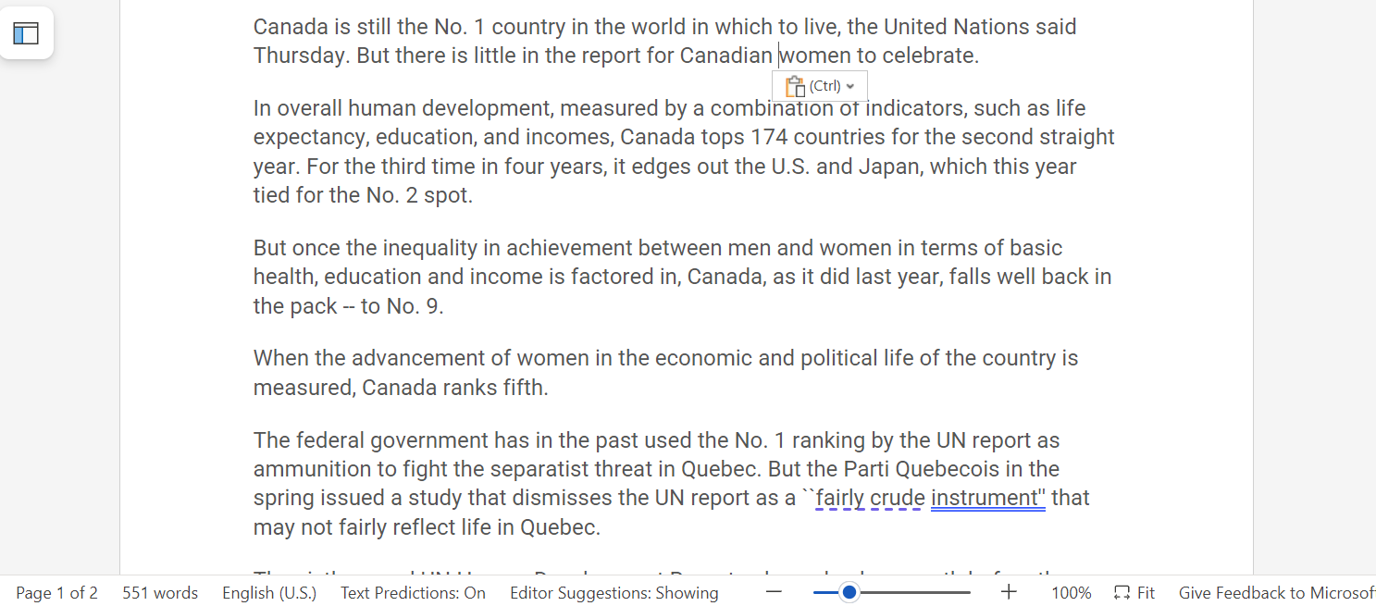
Step 8: Word Count in a Cell
For word count: copy paste the article's body of text into a Word file to get the word count
This is an Excel tip only
© Anne MacLennan, 2024​​​​
Beauchesne, E. (1986). UN ranks Canada best place to live, again; Inequality of women drops country to no. 9: Final edition. The Ottawa Citizen .

Slide 18
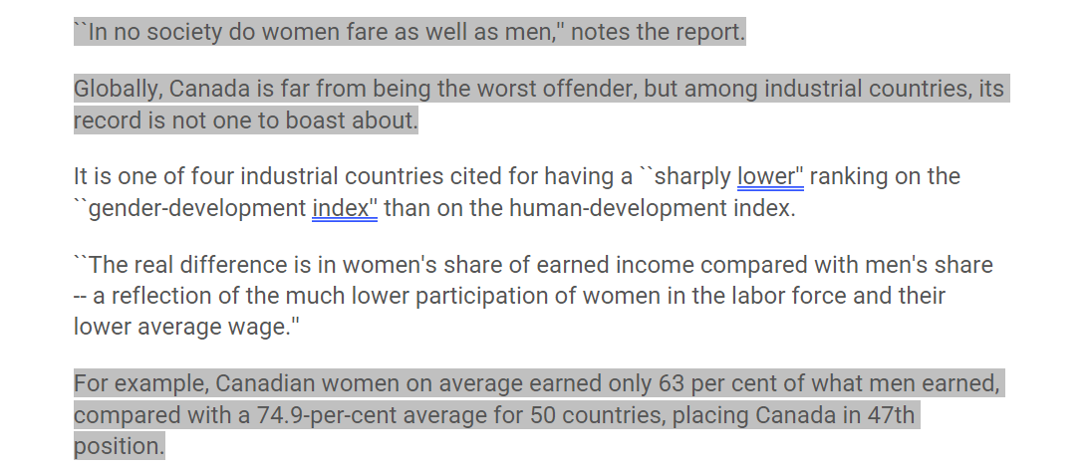
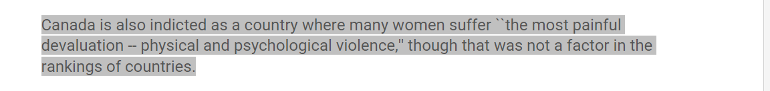
Step 9: Column I "Overall Emotion"
For overall emotion: You would need to develop a code book to define what criteria you need to fit in any of your emotions
© Anne MacLennan, 2024​​​​
Beauchesne, E. (1986). UN ranks Canada best place to live, again; Inequality of women drops country to no. 9: Final edition. The Ottawa Citizen .

Slide 19
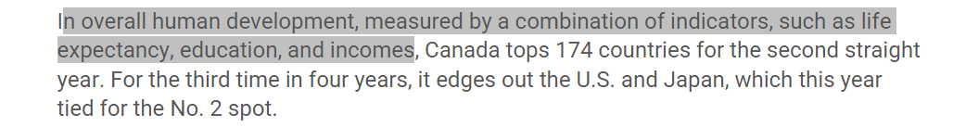
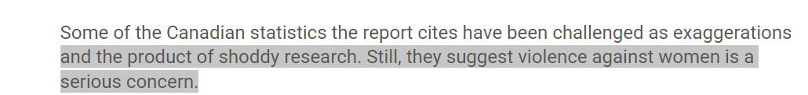
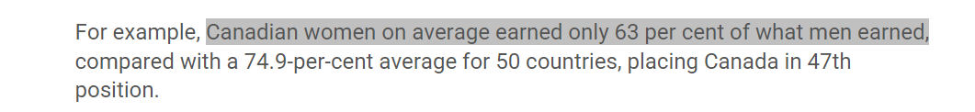
Step 10: Column M "Theme"
For theme: analyze the body of the text to see the major themes, look for key words that indicate that
Human rights, quality of life
Abuse
Labour, Wage Gap
© Anne MacLennan, 2024​​​​
Beauchesne, E. (1986). UN ranks Canada best place to live, again; Inequality of women drops country to no. 9: Final edition. The Ottawa Citizen .

Slide 20
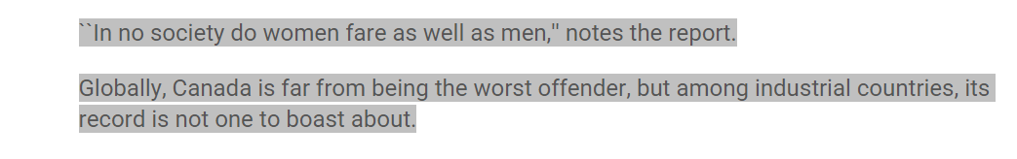

Step 10: Column J "Post Theme"
For post theme: analyze the body of the text to see the language used, and see whether the article is analytical, informative, critical, etc.
Critical of Canada's lacking gender equality practices
Informative about the condition of Canadian women.
© Anne MacLennan, 2024​​​​
Beauchesne, E. (1986). UN ranks Canada best place to live, again; Inequality of women drops country to no. 9: Final edition. The Ottawa Citizen .

Slide 21
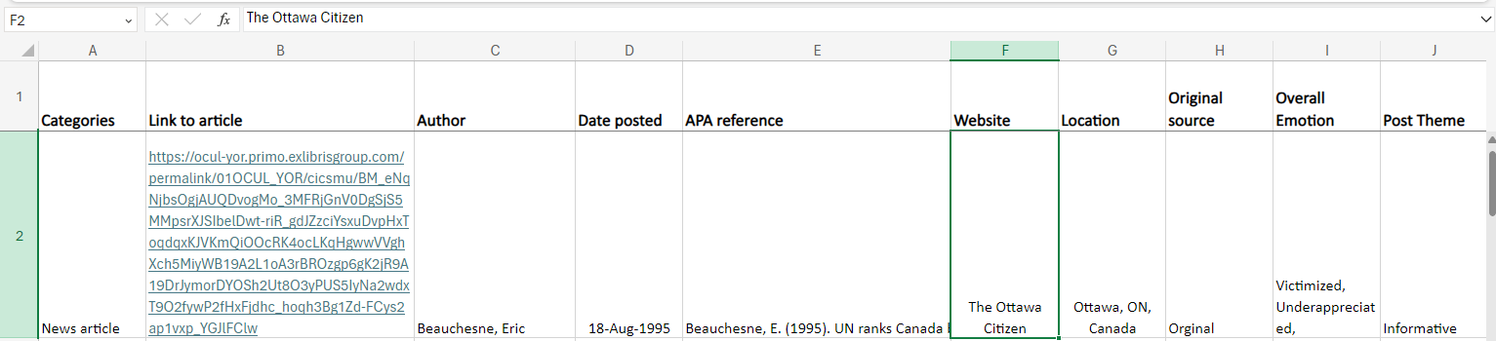
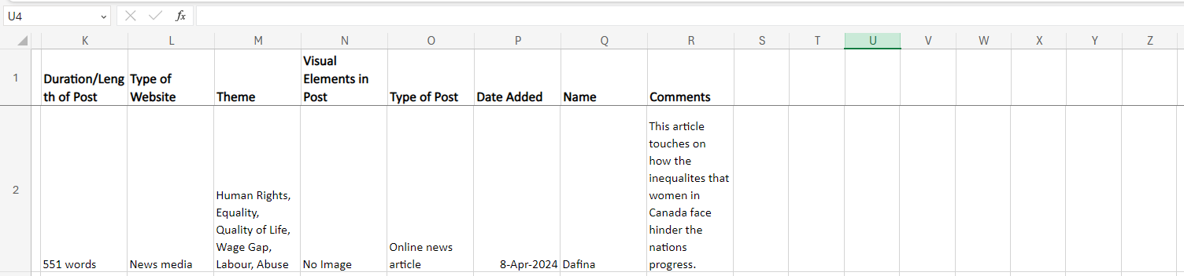
How The Sheet Should Look
© Anne MacLennan, 2024​​​​
Beauchesne, E. (1986). UN ranks Canada best place to live, again; Inequality of women drops country to no. 9: Final edition. The Ottawa Citizen .

Slide 22
References
Beauchesne, E. (1986). UN ranks Canada best place to live, again; Inequality of women drops country to no. 9: Final edition. The Ottawa Citizen.​
Department of Economic and Social Affairs (2024). The sustainable development goals report 2024. United Nations. https://unstats.un.org/sdgs/report/2024/The-Sustainable-Development-Goals-Report-2024.pdf.
Inequality fight goes on as gender gaps persist. (2024, Mar 06). The Chronicle Herald.​
Riseboro, C. (2019). Generation Z knows gender inequality too: Despite the progressive strides that have been made within our team cultures, hiring processes and mentorship programs, we still need to get to the bottom of the deeply rooted gender inequalities that affect Generation Z. The Globe and Mail.​
Sexism, it's not. (2013, December 11). The Globe and Mail, p. 20.​
Smith, A. (2020, Jan 06). Female hockey players stage rally to push against gender inequality. The Calgary Herald.​

