Slide 1

Pitch 4 – UN STG 11 Sustainable Cities
Doing cross tabulation with data

Slide 2

The requirements for this UN SDG data assignment is to complete 5 cross tabulations and/or content analysis from the original data sheets uploaded here. There are examples of both content analysis and cross tabulation for each pitch to show you want to do. Please make sure to do a combination, so that your assignment includes 5 but at least one is a cross tabulation and one is a content analysis. Please submit in the place created for UN SDG data assignment on Submit Assignment Here. The PowerPoints are the examples of what to do. Each has a data narrowed down from the original data sheets that follows. Then the original data sheets that you will used for the assignment will be at the end in this UN SDG data assignments Box. What you submit is 5 different spreadsheets as indicated above.
© Anne MacLennan, 2024​​

Slide 3
UN SDG 11
"With urbanization on the rise and nearly 70 per cent of the population projected to reside in cities by 2050, the development of critical infrastructure, affordable housing, efficient transport systems and essential social services is imperative to create resilient and sustainable cities that meet the needs of all" (DESA, 2024).​
Department of Economic and Social Affairs (2024). The sustainable development goals​ report 2024. United Nations.
© Anne MacLennan, 2024​​​

Slide 4
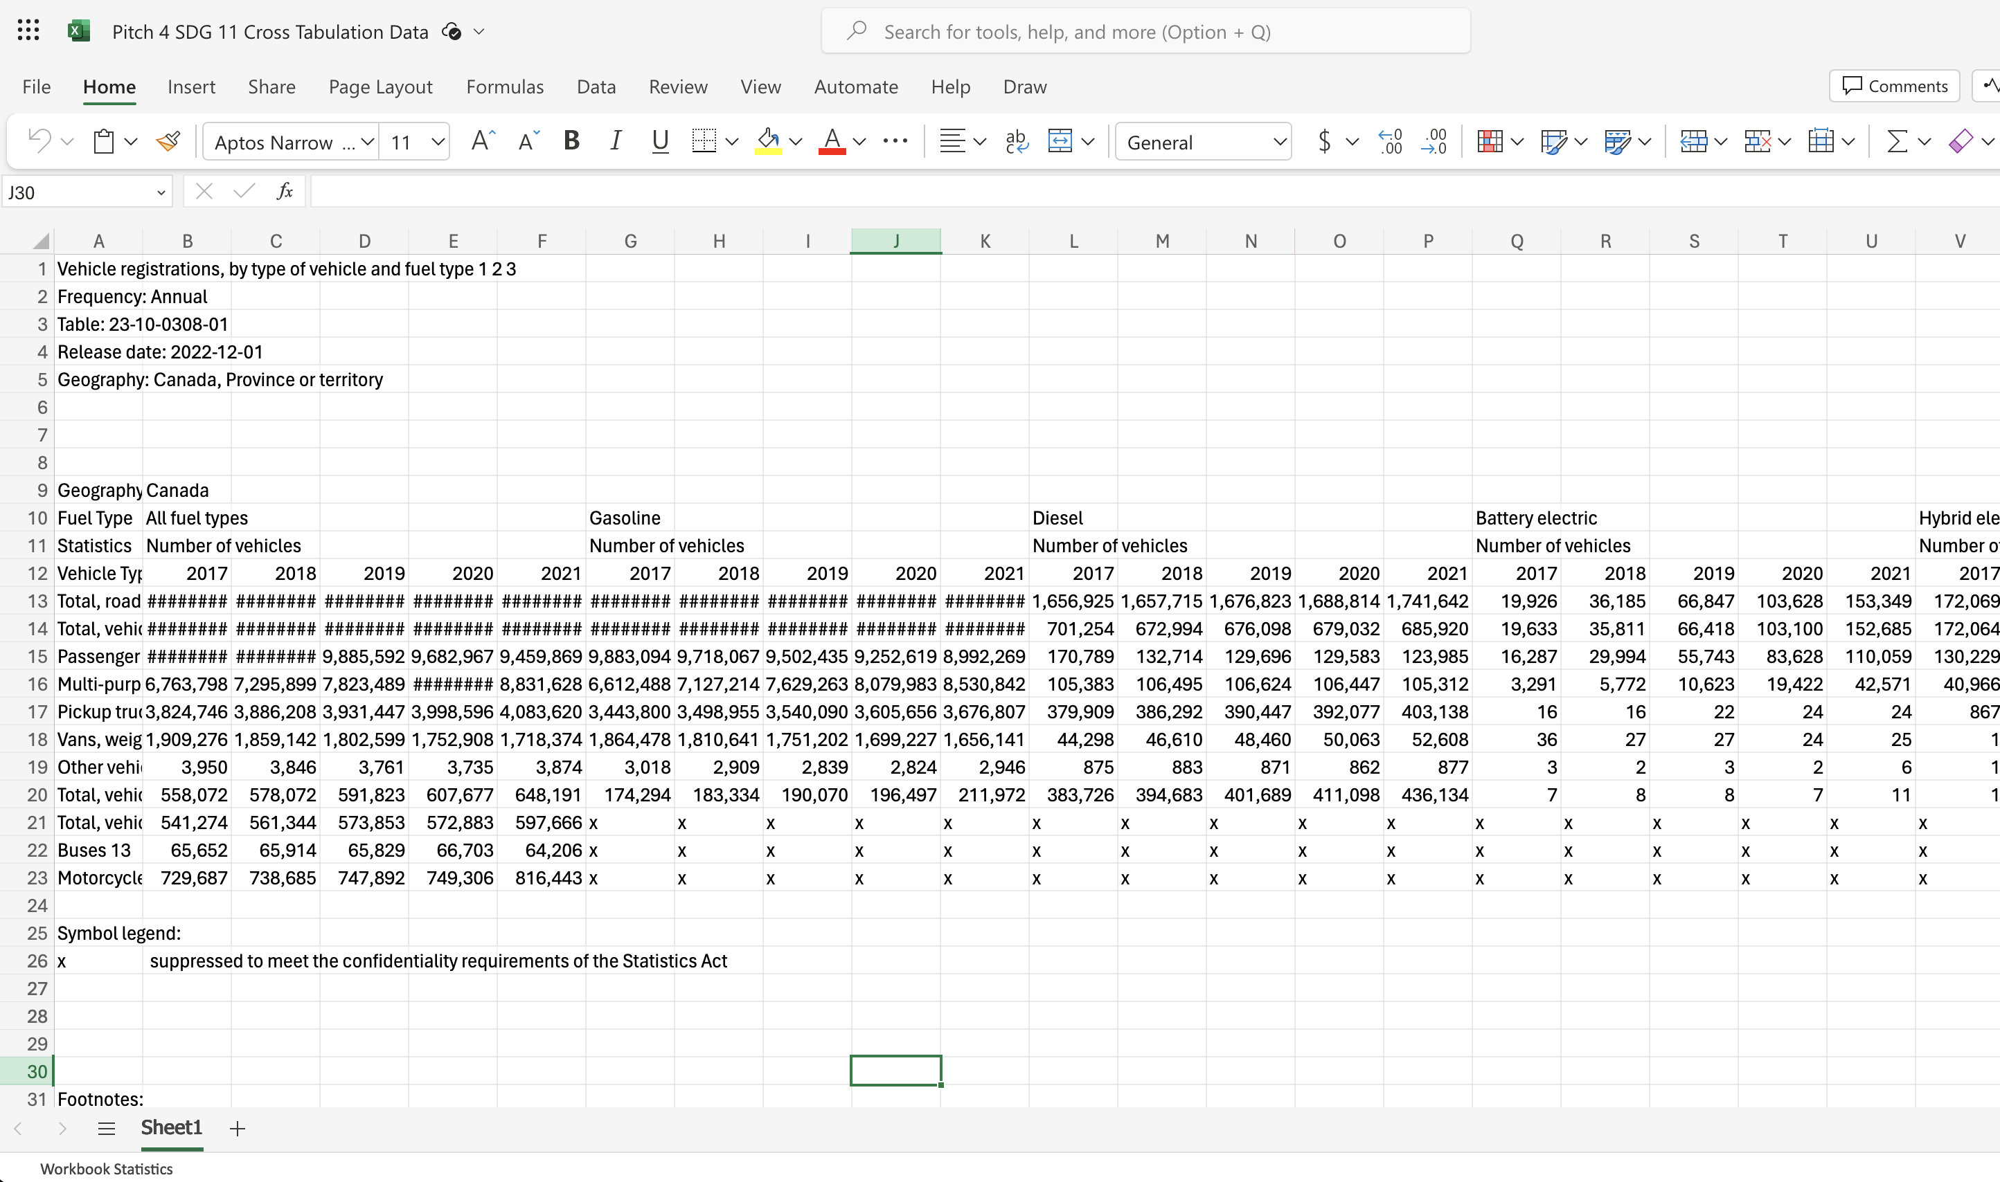
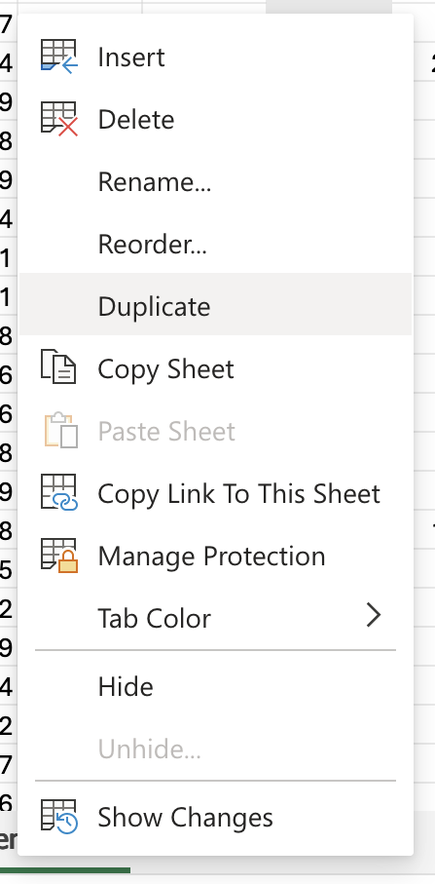
Step 1: Get raw data table and duplicate it for back up
Right click on sheet name
© Anne MacLennan, 2024​​
Statistics Canada. (2024, October 21). Vehicle registrations, by type of vehicle and fuel type. Government of Canada. https://www150.statcan.gc.ca/t1/tbl1/en/tv.action?pid=2310030801

Slide 5
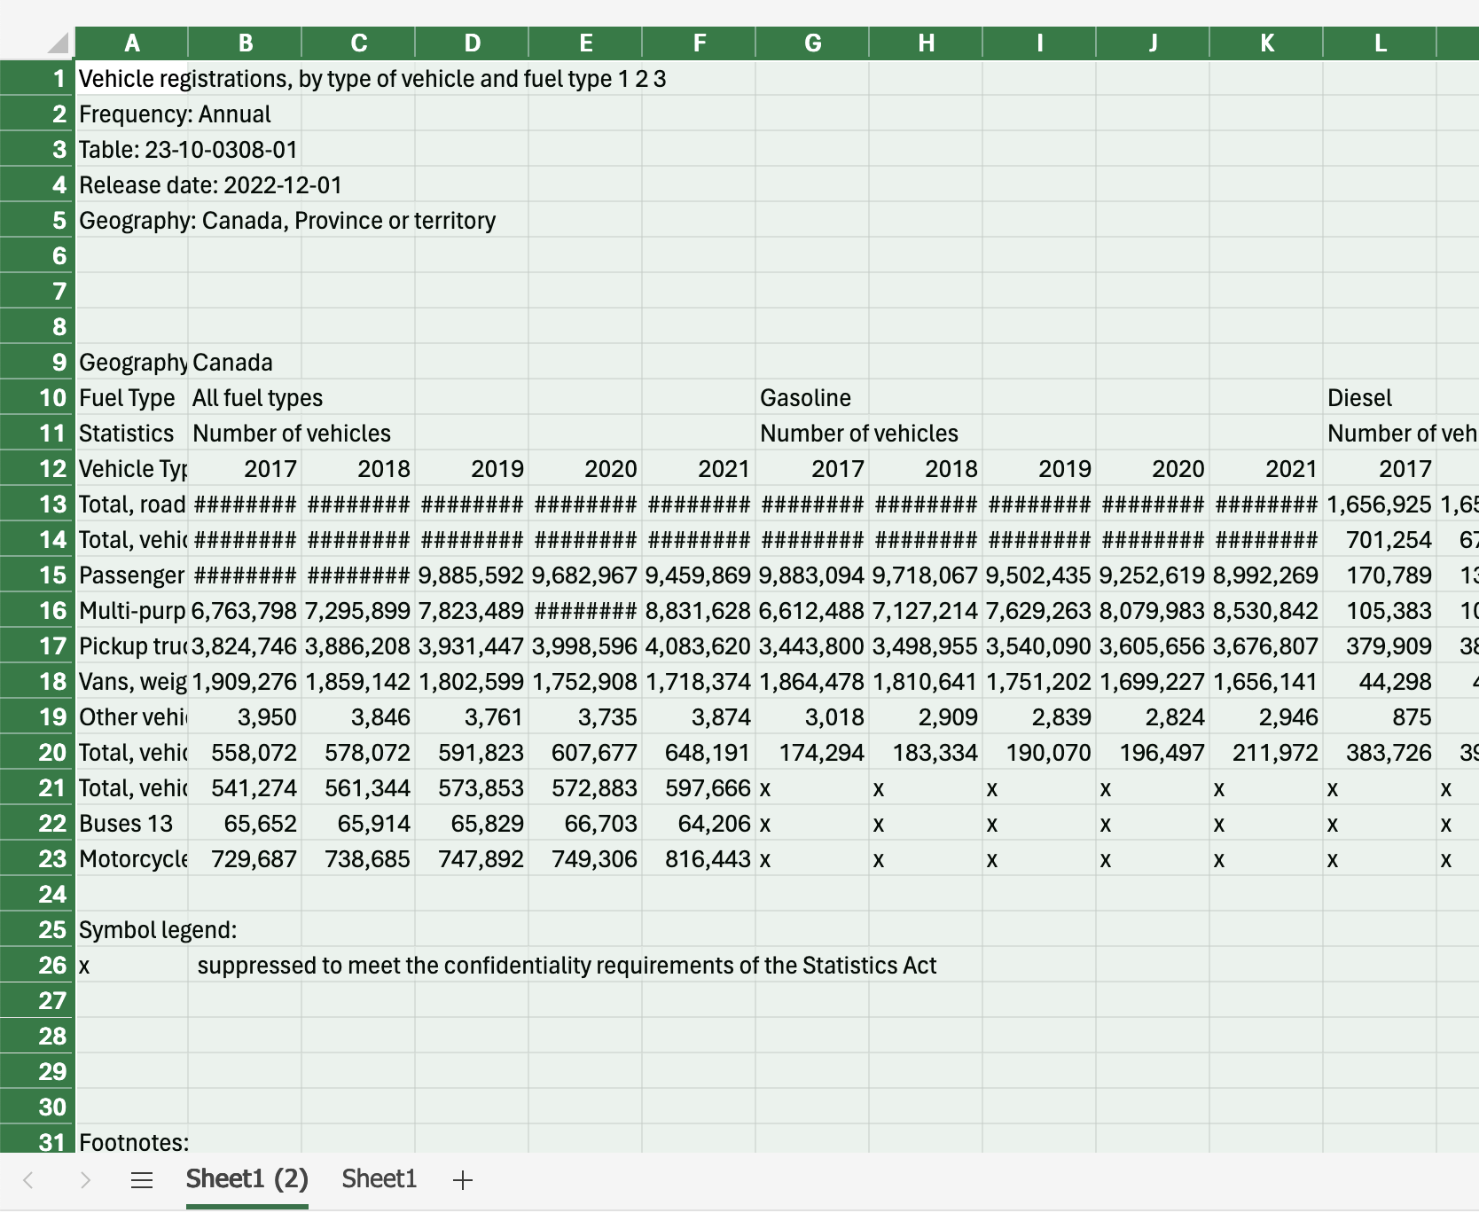
Step 2: Highlight all in the duplicate sheet
The way to highlight an Excel sheet is to go to this cell (box) and click on it. Then the wholesheet will be highlighted.
This is an Excel tip only
© Anne MacLennan, 2024​​
Statistics Canada. (2024, October 21). Vehicle registrations, by type of vehicle and fuel type. Government of Canada. https://www150.statcan.gc.ca/t1/tbl1/en/tv.action?pid=2310030801

Slide 6
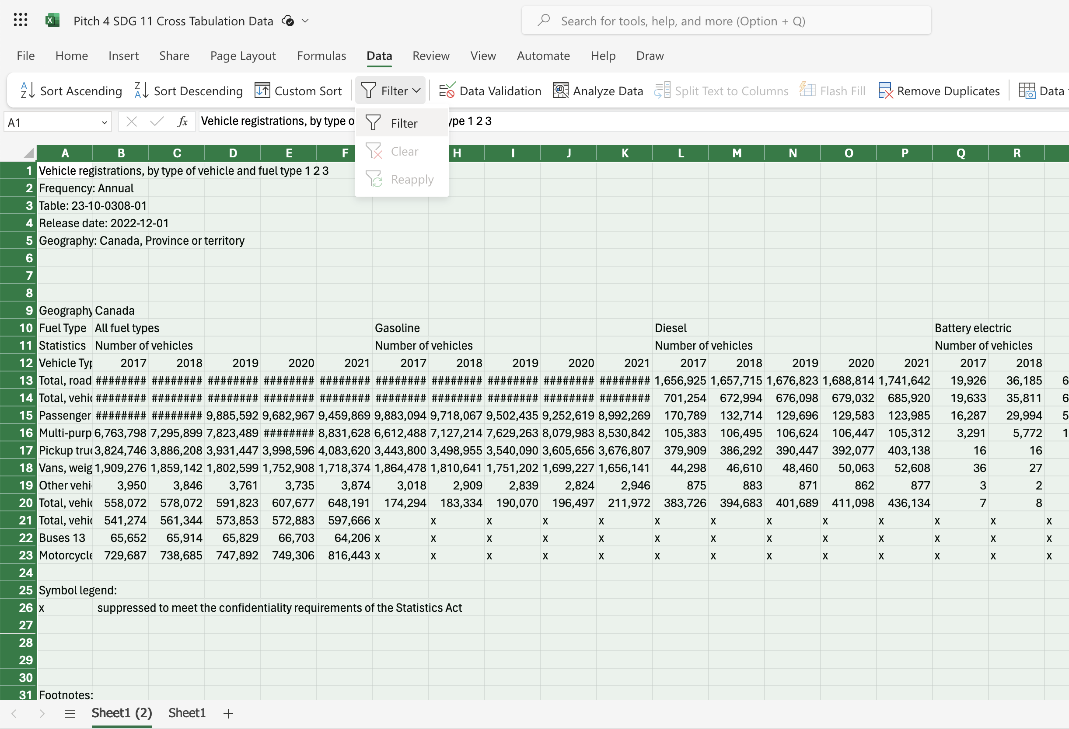
Step 3: Click data and then filter
© Anne MacLennan, 2024​​
Statistics Canada. (2024, October 21). Vehicle registrations, by type of vehicle and fuel type. Government of Canada. https://www150.statcan.gc.ca/t1/tbl1/en/tv.action?pid=2310030801

Slide 7
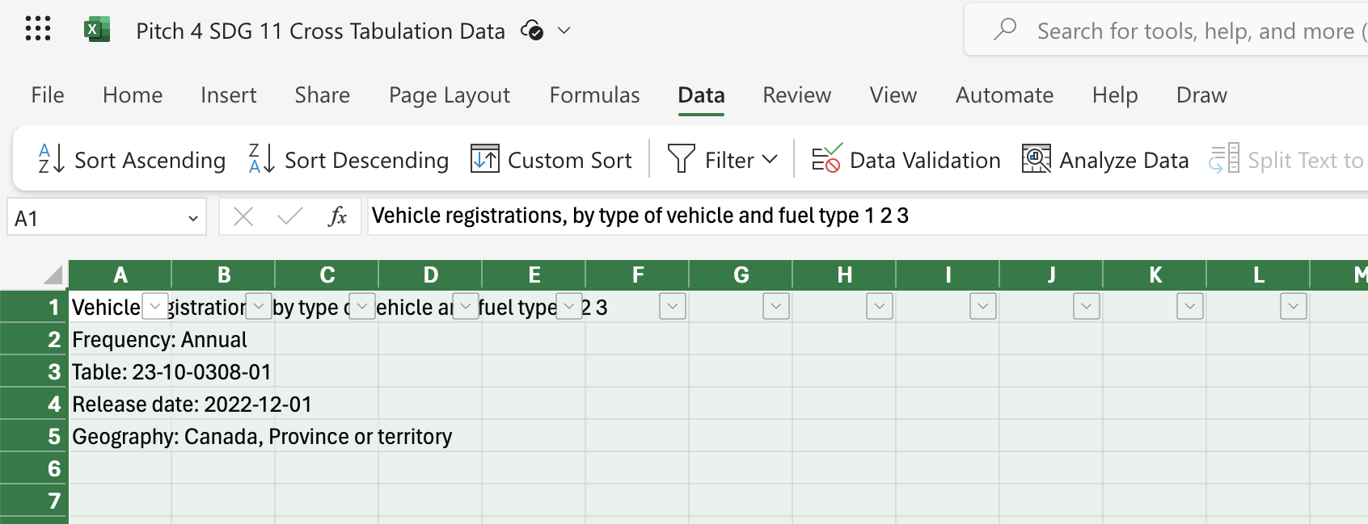
Step 4: Click data and then filter
Make sure the dropdown arrows appear
© Anne MacLennan, 2024​​
Statistics Canada. (2024, October 21). Vehicle registrations, by type of vehicle and fuel type. Government of Canada. https://www150.statcan.gc.ca/t1/tbl1/en/tv.action?pid=2310030801

Slide 8
Cross tabulating
When you cross tabulate what you are doing is comparing at least two variables. You need to pick two variables you want to cross tabulate, such as gender and wages in the workplace.
In step 3, we will select variables by using the select all feature in the filtered columns.
© Anne MacLennan, 2024​​

Slide 9
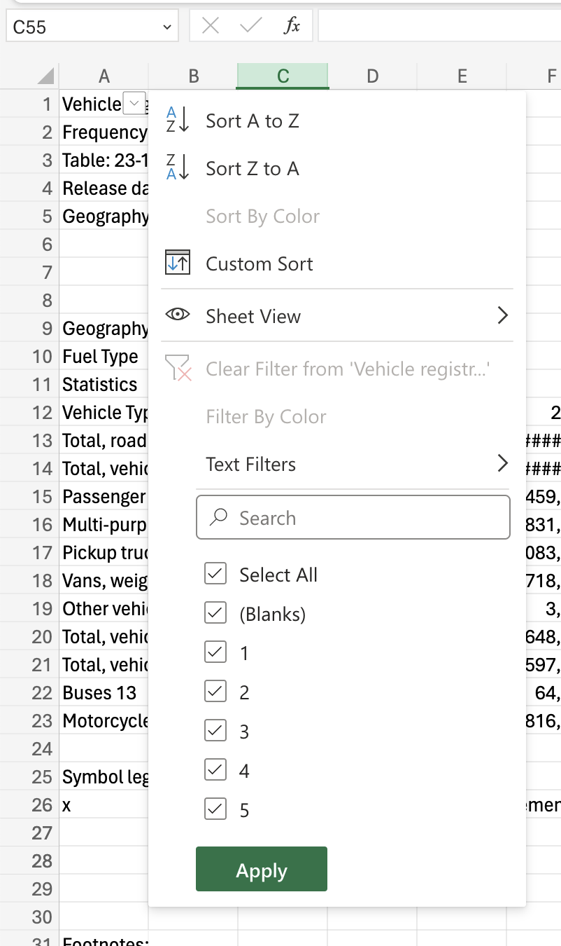
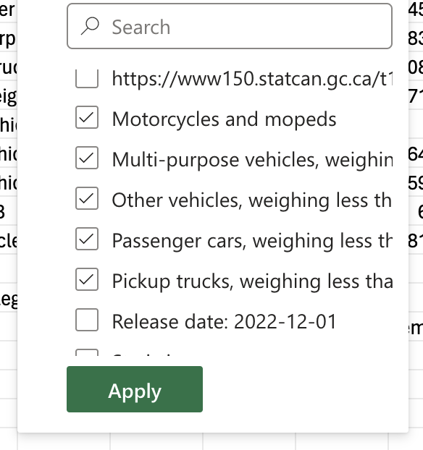
Step 5: Click arrow down to sort column
Make sure to unselect all, then select all relevant input (for this example, Ontario and Quebec). Click apply after.
© Anne MacLennan, 2024​​
Statistics Canada. (2024, October 21). Vehicle registrations, by type of vehicle and fuel type. Government of Canada. https://www150.statcan.gc.ca/t1/tbl1/en/tv.action?pid=2310030801

Slide 10
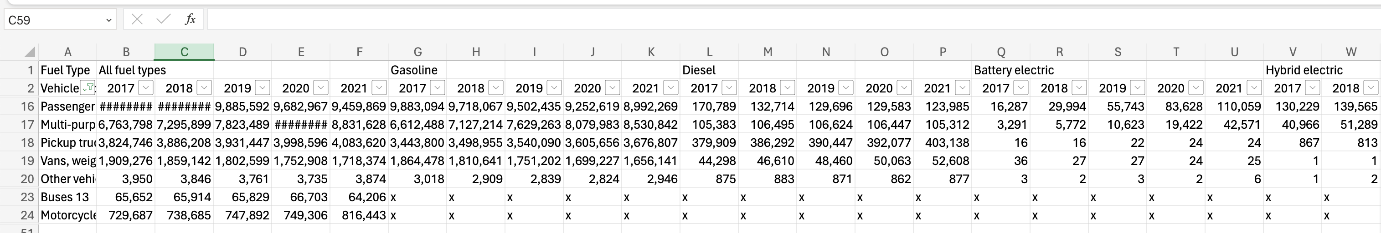
This is how it should look after completing Step 5
© Anne MacLennan, 2024​​
Statistics Canada. (2024, October 21). Vehicle registrations, by type of vehicle and fuel type. Government of Canada. https://www150.statcan.gc.ca/t1/tbl1/en/tv.action?pid=2310030801

Slide 11
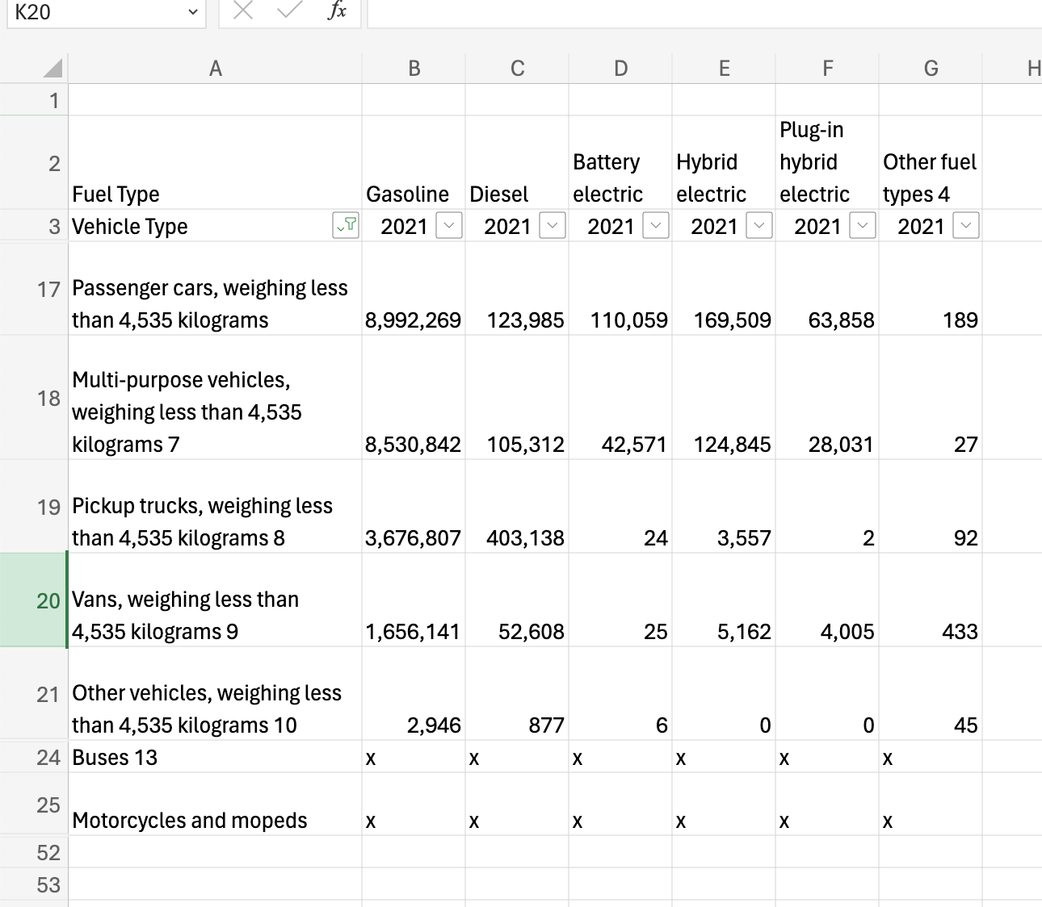
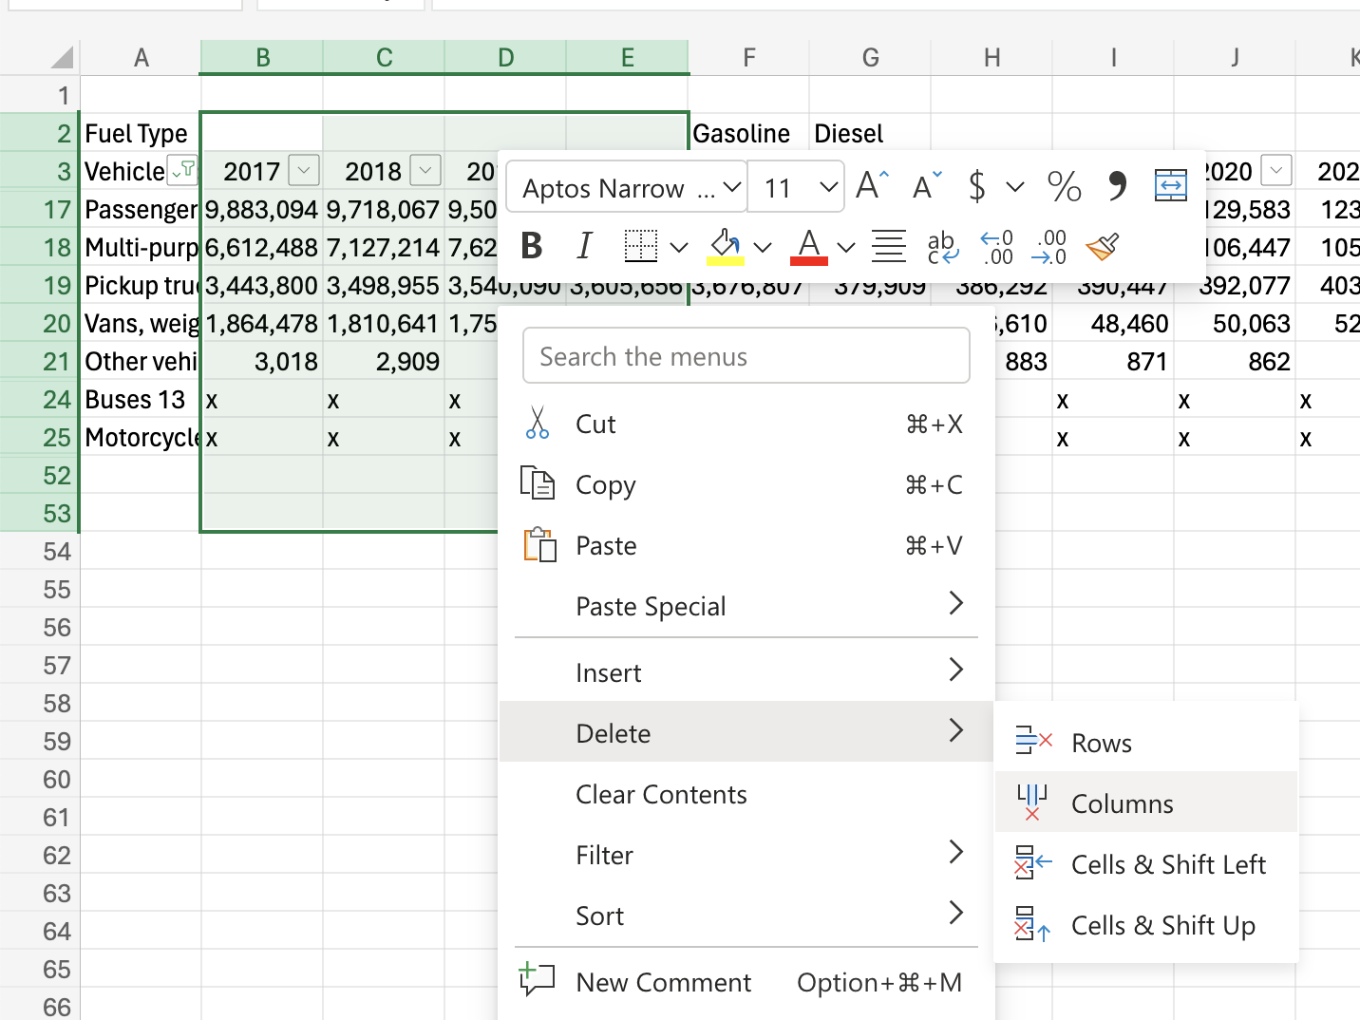
Step 6: Fix headers and formatting
Cross check duplicate sheet (the one you're working on) with the original sheet for important information
Remove data that is not being compared
© Anne MacLennan, 2024​​
Statistics Canada. Table 23-10-0308-01 Vehicle registrations, by type of vehicle and fuel type.https://www150.statcan.gc.ca/t1/tbl1/en/tv.action?pid=2310030801 ​

Slide 12
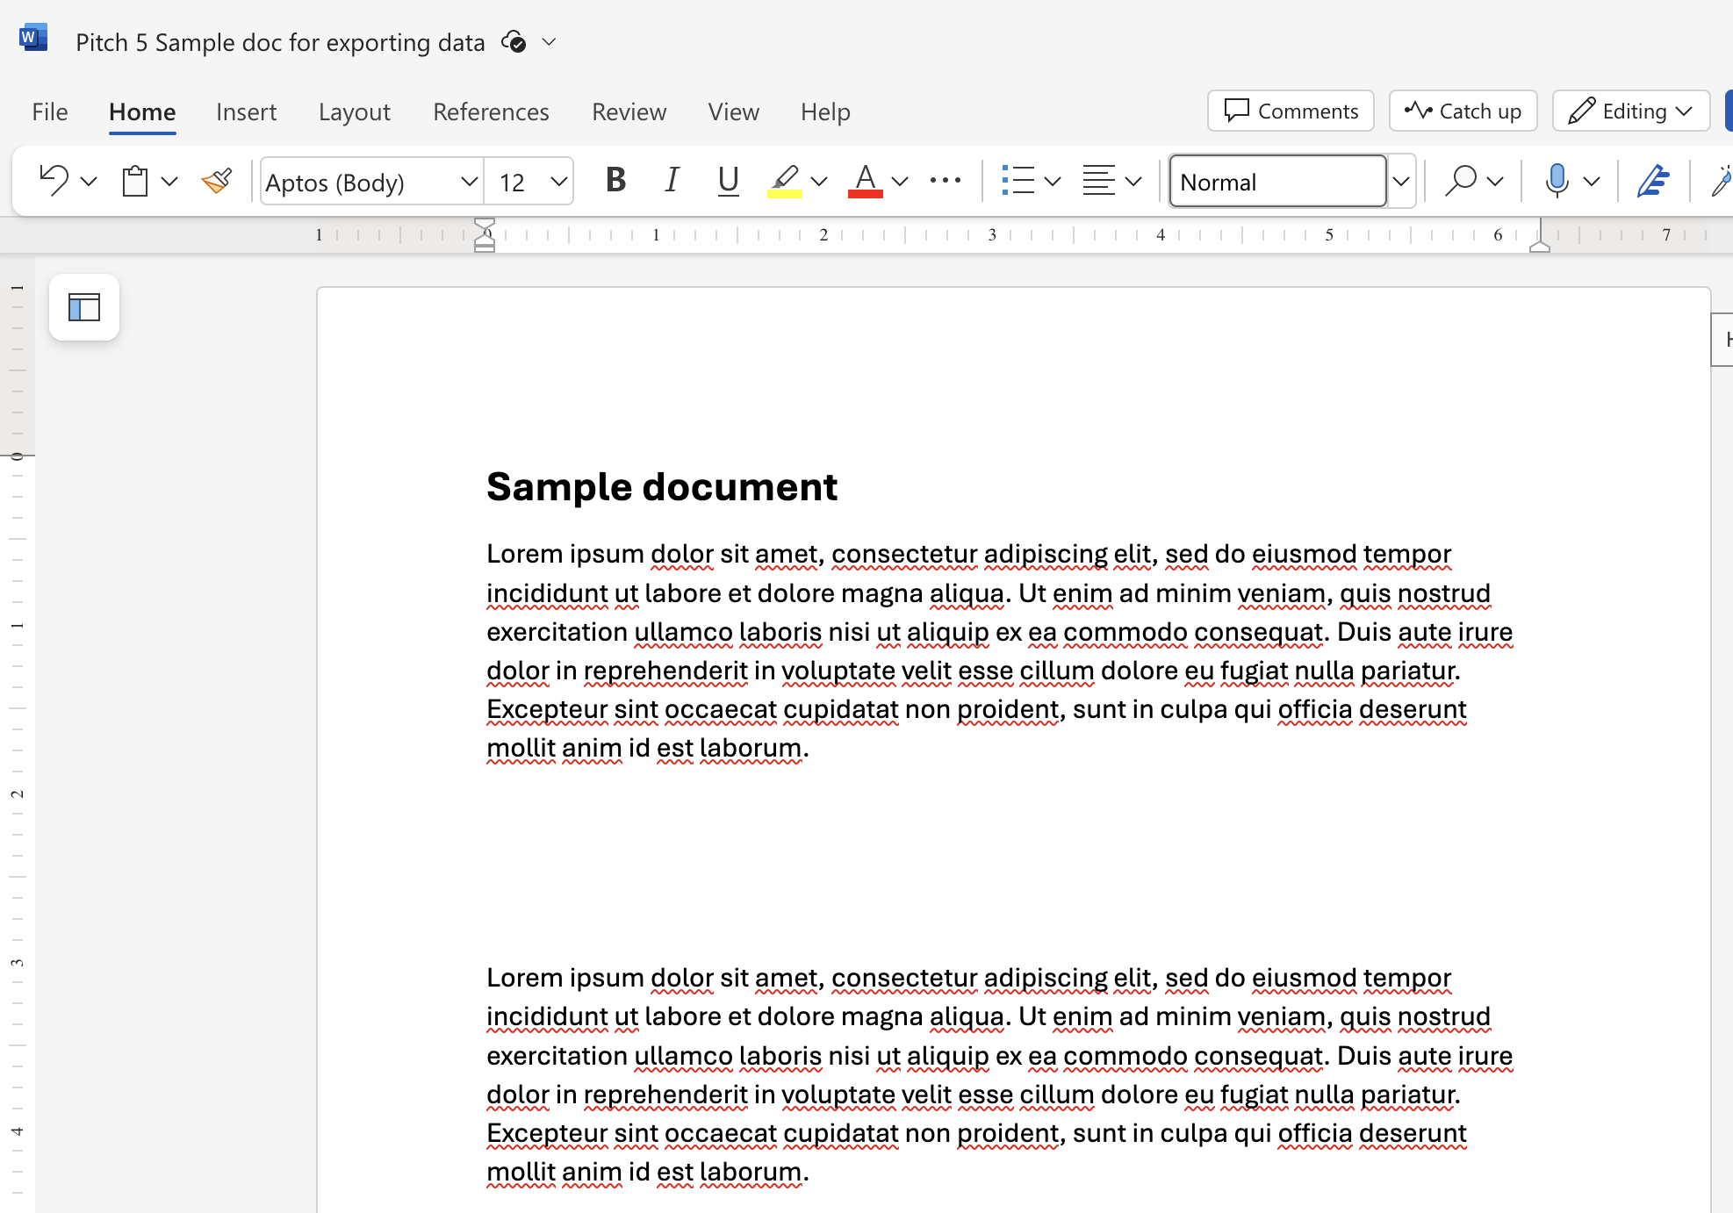
Ways to move data from Excel to Word file
This is an Excel tip only ​​​​
© Anne MacLennan, 2024​​
Statistics Canada. Table 23-10-0308-01 Vehicle registrations, by type of vehicle and fuel type.https://www150.statcan.gc.ca/t1/tbl1/en/tv.action?pid=2310030801 ​

Slide 13
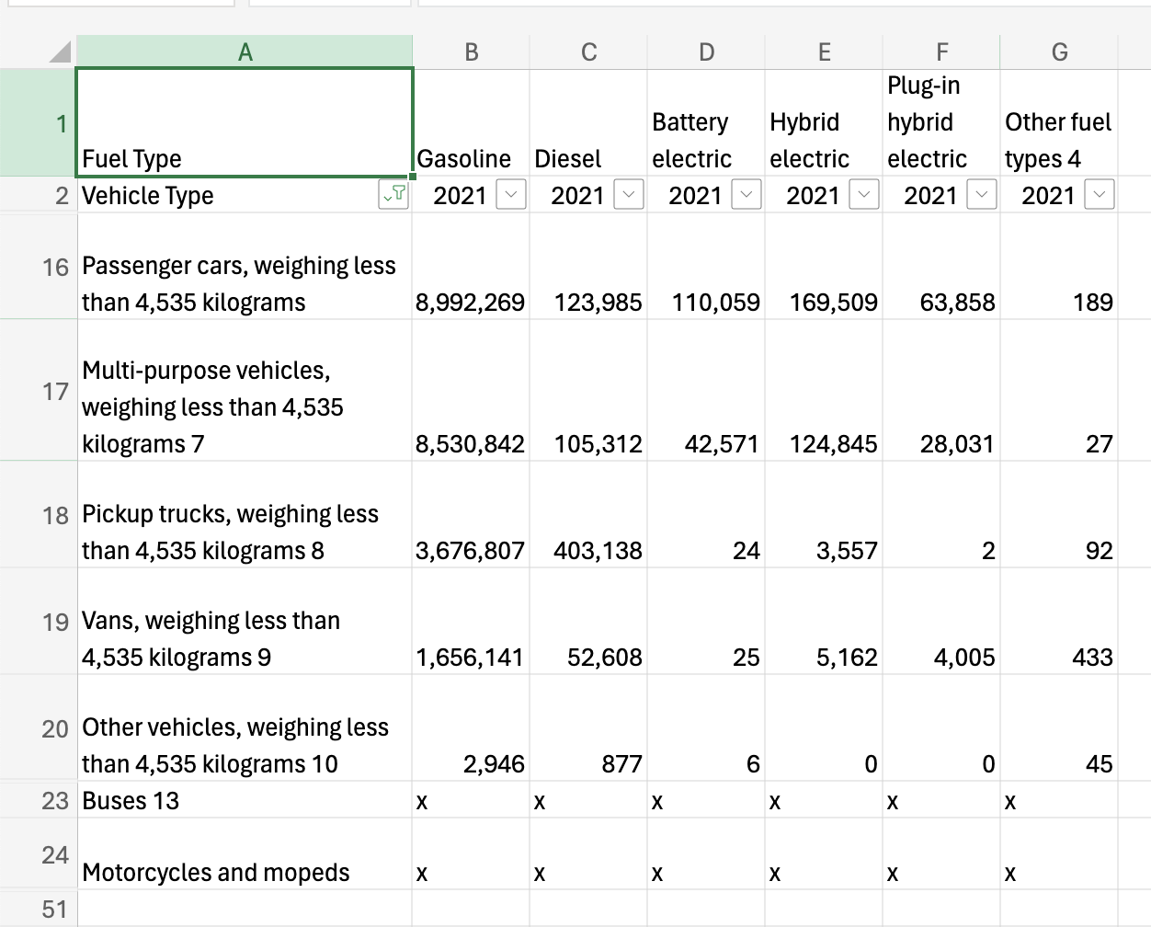
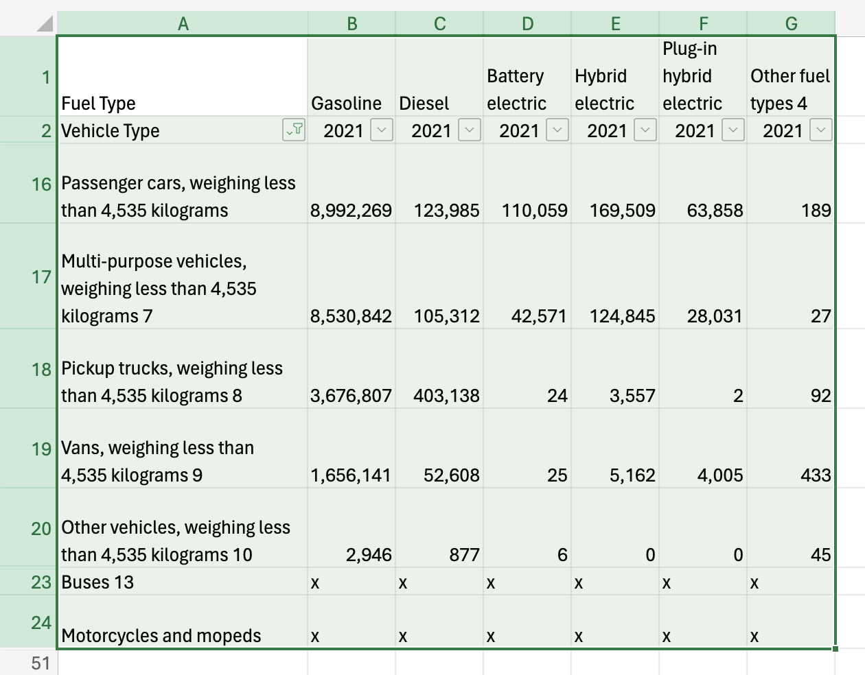
Copy Pasting Step 1: Selecting Data
Click top left cell > hold shift > click bottom right cell to highlight all information
This is an Excel tip only
© Anne MacLennan, 2024​​
Statistics Canada. (2024, October 21). Vehicle registrations, by type of vehicle and fuel type. Government of Canada. https://www150.statcan.gc.ca/t1/tbl1/en/tv.action?pid=2310030801

Slide 14
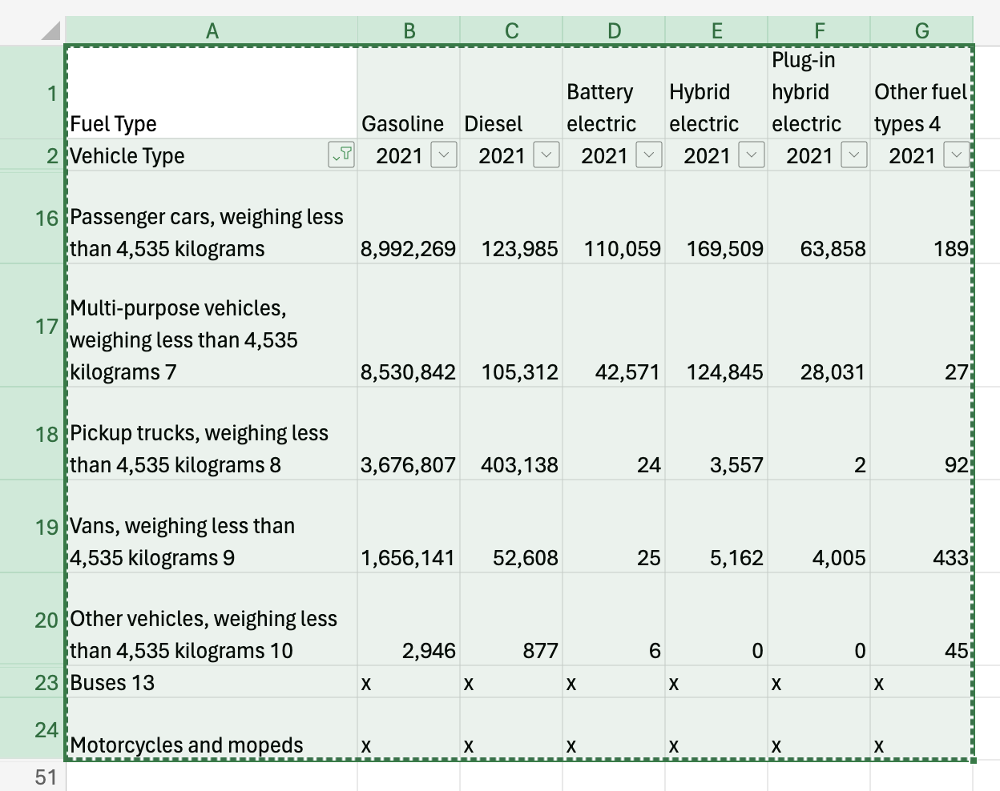
Step 2: Copying and Pasting Data
Ctrl + c (PC) or command + c (Mac) then Ctrl + v (PC) or command + v (Mac) into section in Word file
This is an Excel tip only
Note: marching ants border indicates that the data is copied and ready for pasting
© Anne MacLennan, 2024​​
Statistics Canada. (2024, October 21). Vehicle registrations, by type of vehicle and fuel type. Government of Canada. https://www150.statcan.gc.ca/t1/tbl1/en/tv.action?pid=2310030801

Slide 15
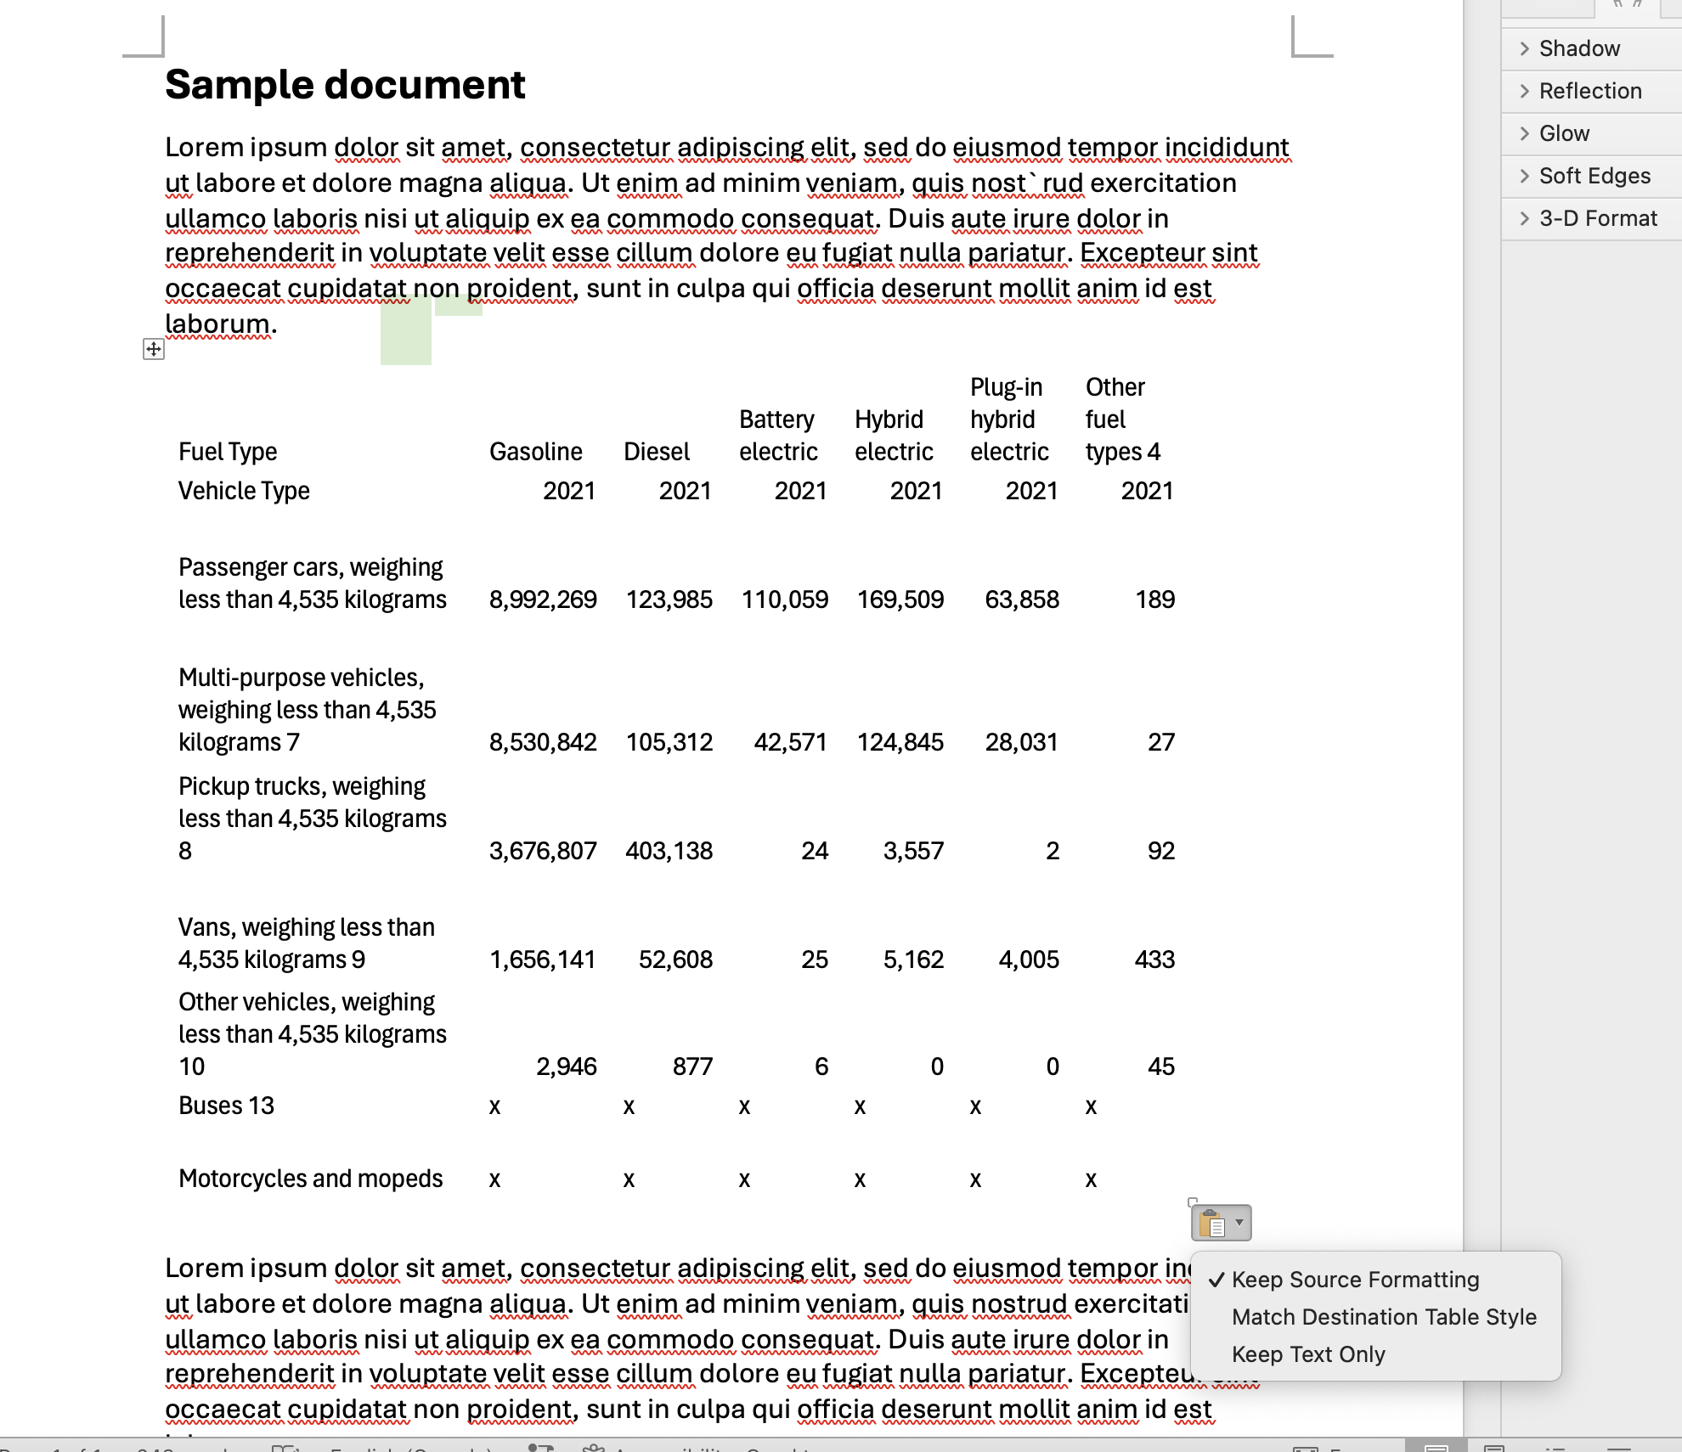
Step 3: Copying and Pasting Data
Ctrl + c (PC) or command + c (Mac) then Ctrl + v (PC) or command + v (Mac) into section in Word file
Statistics Canada. (2024, October 21). Vehicle registrations, by type of vehicle and fuel type. Government of Canada. https://www150.statcan.gc.ca/t1/tbl1/en/tv.action?pid=2310030801
© Anne MacLennan, 2024​​

Slide 16
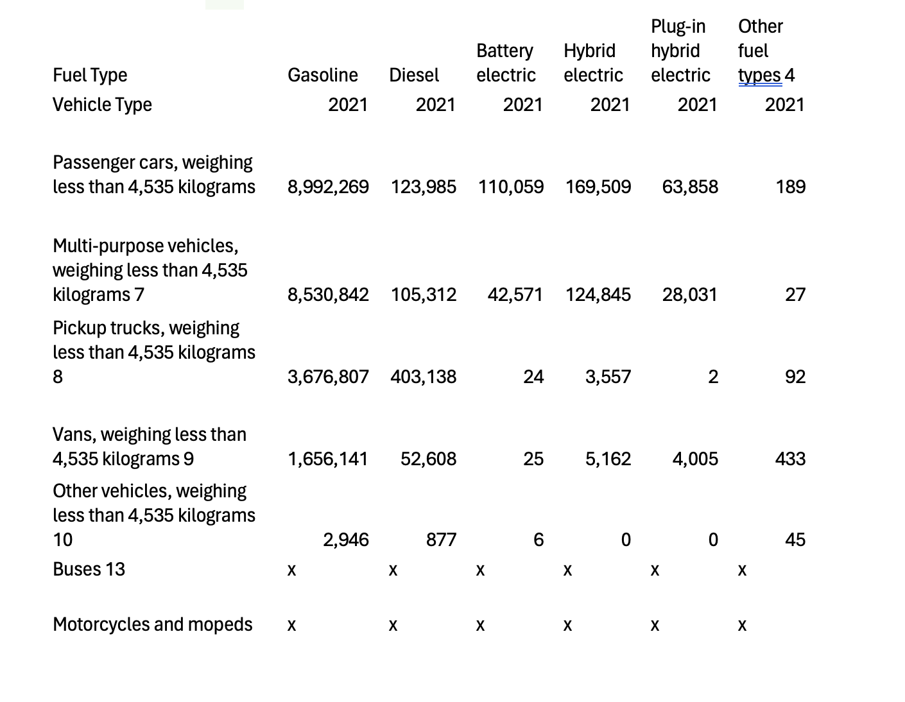
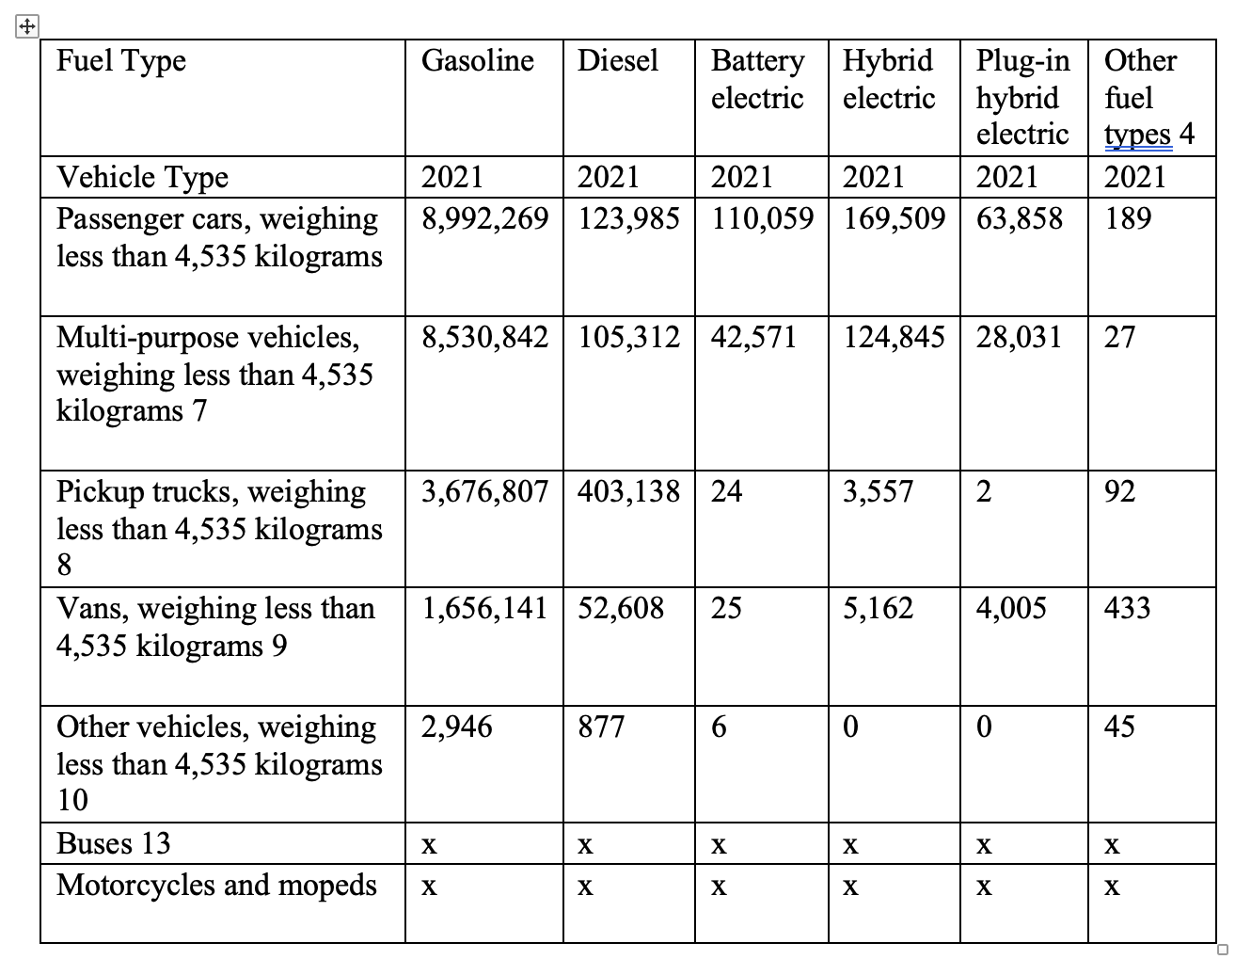
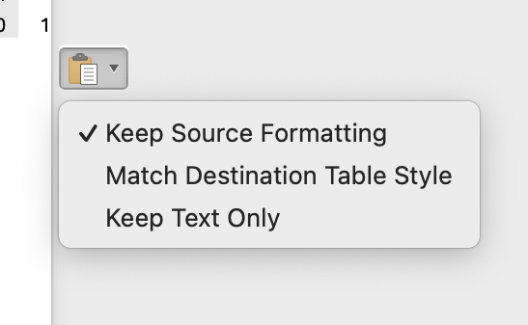
Step 4: Fixing the Formatting
Keep source formatting uses the same fonts and styles as the Excel sheet, match destination table style converts the copied data into the document's style
Make changes as needed
© Anne MacLennan, 2024​​
Statistics Canada. (2024, October 21). Vehicle registrations, by type of vehicle and fuel type. Government of Canada. https://www150.statcan.gc.ca/t1/tbl1/en/tv.action?pid=2310030801

Slide 17
Screenshot Step 1: Taking a Screenshot
Windows key + print scr (PC)
Shift + control + command + 3 (Mac)
© Anne MacLennan, 2024​​

Slide 18
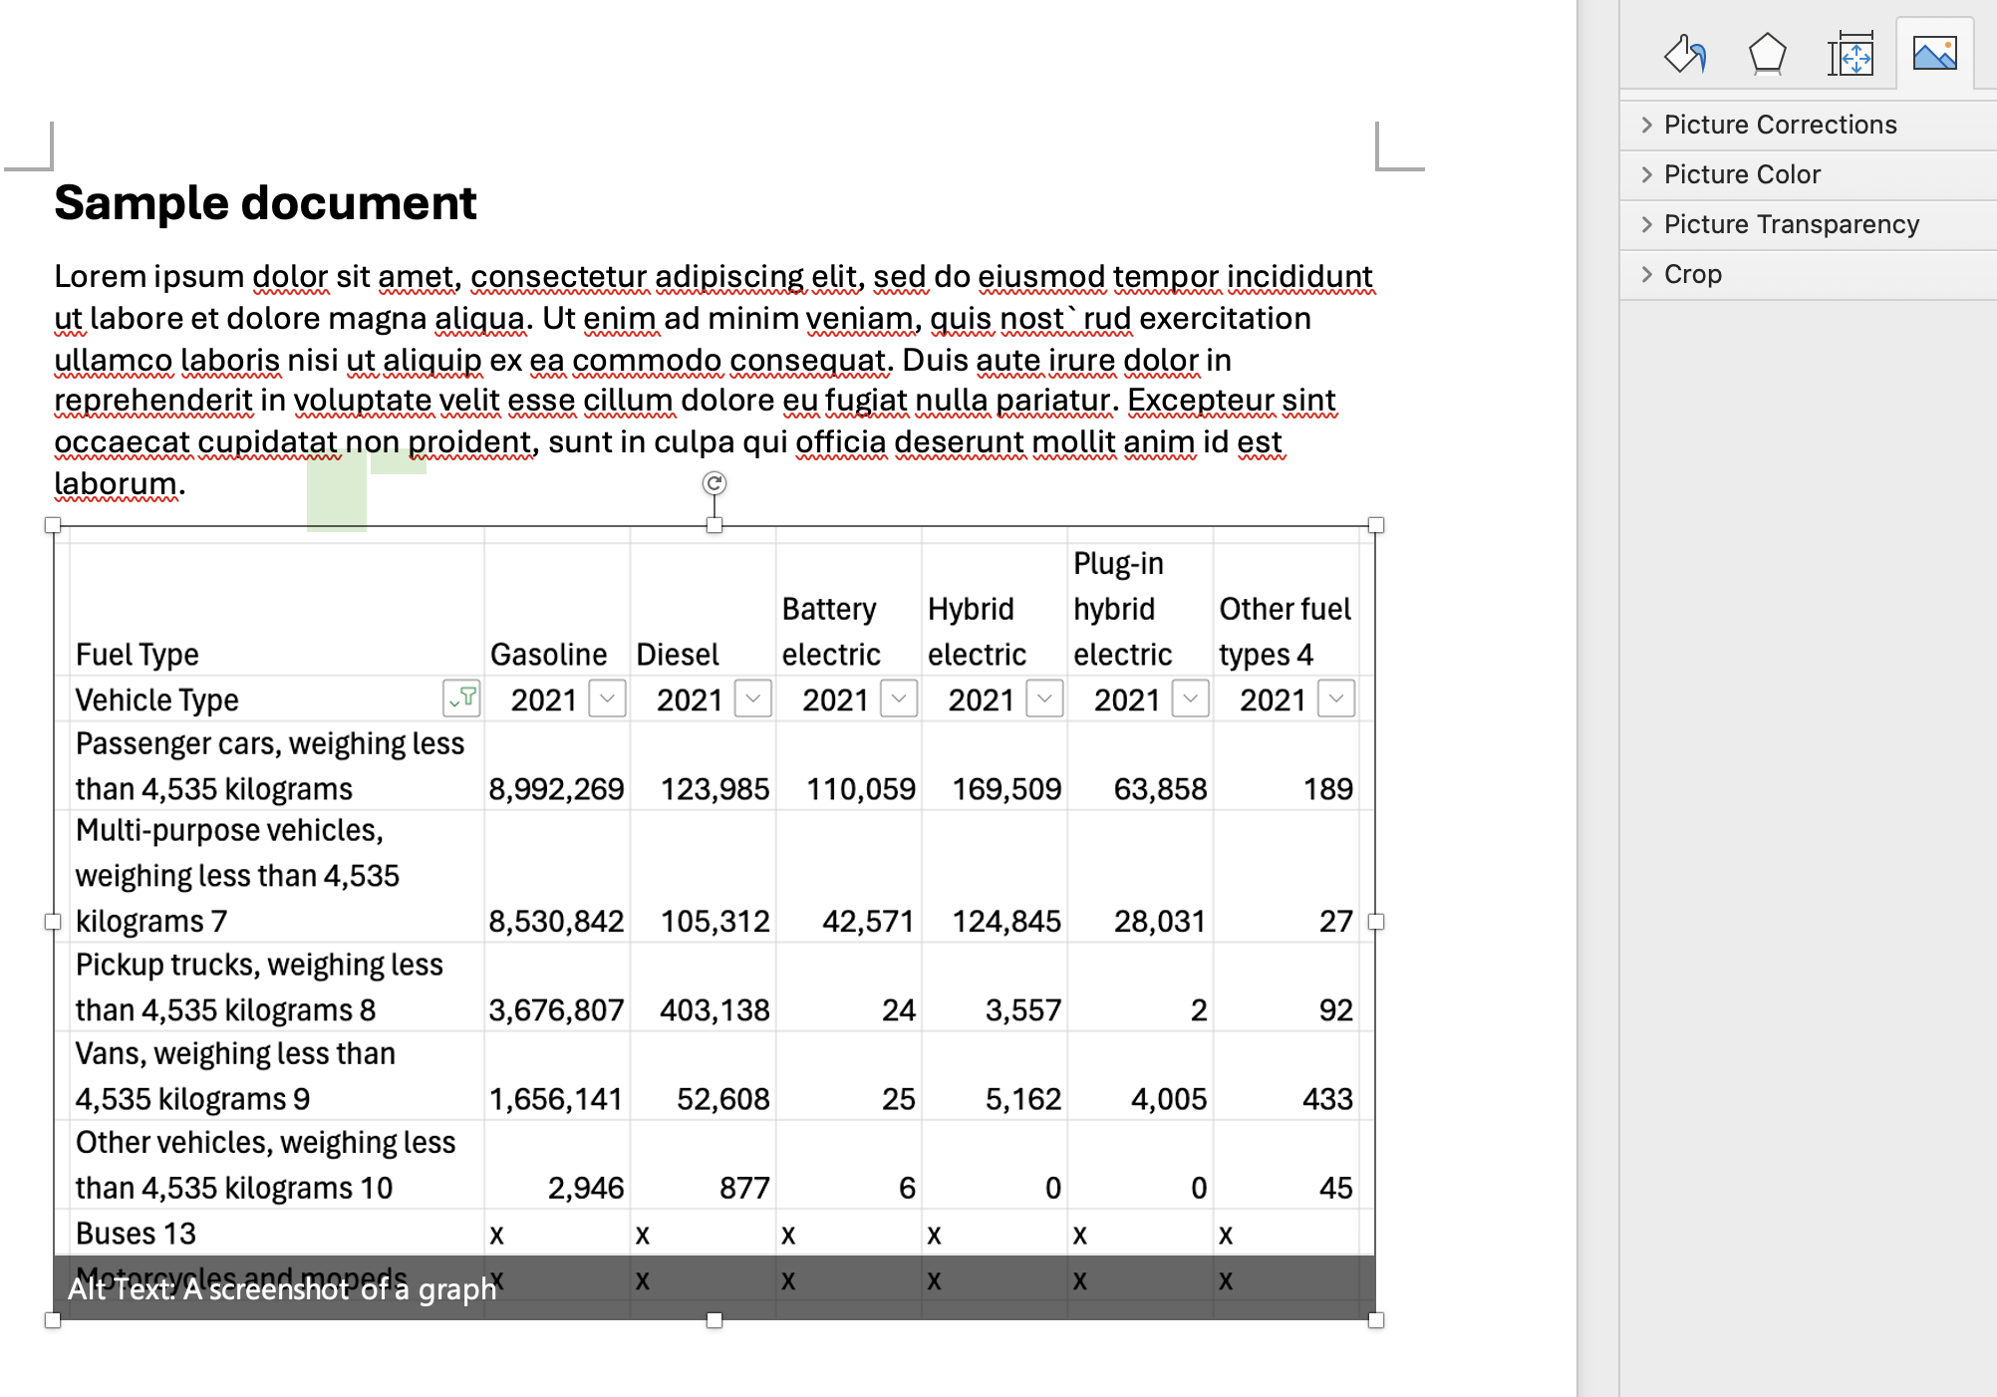
Step 2: Pasting a Screenshot
Go to Word document then press
  Ctrl + V (PC)
  Command + V (Mac)
Edit as needed
Double click to crop and edit
© Anne MacLennan, 2024​​
Statistics Canada. (2024, October 21). Vehicle registrations, by type of vehicle and fuel type. Government of Canada. https://www150.statcan.gc.ca/t1/tbl1/en/tv.action?pid=2310030801

Slide 19
References
Department of Economic and Social Affairs (2024). The sustainable development goals report 2024. United Nations. https://unstats.un.org/sdgs/report/2024/The-Sustainable-Development-Goals-Report-2024.pdf.
Statistics Canada. (2024, October 21). Vehicle registrations, by type of vehicle and fuel type. Government of Canada. https://www150.statcan.gc.ca/t1/tbl1/en/tv.action?pid=2310030801
© Anne MacLennan, 2024​​​

