Slide 1
Accessible Copying and Copyright:
Section 32 and the Copyright Act Review
Heather Martin
Copyright Officer & Manager, E-Learning & Reserves
University of Guelph

Slide 2
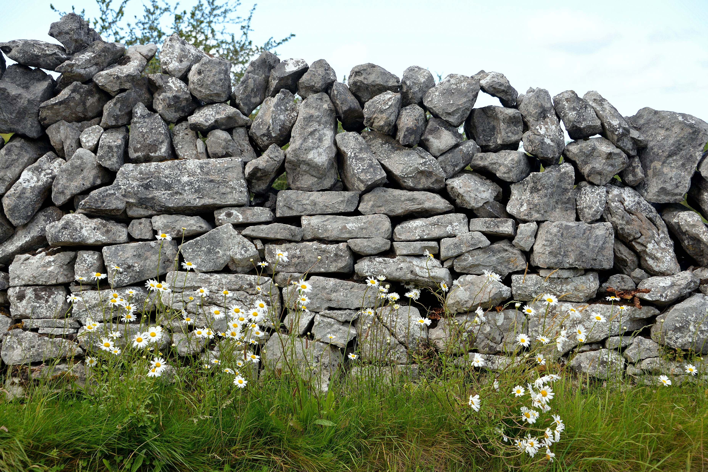
Copyright: barrier to accessibility?
Copyright protects works in all formats
Protects copyright owners from unauthorized use of their works
Term of copyright: Life + 50 (soon 70)
Without authorization, reproduction requires permission, and sometimes payment
Making accessible format copies = need to think about copyright!
Dry stone wall by Keith Ewing, CC BY NC

Slide 3
Copyright Act exceptions
Exceptions to the rights of copyright owners
Also known as users’ rights
Allow for reproduction of works without permission or payment
  In specific circumstances
  With defined limits

Slide 4
Exceptions for accessible copying?
Fair dealing
  research, private study, education, criticism, review, parody, satire, news reporting
  generally not entire works
Educational exceptions
  classroom instruction, exams and tests
Library and Archives exceptions
Section 32 : exception for persons with perceptual disabilities

Slide 5
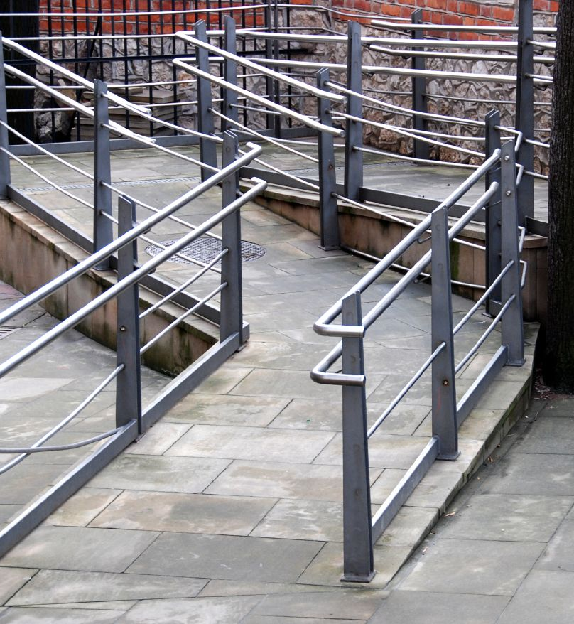
Section 32
Introduced with 1997 Copyright Act amendments
  Authorized copying by persons or non-profit organizations acting on behalf of persons with perceptual disabilities
Limitations
  excluded reproductions of cinematographic works, sound recordings, or broadcasts
  prohibited making of large print books
  commercial availability requirement
Accessible by jurek d. CC BY NC

Slide 6
Copyright Modernization Act Amendments (2012)
Addition of “education” to fair dealing
Mandated 5 year review
Digital lock provisions (technological protection measures)
  Prohibits circumvention or removal of a TPM, even if for a non-infringing purpose (such as fair dealing or S. 32)
  TPMs can control access to and/or copying of a work
  Allowed circumvention for accessible format copying but only if TPM not “unduly impaired”.

Slide 7
Marrakesh Treaty Amendments (2016)
  Language of Section 32 updated to clarify specific works that the exception applies to.
  Restriction on making large print copies of books removed
  Definition of “print disability” modified to include artistic works
  Expanded the purposes for which TPMs or digital locks can be circumvented
  Removes limitation that circumvention of TPM may not unduly impair the TPM.

Slide 8

Obstacles remain….
Cinematographic works still excluded
Commercial availability requirement
Terms and conditions of licenses can override exceptions

Slide 9
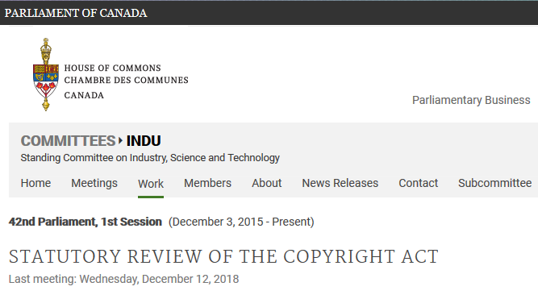
Copyright Act Review
Took place throughout 2018
Public consultation
  40 public meetings, 6 cities
  209 witnesses
  Open mic sessions
  191 written submissions (briefs)

Slide 10
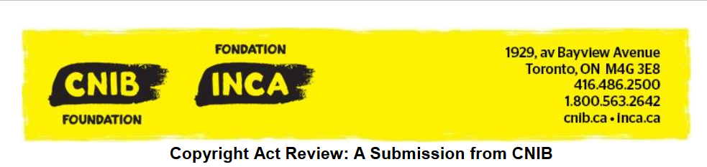

OCUL Video Community
OCUL Accessibility Community

Slide 11
OCUL Accessibility Community Submission
Single focus: remove limitation on cinematographic works
Submission included:
  Details of AODA requirements for libraries of educational institutions
  Challenges of providing accessible formats for video
  Case study illustrating how a university student with a perceptual disability is disadvantaged by cinematographic limitation
  Link to submission of the OCUL Accessibility Community members.

Slide 12
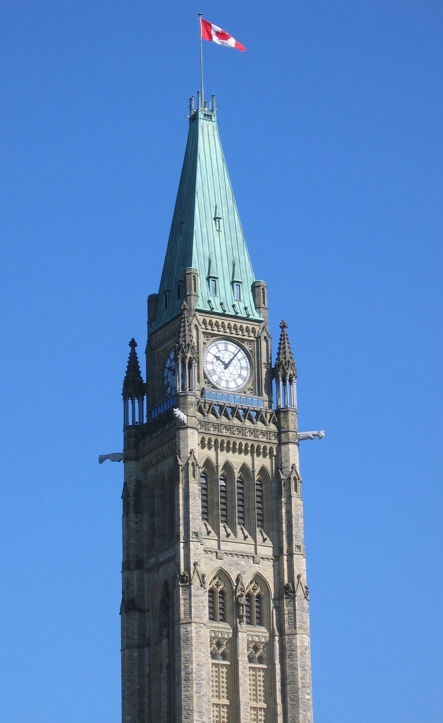
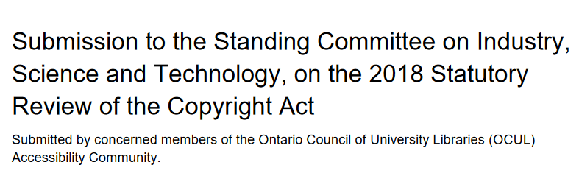
“Currently, Section 32 (1) of the Copyright Act does not provide a technologically neutral exception for providing alternate format materials for people with perceptual disabilities. We recommend removing the limitation on reproducing cinematographic works, in order to facilitate captioning, video description, or any other acts required to make a cinematographic work accessible to a person with a perceptual disability.”

Slide 13
What next?
Committee will review submissions
Committee’s report, including recommendations for changes to the Act, expected in a few months.
Changes before next election?

Slide 14
Questions?

