Slide 1

Pitch 5 - UN SDG 2 Zero Hunger
Content Analysis
© Anne MacLennan, 2024​

Slide 2

The requirements for this UN SDG data assignment is to complete 5 cross tabulations and/or content analysis from the original data sheets uploaded here. There are examples of both content analysis and cross tabulation for each pitch to show you want to do. Please make sure to do a combination, so that your assignment includes 5 but at least one is a cross tabulation and one is a content analysis. Please submit in the place created for UN SDG data assignment on Submit Assignment Here. The PowerPoints are the examples of what to do. Each has a data narrowed down from the original data sheets that follows. Then the original data sheets that you will used for the assignment will be at the end in this UN SDG data assignments Box. What you submit is 5 different spreadsheets as indicated above.
© Anne MacLennan, 2024​​

Slide 3
UN SDG 2
"Achieving zero hunger requires intensified efforts to transform food systems so they are sustainable, resilient and equitable. Moreover, accelerating improvements in diets, nutrition, health and hygiene is A woman sells produce in a village on the southernmost tip of Madagascar, where farmers are struggling to harvest parched crops. crucial to meeting the target of halving the number of children suffering from chronic undernutrition” (DESA, 2024).
Department of Economic and Social Affairs (2024). The sustainable development goals report 2024. United Nations.
© Anne MacLennan, 2024​​​

Slide 4
What is Content Analysis?
Content analysis is a way of generating qualitative data from qualitative data.
It always generates numbers
  Raw qualitative data
  Percentages
Easiest quantitative data
© Anne MacLennan, 2024​​​

Slide 5
What does Content Analysis do?
Make comparisons
Shows or detects trends
© Anne MacLennan, 2024​​​

Slide 6
Categories
The categorization of the data is crucial
The categories must be exhaustive and mutual exclusive
© Anne MacLennan, 2024​​​

Slide 7
Mutually exclusive
1. Means that all the categories have to be separate and clear
  example: 1-10 and 11-20 NOT 1-10 and 10-20 because 10 is in both
2. The data is qualitative mostly to start so to make the
  lines between the categories you need a code book
© Anne MacLennan, 2024​​​

Slide 8
Exhaustive
The categories need to include everything
© Anne MacLennan, 2024​​​

Slide 9
Data Comparisons
Content analysis can reveal a comparison that you expected and confirm your idea
Content analysis can reveal a comparison that is unexpected and force you to think about new data
© Anne MacLennan, 2024​​​

Slide 10
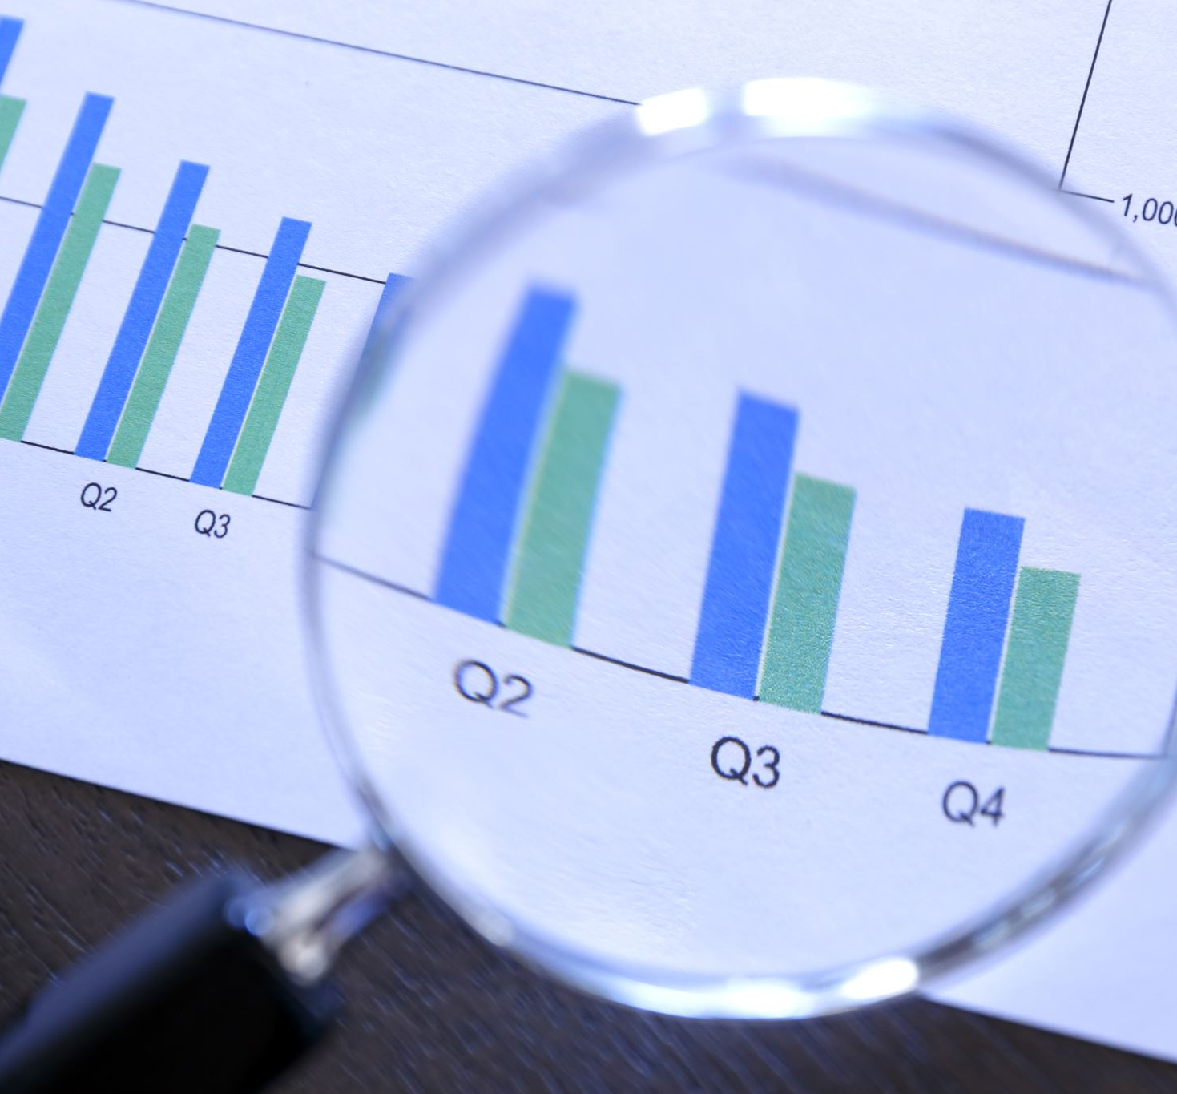
Step 1: Gather a Sample of articles
Gather a list of articles related to your topic
Example: 10 examples of articles related to UN SDG 2: Zero Hunger
© Anne MacLennan, 2024​​​

Slide 11
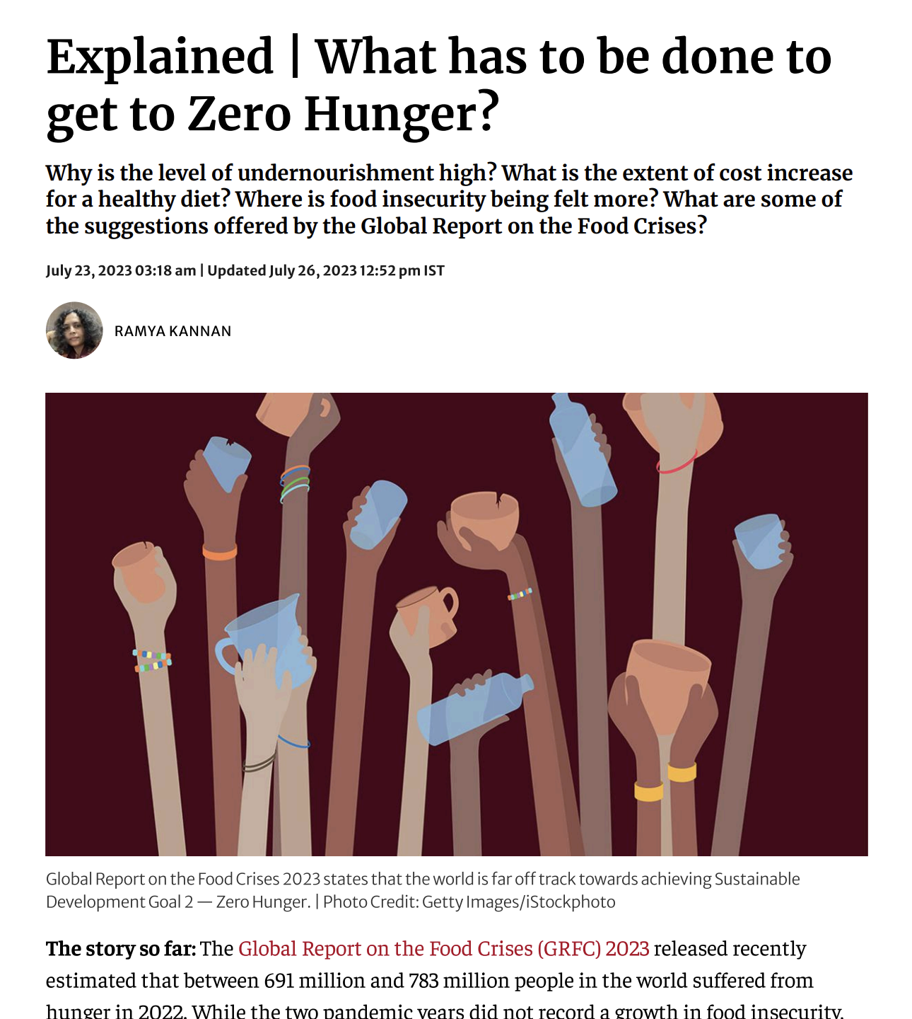
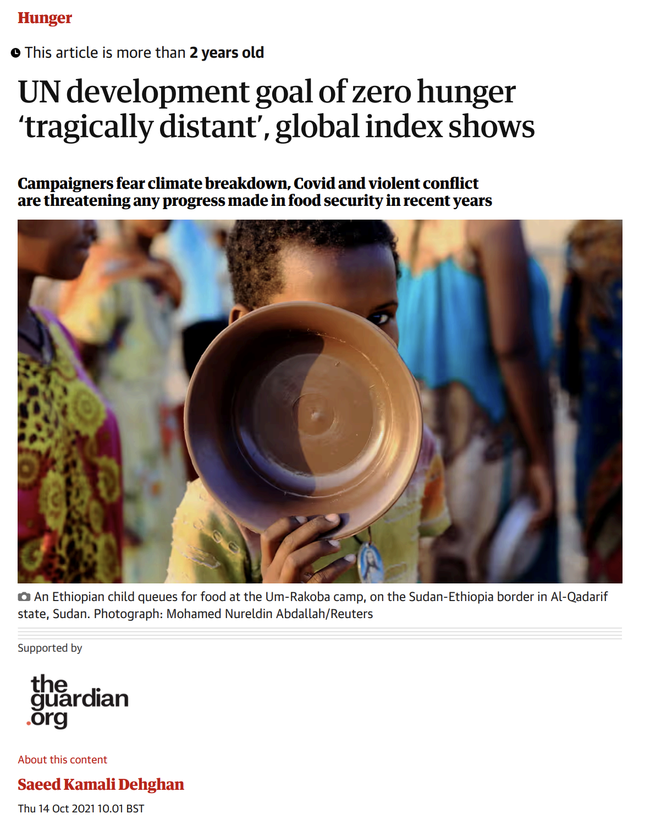
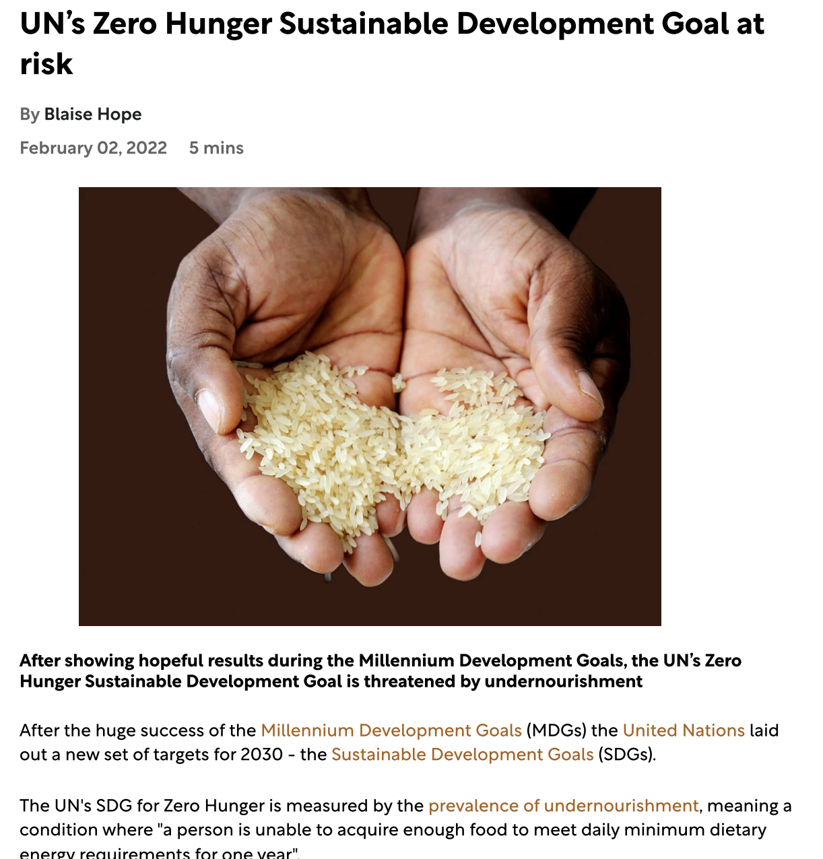
Step 2: Pick out your articles
Gather a list of articles related to your topic
Example: 10 examples of articles related to UN SDG 2: Zero Hunger
Kannan, R. (2023, July 26). Explained: What has to be done to get to zero hunger? The Hindu. https://www.thehindu.com/news/national/explained-what-has-to-be-done-to-get-to-zero-hunger/article67110492.ece
Dehgdan, S. K. (2021, October 14). UN development goal of zero hunger 'tragically distant,' global index shows. The Guardian. https://www.theguardian.com/global-development/2021/oct/14/un-development-goal-of-zero-hunger-tragically-distant-global-index-shows
Hope, B. (2022, February 2). UN’s zero hunger sustainable development goal at risk. Sustainability Magazine. https://sustainabilitymag.com/sustainability/sustainable-zero-hunger-sdg-united-nations-development-undernourishment-goals
© Anne MacLennan, 2024​​​

Slide 12
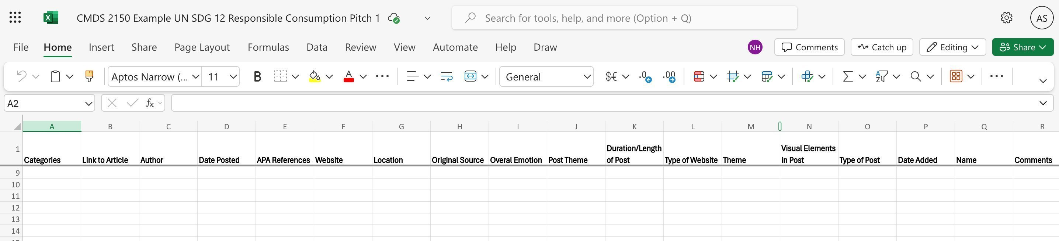
Step 3: Setting up a spreadsheet
Setting up the spreadsheet these are excel tips
Organizing the data in categories is part of your content analysis – you would design the categories
© Anne MacLennan, 2024​​​​​​

Slide 13
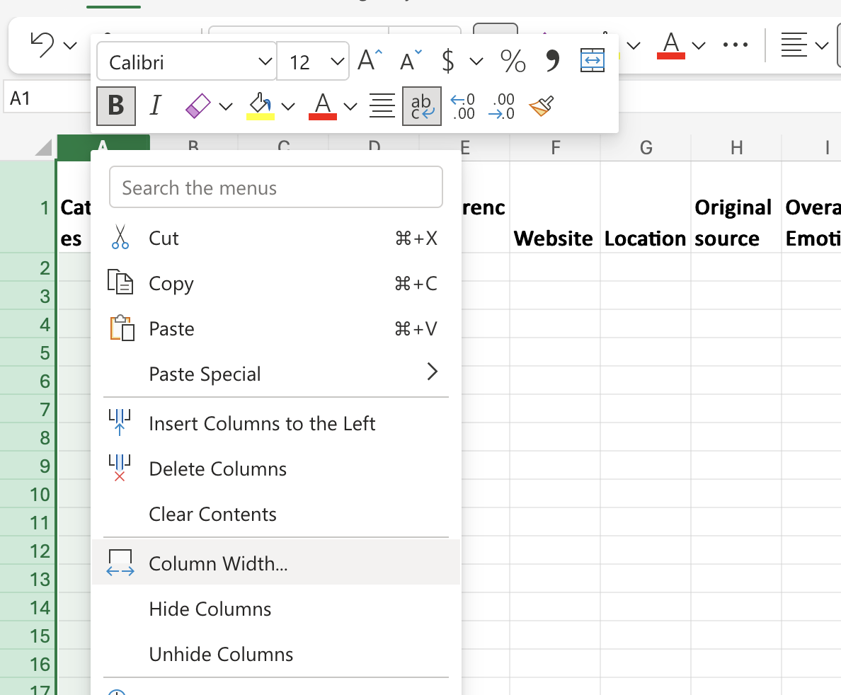
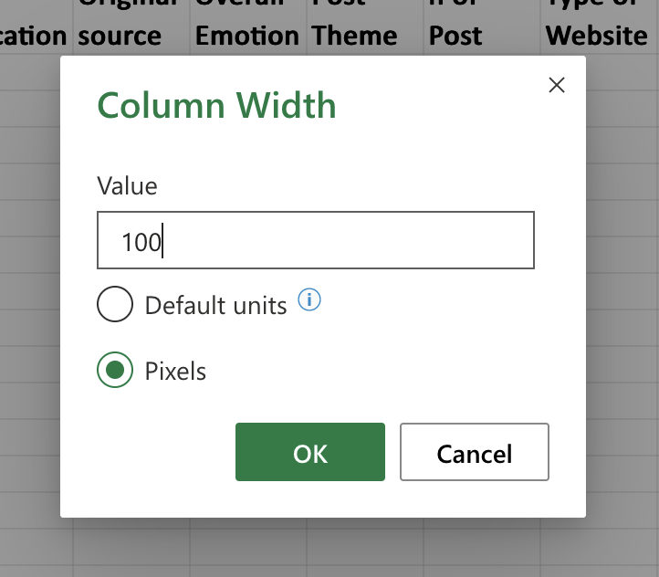
Step 4: Fix column widths
Example: right click on column "A", then click "column width" to adjust
If you want all your widths to be the same, you can do this
This is an Excel tip only
© Anne MacLennan, 2024​​​​​​

Slide 14
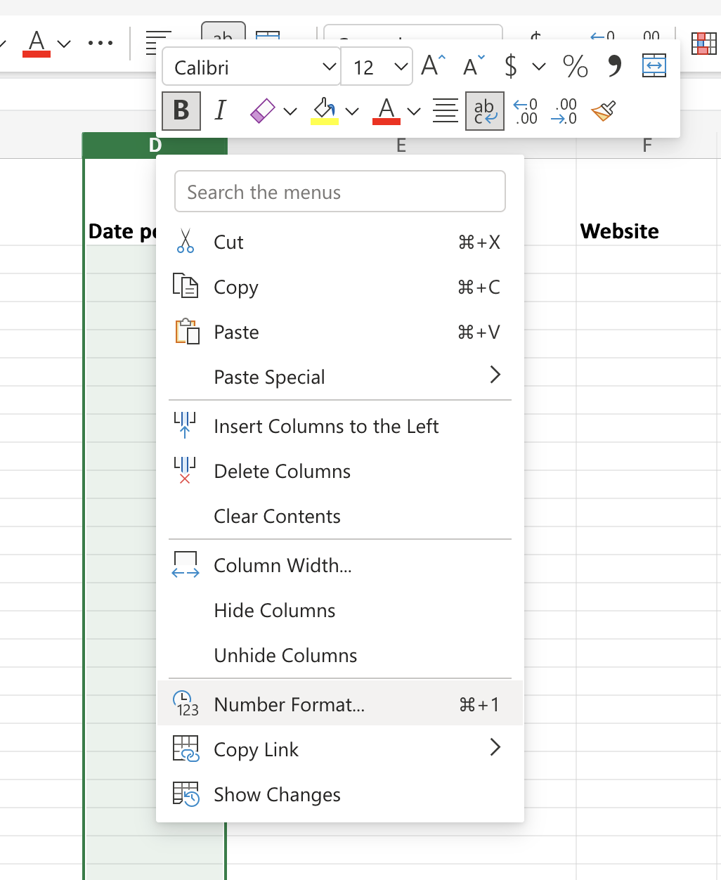
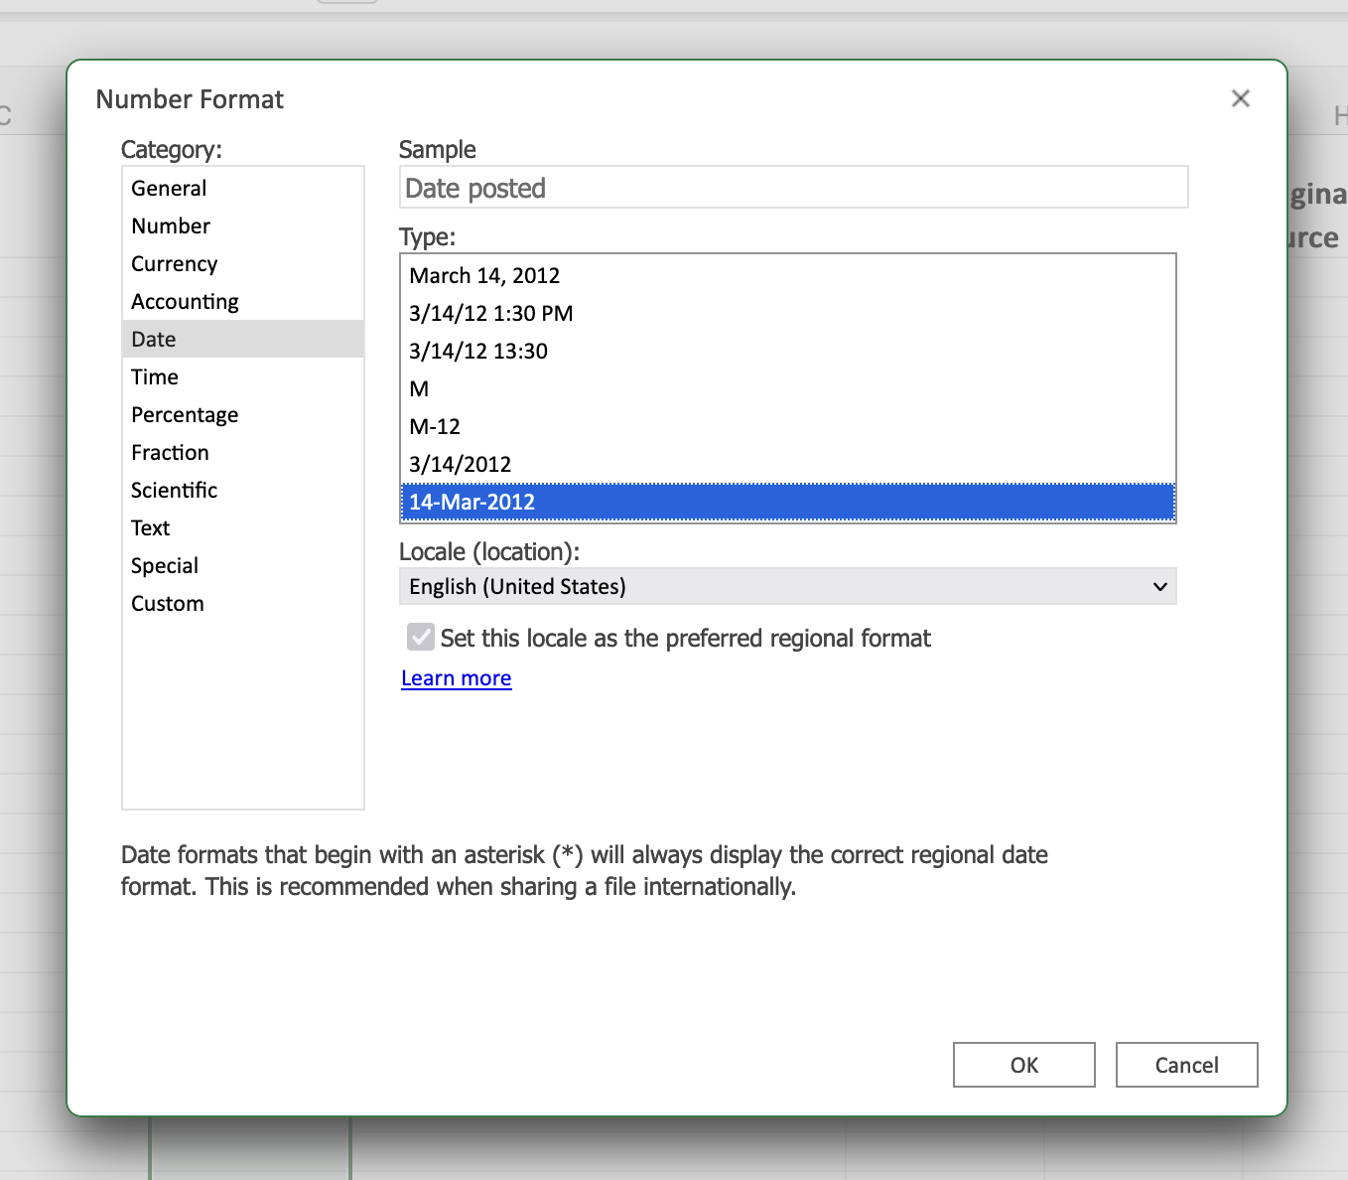
Step 5: Optional - Add a date format
Right click on column, then click "number format" to pick a format
This is an Excel tip only
© Anne MacLennan, 2024​​​​​​

Slide 15
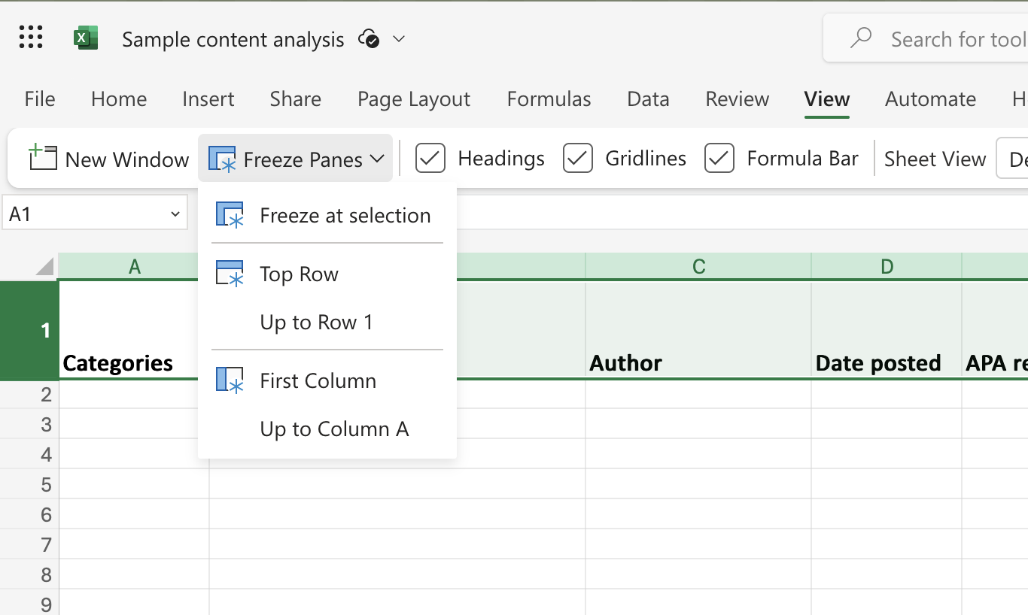
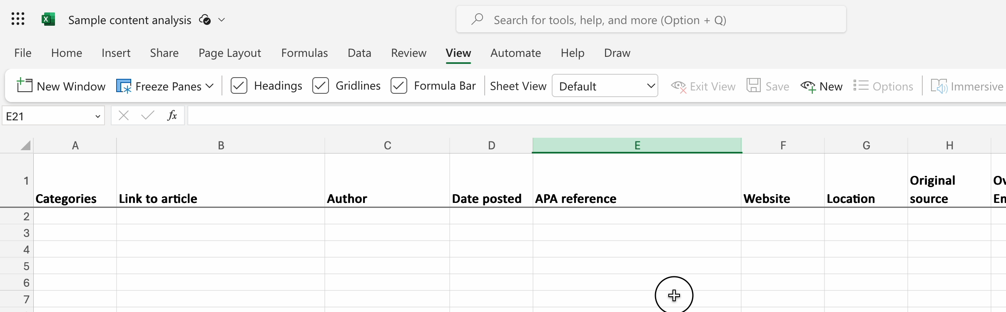
Step 6: Optional – Freeze first row
Right click on row, then click "view", then click "top row" to freeze the top row while scrolling down
This is an Excel tip only
© Anne MacLennan, 2024​​​​​​

Slide 16
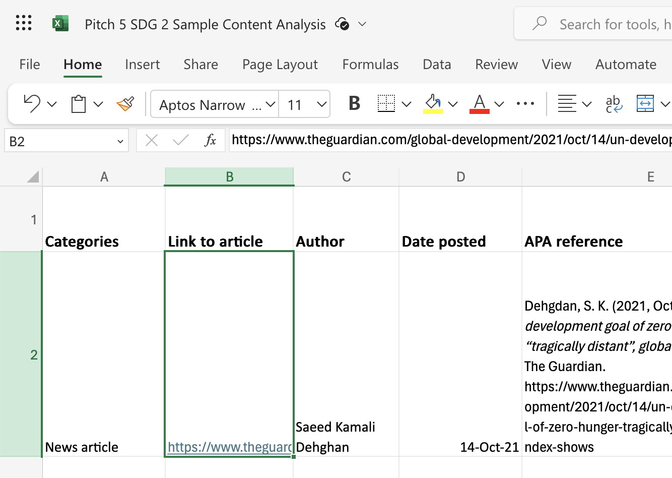
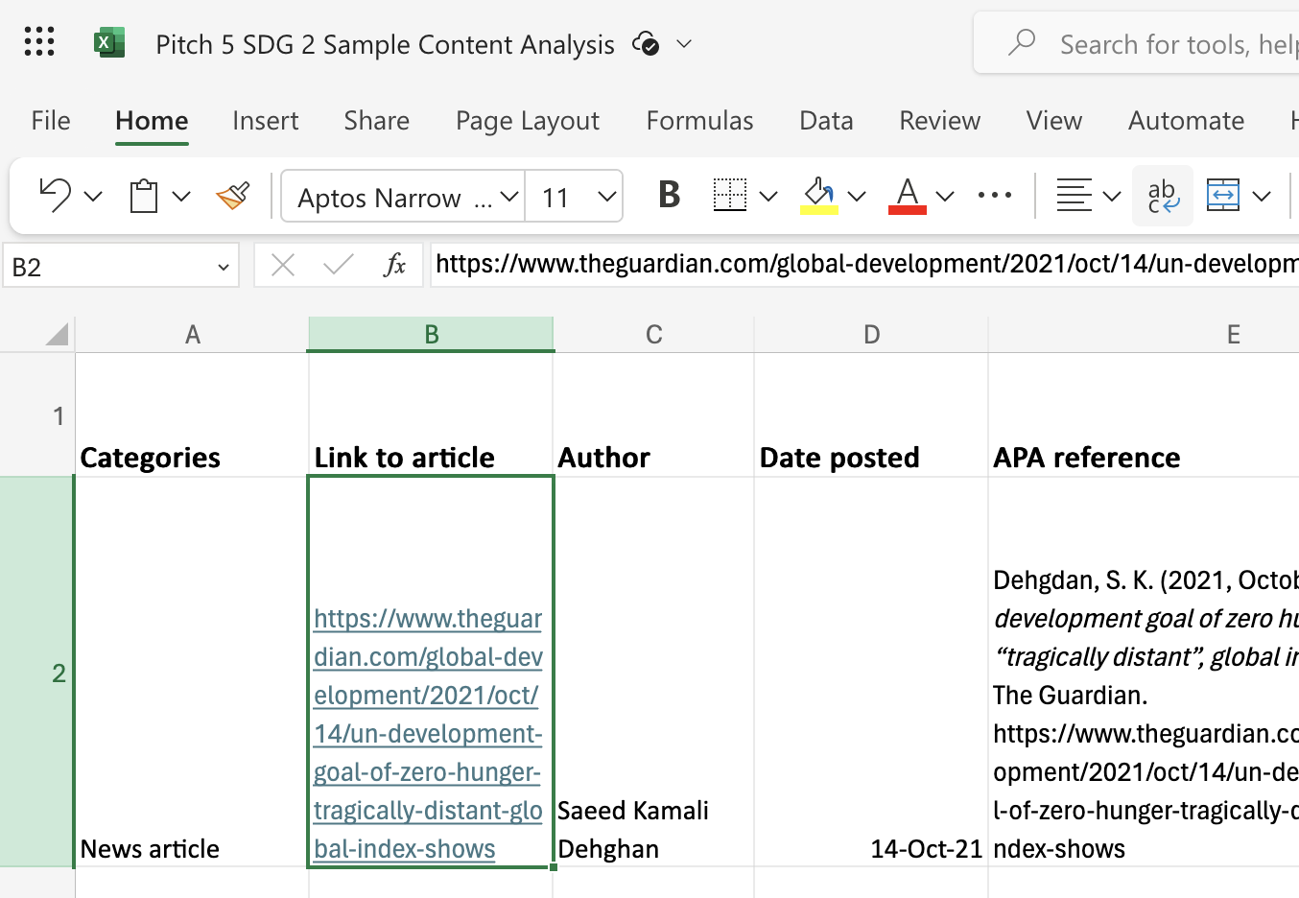
Step 7: Entering data in the spreadsheet
Copy paste and/or write up necessary information into the sheet
If text is too long for a cell, you can click "wrap"
© Anne MacLennan, 2024​​​​​​
Dehgdan, S. K. (2021, October 14). UN development goal of zero hunger 'tragically distant,' global index shows. The Guardian.

Slide 17
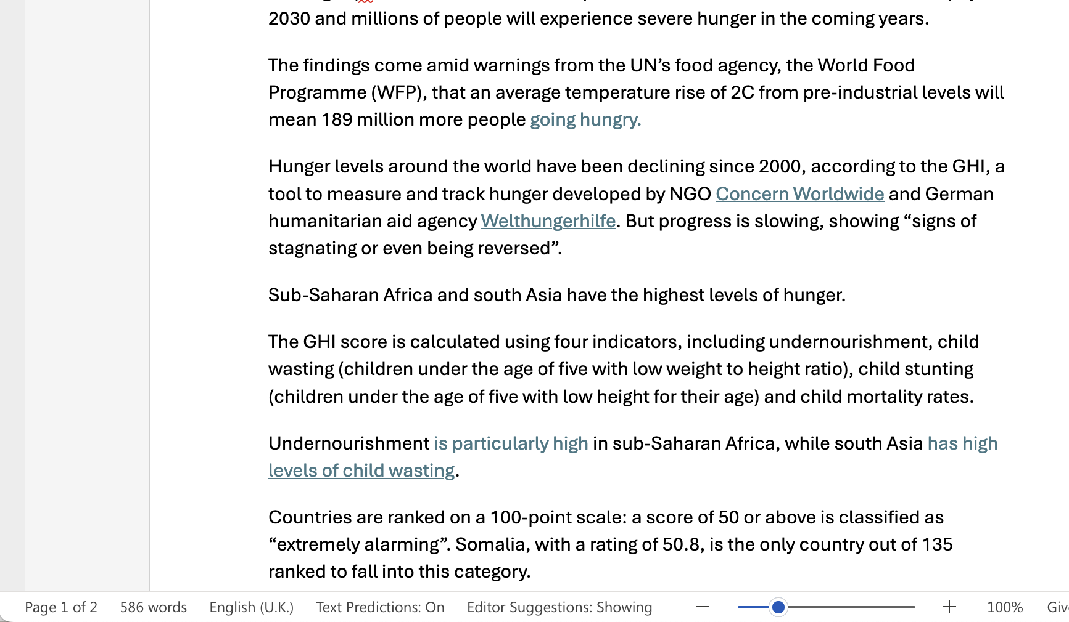
Step 8: Word Count in a Cell
For word count: copy paste the article's body
of text into a Word file to get the word count
This is an Excel tip only
© Anne MacLennan, 2024​​​​​​
Dehgdan, S. K. (2021, October 14). UN development goal of zero hunger 'tragically distant,' global index shows. The Guardian.

Slide 18
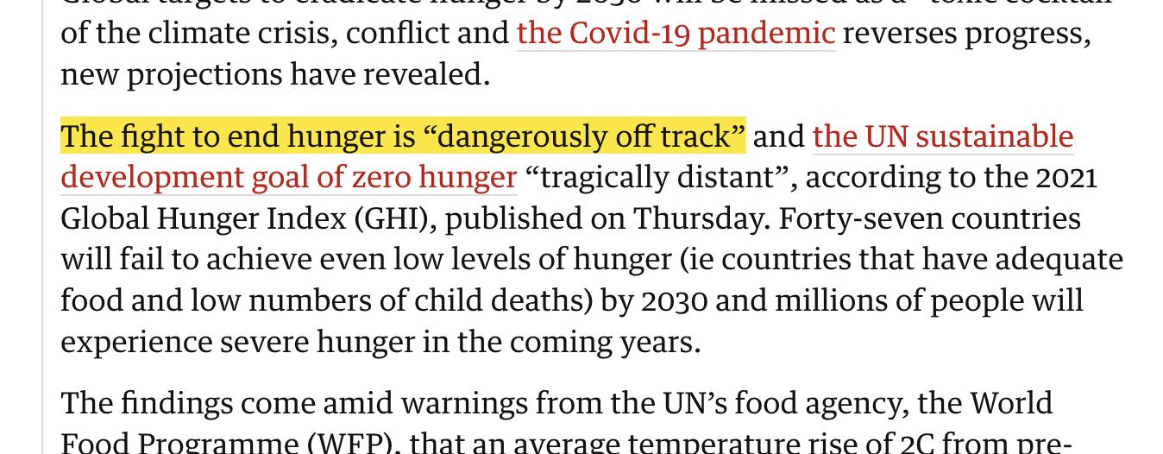
Step 9: Column I "Overall Emotion"
For overall emotion: You would need to develop a code book to define what criteria you need to fit in any of your emotions
Concern and urgency due to the situation
© Anne MacLennan, 2024​​​​​​​
Dehgdan, S. K. (2021, October 14). UN development goal of zero hunger 'tragically distant,' global index shows. The Guardian.

Slide 19
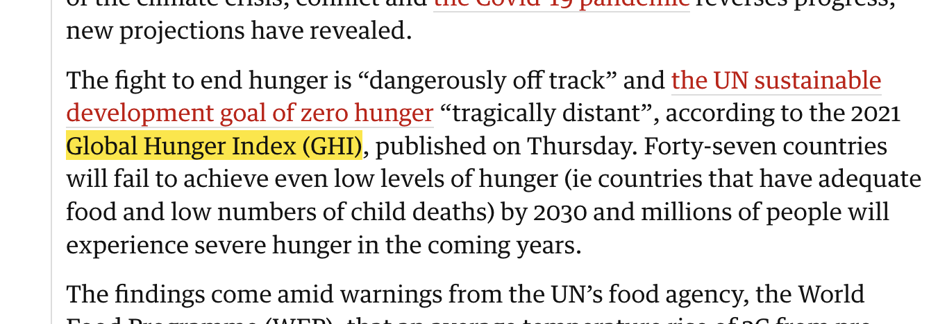
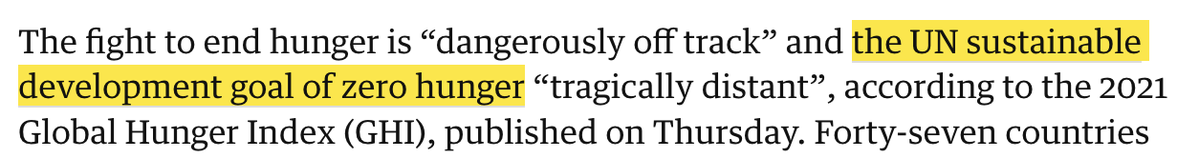
Step 10: Column M "Theme"
For theme: analyze the body of the text to see the major themes, look for key words that indicate that
Global Hunger Index
UN SDG Zero Hunger
© Anne MacLennan, 2024​​​​​​​​
Dehgdan, S. K. (2021, October 14). UN development goal of zero hunger 'tragically distant,' global index shows. The Guardian.

Slide 20
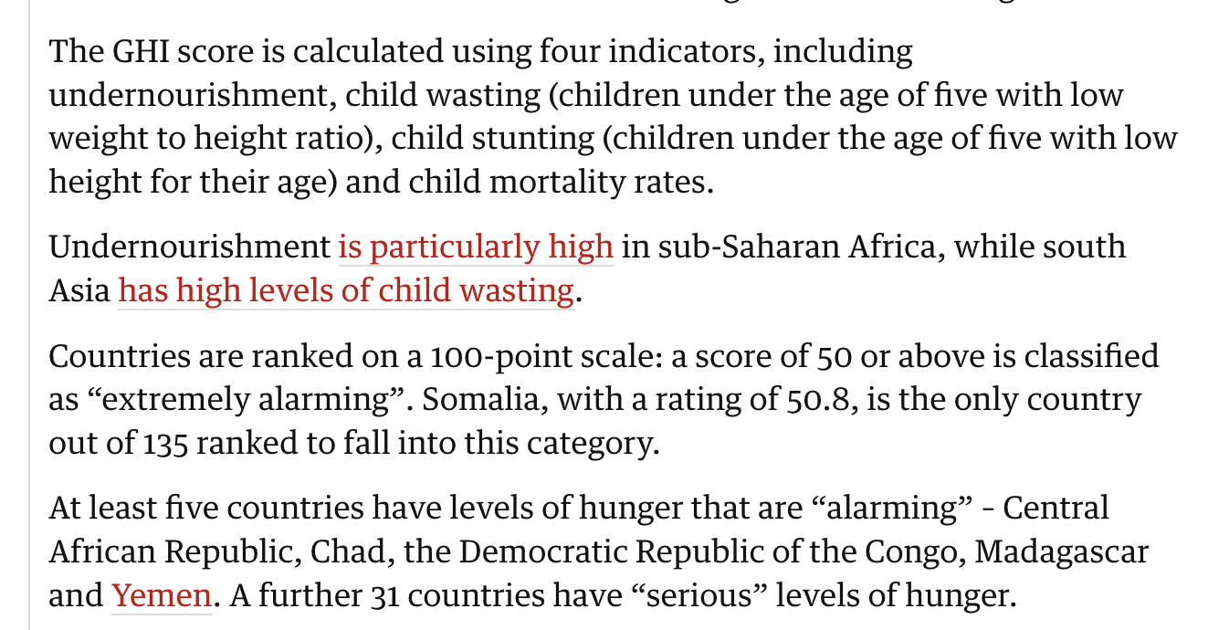
Step 11: Column J "Post Theme"
For post theme: analyze the body of the text to see the language used, and see whether the article is analytical, informative, critical, etc.
Informative of how GHI scores are calculated, what GHI scores mean, etc.
© Anne MacLennan, 2024​​​​​​​​
Dehgdan, S. K. (2021, October 14). UN development goal of zero hunger 'tragically distant,' global index shows. The Guardian.

Slide 21
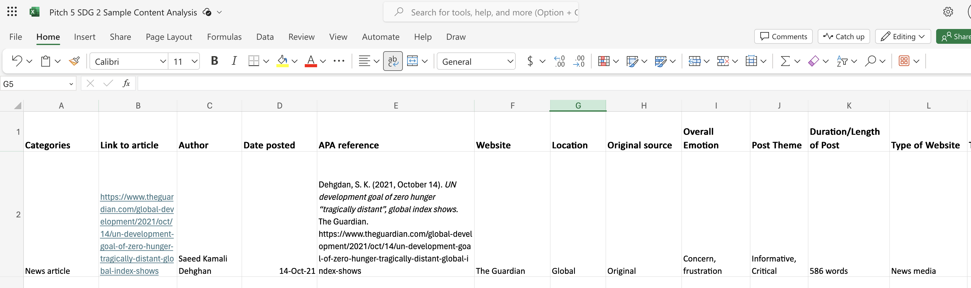
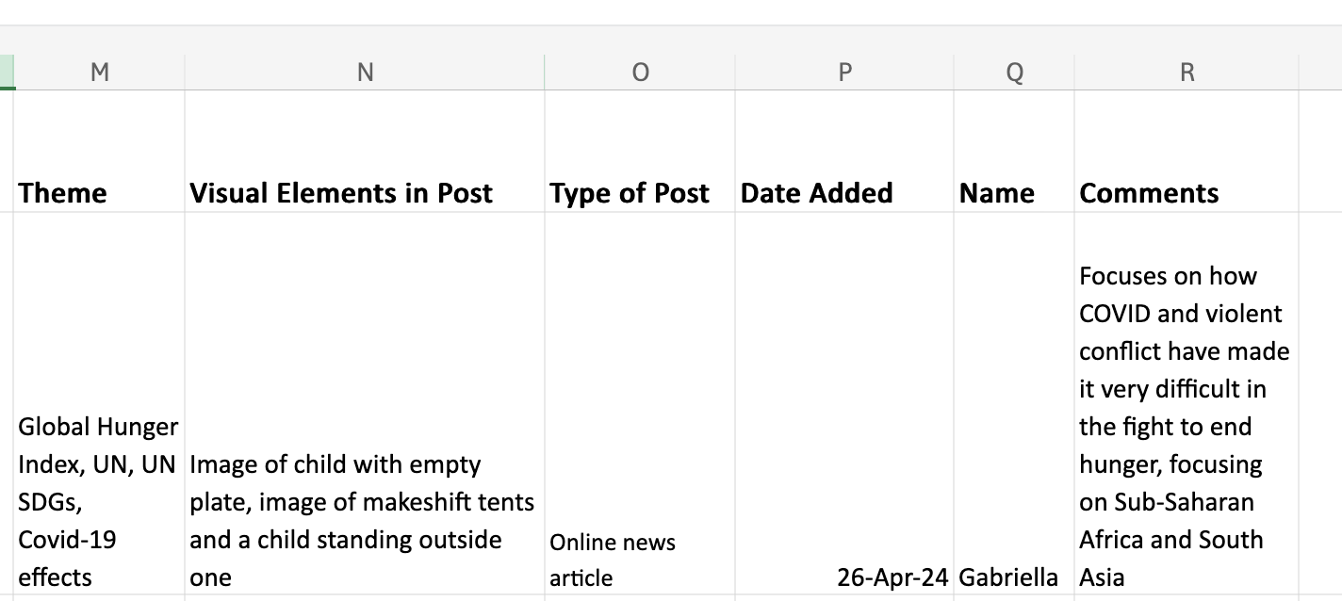
What your sheet should look like
© Anne MacLennan, 2024​​​​​​​​
Dehgdan, S. K. (2021, October 14). UN development goal of zero hunger 'tragically distant,' global index shows. The Guardian.

Slide 22
References
Dehgdan, S. K. (2021, October 14). UN development goal of zero hunger 'tragically distant,' global index shows. The Guardian. https://www.theguardian.com/global-development/2021/oct/14/un-development-goal-of-zero-hunger-tragically-distant-global-index-shows
Department of Economic and Social Affairs (2024). The sustainable development goals report 2024. United Nations. https://unstats.un.org/sdgs/report/2024/The-Sustainable-Development-Goals-Report-2024.pdf.
Hope, B. (2022, February 2). UN’s zero hunger sustainable development goal at risk. Sustainability Magazine. https://sustainabilitymag.com/sustainability/sustainable-zero-hunger-sdg-united-nations-development-undernourishment-goals
Kannan, R. (2023, July 26). Explained: What has to be done to get to zero hunger? The Hindu. https://www.thehindu.com/news/national/explained-what-has-to-be-done-to-get-to-zero-hunger/article67110492.ece
© Anne MacLennan, 2024​​​​​​​​

