Slide 1
Towards an Autochthonous Understanding of Mesopotamian Tuning
Analysis of World Music Session,
Society for Music Theory,
November 4, 2021
Jay Rahn
York University, Toronto
jayrahn@yorku.ca

Slide 2
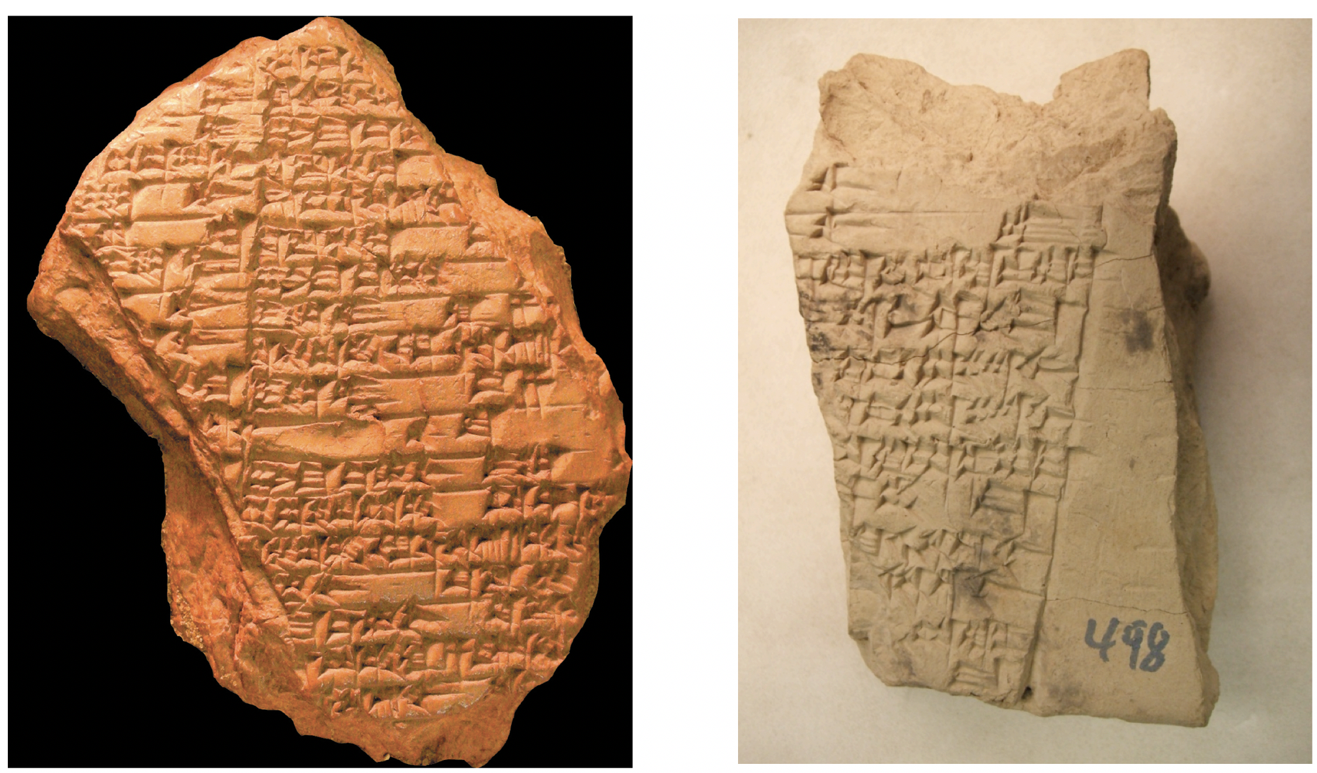
Cuneiform sources of the
Mesopotamian tuning formulation

Slide 3
Unproblematic terms
“3rd string from the front small” [vs 3rd string from back]
“4th string from the front thin” [vs 4th string from back]
acoustics: greater frequency/less frequency
psychoacoustics: higher pitch/lower pitch
“tighten string”/ “loosen string”
acoustics: increase frequency/decrease frequency
psychoacoustics: raise pitch/lower pitch

Slide 4
A potentially problematic contrast
zakû/la-zakû
State: clear/cloudy (liquids, sky)
clean/unclean (ritual offerings)
Process: refined/alloyed (metals)
released/caged (animals)
freed/bound (debtors)

Slide 5
Tuning a harp or lyre: the only musical context for zakû and la-zakû
original state: in a particular tuning, x,
a pair of strings, y and z, that span 4 or 5 strings,
is la-zakû
process: one of the strings, e.g., y, is tightened or loosened
new state: the pair of strings, y and z, is zakû
the tuning of the harp or lyre is changed from x to w
What does this process correspond to?

Slide 6
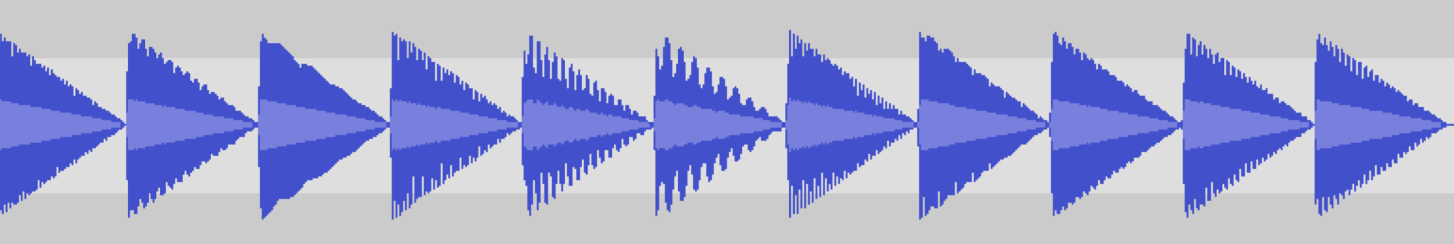

A schematic illustration of tightening one of two plucked strings

Slide 7
11 pairs of tones (both tones have prominent first 6 harmonics), from 300 cents to → 400 cents rough → smooth ← rough undulating la-zakû zakû la-zakû

Slide 8
Defining zakû : smooth (vs consonant, pleasant, etc.)
zakû: smooth (of the sound produced by a pair of strings that spans 4 or 5 strings among the 7 strings at the front of a sammû, i.e., a 9-string harp or lyre employed in Mesopotamian tuning from ca. 1850 BCE onward)

Slide 9
Smoothness vs “Consonance”: A Cross-Cultural Instance
Among the Tsimane’, an indigenous Amazonian group who had not encountered European-derived idioms or produced polyphonic music.
McDermott, Josh H., Alan F. Schultz, Eduardo A. Undurraga, and Ricardo A. Godoy. 2016. Nature 535, 547–550, and supplementary audio files:
https://static-content.springer.com/esm/art%3A10.1038%2Fnature18635/MediaObjects/41586_2016_BFnature18635_MOESM52_ESM.wav;
https://static-content.springer.com/esm/art%3A10.1038%2Fnature18635/MediaObjects/41586_2016_BFnature18635_MOESM53_ESM.wav

Slide 10
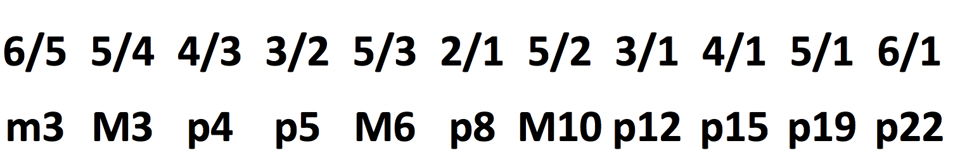
11 potential frequency ratios of zakû string-pairs

Slide 11
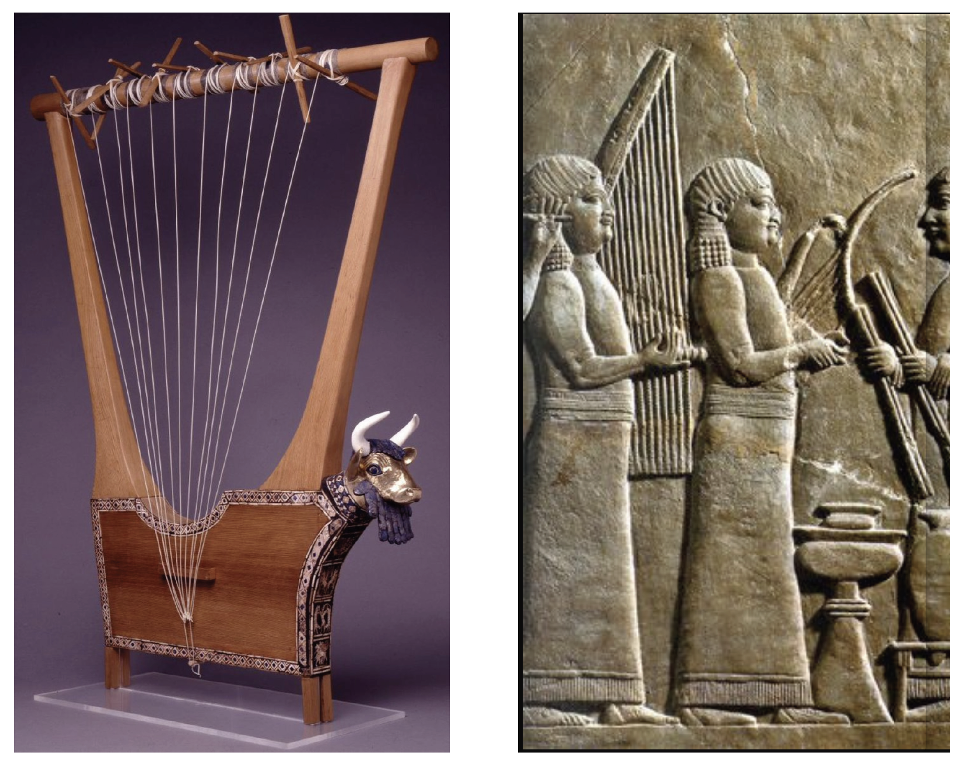
More than 7 (or 9) strings on a
Mesopotamian lyre or harp

Slide 12
Other Mesopotamian usages of zakû/la-zakû
State: clear/cloudy (liquids, sky)
clean/unclean (ritual offerings)
Process: refined/alloyed (metals)
released/caged (animals)
freed/bound (debtors)
Valence: positive/negative

