Slide 1
Reformulating Burmese Harp Tunings
Jay Rahn, York University, Toronto
Analytical Approaches to World Music Special Topics Symposium:
Computational Approaches to World Music Analysis
Royal Birmingham Conservatoire, Birmingham, UK
4:30-5:15 p.m., July 2, 2019

Slide 2


Slide 3
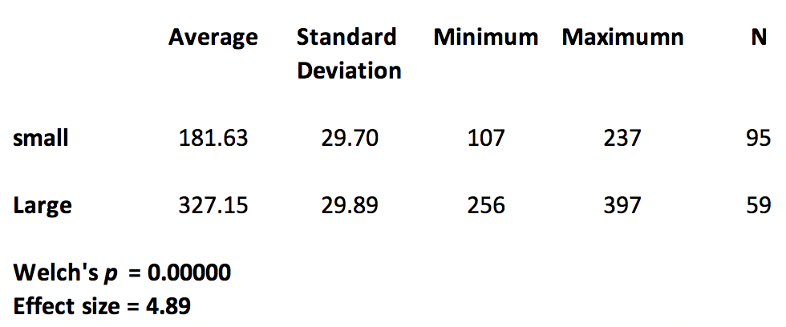
Sizes of small and Large Steps (in cents)

Slide 4
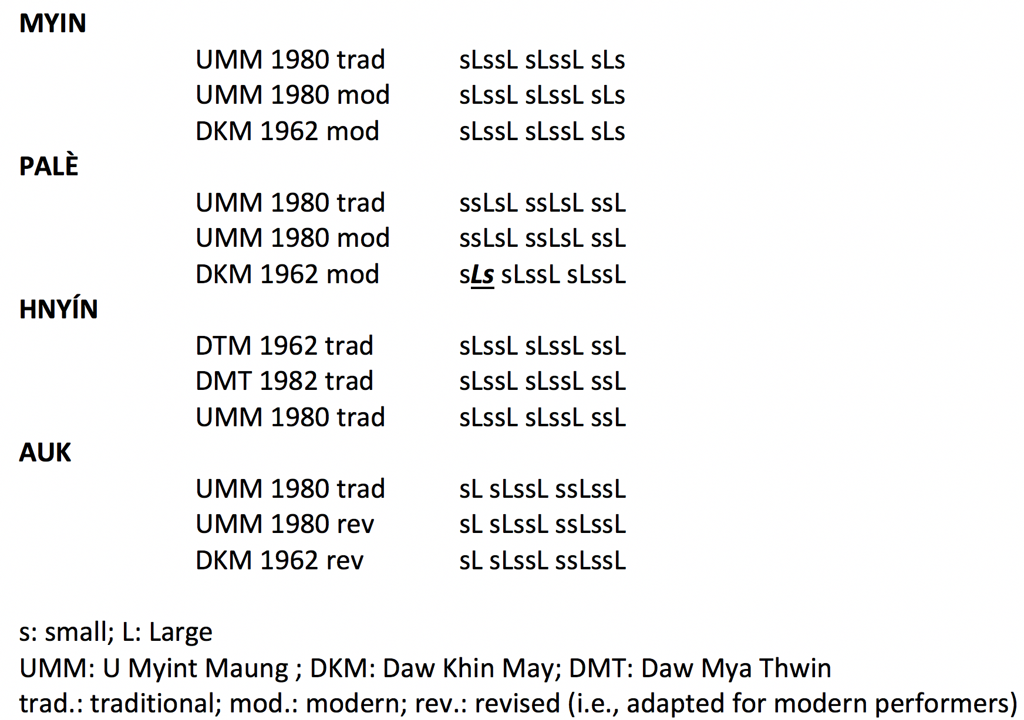

Slide 5
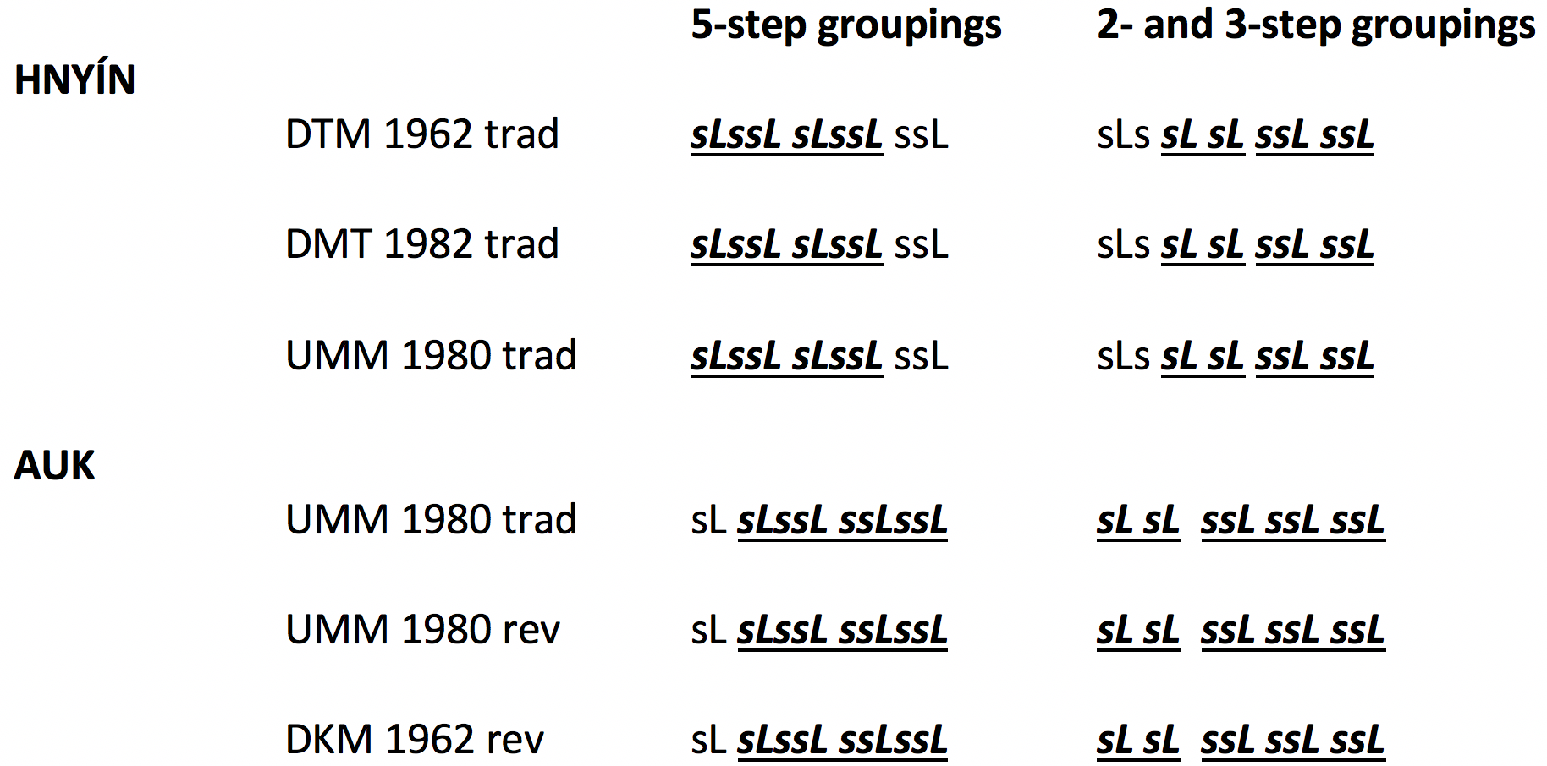
Repetitions of 5-, 2-, and 3-step groupings

Slide 6
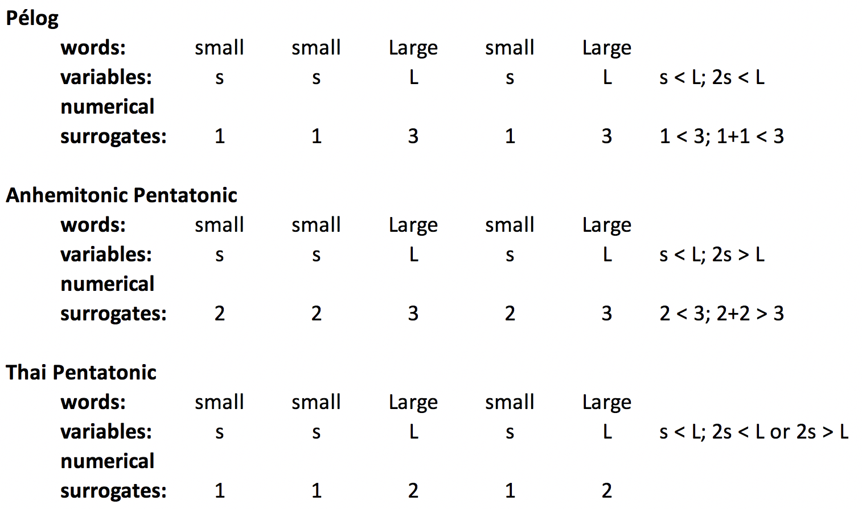
small-small-Large-small-Large Patterns

Slide 7
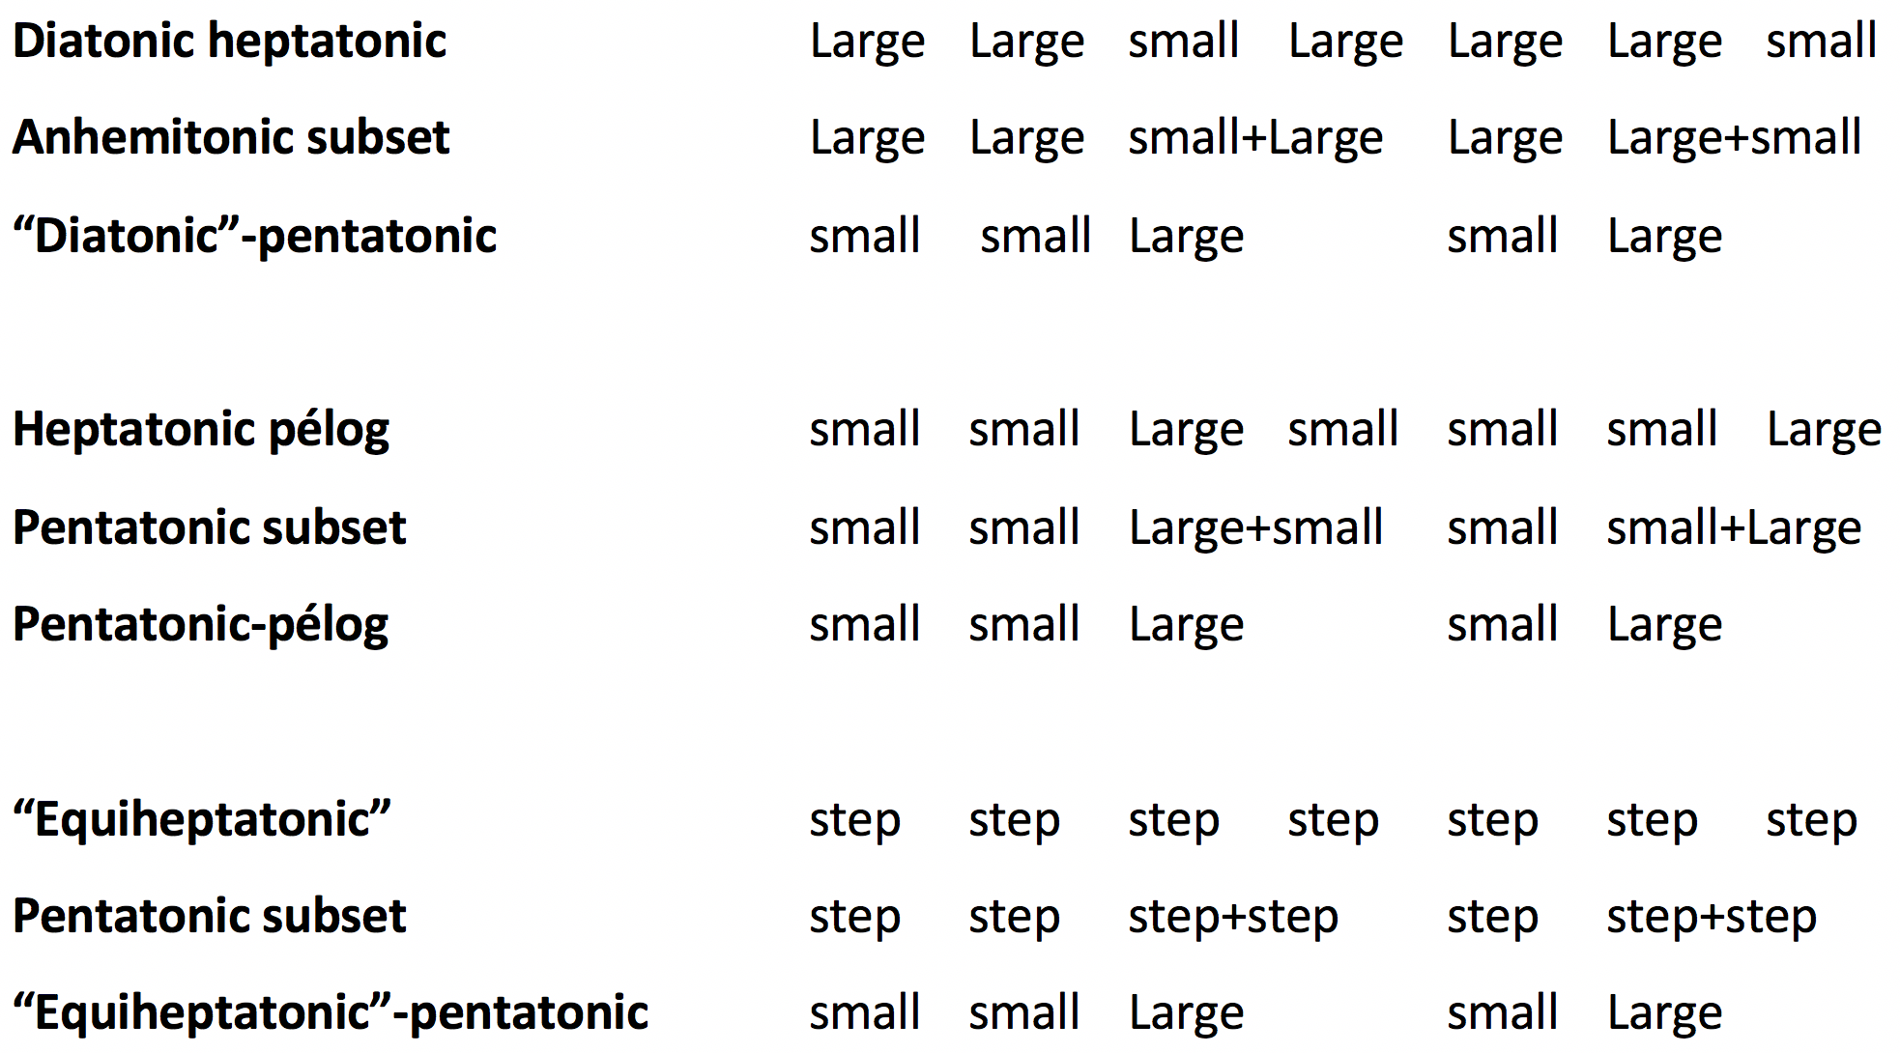
Large and small Heptatonic and Pentatonic Steps

Slide 8
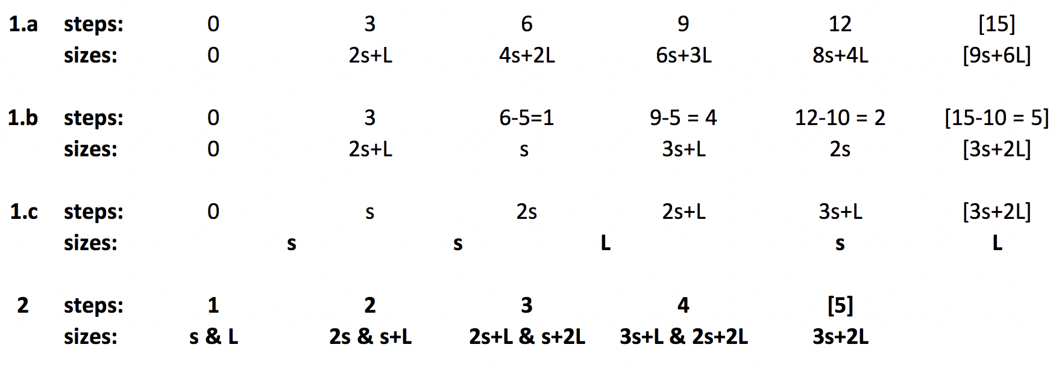
Generation of ssLsL by 3-step intervals of size 2s+L

Slide 9
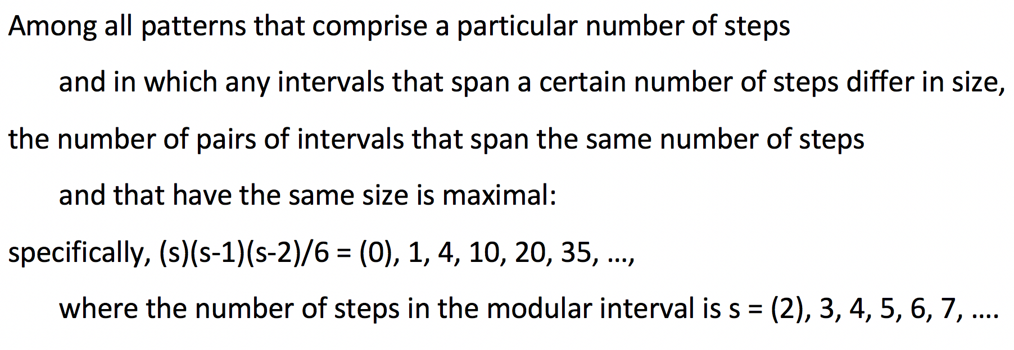
Myhill’s Property and Well-Formedness

Slide 10
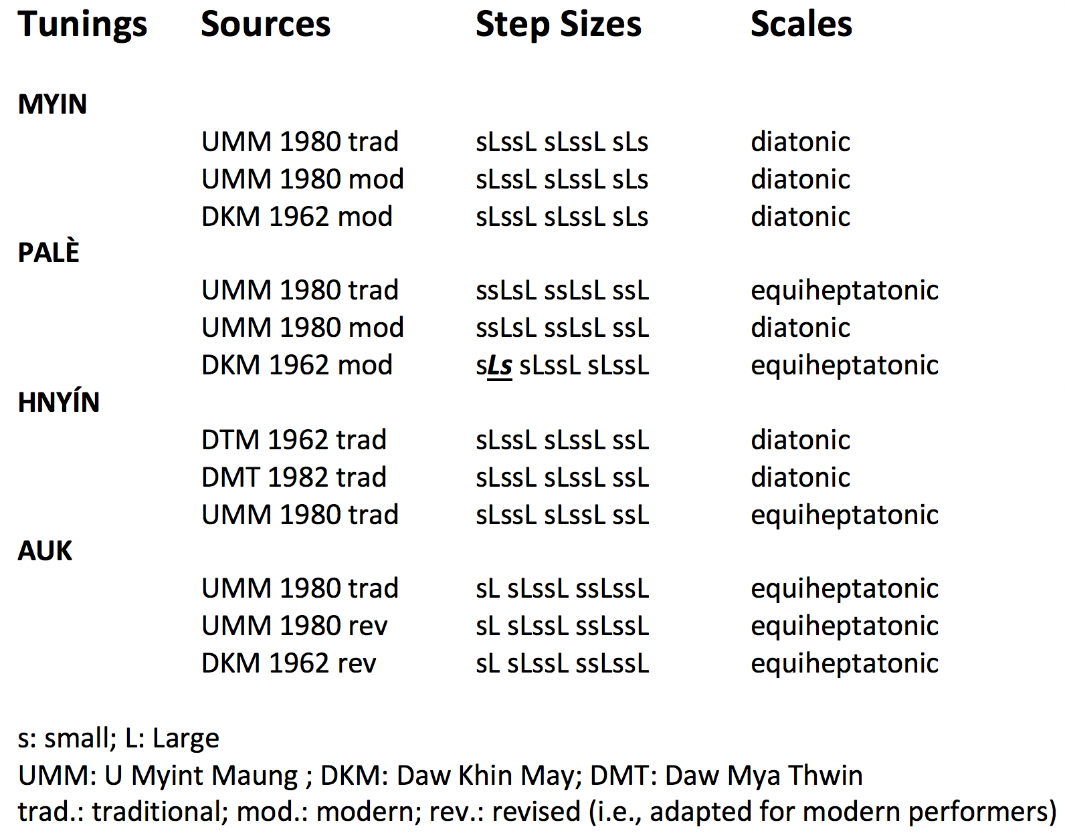

Slide 11
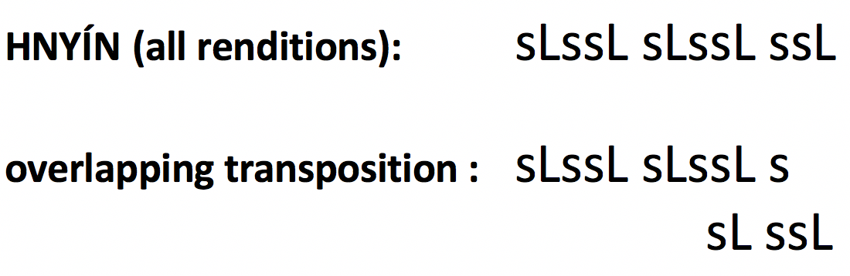
Overlapping Transposition up 2s+L

Slide 12

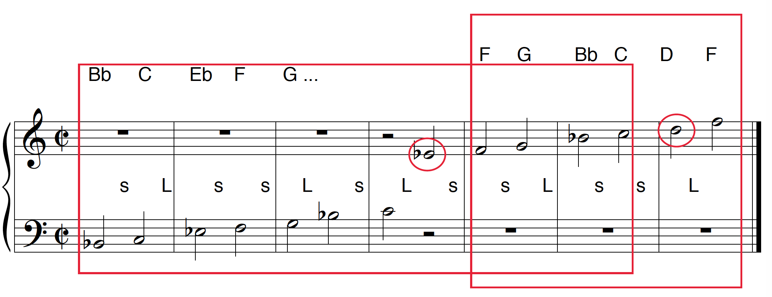
Audio Illustration of
Overlapping Transposition up 2s+L

Slide 13
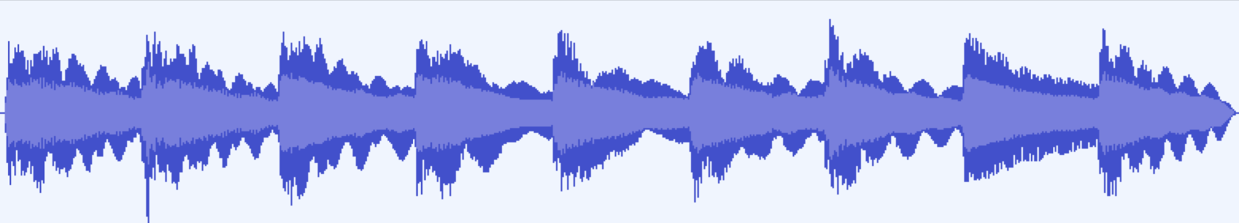
“Octaves” of Hnyìn Tuning

Slide 14
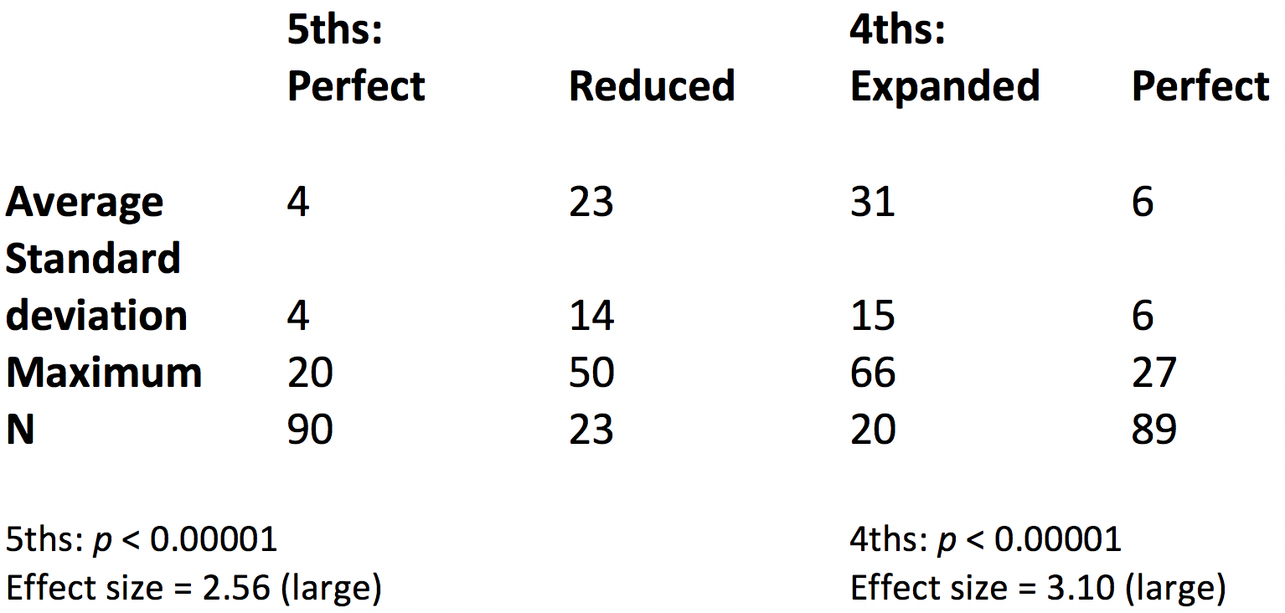
Beats/second of 4ths and 5ths

Slide 15
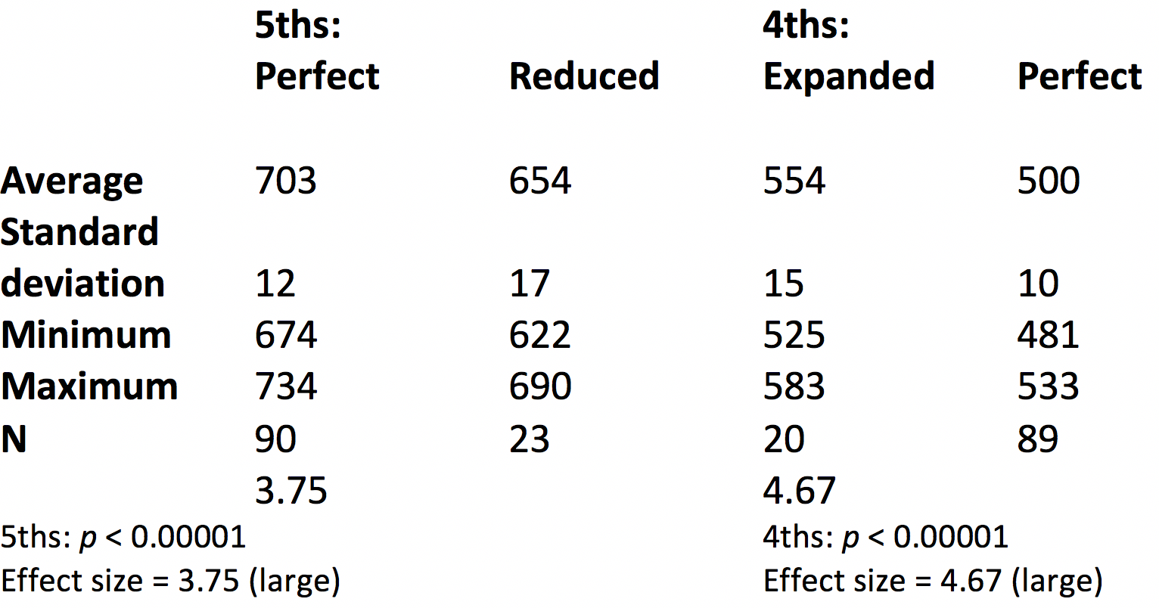
Sizes of 5ths and 4ths (in cents)

Slide 16
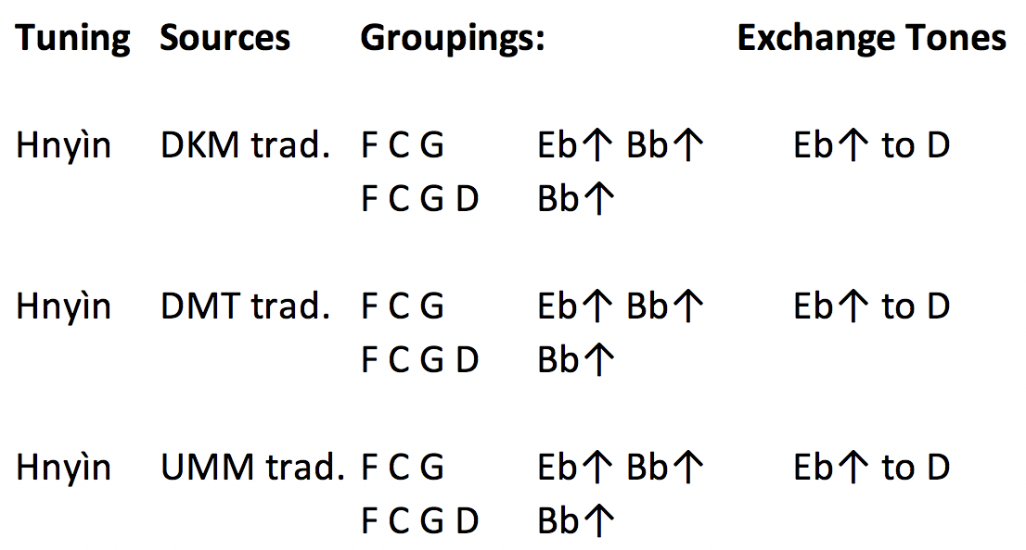
5th and 4th Groupings in Hnyìn Tuning
Top row for lower strings, bottom row for upper strings

Slide 17
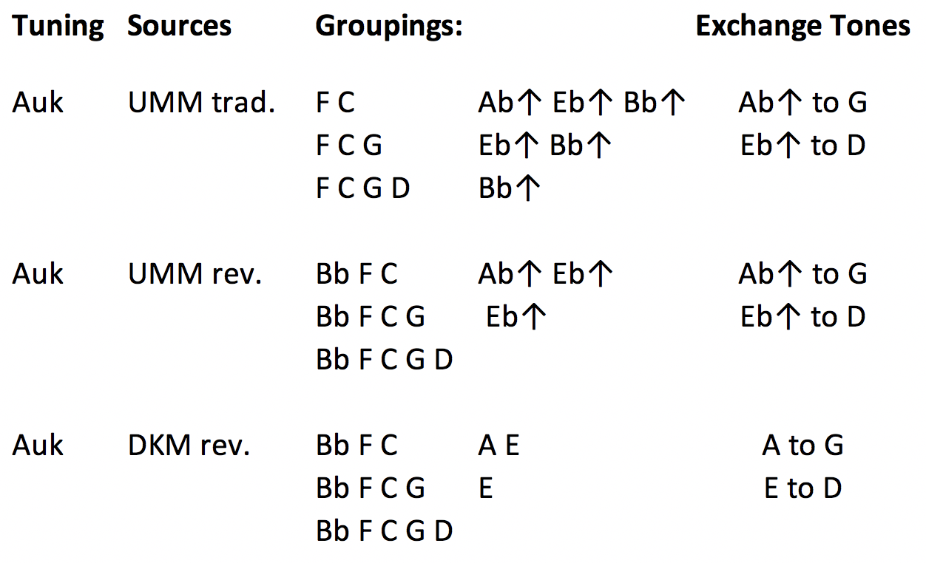
5th and 4th Groupings in Auk Tuning

Slide 18
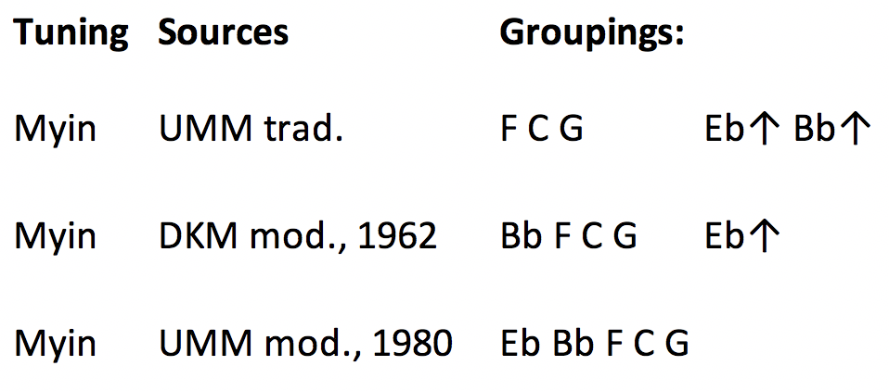
5th and 4th Groupings in Myin Tuning

Slide 19
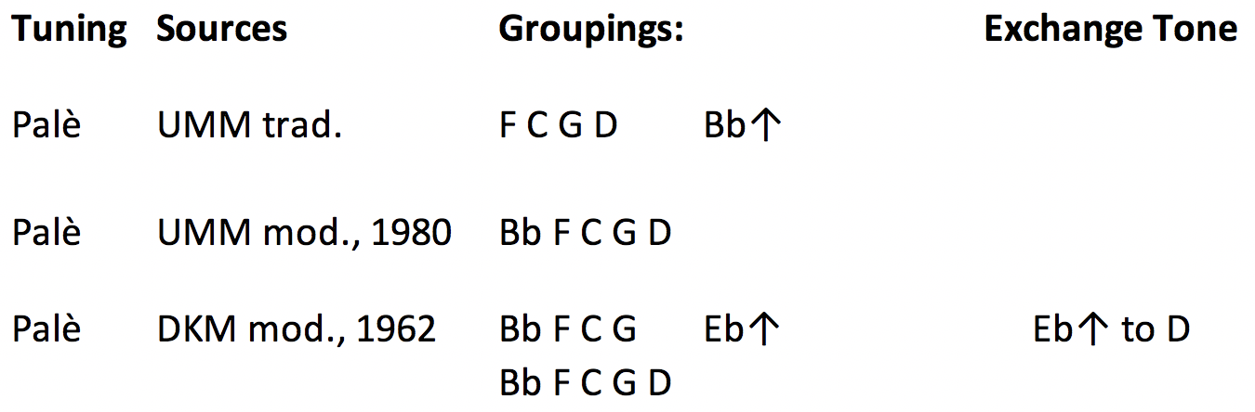
5th and 4th Groupings in Palè Tuning

Slide 20
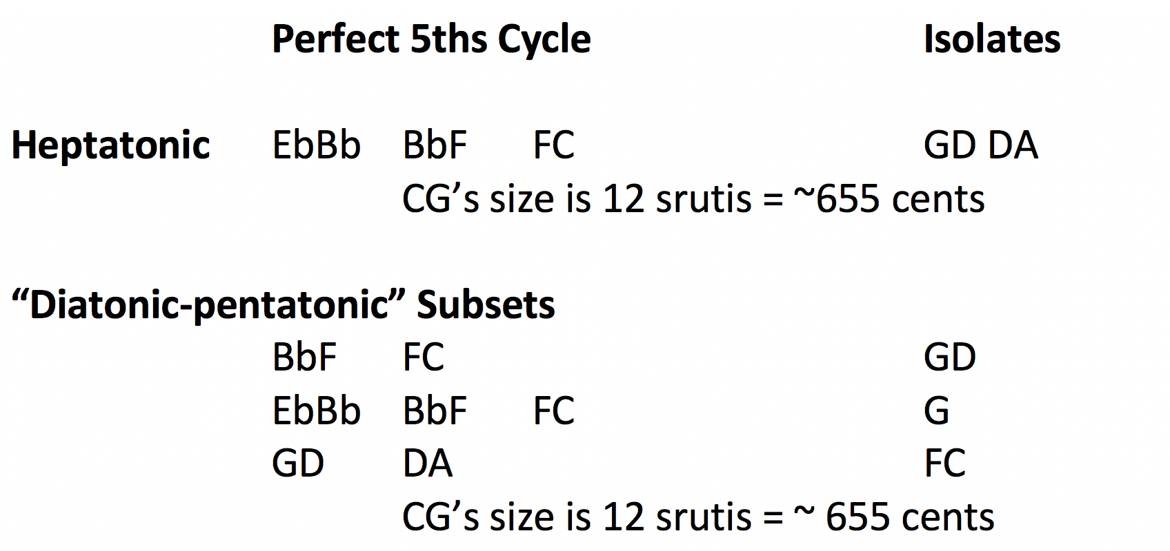
Perfect 5th and 4th Groupings in Ma-grāma Tuning of
Ancient India

Slide 21
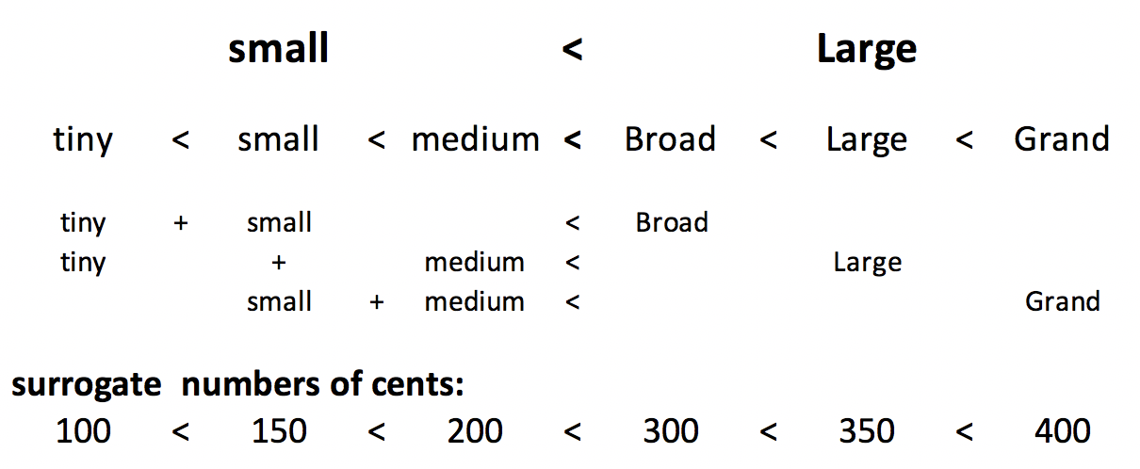
Relationships among Variant Step Sizes

Slide 22
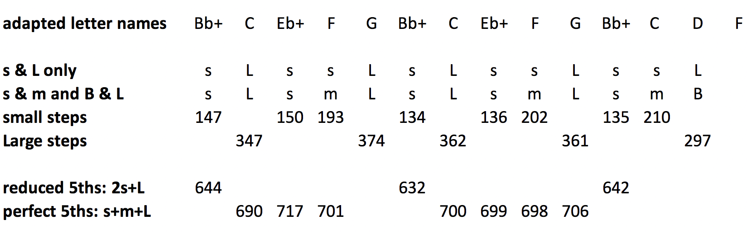
small and Large steps vs. small, medium, Broad, and Large steps in U Myint Maung’s hnyìn tuning

Slide 23
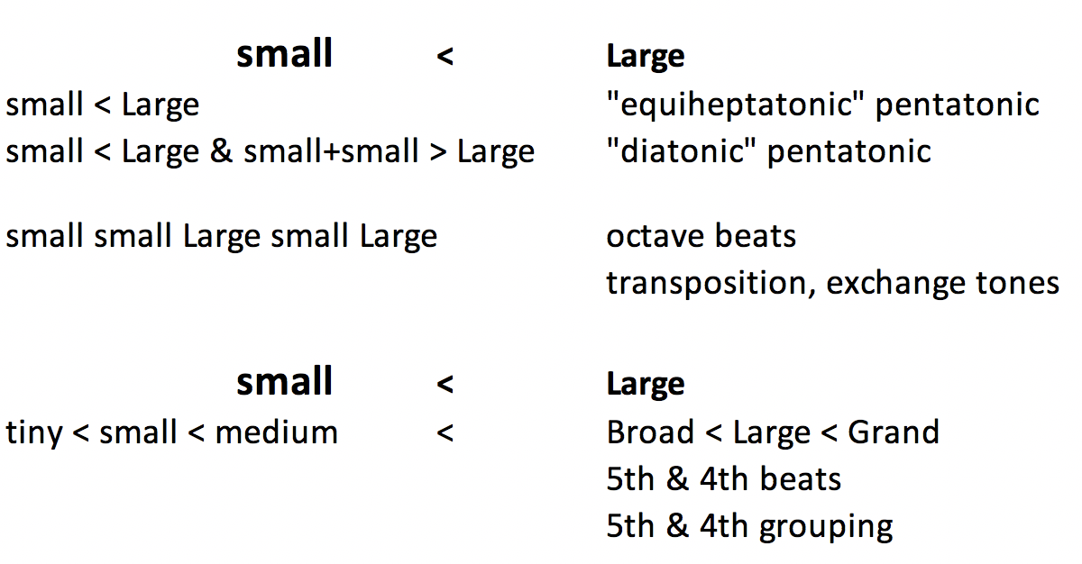
Summary

