Slide 1
Passion, Pathways, and Patience: Understanding Student Engagement Through the Eyes of Our Student Consultants on Teaching
Teaching in Focus Conference 2019
Student Consultants: Cassandra Piccoli, Esther Wanduku, Inderpreet Banwait, Zuzana Balazova
Faculty Panel: Alice Kim, Natasha May, Carolyn Steele
Facilitator: Lisa Endersby, Educational Developer

Slide 2
Land Acknowledgement
We recognize that many Indigenous nations have longstanding relationships with the territories upon which York University campuses are located that precede the establishment of York University. York University acknowledges its presence on the traditional territory of many Indigenous Nations. The area known as Tkaronto has been care taken by the Anishinabek Nation, the Haudenosaunee Confederacy, the Wendat, and the Métis. It is now home to many Indigenous Peoples. We acknowledge the current treaty holders and the Mississaugas of the Credit First Nation. This territory is subject of the Dish With One Spoon Wampum Belt Covenant, an agreement to peaceably share and care for the Great Lakes region.
http://yfile.news.yorku.ca/2019/01/14/new-video-explores-the-importance-of-understanding-the-land-acknowledgement/?utm_source=YFile_Email&utm_medium=Email&utm_content=Top-Stories&utm_campaign=yfile
https://www.youtube.com/watch?time_continue=135&v=qNZi301-p8k
Notes:
2-3 minutes
In performing land acknowledgment, we make what was invisible visible, and invite the land, the First Nations people, and the Truth and Reconciliation Commission (TRC) into our conversations. This act of naming – of inviting something into language – is an underlying principle of advocacy and lies at the heart of higher education.
The etymology of advocacy is ad (to add) + vocare (call or voice): the origin of the word’s meaning is to give voice to something or to call out in order to initiate dialogue. The “ad” prefix makes explicit the importance of multiple voices – and by extension multiple perspectives. In this sense, advocacy compels us to acknowledge a diversity of thoughts and opinions as a starting point rather than as an ideal outcome.
In institutions of higher learning, we have a responsibility to honour spaces for emerging and established voices to engage in productive, respectful, and sometimes even uncomfortable conversations where individuals are safe to speak truth to power, explore and challenge dominant ideologies, and call out injustices and inequalities in order to imagine new ways of existing. Our learning journeys cannot be successful without Aboriginal justice and reconciliation. Our journeys can be parallel. And on this land, we shall learn, work and advocate with our energies in solidarity.

Slide 3
What is SCOTAY?
Student Consultants on Teaching at York
Pilot program in 2018-2019 at the Teaching Commons, supported by the Faculty of Education
Inspired by similar programs at Brigham Young University and University of Lincoln
Inviting and incorporating the student voice into our work in the Teaching Commons and with faculty at York
Inspiring and facilitating reflective conversations on/about teaching based on scheduled classroom observations
Emphasis in our pilot year on discussions on/around student engagement

Slide 4
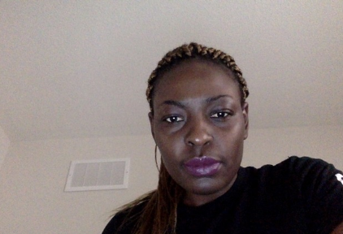
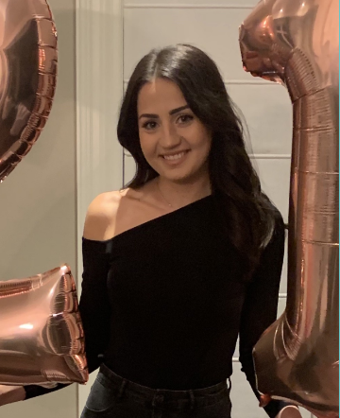
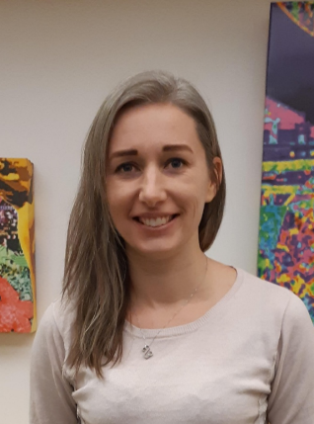
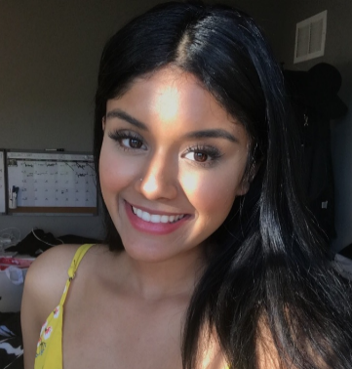
What Do Our Student Consultants Say?
Providing a platform for pedagogic strategy review that includes the students’ voices gives the instructor the opportunity to reflect by asking questions like “What am I teaching?” and, even more deeply, “How am I teaching?”
SCOTAY lessens the instructor-student barrier by fostering communication and interaction
SCOTAY re-positions the student as an active participant in the learning process by lessening the constant ‘passive receiver’ role
The student as observer empowers students through a constant reminder of what it is to learn and how to contribute to the learning process
EDC Conference 2019

Slide 5

Faculty Perspective
Carolyn Steele, Contract Faculty, Department of Humanities
Natasha May, Contract Faculty, Department of Mathematics and Statistics
Alice Kim, Contract Faculty, Department of Psychology

Slide 6

Questions?

Slide 7

Let’s Keep Talking!
Lisa Endersby lendersb@yorku.ca
Carolyn Steele steelec@yorku.ca
Natasha May maynat@yorku.ca
Alice Kim a_kim@yorku.ca

